Slide 1
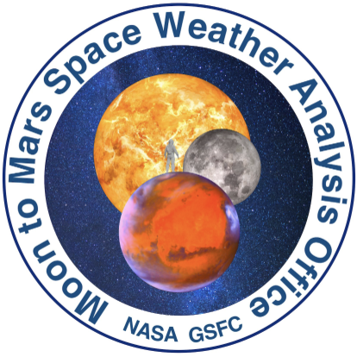




Moon to Mars Space Weather Analysis
National Aeronautics and Space Administration
Heliophysics Investigations by Dr. Hilarie Davis & Dr. Sten Odenwald
6/3/25 HEAT Community Meeting
NASA Heliophysics Education Activation Team (Not all images are from NASA EZIE)

Slide 2

Predicting Space Weather
The Integrated Solar Energetic Proton Alert/Warning System (ISEP) project is a partnership between NASA Goddard’s Community Coordinated Modeling Center (CCMC) and NASA JSC Space Radiation Analysis Group (SRAG) to transition research Solar Energetic Particle models to operations.
The project aimed to identify, transition, and evaluate new models for Research to Operations (R2O), to develop software tailored for SRAG.
CCMC has transitioned 6+ real-time models and built the SEP Scoreboard application.
The tool was used in a real time setting by SRAG and M2M for the Artemis 1 mission.
Currently working closely with missions like PSP, Solar Orbiter, and MAVEN who use M2M analyses and notifications to create a database specific for their missions.
Heliophysics Education Activation Team

Slide 3
Framework for Heliophysics Education (FHE)
Developed by NASA HEAT in 2022
https://science.nasa.gov/learn/heat/big-ideas/
Structured around NASA’s Big Heliophysics Questions:
What are the impacts of the Sun on humanity?
How do the Earth, the solar system, and heliosphere respond to changes on the Sun?
What causes the Sun to vary?
Heliophysics Education Activation Team

Slide 4
FHE has Developed Big Ideas for the NASA Questions
1. What are the impacts of the Sun on humanity?
1.1 The Sun is really big and its gravity influences all objects in the solar system. (PS2, ESS1)
1.2 The Sun is active and can impact technology on Earth via space weather. (PS1, PS2, PS4, ESS2, ESS3)
1.3 The Sun’s energy drives Earth’s climate, but the climate is in a delicate balance and is changing due to human activity. (PS1, PS2, PS3, LS4, ESS2, ESS3)
2. How do the Earth, the solar system, and heliosphere respond to changes on the Sun?
2.1 Life on Earth has evolved with complex diversity because of our location near the Sun. It is just right! (PS3, PS4, LS1, LS2, ESS2)
2.2 The Sun defines the space around it, which is different from interstellar space. (PS2, ESS1, ESS2)
2.3 The Sun is the primary source of light in our solar system. (PS1, PS2, PS3,PS4, ESS1)
3. What causes the Sun to vary?
3.1 The Sun is made of churning plasma, causing the surface to be made of complex, tangled magnetic fields. (PS1, PS2, ESS1, ESS2)
3.2 Energy from the Sun is created in the core and travels outward through the Sun and into the heliosphere. (PS1, PS3, PS4, ESS1, ESS2, ESS3)
3.3 Our Sun, like all stars, has a life cycle. (PS1, LS1, ESS1)
Heliophysics Education Activation Team

Slide 5
Space Weather in the Framework with Standards
Question 1: What are the impacts of the Sun on humanity?
1.2 The Sun is active and can impact technology on Earth via space weather. (PS1, PS2, PS4, ESS2, ESS3)
Question 2: How do the Earth, the solar system, and heliosphere respond to changes on the Sun?
2.2 The Sun defines the space around it, which is different from interstellar space. (PS2, ESS1, ESS2)
Question 3: What causes the Sun to vary?
3.1 The Sun is made of churning plasma, causing the surface to be made of complex, tangled magnetic fields. (PS1, PS2, ESS1, ESS2)
3.2 Energy from the Sun is created in the core and travels outward through the Sun and into the heliosphere. (PS1,
Heliophysics Education Activation Team

Slide 6
Modeling in the Next Generation Science Standards
“Developing and using models" is one of the eight core Science and Engineering Practices. It involves using models, like diagrams, simulations, or physical replicas to represent and understand phenomena, systems, or processes. Models help students make sense of complex ideas, communicate their understanding, and revise their explanations over time.
Dynamic Representation: Models are not static representations but rather evolving tools that reflect a student's developing understanding of a concept.
Types of Models: NGSS recognizes various forms of models, including diagrams, simulations, replicas, mathematical representations, and physical models.
Purpose of Modeling: Modeling is used to: 1) Explain what is happening or predict what will happen, 2) Sift through and communicate prior knowledge, 3)Track the growth of conceptual understanding, 4)Demonstrate mastery of unit concepts.
Process of Modeling: Modeling is a dynamic process that involves: 1) Recording initial thinking and understanding, 2) Returning to the model to revise and expand explanations.
Importance of Modeling: Modeling is crucial for students to explore all fields of science and develop a deeper understanding of scientific concepts.
Heliophysics Education Activation Team

Slide 7
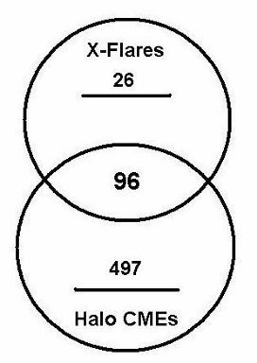
Introductory Level Investigation
When is it a high alert for space weather?
Halo CMEs are potentially the most damaging. How do we predict them?
SpaceMath # 244 [Grade:4-7 | Topics: Percentages; Venn Diagramming]
Students create a Venn Diagram to summarize data on a series of solar storms and determine how often solar flares occur when a solar plasma eruption happens.
Between 1996 and 2006,
SOHO detected 11,031 CMEs. Of these, 593 were Halo CMEs.
During these same years,
there were 122 extremely
intense X-flares. Of these
96 happened at the same
time as the Halo CMEs.
The total number of Halo CMEs is 593. Of these only 96 occurred
with an X-Flare, so the fraction of Halo CMEs is just 96/593 = 0.16 or 16%. (But if you see an X-class flare, about (96/122 =) 79% of the time you will see a Halo CME!) That’s why space weather forecasters watch for X-class flares!
Question: What percentage of Halo CMEs happened at the same time as an X-class
flare?
Heliophysics Education Activation Team

Slide 8
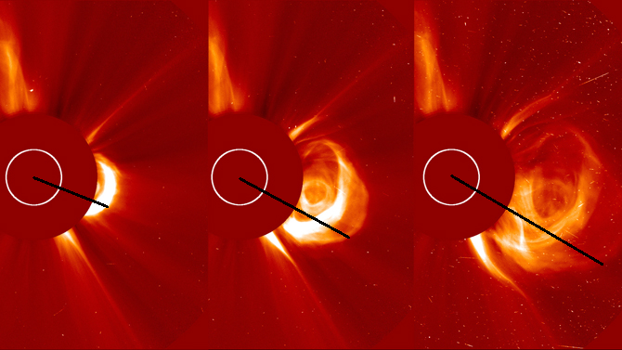
Intermediate Level Investigation
How do scientists calculate the speed of a Coronal Mass Ejection?
Scale; Proportions; Calculating speeds and times
ΔT = 0.5 hours.
Lengths: D1= 2.1 Mkm at time=0 hours,
D2= 3.3 Mkm at time=0.5 hours,
D3= 4.6 Mkm at time=1.0 hours
Speeds: V1= (D2-D1) /0.5h = 2.4 Mkm/h
V2=(D3-D2)/0.5h = 2.6 Mkm/h
Arrival at Earth: T = 150 Mkm/(2.6 Mkm/h)
= 58 hours or 2.4 days
CME September 6, 2017 (Credit:SOHO/LASCO)
See: Coronal Mass Ejections and Earth's Space Weather Environment,
Sten Odenwald & Hilarie Davis, The Earth Scientist | Volume XLII, Issue 1 Page 13-20,.
Heliophysics Education Activation Team

Slide 9
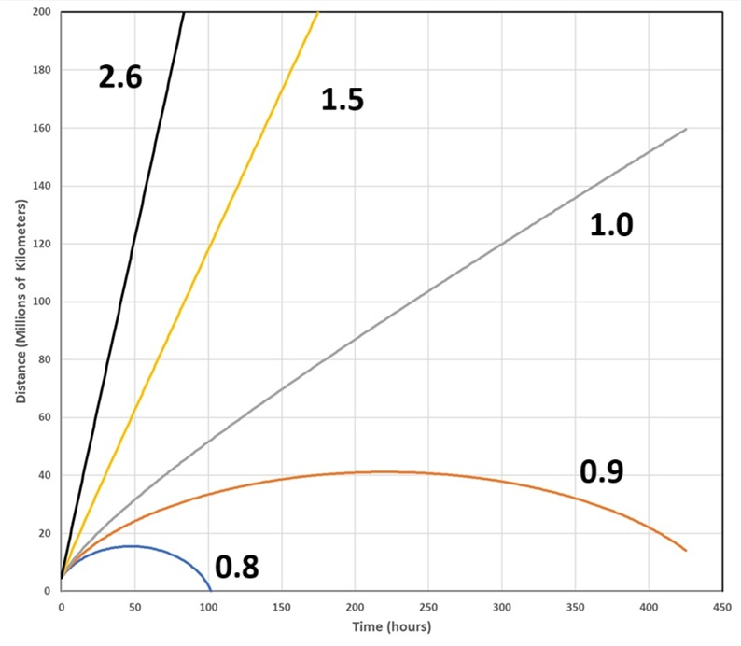


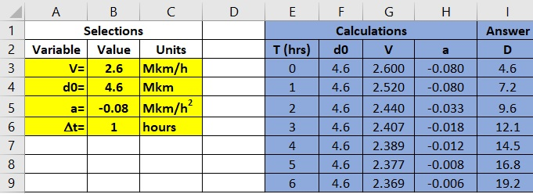
Advanced Level Investigation
How do scientists know when a CME will arrive?
Algebra II: An application of the Ballistics Equation.
Because ‘d’ constantly changes, this has to be solved
iteratively using a spreadsheet and taking time steps of 1 hour.
For previous CME with V = 2.6 Mkm/hr,
arrival at Earth in 62 hrs.
Heliophysics Education Activation Team

Slide 10
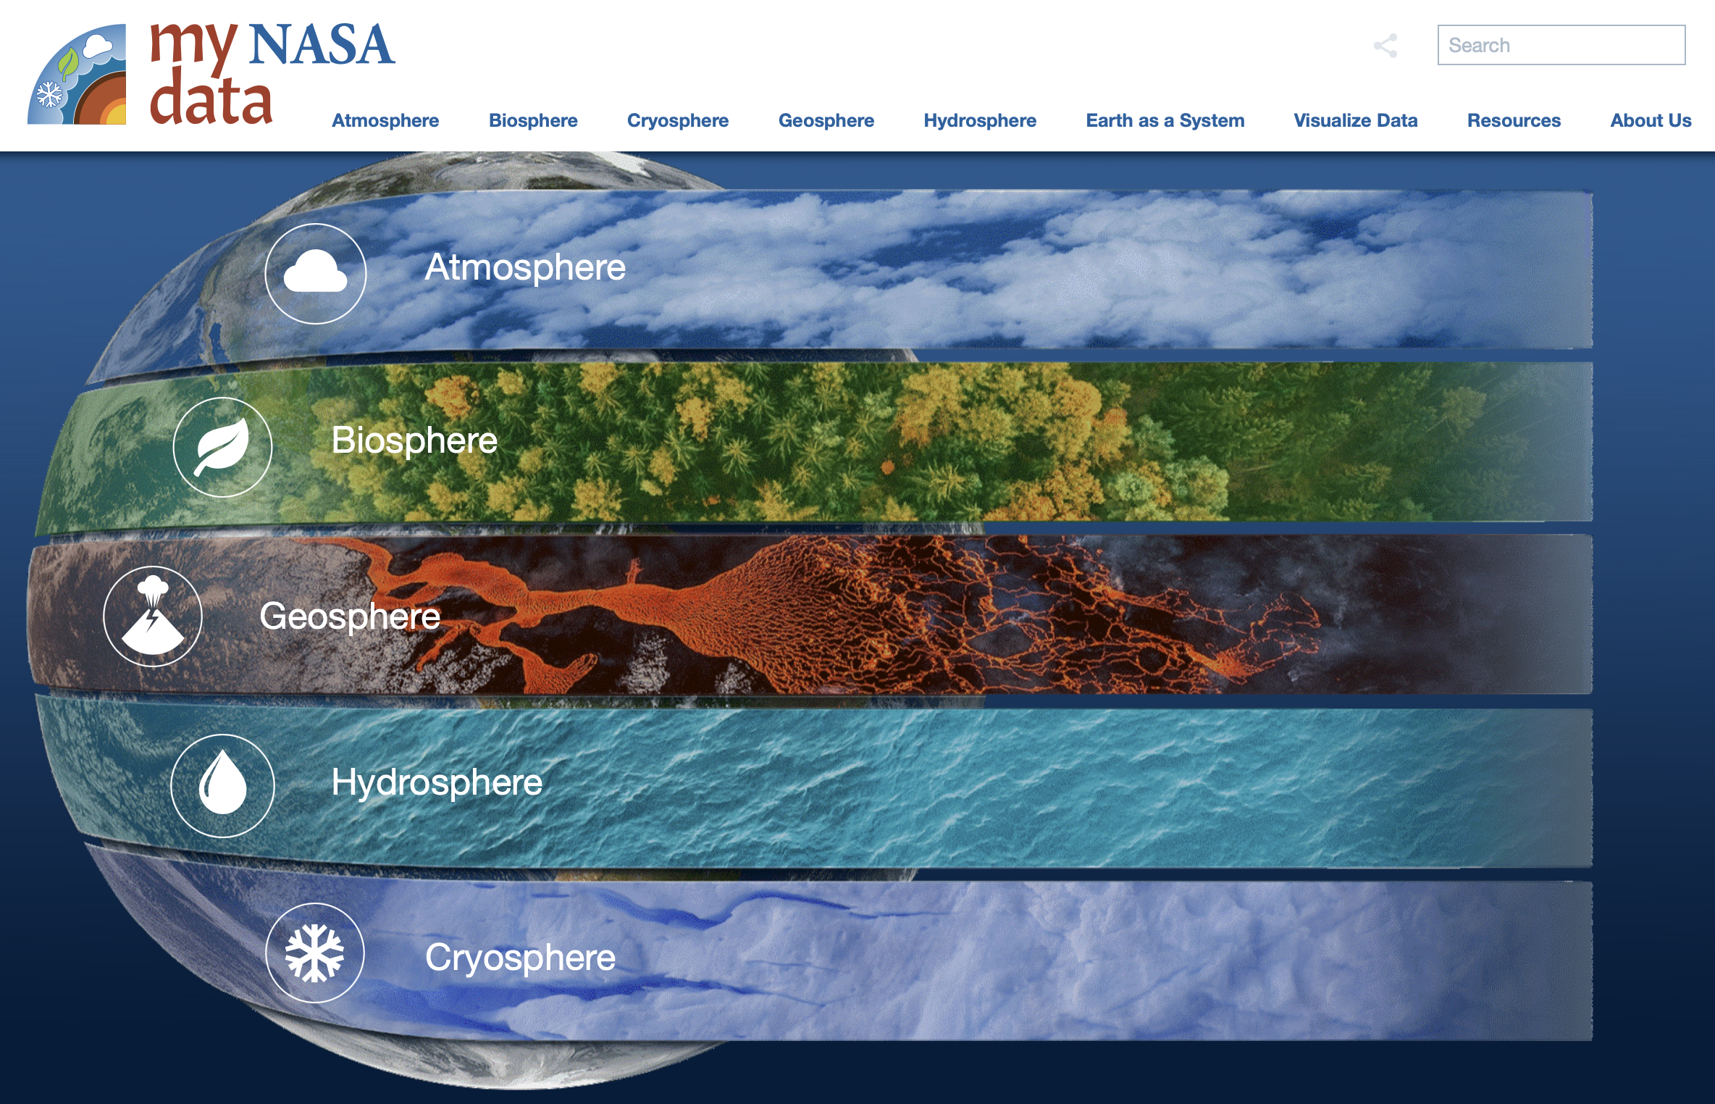
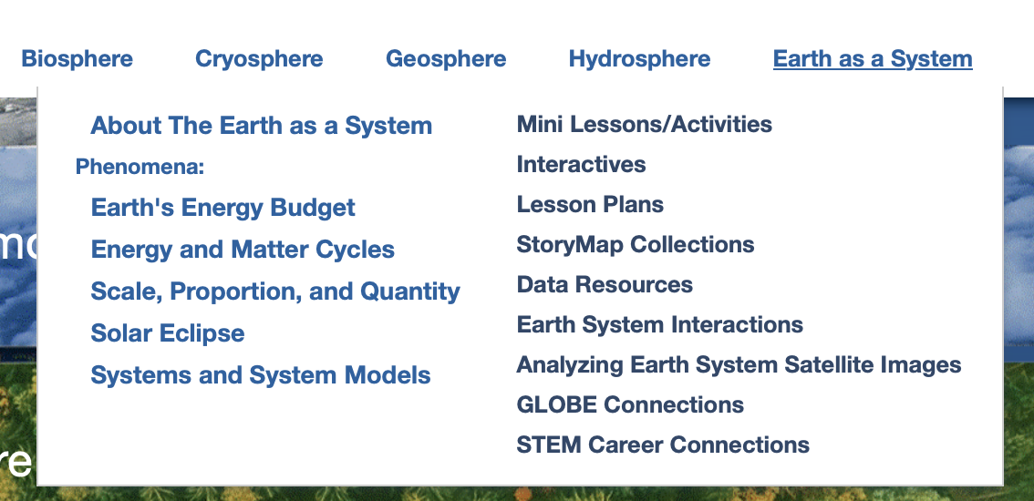
Coming Soon! My NASA Data Space Weather Phenomena
In Development:
Mini-Lessons/Activities
Interactives
Lesson Plans
StoryMap
  Engage: What is space weather?
  Explore: How do scientists predict space weather?
  Explain: Space Weather Forecast
  Extend: Aurora Viewing During Spolar Cycle 25
  Evaluate: Why Space Weather Matters
Space Weather
Heliophysics Education Activation Team

Slide 11
Coming Soon My NASA Data Space Weather Phenomena
TOPICS
MISSIONS
Space Weather
Solar Wind
Aurora
Magnetosphere
Magnetic Reconnection
Solar Cycle
Sunspots
CMEs
Solar Flares
Kp Index
Corona
Heliosphere
Coronagraphs
Ionosphere
SOHO
Moon to Mars
IMAP
SDO
ICON
MMS
STEREO
IBEX
Voyager
Release of resources scheduled for August 2025 to coincide with the start of the school year and the IMAP launch in September 2025.
Heliophysics Education Activation Team

Slide 12
NASA HEAT
For more information on M2M Analyses
mary.aronne@nasa.gov
Framework for Heliophysics Education
https://science.nasa.gov/learn/heat/big-ideas/
Heliophysics Education Activation Team

Slide 13
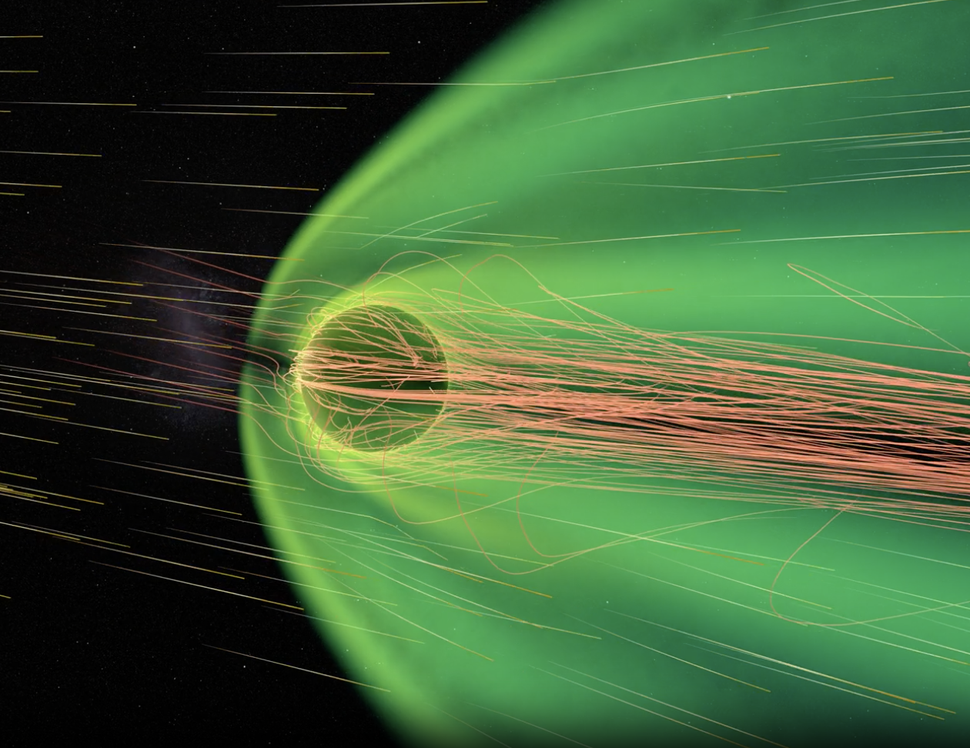
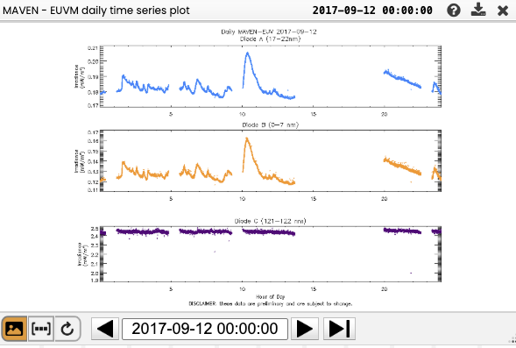
Integrated Space Weather Analysis System (ISWA) Data
Solar Storm Excites Martian Magnetosphere
https://svs.gsfc.nasa.gov/5502
Using ISWA layouts for the storm on 2017-09-12 to generate a few plots of Mars SWx: https://iswa.ccmc.gsfc.nasa.gov/IswaSystemWebApp/?layout=marssw

