Slide 1




The Heliophysics Big Year
National Aeronautics and Space Administration
Dr. Sten Odenwald, Astronomer
NASA Heliophysics Education Activation Team

Slide 2


July 2024: What is Heliophysics?
Heliophysics is the discipline in space science that deals with the matter and energy of our Sun and its effects on the solar system.
It also studies how the Sun varies and how those changes pose a hazard to humans on Earth and in space
Heliophysics Education Activation Team

Slide 3



Heliophysics Big Year Timeline
Annular Eclipse
Total Eclipse
Solar Parker
Probe Perihelion
October 14, 2023
April 8, 2024
December 24, 2024
ADD MEDIA HERE
ADD MEDIA HERE
ADD MEDIA HERE
Heliophysics Education Activation Team

Slide 4

Heliophysics Big Year Themes
2023
October- Annular Solar Eclipse
November- Mission Fleet
December- Citizen Science
2024
January- The Sun Touches Everything
February- Fashion
March- Experiencing the Sun
April- Total Solar Eclipse
May- Visual Art
June- Performance Art
July- Physical and Mental Health
August- Back to School
September- Environment / Sustainability
November- Bonus Science
December- Parker’s Perihelion
https://www.nasa.gov/science-research/heliophysics/nasa-announces-monthly-themes-to-celebrate-the-heliophysics-big-year/
Heliophysics Education Activation Team

Slide 5
July 2024 : NASA’s Big Questions
1. What causes the Sun to vary?
2. How do the Earth and the heliosphere respond?
3. What are the impacts on humanity?
These Big Questions form the basis for the
Framework for Heliophysics Education
https://science.nasa.gov/learn/heat/big-ideas/
Heliophysics Education Activation Team

Slide 6
How to Teach Heliophysics
Framework for Heliophysics Education
3 Heliophysics Investigatory Questions
What causes the Sun to vary?
1.1 The Sun is really big and its gravity influences all objects in the solar system. (PS2, ESS1)
1.2 The Sun is active and can impact technology on Earth via space weather. (PS1,PS2, PS4, ESS2, ESS3)
1.3 The Sun’s energy drives Earth’s climate, but the climate is in a delicate balance and is changing due to human activity. (PS1, PS2, PS3, LS4, ESS2, ESS3)
How do Earth, the solar system, and the heliosphere respond to changes on the Sun?
2.1 Life on Earth has evolved with complex diversity because of our location near the Sun. It is just right! (PS3, PS4, LS1, LS2, ESS2)
2.2 The Sun defines the space around it, which is different from interstellar space. (PS2, ESS1, ESS2)
2.3 The Sun is the primary source of light in the solar system. (PS1, PS2, PS3,PS4, ESS1)
What are the impacts of changes on the Sun on humans?
3.1 The Sun is made of churning plasma, causing the surface to be made of complex, tangled magnetic fields. (PS1, PS2, ESS1, ESS2)
3.2 Energy from the Sun is created in the core and travels outward through the Sun and into the heliosphere. (PS1, PS3, PS4, ESS1, ESS2, ESS3)
3.3 Our Sun, like all stars, has a life cycle. (PS1, LS1, ESS1)
3 NGSS-aligned
Big Ideas per Question
3 Guiding Questions per Idea
-1 Question per Level-
Heliophysics
Resource Database
Heliophysics Education Activation Team
Notes:
The Framework for Heliophysics Education provides the background and scaffolding educators need to incorporate heliophysics topics into existing STEM curricula. Using the three main questions that heliophysicists investigate as the foundation, this framework connects heliophysics topics with NGSS Disciplinary Core Ideas, to create NGSS-aligned Heliophysics Big Ideas.
The nine Heliophysics Big Ideas encompass the major heliophysics concepts that can be explored through existing Next Generation Science Standards (NGSS) disciplinary core ideas. Each Heliophysics Big Idea has a guiding question for each level, designed to support inquiry-based learning.
Introductory Learner = A younger learner (K-5), or a learner new to the subject matter.
Intermediate Learner = A middle-aged learner (6-8), or a learner that has some familiarity with the subject matter.
Advanced Learner = An older learner (9-12+), or a learner that has a lot of experience with the subject matter.

Slide 7
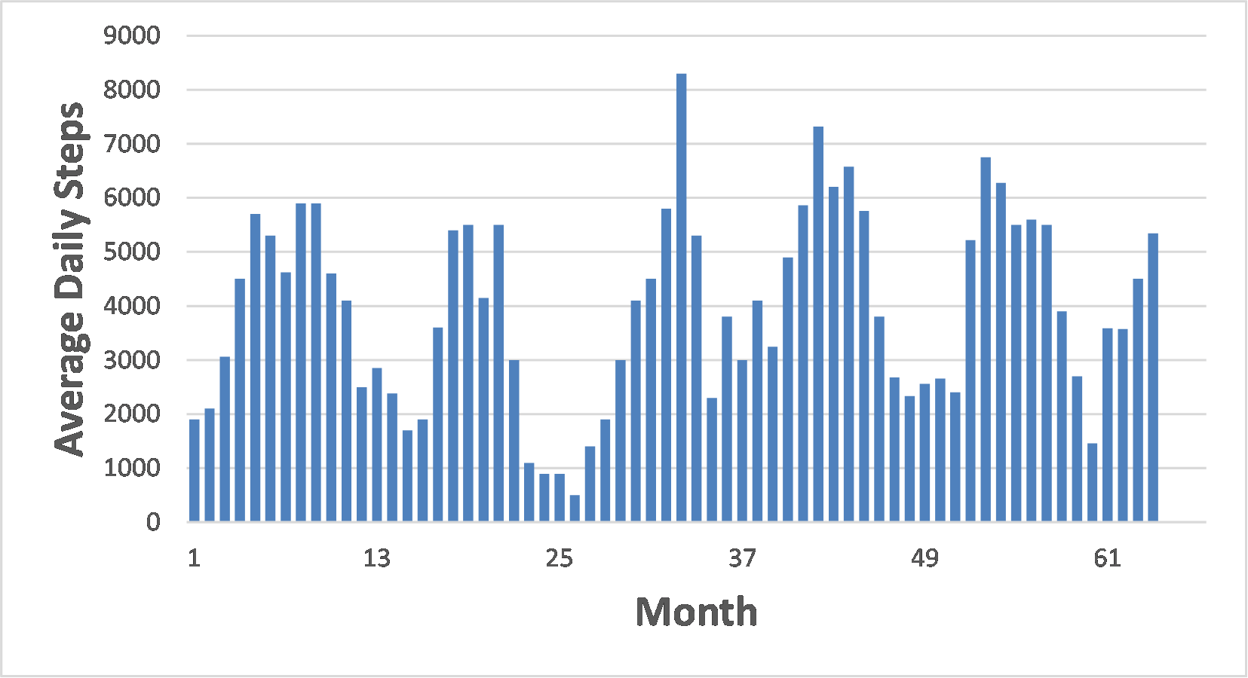
July 2024: Physical and Mental Health
We are all familiar with the idea of accumulating 10,000 steps each day to keep active. This level of fitness wards off many different physical and even mental illnesses.
Curiously, there is no evidence that 10,000 is a magic number. It was actually invented in Japan as part of a marketing ploy and 10,000 was literally pulled out of a hat because in Japanese the word for ‘10,000’ rhymed with some other word used in a marketing slogan.
Still, it is better to take ‘a lot of steps’ rather than to be inactive.
Heliophysics Education Activation Team

Slide 8

July 2024 – Beginning – Steps and Time
If you average 5000 steps a day, and each step takes about 1 second, how much time do you spend walking?
Heliophysics Education Activation Team

Slide 9

July 2024 – Beginning – Steps and Time
If you average 5000 steps a day, and each step takes about 1 second, how much time do you spend walking?
5000 steps/day x 1 second/step
= 5000 seconds/day
= 5000 seconds / (3600 seconds/hr)
= 1.39 hours/day
= 1:23:17
If allowed, bring your smartphone to school and use the Health app to track your daily steps. How are you doing?
Heliophysics Education Activation Team

Slide 10

July 2024 – Beginning – Steps and Time
If each step takes about 1 second, and each step is about 24-inches (0.7 meters) how long will it take for you to walk to the sun?
Distance to sun = 150 million km.
Heliophysics Education Activation Team

Slide 11

July 2024 – Beginning – Steps and Time
1 step = 0.7meter
1 km = 1000 meters
Steps to the sun =
150 million km x 1000 m/1km
= 150 billion steps.
1 step = 1 second
Time = 150 billion steps x 1 sec/1step
Time = 150 billion seconds
Time = 1.7 million days
Time = 4,756 years
Heliophysics Education Activation Team

Slide 12
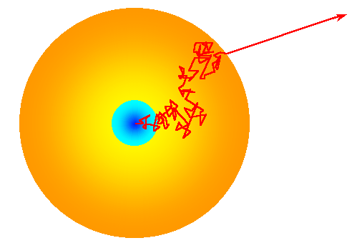
July 2024 – Intermediate – Random Walk
For light to leave the interior of the sun, it does not take a direct route but performs what is called a random walk. A photon scatters from one atom to the next traveling at the speed of light and losing energy along the way.
Heliophysics Education Activation Team

Slide 13
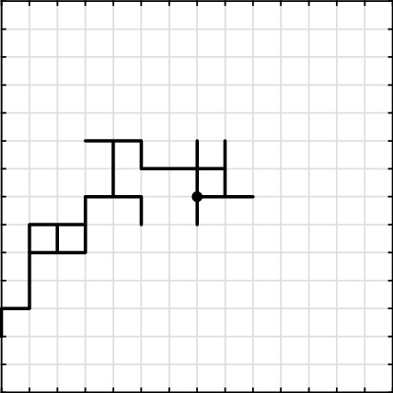
July 2024 – Intermediate – Random Walk
Mathematically we can model this process.
On a 2-d grid, start at the Origin.
Toss a coin twice.
Toss 1: If heads, you will move along the X axis. If tails you will move along the Y-axis.
Toss 2: Tells you if you will take a step forwards (heads) or backwards (tails) or up(heads) or down(tails).
Mark your path after each step. Repeat this process about ten times and see where you wind up on the grid.
How far from the origin ‘as the crow flies’ did you get on the last step?
Heliophysics Education Activation Team

Slide 14
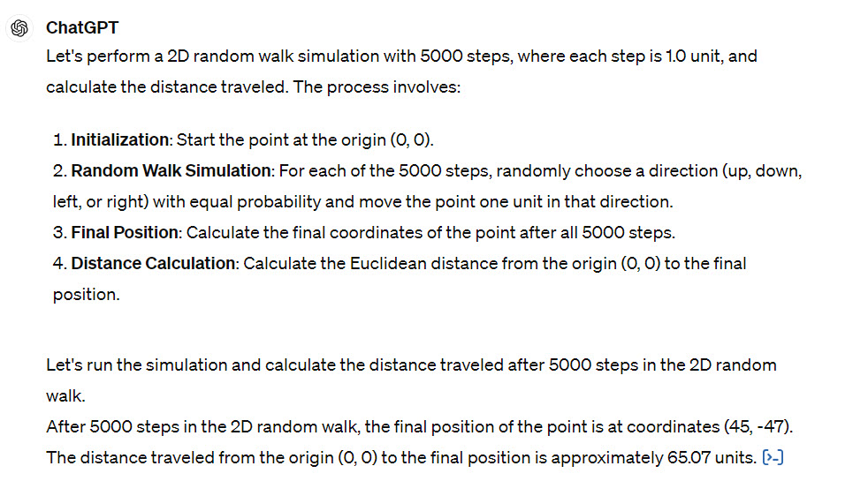
July 2024 – Intermediate – Random Walk
Use ChatGPT as a simulator.
Enter the query
“In 2-D, perform a Random Walk simulation and calculate the distance traveled after 16 steps if each step is 1.0 units.”
Repeat the query for 25 steps, 100 steps, 625 steps, 1000 steps, 5000 steps and 10,000 steps. Note the distance each time.
Heliophysics Education Activation Team

Slide 15
July 2024 – Intermediate – Random Walk
Create a model in which the distance traveled is given by the formula
Distance = Step x √N
Steps | ChatGPT | Model
16 | 3 | 4
25 | 5 | 5
100 | 9 | 10
625 | 23 | 25
1000 | 33 | 31
5000 | 65 | 70
10000 | 110 | 100
How do the simulations compare
to the mathematical model?
Heliophysics Education Activation Team

Slide 16
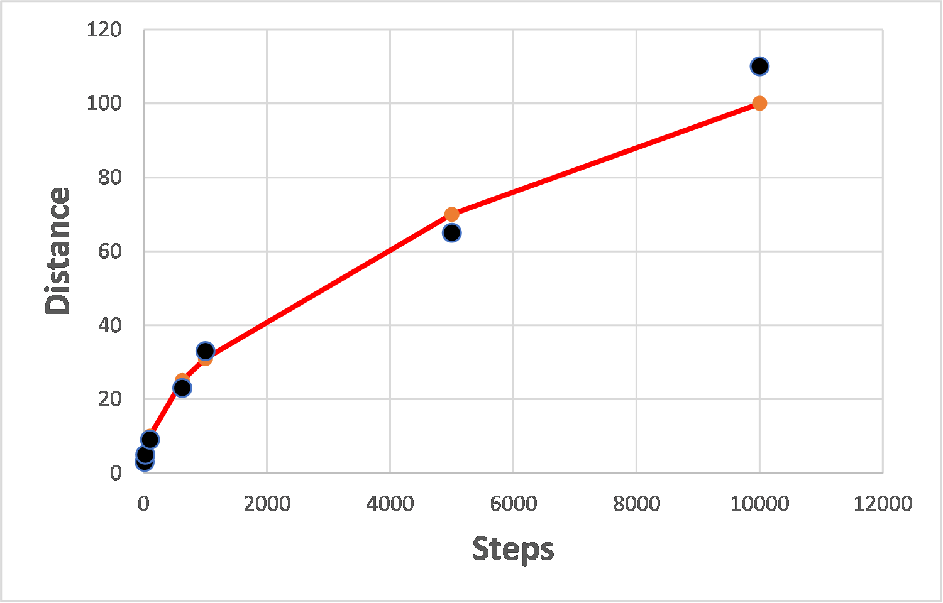
July 2024 – Intermediate – Random Walk
Create a model in which the distance traveled is given by the formula
Distance = Step x √N
How do the simulations compare
to the mathematical model?
Heliophysics Education Activation Team

Slide 17
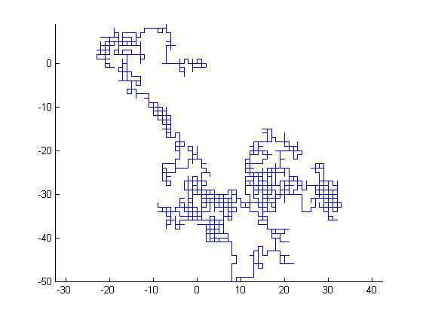
July 2024 – Intermediate – Random Walk
If you take a 0.7-meter step, how many steps will it take you to travel 1 mile from where you started?
Heliophysics Education Activation Team

Slide 18
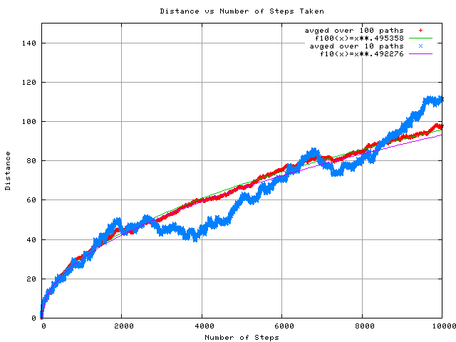
July 2024 – Intermediate – Random Walk
If you take a 0.7-meter step, how many steps will it take you to travel 1 mile from where you started?
D = 0.7 x √N
N = (D/0.7)²
N = (1000/0.7)²
N = (1428)²
N = 2 million.
Time = 1sec/step
T = N x 1 sec/step
T = 2 million seconds
T = 23 days.
Heliophysics Education Activation Team

Slide 19
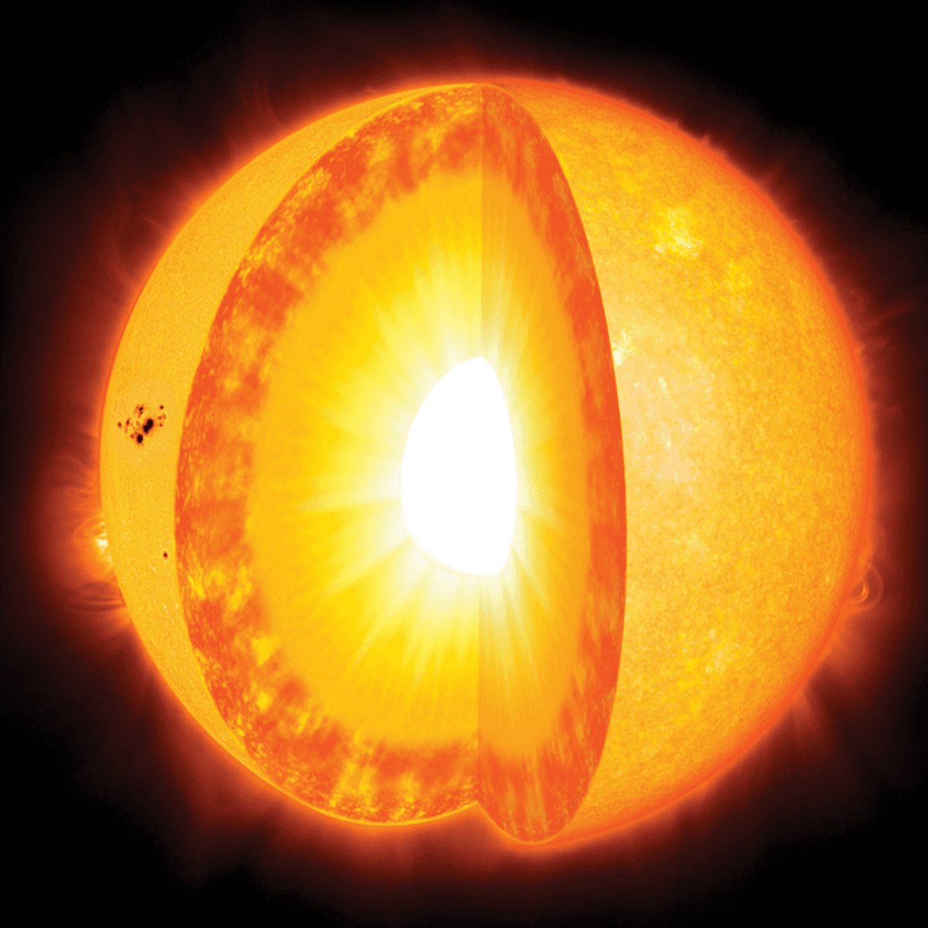
July 2024 – Advanced – Sunlight Escape
Core of the sun
Radius: 140,000 km
Step size: 0.1 mm
Exterior
Radius: 690,000 km
Step Size: 3 mm
Long Steps
Short Steps
Heliophysics Education Activation Team

Slide 20
July 2024 – Advanced – Sunlight Escape
Core of the sun
Distance: 140,000 km
Step size: 0.1 mm
Exterior
Distance: 690,000 km – 140,000 km = 550000 km
Step Size: 3 mm
Step size = 0.1 mm / 1000 mm/m = 1.0x10⁻⁴ m
Steps = (140000000 m/1.0x10⁻⁴)²
Steps = 2.0x10²⁴ steps
Time/step = 1.0x10⁻⁴m / (3x10⁸ m/s) = 3.3x10⁻¹³ sec/step
Travel Time = 21,000 years
Step size = 3 mm / 1000 mm/m = 3.0x10⁻³ m
Steps = (550000000 m/1.0x10⁻⁴)²
Steps = 3.4x10²² steps
Time/step = 3.0x10⁻³m / (3x10⁸ m/s) = 1.0x10⁻¹¹ sec/step
Travel Time = 11,000 years
Total exit time = 32,000 years...give or take!
Heliophysics Education Activation Team

Slide 21
August 2024 – Back to School
Next Time!
Heliophysics Education Activation Team

