Slide 1




The Heliophysics Big Year
National Aeronautics and Space Administration
Dr. Sten Odenwald, Astronomer
NASA Heliophysics Education Activation Team

Slide 2
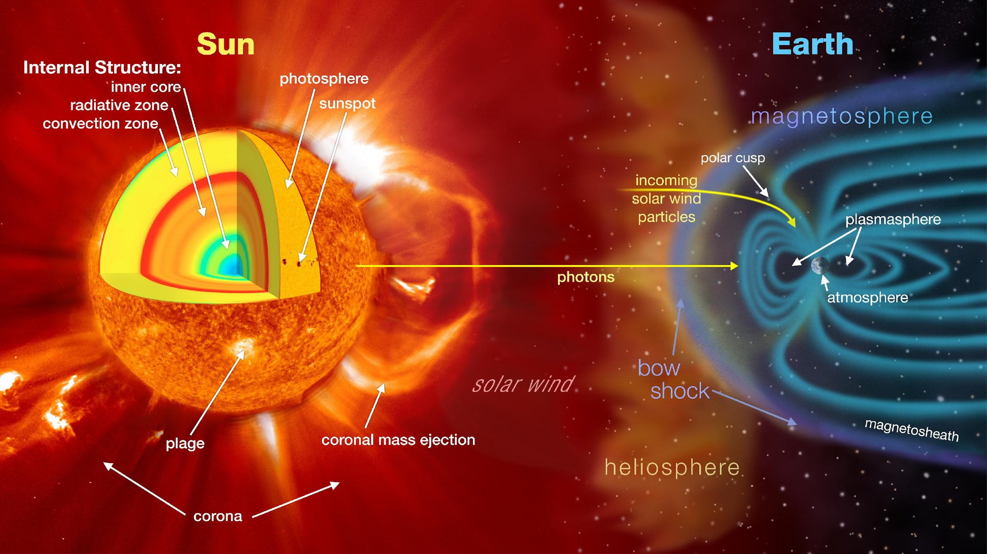

June 2024: What is Heliophysics?
Heliophysics is the discipline in space science that deals with the matter and energy of our Sun and its effects on the solar system.
It also studies how the Sun varies over time and how those changes can sometimes pose a hazard to humans on Earth and in space.
Heliophysics Education Activation Team

Slide 3
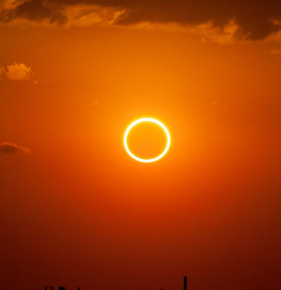
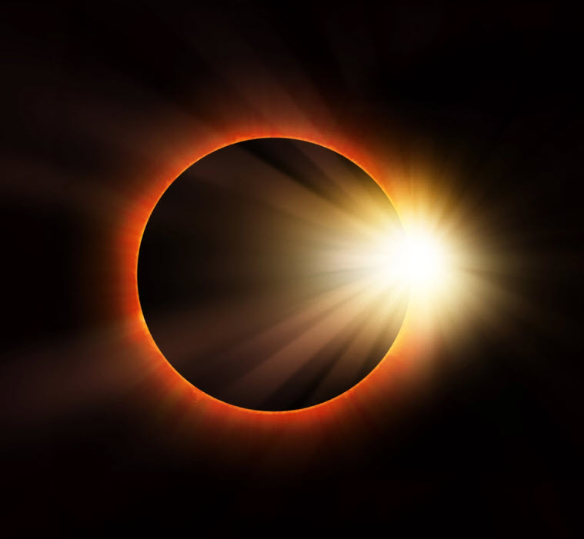
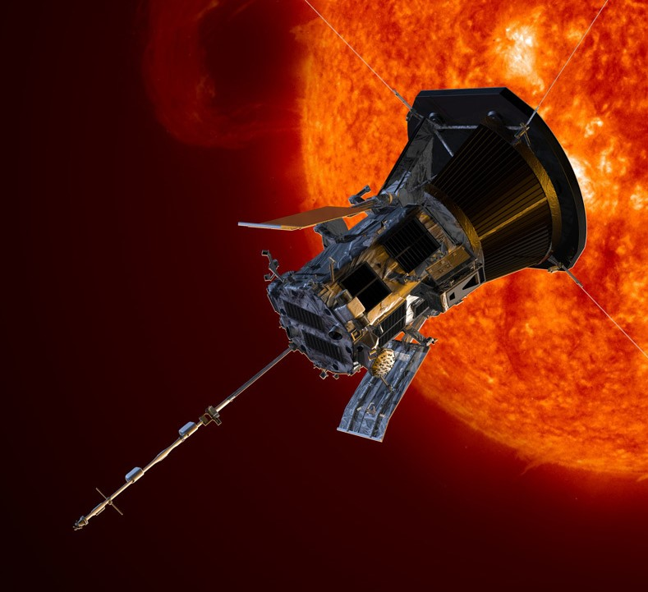
Heliophysics Big Year Timeline
Annular Eclipse
Total Eclipse
Solar Parker
Probe Perihelion
October 14, 2023
April 8, 2024
December 24, 2024
ADD MEDIA HERE
ADD MEDIA HERE
ADD MEDIA HERE
Heliophysics Education Activation Team

Slide 4

Heliophysics Big Year Themes
2023
October- Annular Solar Eclipse
November- Mission Fleet
December- Citizen Science
2024
January- The Sun Touches Everything
February- Fashion
March- Experiencing the Sun
April- Total Solar Eclipse
May- Visual Art
June- Performance Art
July- Physical and Mental Health
August- Back to School
September- Environment / Sustainability
November- Bonus Science
December- Parker’s Perihelion
https://www.nasa.gov/science-research/heliophysics/nasa-announces-monthly-themes-to-celebrate-the-heliophysics-big-year/
Heliophysics Education Activation Team

Slide 5
June 2024 : NASA’s Big Questions
1. What causes the Sun to vary?
2. How do the Earth and the heliosphere respond?
3. What are the impacts on humanity?
These Big Questions form the basis for the
Framework for Heliophysics Education
https://science.nasa.gov/learn/heat/big-ideas/
Heliophysics Education Activation Team

Slide 6
How to Teach Heliophysics
Framework for Heliophysics Education
3 Heliophysics Investigatory Questions
What causes the Sun to vary?
1.1 The Sun is really big and its gravity influences all objects in the solar system. (PS2, ESS1)
1.2 The Sun is active and can impact technology on Earth via space weather. (PS1,PS2, PS4, ESS2, ESS3)
1.3 The Sun’s energy drives Earth’s climate, but the climate is in a delicate balance and is changing due to human activity. (PS1, PS2, PS3, LS4, ESS2, ESS3)
How do Earth, the solar system, and the heliosphere respond to changes on the Sun?
2.1 Life on Earth has evolved with complex diversity because of our location near the Sun. It is just right! (PS3, PS4, LS1, LS2, ESS2)
2.2 The Sun defines the space around it, which is different from interstellar space. (PS2, ESS1, ESS2)
2.3 The Sun is the primary source of light in the solar system. (PS1, PS2, PS3,PS4, ESS1)
What are the impacts of changes on the Sun on humans?
3.1 The Sun is made of churning plasma, causing the surface to be made of complex, tangled magnetic fields. (PS1, PS2, ESS1, ESS2)
3.2 Energy from the Sun is created in the core and travels outward through the Sun and into the heliosphere. (PS1, PS3, PS4, ESS1, ESS2, ESS3)
3.3 Our Sun, like all stars, has a life cycle. (PS1, LS1, ESS1)
3 NGSS-aligned
Big Ideas per Question
3 Guiding Questions per Idea
-1 Question per Level-
Heliophysics
Resource Database
Heliophysics Education Activation Team
Notes:
The Framework for Heliophysics Education provides the background and scaffolding educators need to incorporate heliophysics topics into existing STEM curricula. Using the three main questions that heliophysicists investigate as the foundation, this framework connects heliophysics topics with NGSS Disciplinary Core Ideas, to create NGSS-aligned Heliophysics Big Ideas.
The nine Heliophysics Big Ideas encompass the major heliophysics concepts that can be explored through existing Next Generation Science Standards (NGSS) disciplinary core ideas. Each Heliophysics Big Idea has a guiding question for each level, designed to support inquiry-based learning.
Introductory Learner = A younger learner (K-5), or a learner new to the subject matter.
Intermediate Learner = A middle-aged learner (6-8), or a learner that has some familiarity with the subject matter.
Advanced Learner = An older learner (9-12+), or a learner that has a lot of experience with the subject matter.

Slide 7
June 2024 – Performance Art
The Sun also shows up in music and dance – two areas that will be celebrated this month.
Carly Simon’s ‘You’re so vain’ song mentioned the total eclipse of the sun in Nova Scotia.
So, how do songs about the Sun compare to the sunspot cycle?
Are there more of them when there are more sunspots?
1964: House of the Rising Sun - Animals
1969: Here Comes the Sun – Beatles
1971: Ain't No Sunshine – Bill Withers
1972: You’re So Vain – Carly Simon
1974: Don’t Let the Sun Go Down on Me – Elton John
1983: Total Eclipse of the Heart – Bonnie Tyler
1983: King of Pain (Spot on the Sun) – The Police
1997: Walkin’ on the Sun – Smash Mouth
2003: Soak up the Sun – Sheryl Crow
2016: Trip Around the Sun – Kenny Chesney
https://www.cloudynights.com/topic/213605-songs-that-mention-the-sun/
Heliophysics Education Activation Team

Slide 8
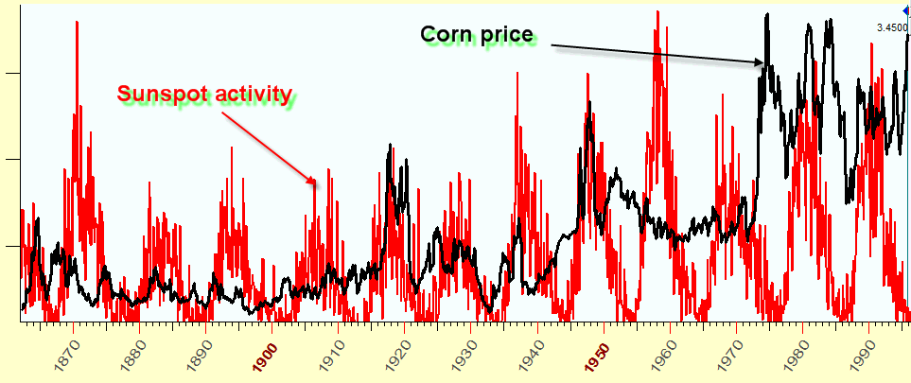
June 2024 – Performance Art
The sunspot cycle is a feature of the sun
that has captivated attention for over 200
years. Many attempts have been made to
correlate agricultural cycles, weather and
other human activity to the rise and fall of
sunspots numbers.
In this activity we are going to see if the
number of songs released each year with
the sun as a theme has anything to do with the sunspot cycle.
https://www.timingsolution.com/TS/Articles/sunspot/
Can you propose a hypothesis that might make this connection happen?
How would your hypothesis work as a physical process?
Heliophysics Education Activation Team

Slide 9
June 2024 – Performance Art
Whether you have a detailed hypothesis in mind, or are just curious about this data, you first want to check that your hypothesis is needed in the first place.
So, let’s plot the data in various ways and see if the sunspot data lines up (is correlated) with the number of songs released each year about the sun.
https://www.timingsolution.com/TS/Articles/sunspot/
Heliophysics Education Activation Team

Slide 10
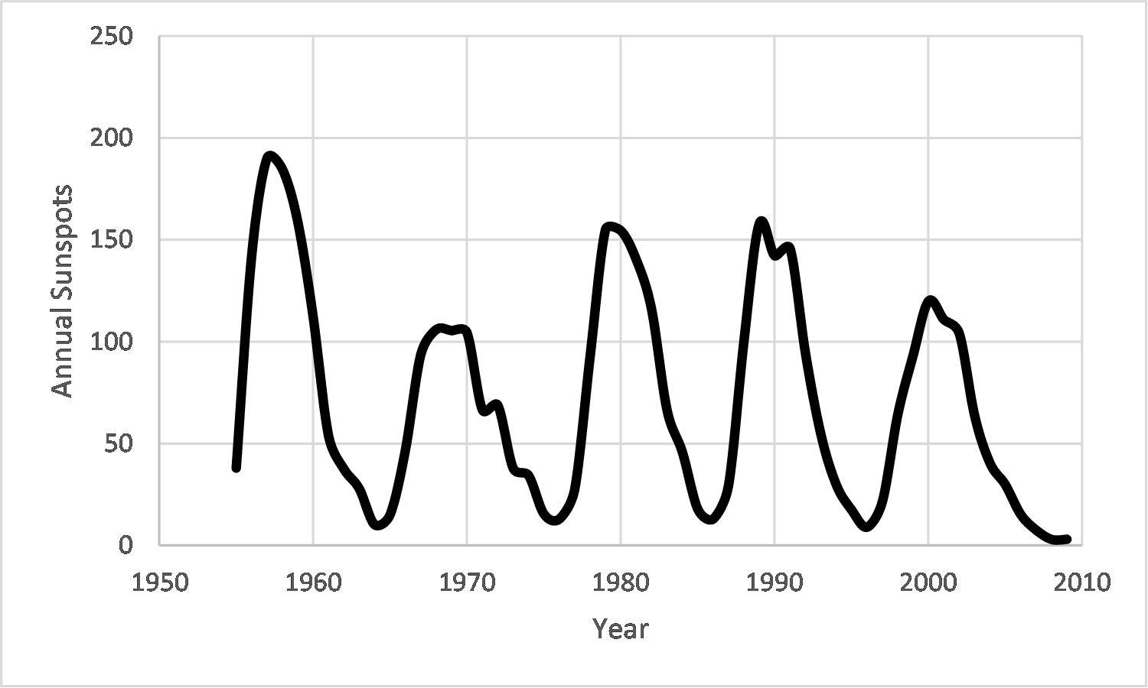
June 2024 – Beginning – Plotting the Data
Sunspot counts by year.
HBYDataJune.xls
This data comes from the Australian Space
Weather Service website, which has a
table of the annual numbers.
https://www.sws.bom.gov.au/Educational/2/3/6
Heliophysics Education Activation Team

Slide 11
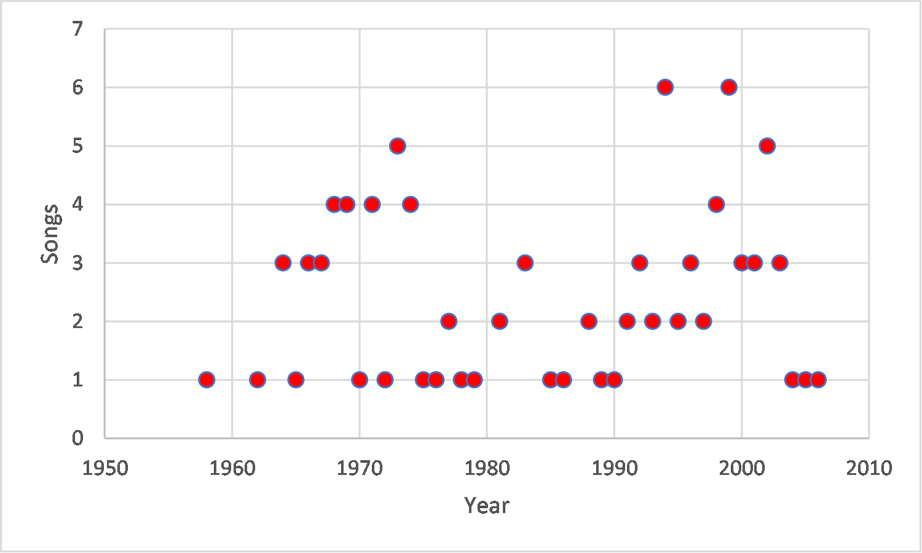
June 2024 – Beginning – Plotting the Data
Number of songs released
each year.
This comes from a tedious search with
Google for ‘songs that mention the sun’
and then searching each song title to
get the year that it was released.
100 songs were identified between
1958-2008
HBYDataJune.xls
Heliophysics Education Activation Team

Slide 12
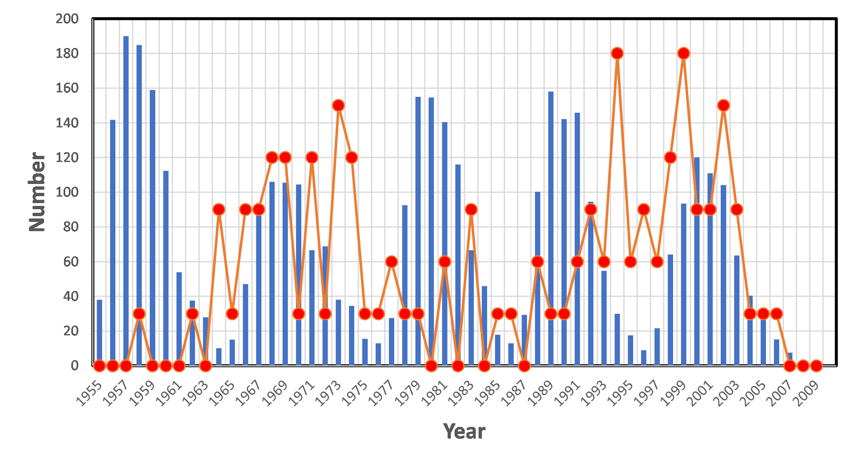
June 2024 – Beginning – Plotting the Data
Song data has been
multiplied by 30x to put
on same number scale as
sunspot counts.
Scientists often change
the color scale of an
image or adjust the
data for plotting by
re-scaling it so that it
can be more easily
compared.
It is important to put the data into a form (plots, images, etc) that make it easier to analyze.
Bar graphs, Line graphs, Pie charts, box-and-whisker, or combinations of these, etc.
Ask students which kinds of plots work best for them...This can be a matter of individual preference.
Heliophysics Education Activation Team

Slide 13
June 2024 – Intermediate– Looking for Patterns
Do the amplitudes match?
The range for the sunspot data is 0-190
The range for the song data is 0 – 6
No. The ranges are not the same
Heliophysics Education Activation Team

Slide 14
June 2024 – Intermediate– Looking for Patterns
Do the peaks and valleys match up in time?
Between 1958-1963 sunspot data at a maximum and song data at minimum.
Between 1965-1973 sunspot data at a maximum and song data at a maximum.
Between1983 and 1989 sunspots at a minimum and song data at a minimum.
There is no correlation between maxima and minima
Heliophysics Education Activation Team

Slide 15
June 2024 – Intermediate– Looking for Patterns
Is there an overall trend in time?
The sunspot data rises and falls with an 11-year cycle.
The song data after 1965 seems to have a rising and falling trend with a period of about 1997-1969 = 28 years.
The cycle lengths do not match nor are they multiples of each other.
Fails the trend test.
Heliophysics Education Activation Team

Slide 16
June 2024 – Intermediate – Looking for Patterns
Test | Evaluation
Amplitudes correlated? | No
Peaks and Valleys match? | No
Overall trends match? | No
Assessment | The songs released each year are not correlated with sunspot numbers
Heliophysics Education Activation Team

Slide 17
June 2024 – Advanced – Checking for Correlations
The previous assessment was subjective. It relied on a human making a judgment about trends.
The huge mismatch between the ranges of the two things being compared can hide actual correlations between them in the face of natural sampling variation.
Heliophysics Education Activation Team

Slide 18
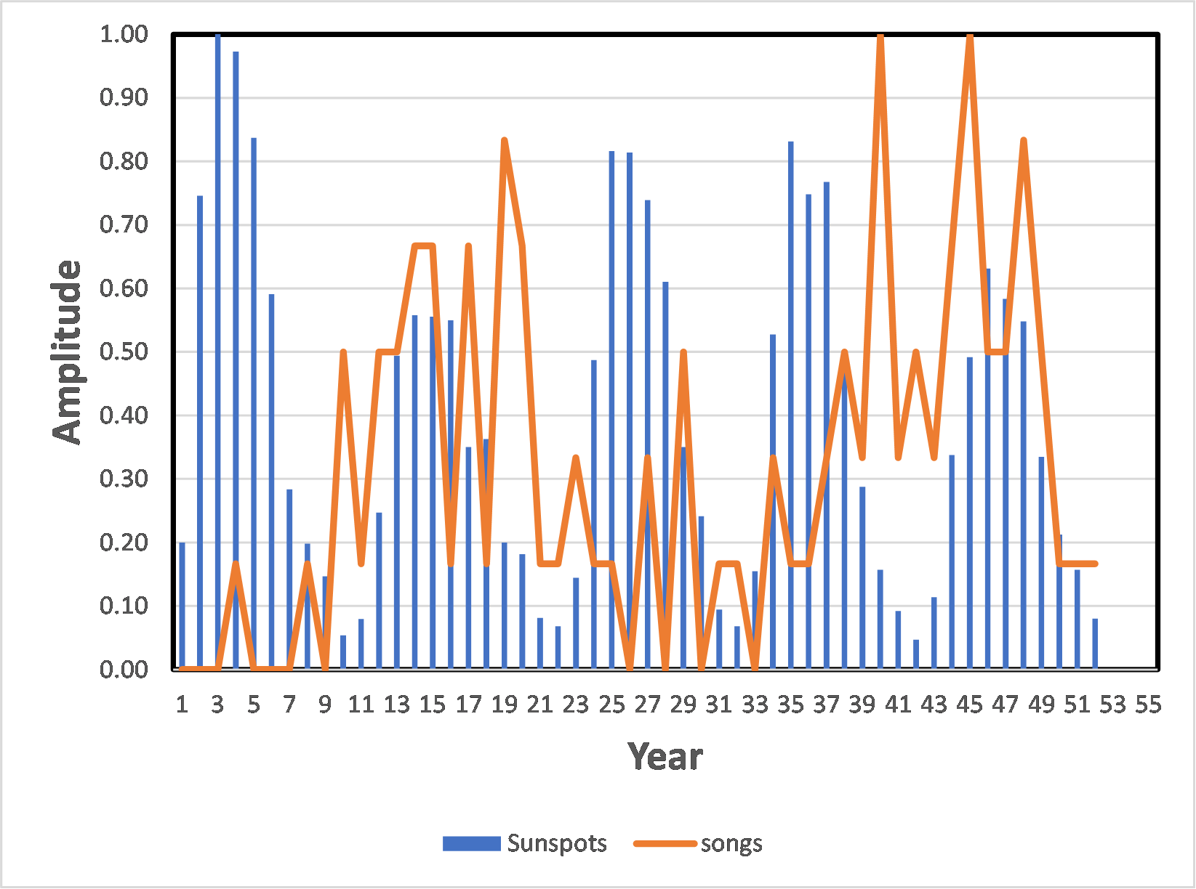
June 2024 – Advanced – Checking for Correlations
Over this span of yearly measurements the amplitude of the sunspot variation (0-190) does not match the range of the song releases (0-6) so
1 - We conclude that the amplitude scales are not correlated.
Preparing the data for testing:
Re-scale the data to the same range (0-1) by dividing each datum by the maximum value in the range.
Heliophysics Education Activation Team

Slide 19
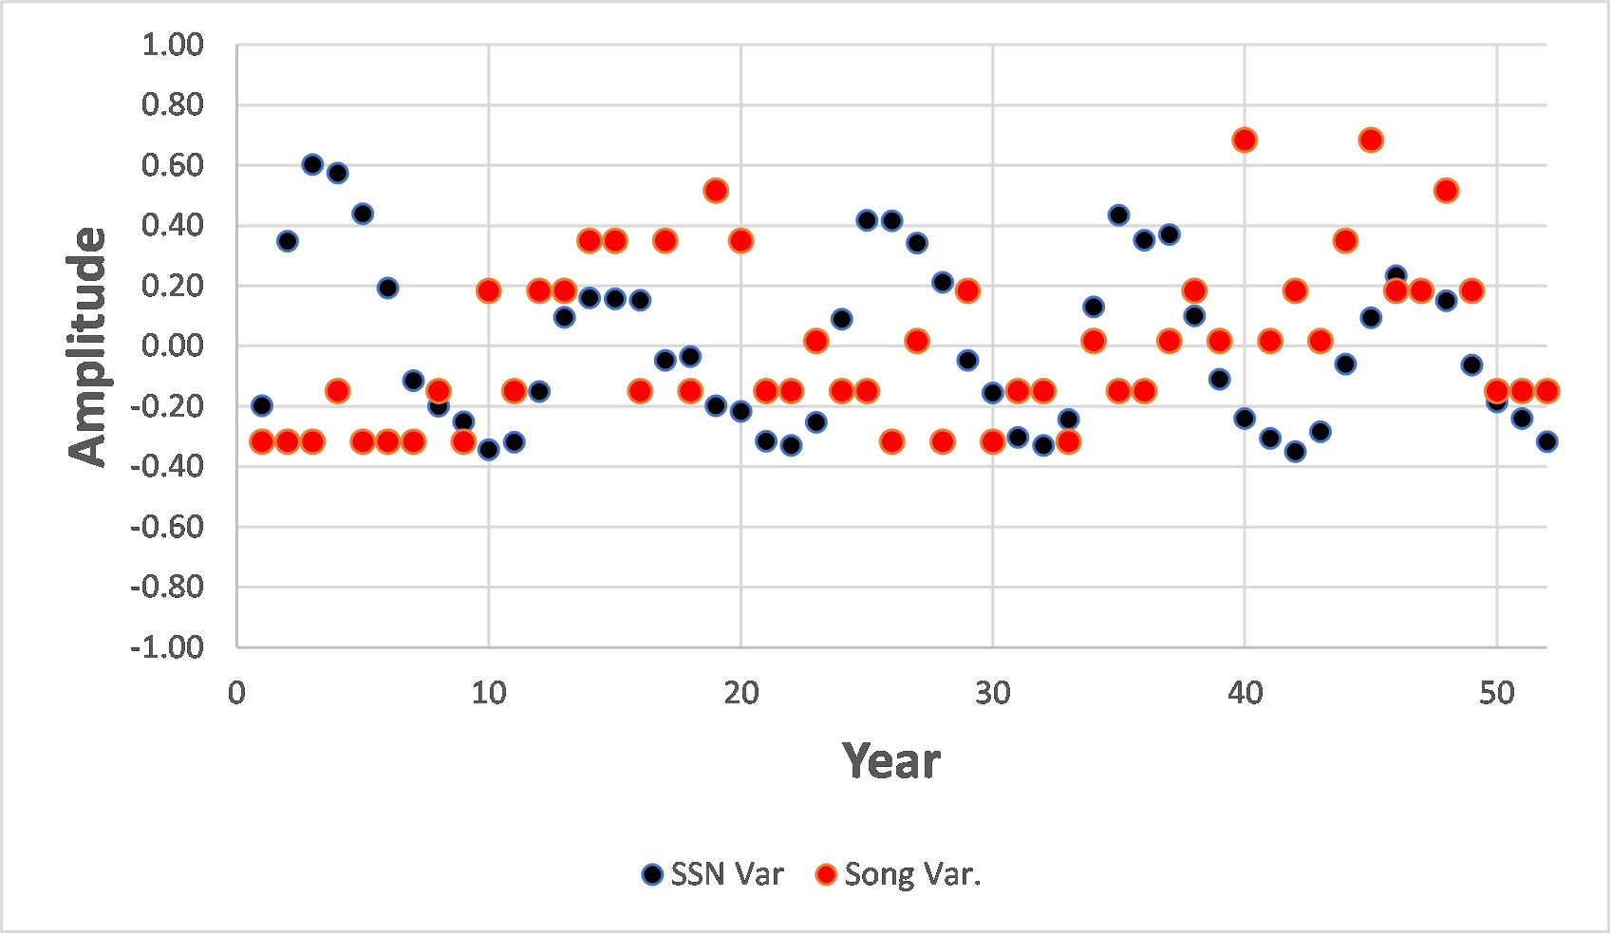
June 2024 – Advanced – Checking for Correlations
2. Subtract the average value of
each set of data from the corresponding
set of data.
Average of SSN = 0.40
Average of Songs = 0.32
Heliophysics Education Activation Team

Slide 20
June 2024 – Advanced – Checking for Correlations
The data with the corresponding means subtracted will now be tested to see if the relationship between the two series (deviations from the means) can be explained by statistical variance, also called sampling error.
If it can, we can conclude that the song data and the sunspot data are not correlated and the deviations have a frequency consistent with pure sampling error.
If we can’t, we have to conclude that the differences between the two data cannot be explained by statistical variance alone. They must be correlated.
3. Testing for correlation
Heliophysics Education Activation Team

Slide 21
June 2024 – Advanced – Checking for Correlations
Assume that the SSN data is fixed.
Subtract the SSN values from the Song values for each year.
Compute the s.d. of the difference and plot the frequency distribution
Compare
Determine whether the differences are statistically significant.
Heliophysics Education Activation Team

Slide 22
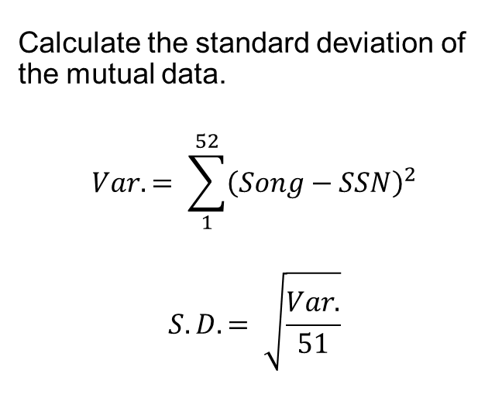
June 2024 – Advanced – Checking for Correlations
Ave = 0.0
Var. = 8.70
s.d. = 0.41
Heliophysics Education Activation Team

Slide 23
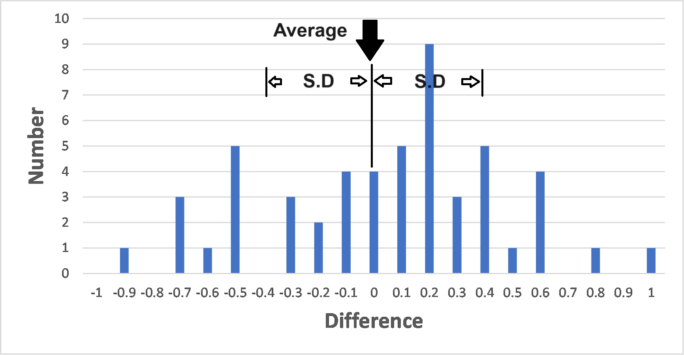
June 2024 – Advanced – Checking for Correlations
Plot the frequency histogram of the differences
Heliophysics Education Activation Team

Slide 24
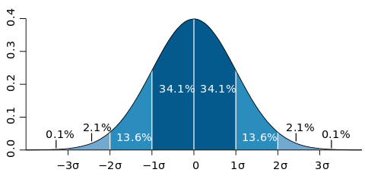
June 2024 – Advanced – Checking for Correlations
For a distribution consistent with pure random noise, we should get a Gaussian distribution for a large enough sample.
Heliophysics Education Activation Team

Slide 25
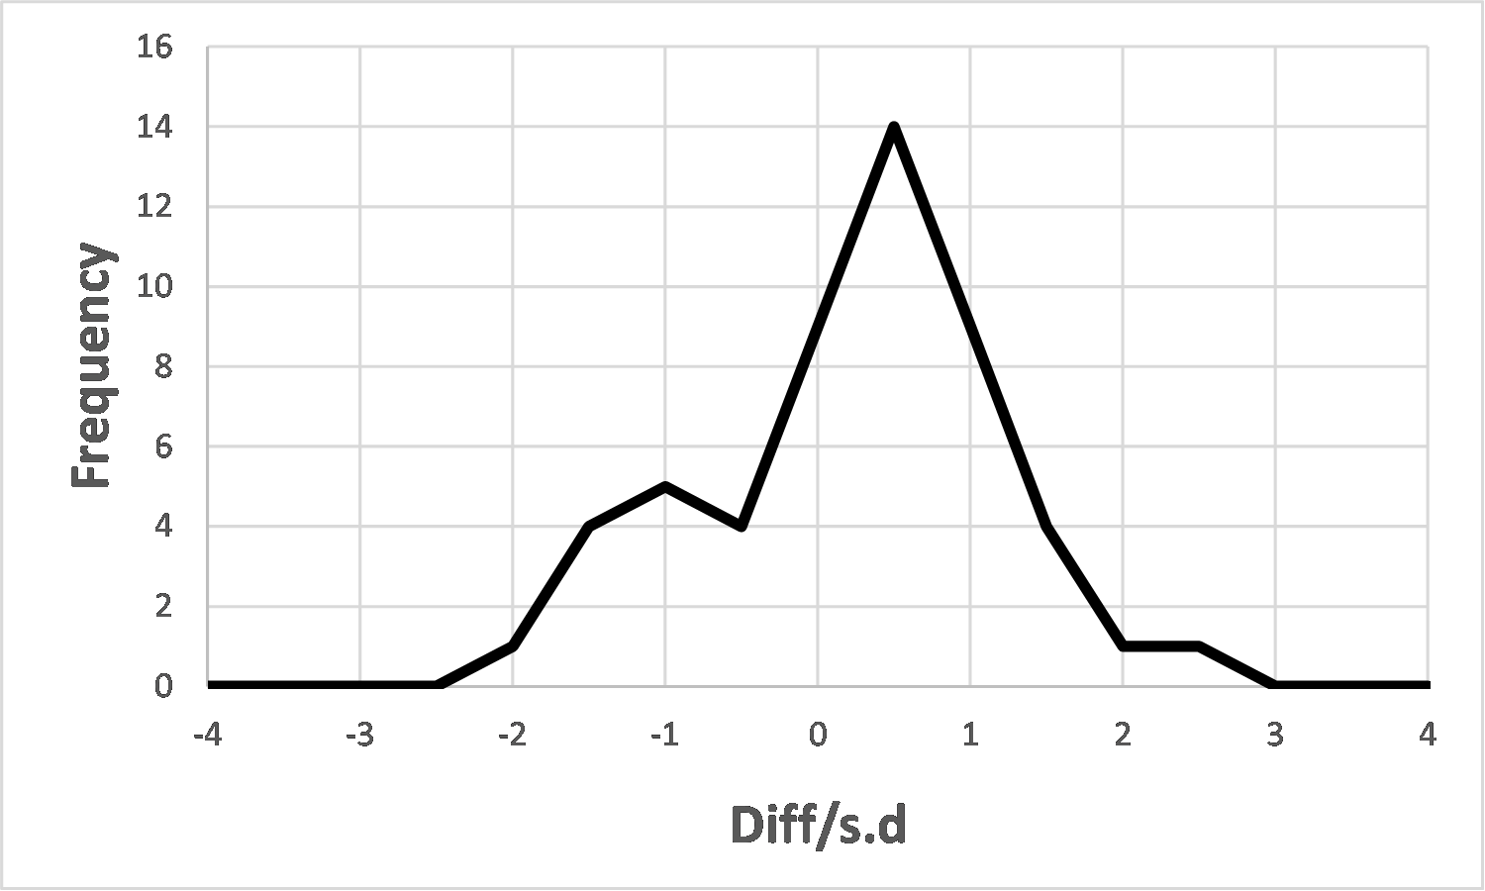
June 2024 – Advanced – Checking for Correlations
If we change our differences into multiples of the s.d = 0.41 we get 100% of the differences within +/-3 standard deviations of the mean.
This means that the differences are essentially purely random and do not support the idea that there is a correlation between SSN and Songs.
The Null Hypothesis can be rejected at the 99.6% (3-sigma) confidence level or p = 0.004 which is <0.05.
Heliophysics Education Activation Team

Slide 26
June 2024: Advanced – Checking for Correlations
Student’s T-Test Calculator:
https://www.socscistatistics.com/tests/studentttest/default2.aspx
N=52 paired, normalized samples with non-zero means
One-tailed distribution (all positive values)
DOF = 52 – 1 = 51.
The t-value is 1.49.
The p-value is .069.
The result is not significant at p < .05.
Once again, the hypothesis that the data are correlated can be rejected with a confidence greater that 99.6%
Heliophysics Education Activation Team

Slide 27
June 2024: Advanced – Checking for Correlations
ChatGPT Query: Consider two sequences called Spots and Songs given by the following data:
Spots: 0.20, 0.75, 1.00, 0.97, 0.84, 0.59, 0.28, 0.20, 0.15, 0.05, 0.08, 0.25, 0.49, 0.56, 0.56, 0.55, 0.35, 0.36, 0.20, 0.18, 0.08, 0.07, 0.14, 0.49, 0.82, 0.81, 0.74, 0.61, 0.35, 0.24, 0.09, 0.07, 0.15, 0.53, 0.83, 0.75, 0.77, 0.50, 0.29, 0.16, 0.09, 0.05, 0.11, 0.34, 0.49, 0.63, 0.58, 0.55, 0.33, 0.21, 0.16, 0.08
Songs: 0.00, 0.00, 0.00, 0.17, 0.00, 0.00, 0.00, 0.17, 0.00, 0.50, 0.17, 0.50, 0.50, 0.67, 0.67, 0.17, 0.67, 0.17, 0.83, 0.67, 0.17, 0.17, 0.33, 0.17, 0.17, 0.00, 0.33, 0.00, 0.50, 0.00, 0.17, 0.17, 0.00, 0.33, 0.17, 0.17, 0.33, 0.50, 0.33, 1.00, 0.33, 0.50, 0.33, 0.67, 1.00, 0.50, 0.50, 0.83, 0.50, 0.17, 0.17, 0.17
Use a one-sided, Student-T test to determine whether to accept or reject the null hypothesis that the two sequences are correlated. Show the work.
Heliophysics Education Activation Team

Slide 28
June 2024: Advanced – Checking for Correlations
ChatGPT Response – summarized with comment:
Average of Spots: 26.52/60 = 0.442 this is wrong because there are 52 values not 60
Average of Songs: 20.50/60 = 0.341 this is wrong because there are 52 values not 60
It then computes a t-statistic of 5.624 for 58 degrees of freedom.... This is wrong and should be 51.
For a one-tailed test with a significance level of 0.05 and 58 degrees of freedom, wrong
The critical value is approximately 1.671. wrong
Since the absolute value of the t-statistic (5.624) is greater than the critical value (1.671), we reject the null hypothesis.
There is sufficient evidence to suggest that the sequences Spots and Songs are correlated. wrong
Don’t use ChatGPT to do statistical testing. Use a dedicated online calculator!
With ChatGPT you must always check the answer
Heliophysics Education Activation Team

Slide 29
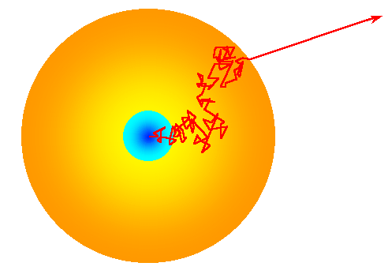
July 2024: Physical and Mental Health
Next Time!
This month explores connections between the Sun and our physical and mental health from solar-inspired sports teams to Sun-themed meditations.
How many steps would it take for you to walk to the Sun?
How long does it take for light to travel from the sun’s core to its surface?
Heliophysics Education Activation Team

