Slide 1




The Heliophysics Big Year
National Aeronautics and Space Administration
Dr. Sten Odenwald, Astronomer
NASA Heliophysics Education Activation Team

Slide 2
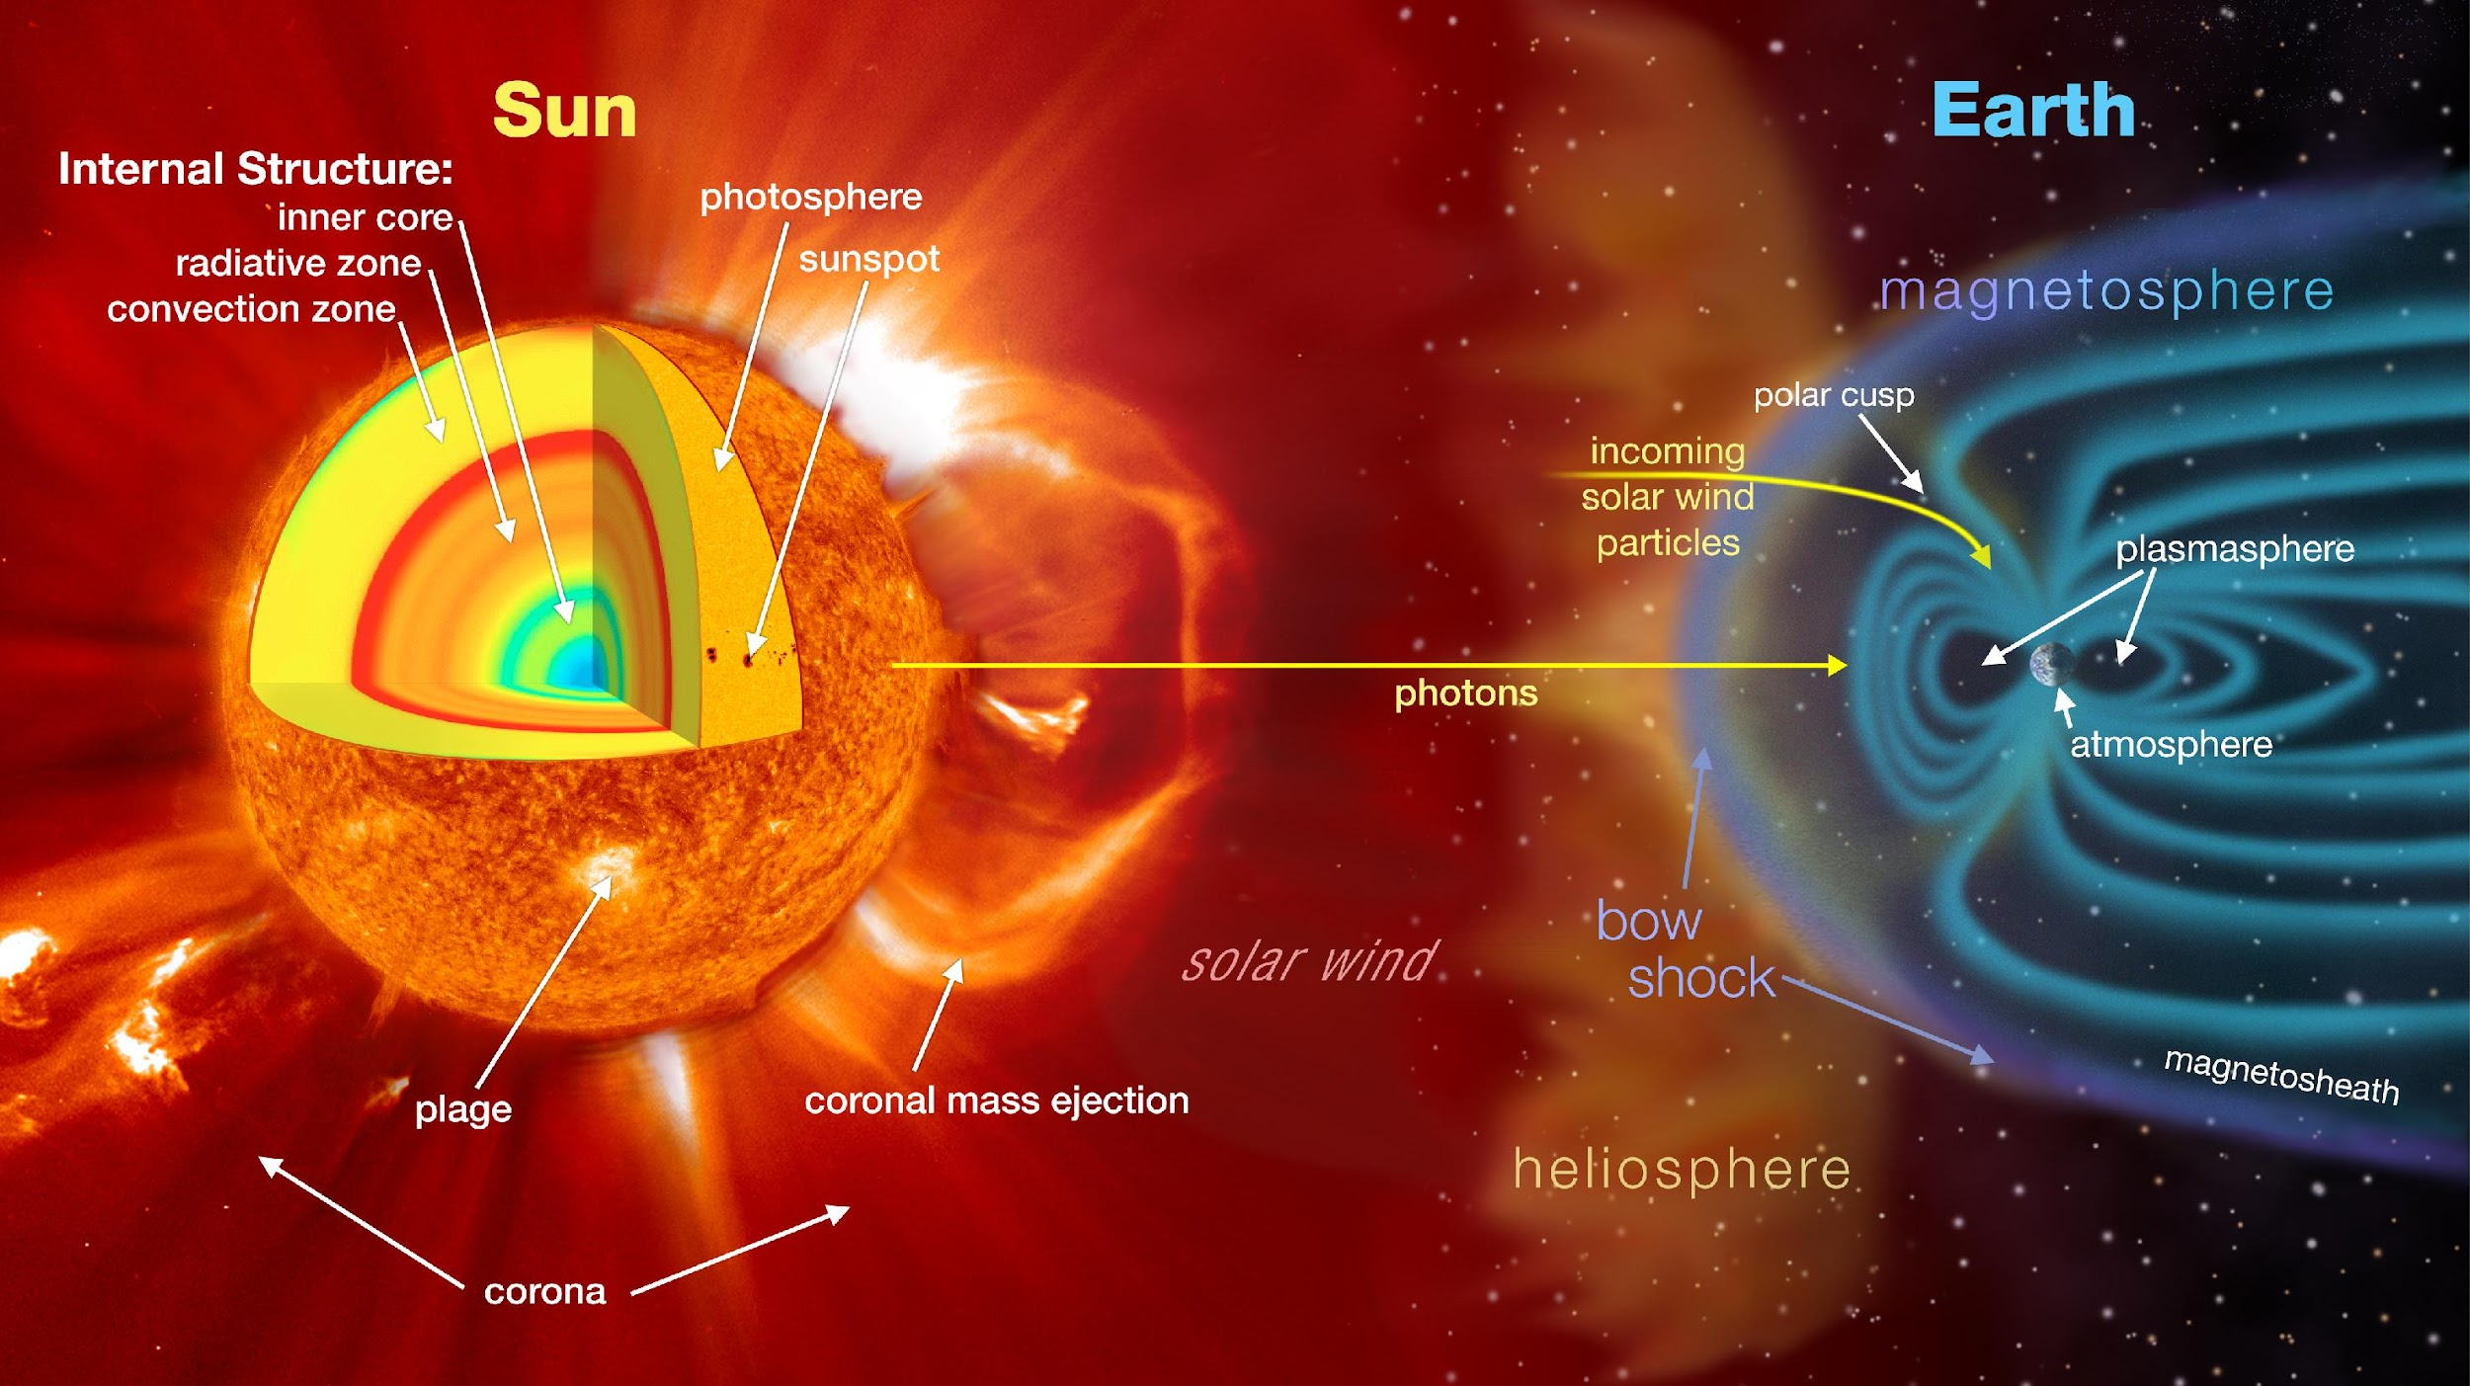

April 2024: What is Heliophysics?
Heliophysics is the discipline in space science that deals with the matter and energy of our Sun and its effects on the solar system.
It also studies how the Sun varies over time and how those changes can sometimes pose a hazard to humans on Earth and in space.
Heliophysics Education Activation Team

Slide 3
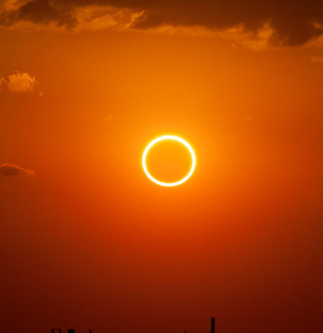
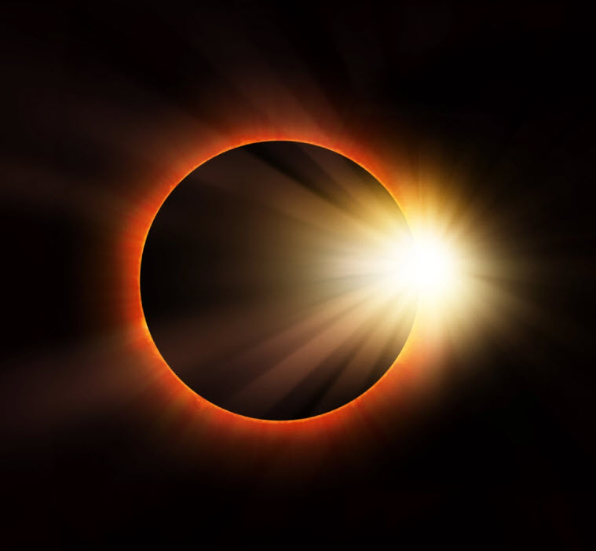
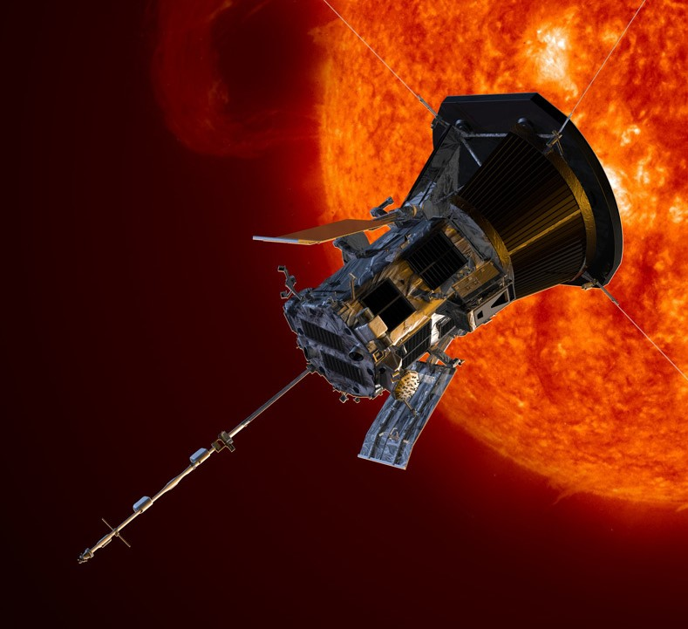
Heliophysics Big Year Timeline
Annular Eclipse
Total Eclipse
Solar Parker
Probe Perihelion
October 14, 2023
April 8, 2024
December 24, 2024
ADD MEDIA HERE
ADD MEDIA HERE
ADD MEDIA HERE
Heliophysics Education Activation Team

Slide 4

Heliophysics Big Year Themes
2023
October- Annular Solar Eclipse
November- Mission Fleet
December- Citizen Science
2024
January- The Sun Touches Everything
February- Fashion
March- Experiencing the Sun
April- Total Solar Eclipse
May- Visual Art
June- Performance Art
July- Physical and Mental Health
August- Back to School
September- Environment / Sustainability
November- Bonus Science
December- Parker’s Perihelion
https://www.nasa.gov/science-research/heliophysics/nasa-announces-monthly-themes-to-celebrate-the-heliophysics-big-year/
Heliophysics Education Activation Team

Slide 5
April 2024 : NASA’s Big Questions
1. What causes the Sun to vary?
2. How do the Earth and the heliosphere respond?
3. What are the impacts on humanity?
These Big Questions form the basis for the
Framework for Heliophysics Education
https://science.nasa.gov/learn/heat/big-ideas/
Heliophysics Education Activation Team

Slide 6
How to Teach Heliophysics
Framework for Heliophysics Education
3 Heliophysics Investigatory Questions
What causes the Sun to vary?
1.1 The Sun is really big and its gravity influences all objects in the solar system. (PS2, ESS1)
1.2 The Sun is active and can impact technology on Earth via space weather. (PS1,PS2, PS4, ESS2, ESS3)
1.3 The Sun’s energy drives Earth’s climate, but the climate is in a delicate balance and is changing due to human activity. (PS1, PS2, PS3, LS4, ESS2, ESS3)
How do Earth, the solar system, and the heliosphere respond to changes on the Sun?
2.1 Life on Earth has evolved with complex diversity because of our location near the Sun. It is just right! (PS3, PS4, LS1, LS2, ESS2)
2.2 The Sun defines the space around it, which is different from interstellar space. (PS2, ESS1, ESS2)
2.3 The Sun is the primary source of light in the solar system. (PS1, PS2, PS3,PS4, ESS1)
What are the impacts of changes on the Sun on humans?
3.1 The Sun is made of churning plasma, causing the surface to be made of complex, tangled magnetic fields. (PS1, PS2, ESS1, ESS2)
3.2 Energy from the Sun is created in the core and travels outward through the Sun and into the heliosphere. (PS1, PS3, PS4, ESS1, ESS2, ESS3)
3.3 Our Sun, like all stars, has a life cycle. (PS1, LS1, ESS1)
3 NGSS-aligned
Big Ideas per Question
3 Guiding Questions per Idea
-1 Question per Level-
Heliophysics
Resource Database
Heliophysics Education Activation Team
Notes:
The Framework for Heliophysics Education provides the background and scaffolding educators need to incorporate heliophysics topics into existing STEM curricula. Using the three main questions that heliophysicists investigate as the foundation, this framework connects heliophysics topics with NGSS Disciplinary Core Ideas, to create NGSS-aligned Heliophysics Big Ideas.
The nine Heliophysics Big Ideas encompass the major heliophysics concepts that can be explored through existing Next Generation Science Standards (NGSS) disciplinary core ideas. Each Heliophysics Big Idea has a guiding question for each level, designed to support inquiry-based learning.
Introductory Learner = A younger learner (K-5), or a learner new to the subject matter.
Intermediate Learner = A middle-aged learner (6-8), or a learner that has some familiarity with the subject matter.
Advanced Learner = An older learner (9-12+), or a learner that has a lot of experience with the subject matter.

Slide 7
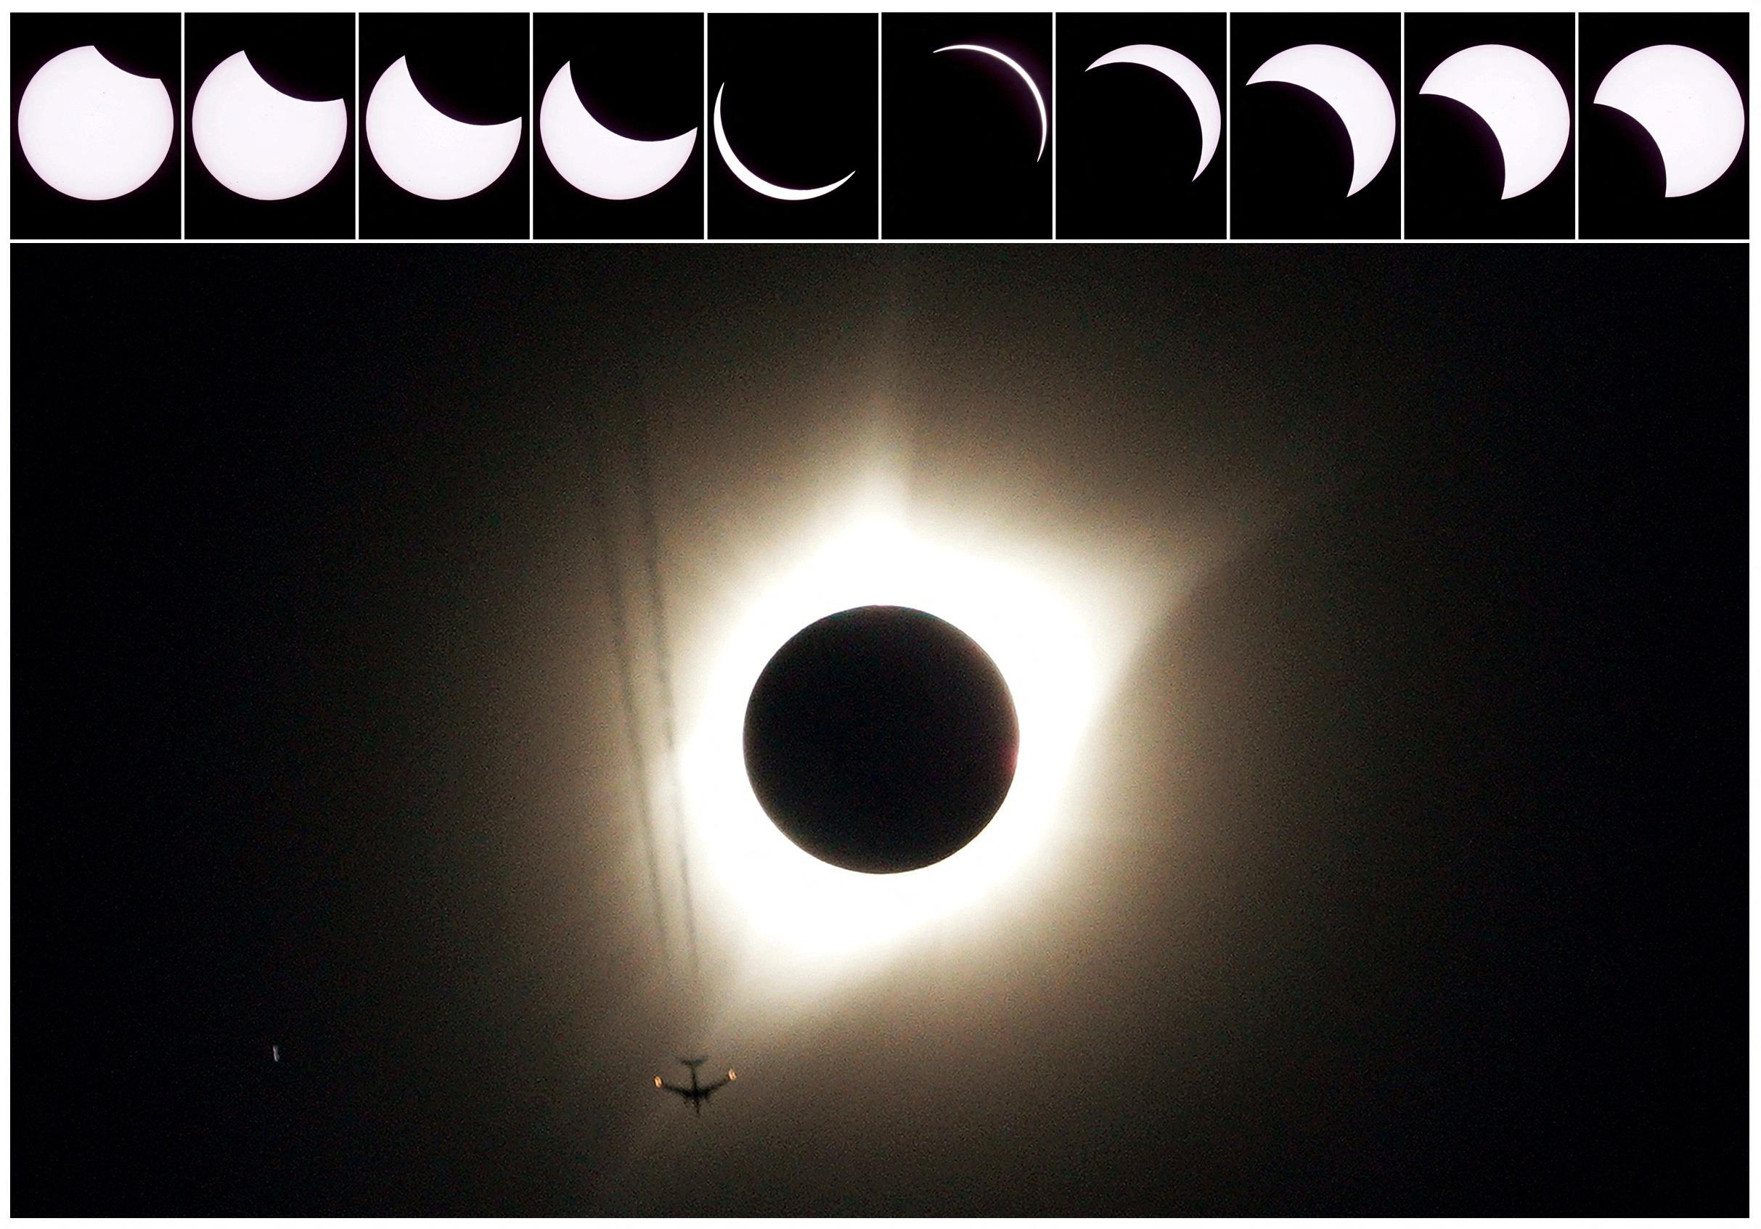
April 2024 – Total Solar Eclipse
April 8, 2024.
(Credit: Reuters)
Heliophysics Education Activation Team

Slide 8
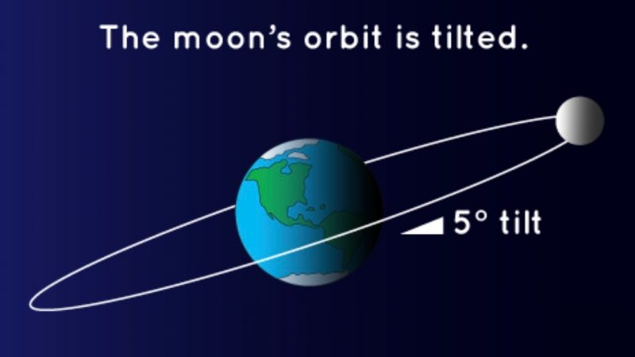
April 2024 – Total Solar Eclipse
Illustration of the tilt of the Moon’s orbit, with respect to the Earth-Sun plane.
It’s why we don’t have lunar and solar eclipses every month. Not to scale. Image via NASA SpacePlace.
Heliophysics Education Activation Team

Slide 9
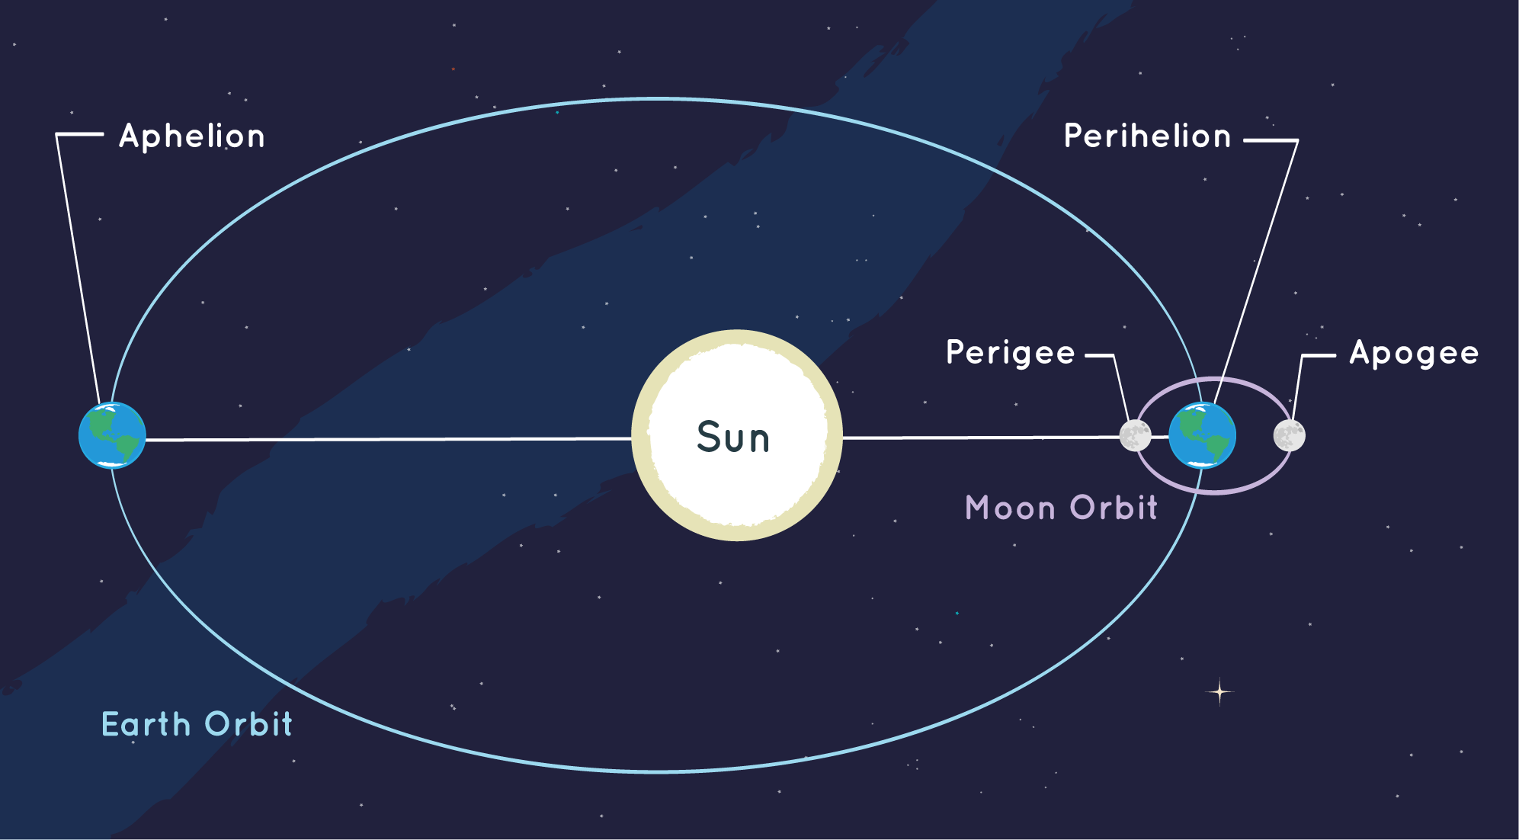
April 2024 – Total Solar Eclipse
The point at which a planet is closest to the Sun is called perihelion. The farthest point is called aphelion. (Credit: NOAA)
Heliophysics Education Activation Team

Slide 10
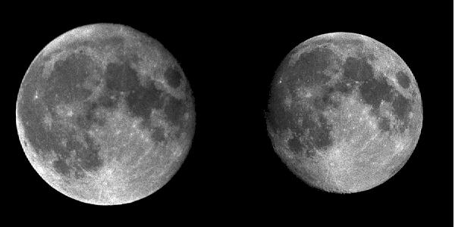
April 2024 – Total Solar Eclipse
Lunar size
Credit John Walker
https://www.fourmilab.ch/earthview/moon_ap_per.html
Perigee Apogee
Heliophysics Education Activation Team

Slide 11
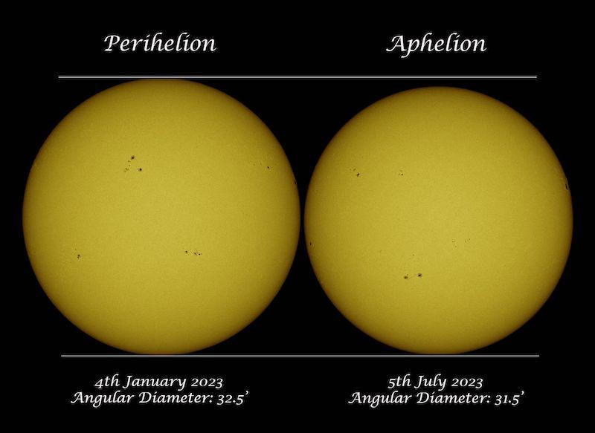
April 2024 – Total Solar Eclipse
Sun size comparison
(Credit: EarthSky/ Soumyadeep Mukherjee)
Heliophysics Education Activation Team

Slide 12
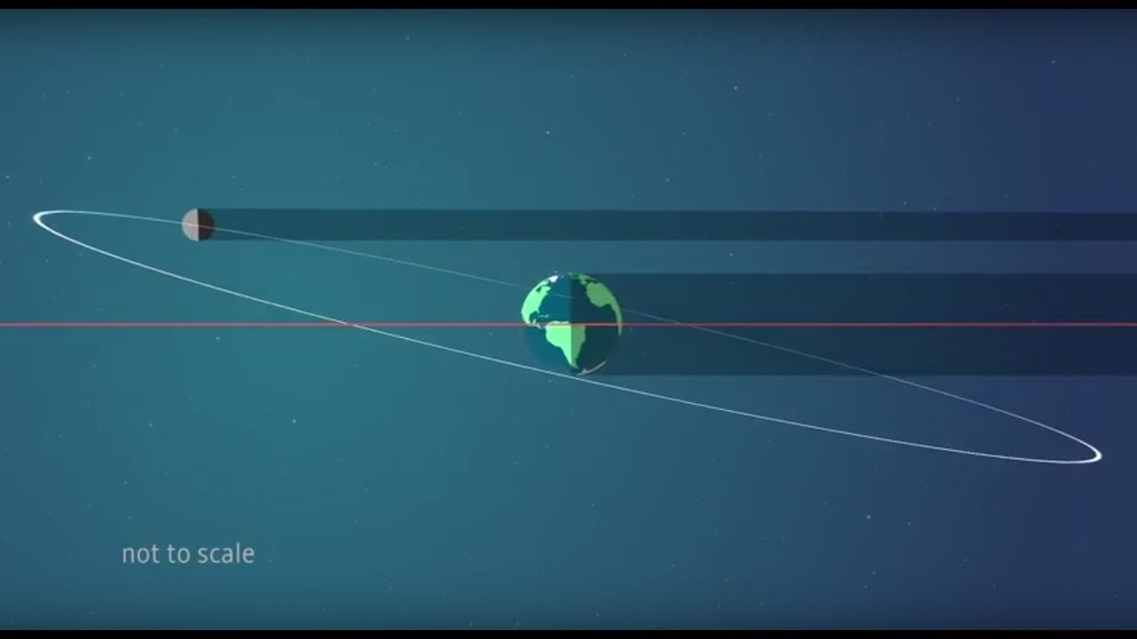
April 2024 – Total Solar Eclipse
As the Moon orbits Earth, it
also wobbles up and down,
making total eclipses rarer
than they otherwise would
be. Credit: NASA
Heliophysics Education Activation Team

Slide 13
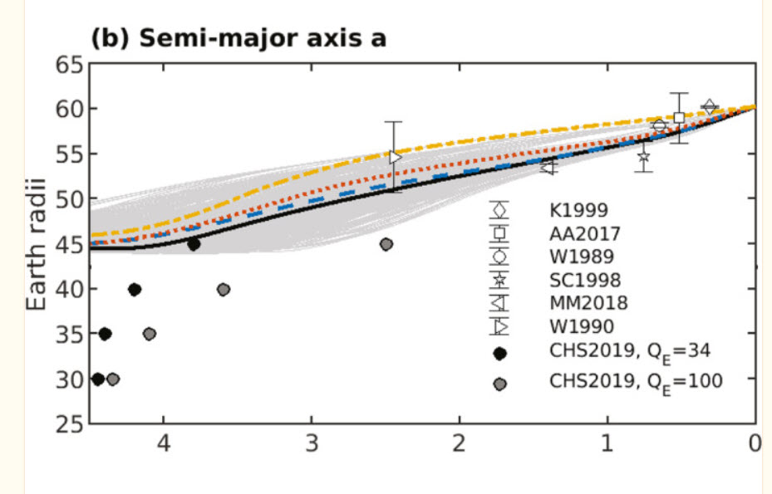
April 2024 – Total Solar Eclipse
Moon orbit drift from geology and recent lunar laser ranging.
Current rate is 3 cm/year
Today
Heliophysics Education Activation Team

Slide 14
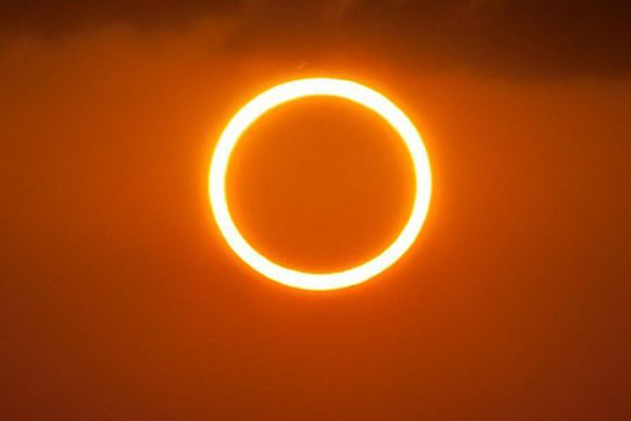
April 2024 – Total Solar Eclipse
Conclusions
There was a time when the Moon was so close it completely blocked the disk of the Sun.
There will come a time when the Moon’s disk will always appear too small to fully block the Sun.
This means that one day, there will be an end to Total Solar Eclipses.
Heliophysics Education Activation Team

Slide 15
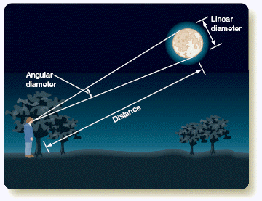
April 2024 – Beginners: Angular size
We see things as they appear to be to our eyes and brain.
We may know that a car is 10-feet long, but when we see it at a distance it appears smaller.
Our Moon is 3,475 km in diameter, but at a distance of 363,000 km from Earth, it is only about as big as a child’s fingernail at arms-length.
We can see how this works using ‘similar triangles’.
Seeds Foundations of Astronomy, 9th edition
Heliophysics Education Activation Team

Slide 16
April 2024 – Beginners: Angular size
Similar Triangles and proportions:
Moon
fingernail
Arms length
Moon distance
Heliophysics Education Activation Team

Slide 17
April 2024 – Beginners: Angular size
Proportions: Show that the thumb has about same proportion to the Moon and so its angle is the same.
Arm = 24-inches
Fingernail = ¼-inch 0.25-inch / 24-inches = 0.01 angle = 0.6º
Moon = 3,500 km
Distance = 363,000 km 3,500 km / 363,000 km = 0.01 angle = 0.6º
Heliophysics Education Activation Team

Slide 18
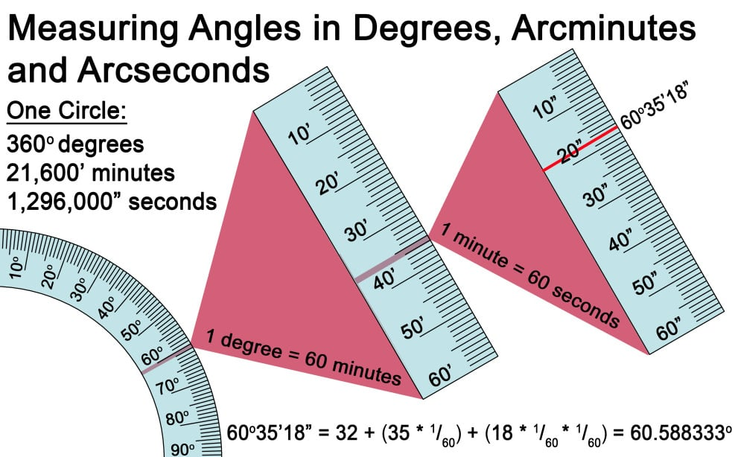
April 2024 – Intermediate: Lunar distance
The Moon’s angular size is given by
Linear diameter (km)
= 57.3º x ------------------------
Distance (km)
Example: For a diameter = 3,500 km and D = 363,000 km
Θ = 57.3º x 3500/363000 = 0.55º
We prefer to use arc-sec measure where 1º = 3600 “ so
Θ = 0.55 x 3600 = 1988”
Heliophysics Education Activation Team

Slide 19
April 2024 – Intermediate: Lunar Distance
Over the last one billion years, the lunar distance has increased from 300,000 km to 363,000 km.
What linear equation models this change in distance?
363,000
300,000
1 billion 0
Heliophysics Education Activation Team

Slide 20
April 2024 – Intermediate: Lunar Distance
Over the last one billion years, the lunar distance has increased from 300,000 km to 363,000 km.
What linear equation models this change in distance?
Slope = (363000-300000)/1000 million years = 63 km/Myr
D = 300,000 + 63 T
Where T is in millions of years.
Heliophysics Education Activation Team

Slide 21
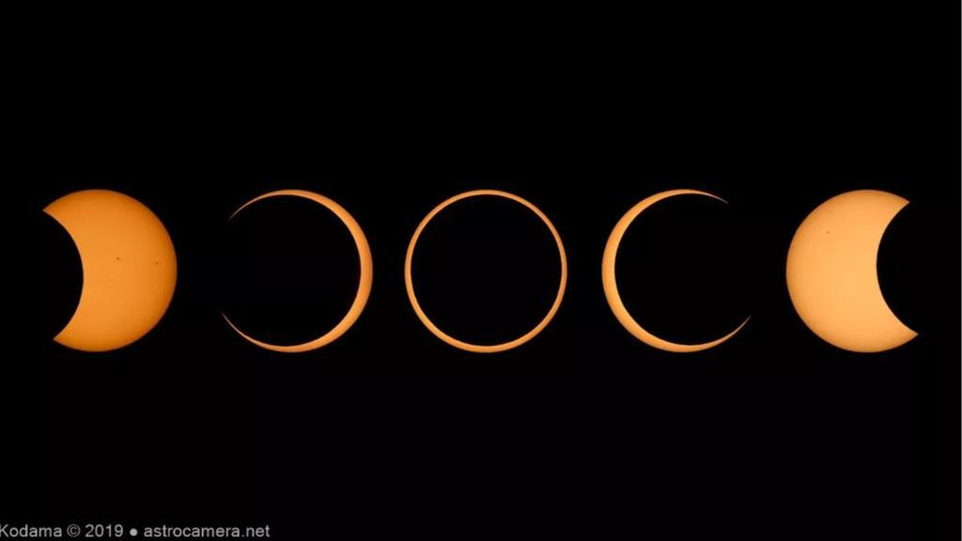
April 2024 – Intermediate:
If the Sun’s diameter is 0.5º today, in how many million years will the Moon’s diameter start to be less than the Sun’s diameter?
Heliophysics Education Activation Team

Slide 22
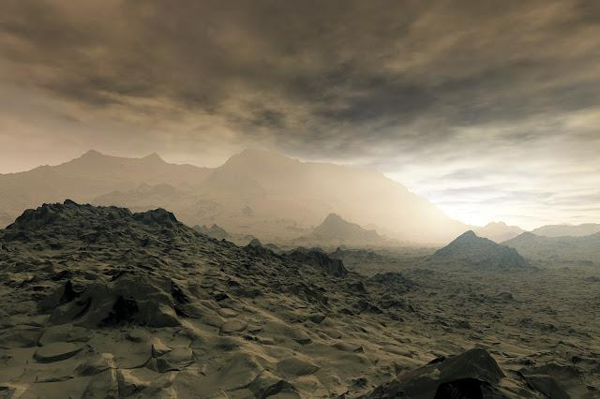
April 2024 – Intermediate:
If the Sun’s diameter is 0.5 today, in how many million years will the Moon’s diameter start to be less than this?
3,500 km
Θ = 57.3º ---------------- = 0.5º
D
D = (57.3/0.5) x 3500 km = 401,000 km.
Then:
401,000 km = 363,000 +63T
T = 600 million years.
Image Credit: Detlev Van Ravenswaay
Heliophysics Education Activation Team

Slide 23
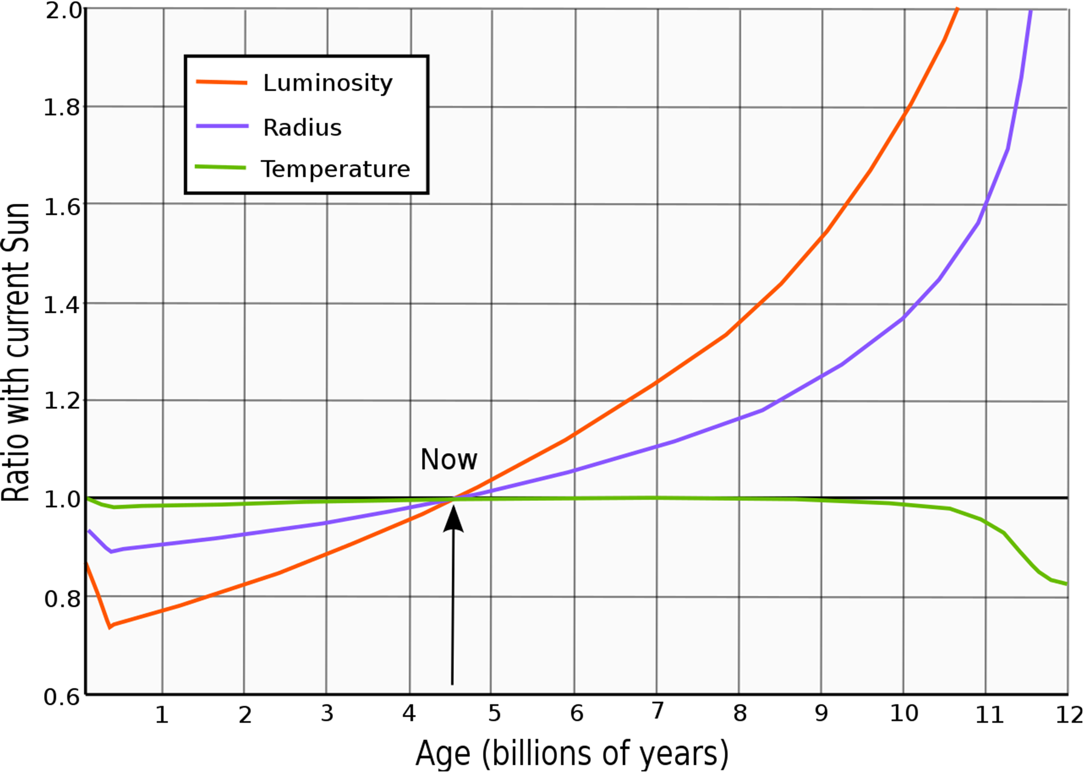
April 2024 – Advanced: Everything Changes!
The Sun’s radius is changing
1 billion yrs ago = 95% of today
1 billion yrs from now = 105% of today
What is a linear equation that models the
diameter change in time units of 1 million yrs
if the radius today is 696,000 km?
The lunar distance is changing too.
Perigee distance:
D = 363,000 + 63T km
Apogee distance:
D = 405,000 + 63T km
Heliophysics Education Activation Team

Slide 24
April 2024 – Advanced: Everything Changes!
The Sun’s diameter is changing
1 billion yrs ago = 95% of today
R = 696,000 x 0.95 = 661,000 km
T = -1000 Myrs
1 billion yrs from now = 105% of today
R = 696,000 x 1.05 = 730,800 km
T = +1000 Myrs
Slope = (730800-661000)/(1000-(-1000))
= 69800k m/2000 Myr
= +35 km/Myr.
R = 696,000 + 35 T km
Diameter = 1,392,000 + 70T km
Heliophysics Education Activation Team

Slide 25
April 2024 – Advanced: Everything Changes!
What are the formulae for the angular size of the Sun and Moon assuming the distance to the Sun is fixed at 150 million km?
Q = 57.3 x (Diameter (km)/Distance (km)) degrees
Sun:
Θs = 57.3 x (1,392,000 + 70T km)/150 million km
Θs = 0.50 + 0.000027 T
Moon Apogee:
Distance = 405000+63T
Θa = 57.3 x (3,500) / (405000+63T)
Moon Perigee:
D = 363,000 + 63T km
Θp = 57.3 x (3,500) / (363,000+63T)
Heliophysics Education Activation Team

Slide 26
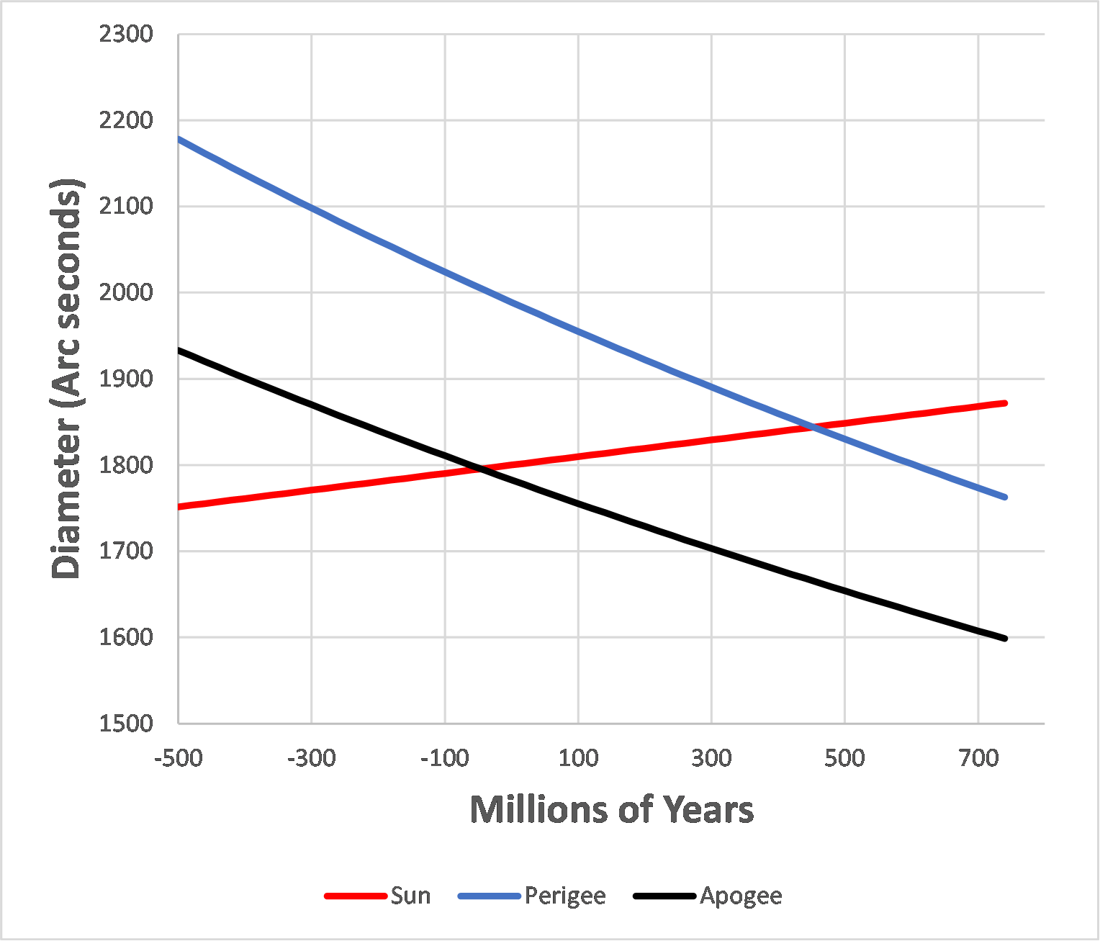
April 2024 – Advanced: Everything Changes!
Plot the equations for Θs, Θa and Θp.
When will the first and last total solar eclipses will occur?
Point A = 40 million years ago
Point B = 460 million years from now
This assumes a linear increase in lunar distance, which is not quite accurate,
Heliophysics Education Activation Team

Slide 27
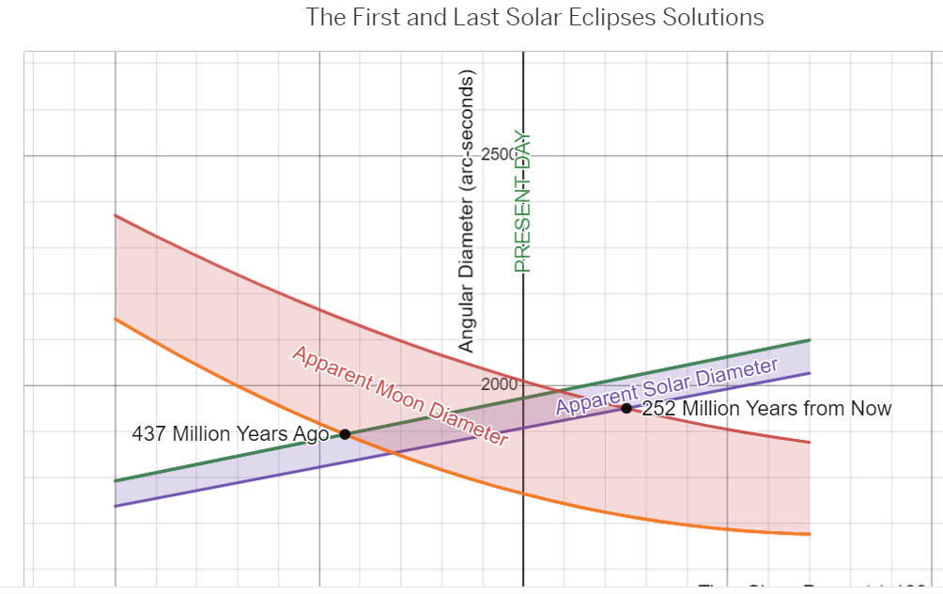
April 2024 – Advanced: Everything Changes!
A more accurate prediction is available through DESMOS which uses parabolic lunar evolution and not linear.
Point A = 437 million years ago
Point B = 252 million years from now
DESMOS provides an interactive math lab for students that plots equations and provides the appropriate NGSS and Math standards plus a guided narrative on the nature of the problem.
DESMOS Lab: Created by Luke Henke and Sten Odenwald
https://teacher.desmos.com/activitybuilder/custom/657881d995f85f6585cd3ad5
Heliophysics Education Activation Team

Slide 28
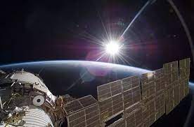
May 2024: Visual Art
Next Time!
The Sun has been depicted in art for thousands of years. This month looks at ways artists around the world are portraying the Sun, from graphic illustrations to street art to ceramics.
One of the most common beliefs is that the Sun is yellow, but it is actually white, as pictures from the ISS always show.
Heliophysics Education Activation Team

