Slide 1



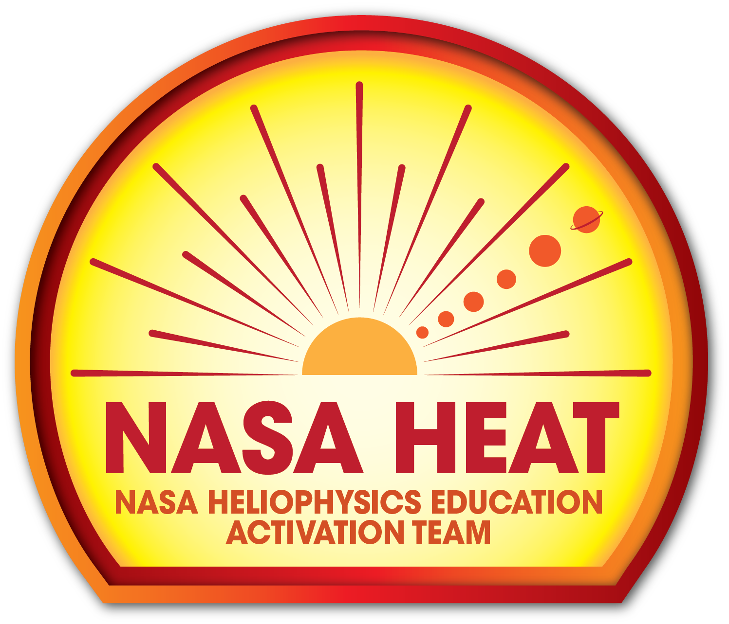
The Heliophysics Big Year
National Aeronautics and Space Administration
Dr. Sten Odenwald, Astronomer
NASA Heliophysics Education Activation Team

Slide 2
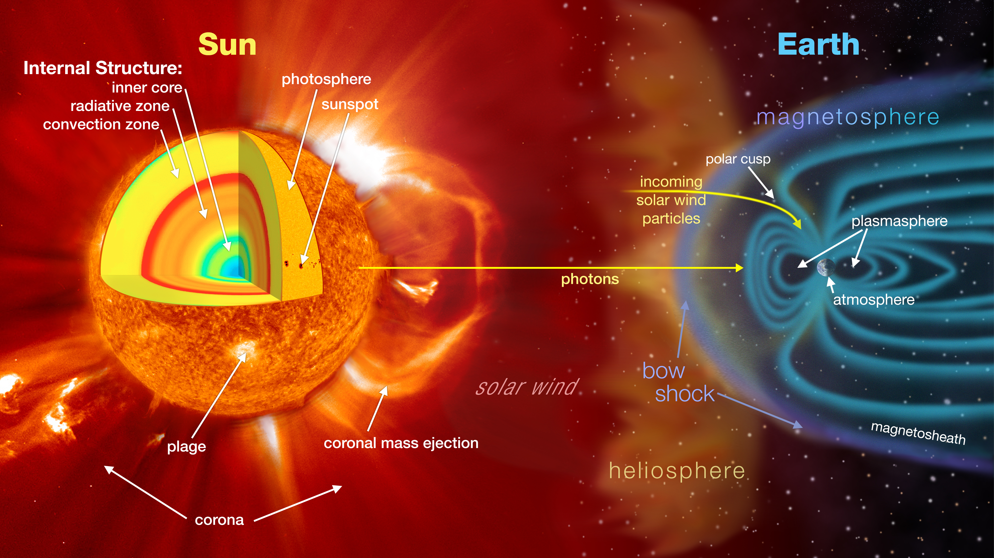

March 2023: What is Heliophysics?
Heliophysics is the discipline in space science that deals with the matter and energy of our Sun and its effects on the solar system.
It also studies how the Sun varies and how those changes pose a hazard to humans on Earth and in space
Heliophysics Education Activation Team

Slide 3
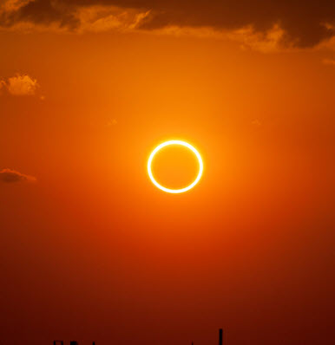
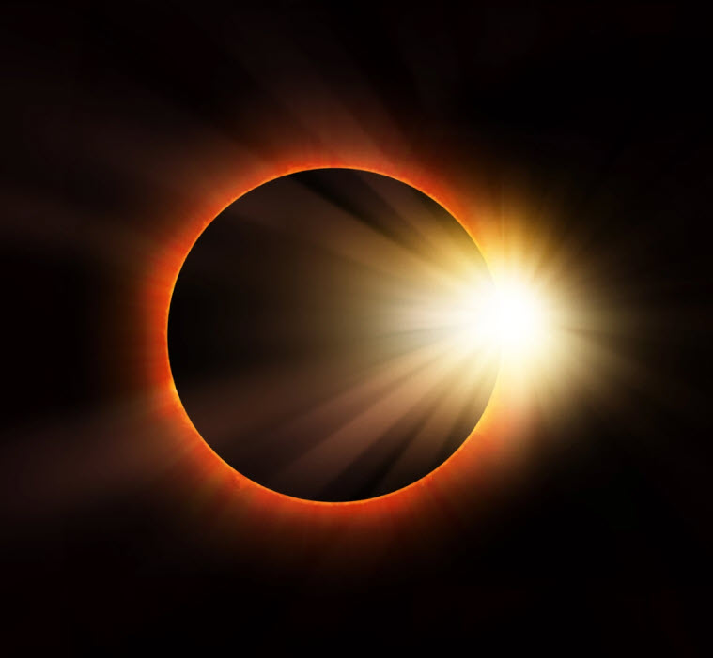
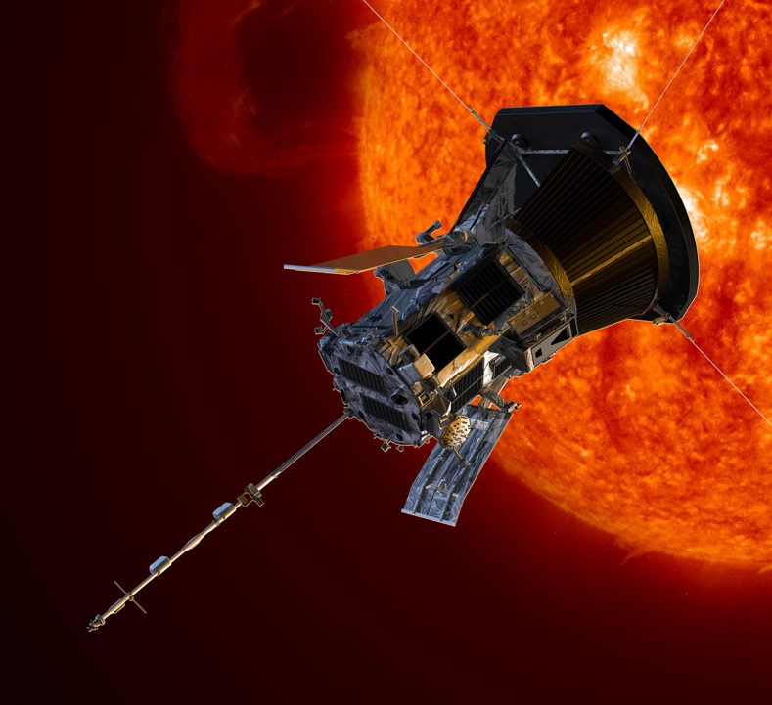
Heliophysics Big Year Timeline
Annular Eclipse
Total Eclipse
Solar Parker
Probe Perihelion
October 14, 2023
April 8, 2024
December 24, 2024
ADD MEDIA HERE
ADD MEDIA HERE
ADD MEDIA HERE
Heliophysics Education Activation Team

Slide 4

Heliophysics Big Year Themes
2023
October- Annular Solar Eclipse
November- Mission Fleet
December- Citizen Science
2024
January- The Sun Touches Everything
February- Fashion
March- Experiencing the Sun
April- Total Solar Eclipse
May- Visual Art
June- Performance Art
July- Physical and Mental Health
August- Back to School
September- Environment / Sustainability
November- Bonus Science
December- Parker’s Perihelion
https://www.nasa.gov/science-research/heliophysics/nasa-announces-monthly-themes-to-celebrate-the-heliophysics-big-year/
Heliophysics Education Activation Team

Slide 5
March 2024 : NASA’s Big Questions
1. What causes the Sun to vary?
2. How do the Earth and the heliosphere respond?
3. What are the impacts on humanity?
These Big Questions form the basis for the
Framework for Heliophysics Education
https://science.nasa.gov/learn/heat/big-ideas/
Heliophysics Education Activation Team

Slide 6
How to Teach Heliophysics
Framework for Heliophysics Education
3 Heliophysics Investigatory Questions
What causes the Sun to vary?
1.1 The Sun is really big and its gravity influences all objects in the solar system. (PS2, ESS1)
1.2 The Sun is active and can impact technology on Earth via space weather. (PS1,PS2, PS4, ESS2, ESS3)
1.3 The Sun’s energy drives Earth’s climate, but the climate is in a delicate balance and is changing due to human activity. (PS1, PS2, PS3, LS4, ESS2, ESS3)
How do Earth, the solar system, and the heliosphere respond to changes on the Sun?
2.1 Life on Earth has evolved with complex diversity because of our location near the Sun. It is just right! (PS3, PS4, LS1, LS2, ESS2)
2.2 The Sun defines the space around it, which is different from interstellar space. (PS2, ESS1, ESS2)
2.3 The Sun is the primary source of light in the solar system. (PS1, PS2, PS3,PS4, ESS1)
What are the impacts of changes on the Sun on humans?
3.1 The Sun is made of churning plasma, causing the surface to be made of complex, tangled magnetic fields. (PS1, PS2, ESS1, ESS2)
3.2 Energy from the Sun is created in the core and travels outward through the Sun and into the heliosphere. (PS1, PS3, PS4, ESS1, ESS2, ESS3)
3.3 Our Sun, like all stars, has a life cycle. (PS1, LS1, ESS1)
3 NGSS-aligned
Big Ideas per Question
3 Guiding Questions per Idea
-1 Question per Level-
Heliophysics
Resource Database
Heliophysics Education Activation Team
Notes:
The Framework for Heliophysics Education provides the background and scaffolding educators need to incorporate heliophysics topics into existing STEM curricula. Using the three main questions that heliophysicists investigate as the foundation, this framework connects heliophysics topics with NGSS Disciplinary Core Ideas, to create NGSS-aligned Heliophysics Big Ideas.
The nine Heliophysics Big Ideas encompass the major heliophysics concepts that can be explored through existing Next Generation Science Standards (NGSS) disciplinary core ideas. Each Heliophysics Big Idea has a guiding question for each level, designed to support inquiry-based learning.
Introductory Learner = A younger learner (K-5), or a learner new to the subject matter.
Intermediate Learner = A middle-aged learner (6-8), or a learner that has some familiarity with the subject matter.
Advanced Learner = An older learner (9-12+), or a learner that has a lot of experience with the subject matter.

Slide 7
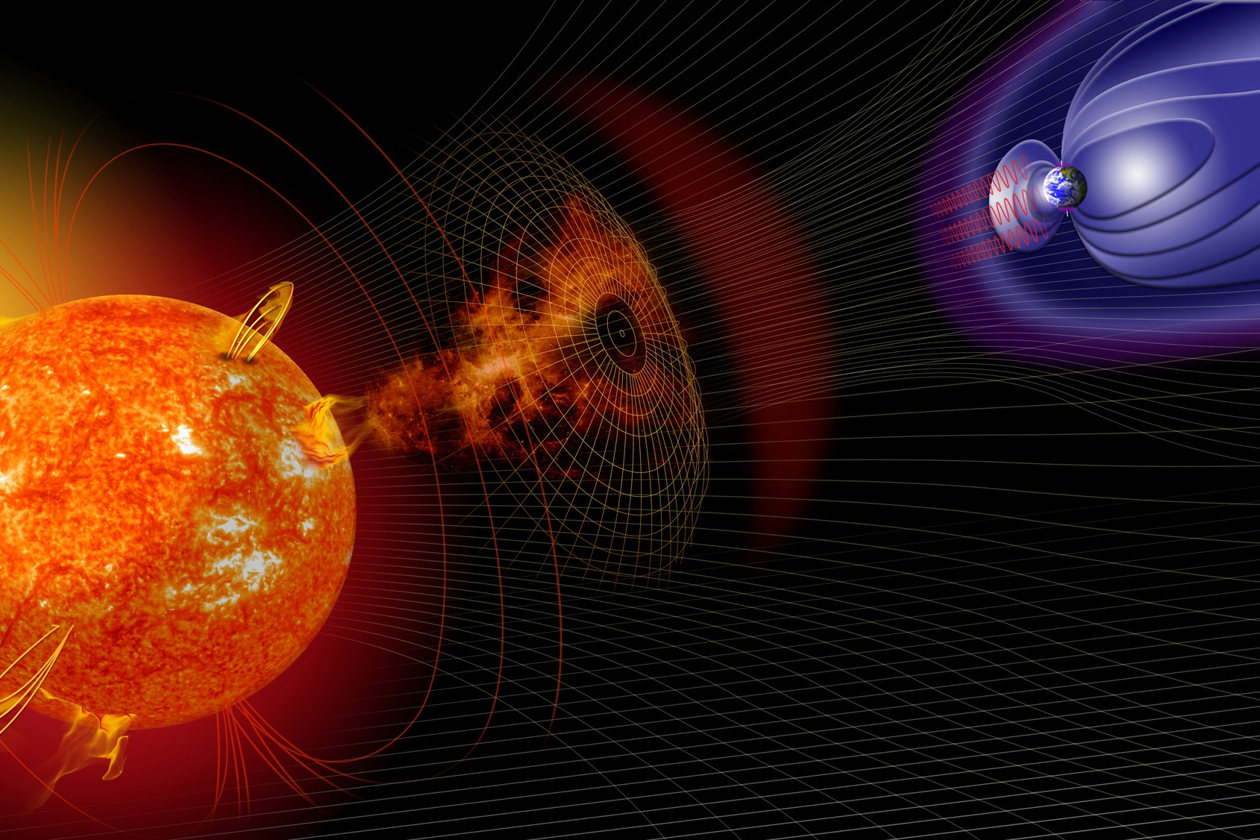
March 2024 – Experiencing the Sun
How does the sun affect us?
Gravity
Visible Light
Solar Flares
Coronal Mass Ejections
Solar Wind
Heliophysics Education Activation Team

Slide 8
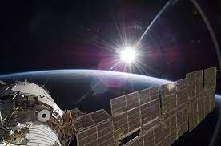
March 2024
1.2 The Sun is active and can impact
technology on Earth via space weather.
(PS1,PS2, PS4, ESS2, ESS3)
3.1 The Sun is made of churning plasma,
causing the surface to be made of
complex, tangled magnetic fields.
(PS1, PS2, ESS1, ESS2)
Heliophysics Education Activation Team

Slide 9
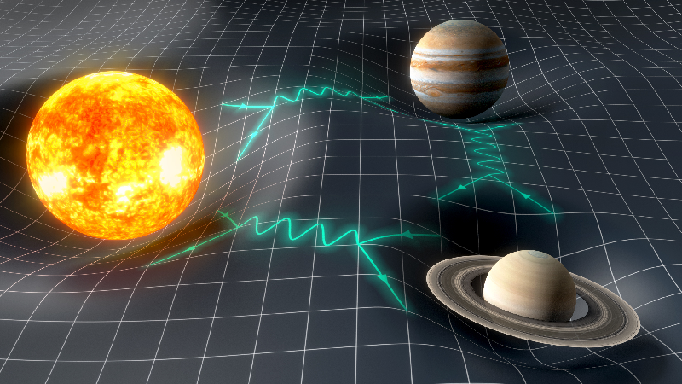
March 2024: Easy Stuff - Gravity
Gravity is not really a force.
Credit: Y. Gominet/Paris Observatory
https://physics.aps.org/articles/v12/113
Heliophysics Education Activation Team

Slide 10
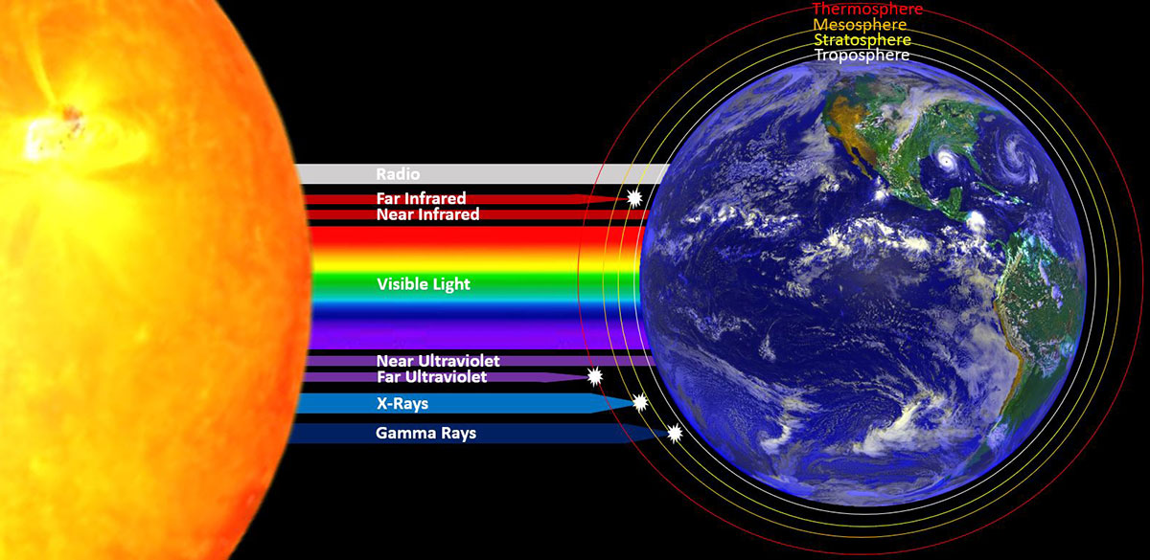
March 2024: Easy Stuff - Radiation
Light is produced by photons that carry energy.
Global Geoenginnering:
https://geoengineering.global/solar-radiation-management/
Heliophysics Education Activation Team

Slide 11
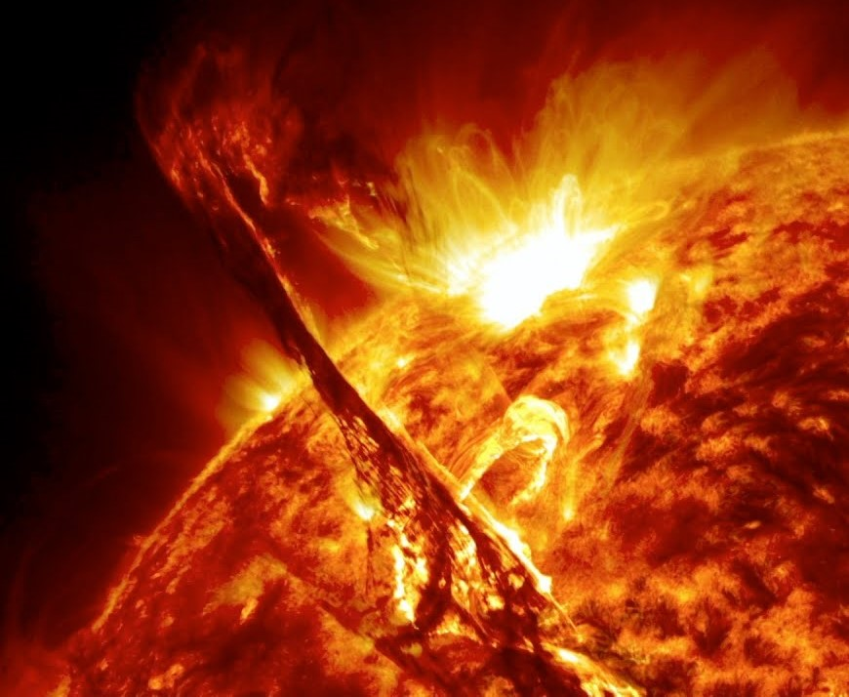
March 2024: Harder Stuff - Solar Flares
Solar flares are created when magnetic fields near the sun’s surface get tangled up.
The energy stored in the magnetic fields gets explosively released.
This heats up nearby matter to millions of degrees.
This hot plasma emits x-rays to give us an electromagnetic ‘blast’ that takes 9 minutes to get to Earth...if we are unlucky.
Heliophysics Education Activation Team

Slide 12
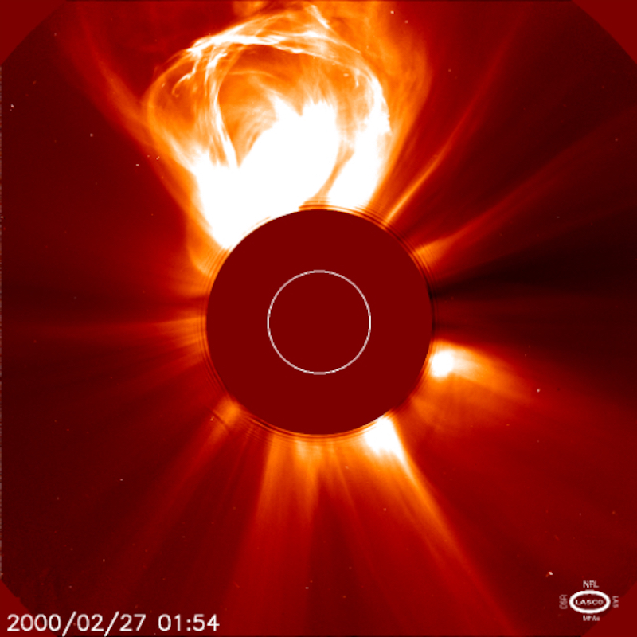
March 2024: Harder Stuff - Coronal Mass Ejections
Some of the energy in a flare can accelerate matter, ejecting it into space. These are called coronal mass ejections because we see them as clouds bursting out from the corona.
CMEs contain billions of tons of plasma and magnetic fields from the sun dragged along for the ride.
If a CME is directed at Earth, powerful disturbances are produced in Earth’s magnetic field that cause spectacular aurora...and can harm our technology.
Heliophysics Education Activation Team

Slide 13
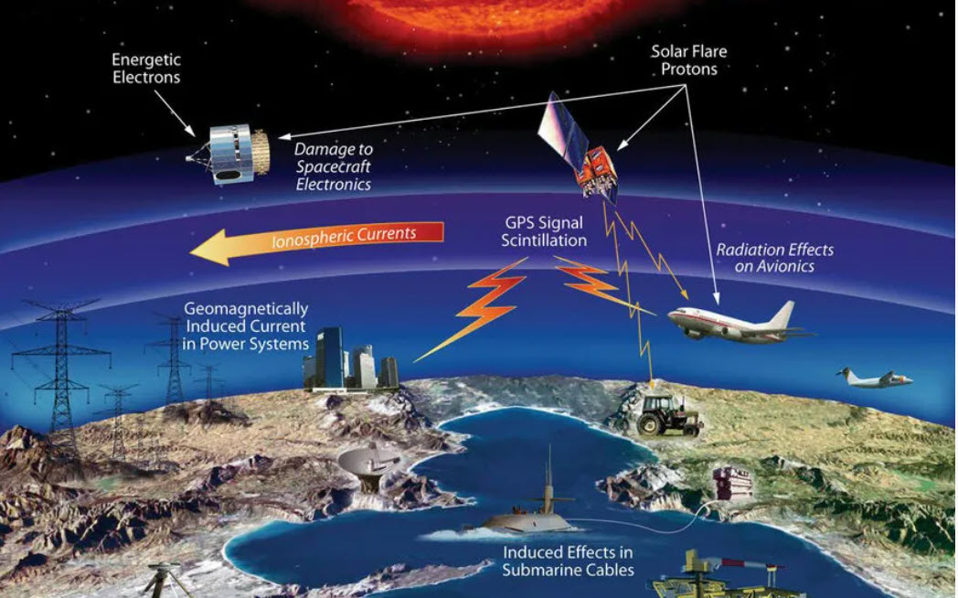
March 2024: Space Weather
A famous actress once said ‘Lions and tigers and bears, oh my!”.
Solar flares, coronal mass ejections, high-speed wind streams and the solar wind are ingredients to the bad things we call space weather.
Space weather affects many Earth systems, and can also invade our technology to cause electrical power outages and satellite failures.
Heliophysics Education Activation Team

Slide 14
Space Weather
‘Bad Hair Days’
Solar Storms
Solar Wind
Coronal Holes
Cosmic
Rays
Solar Flares
Coronal Mass Ejections
X-rays
8 min.
Energetic
Particles
~1-hr
Plasma + magnetic field
14-hr to 4 days
Milder
Geomagnetic
Storms
Ionosphere
disruption
and Heating
Geomagnetic Storms
No SPEs
SPEs
Satellite
Anomalies
Satellite
Anomalies
Satellite
Anomalies
GPS problems
Satellite drag
Power Grid problems
GLEs

Slide 15
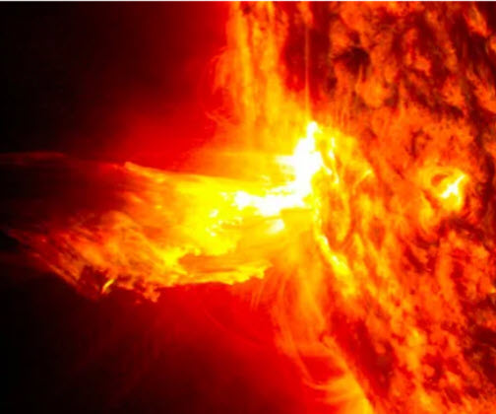
March 2024: Beginners – Space Weather
During a particular month the following events were recorded:
Total solar flares: 22
Total CMEs: 12
Both Flares and CMEs: 7
Based on this data, if you see a flare on the sun, what is the probability that a CME will also occur?
Heliophysics Education Activation Team

Slide 16
March 2024: Beginners – Space Weather
Total solar flares: 22
Total CMEs: 12
Both Flares and CMEs: 7
Venn Diagrams!
Flares
Both
CMEs
22-7
=15
12-7
= 5
7
Heliophysics Education Activation Team

Slide 17
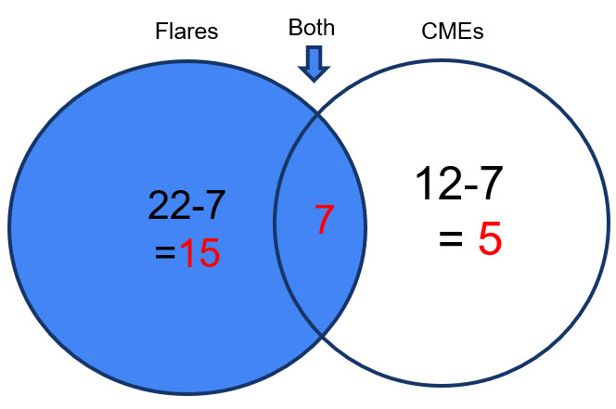
March 2024: Beginners – Space Weather
Based on this data, if you see a flare on the sun, what is the probability that a CME will also occur?
Both CME and Flare 7
P = --------------------------- = -------
All Flares Observed 22
= 0.32 or 32%
or about 1 in 3 odds.
Heliophysics Education Activation Team

Slide 18
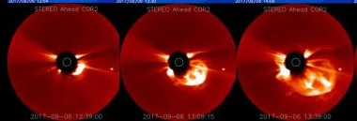
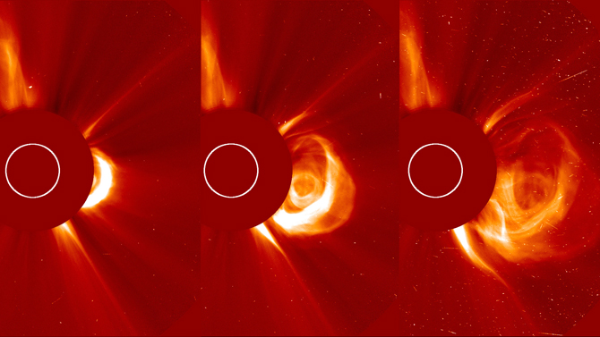
March 2024: Intermediate – CME speeds and arrival
Top sequence: 12:39, 13:09 and 13:39.
(NASA, SoHO LASCO Sep 6, 2017)
Solar disk diam: 2mm = 1.4 million km
CME Pos 1 = 4mm at T = 12:39
Pos 2 = 7mm at T = 13:09
Pos 3 = 12mm at T = 13:39
Heliophysics Education Activation Team

Slide 19
March 2024: Intermediate – CME speeds and arrival
Solar disk diam: 2mm = 1.4 million km
So 1 mm = 700,000 km
Convert mm to km to get:
Pos 1 = 2.8 megaKm at T = 0 min
Pos 2 = 4.9 megaKm at T = 30 min
Pos 3 = 8.4 megaKm at T = 60 min
Heliophysics Education Activation Team

Slide 20
March 2024: Intermediate – CME speeds and arrival
Speeds:
S1 = (Pos2 – Pos1)/30 min
S1 = (4.9-2.8)/30 megaKm/min
S1 = 70,000 km/min or 1,166 km/s
S2 = (Pos3 - Pos2)/30 min
S2 = (8.4 – 4.9)/30 megaKm/ min
S2 = 117,000 km/min or 1,944 km/s.
Heliophysics Education Activation Team

Slide 21
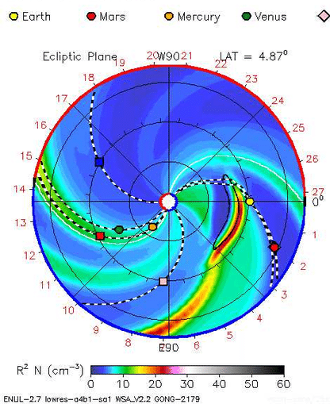
March 2024: Intermediate – CME speeds and arrival
Arrival time at Earth:
150 million km.
At speed S2 of 117,000 km/min
T = 150 million / 117,000
= 1,282 minutes
or 21 hours.
Heliophysics Education Activation Team

Slide 22
March 2024: Advanced – CME Deceleration
Our previous CME was traveling at 1,944 km/s as it left the solar corona. At this constant speed it would take 13.3 hours to reach Earth.
But solar gravity will cause it to decelerate as it goes outwards.
Suppose that the CME decelerates at a rate of -10 km/s per hour
If the speed of the CME follows the formula:
V = -10T +1944 where T is the time in hours.
where Vinitial = 1944 km/sec
Deceleration = -10 km/sec/hour
How long will it take to get to Earth at a distance of 150 million km?
Heliophysics Education Activation Team

Slide 23
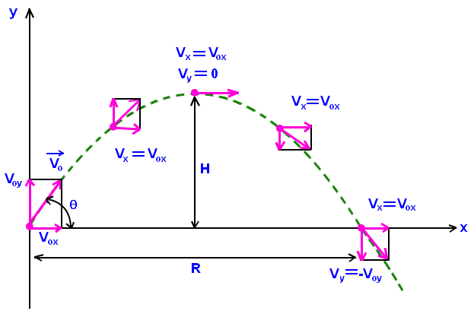
March 2024: Advanced – CME Deceleration
Let’s put all units in terms of hours so that T is in hours and:
solar deceleration a = -10 km/sec/hr so a = -10 km/sec/hr x (3600 sec/hr) a = -36000 km/hr/hr.
The initial speed is 1,944 km/sec so V = 1,944 km/sec x (3600 sec/hr) V= 6.7 million km/hr.
Ballistic Formula: D = d0 + VT - ½ a T² with deceleration where a = +36000 km/hr/hr
At the sun, d0 = 0. We want to get to D = 150 million km.
So 0 = ½aT² - VT + D Or 0 = 18000T² – 6.7millionT +150 million.
This is a quadratic equation where A = 18000. B = -6.7 million C = 150 million
- B + (B² -4AC)^{1/2}
Quadratic formula: T = --------------------------
2A
Heliophysics Education Activation Team

Slide 24
March 2024: Advanced – CME Decelleration
A = 18000.
B = -6.7 million
C = 150 million
- B +/- (B² - 4AC)^{1/2}
Quadratic formula: T = --------------------------
2A
So (B²-4AC)^{1/2} = (4.48x10¹³ - 1.08x10¹³)^{1/2} = 5.8 million km/h
T+ = (6.7million + 5.84 million)/(2x18000) = 348 hours. CME returns to the sun....Not a physical result
T- = (6.7 million – 5.84 million)/(2x18000) = 24 hours. That’s more like it!!
This is a bit slower than the 21 hours we estimated without including a model for the deceleration by the sun’s gravity.
Heliophysics Education Activation Team

Slide 25
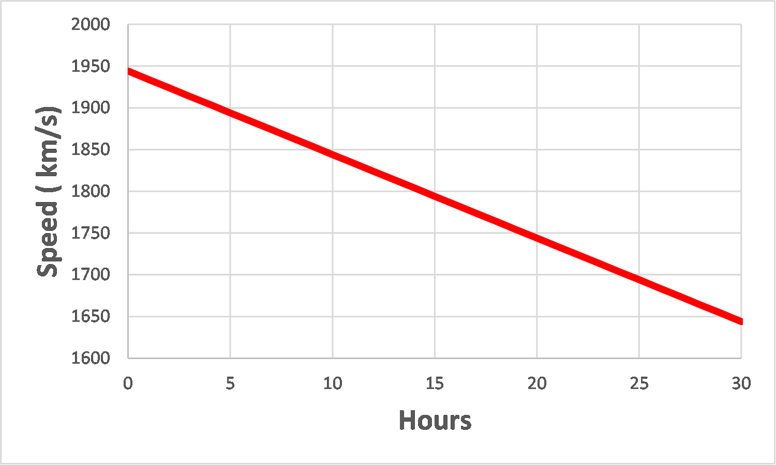
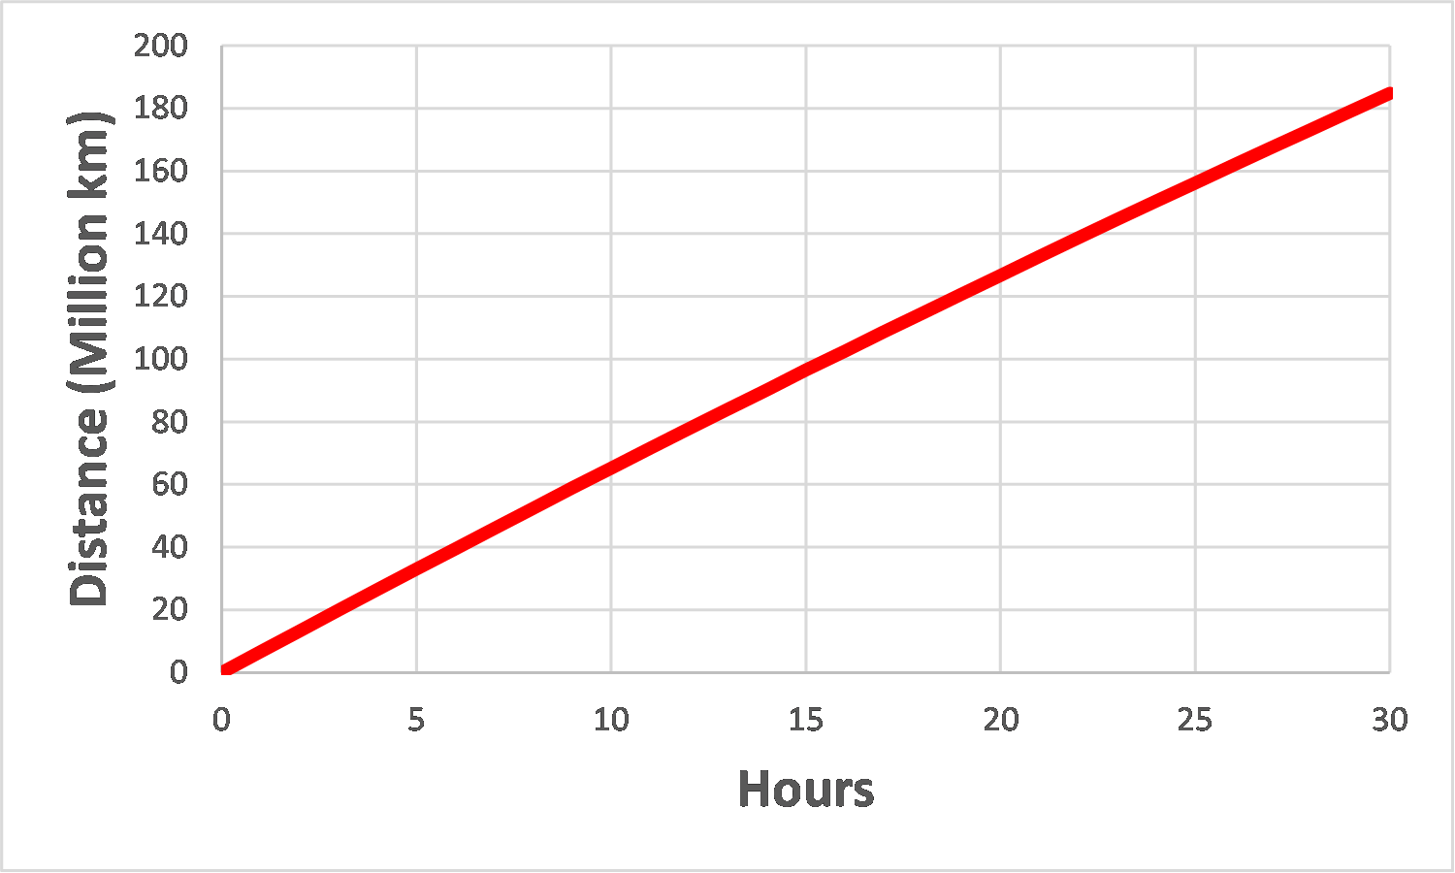
March 2024: Advanced – CME Decelleration
CME arrival time = 24 hours Speed = 1,700 km/s
Heliophysics Education Activation Team

Slide 26
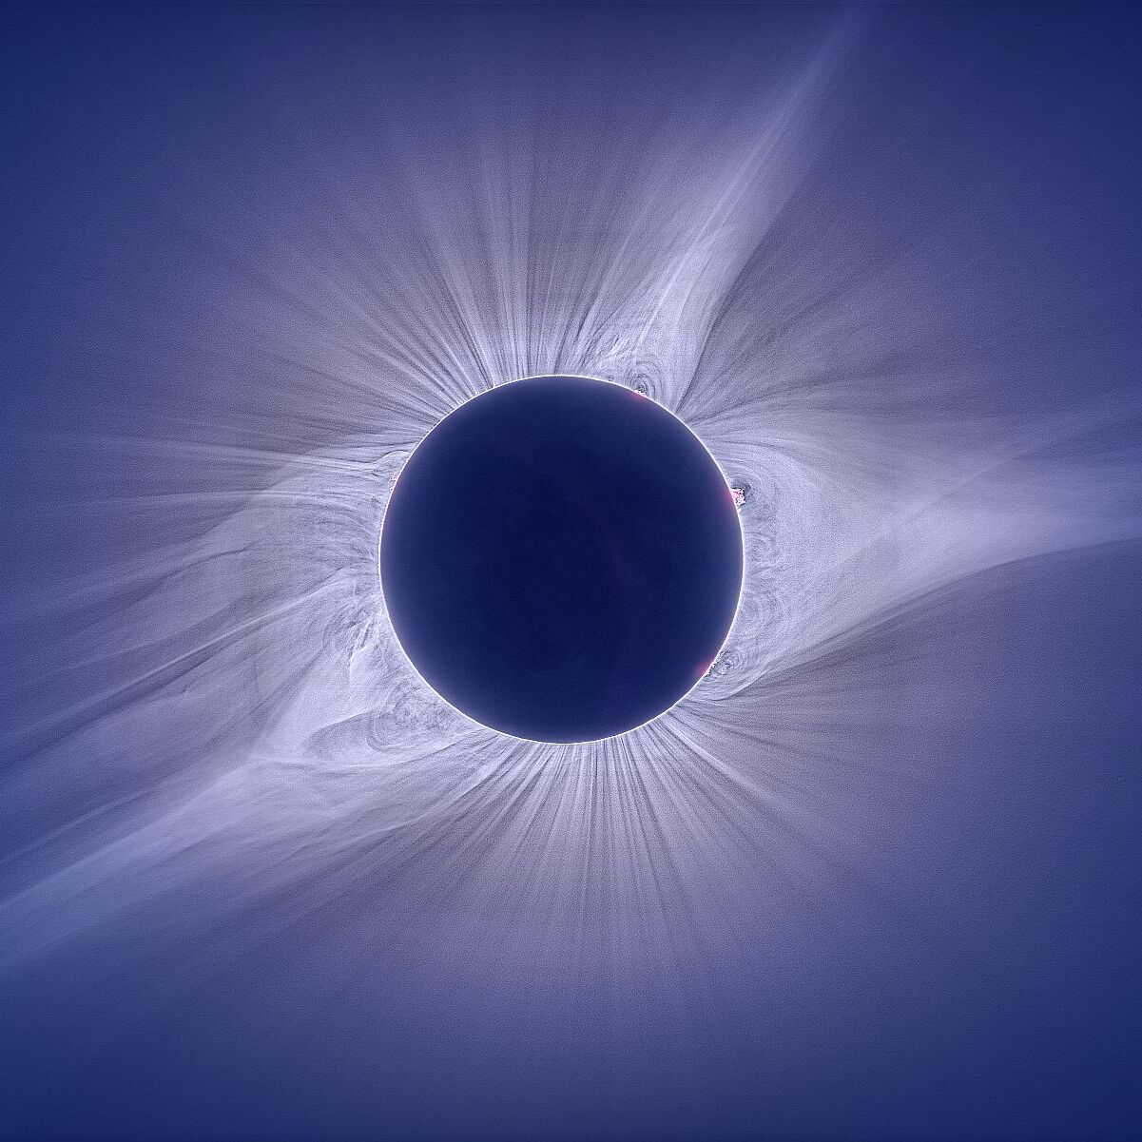
April 2023: Total Solar Eclipse
Next Time!
The Sun may be 93 million miles away, but we can still experience it from home, whether its watching eclipses, auroras, or observing its daily influence on our lives.
Heliophysics Education Activation Team

