Slide 1



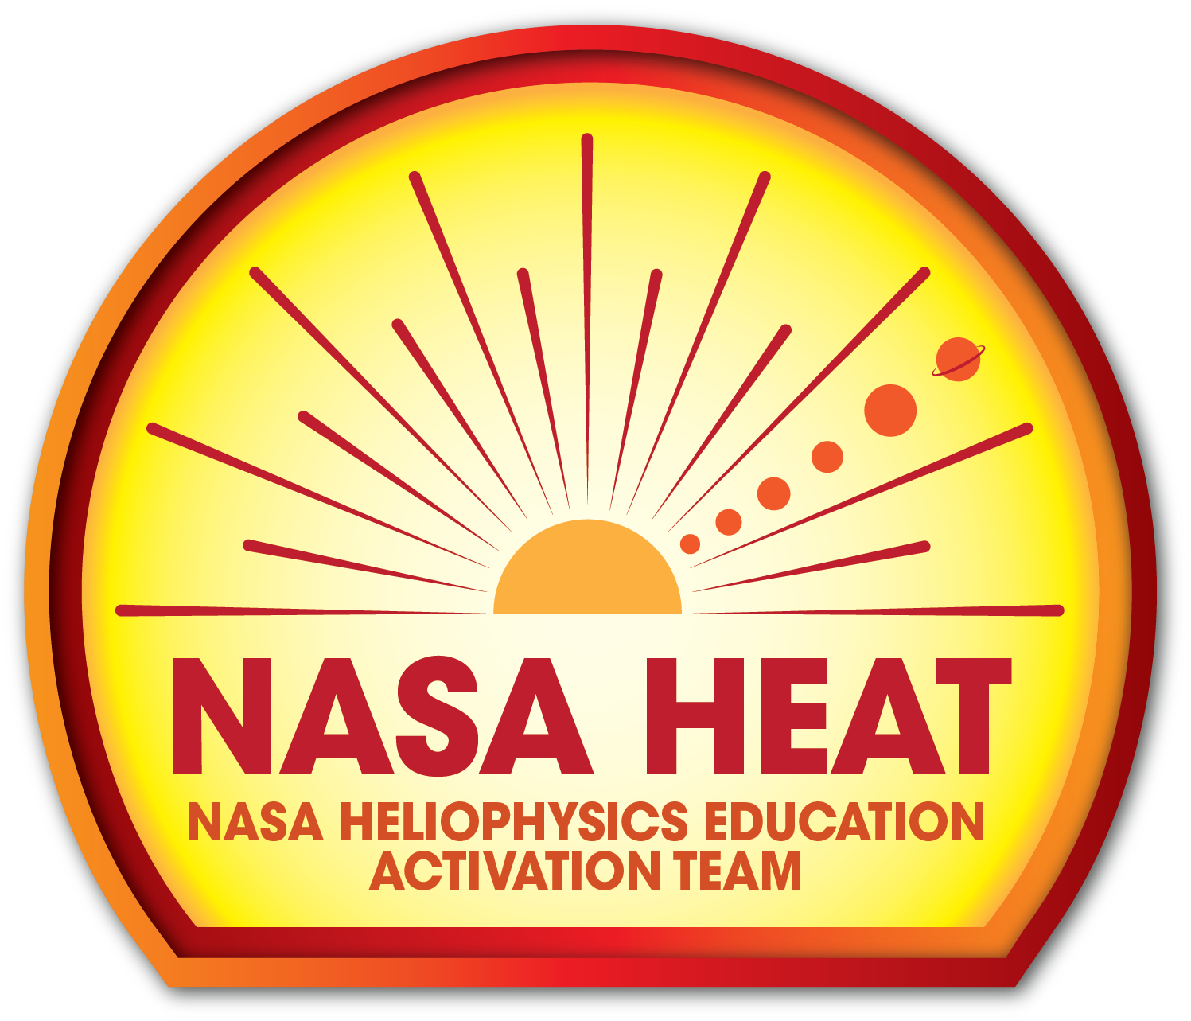
The Heliophysics Big Year
National Aeronautics and Space Administration
Dr. Sten Odenwald, Astronomer
NASA Heliophysics Education Activation Team

Slide 2


December 2023: What is Heliophysics?
Heliophysics is the discipline in space science that deals with the matter and energy of our Sun and its effects on the solar system.
It also studies how the Sun varies and how those changes pose a hazard to humans on Earth and in space
Heliophysics Education Activation Team

Slide 3



Heliophysics Big Year Timeline
Annular Eclipse
Total Eclipse
Solar Parker
Probe Perihelion
October 14, 2023
April 8, 2024
December 24, 2024
ADD MEDIA HERE
ADD MEDIA HERE
ADD MEDIA HERE
Heliophysics Education Activation Team

Slide 4

Heliophysics Big Year Themes
2023
October- Annular Solar Eclipse
November- Mission Fleet
December- Citizen Science
2024
January- The Sun Touches Everything
February- Fashion
March- Experiencing the Sun
April- Total Solar Eclipse
May- Visual Art
June- Performance Art
July- Physical and Mental Health
August- Back to School
September- Environment / Sustainability
November- Bonus Science
December- Parker’s Perihelion
https://www.nasa.gov/science-research/heliophysics/nasa-announces-monthly-themes-to-celebrate-the-heliophysics-big-year/
Heliophysics Education Activation Team

Slide 5
February 2024 : NASA’s Big Questions
1. What causes the Sun to vary?
2. How do the Earth and the heliosphere respond?
3. What are the impacts on humanity?
These Big Questions form the basis for the
Framework for Heliophysics Education
https://science.nasa.gov/learn/heat/big-ideas/
Heliophysics Education Activation Team

Slide 6
How to Teach Heliophysics
Framework for Heliophysics Education
3 Heliophysics Investigatory Questions
What causes the Sun to vary?
1.1 The Sun is really big and its gravity influences all objects in the solar system. (PS2, ESS1)
1.2 The Sun is active and can impact technology on Earth via space weather. (PS1,PS2, PS4, ESS2, ESS3)
1.3 The Sun’s energy drives Earth’s climate, but the climate is in a delicate balance and is changing due to human activity. (PS1, PS2, PS3, LS4, ESS2, ESS3)
How do Earth, the solar system, and the heliosphere respond to changes on the Sun?
2.1 Life on Earth has evolved with complex diversity because of our location near the Sun. It is just right! (PS3, PS4, LS1, LS2, ESS2)
2.2 The Sun defines the space around it, which is different from interstellar space. (PS2, ESS1, ESS2)
2.3 The Sun is the primary source of light in the solar system. (PS1, PS2, PS3,PS4, ESS1)
What are the impacts of changes on the Sun on humans?
3.1 The Sun is made of churning plasma, causing the surface to be made of complex, tangled magnetic fields. (PS1, PS2, ESS1, ESS2)
3.2 Energy from the Sun is created in the core and travels outward through the Sun and into the heliosphere. (PS1, PS3, PS4, ESS1, ESS2, ESS3)
3.3 Our Sun, like all stars, has a life cycle. (PS1, LS1, ESS1)
3 NGSS-aligned
Big Ideas per Question
3 Guiding Questions per Idea
-1 Question per Level-
Heliophysics
Resource Database
Heliophysics Education Activation Team
Notes:
The Framework for Heliophysics Education provides the background and scaffolding educators need to incorporate heliophysics topics into existing STEM curricula. Using the three main questions that heliophysicists investigate as the foundation, this framework connects heliophysics topics with NGSS Disciplinary Core Ideas, to create NGSS-aligned Heliophysics Big Ideas.
The nine Heliophysics Big Ideas encompass the major heliophysics concepts that can be explored through existing Next Generation Science Standards (NGSS) disciplinary core ideas. Each Heliophysics Big Idea has a guiding question for each level, designed to support inquiry-based learning.
Introductory Learner = A younger learner (K-5), or a learner new to the subject matter.
Intermediate Learner = A middle-aged learner (6-8), or a learner that has some familiarity with the subject matter.
Advanced Learner = An older learner (9-12+), or a learner that has a lot of experience with the subject matter.

Slide 7

February 2024 – Fashion, Color and Light
What is color?
Investigating visible light
and color filters
in fashion and
heliophysics
Heliophysics Education Activation Team

Slide 8
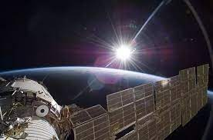
February 2024
The sun is a white star not a yellow one so where does color come from?
The Sun is the primary source of light in the solar system. (PS1, PS2, PS3,PS4, ESS1)
Energy from the Sun is created in the core and travels outward through the Sun and into the heliosphere. (PS1, PS3, PS4, ESS1, ESS2, ESS3)
Heliophysics Education Activation Team

Slide 9
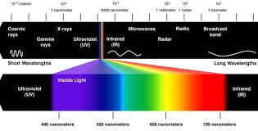
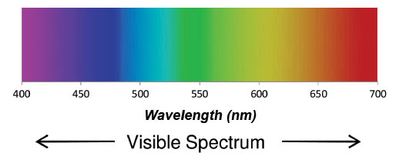
February 2024: Sunlight and the Visible Spectrum
Light is produced by photons that carry energy.
The amount of energy they carry depends on their wavelength.
We can sort these photons from their highest energy to their lowest energy by creating a ‘spectrum’ of wavelengths.
This spectrum, for wavelengths the human eye is sensitive to is called the Visible Spectrum.
Heliophysics Education Activation Team

Slide 10
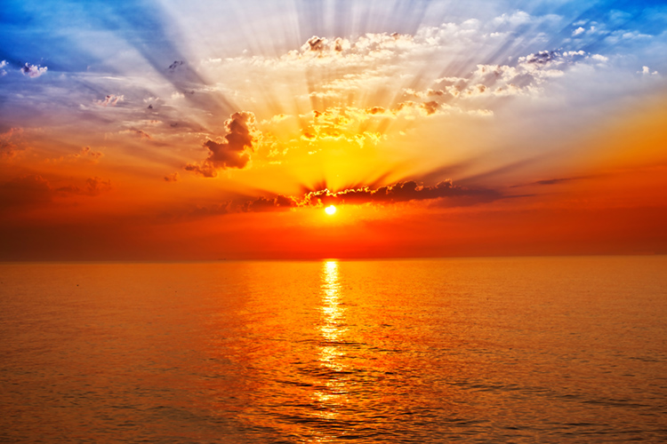
February 2024: Origin of Color
Color does not exist in Nature.
Color is a purely internal coding of the wavelengths of visible light by the brain.
It is called a ‘qualia’ by brain researchers, and like consciousness, it is not known where the perception of color comes from.
Heliophysics Education Activation Team

Slide 11
February 2024: Origin of Color
The interaction of light with matter tends to favor some wavelengths over others.
Light from the sun passing through dust in the atmosphere causes shorter wavelengths to be deflected out of the light into other directions.
This leaves behind longer wavelength light, which we perceive as red. Meanwhile, the shorter wavelength light is scattered across the sky giving the sky a blue color
Heliophysics Education Activation Team

Slide 12
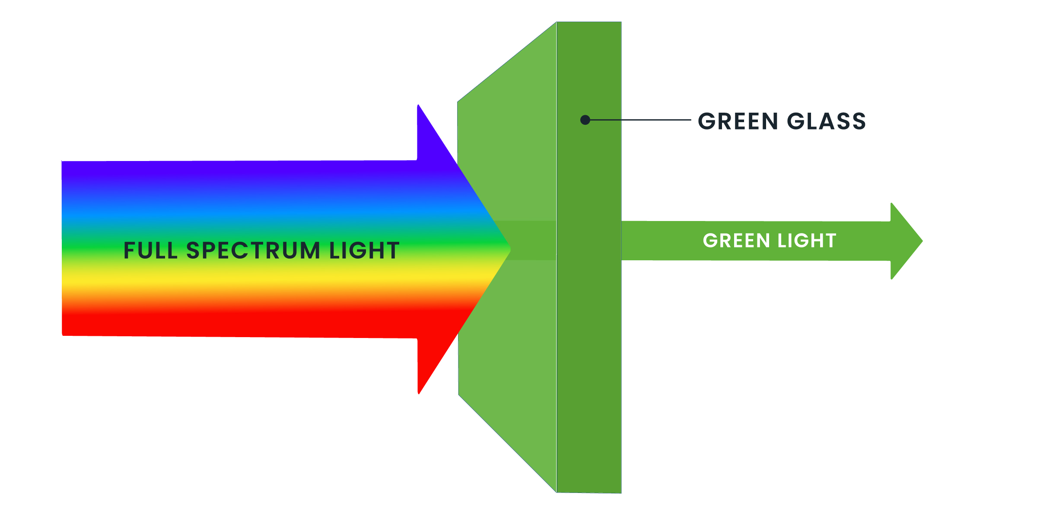
February 2024: Filtered Light
Like sunlight during a sunset, visible light interacting with matter can cause some of this light to be absorbed if the chemistry of the material is just right.
The matter will pass some wavelengths but not others.
We call this a ‘light filter’, or just a filter for short.
Heliophysics Education Activation Team

Slide 13
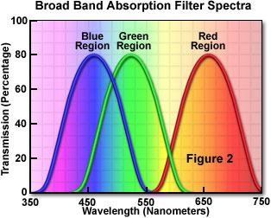
February 2024: How filters work
Filters can be designed to pass only specific wavelengths.
In photography, and in the human retina, light is filtered into its Red, Green and Blue components.
The same principle applies to fashion and art using different pigments. By balancing the RGB properties of compounds, millions of different colors can be created
Heliophysics Education Activation Team

Slide 14
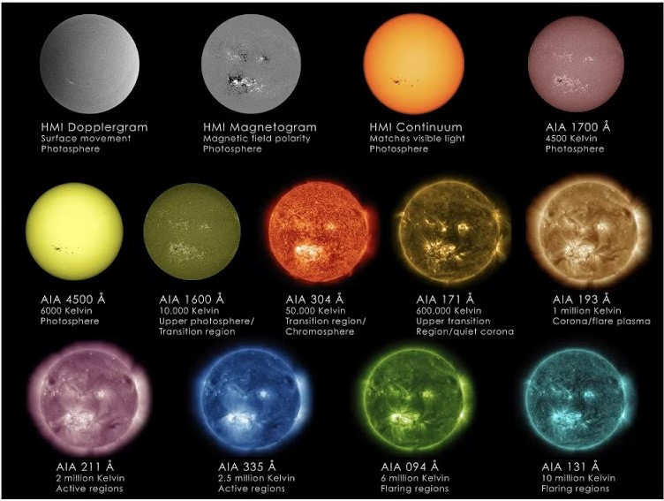
February 2024: Filters in Heliophysics
Different physical processes produce light in different specific colors.
In Heliophysics we use this principle to diagnose why the sun works the way it does.
Heliophysics Education Activation Team

Slide 15
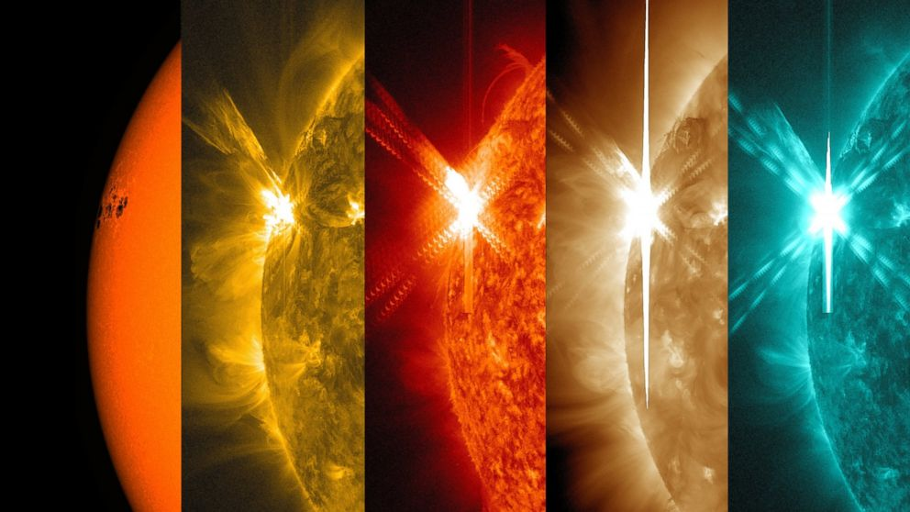
February 2024: Filters in Heliophysics
Heliophysics Education Activation Team

Slide 16
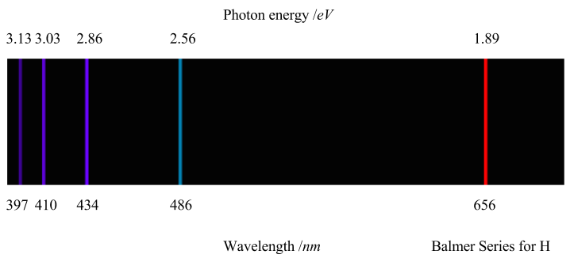
February 2024: Simple Transmission Filters
Beginners: You want to study the sun by using a filter that passes only the light from hydrogen at a wavelength near 656 nanometers (nm). Which filter should you use?
A) Passes wavelengths shorter than 700 nm.
B) Passes wavelengths longer than 450 nm
C) Passes wavelengths from 500 to 700 nm
D) Passes wavelengths from 650 to 660 nm.
Heliophysics Education Activation Team

Slide 17
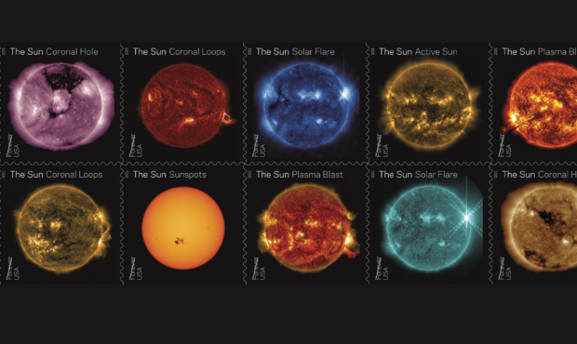
February 2024 – Simple Transmission Filters
Heliophysics Education Activation Team

Slide 18
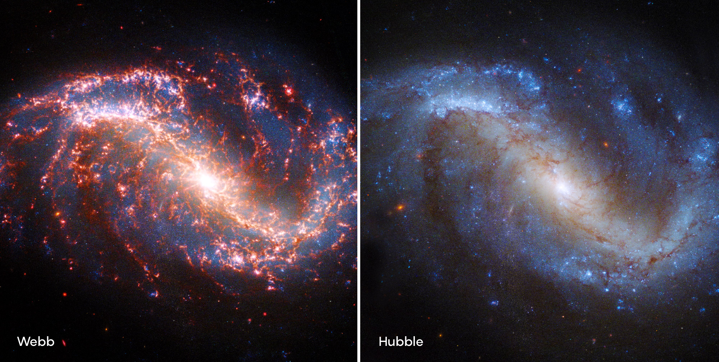
February 2024 – Simple Transmission Filters
Heliophysics Education Activation Team

Slide 19
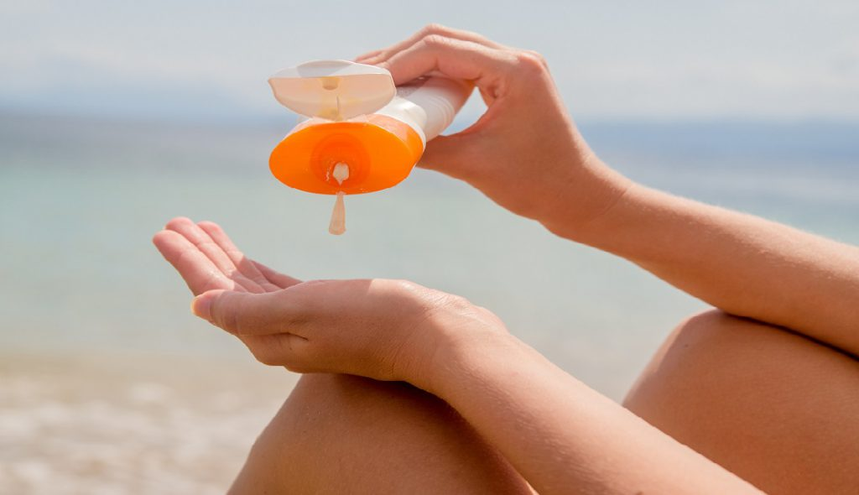
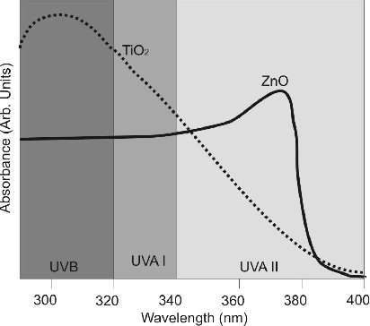
February 2024 – Intermediate: UV Filters and Sunblock
Zinc oxide and bandpass filters
Heliophysics Education Activation Team

Slide 20
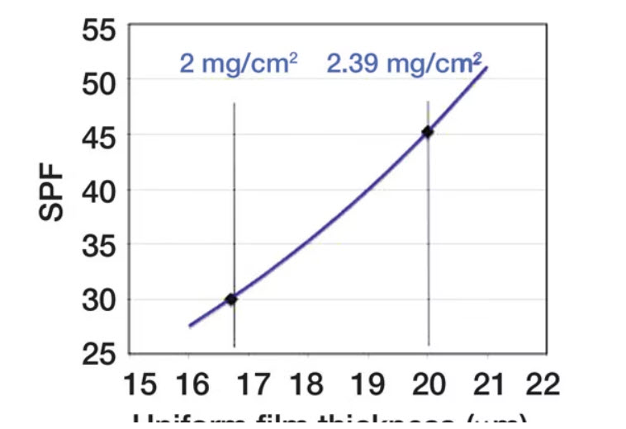
February 2024 – Intermediate: UV Filters and Sunblock
Applying a sunblock lotion.
A sunbather applies a sunblock to her entire exposed body surface.
How much should she use to get an SPF of 45 so that she can be in the sun for the entire day?
Surface area = 1.8 meters²
Bathing suit coverage = 30%
Cream density = 2.4 gm/cm³
Credit Paul McCormick:
http://tinyurl.com/3aj9v7mb
Heliophysics Education Activation Team

Slide 21
February 2024 – Intermediate: UV Filters and Sunblock
Skin coverage: 1.8 m² x 0.7 = 1.3 m²
Graph says we need a 20 micron layer to get to SPF = 45.
Volume of liquid = Area x thickness
=1.3m² x 20 x 10⁻⁶ meters = 2.6x10⁻⁵ m³
In terms of cubic centimeters:
2.6x10⁻⁵ m³ x (100 cm/m)³ = 26 cm³.
Credit Paul McCormick:
http://tinyurl.com/3aj9v7mb
Heliophysics Education Activation Team

Slide 22
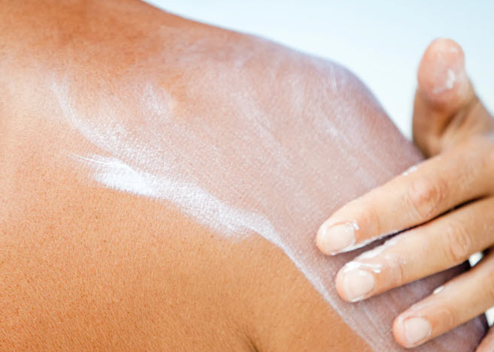
February 2024 – Intermediate: UV Filters and Sunblock
We need to apply 26 cm³ of sunblock. The density is 2.4 gm/cm³ so we need
26/2.4 = 11 grams of sunblock.
Lower quality screens have lower density and require more cream to get the same SPF.
Heliophysics Education Activation Team

Slide 23
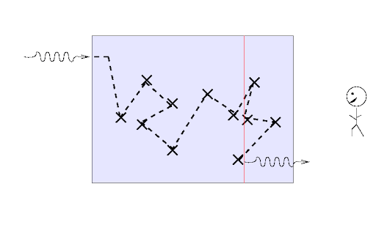
February 2024 – Advanced – Light transport through matter
Opacity and color.
Light is attenuated when it passes through matter according to Beer’s Law, which can be stated mathematically as
I(X) = I_{o} e^{-kX}
where k is the absorption coefficient, which depends on the wavelength of the light and the composition of matter
x=0 x = X
Heliophysics Education Activation Team

Slide 24
February 2024 – Advanced – Light transport through matter
This can also be expressed in terms of the optical depth of the material given by the Greek letter tau (τ).
I(X) = I_{o} e^{-τ}
0 τ
x=0 x = X
Heliophysics Education Activation Team

Slide 25
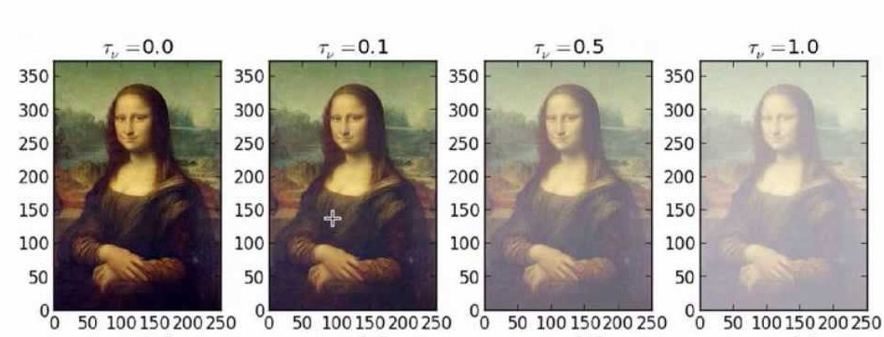
February 2024 - Advanced – Light transport through matter
Absorption of radiation depends on the wavelength of the radiation.
Suppose that you have a material which has the following property:
K = 0.35 cm⁻¹ at a wavelength of 300 nm
K = 0.05 cm⁻¹ at a wavelength of 800 nm
What percentage of the light at these two wavelengths will remain after passing through 1.5 centimeters of a filtering material?
Heliophysics Education Activation Team

Slide 26
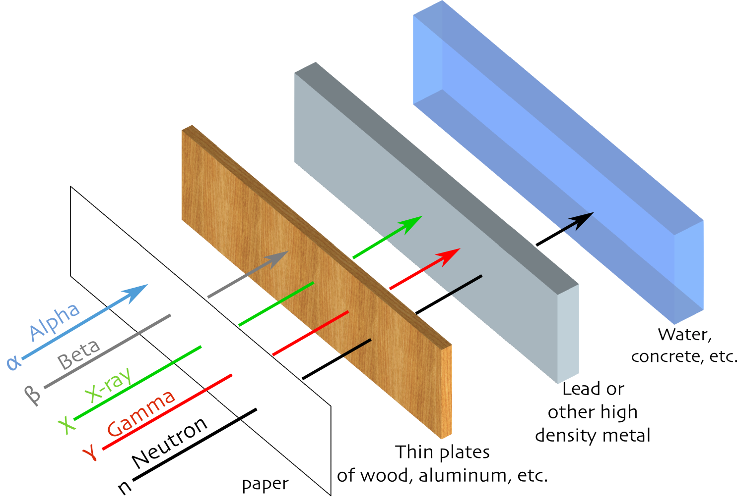
February 2024 - Advanced – Light transport through matter
K = 0.35 cm⁻¹ at a wavelength of 300 nm
X = 1.5 centimeters
I(X) = I_{o} e^{- (0.35) (1.5)}
I(1.5) = Io e^{-0.53} (i.e. τ = 0.53)
I(1.5) = I(0) x 0.59
So 100% x I(1.5)/Io = 59%
Heliophysics Education Activation Team

Slide 27
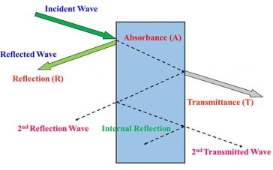
February 2024 - Advanced – Light transport through matter
K = 0.35 cm⁻¹ at a wavelength of 300 nm
X = 1.5 centimeters
I(X) = I_{o} e^{- (0.05) (1.5)}
I(1.5) = Io e^{-0.075} (i.e. τ = 0.075)
I(1.5) = I(0) x 0.93
So 100% x I(1.5)/Io = 93%
Heliophysics Education Activation Team

Slide 28
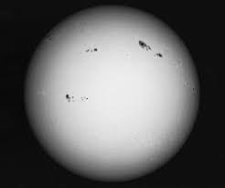
February 2024 - Advanced – Light transport through matter
So for the light at 300 nm, it will be attenuated to 59% of its initial brightness. The optical depth of the material is τ = 0.53
For light at 800 nm, it will be attenuated to 93% of its initial intensity. The optical depth is only τ = 0.075
Heliophysics Education Activation Team

Slide 29
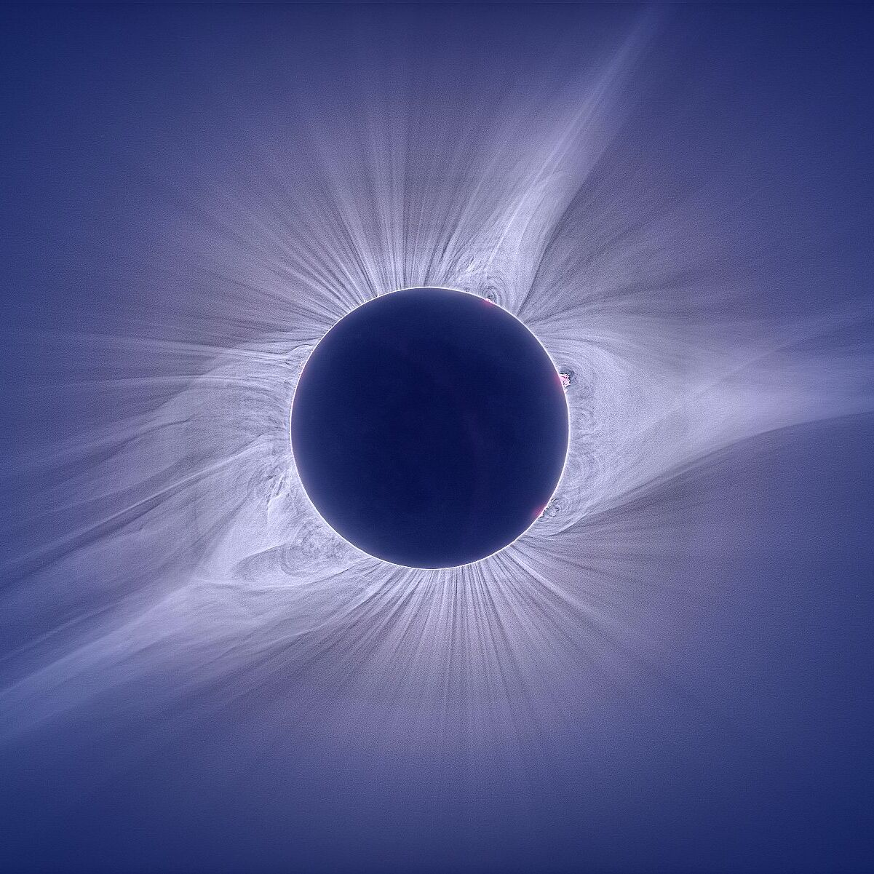
February 2023: Experiencing the Sun
Next Time!
The Sun may be 93 million miles away, but we can still experience it from home, whether its watching eclipses, auroras, or observing its daily influence on our lives.
Heliophysics Education Activation Team

