Slide 1




The Heliophysics Big Year
National Aeronautics and Space Administration
Dr. Sten Odenwald, Astronomer
NASA Heliophysics Education Activation Team

Slide 2


December 2023: What is Heliophysics?
Heliophysics is the discipline in space science that deals with the matter and energy of our Sun and its effects on the solar system.
It also studies how the Sun varies over time and how those changes can sometimes pose a hazard to humans on Earth and in space.
Heliophysics Education Activation Team

Slide 3



Heliophysics Big Year Timeline
Annular Eclipse
Total Eclipse
Solar Parker
Probe Perihelion
October 14, 2023
April 8, 2024
December 24, 2024
ADD MEDIA HERE
ADD MEDIA HERE
ADD MEDIA HERE
Heliophysics Education Activation Team

Slide 4

Heliophysics Big Year Themes
2023
October- Annular Solar Eclipse
November- Mission Fleet
December- Citizen Science
2024
January- The Sun Touches Everything
February- Fashion
March- Experiencing the Sun
April- Total Solar Eclipse
May- Visual Art
June- Performance Art
July- Physical and Mental Health
August- Back to School
September- Environment and Sustainability
November- Bonus Science
December- Parker’s Perihelion
https://www.nasa.gov/science-research/heliophysics/nasa-announces-monthly-themes-to-celebrate-the-heliophysics-big-year/
Heliophysics Education Activation Team

Slide 5
January 2023 : NASA’s Big Questions
1. What causes the Sun to vary?
2. How do the Earth and the heliosphere respond?
3. What are the impacts on humanity?
These Big Questions form the basis for the
Framework for Heliophysics Education
https://science.nasa.gov/learn/heat/big-ideas/
Heliophysics Education Activation Team

Slide 6
How to Teach Heliophysics
Framework for Heliophysics Education
3 Heliophysics Investigatory Questions
What causes the Sun to vary?
1.1 The Sun is really big and its gravity influences all objects in the solar system. (PS2, ESS1)
1.2 The Sun is active and can impact technology on Earth via space weather. (PS1,PS2, PS4, ESS2, ESS3)
1.3 The Sun’s energy drives Earth’s climate, but the climate is in a delicate balance and is changing due to human activity. (PS1, PS2, PS3, LS4, ESS2, ESS3)
How do Earth, the solar system, and the heliosphere respond to changes on the Sun?
2.1 Life on Earth has evolved with complex diversity because of our location near the Sun. It is just right! (PS3, PS4, LS1, LS2, ESS2)
2.2 The Sun defines the space around it, which is different from interstellar space. (PS2, ESS1, ESS2)
2.3 The Sun is the primary source of light in the solar system. (PS1, PS2, PS3,PS4, ESS1)
What are the impacts of changes on the Sun on humans?
3.1 The Sun is made of churning plasma, causing the surface to be made of complex, tangled magnetic fields. (PS1, PS2, ESS1, ESS2)
3.2 Energy from the Sun is created in the core and travels outward through the Sun and into the heliosphere. (PS1, PS3, PS4, ESS1, ESS2, ESS3)
3.3 Our Sun, like all stars, has a life cycle. (PS1, LS1, ESS1)
3 NGSS-aligned
Big Ideas per Question
3 Guiding Questions per Idea
-1 Question per Level-
Heliophysics
Resource Database
Heliophysics Education Activation Team
Notes:
The Framework for Heliophysics Education provides the background and scaffolding educators need to incorporate heliophysics topics into existing STEM curricula. Using the three main questions that heliophysicists investigate as the foundation, this framework connects heliophysics topics with NGSS Disciplinary Core Ideas, to create NGSS-aligned Heliophysics Big Ideas.
The nine Heliophysics Big Ideas encompass the major heliophysics concepts that can be explored through existing Next Generation Science Standards (NGSS) disciplinary core ideas. Each Heliophysics Big Idea has a guiding question for each level, designed to support inquiry-based learning.
Introductory Learner = A younger learner (K-5), or a learner new to the subject matter.
Intermediate Learner = A middle-aged learner (6-8), or a learner that has some familiarity with the subject matter.
Advanced Learner = An older learner (9-12+), or a learner that has a lot of experience with the subject matter.

Slide 7
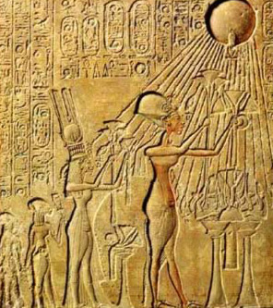
January 2024: The Sun Touches Everything
From agriculture to economics, the Sun touches all parts of our lives. This month delves into all the ways we’re influenced by the Sun.
By far the biggest way is through its sunlight, which allows crops to grow.
For thousands of years, our ancestors erected monuments like Stonehenge to keep track of the motion of the sun and identify when the spring planting season should occur.
Heliophysics Education Activation Team

Slide 8
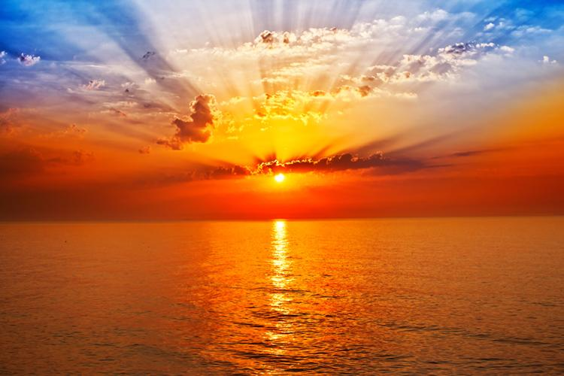
January 2024
The Sun is the primary source of light in the solar system. (PS1, PS2, PS3,PS4, ESS1)
Energy from the Sun is created in the core and travels outward through the Sun and into the heliosphere. (PS1, PS3, PS4, ESS1, ESS2, ESS3)
Image credit: SurferToday.com/sunrise
Heliophysics Education Activation Team

Slide 9
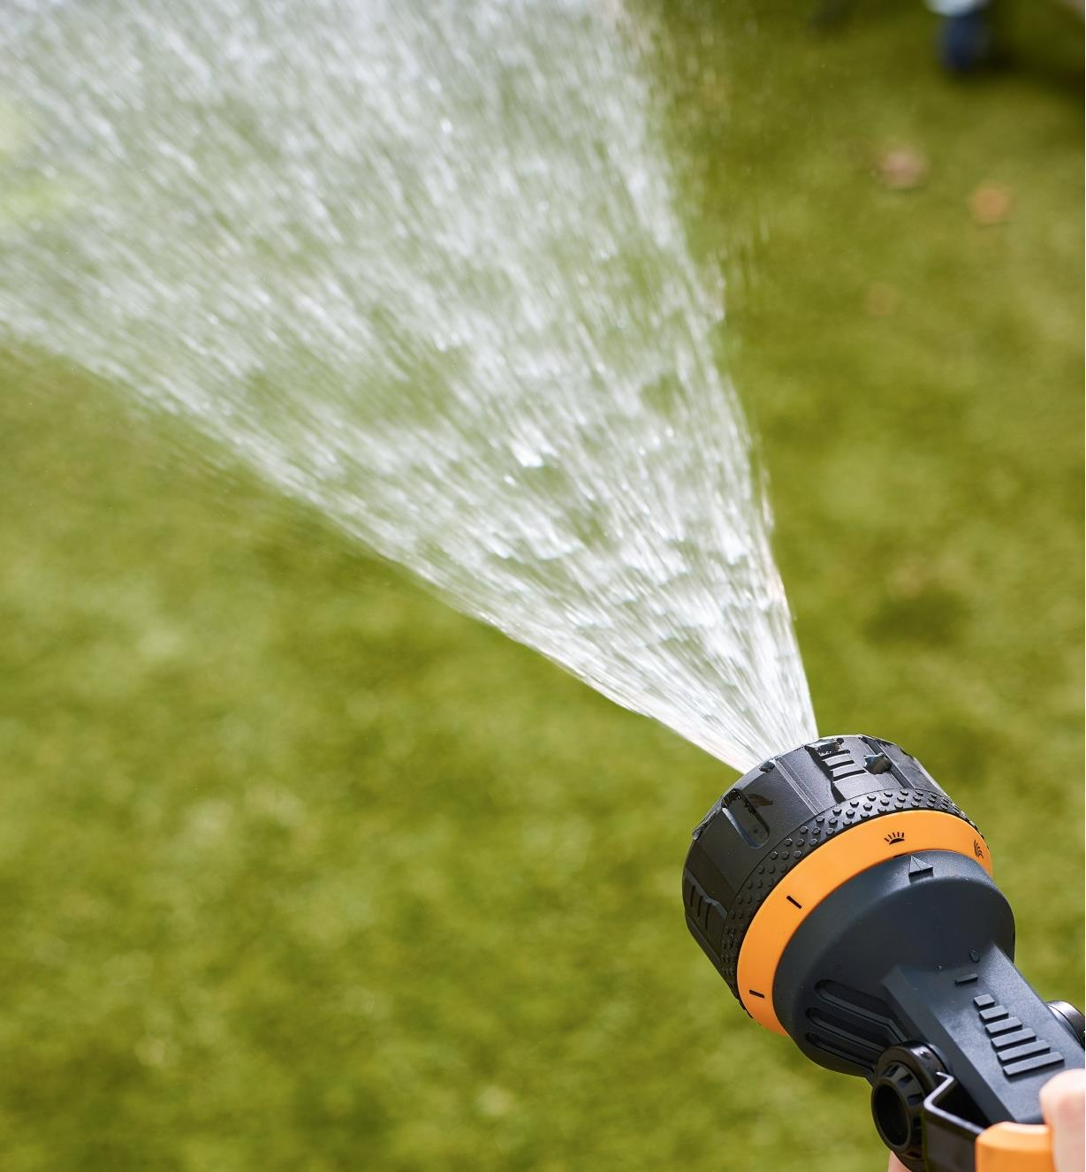
January 2024
Beginning: The difference between power and intensity.
Power: The quantity of energy leaving the source every second. : Unit = Watts
Intensity: The amount of power passing through an area.
Unit = Watts/square-meter
Less
Intense
Water leaving the nozzle
Water fanning out as it
travels outwards
More
Intense
Heliophysics Education Activation Team

Slide 10

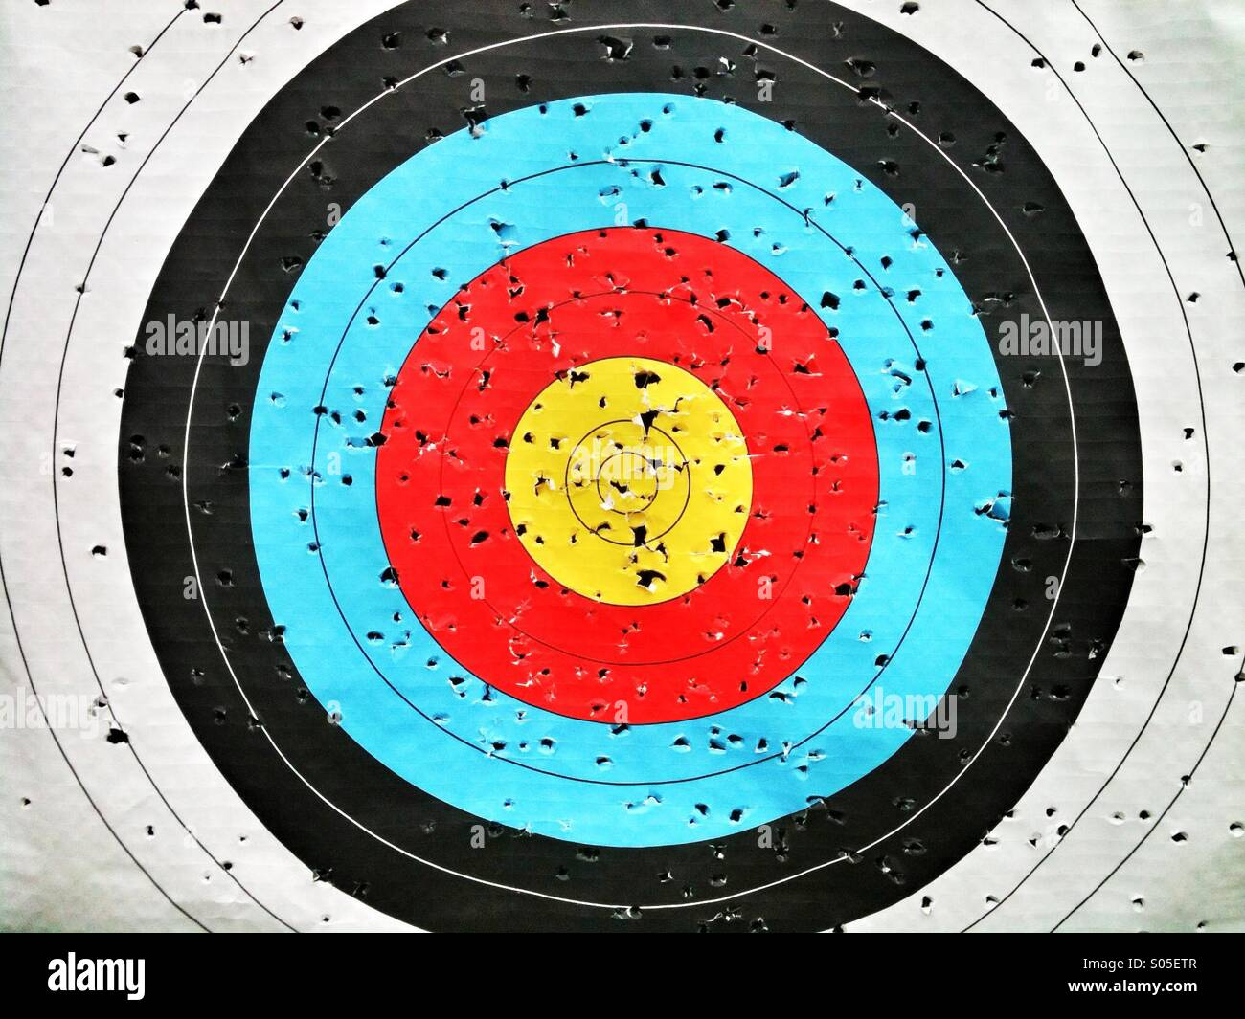
January 2024
Heliophysics Education Activation Team

Slide 11
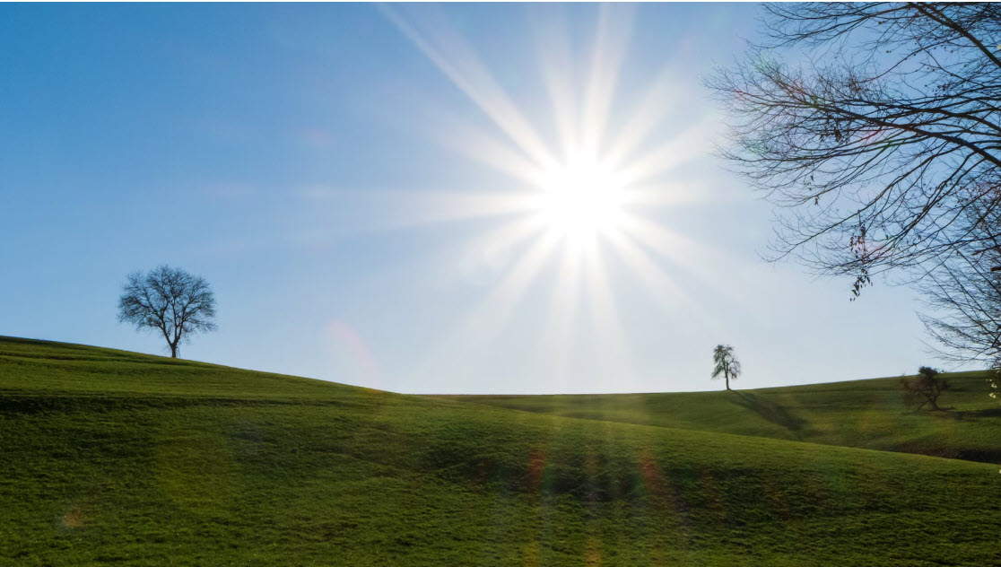
January 2024
Sun emits 3.8x10²⁶ watts of luminous power. This light energy flows out into space in all directions.
Heliophysics Education Activation Team

Slide 12
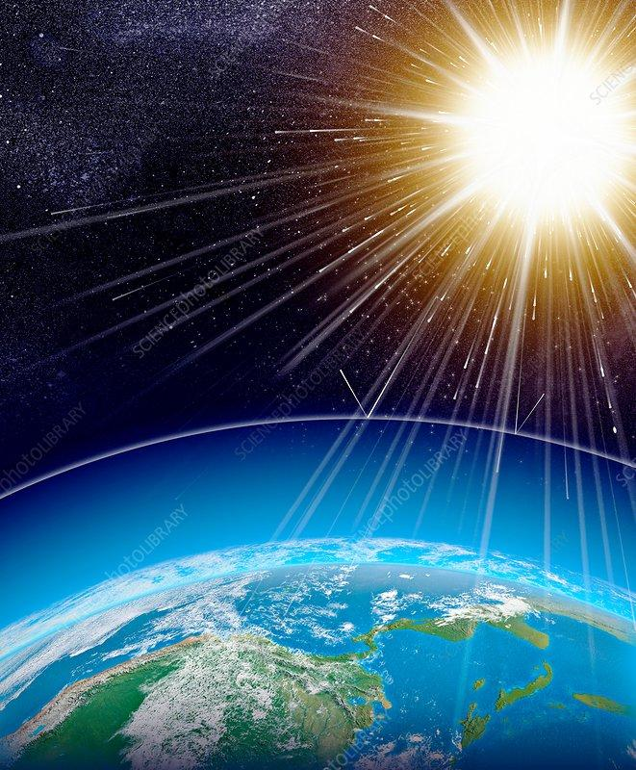
January 2024: Albedo
The intensity of sunlight energy is the power flowing across a spherical surface at a distance d from the sun.
Power 3.8x10²⁶ watts
I = ----------- = ---------------------------------
Area 4 π (149 million km)²
I = 1,360 watts/meter²
Earth rotates so its surface area is 4x its actual area,
so I = 1,360/4 = 340 Watts/m²
1400 w/m²
Heliophysics Education Activation Team

Slide 13
January 2024: Albedo
340 watts/m²
Sunlight absorption and climate change.
The ability for a surface to reflect light is called its Albedo.
Snow: A=0.7; Asphalt = 0.1
This means that a surface absorbs
(1-A) of the energy falling on it.
Snow: (1-0.7) = 0.3 Asphalt = 0.9
Atmosphere
Reflected
Causes
Heating
Absorbed
Ground
Heliophysics Education Activation Team

Slide 14
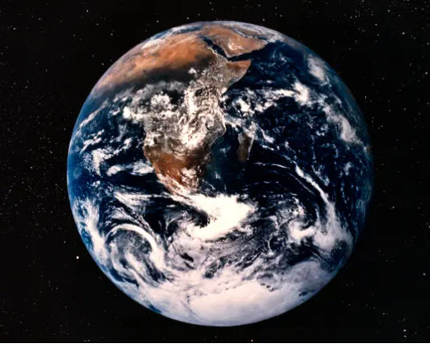
January 2024: Elementary Problem
Problem: A planet receives 360 W/m² at the top of its atmosphere. How much of this energy is absorbed by the planet and how much is reflected if:
30% of its surface is land with A=0.3
50% of its surface is oceans with A=0.1
20% of its surface is ice caps with A=0.7
Heliophysics Education Activation Team

Slide 15
January 2024: Elementary Problem
Problem: A planet receives 360 W/m² at the top of its atmosphere. How much of this energy is absorbed by the planet and how much is reflected if:
30% of its surface is land with A=0.3
50% of its surface is oceans with A=0.1
20% of its surface is ice caps with A=0.7
Absorbed: 0.2 x (1-0.7) + 0.3 x (1-0.3) + 0.5 x (1-0.1) = 0.72 or 72% absorbed
Reflected: 0.2 x 0.7 + 0.3 x 0.3 + 0.5x 0.1 = 0.28 or 28% reflected.
What is missing? The Atmosphere and clouds!
Heliophysics Education Activation Team

Slide 16
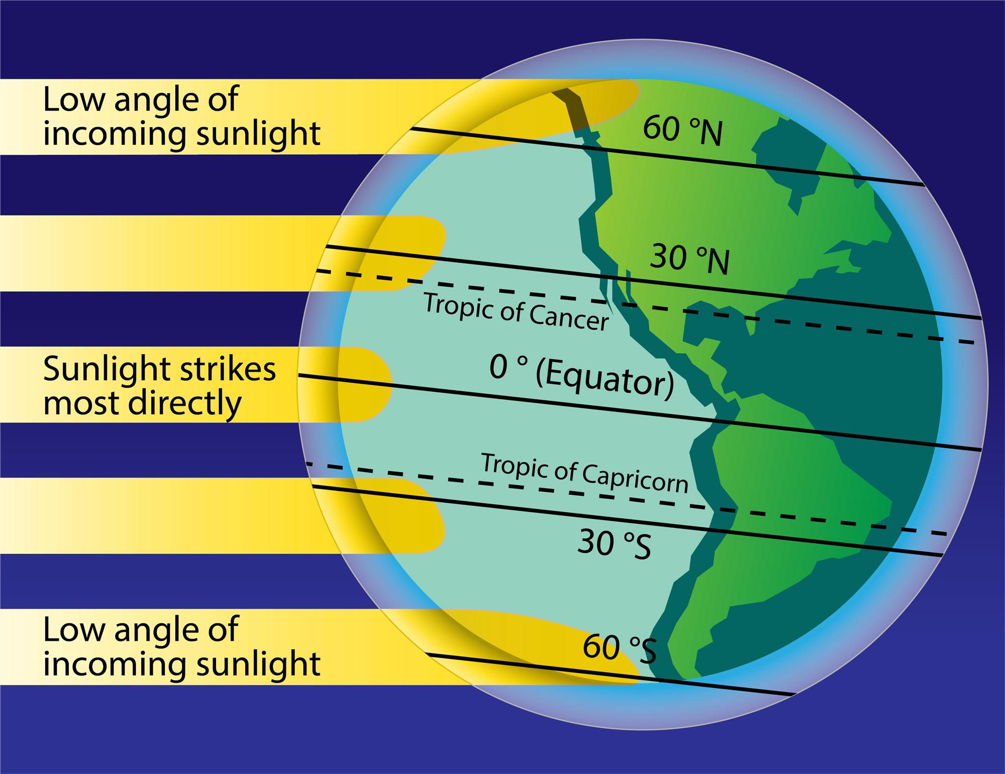
January 2024: Intermediate - Surface Heating
Latitude effect
Near equator, solar rays are mostly vertical to the surface, so sunlight intensity is higher.
Near poles, solar rays are spread out over larger area, so intensity is lower.
Intensity = 360 x cos(Latitude) Watts/m²
Example: Your latitude is 45º North
Intensity = 360 cos(45) Watts/m²
= 250 Watts/m²
Heliophysics Education Activation Team

Slide 17
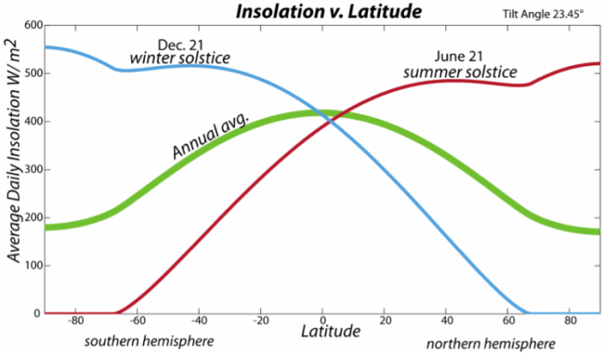
January 2024: Intermediate
Combined latitude and Seasonal Effects.
What makes things complicated is that both the latitude and day of the year affect how much sunlight the surface of Earth receives.
This affects climate and using solar panels to gather ‘green’ electricity on your roof-top.
370 Watt/m²
difference
Heliophysics Education Activation Team

Slide 18
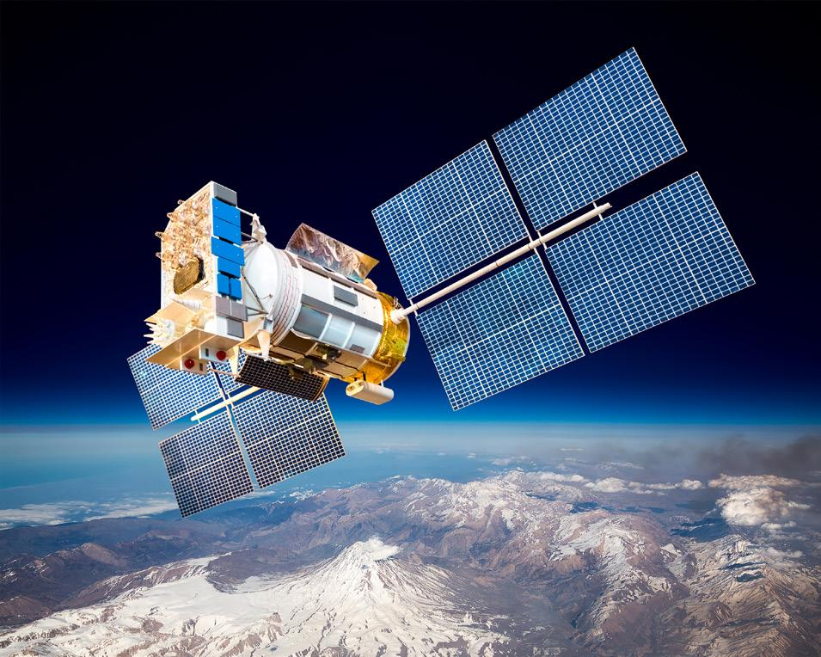
January 2024: Intermediate – Solar Panels
Spacecraft Design
1- Pointing: Solar panels always pointed at sun so their surface is perpendicular. This eliminates ‘latitude and season’ effects.
2 – Efficiency: Use very efficient solar panels that convert 24% of sunlight into electricity.
3- Location: Distance from sun
4- Maximum power needed
Heliophysics Education Activation Team

Slide 19
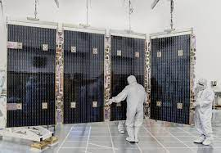
January 2024 – Webb Space Telescope
Distance from Sun: 150 million km
3.8x10²⁶ Watts
I = ------------------------------- = 1400 W/m²
4 π (1.5x10¹¹ meters)²
Power = 1,000 watts
Efficiency = 10%
Area = (1/0.10) x 1000/1400 = 7.1 m².
2.2 m tall x 3.3m long = 7.3 m²
Heliophysics Education Activation Team

Slide 20
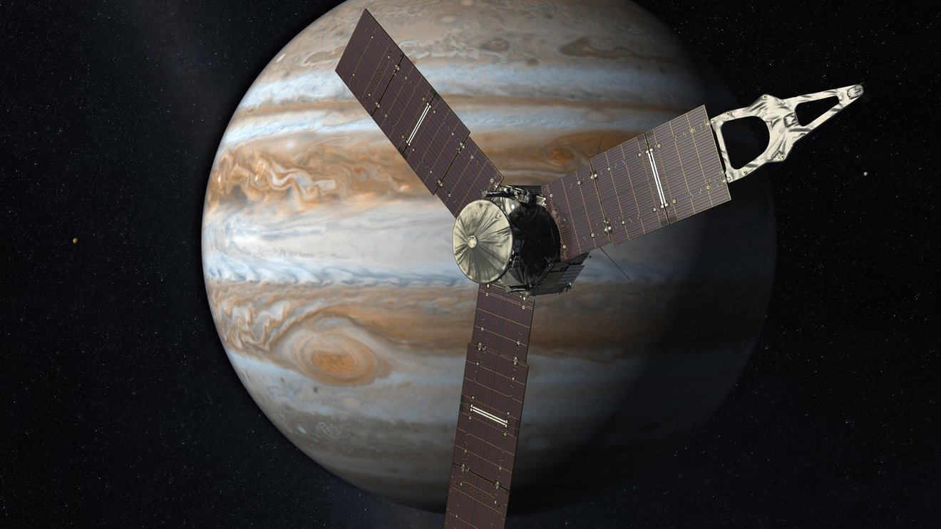
January 2024 – Intermediate Problem
The Juno spacecraft is located 832 million km from the sun in orbit around Jupiter.
It requires 500 watts to operate its experiments.
If the solar panels convert sunlight into electricity with 24% efficiency, how many square meters of solar panels does the spacecraft need?
Heliophysics Education Activation Team

Slide 21
January 2024 – Intermediate Problem
D = 832 million km
3.8x10²⁶ Watts
I = ------------------------------- = 44 W/m²
4 π (8.3x10¹¹ meters)²
Power = 500 watts
Efficiency = 24%
Area = (1/0.24) x 500/44 = 47 m².
3 panels Each: 9m x 1.7m
Total = 47 m²
Heliophysics Education Activation Team

Slide 22
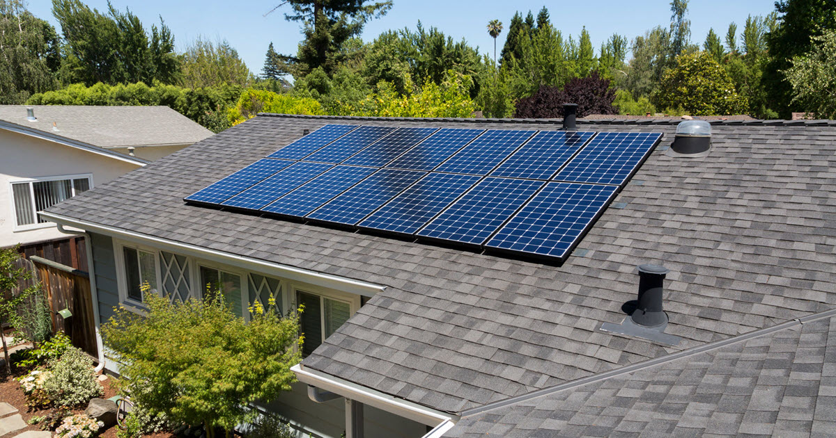
January 2024 – Advanced – Home Solar Power System
The latitude of your home is 40º N and your south-facing roof has a tilt of 45º. Your home needs 30,000 watt-hours to operate each day.
If the solar panel efficiency is 15% and the solar irradiance is 360 watts/m², what is the minimum area of the solar array that you need on the Winter Solstice at Noon?
First, draw a figure showing the geometry of the problem.
45
The system has to generate 30,000
Watt-hours for the day, but sun only
available for 10 hours a day so we need
3,000 watts.
Heliophysics Education Activation Team

Slide 23
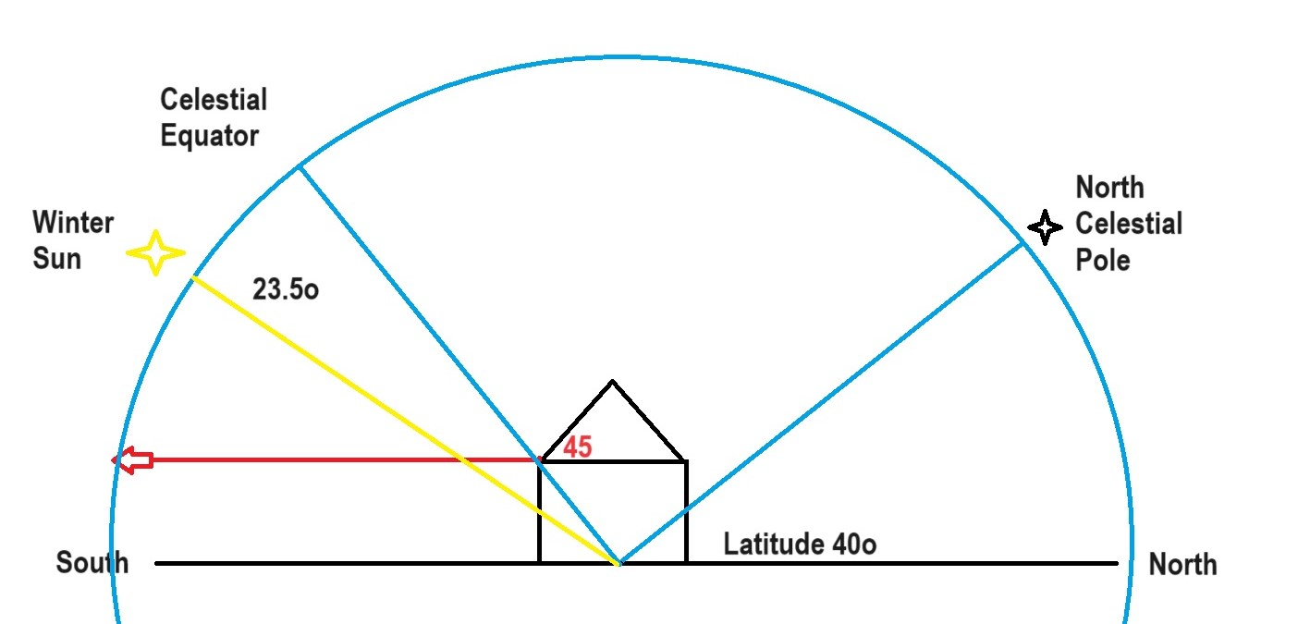
January 2024 - Advanced
.
Heliophysics Education Activation Team

Slide 24
January 2024 - Advanced
We want to calculate the solar irradiance on the array that is tilted at this latitude.
At Noon, the sun has an elevation above the south horizon of
180 – 23.5 – 90 – 40 = 26.5º
Heliophysics Education Activation Team

Slide 25
January 2024 - Advanced
But the roof is tilted northwards at an angle of 180- 45 = 135º, so that means the perpendicular axis to the roof is tilted at 135 – 90 = 45º towards the south.
The difference between the normal direction and the solar direction is just
45-26.5 = -18.5º
The solar intensity falling on the roof is just
I = 360 sin(90-18.5) = 341 watts/m²
Heliophysics Education Activation Team

Slide 26
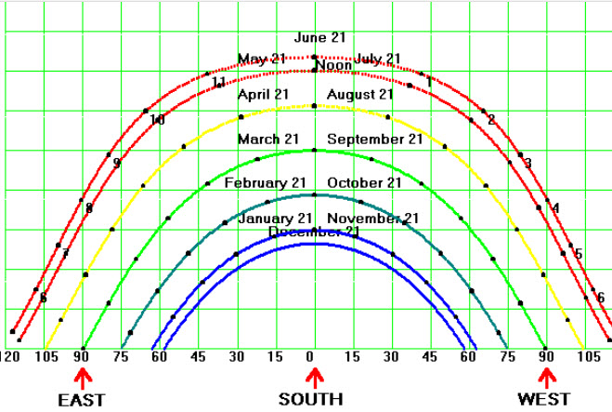
January 2024 - Advanced
A bit of logic.
We need to supply a house with a total of 30,000 watt-hours each 24-hour period. In the daytime we will fully charge our batteries for nighttime use.
We need to generate from the sun the full 30,000 watt-hours during the daytime. Near the winter solstice we only have 6 hours to do this!
The 6-hour solar window
Heliophysics Education Activation Team

Slide 27
January 2024 - Advanced
A bit of logic.
We need to supply a house with a total of 30,000 watt-hours each 24-hour period. In the daytime we will fully charge our batteries for nighttime use in 6 hours.
We need to generate from the sun the full 30,000 watt-hours during the 6-hour daytime window.
Heliophysics Education Activation Team

Slide 28
January 2024 - Advanced
A bit of math
30,000 watt-hours of energy is needed
Panels must provide X (watts) x 6 hours = 30,000 watt-hours.
So the panels have to produce
30,000 watt hours/6 hours
= 5,000 watts
Heliophysics Education Activation Team

Slide 29
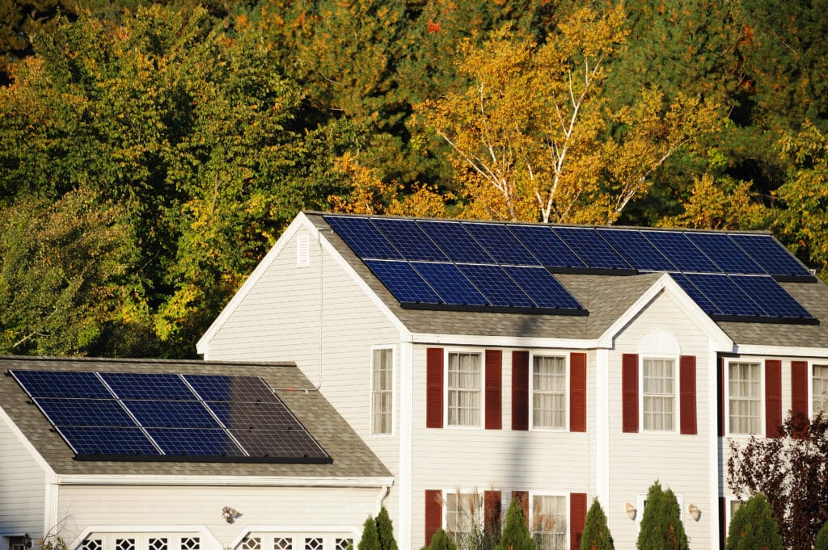
January 2024 - Advanced
A bit of math
We need 5,000 watts
Panels have an efficiency of 15% and the sun supplies 341 watts/m²
5000/0.15
Panel area = ----------------
341w/m²
Area = 98 meter².
Size = 15m x 6.5m (49 feet x 21 feet)
Heliophysics Education Activation Team

Slide 30

February 2023: Fashion, Color and Light
Next Time!
What is color?
Investigating visible light
and color filters
in fashion and heliophysics
Heliophysics Education Activation Team

