Slide 1



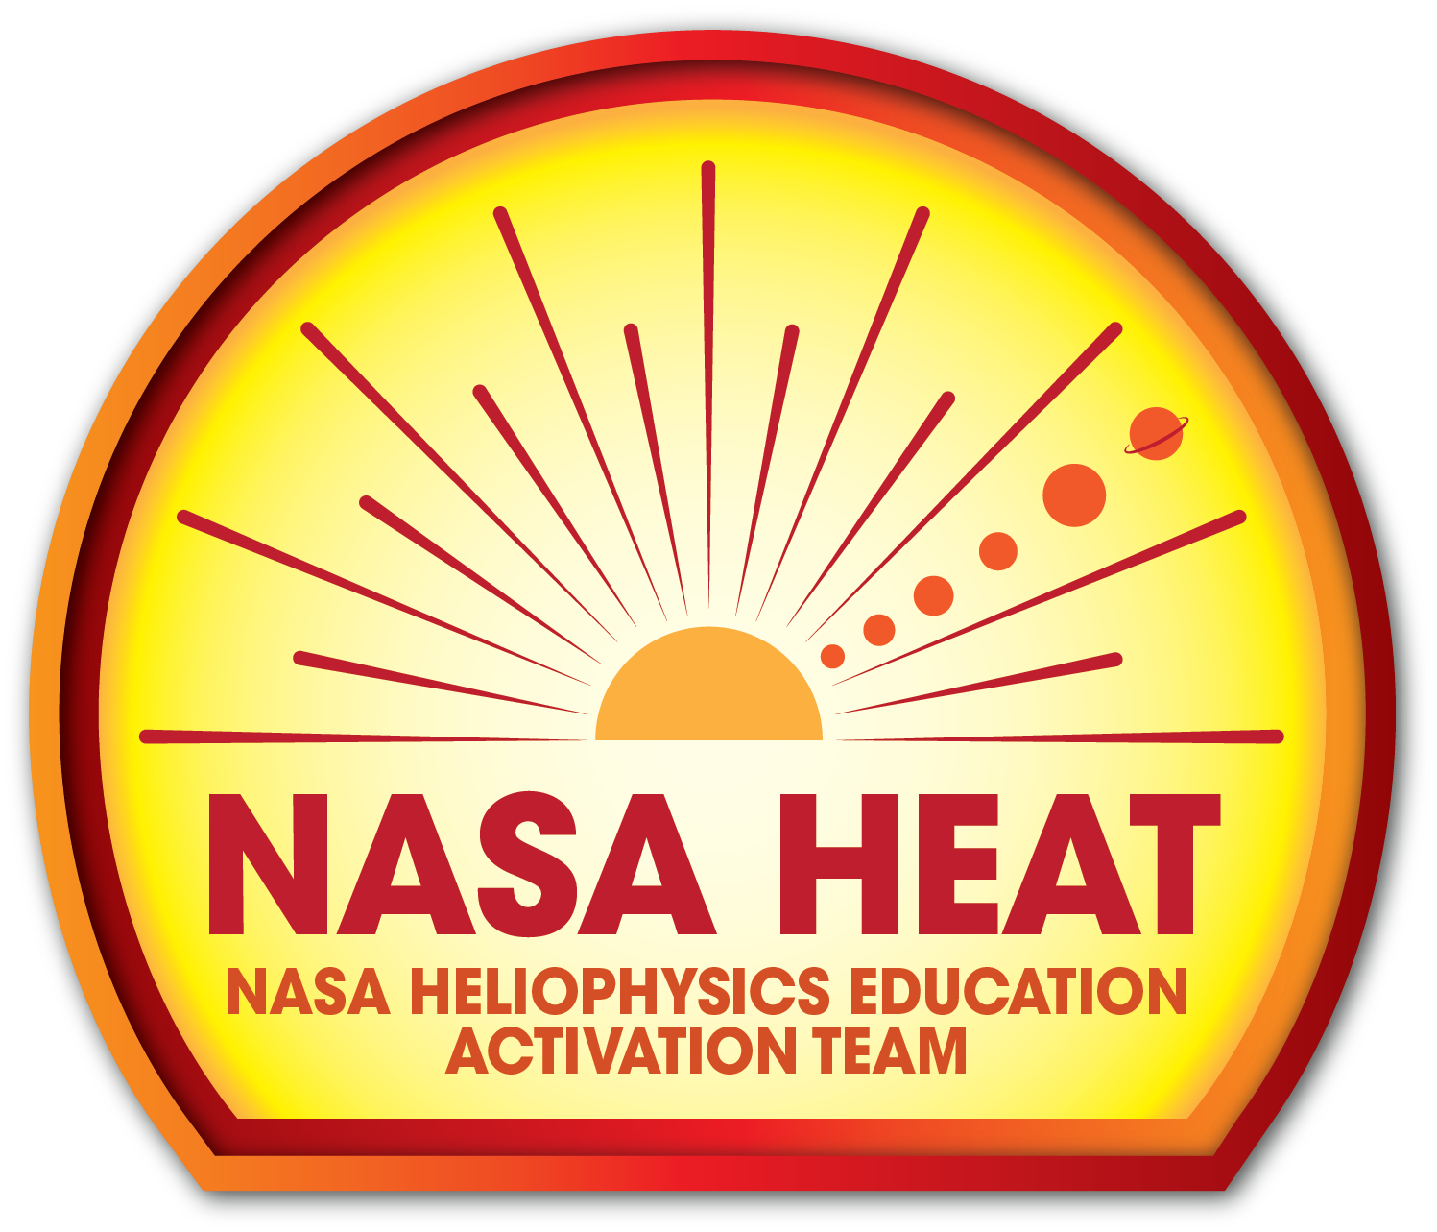
The Heliophysics Big Year
National Aeronautics and Space Administration
Dr. Sten Odenwald, Astronomer
NASA Heliophysics Education Activation Team

Slide 2


December 2023: What is Heliophysics?
Heliophysics is the discipline in space science that deals with the matter and energy of our Sun and its effects on the solar system.
It also studies how the Sun varies and how those changes pose a hazard to humans on Earth and in space
Heliophysics Education Activation Team

Slide 3



Heliophysics Big Year Timeline
Annular Eclipse
Total Eclipse
Solar Parker
Probe Perihelion
October 14, 2023
April 8, 2024
December 24, 2024
ADD MEDIA HERE
ADD MEDIA HERE
ADD MEDIA HERE
Heliophysics Education Activation Team

Slide 4
December 2023 : HBY Schedule
December 19 – Citizen Science
January 16 - The Sun Touches Everything
February 20 - Fashion
March 19 - Experiencing the Sun
April 16 - April 8 Total Solar Eclipse
Heliophysics Education Activation Team

Slide 5
December 2023 : NASA’s Big Questions
1. What causes the Sun to vary?
2. How do the Earth and the heliosphere respond?
3. What are the impacts on humanity?
These Big Questions form the basis for the
Framework for Heliophysics Education
https://science.nasa.gov/learn/heat/big-ideas/
Heliophysics Education Activation Team

Slide 6
December 2023 : The Framework for Heliophysics Education
What are the impacts of the Sun on humanity?
1.1 The Sun is really big and its gravity influences all objects in the solar system. (PS2, ESS1)
1.2 The Sun is active and can impact technology on Earth via space weather. (PS1, PS2, PS4, ESS2, ESS3) <<<<<<< Tonight
1.3 The Sun’s energy drives Earth’s climate, but the climate is in a delicate balance and is changing due to human activity. (PS1, PS2, PS3, LS4, ESS2, ESS3)
How do the Earth, the solar system, and heliosphere respond to changes on the Sun?
2.1 Life on Earth has evolved with complex diversity because of our location near the Sun. It is just right! (PS3, PS4, LS1, LS2, ESS2)
2.2 The Sun defines the space around it, which is different from interstellar space. (PS2, ESS1, ESS2)
2.3 The Sun is the primary source of light in our solar system.(PS1, PS2, PS3,PS4, ESS1)
What Causes the Sun to Vary?
3.1 The Sun is made of churning plasma, causing the surface to be made of complex, tangled magnetic fields. (PS1, PS2, ESS1, ESS2)
3.2 Energy from the Sun travels outward through the Sun and into the heliosphere. (PS1, PS3, PS4, ESS1, ESS2, ESS3) <<<<< Tonight
3.3 Our Sun, like all stars, has a life cycle. (PS1, LS1, ESS1)
Heliophysics Education Activation Team

Slide 7
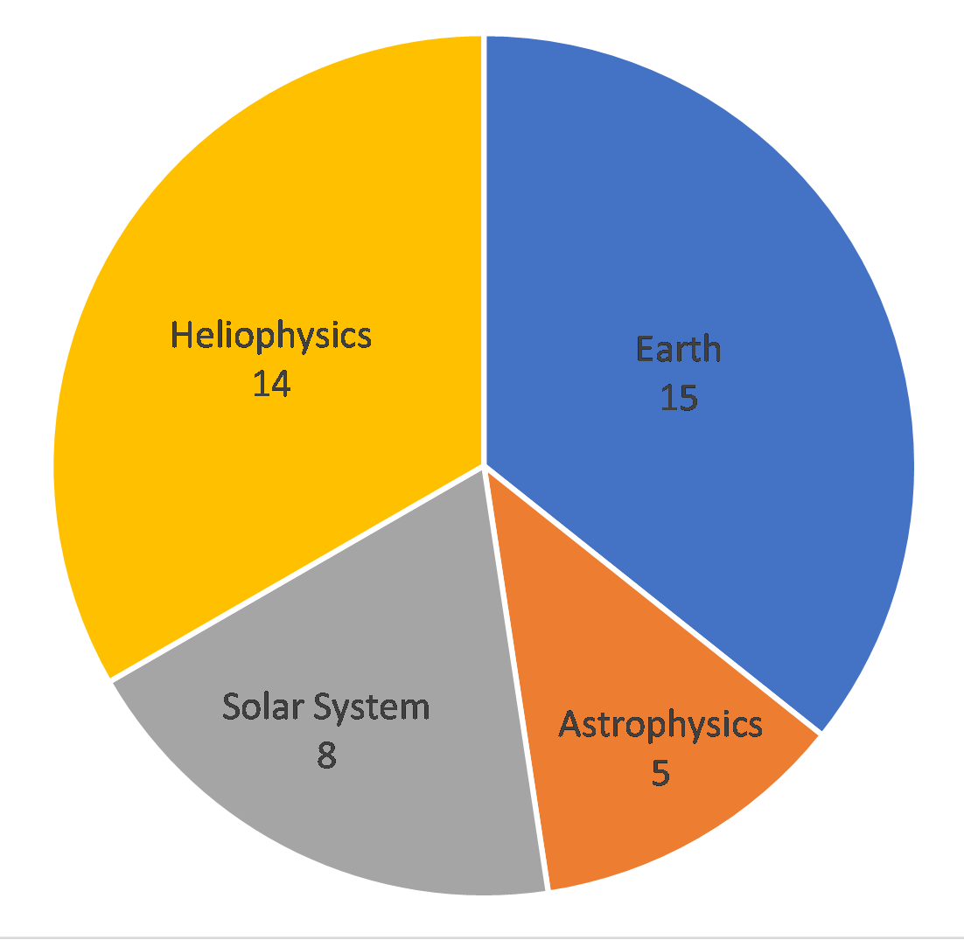
December 2023: Citizen Science
Citizen science has enabled many heliophysics discoveries, including new types of auroras.
This month will explore ongoing citizen science projects in heliophysics
https://science.nasa.gov/heliophysics/programs/citizen-science
Heliophysics Education Activation Team

Slide 8
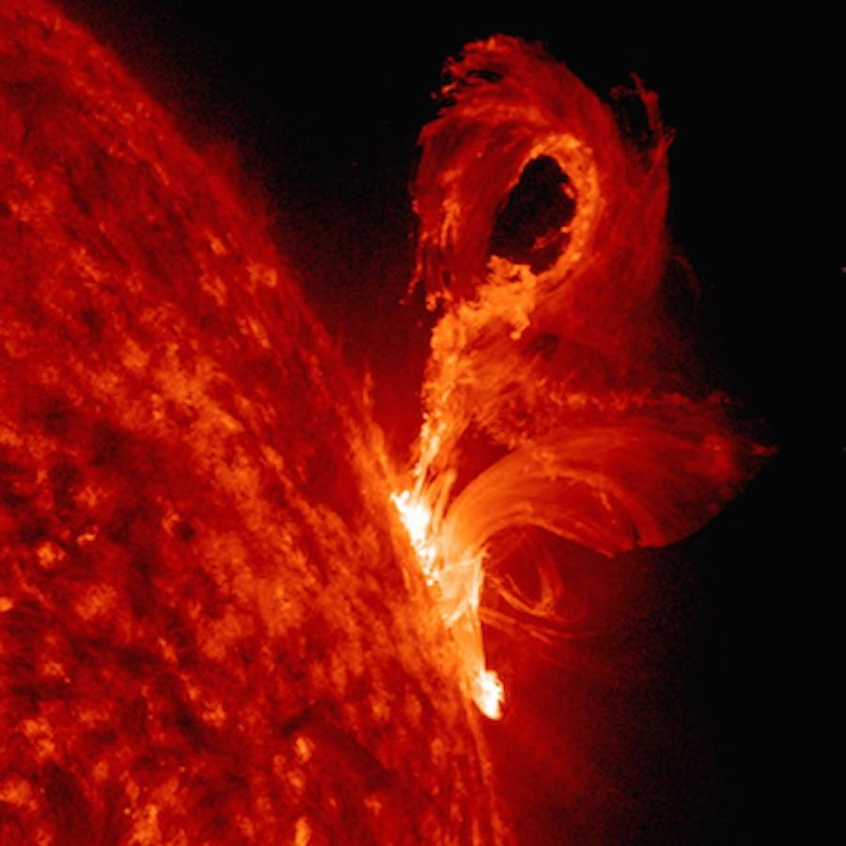
December 2023: Citizen Science
Projects about the sun:
Sungrazer
Solar Active Region Spotter
Solar Jet Hunter
Sunsketcher
Megamovie
RadioJOVE
CATE
Heliophysics Education Activation Team

Slide 9
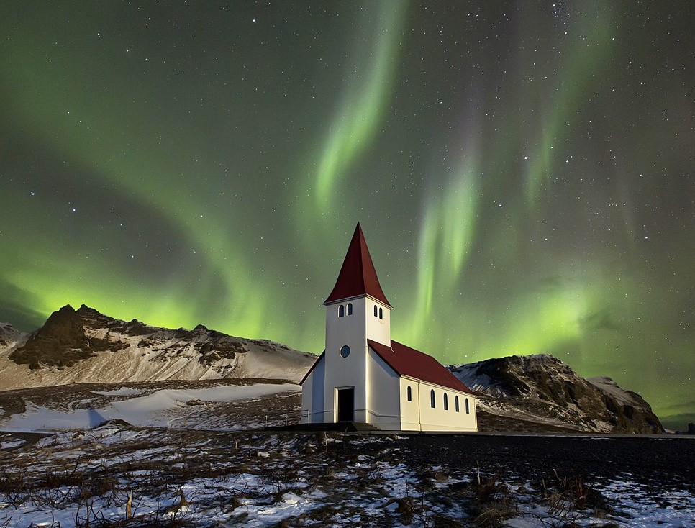
December 2023: Citizen Science
Projects about solar impacts
Aurorasaurus
HamSci
EZIE-Mag
DEB Initiative
Soundscapes
Eclipse Ballooning Project
HARP
Heliophysics Education Activation Team

Slide 10
December 2023: Citizen Science
Sungrazer.................................
Solar Active Region Spotter.....
Solar Jet Hunter.......................
Sunsketcher.............................
Megamovie..............................
RadioJOVE..............................
CATE.......................................
https://sungrazer.nrl.navy.mil/
https://www.zooniverse.org/projects/eimason/solar-active-region-spotter
https://science.nasa.gov/citizen-science/summary/solar-jet-hunter/
https://sunsketcher.org/
https://eclipsemegamovie.org/
https://radiojove.gsfc.nasa.gov/
https://science.nasa.gov/sciact-team/citizen-cate-experiment/
Heliophysics Education Activation Team

Slide 11
December 2023: Citizen Science
Aurorasaurus...............................
HamSci........................................
EZIE-Mag....................................
DEB Initiative...............................
Soundscapes..............................
Eclipse Ballooning Project..........
Heliophysics Audified HARP.....
https://science.nasa.gov/citizen-science/summary/aurorasaurus/
https://science.nasa.gov/citizen-science/summary/ham-radio-science-citizen-investigation/
https://ezie.jhuapl.edu/outreach/ezie-mag/
https://debinitiative.org/
https://eclipsesoundscapes.org/
https://science.nasa.gov/sciact-team/nationwide-eclipse-ballooning-project/
https://listen.spacescience.org/
Heliophysics Education Activation Team

Slide 12
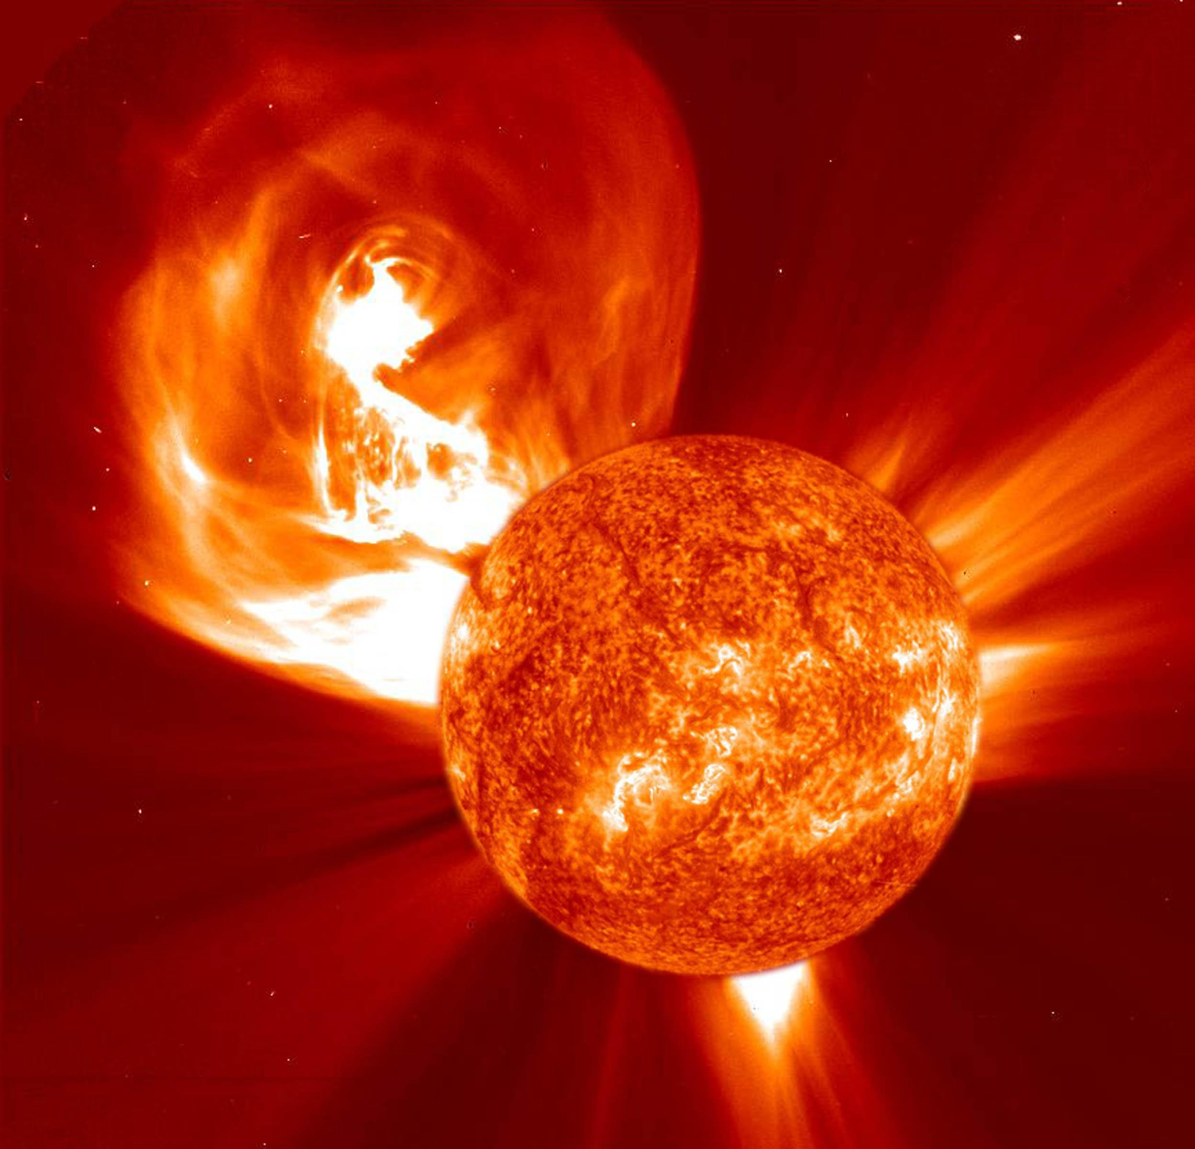
December 2023: Aurora Science
Step 1:
Solar storms produce clouds of
plasma called coronal mass ejections
The Sun is active and can impact technology on Earth via space weather. (PS1, PS2, PS4, ESS2, ESS3)
Heliophysics Education Activation Team

Slide 13
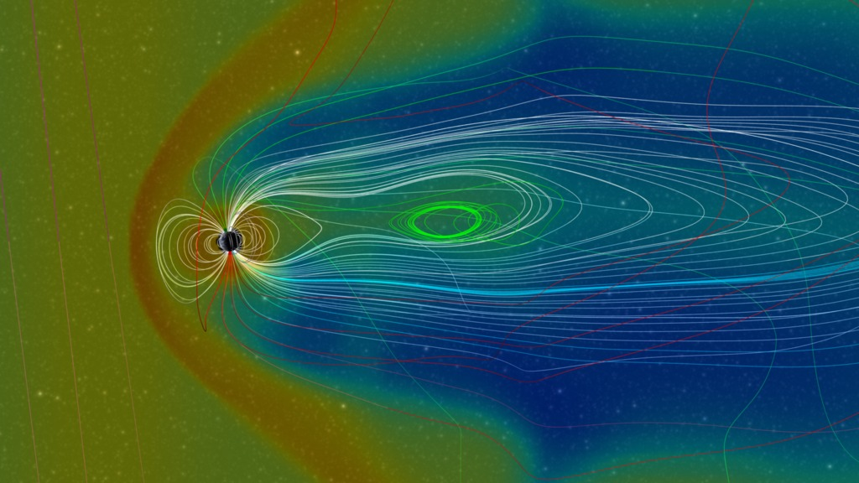
December 2023: Aurora Science
Step 2:
Coronal mass ejections can impact
Earth’s magnetic field causing
magnetic reconnection.
The Sun is active and can impact technology on Earth via space weather. (PS1, PS2, PS4, ESS2, ESS3)
Heliophysics Education Activation Team

Slide 14
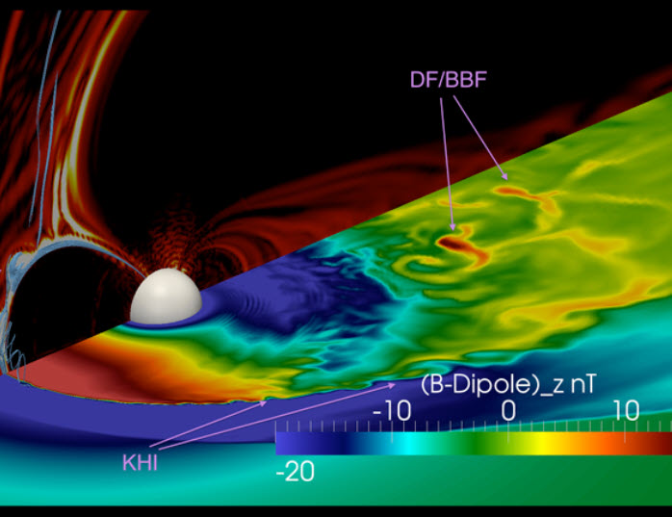
December 2023: Aurora Science
Step 3:
Magnetic reconnection releases
energy stored in the magnetic field,
which causes charged particles to
flow into the polar regions
The Sun is active and can impact technology on Earth via space weather. (PS1, PS2, PS4, ESS2, ESS3)
Heliophysics Education Activation Team

Slide 15
December 2023: Aurora Science
Step 4:
These energetic particles, mostly
electrons, collide with the atmosphere
to produce the aurora
The Sun is active and can impact technology on Earth via space weather. (PS1, PS2, PS4, ESS2, ESS3)
Heliophysics Education Activation Team

Slide 16
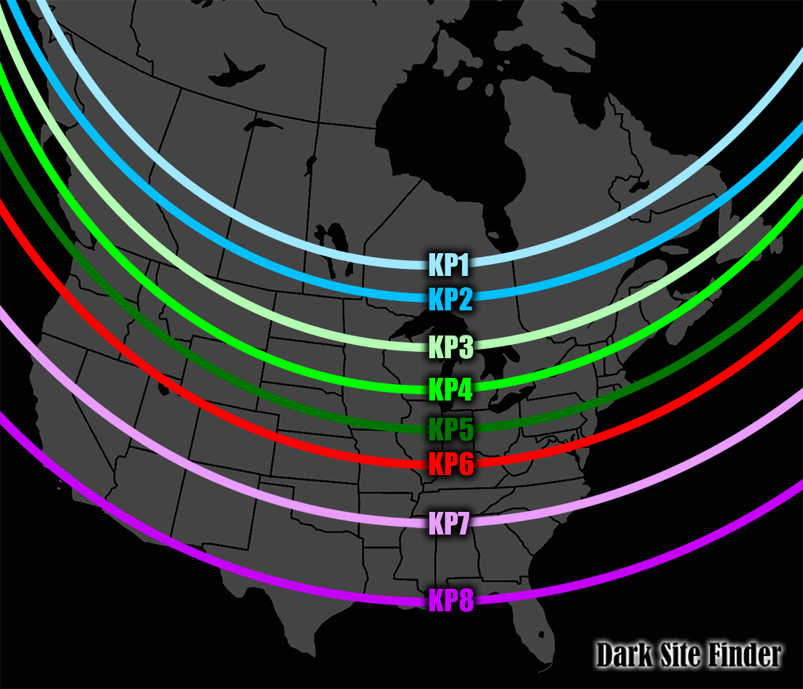
December 2023
When to look:
There are many online sites that give forecasts for aurora sightings in the next few days. Typically the Kp index is used to gauge geomagnetic activity.
NOAA Space Weather Prediction Center: https://www.swpc.noaa.gov/
Heliophysics Education Activation Team

Slide 17
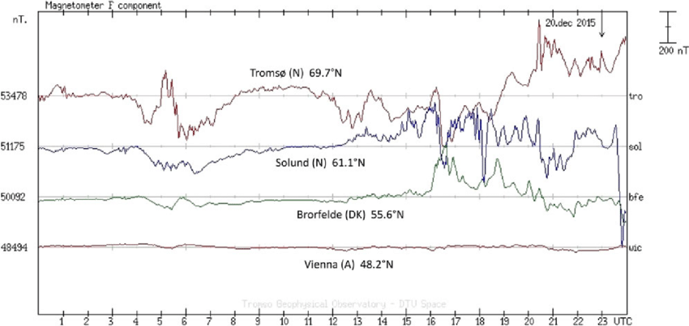
December 2023
Once a coronal mass ejection aimed towards Earth is sighted by NASA spacecraft (SOHO, SDO), magnetic storms are soon to follow in a few days.
They often happen in the daytime so by looking at geomagnetic disturbances (Kp index) you can tell if the storm is strong enough to produce an auroral event that evening.
Magnetic storm beginning on 20 December 2015
Heliophysics Education Activation Team

Slide 18
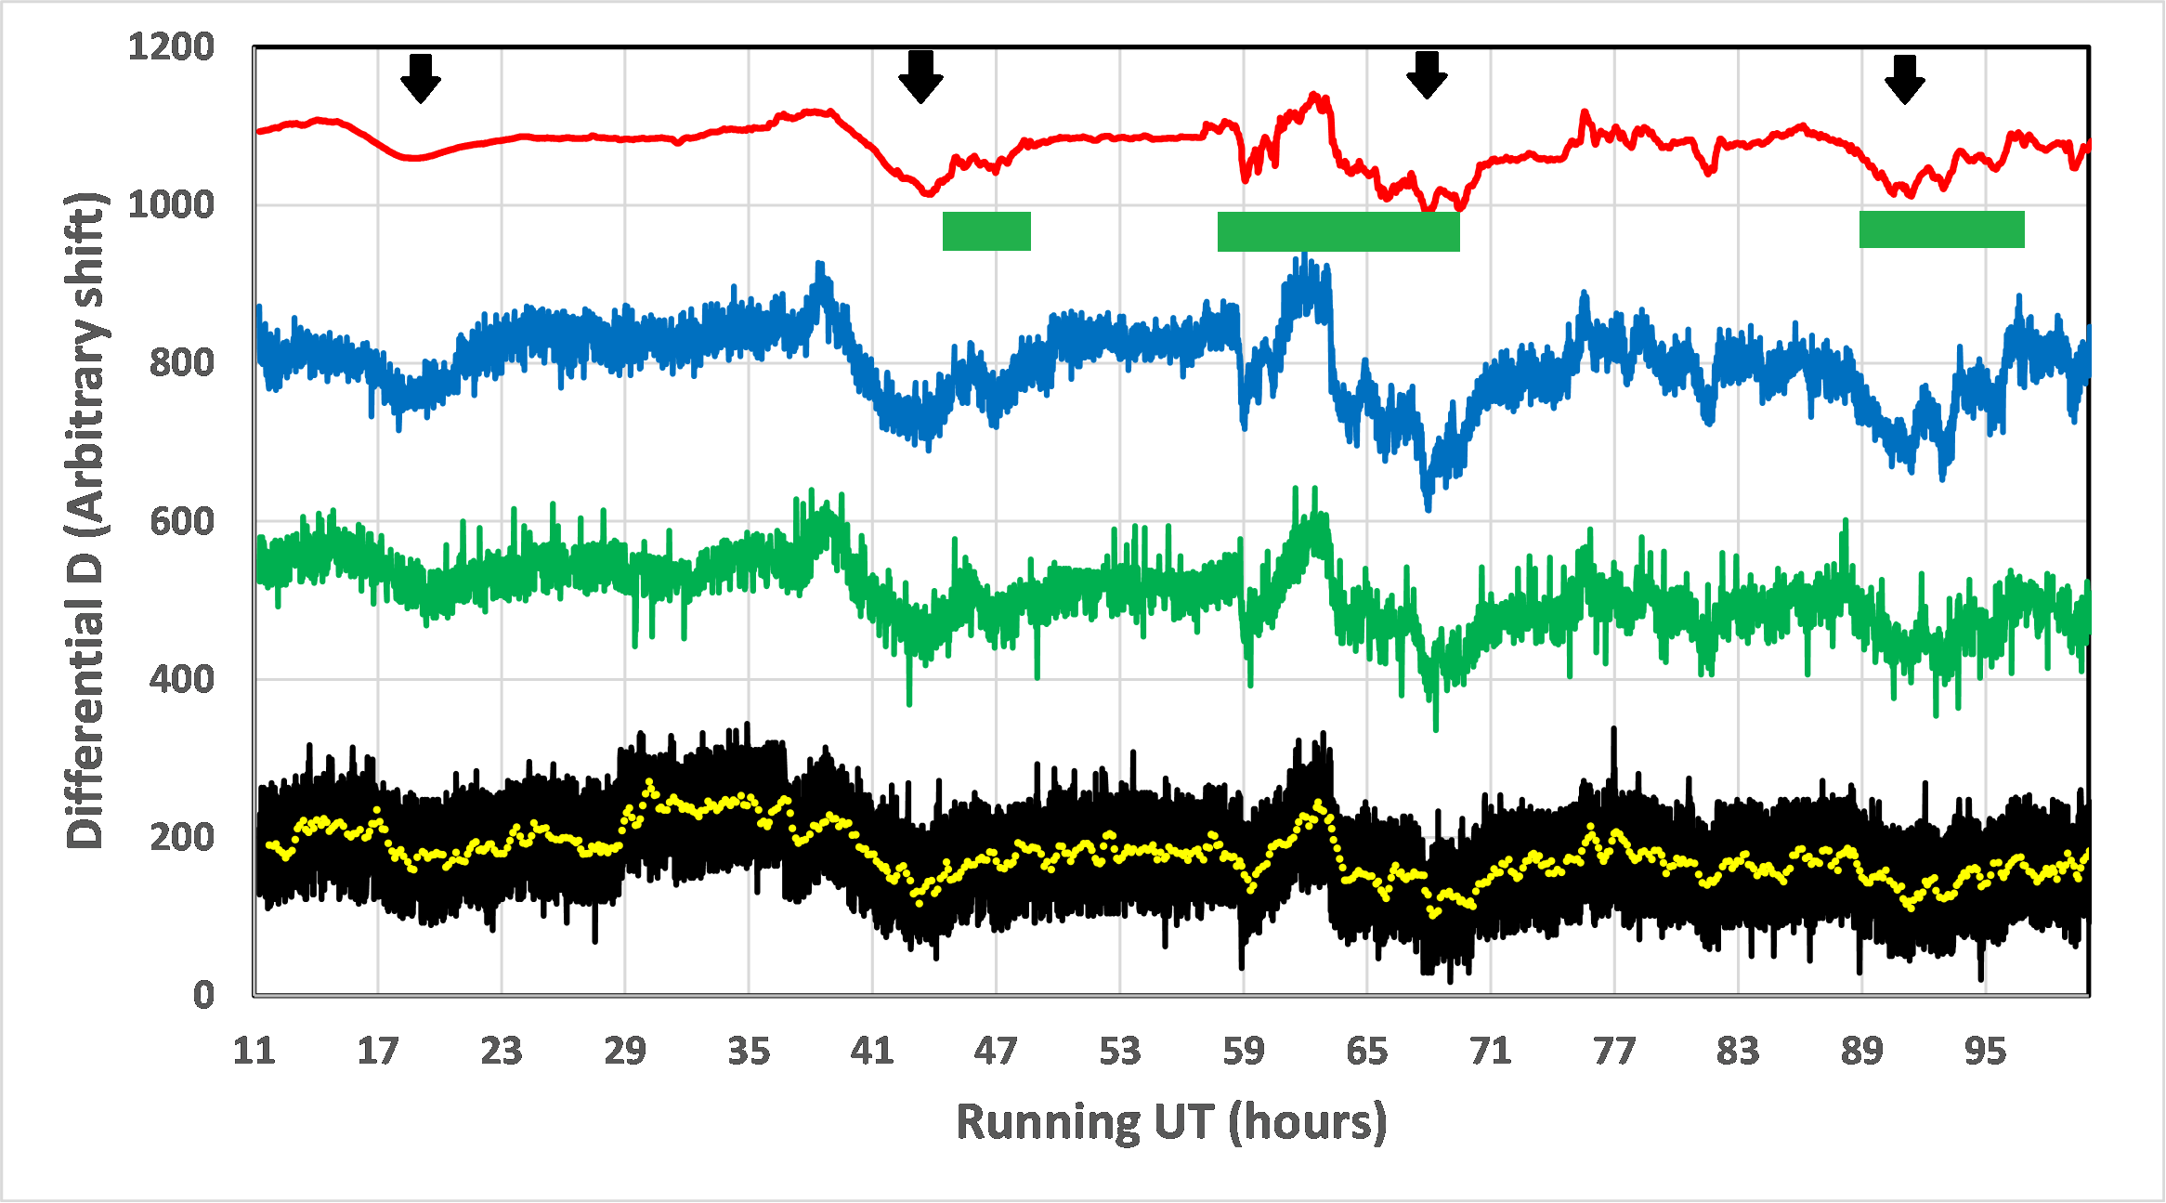
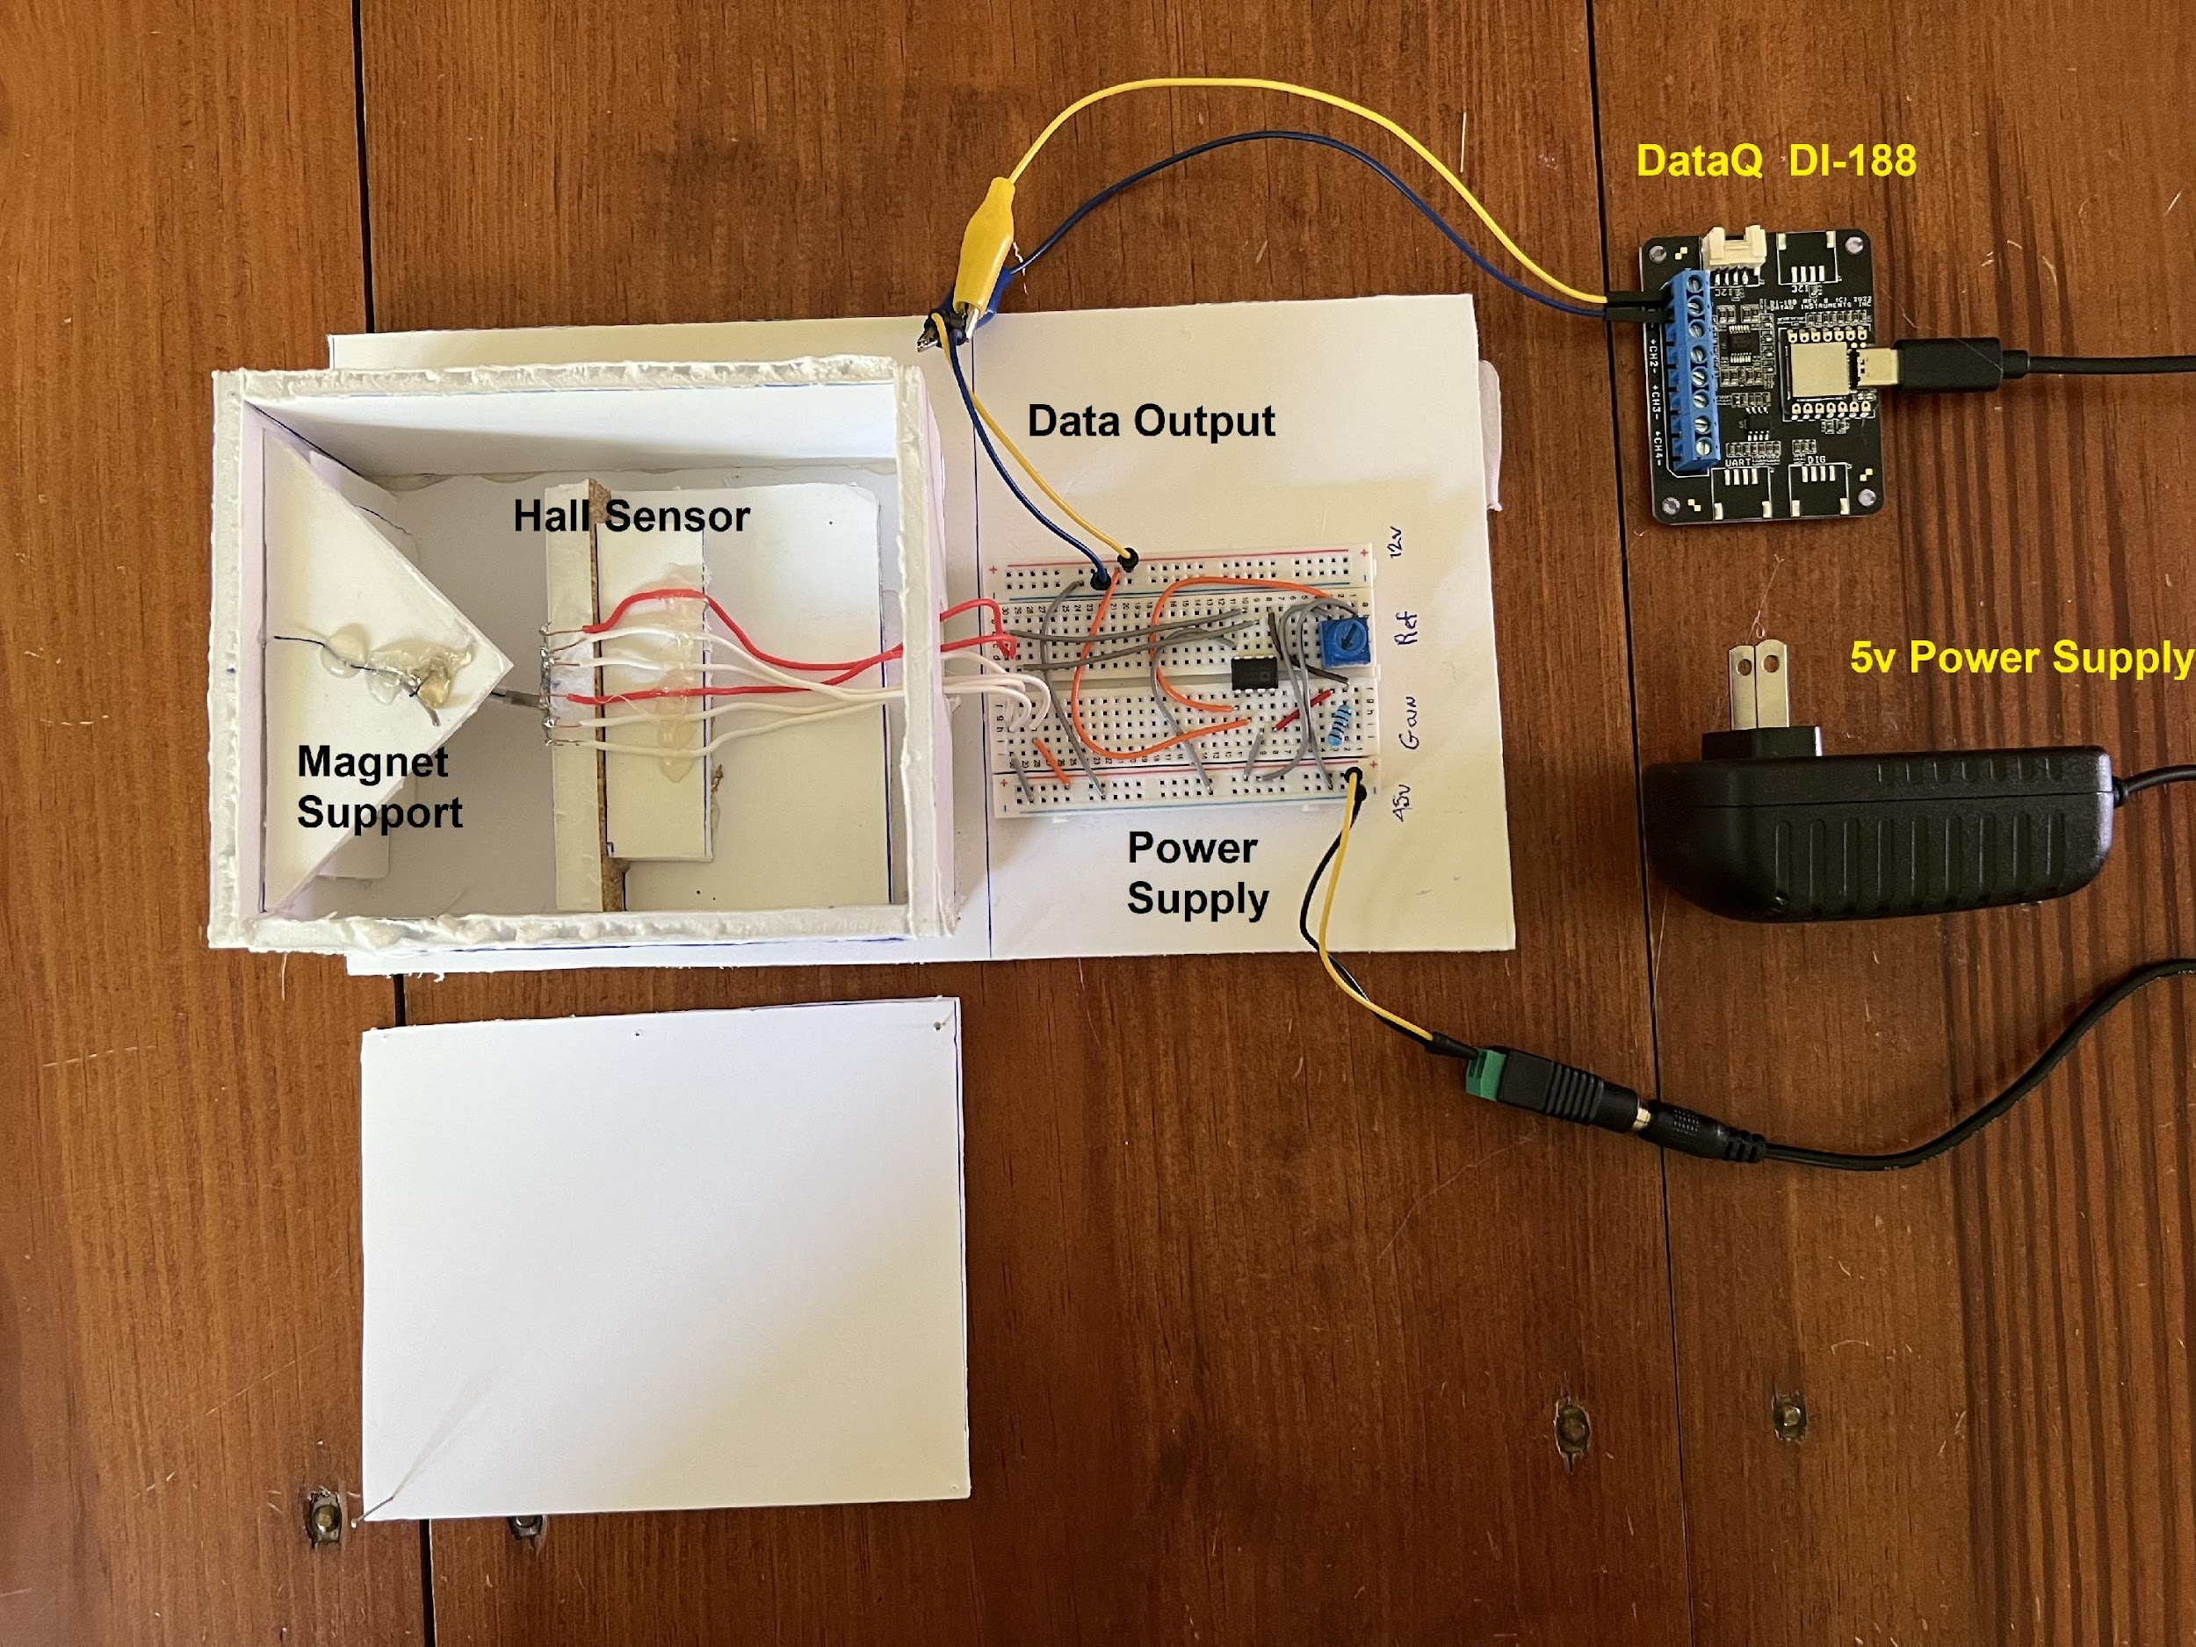
December 2023
DIY magnetometers can be built to track them yourself for under $50.
See ‘DIY Magnetometers’ by Sten Odenwald
Email me for details: odenwald@astronomycafe.net
Heliophysics Education Activation Team

Slide 19
December 2023: Aurora Math
Aurora science provides some interesting opportunities to see how math is used in the Real World (Earth-1).
SpaceMath@NASA has developed over 1000 math problems designed for grades 3-12.
Main webpage: http://spacemath.gsfc.nasa.gov
Search engine: https://spacemath.gsfc.nasa.gov/Search.html
Heliophysics Education Activation Team

Slide 20
December 2023: Aurora Questions Answered by Math
How high up are aurora?
Do they ever reach the ground?
Can you hear an aurora?
Heliophysics Education Activation Team

Slide 21
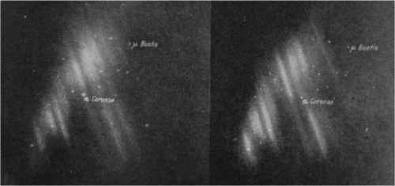
December 2023: Aurora Heights
In the early 1900s, Norwegian scientist Carl Stormer and an assistant donned fur coats and braved freezing Arctic temperatures in order to take simultaneous photographs of auroral features from different locations in Norway.
By comparing pairs of pictures, Stormer could triangulate the height of portions of the aurora
Heliophysics Education Activation Team

Slide 22
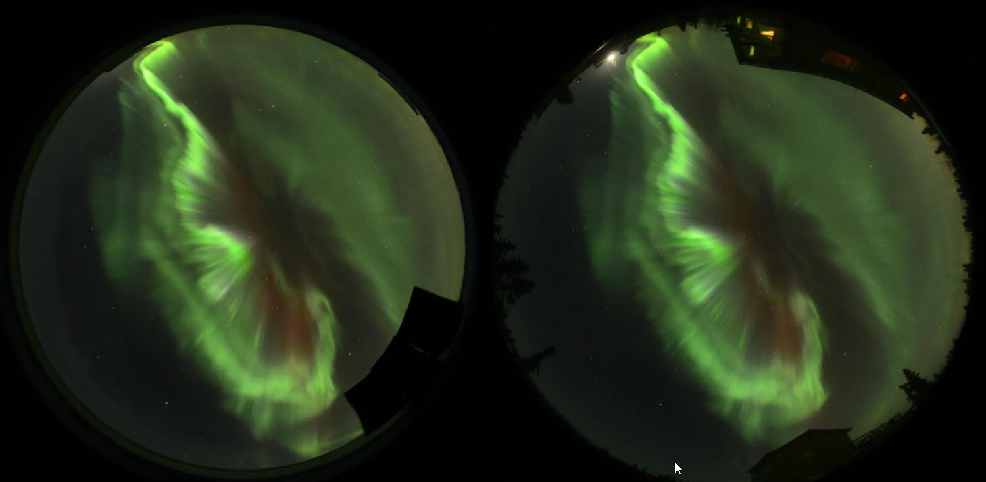
December 2023: Aurora Heights – By Parallax
The Parallax Method
The technology that Ryuho Kataoka, an associate professor at the National Institute of Polar Research in Tokyo, and his colleagues used provides more precise measurements.
They set up digital Nikon cameras—equipped with wide-angle fisheye lenses capable of capturing expanses of sky in Alaska.
https://www.sciencefriday.com/articles/a-double-take-on-the-northern-lights/
Heliophysics Education Activation Team

Slide 23
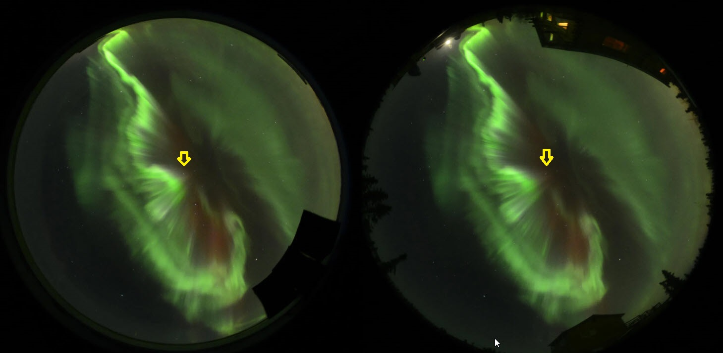
December 2023: Aurora Heights - Introductory
Select the Reference Star
Heliophysics Education Activation Team

Slide 24
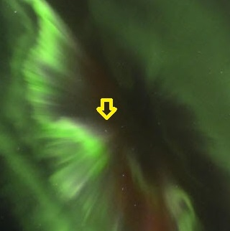
December 2023: Aurora Heights - Introductory
Blink Image A
Heliophysics Education Activation Team

Slide 25
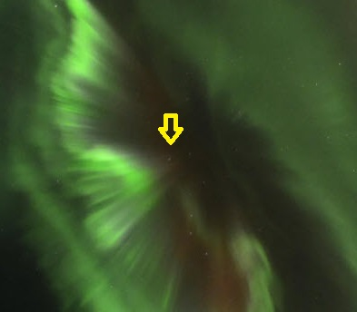
December 2023: Aurora Heights - Introductory
Blink Image B
Heliophysics Education Activation Team

Slide 26
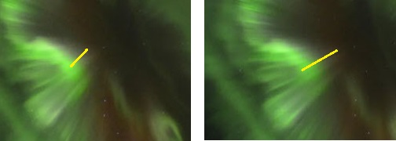
December 2023: Aurora Heights - Introductory
Parallax Shift
Image is 0.5º x 26 moons = 13º
From the scale of the image:
Using the star as a reference:
Length A = 2 degrees
Length B = 3 degrees
Difference Angle = 1.0 degrees
The field of view of this picture is cropped so that its
width on the sky is about 26 times the full moon.
Heliophysics Education Activation Team

Slide 27
December 2023: Aurora Heights - Introductory
Parallax Geometry
Length A = 2 degrees
Length B = 3 degrees
Parallax Angle: B – A = 1 degree
Base line = 2 km from A to B
Distance = 2 km x (57.3º/1º) = 114 km
Exaggerated
diagram
%
A B
Heliophysics Education Activation Team

Slide 28
December 2023: Aurora Heights - Introductory
Distance to Height:
Distance = 2 km x (57.3/1 ) = 114 km
Height = 114 x sin(60º)
Height = 114 x 0.866
Height = 99 kilometers.
114 km
Height
60º
Heliophysics Education Activation Team

Slide 29
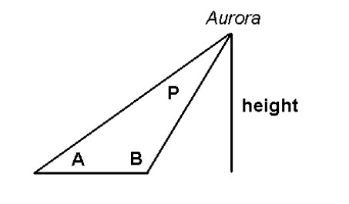
December 2023: Angular height and scale drawing
Method 2: Scale Drawing
Suppose that two observers were located 30 kilometers apart (length of AB).
Observer A measured an angle A of 53º Observer B measured an angle B of 114º.
By making a scaled drawing of this triangle, what was the height of the auroral feature they were studying?
About 100 km.
https://spacemath.gsfc.nasa.gov/weekly/Page11.pdf
Heliophysics Education Activation Team

Slide 30
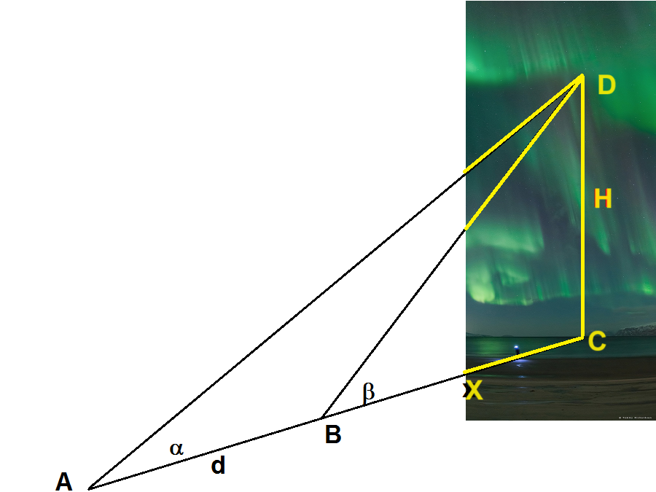
December 2023: Height by Trigonometry
Method 3: By trigonometry
The basic idea is that two observers will be spotting the same feature on an aurora.
This is like the previous method but relies on computation and not scale drawings so is more general.
Heliophysics Education Activation Team

Slide 31
December 2023: Height by Trigonometry
The simplest geometry occurs if you have two observers, A and B, located along the same line ABC as the direction towards the auroral feature.
Observers A and B measure the elevation angles α and β and are standing a distance d apart.
Amazingly, we don’t need to know the length x=BC to determine H!
Heliophysics Education Activation Team

Slide 32
December 2023: Height by Trigonometry
H
Tan β = --------
X
D
H
β
B
C
X
Heliophysics Education Activation Team

Slide 33
December 2023: Height by Trigonometry
H
Tan α = -------
d + X
D
H
α
A
C
d+ X
Heliophysics Education Activation Team

Slide 34
December 2023: Height by Trigonometry
Tan α = H / (d+x)
Multiply both sides by (d+x) and cancil
H = (d+x)Tan α
H = d Tan α + xTan α
Heliophysics Education Activation Team

Slide 35
December 2023: Height by Trigonometry
But Tan β = H/x so x = H/Tan β
Since H = d Tan α + xTan α
Eliminate x: H = d Tan α + (H/Tan β) Tan α
Put Hs on same side: H – H(Tan α/Tan β) = d Tan α
Simplify: H (1 – Tan α/Tan β) = d Tan α
Heliophysics Education Activation Team

Slide 36
December 2023: Height by Trigonometry
Put H on the one side:
d Tan α
H = -----------------
1 – Tan α/Tan β
d Tan α Tan β
so H = ----------------
Tan β - Tan α
Heliophysics Education Activation Team

Slide 37
December 2023: Height by trigonometry
Example.
Observer 1 measures α = 35 degrees
Observer 2 measures β = 45 degrees
d = 75 km
75 (0.70)(1.0)
H = ------------------ = 175 km
1.0 – 0.7
Can you find the length of X?
Heliophysics Education Activation Team

Slide 38
December 2023: Aurora Math Answers to Questions
How high up are aurora? Minimum altitude 90 km
Do they ever reach the ground? Never
Can you hear an aurora? Nope. Too far away
Heliophysics Education Activation Team

Slide 39
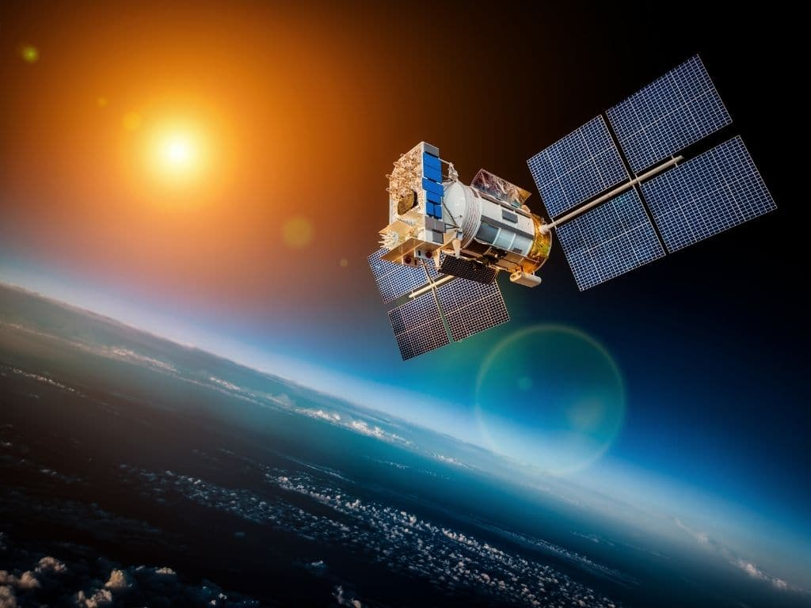
January 2023: The Sun Touches Everything
Next Time!
From agriculture to economics, the Sun touches all parts of our lives. By far the biggest way is through its sunlight, which allows crops to grow but also provides electrical power for spacecraft and your home.
Math: Solar electricity calculations for your home and your spacecraft!
Heliophysics Education Activation Team

