Slide 1




The Heliophysics Big Year
National Aeronautics and Space Administration
Dr. Sten Odenwald, Astronomer
NASA Heliophysics Education Activation Team

Slide 2


November 2023: What is Heliophysics?
Heliophysics is the discipline in space science that deals with the matter and energy of our Sun and its effects on the solar system.
It also studies how the Sun varies over time and how those changes can sometimes pose a hazard to humans on Earth and in space.
Heliophysics Education Activation Team

Slide 3



Heliophysics Big Year Timeline
Annular Eclipse
Total Eclipse
Solar Parker
Probe Perihelion
October 14, 2023
April 8, 2024
December 24, 2024
ADD MEDIA HERE
ADD MEDIA HERE
ADD MEDIA HERE
Heliophysics Education Activation Team

Slide 4
November 2023 : HBY Schedule
November 30 – NASA Heliophysics Mission Fleet
December 19: Citizen Science
January 16: The Sun Touches Everything
February 20: Fashion
March 19: Experiencing the Sun
April 8 – April 16: Total Solar Eclipse
May 21– December: Topics to follow
Heliophysics Education Activation Team

Slide 5
November 2023 : NASA’s Big Questions
1. What causes the Sun to vary?
2. How do the Earth and the heliosphere respond?
3. What are the impacts on humanity?
These Big Questions form the basis for the
Framework for Heliophysics Education
https://science.nasa.gov/learn/heat/big-ideas/
Heliophysics Education Activation Team

Slide 6
November 2023 : The Framework for Heliophysics Education
What are the impacts of the Sun on humanity?
1.1 The Sun is really big and its gravity influences all objects in the solar system. (PS2, ESS1)
1.2 The Sun is active and can impact technology on Earth via space weather. (PS1, PS2, PS4, ESS2, ESS3) <<< Tonight >>>
1.3 The Sun’s energy drives Earth’s climate, but the climate is in a delicate balance and is changing due to human activity. (PS1, PS2, PS3, LS4, ESS2, ESS3)
How do the Earth, the solar system, and heliosphere respond to changes on the Sun?
2.1 Life on Earth has evolved with complex diversity because of our location near the Sun. It is just right! (PS3, PS4, LS1, LS2, ESS2)
2.2 The Sun defines the space around it, which is different from interstellar space. (PS2, ESS1, ESS2)
2.3 The Sun is the primary source of light in our solar system.(PS1, PS2, PS3,PS4, ESS1)
What Causes the Sun to Vary?
3.1 The Sun is made of churning plasma, causing the surface to be made of complex, tangled magnetic fields. (PS1, PS2, ESS1, ESS2)
3.2 Energy from the Sun is created in the core and travels outward through the Sun and into the heliosphere. (PS1, PS3, PS4, ESS1, ESS2, ESS3)
3.3 Our Sun, like all stars, has a life cycle. (PS1, LS1, ESS1)
Heliophysics Education Activation Team

Slide 7
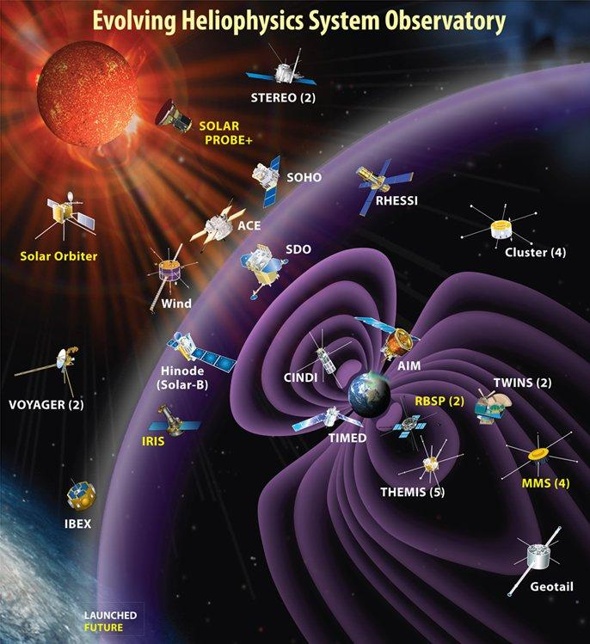
November 2023: NASA’s Mission Fleet
There are 48 operating missions
From the sun’s corona to 120 AU.
These instruments and spacecraft measure the magnetic fields, the solar wind, particles and radiation storms.
Some missions carry imagers that study the solar surface, corona and interplanetary medium.
Heliophysics Education Activation Team

Slide 8
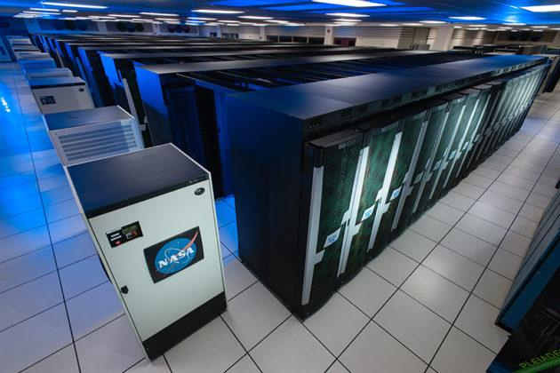
November 2023 : Mission Mathematics
The entire constellation of NASA missions collects terabytes of data every day from instruments across the entire solar system.
The Sun is active and can impact technology on Earth via space weather. (PS1, PS2, PS4, ESS2, ESS3)
Digital communication is used to communicate in space. (HS-PS4-2.)
Heliophysics Education Activation Team

Slide 9
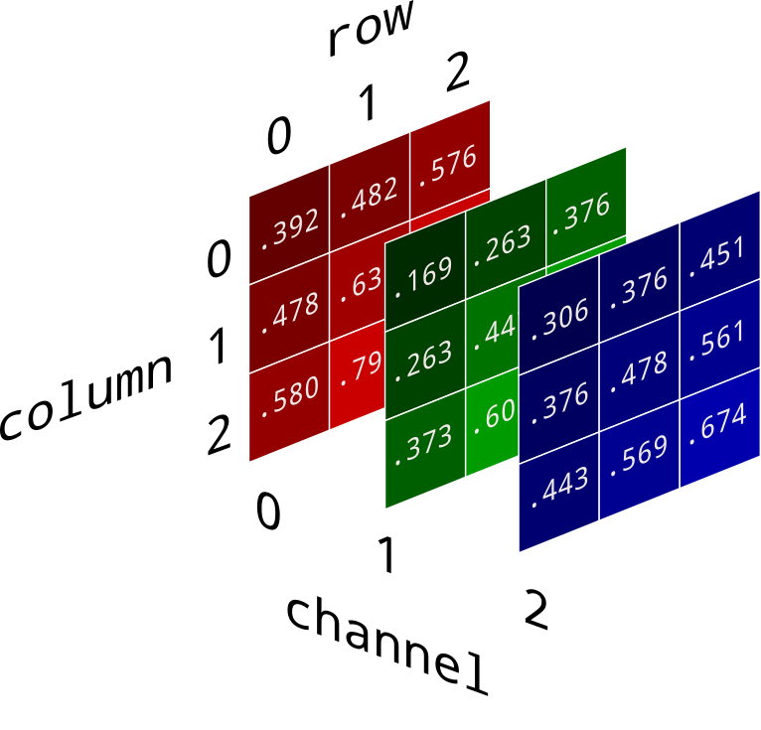
November 2023
Instruments convert data into numbers that represent intensity values.
Images: Each value has a specific X and Y coordinate defining a particular pixel.
There may be three or more intensity values for each pixel depending on the filters used.
Heliophysics Education Activation Team

Slide 10

November 2023
Each number is converted into a binary code, which is a series of on-off values called bits. There are 8 bits to each byte of data.
000 = 0 100 = 4
001 = 1 101 = 5
010 = 2 110 = 6
011 = 3 111 = 7 etc
01101001 = 2⁰ + 2³ +2⁵+2⁶ = 105 base 10
Heliophysics Education Activation Team

Slide 11
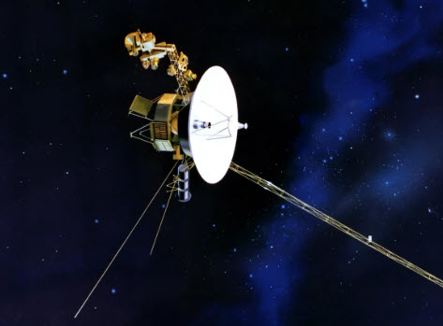
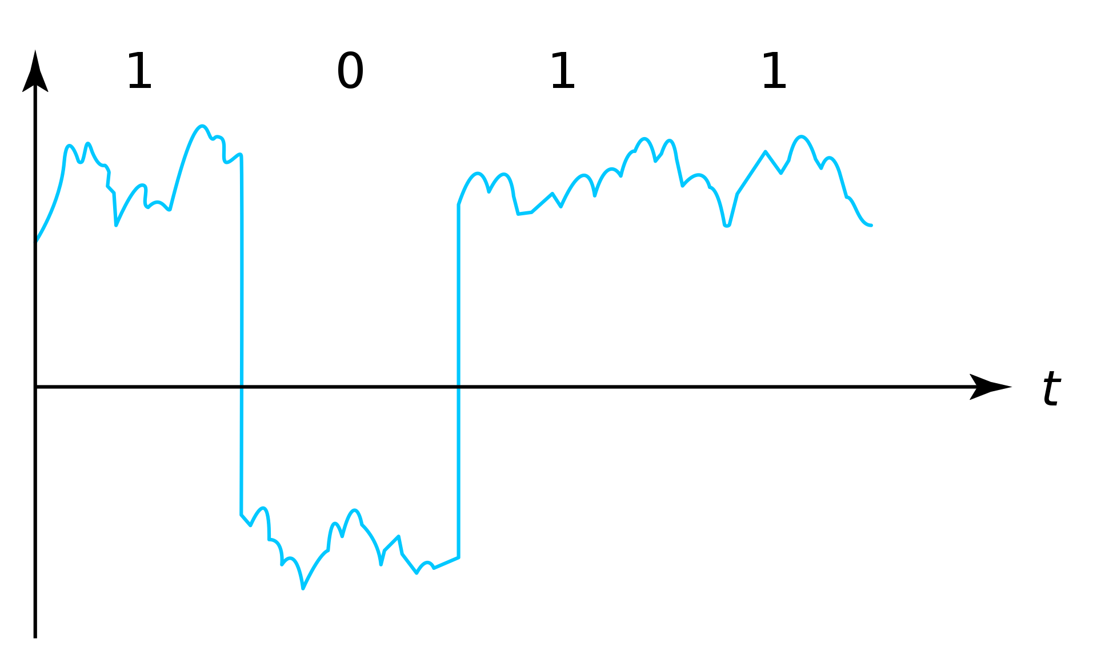
November 2023
The strings of binary bits are transmitted by the spacecraft back to earth.
Transmitter ‘on’ = 1, Transmitter ‘off’ = 0.
Heliophysics Education Activation Team

Slide 12
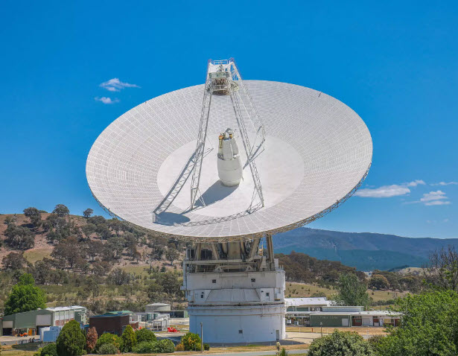
November 2023
The ground stations receive the binary ‘on-off’ data, but after traveling millions of kilometers the signals are so weak that you need large dishes to collect the feeble energy.
Otherwise you can’t distinguish the ‘on’ state from the ‘off’ state in the transmitted signal.
Heliophysics Education Activation Team

Slide 13
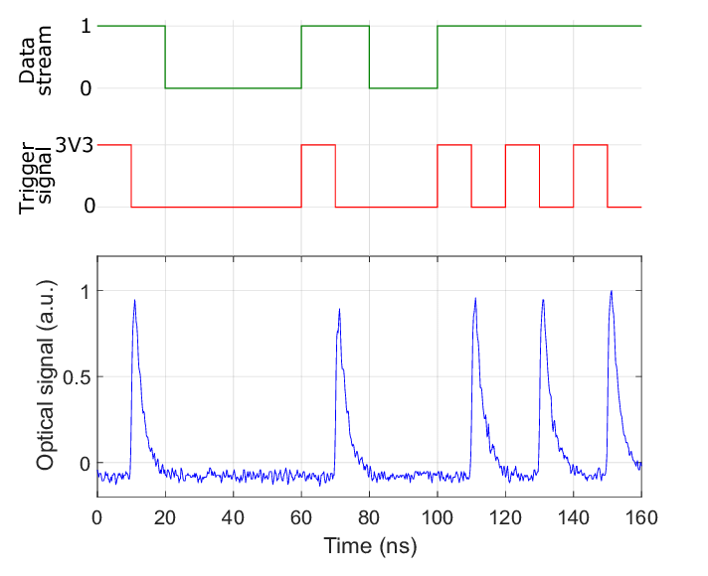
November 2023
The received signal takes the form of pulses of radio energy that are
‘on’ = 1
‘off’ = 0
to represents the binary 1s and 0s of the numbers
Heliophysics Education Activation Team

Slide 14
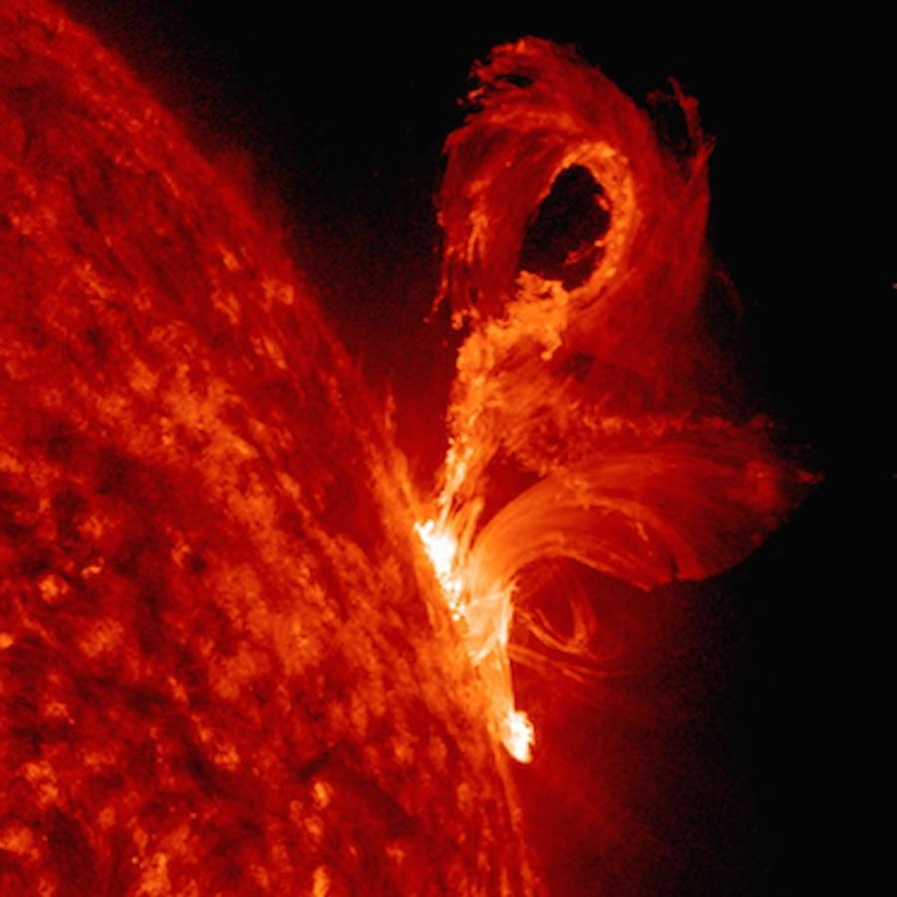
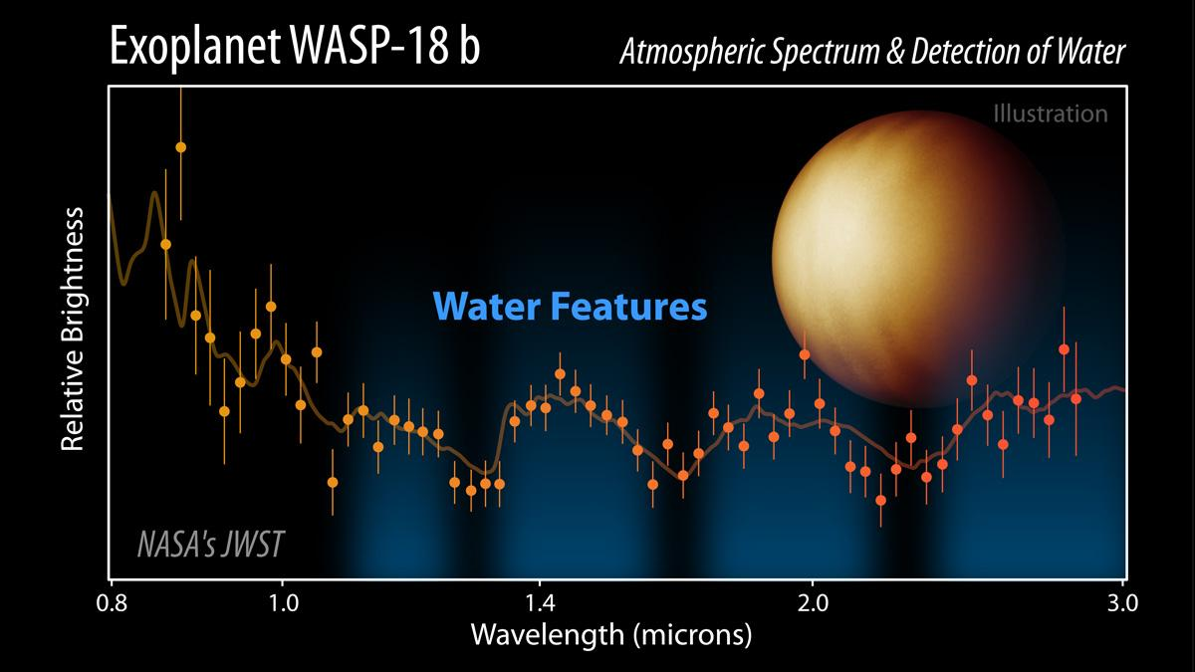
November 2023
Then scientists translate the numbers back into digital images or other kinds of data such as spectra.
Heliophysics Education Activation Team

Slide 15
November 2023 : Data Transfer - Introductory
Problem: xx
Old Way: 300-baud modem (300 bits per second)
Typical image 1024x1024 pixels, 16-bit color
1024x1024 Pixels x 16 bits/pixel = 16 megabits/picture.
Transfer at 300 bits/sec: 16 million/300 = 3333 sec = 56 minutes.
New Way: Cell Phone: 4G = 50 megabits/sec
Transfer time: 16 million/50 million = 0.3 seconds.
Heliophysics Education Activation Team

Slide 16
November 2023 : Data Transfer - Exploratory
Problem: xx
Solar Dynamics Observatory transfers 130 megabits/sec at a continuous rate, 24/7/365.
In 1 days this equals 86,400 seconds/day x 130 megabits/second =
11.2 million million bits/day = 11.2/8 = 1.4 terabytes per day.
This is used to transmit to Earth about 70,000 images every day,
or one image every second.
Heliophysics Education Activation Team

Slide 17
November 2023 : Data Storage - Exploratory
Average smartphone stores about 256 gigabytes
In one day, SDO accumulates 1.4 terabytes = 1400 gigabytes
That equals 1400 gigabytes
-------------------- = 5 ½ smartphones every day.
256 gigabytes
Heliophysics Education Activation Team

Slide 18
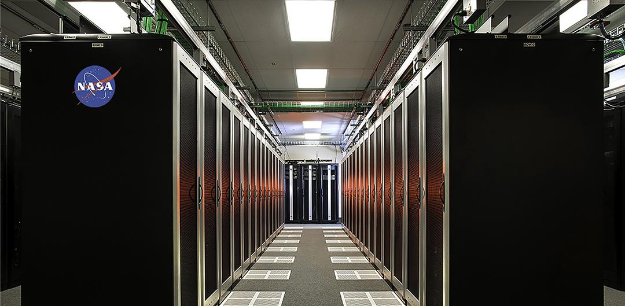
November 2023 : Data Storage - Exploratory
1.4 terabytes/day x 365 days/year =
511 terabytes/year or 0.5 petabytes for ONE MISSION
where 1000 terabytes = 1 petabyte.
As of 2023, there is over 213 petabytes of unique data stored in the NASA, NAS archival storage system.
213 petabytes = 213,000 terabytes
NASA needs 215 more petabytes of storage by the year 2025. That’s a LOT of smartphones!

Slide 19
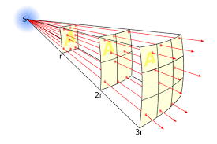
November 2023 : Data Transfer - Advanced
Problem:
The Inverse-square law
Spacecraft with a 100-watt transmitter
Intensity = Power/Area
= 100 W/1 m² = 100 w/m².
Heliophysics Education Activation Team

Slide 20
November 2023 : Data Transfer - Advanced
The Inverse-square law
A 100-watt bulb is placed 10 meters away.
A 1-watt flashlight is placed 1 meter way.
I = power/area where Area = 4π R²
Light bulb: I = 100 watts/4π(10m)² = 0.08 watt/m²
Flashlight: I = 1 watt/4π(1m)² = 0.08 watt/m²
Heliophysics Education Activation Team

Slide 21
November 2023 : Picture Transfer - Advanced
Voyager 1 has a 23-watt transmitter
Distance = 120 AU ; 1AU = 1.5x10¹¹ meters
Voyager distance = 120 x 1.5x10¹¹ = 1.8x10¹³ m.
Intensity = power/area
What area should we use?
Heliophysics Education Activation Team

Slide 22
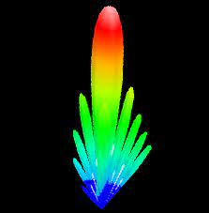
November 2023 : Picture Transfer - Advanced
R= 1.8x10¹³ m.
What area should we use?
Surface area of a sphere with radius R:
S = 4 π R² = 4(3.14)(1.8x10¹³m)² = 4.0x10²⁷ m²
But the 34.7-m Voyager dish focusses the transmitted 23-watts of power into a beam with an angle of 0.5-degrees or an area of 0.25 square degrees.
The full sky has 41,253 square degrees, so the beam fraction at 120 AU is A = 0.25/41253 = 6x10⁻⁶ .
So S = 6x10⁻⁶ x 4.0x10²⁷ m² = 2.4x10²² m².
Heliophysics Education Activation Team

Slide 23
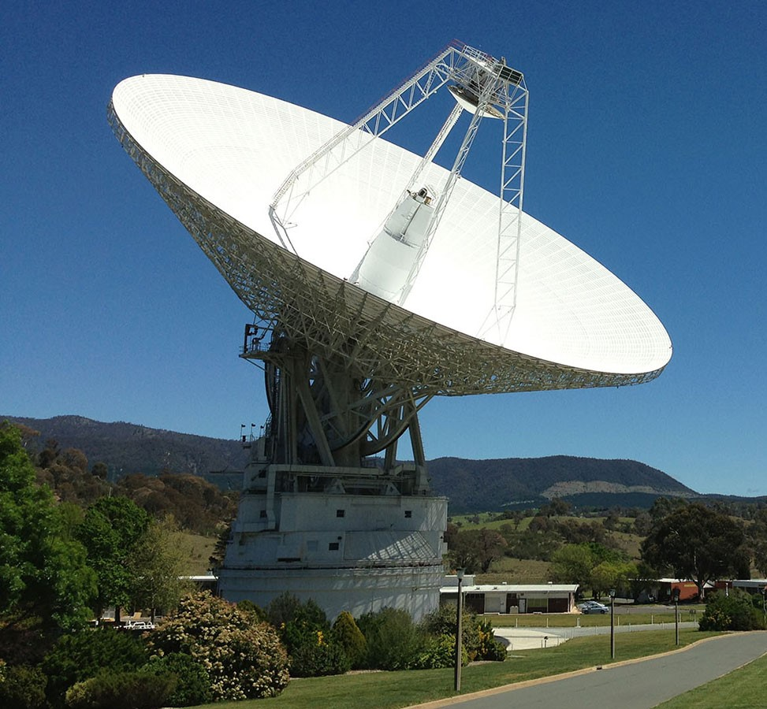
November 2023 : Picture Transfer - Advanced
P = 23 watts and S = 2.4x10²² m²
Intensity of the signal at Earth is then
I = power/area = 23 watts/2.4x10²² m²
= 9.5x10⁻²² watts/m².
How do we detect a signal this weak? Use a BIG DISH!
R = 35m, Area = π (35)² = 3846 m².
So P at antenna = 9.5x10⁻²² x 3846
= 3.7x10⁻¹⁸ watts.
Heliophysics Education Activation Team

Slide 24
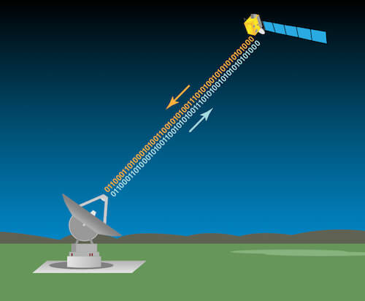
November 2023
Voyager 1 is at 120 AU. Its rate is 160 bits/sec now.
Back in 1994, when Voyager was closer to Earth, we still received data at 7,400 bits/sec. In 2050 it will be slowed to 40 bits/sec.
Voyager images contain 800 lines, 800 dots (pixels) per line, and 8 bits per pixel. Most pixels are black so data can be compressed by 60%.
Heliophysics Education Activation Team

Slide 25
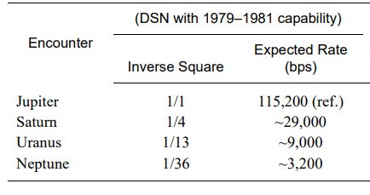
November 2023
120 AU 1/14,400 160
1500 AU 1/2,250,000 1
Heliophysics Education Activation Team

Slide 26
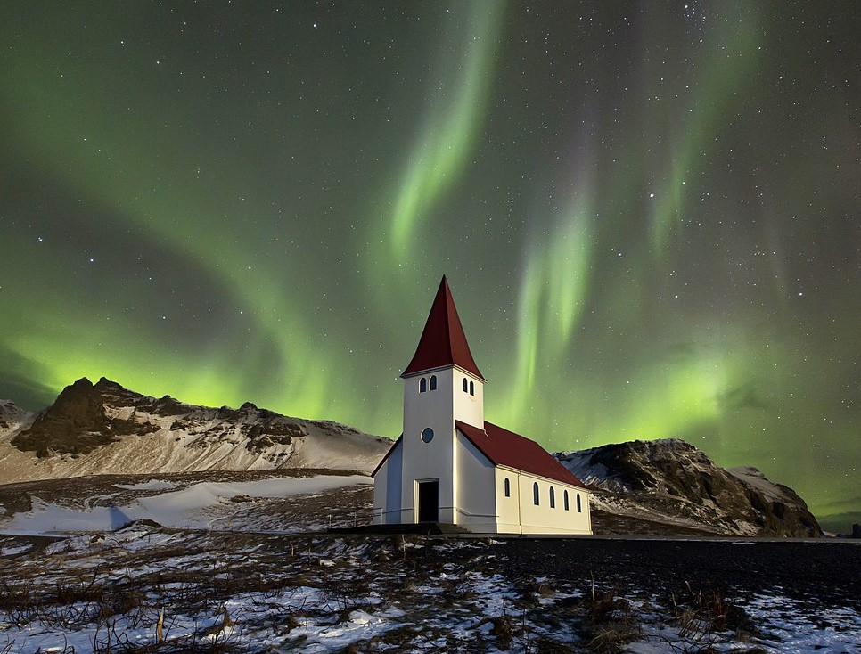
December 2023
Next Time: HBY and Citizen Science
December 19, 7PM EST; 4PM PST
Citizen science has enabled many heliophysics discoveries, including new types of auroras.
How high up in the sky are auroras?
Heliophysics Education Activation Team

