Slide 1




National Aeronautics and Space Administration
The Heliophysics Big Year
Dr. Sten Odenwald, Astronomer
NASA Heliophysics Education Activation Team

Slide 2

NASA’s Big Questions
1. What causes the Sun to vary?
2. How do the Earth and the heliosphere respond?
3. What are the impacts on humanity?
These Big Questions form the basis for the
Framework for Heliophysics Education
https://science.nasa.gov/learn/heat/big-ideas/
Heliophysics Education Activation Team

Slide 3
The Framework for Heliophysics Education
What are the impacts of the Sun on humanity?
1.1 The Sun is really big and its gravity influences all objects in the solar system. (PS2, ESS1)
1.2 The Sun is active and can impact technology on Earth via space weather. (PS1, PS2, PS4, ESS2, ESS3)
1.3 The Sun’s energy drives Earth’s climate, but the climate is in a delicate balance and is changing due to human activity. (PS1, PS2, PS3, LS4, ESS2, ESS3)
How do the Earth, the solar system, and heliosphere respond to changes on the Sun?
2.1 Life on Earth has evolved with complex diversity because of our location near the Sun. It is just right! (PS3, PS4, LS1, LS2, ESS2)
2.2 The Sun defines the space around it, which is different from interstellar space. (PS2, ESS1, ESS2)
2.3 The Sun is the primary source of light in our solar system.(PS1, PS2, PS3,PS4, ESS1)
What Causes the Sun to Vary?
3.1 The Sun is made of churning plasma, causing the surface to be made of complex, tangled magnetic fields. (PS1, PS2, ESS1, ESS2)
3.2 Energy from the Sun is created in the core and travels outward through the Sun and into the heliosphere. (PS1, PS3, PS4, ESS1, ESS2, ESS3)
3.3 Our Sun, like all stars, has a life cycle. (PS1, LS1, ESS1)
Heliophysics Education Activation Team

Slide 4
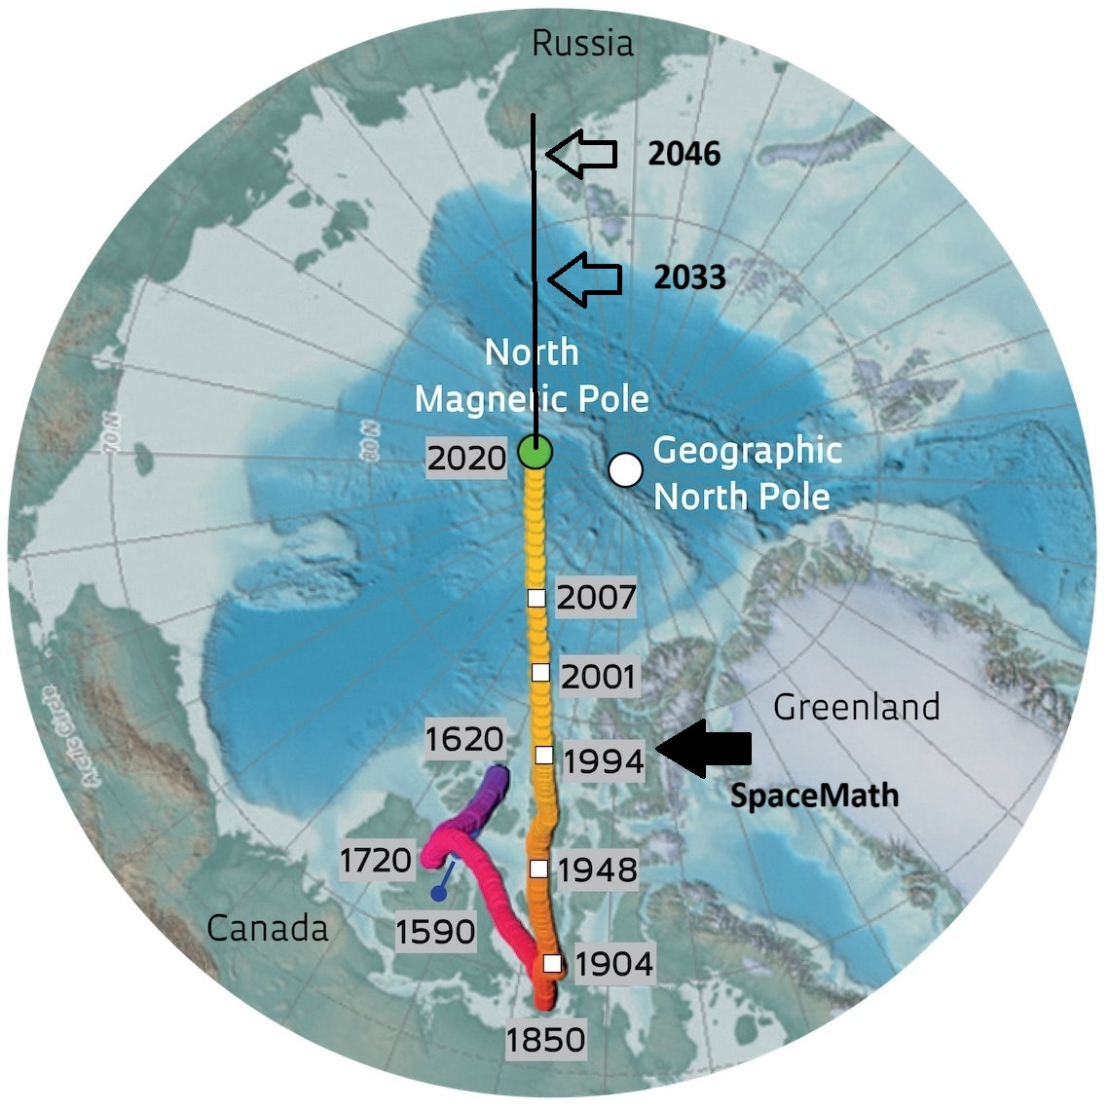
Earth’s Magnetic Pole Wander
The magnetic poles of Earth do not
stay fixed, but wander geographically.
Why does this happen?
https://revistapesquisa.fapesp.br/en/the-wandering-north-pole/
Heliophysics Education Activation Team

Slide 5
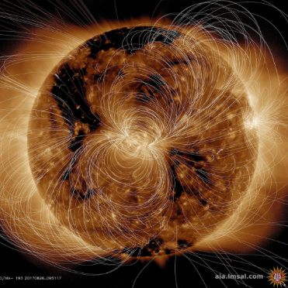
Our magnetic sun – The magnetic dynamo
Our sun generates a powerful
magnetic field through the motion
of plasma below its surface.
A combination of rotation and
convection creates currents in the
solar plasma that periodically grow
and weaken, and shift position.
This creates the 11-year sunspot
cycle.
NASA/ SDO
Heliophysics Education Activation Team

Slide 6
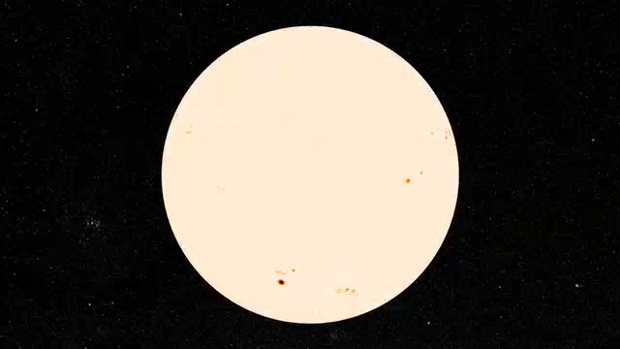
Our magnetic sun
Thanks to satellites such
as SOHO and the GONG
program, we can look below
the solar surface, and with
powerful mathematical models,
and see how the magnetic
field is created.
NASA/ SDO / SVS
Heliophysics Education Activation Team

Slide 7
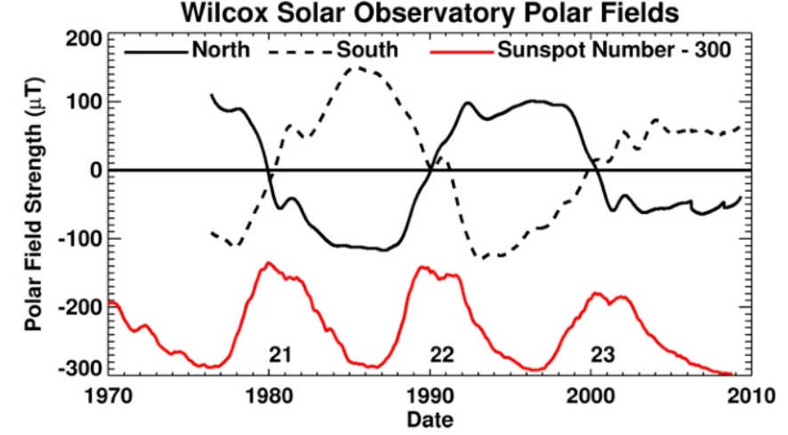
Our magnetic sun
Here is a plot of the sun’s
polar field strength and
how its strength and
polarity change with each
sunspot cycle.
It takes a full 22-years for
the sun to complete one
full magnetic cycle. This is
called the Hale Cycle.
https://link.springer.com/article/10.12942/lrsp-2010-1
Heliophysics Education Activation Team

Slide 8
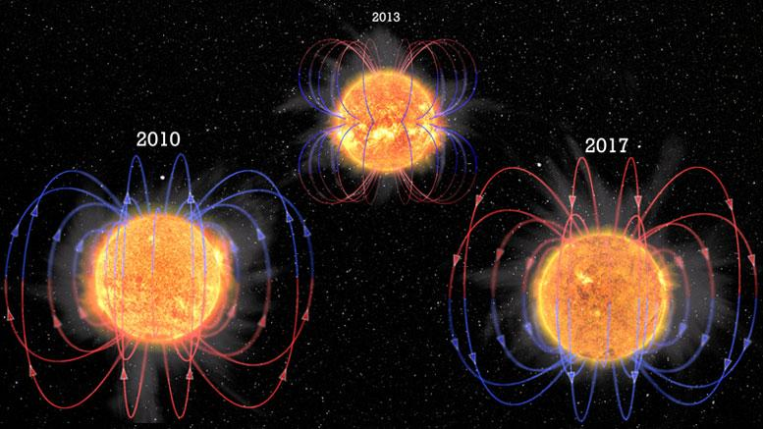
Our magnetic sun
Each sunspot cycle,
the sun’s magnetic
poles flip polarity.
With Magnetic
Dynamo Theory and
supercomputers, we
can watch how this
process happens.
NASA/SDO/A. Strugarek et al; Illustrations: L. Almeida, Federal University of Rio Grande do Norte (UFRN), Brazil
Heliophysics Education Activation Team

Slide 9
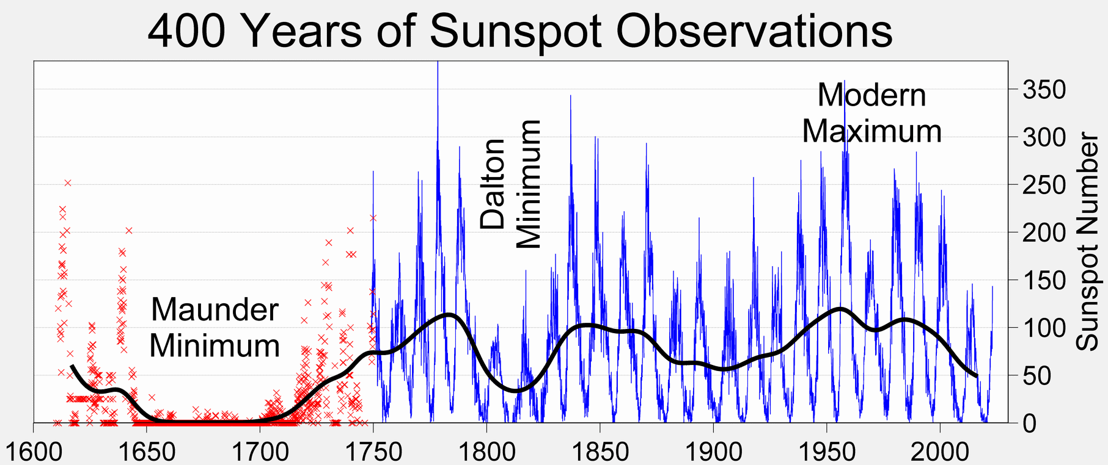
Our magnetic sun
On the sun, we have only tracked magnetic polarity reversals since 1600.
https://en.wikipedia.org/wiki/Solar_cycle
Heliophysics Education Activation Team

Slide 10

Our magnetic sun
On the sun, we have only tracked magnetic polarity reversals since 1600.
Math Alert!
(2025-1750)/25
11 years/cycle
https://en.wikipedia.org/wiki/Solar_cycle
Heliophysics Education Activation Team

Slide 11
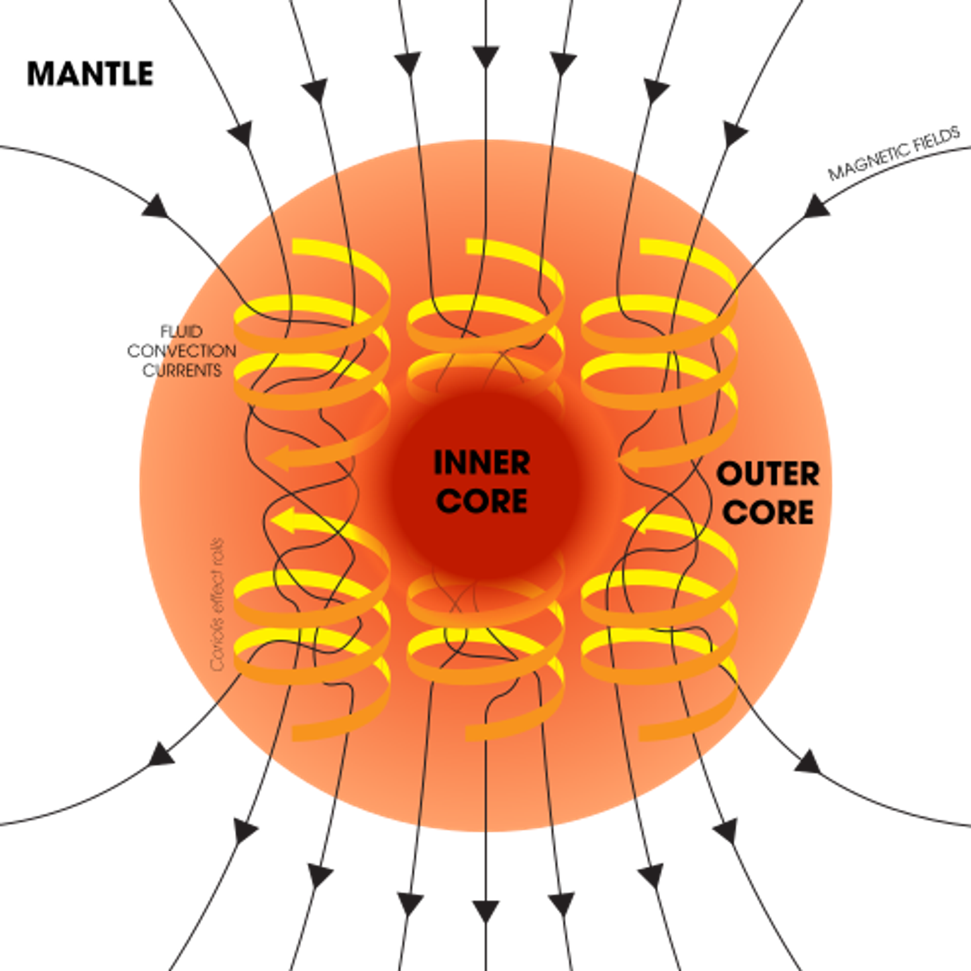
Our magnetic Earth
Our Earth also generates a
magnetic field.
Instead of currents in a plasma
It has a liquid iron-nickel outer core
that circulates and undergoes
convection just like the sun.
Because of the faster rotation and
higher density, Dynamo Theory
predicts a much longer
‘sunspot cycle’ for Earth lasting over
250,000 years.
Image by Wikipedia: Dynamo Theory; USGS
Heliophysics Education Activation Team

Slide 12
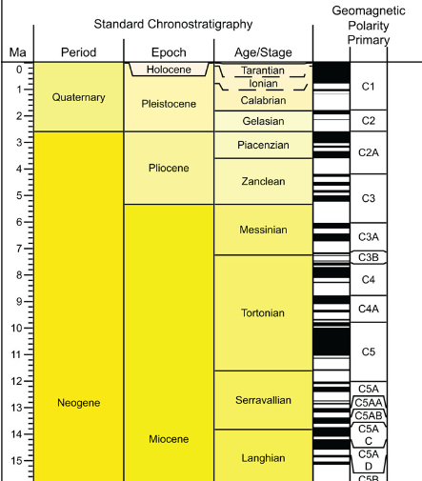
Our magnetic Earth
For Earth, magnetic polarity
information is captured in cooling
magma, and so we can trace
magnetic reversals back for
100s of millions of years.
Over a period of 83 million years,183
reversals have been detected.
Current reversal
happened
781,000 years ago.
We are now in the
Brunhes-Matuyama
Chron
https://www.lyellcollection.org/doi/full/10.1144/sp373.17
Heliophysics Education Activation Team

Slide 13
Our magnetic Earth; Introductory math
For Earth, magnetic polarity
information is captured in cooling
magma, and so we can trace
magnetic reversals back for
100s of millions of years.
Over a period of 83 million years,183
reversals have been detected.
Math Alert!
83,000,000 / 183 = 450,000 years
Current reversal
happened
781,000 years ago.
We are now in the
Brunhes-Matuyama
Chron
https://www.lyellcollection.org/doi/full/10.1144/sp373.17
Heliophysics Education Activation Team

Slide 14
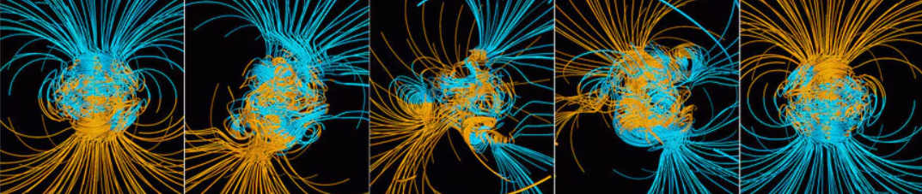
Our magnetic Earth
With supercomputers we can actually start to model what such reversals
look like on Earth using Magnetic Dynamo Theory.
Credit: Gary Glatzmaier
https://www.semanticscholar.org/paper/Magnetic-Polarity-Reversals-in-the-Core-Glatzmaier-Coe/92a04227faf71a4498c9d1e7446f9b13b67d129d
Heliophysics Education Activation Team

Slide 15
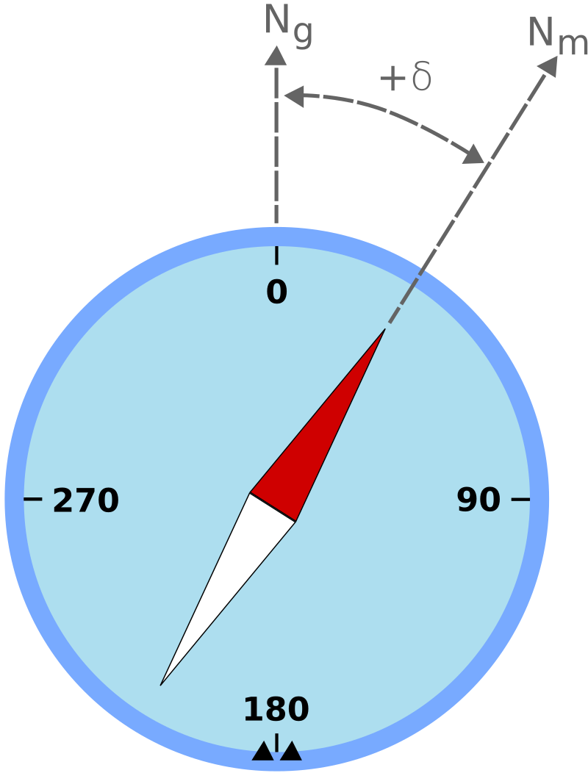
Our magnetic Earth
At each point on Earth, the angle
between the compass needle pointing to Magnetic North and the actual geographic North Pole is called the magnetic Declination.
https://en.wikipedia.org/wiki/Magnetic_declination#/media/File:Magnetic_declination.svg
Heliophysics Education Activation Team

Slide 16
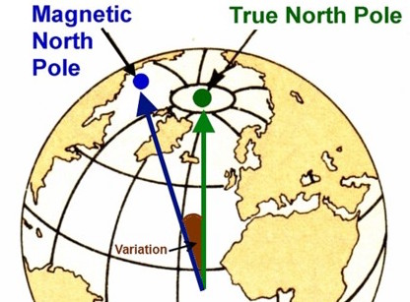
Our magnetic Earth
On Earth’s surface these
changes cause the surface
field to vary over time.
Mariners knew about this in
the 1700s because they relied
on magnetic compasses to give
them accurate bearings for
navigation.
https://www.marine-education.co.uk/2019/08/31/taking-bearings-on-a-nautical-chart/
Heliophysics Education Activation Team

Slide 17
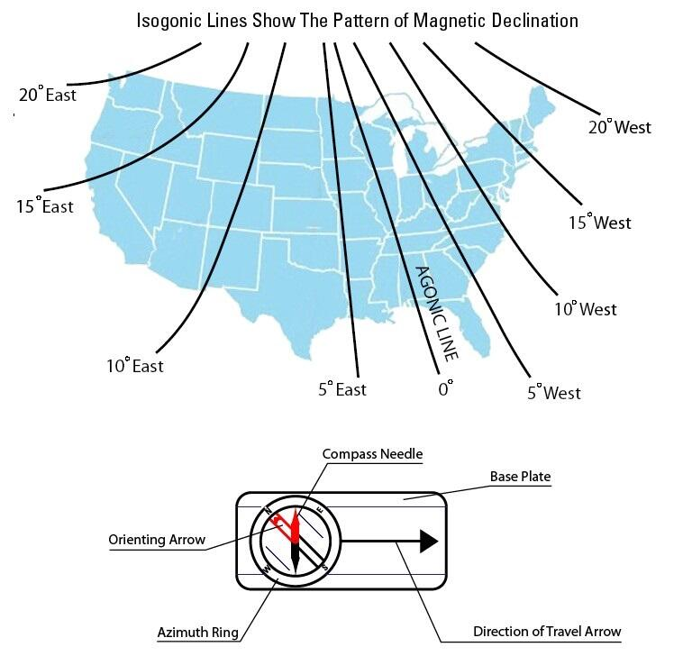
Our magnetic Earth
Compasses west of the
Mississippi River the angle
between geographic North and
magnetic North will be an angle
towards the east.
Example, in Northern California,
Magnetic North is 15-degrees to
the east of Geographic North.
https://www.usgs.gov/educational-resources/magnetic-declination-varies-considerably-across-united-states
Heliophysics Education Activation Team

Slide 18
Our magnetic Earth: Intermediate math
In the High Sierras, the declination is 12 degrees East.
The map says that from where I am standing my
destination is one kilometer due North.
What will my compass bearing have to be so that I am
walking in the right direction?
Heliophysics Education Activation Team

Slide 19
Our magnetic Earth: Intermediate math
In the High Sierras, the declination is 12 degrees East.
This means that True Geographic North is 12-degrees
to the East of Magnetic North.
0
270
90
180
Heliophysics Education Activation Team

Slide 20
Our magnetic Earth: Intermediate math
In the High Sierras, the declination is 12º East.
This means that True Geographic North is 12º to the East of Magnetic North.
So, the compass bearing is 12º East
Walk in that direction.
True
North
True
West
True
East
True
South
Heliophysics Education Activation Team

Slide 21
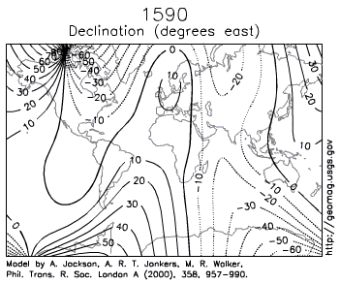
Our magnetic Earth
The magnetic declination
changes from year to year,
so older navigation maps
had to be re-drawn every
few years at great expense.
https://en.wikipedia.org/wiki/Magnetic_declination#/media/File:Earth_Magnetic_Field_Declination_from_1590_to_1990.gif
Heliophysics Education Activation Team

Slide 22
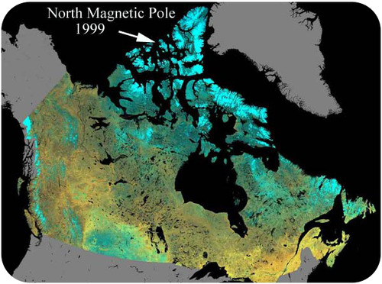
Our magnetic Earth
Magnetic declination changes
because the North Magnetic Pole
is not located in a fixed place on
Earth’s surface.
https://courses.lumenlearning.com/geo/chapter/reading-continental-drift-2/
Heliophysics Education Activation Team

Slide 23
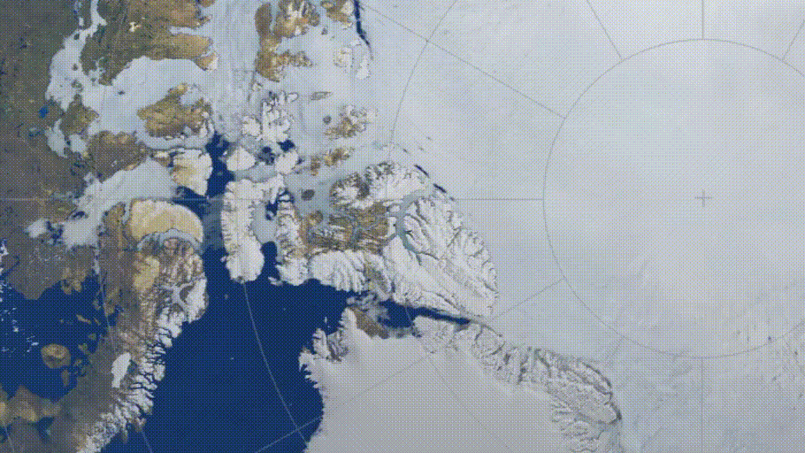
Our magnetic Earth
Magnetic declination
changes because the
North Magnetic Pole
is not located in a fixed
place on Earth’s surface.
https://allthatsinteresting.com/magnetic-north-pole-moving
Heliophysics Education Activation Team

Slide 24
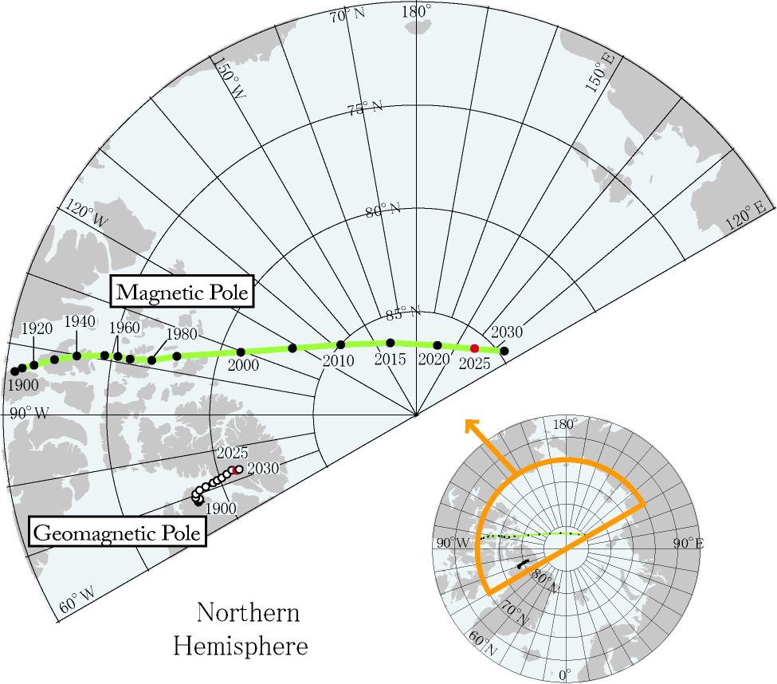
Our magnetic Earth; Advanced Math
The motion is not
uniform in speed. The
dots are spaced every
10 years before 2000
and every five years since 2000.
https://wdc.kugi.kyoto-u.ac.jp/poles/polesexp.html
Heliophysics Education Activation Team

Slide 25
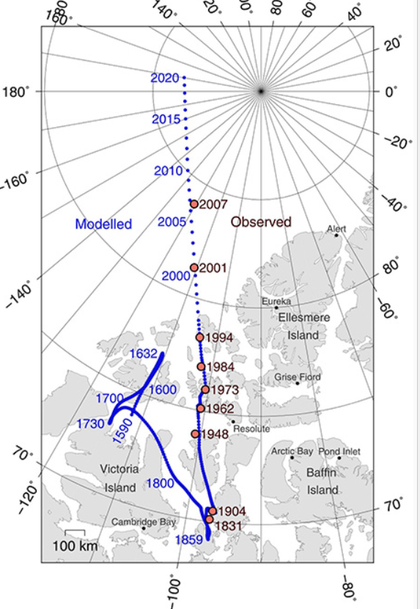
Our magnetic Earth: Advanced Math
Modeling the speed of the change
Year |  | Distance
1962 |  | 0 km
1984 |  | 160 km
2007 |  | 0 km
2020 |  | 600 km
https://www.earthdate.org/episodes/the-wandering-pole
Heliophysics Education Activation Team

Slide 26
Our magnetic Earth: Advanced Math
Estimating the speed of the change
Year |  | Distance
1962 |  | 0 km
1984 |  | 160 km
2007 |  | 0 km
2020 |  | 600 km
https://www.earthdate.org/episodes/the-wandering-pole
Heliophysics Education Activation Team

Slide 27
Our magnetic Earth: Advanced Math
Estimating the speed of the change
Year |  | Distance
1962 |  | 0 km
1984 |  | 160 km
2007 |  | 0 km
2020 |  | 600 km
Speed = 160 km/(1984-1962)
= 160 km/22 yrs
= 7 km/yr
https://www.earthdate.org/episodes/the-wandering-pole
Heliophysics Education Activation Team

Slide 28
Our magnetic Earth: Advanced Math
Estimating the speed of the change
Year |  | Distance
1962 |  | 0 km
1984 |  | 160 km
2007 |  | 0 km
2020 |  | 600 km
Speed = 600 km/(2020-2007)
= 600 km/13 yrs
= 46 km/yr
https://www.earthdate.org/episodes/the-wandering-pole
Heliophysics Education Activation Team

Slide 29
Our magnetic Earth: Advanced Math
Estimating the speed of the change
Year |  | Distance
1962 |  | 0 km
1984 |  | 160 km
2007 |  | 0 km
2020 |  | 600 km
Speed = 7 km/yr
Speed = 46 km/yr
Polar wander is speeding up!
46 km/yr = 126 meters/day.
https://www.earthdate.org/episodes/the-wandering-pole
Heliophysics Education Activation Team

Slide 30
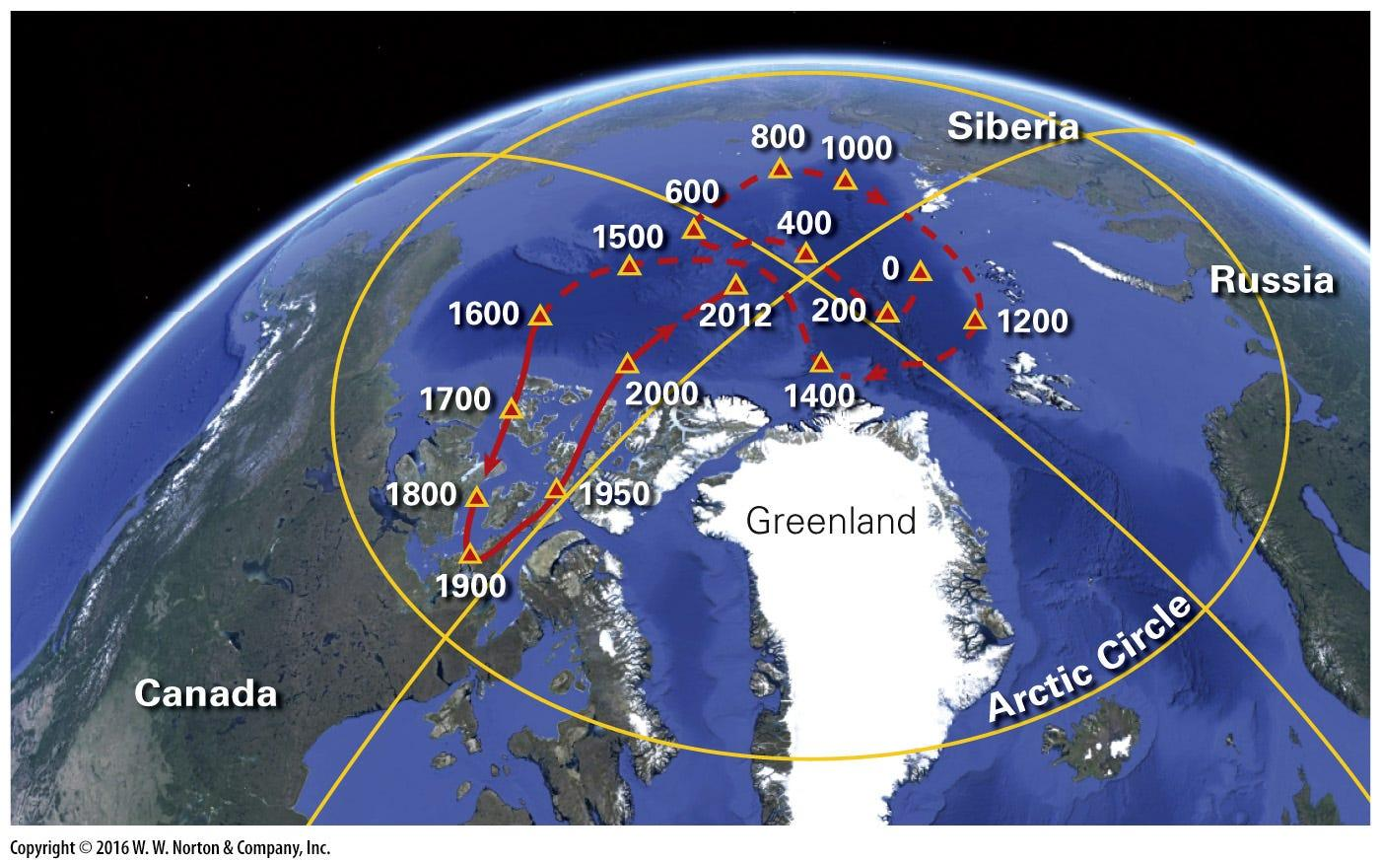
Our magnetic Earth
This Polar Wander has
been going on for centuries.
https://utahgeology.com/were-the-ice-ages-really-just-true-polar-wandering-events/
Heliophysics Education Activation Team

Slide 31
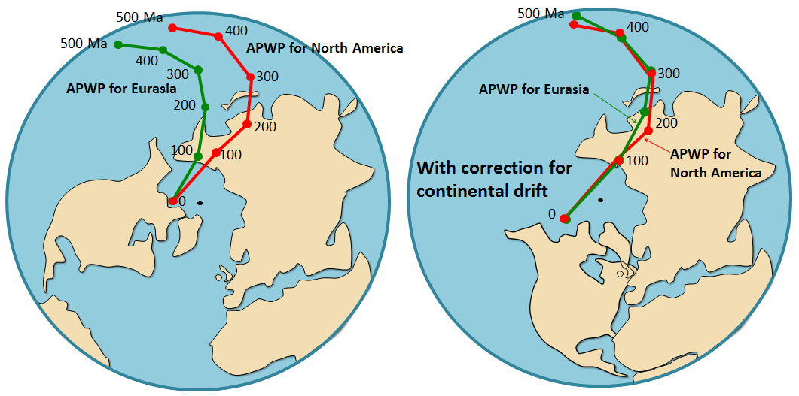
Our magnetic Earth
Hard to map over millions
of years because of
continental drift.
https://openoregon.pressbooks.pub/earthscience/chapter/7-3-geological-renaissance-of-the-mid-20th-century-2/
Heliophysics Education Activation Team

Slide 32
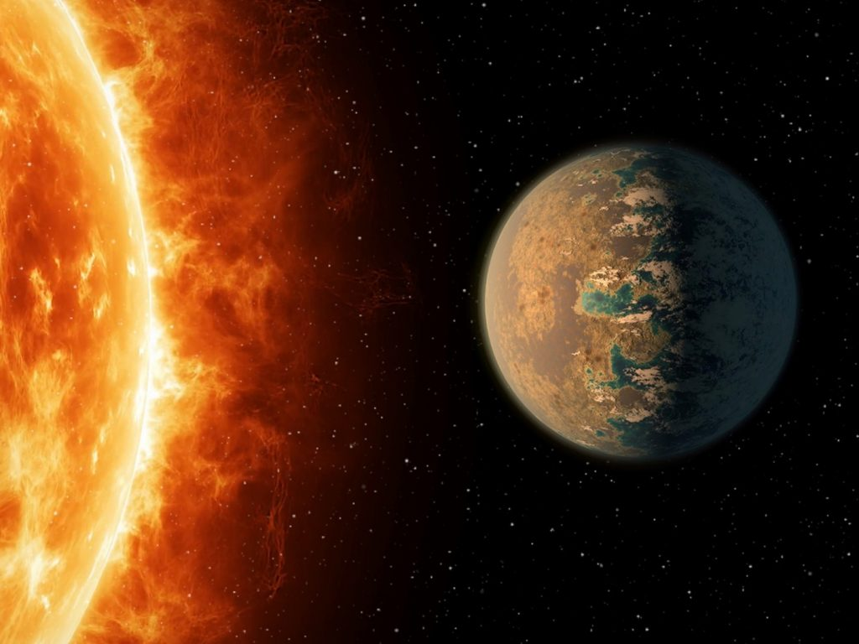
Next Time – Extreme Space Weather and Habitable Worlds
Heliophysics Education Activation Team

