Slide 1




National Aeronautics and Space Administration
The Heliophysics Big Year
Dr. Sten Odenwald, Astronomer
NASA Heliophysics Education Activation Team

Slide 2

NASA’s Big Questions
1. What causes the Sun to vary?
2. How do the Earth and the heliosphere respond?
3. What are the impacts on humanity?
These Big Questions form the basis for the
Framework for Heliophysics Education
https://science.nasa.gov/learn/heat/big-ideas/
Heliophysics Education Activation Team

Slide 3
The Framework for Heliophysics Education
What are the impacts of the Sun on humanity?
1.1 The Sun is really big and its gravity influences all objects in the solar system. (PS2, ESS1)
1.2 The Sun is active and can impact technology on Earth via space weather. (PS1, PS2, PS4, ESS2, ESS3)
1.3 The Sun’s energy drives Earth’s climate, but the climate is in a delicate balance and is changing due to human activity. (PS1, PS2, PS3, LS4, ESS2, ESS3)
How do the Earth, the solar system, and heliosphere respond to changes on the Sun?
2.1 Life on Earth has evolved with complex diversity because of our location near the Sun. It is just right! (PS3, PS4, LS1, LS2, ESS2)
2.2 The Sun defines the space around it, which is different from interstellar space. (PS2, ESS1, ESS2)
2.3 The Sun is the primary source of light in our solar system.(PS1, PS2, PS3,PS4, ESS1)
What Causes the Sun to Vary?
3.1 The Sun is made of churning plasma, causing the surface to be made of complex, tangled magnetic fields. (PS1, PS2, ESS1, ESS2)
3.2 Energy from the Sun is created in the core and travels outward through the Sun and into the heliosphere. (PS1, PS3, PS4, ESS1, ESS2, ESS3)
3.3 Our Sun, like all stars, has a life cycle. (PS1, LS1, ESS1)
Heliophysics Education Activation Team

Slide 4
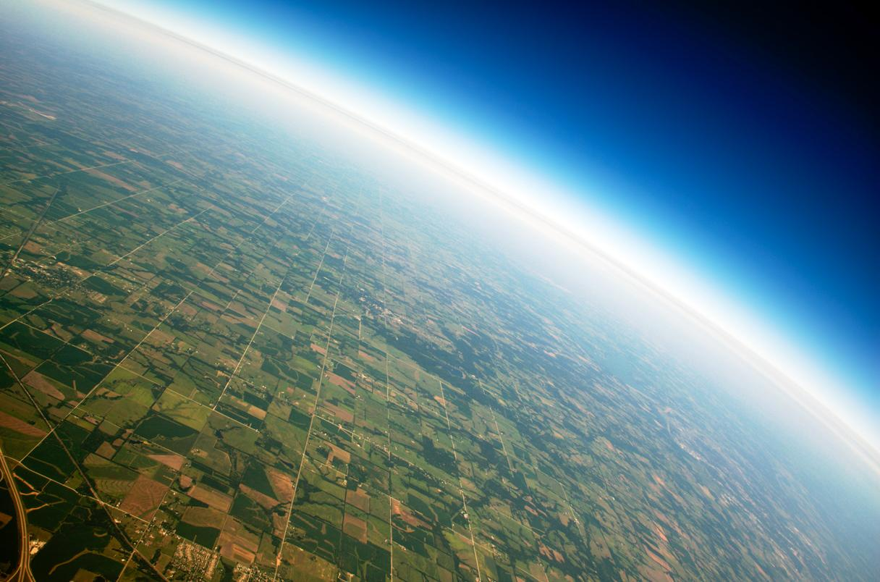
Investigating solar winds and atmosphere loss
The thickness of our atmosphere can
be traversed if you:
Bicycled from Baltimore to Washington DC (38 miles)
Drove from San Francisco to Sacramento (92 miles)
Heliophysics Education Activation Team

Slide 5
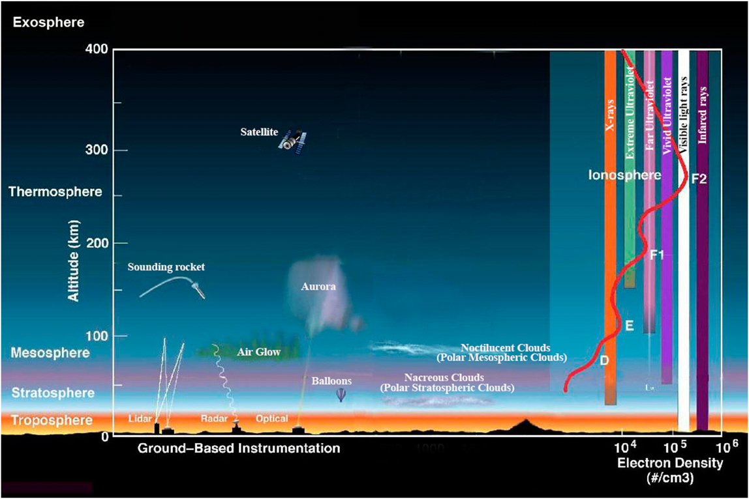
Anatomy of our atmosphere
Our
atmospheric
layers
Credit: NASA/Goddard. https://www.nccs.nasa.gov/news-events/nccs-highlights/global-ozone-profile
Heliophysics Education Activation Team

Slide 6
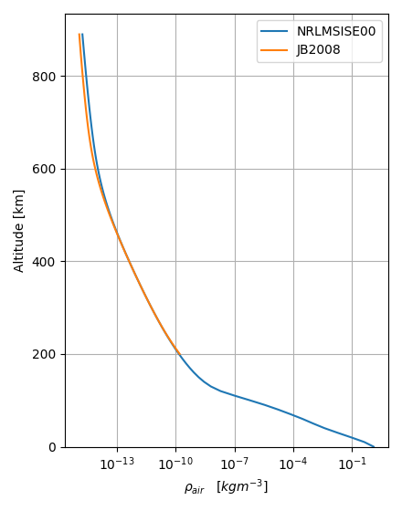
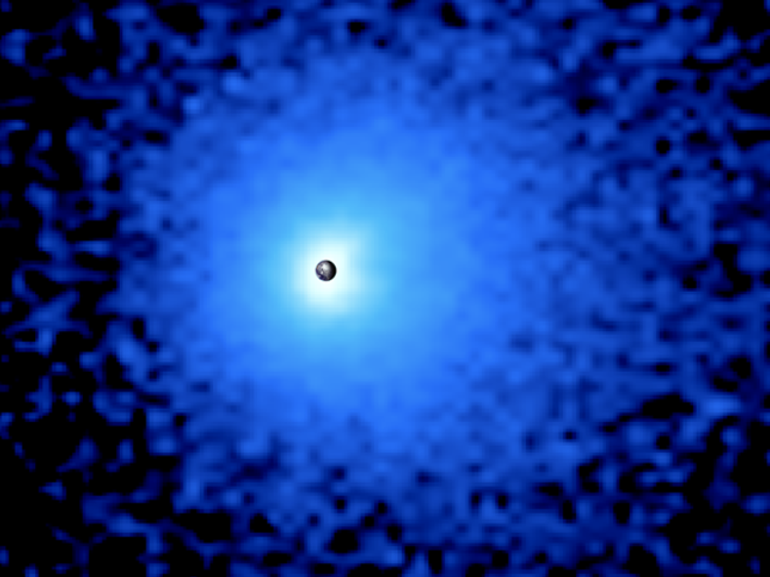
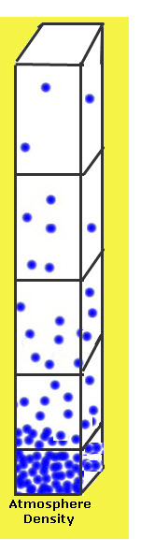
Extent of our atmosphere
Geocorona: Credit: PROCYON/ Rikkyo University
Heliophysics Education Activation Team

Slide 7
When bad things happen to good planets
Current mass: 5,000 trillion tons
Atmosphere loss:
Photodissociation
X-ray heating
Jeans Mechanism
Solar Wind
Current Earth loss rate:
95,000 tons/yr hydrogen
1,500 tons/yr helium
100 tons/yr oxygen
Heliophysics Education Activation Team

Slide 8
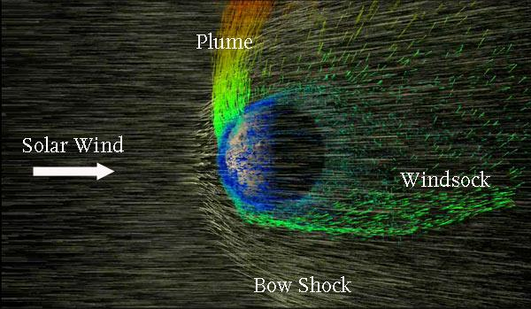
When bad things happen to good planets
Credit: NASA / Greg Shirah, labels by S&T
Heliophysics Education Activation Team

Slide 9
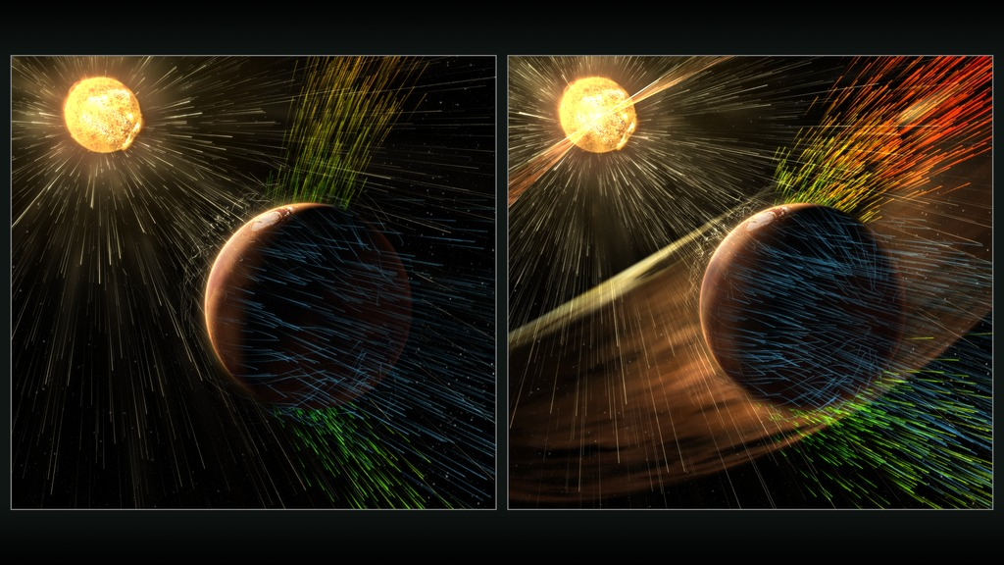
When bad things happen to good planets
Credit: NASA/MAVEN https://www.youtube.com/watch?v=8Uwt9HxOH74
Heliophysics Education Activation Team

Slide 10
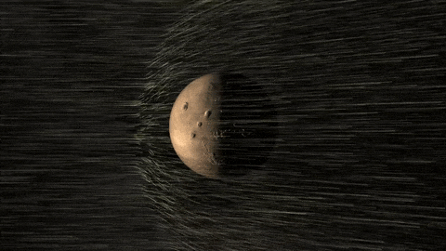
Atmospheric stripping - Mars
Credit: NASA/MAVEN https://www.youtube.com/watch?v=8Uwt9HxOH74
Heliophysics Education Activation Team

Slide 11
Solar wind ablation and spallation modeling
Can we model atmosphere escape by solar wind collisions?
Solar wind is mostly protons
Atmosphere is mostly hydrogen of uniform density
Every solar proton collision removes exactly one hydrogen atom
Heliophysics Education Activation Team

Slide 12
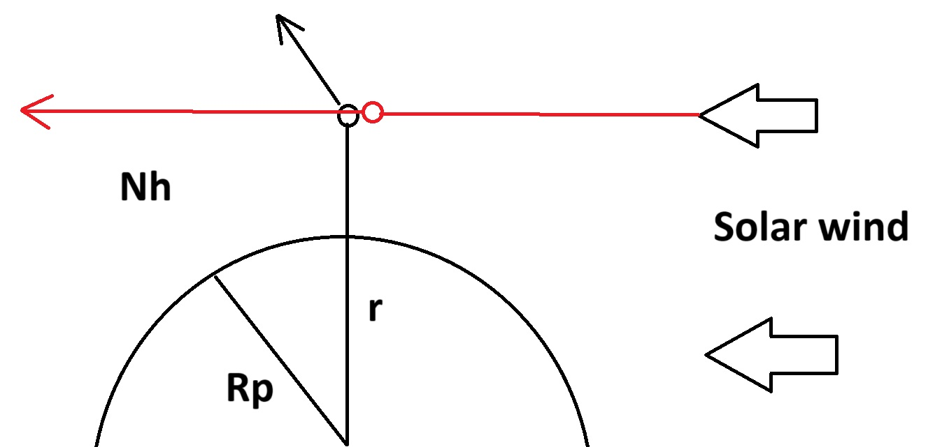
Solar wind ablation and spallation modeling
doesn’t escape
escapes
Collision
No escape
No escape
No escape
Heliophysics Education Activation Team

Slide 13
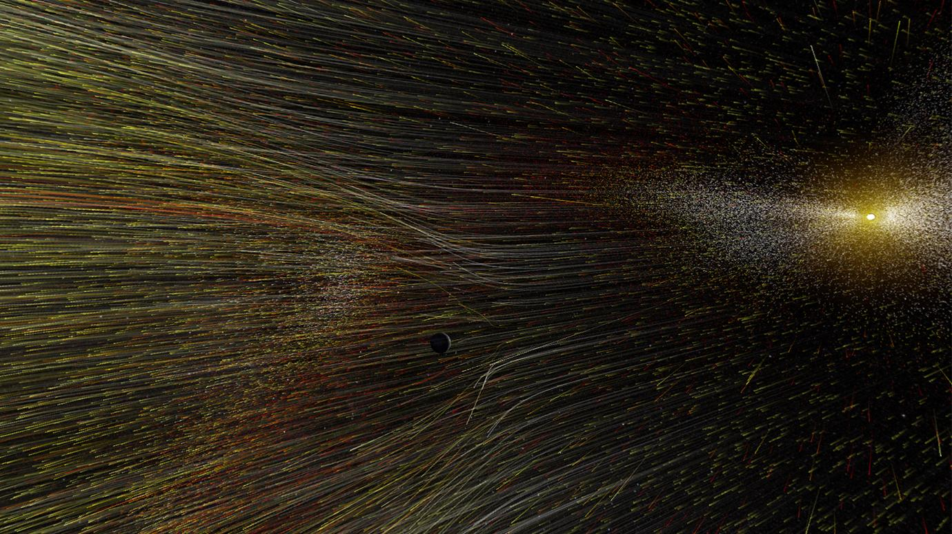
Solar wind ablation and spallation modeling
Solar wind flow
Sznajder (2023)
2.7x10⁸ protons/cm²/sec
(SOHO,WIND,ACE)
Artist rendering of solar wind: Credit NASA
https://www.sciencedirect.com/science/article/abs/pii/S0273117723000947
Heliophysics Education Activation Team

Slide 14
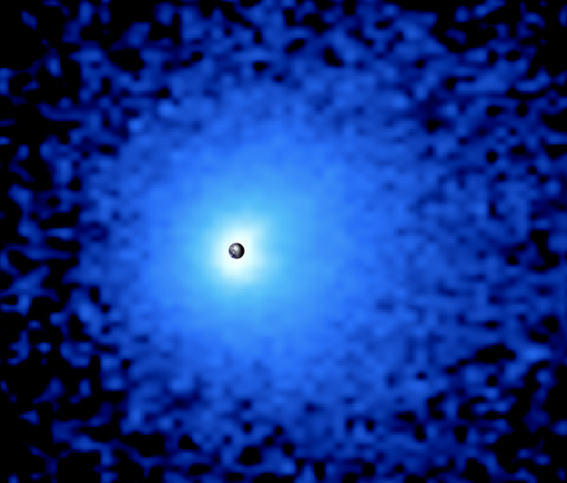
Solar wind ablation and spallation modeling
Geocorona density
Gomez et al (2021)
IBEX spacecraft detects
10 cm⁻³ at 10 Re
Credit: PROCYON/Rikkyo University)
https://agupubs.onlinelibrary.wiley.com/doi/pdf/10.1029/2021GL093695
Heliophysics Education Activation Team

Slide 15
Solar wind ablation and spallation modeling
Geometric factors
Radius of Earth 1 Re = 6,378 km
Outer limit to geocorona: 20 Re or 0.4 lunar distance
Heliophysics Education Activation Team

Slide 16
Solar wind ablation and spallation modeling
How many atmospheric collisions per second?
Area = π r² - π R² where R = 6,378 km
r = 20Re = 1.3x10⁵ km = 1.3 x 10¹⁰ cm
Area = 5.3 x 10²⁰ cm²
Earth area = π (637800000 cm)² = 1.3 x 10¹⁸ cm²
Collisions = solar wind flow x Annual Area
= (2.7x10⁸ protons/cm²/sec) x (5.3 x 10²⁰ cm² – 1.3x10¹⁸ cm²)
= 1.4x10²⁹ collisions/sec
r
Heliophysics Education Activation Team

Slide 17
Solar wind ablation and spallation modeling
How much mass is ejected every year?
Collisions = 1.4x10²⁹ per second
Each collisions ejects one hydrogen atom (proton); mass = 1.7x10⁻²⁷ kg
Mass loss = 1.4x10²⁹ protons/sec x 1.7x10⁻²⁷ kg/proton
= 240 kg/sec of hydrogen.
Mass loss per year = 240 kg/sec x 3.1x10⁷ sec/yr
= 7.6 million tons of hydrogen/year
But the measured number is 95,000 tons/year so our model is off by 80x
Heliophysics Education Activation Team

Slide 18

Solar wind ablation and spallation modeling
How much mass is ejected every year?
Collisions = 1.4x10²⁹ per second
Each collisions ejects one hydrogen atom (proton); mass = 1.7x10⁻²⁷ kg
Mass loss = 1.4x10²⁹ protons/sec x 1.7x10⁻²⁷ kg/proton
= 240 kg/sec of hydrogen.
Mass loss per year = 240 kg/sec x 3.1x10⁷ sec/yr
= 7.6 million tons of hydrogen/year
But the measured number is 95,000 tons/year so our model is off by 80x
Heliophysics Education Activation Team

Slide 19
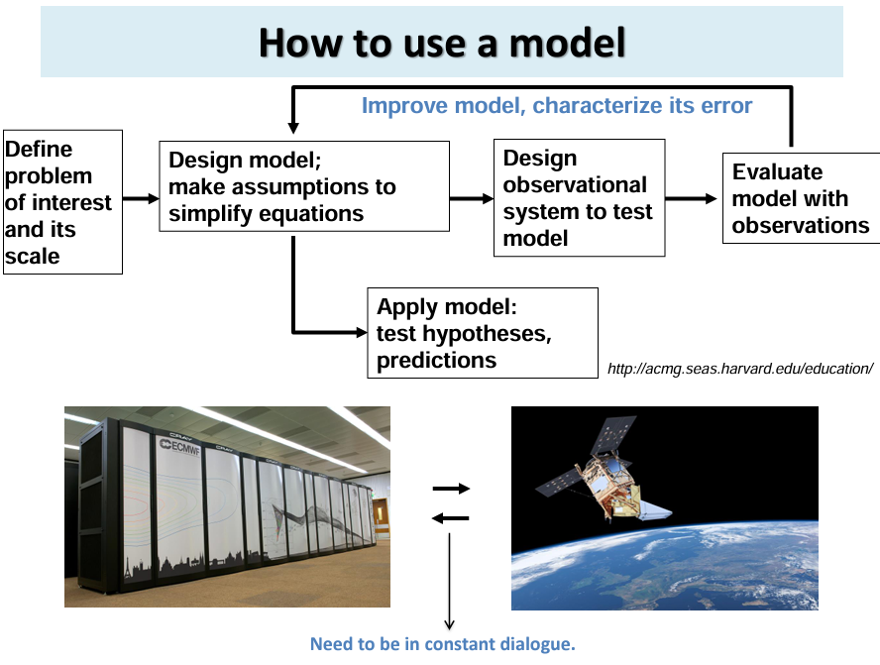
Solar wind ablation and spallation modeling
Professional modeling with all known factors and math used:
Model building is an
iterative process.
This is the first ‘loop’
Scientists call it a ‘toy’ model
or a ‘back of the envelope’
calculation
Diagram from: https://atmosphere.copernicus.eu/sites/default/files/custom-uploads/3rd-joint-training/ACT2021_AVoulgarakis.pdf
Heliophysics Education Activation Team

Slide 20
When bad things happen to good planets
Professional modeling with all known factors and math used:
Model building is an
iterative process.
This is the first ‘loop’
Scientists call it a ‘toy’ model
or a ‘back of the envelope’
calculation
That’s what we just created
Diagram from: https://atmosphere.copernicus.eu/sites/default/files/custom-uploads/3rd-joint-training/ACT2021_AVoulgarakis.pdf
Heliophysics Education Activation Team

Slide 21

Solar wind ablation and spallation modeling
Check your assumptions- Why were we off by 80x?
First of all our Toy Model wasn’t all that bad
Instead of being off by only 80x,
we could just as easily have been off by 1,000 or 1,000,000 !!!!!!!!!
Heliophysics Education Activation Team

Slide 22
Solar wind ablation and spallation modeling
Check your assumptions- Why were we off by 80x?
Solar wind is mostly protons – this is measured – Probably not a problem
Atmosphere is mostly hydrogen of uniform density
Atmosphere contains oxygen and nitrogen ions - Treat each species separately
Density falls exponentially with distance - Warning: Calculus needed
Density varies with solar wind x-ray heating – Even more calculus
Every solar proton collision removed one hydrogen atom. Collision process is complex.
More than one ion can be ejected – Stochastic modeling
Ejection only happens if ion speed higher than escape speed – Calculus
Solar wind spallation not the only ejection mechanism – Examine and model all others
Heliophysics Education Activation Team

Slide 23
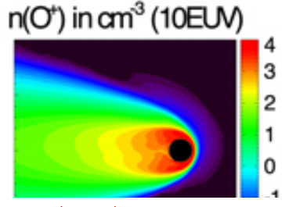
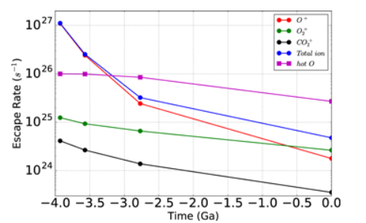
Solar wind ablation and spallation modeling
Professional modeling with all known factors and math used:
Modeling Martian Atmospheric Losses over Time: Implications for Exoplanetary
Climate Evolution and Habitability
Chuanfei Dong (2018) The Astrophysical Journal v. 859, L14.
Our estimate
For EARTH
1.4x10²⁹/sec
Heliophysics Education Activation Team

Slide 24
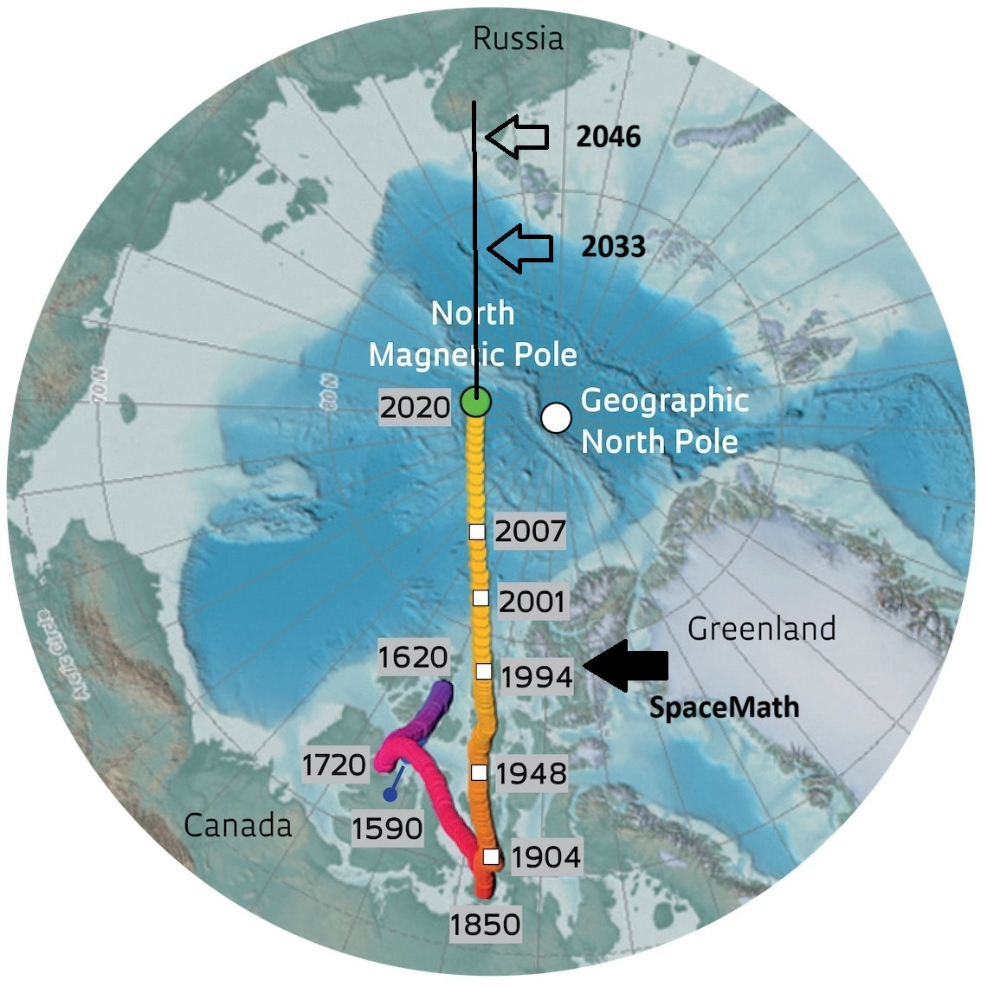
Next Time : April
Where is the Magnetic North Pole now?
Heliophysics Education Activation Team

