Slide 1




National Aeronautics and Space Administration
The Heliophysics Big Year
Dr. Sten Odenwald, Astronomer
NASA Heliophysics Education Activation Team

Slide 2

NASA’s Big Questions
1. What causes the Sun to vary?
2. How do the Earth and the heliosphere respond?
3. What are the impacts on humanity?
These Big Questions form the basis for the
Framework for Heliophysics Education
https://science.nasa.gov/learn/heat/big-ideas/
Heliophysics Education Activation Team

Slide 3
The Framework for Heliophysics Education
What are the impacts of the Sun on humanity?
1.1 The Sun is really big and its gravity influences all objects in the solar system. (PS2, ESS1)
1.2 The Sun is active and can impact technology on Earth via space weather. (PS1, PS2, PS4, ESS2, ESS3)
1.3 The Sun’s energy drives Earth’s climate, but the climate is in a delicate balance and is changing due to human activity. (PS1, PS2, PS3, LS4, ESS2, ESS3)
How do the Earth, the solar system, and heliosphere respond to changes on the Sun?
2.1 Life on Earth has evolved with complex diversity because of our location near the Sun. It is just right! (PS3, PS4, LS1, LS2, ESS2)
2.2 The Sun defines the space around it, which is different from interstellar space. (PS2, ESS1, ESS2)
2.3 The Sun is the primary source of light in our solar system.(PS1, PS2, PS3,PS4, ESS1)
What Causes the Sun to Vary?
3.1 The Sun is made of churning plasma, causing the surface to be made of complex, tangled magnetic fields. (PS1, PS2, ESS1, ESS2)
3.2 Energy from the Sun is created in the core and travels outward through the Sun and into the heliosphere. (PS1, PS3, PS4, ESS1, ESS2, ESS3)
3.3 Our Sun, like all stars, has a life cycle. (PS1, LS1, ESS1)
Heliophysics Education Activation Team

Slide 4
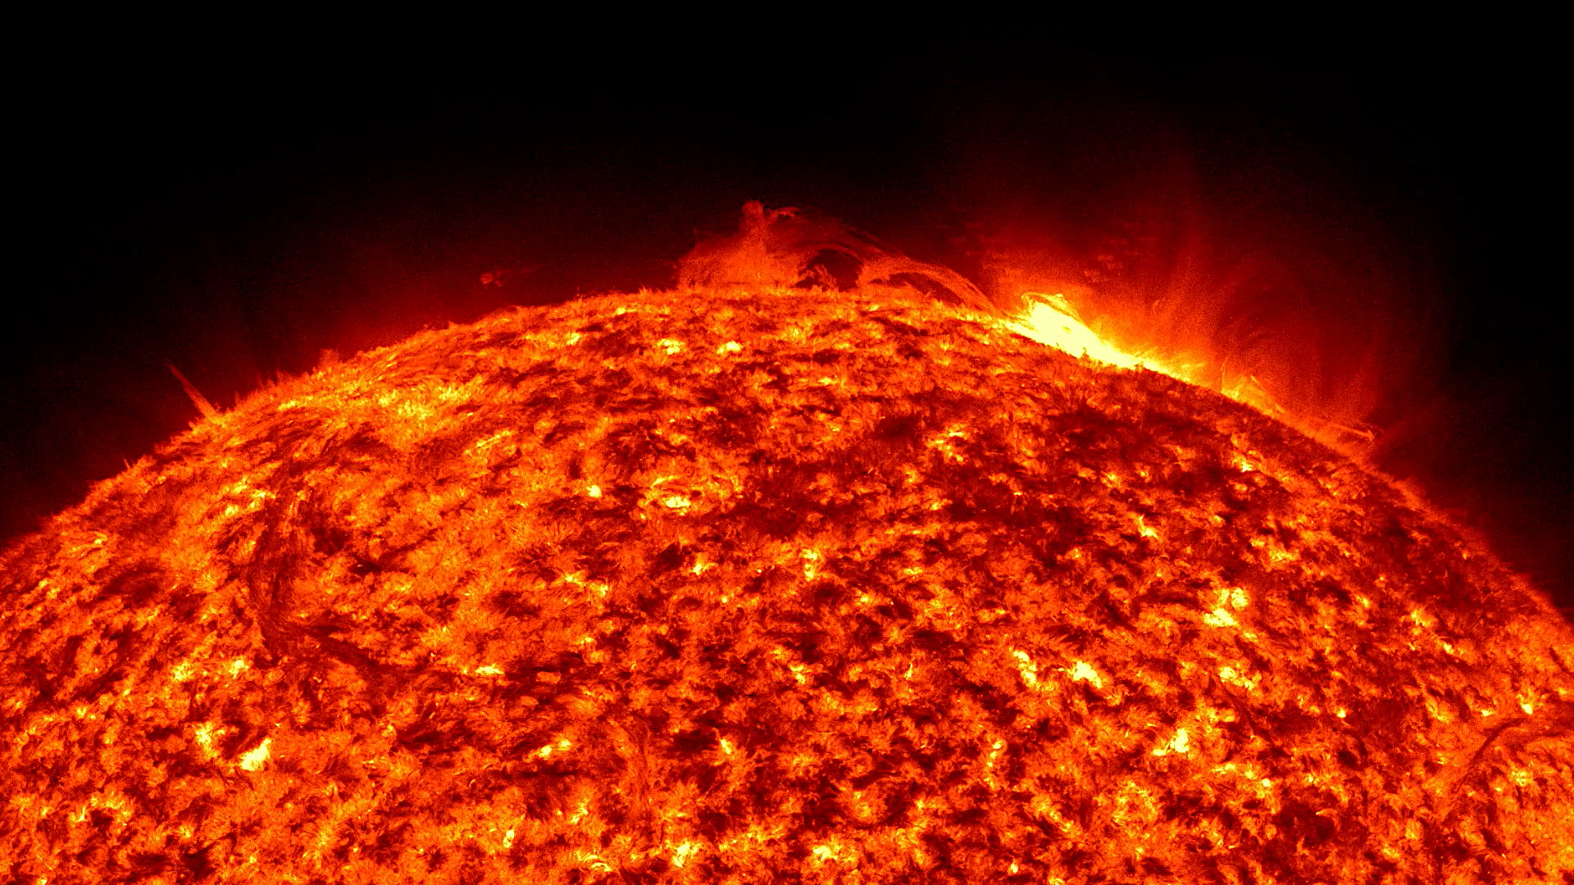
Is there a solar superflare in our future?
Ordinary flares are
pretty common,
especially around
Sunspot Maximum.
Heliophysics Education Activation Team

Slide 5
FHE Connection to Solar Superflares
What are the impacts of the Sun on humanity?
1.1 The Sun is really big and its gravity influences all objects in the solar system. (PS2, ESS1)
1.2 The Sun is active and can impact technology on Earth via space weather. (PS1, PS2, PS4, ESS2, ESS3)
What Causes the Sun to Vary?
3.1 The Sun is made of churning plasma, causing the surface to be made of complex, tangled magnetic fields. (PS1, PS2, ESS1, ESS2)
3.2 Energy from the Sun is created in the core and travels outward through the Sun and into the heliosphere. (PS1, PS3, PS4, ESS1, ESS2, ESS3)
Heliophysics Education Activation Team

Slide 6
Math Problems on Solar Superflares
Introductory
Intermediate
Advanced
Heliophysics Education Activation Team

Slide 7
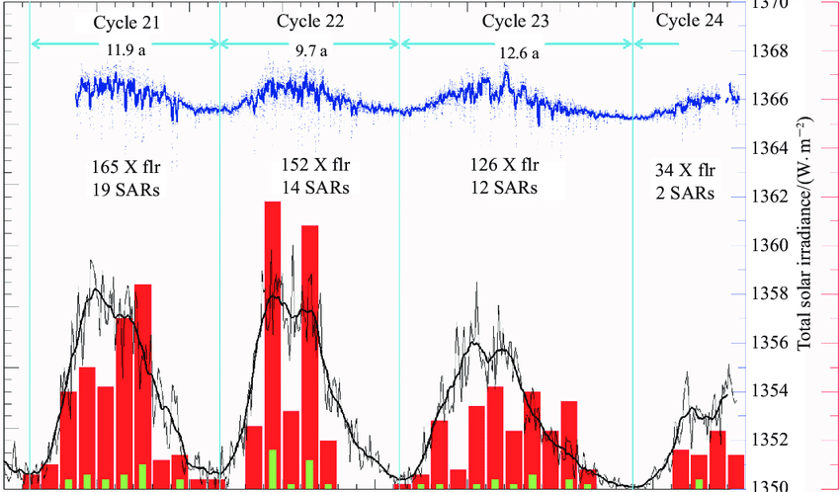
Is there a solar superflare in our future?
Ordinary flares are
pretty common,
especially around
Sunspot Maximum.
Credit: Wang, 2014: https://www.researchgate.net/publication/280207724_Magnetohydrodynamic_process_in_solar_activity
Heliophysics Education Activation Team

Slide 8
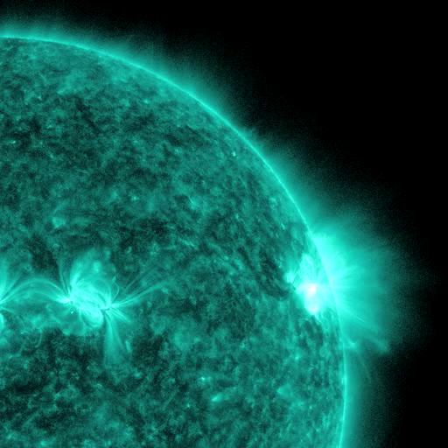
Is there a solar superflare in our future?
The biggest solar flares
Emit huge amounts of
x-ray radiation.
C = 1
M = 10
X = 100
X5 = 500 times C1
Heliophysics Education Activation Team

Slide 9
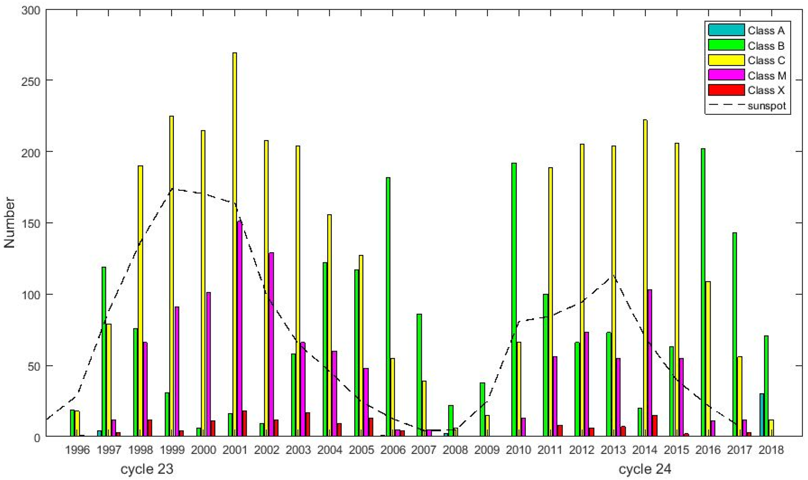
Is there a solar superflare in our future?
The biggest solar flares
Emit huge amounts of
x-ray radiation.
C = 1
M = 10
X = 100
X5 = 500 times C1
Credit: Grodji et al, 2021, Atmosphere 2022, 13(1), 69; https://doi.org/10.3390/atmos13010069
Heliophysics Education Activation Team

Slide 10
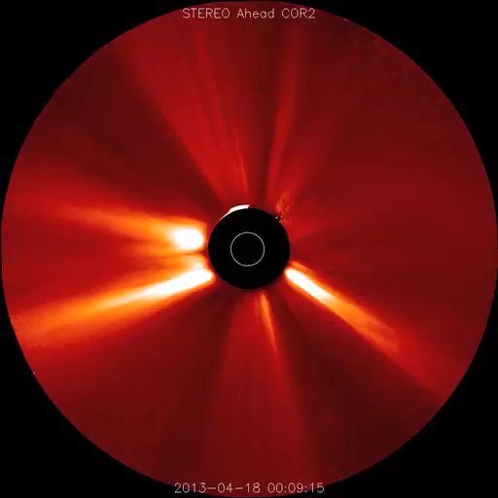
Is there a solar superflare in our future?
Coronal mass ejections are another
form of solar storm that ejects
billions of tons of magnetized plasma
into interplanetary space.
Heliophysics Education Activation Team

Slide 11
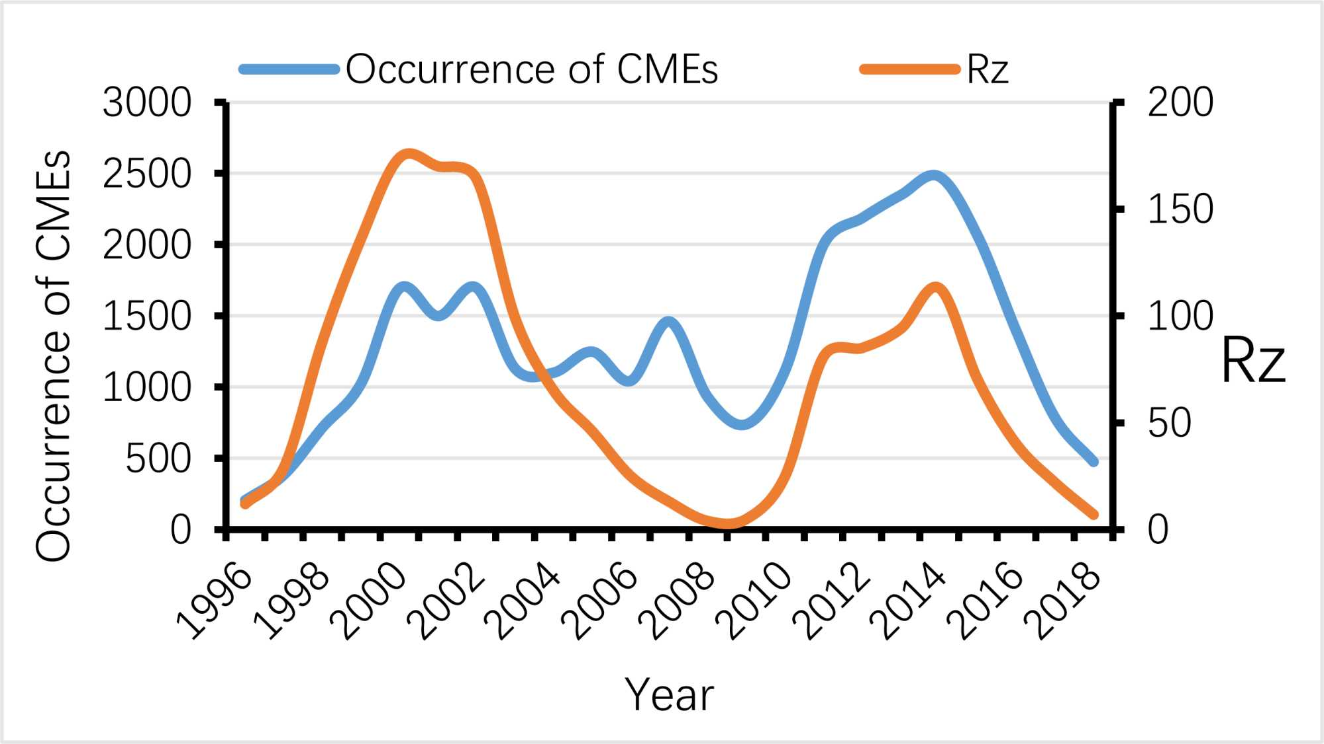
Is there a solar superflare in our future?
Coronal mass ejections are another form of solar storm that ejects
billions of tons of magnetized plasma
into interplanetary space.
Credit: Kabore et al 2024; https://www.scirp.org/journal/paperinformation?paperid=137364
Heliophysics Education Activation Team

Slide 12
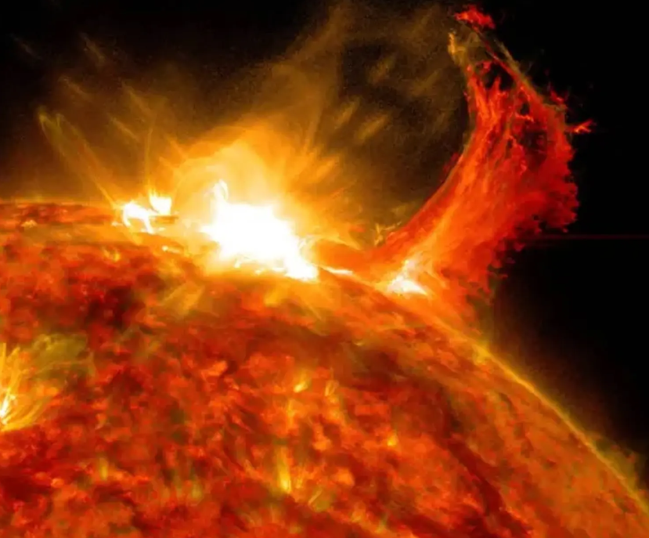
Is there a solar superflare in our future?
The most powerful X-class
solar flares are often associated
with coronal mass ejections but
not always
Heliophysics Education Activation Team

Slide 13
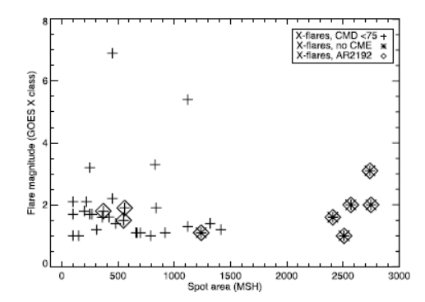
Is there a solar superflare in our future?
The most powerful X-class
solar flares are often associated
with coronal mass ejections but
not always
No CMEs
Among the Earth-facing 42 X-class flares observed between 2011 and 2014 by the Solar Dynamics Observatory
9 had no associated CMEs.
Credit: Harra et al, 2016, https://doi.org/10.1007/s11207-016-0923-0
Heliophysics Education Activation Team

Slide 14
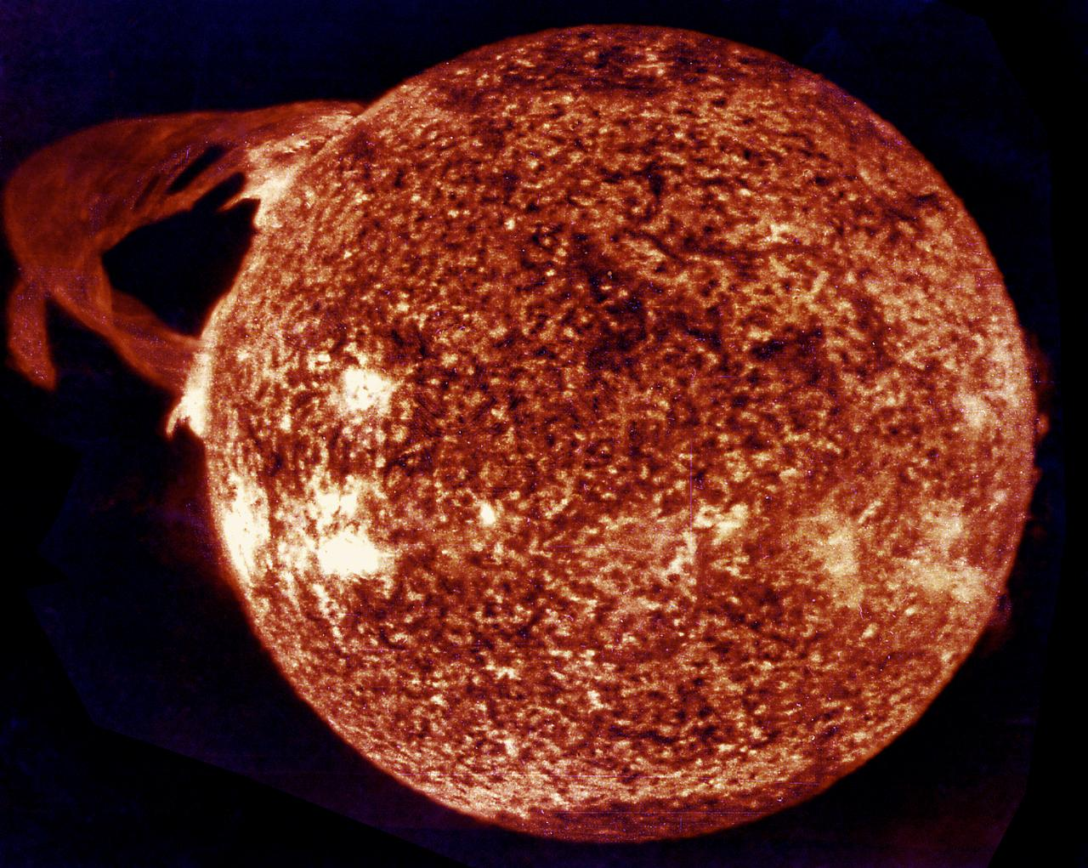
Is there a solar superflare in our future?
Other phenomena such as eruptive
prominences can look spectacular
and menacing, but in fact carry so
little mass and energy that they are
not much of a hazard to us.
This photograph of the Sun, taken on
December 19, 1973, shows the famous
‘Skylab Flare’. It ejected matter ‘sideways’
to Earth’s orbital location and none of
the matter reached Earth.
Heliophysics Education Activation Team

Slide 15
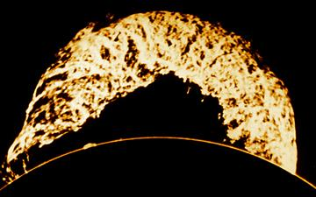
Is there a solar superflare in our future?
Here is another eruptive prominence
spotted on June 4, 1946
Heliophysics Education Activation Team

Slide 16
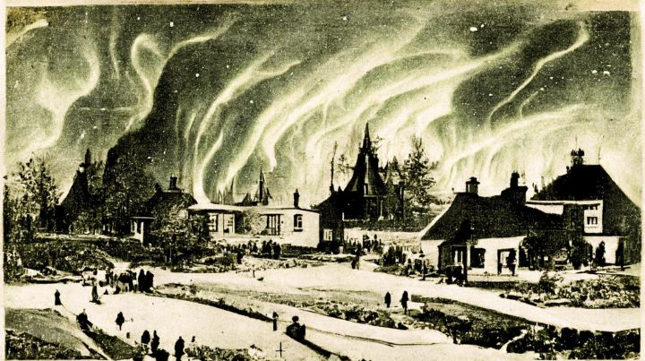
Is there a solar superflare in our future?
The 1859 Carrington-Hodgson
Event was the most troubling
solar storm in the last 200 years.
The aurora it produced, along with
magnetic and telegraph disturbances,
was seen world-wide even near the
Equator.
https://mind4survival.com/the-carrington-event/
Heliophysics Education Activation Team

Slide 17
Is there a solar superflare in our future?
The 1859 Carrington-Hodgson
Event was the most troubling
solar storm in the last 200 years.
The aurora it produced, along with
magnetic and telegraph disturbances,
were seen world-wide even near the
Equator.
But wait…there’s more!
https://mind4survival.com/the-carrington-event/
Heliophysics Education Activation Team

Slide 18
Is there a solar superflare in our future?
Ice cores reveal huge solar storm struck Earth around 660 BCE
Similar peaks are associated with intense solar storms believed
to have occurred in the years 775 CE and 994 CE.
https://physicsworld.com/a/ice-cores-reveal-huge-solar-storm-struck-earth-around-660-bc/
Heliophysics Education Activation Team

Slide 19
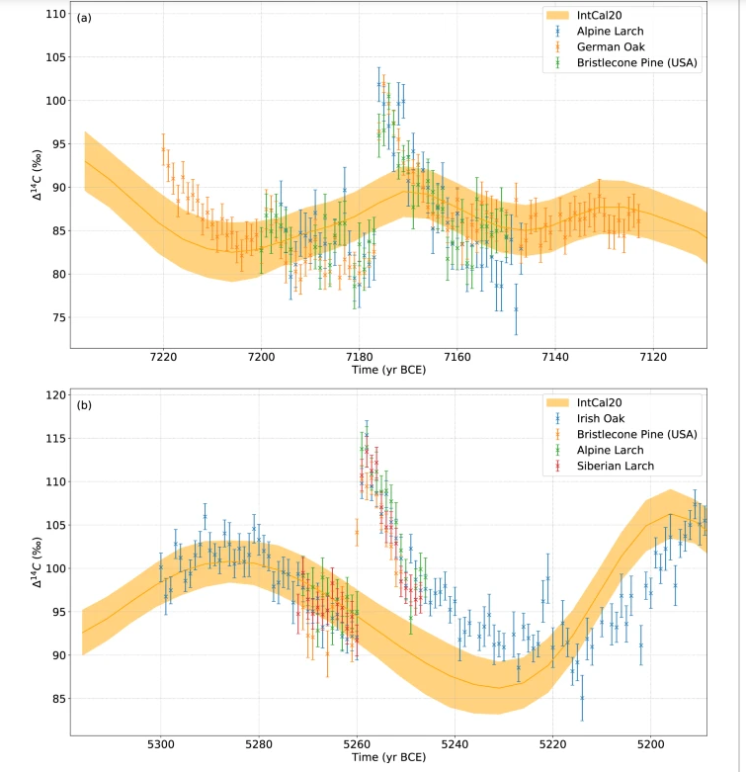
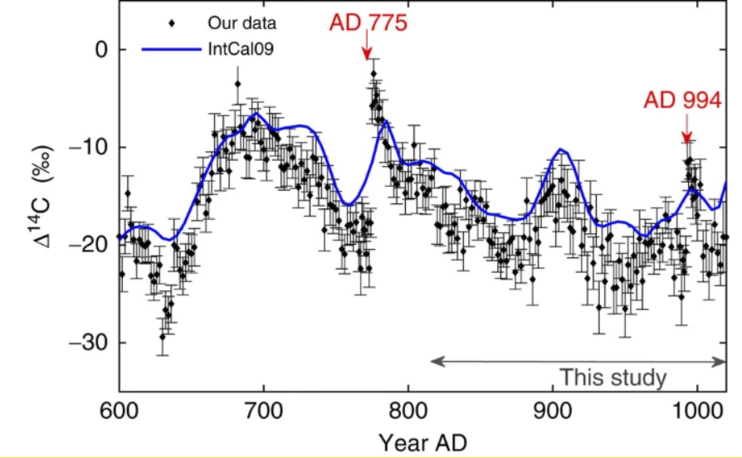
Is there a solar superflare in our future?
https://www.nature.com/articles/ncomms2783
Heliophysics Education Activation Team

Slide 20
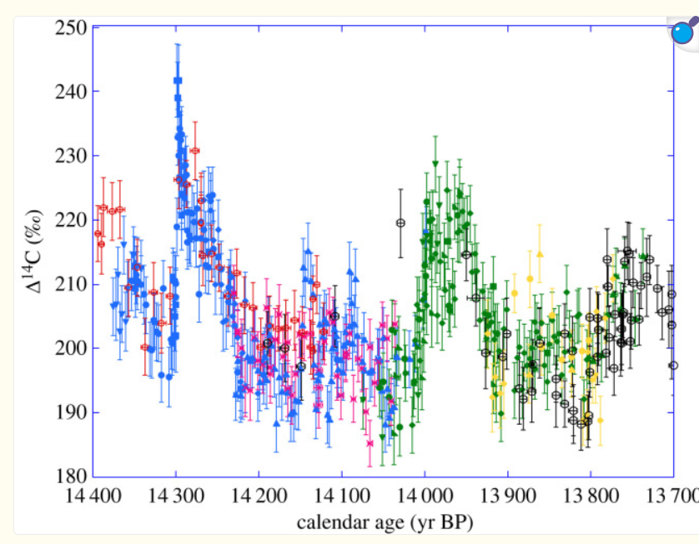
Is there a solar superflare in our future?
Another recent event discovered
in 2023.
The asymmetric shape of the 14,300 BP
spike is similar in shape to the 775 CE
event, but twice as large in amplitude.
https://pmc.ncbi.nlm.nih.gov/articles/PMC10586540/
Heliophysics Education Activation Team

Slide 21
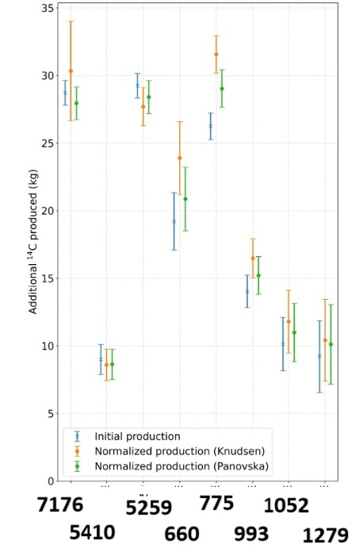
Is there a solar superflare in our future?
775 CE
Further back in time, ice cores also seem to reveal
events taking place in 7176 BCE and 5259 BCE.
https://www.nature.com/articles/s41467-022-28804-9
The increasing number of discoveries of
strong SEP events that hit Earth over the
past 12,000 years indicates they cannot be
considered as extremely rare anymore.
660 CE
5410 BCE
1279 CE
Heliophysics Education Activation Team

Slide 22
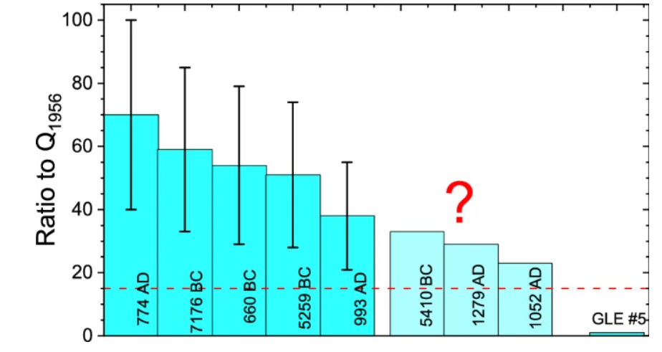
Is there a solar superflare in our future?
We can rank these SEP events by
comparing their fluences to that of
a well-studied major SEP event in 1956.
1956
Heliophysics Education Activation Team

Slide 23
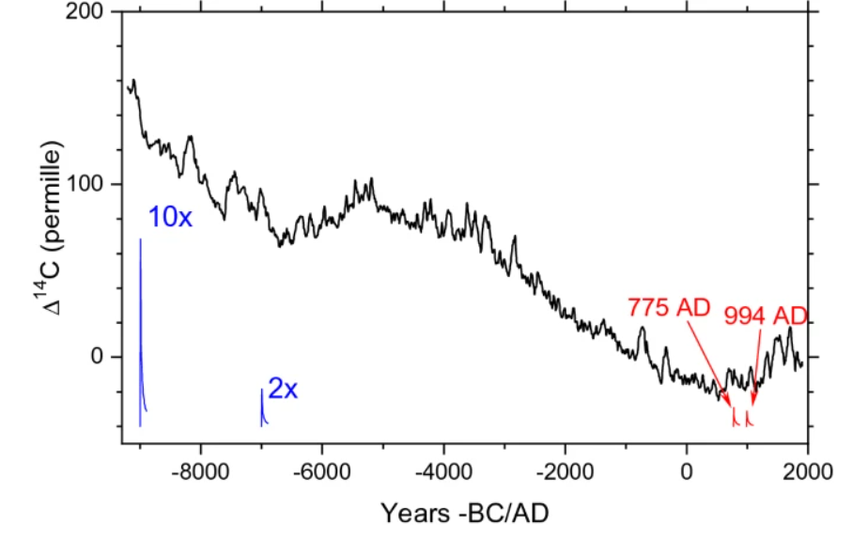
Is there a solar superflare in our future?
Combining this statistical data
it is estimated that the
probability of an event stronger
than the strongest event seen
thus far, over the entire Holocene
Period (11,700 BP) is lower than
1 event per 5,000 years.
P(> 10¹¹ (cm² year)⁻¹) ≤ 1.9 × 10⁻⁴ year⁻¹.
However, we have seen 10 major events in
the last 10,000 years so that works out
to one Super Carrington Event
every 1000 years.
7176
5410
660
Heliophysics Education Activation Team

Slide 24
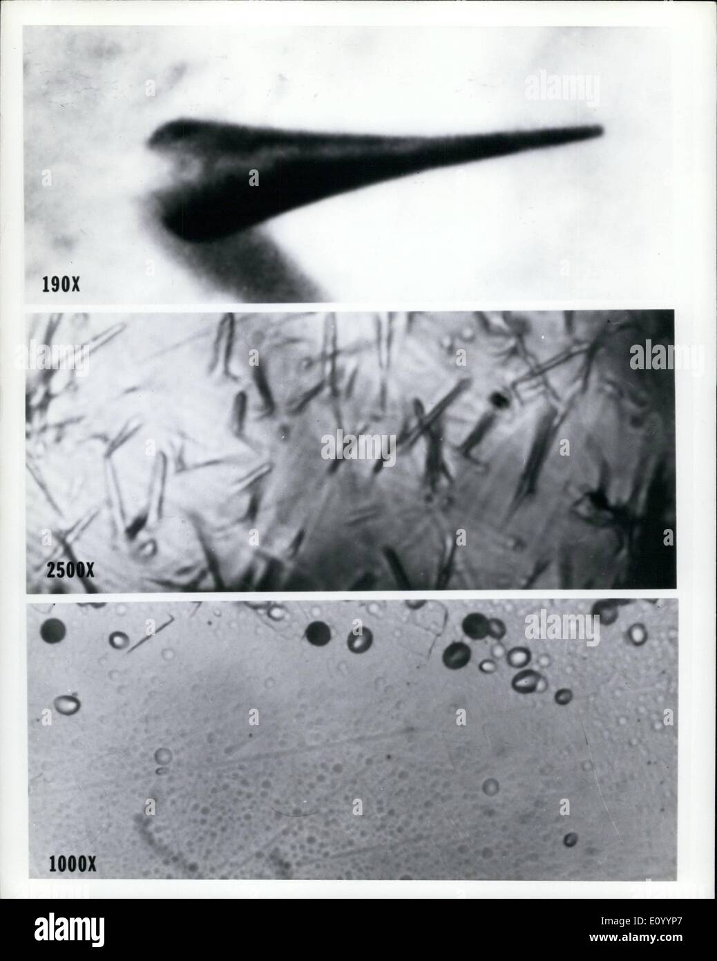
Is there a solar superflare in our future?
How typical is the current era?
Lunar cosmic ray studies: The flux of SEP above 10 MeV has not changed over the last 5 million years.
Poluianov, S.; et al. (2018). “Solar Energetic Particles and galactic cosmic rays over millions of years as inferred from data on cosmogenic 26Al in lunar samples". Astronomy and Astrophysics. V.1618: p.A96.
¹⁴C data over the last 11,000 years shows no period significantly higher than the present.
https://www.aanda.org/articles/aa/full_html/2018/10/aa33561-18/aa33561-18.html
Heliophysics Education Activation Team

Slide 25
Is there a solar superflare in our future?
How powerful are these historical ‘super flares’?
774 CE flare ranged from 10³⁴ to 10³⁶ erg would imply a ~ X3000 to X300000 SXR flare.
Miyake F, Nagaya K, Masuda K, Nakamura T (2012) A signature of cosmic-ray increase in AD 774–775 from tree rings in Japan.
Nature 486:240. https://doi.org/10.1038/nature11123
For comparison the 1859 Carrington flare is ~ X45 and ~ 5 × 10³² erg.
On November 4, 2003 we experienced an X35 flare – the strongest during the Space Age.
Heliophysics Education Activation Team

Slide 26
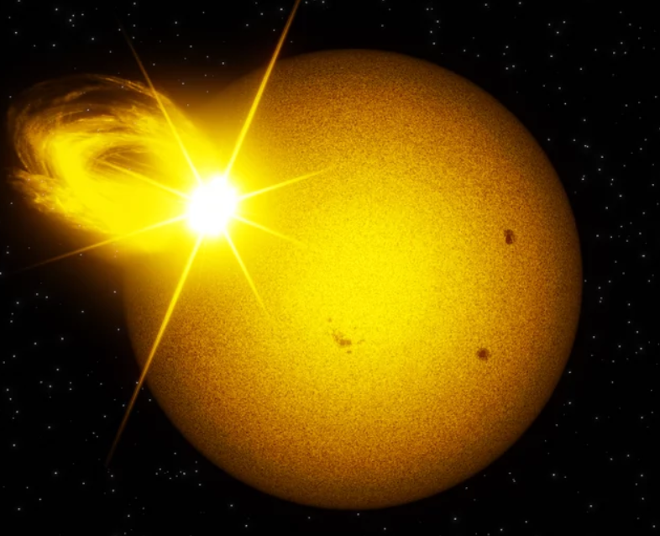
Is there a solar superflare in our future?
Surveys of other sun-like stars.
Study of 56,450 Kepler stars similar to our Sun
Four years of Kepler observations,
10²⁶ to 10²⁹ joules : 10 to 10,000 times a typical solar flare.
Equivalent of being able to observe the Sun for 220,000 years
Vasilyev et al,2024, Sun-like stars produce superflares roughly
once per century, Science, Vol 386, Issue 6727, pp. 1301-1305,
DOI: 10.1126/science.adl5441
Wichmann, Fuhrmeister, Wolter and Nagel, 2014, Kepler super-flare stars, Astron. Astrop, v. 567.
Maehara, H., Shibayama, T., Notsu, S., et al. 2012, Super flares on solar-type stars, Nature, 485, 478
Image credit:MPS/Alexey Chizhik; https://www.mpg.de/23854476/solar-superflares-once-per-century
Heliophysics Education Activation Team

Slide 27
Is there a solar superflare in our future?
Surveys of other sun-like stars.
Study of 56,450 Kepler stars similar to our Sun
Four years of Kepler observations,
Energy: 10²⁶ to 10²⁹ joules : 10 to 10,000 times a normal solar flare.
Equivalent of being able to observe the Sun for 220,000 years
Let’s do the math!
Heliophysics Education Activation Team

Slide 28
Is there a solar superflare in our future?
Surveys of other sun-like stars.
Study of 56,450 Kepler stars similar to our Sun
Four years of Kepler observations,
Energy: 10²⁶ to 10²⁹ joules : 10 to 10,000 times a normal solar flare.
Equivalent of being able to observe the Sun for 220,000 years
You observe a family of 5 humans for one year.
Humans have a life span of 100 years.
Let’s do the math!
If we observe 5 humans randomly selected across this one year, it is as though
we studied one human for (100 yrs/5) x 1 sample = 20 years.
Heliophysics Education Activation Team

Slide 29
Is there a solar superflare in our future?
Surveys of other sun-like stars.
Study of 56,450 Kepler stars similar to our Sun
Four years of Kepler observations,
Energy: 10²⁶ to 10²⁹ joules : 10 to 10,000 times a normal solar flare.
Equivalent of being able to observe the Sun for 220,000 years
You observe a family of 5 humans for two years.
Humans have a life span of 100 years.
Let’s do the math!
If we observe 5 humans randomly selected across this one year, it is as though
we studied one human for (100 yrs/5) x 2 samples = 40 years.
Heliophysics Education Activation Team

Slide 30
Is there a solar superflare in our future?
Surveys of other sun-like stars.
Study of 56,450 Kepler stars similar to our Sun
Four years of Kepler observations,
Energy: 10²⁶ to 10²⁹ joules : 10 to 10,000 times a normal solar flare.
Equivalent of being able to observe the Sun for 220,000 years
The survey selected Sun-like stars similar in age to our sun to within about 3 billion years.
If we observe 56,450 stars randomly selected across 4 years of time, it is as though
we statistically observed our sun for about
3 billion years
------------------ x 4 samples = about 213,000 years. Close enough.
56,400 stars
Heliophysics Education Activation Team

Slide 31
Is there a solar superflare in our future?
Surveys of other sun-like stars.
Study of 56,450 Kepler stars similar to our Sun
Four years of Kepler observations,
Energy: 10²⁶ to 10²⁹ joules : 10 to 10,000 times a normal solar flare.
Equivalent of being able to observe the Sun for 220,000 years
Flare behavior similar to the Sun over a span of about 220,000 years.
Many small flares, fewer big flares, and very few enormous flares.
Sun-like stars produce superflares roughly once per century.
Heliophysics Education Activation Team

Slide 32
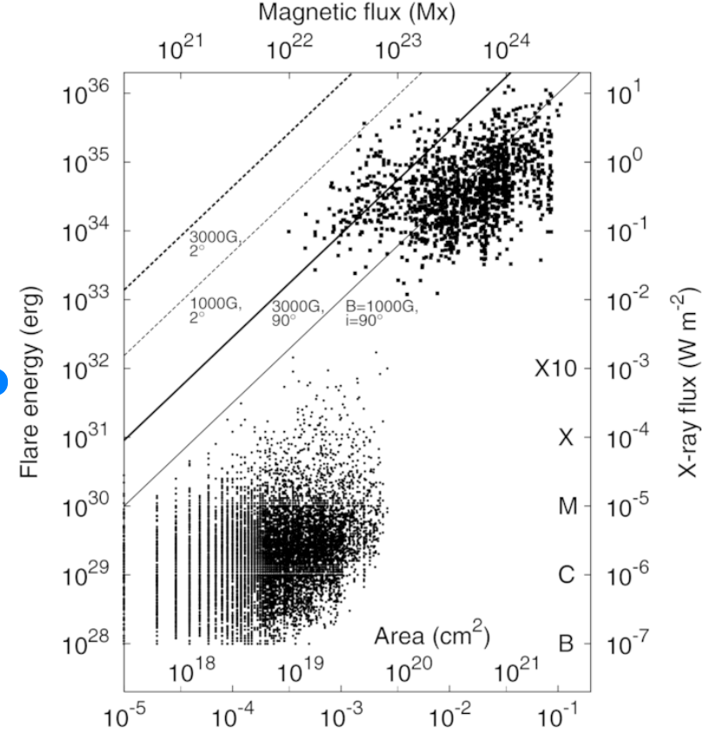
Is there a solar superflare in our future?
Here is a plot showing
solar flares versus
Kepler-star flares.
Kepler
774 CE
Solar
Super flares on other sun-like stars
https://iopscience.iop.org/article/10.1088/0004-637X/771/2/127
Heliophysics Education Activation Team

Slide 33
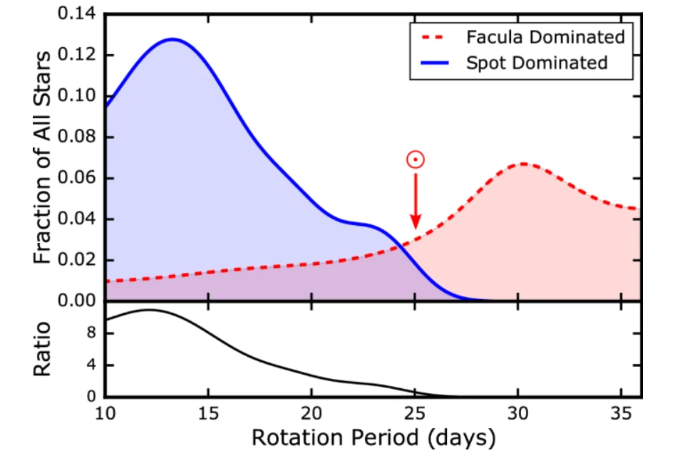
Is there a solar superflare in our future?
When the sun-like stars are plotted
against their rotation periods and
type of flaring activity, our sun is
in a curious location.
Powerful spot-dominated flares more common
in fast rotators.
Less-powerful facula-dominated flare more
common in slow rotators.
Cliver et al, 2022, Extreme Solar Events, https://link.springer.com/article/10.1007/s41116-022-00033-8#Fig59
Heliophysics Education Activation Team

Slide 34
Is there a solar superflare in our future?
When the sun-like stars are plotted
against their rotation periods and
type of flaring activity, our sun is
in a curious location.
Powerful spot-dominated flares more common
in fast rotators.
Less-powerful facula-dominated flare more
common in slow rotators.
Fewer superstorms in our sun’s future!
Cliver et al, 2022, Extreme Solar Events, https://link.springer.com/article/10.1007/s41116-022-00033-8#Fig59
Heliophysics Education Activation Team

Slide 35
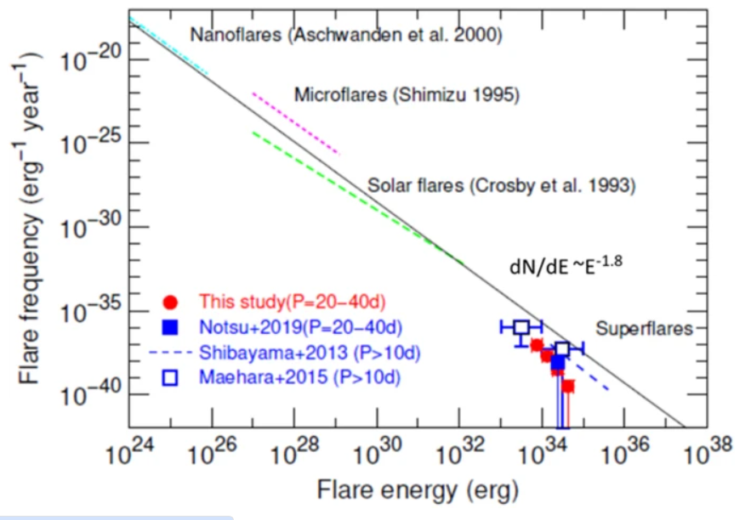
Is there a solar superflare in our future?
Maehara et al. (2015) determined
that occurrence frequency of
10³³ erg solar flares would be
once every 500 years.
Notsu et al. deduced that flares
with 10³⁴ erg occur on old
(~ 4.6 Gyr), slowly
rotating (P_{rot} ∼ 25 days)
Sun-like stars approximately
once every 2000–3000 years.
Heliophysics Education Activation Team

Slide 36
Is there a solar superflare in our future? Likely Impacts
Prototype = | Carrington | 774 CE | 12,300 BCE
Duration | Days | Mo. To Yrs | 5-10 years?
Magnetosphere | Partial loss | Full loss | Full loss
Van Allen Belts | Partial loss | Full loss | Full loss
Astronauts | LD20? | LD50? | LD100?
Electric Grid | > 50% global loss | Full loss | Full loss
GEO Satellites | > 50% loss | Full loss | Full loss
LEO Satellites | < 50% loss | Ful loss | Full loss
Heliophysics Education Activation Team

Slide 37
Is there a solar superflare in our future? Likely Impacts
Prototype= | Carrington | 774 CE | 12,300 CE
Duration | Days | Mo. To Yrs | 5-10 years
Ozone Layer | Total loss | Total loss | Total loss
Geomagnetic field at surface | Highly variable in some areas | Highly variable everywhere | Highly variable everywhere
UV-B and C | Minimal hazard | Major hazard | Major hazard
Atmosphere | No loss below 100 km | Some loss below 100 km | Significant loss above 20-km
Heliophysics Education Activation Team

Slide 38
Is there a solar superflare in our future? Likely Impacts
Prototype= | Carrington | 774 CE | 12,300 CE
Duration | Days | Mo. To Yrs | 5-10 years
Ozone Layer | Total loss | Total loss | Total loss
Geomagnetic field at surface | Highly variable in some areas | Highly variable everywhere | Highly variable everywhere
UV-B and C | Minimal hazard | Major hazard | Major hazard
Atmosphere | No loss below 100 km | Some loss below 100 km | Significant loss above 20-km
Surface and ocean life survives unaffected with proper UV shielding by day
Heliophysics Education Activation Team

Slide 39
Is there a solar superflare in our future?
The odds are perhaps better than one-in-thirteen we will see another
Carrington-level event within your lifetime if you are under 20 years old.
Do the math!
Heliophysics Education Activation Team

Slide 40
Is there a solar superflare in our future?
The odds are perhaps better than one-in-thirteen we will see another
Carrington-level event within your lifetime if you are under 20 years old.
C¹⁴ record shows as many as
8 events in the last 9,000 years,
but there could be more.
Upper limit is one per 1,000 years.
Time window: 100-20 = 80 years.
80 years/1000 years = 0.08 = 1/13
Odds are one in 13.
This is a lower limit because if more
are discovered, say twice as many,
the interval is 500 years and the
odds are one-in-six.
Morina et al, 2019 estimate a ten-year rate
as high as 0.02, which for our 80-year
calculation is 0.16 or one-in-six.
Morina et al, 2019, Probability estimation of a Carrington-like geomagnetic storm. Sci Rep 9, 2393 (2019). https://doi.org/10.1038/s41598-019-38918-8
Heliophysics Education Activation Team

Slide 41
Is there a solar superflare in our future?
The odds are perhaps better than one-in-thirteen we will see another
Carrington-level event within your lifetime if you are under 20 years old.
The odds are perhaps one-in- fifty six that you might see another superflare
in your lifetime.
Do the math!
Heliophysics Education Activation Team

Slide 42
Is there a solar superflare in our future?
The odds are perhaps better than one-in-thirteen we will see another
Carrington-level event within your lifetime if you are under 20 years old.
The odds are perhaps one-in- fifty six that you might see another superflare
in your lifetime.
774 CE and 7176 BCE would classify as Kepler super flare events.
Two super flare events every 9,000 years.
One super flare every 4,500 years.
Time window: 100 – 20 = 80 years.
80 yrs/ 4,500 yrs = 0.018 = 1/56
Odds are one in 56
Heliophysics Education Activation Team

Slide 43
Is there a solar superflare in our future?
For more about this, see my blog at Astronomy Café.
Heliophysics Education Activation Team

Slide 44
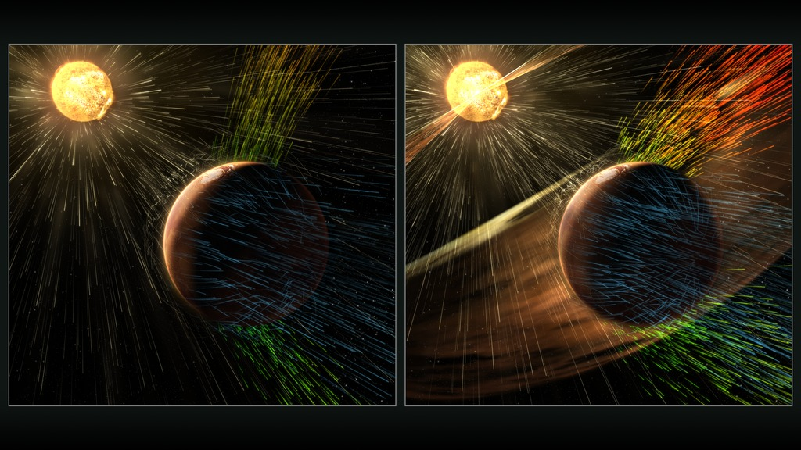
Next Time: March
The Solar Wind: How some planets lose their atmospheres
Heliophysics Education Activation Team

