Slide 1




National Aeronautics and Space Administration
The Heliophysics Big Year
Dr. Sten Odenwald, Astronomer
NASA Heliophysics Education Activation Team

Slide 2

NASA’s Big Questions
1. What causes the Sun to vary?
2. How do the Earth and the heliosphere respond?
3. What are the impacts on humanity?
These Big Questions form the basis for the
Framework for Heliophysics Education
https://science.nasa.gov/learn/heat/big-ideas/
Heliophysics Education Activation Team

Slide 3
The Framework for Heliophysics Education
What are the impacts of the Sun on humanity?
1.1 The Sun is really big and its gravity influences all objects in the solar system. (PS2, ESS1)
1.2 The Sun is active and can impact technology on Earth via space weather. (PS1, PS2, PS4, ESS2, ESS3)
1.3 The Sun’s energy drives Earth’s climate, but the climate is in a delicate balance and is changing due to human activity. (PS1, PS2, PS3, LS4, ESS2, ESS3)
How do the Earth, the solar system, and heliosphere respond to changes on the Sun?
2.1 Life on Earth has evolved with complex diversity because of our location near the Sun. It is just right! (PS3, PS4, LS1, LS2, ESS2)
2.2 The Sun defines the space around it, which is different from interstellar space. (PS2, ESS1, ESS2)
2.3 The Sun is the primary source of light in our solar system.(PS1, PS2, PS3,PS4, ESS1)
What Causes the Sun to Vary?
3.1 The Sun is made of churning plasma, causing the surface to be made of complex, tangled magnetic fields. (PS1, PS2, ESS1, ESS2)
3.2 Energy from the Sun is created in the core and travels outward through the Sun and into the heliosphere. (PS1, PS3, PS4, ESS1, ESS2, ESS3)
3.3 Our Sun, like all stars, has a life cycle. (PS1, LS1, ESS1)
Heliophysics Education Activation Team

Slide 4
Is Earth’s polarity about to flip?
Before we can answer this question
we must first have a basic idea:
What the ‘geo’-magnetic field looks like.
How it is produced.
How it is changing in time.
Heliophysics Education Activation Team

Slide 5

Is Earth’s polarity about to flip? Geomagnetism
What does Earth’s interior look like?
?
Mary Hill Museum
Heliophysics Education Activation Team

Slide 6
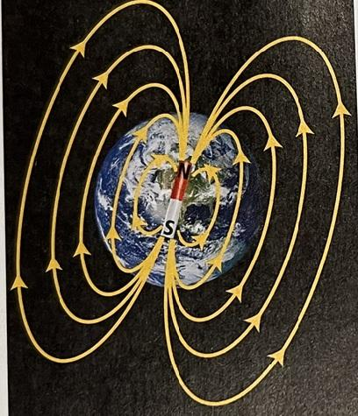
Is Earth’s polarity about to flip? Geomagnetism
Typical textbook illustration
Earth Science:
Geology, The Environment & The Universe
McGraw Hill 2017 edition.
Heliophysics Education Activation Team

Slide 7
Is Earth’s polarity about to flip? Geomagnetism
Typical textbook illustration
Earth Science:
Geology, The Environment & The Universe
McGraw Hill 2017 edition.
Wrong!
Heliophysics Education Activation Team

Slide 8
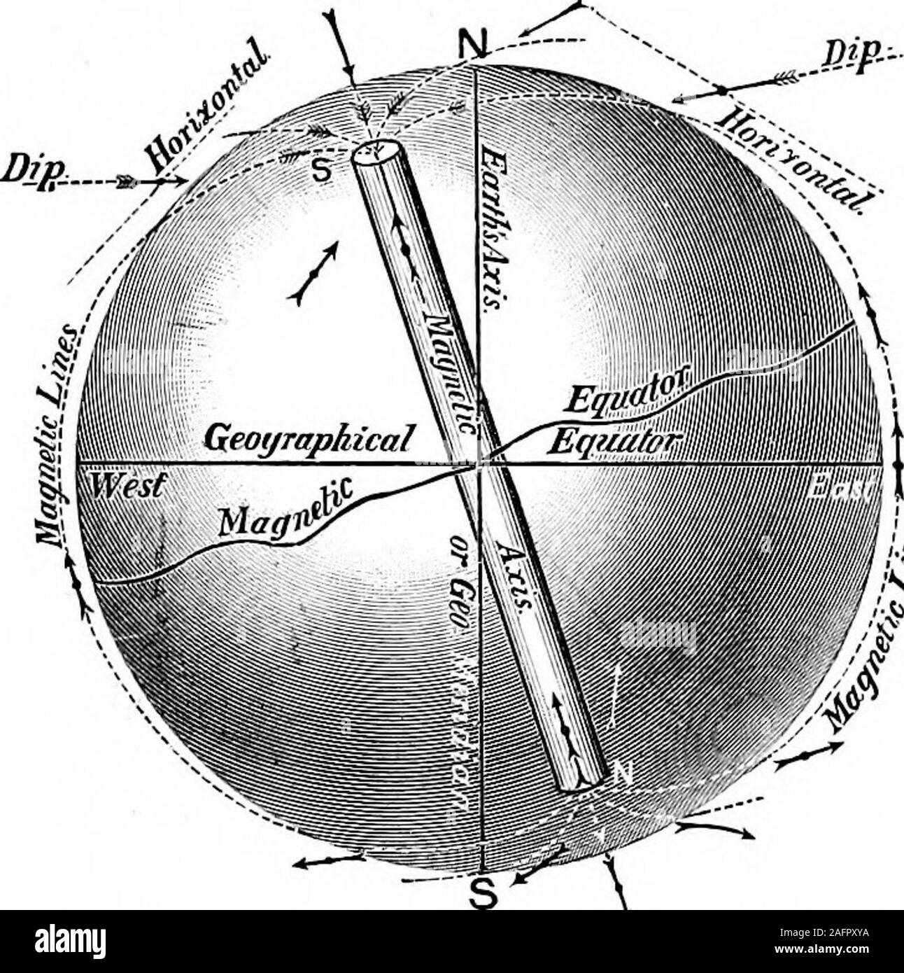
Is Earth’s polarity about to flip? Geomagnetism
What does it look like?
1895
Principles of Physics, Alfred Gage, Figure 416
Almy Stock Photo 2AFPXYA – No copyright; Public Domain
Heliophysics Education Activation Team

Slide 9
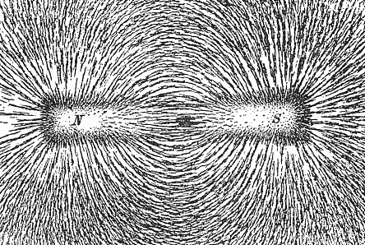
Is Earth’s polarity about to flip? Misconceptions
Wrong Visual Model
The source is not a simple bar magnet
Wikipedia: Bar magnet
Heliophysics Education Activation Team

Slide 10
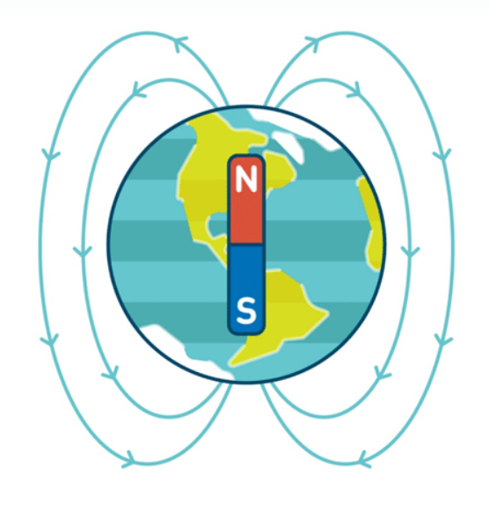
Is Earth’s polarity about to flip? Misconceptions
Wrong Visual Model
The source is not a simple bar magnet
The polarity is not North-type just because compass
needles ‘point North’
Credit: Shalom Education.
https://www.shalom-education.com/courses/gcse-physics/lessons/magnetism-and-electromagnetism/topic/the-earths-magnetic-field-2/
Heliophysics Education Activation Team

Slide 11
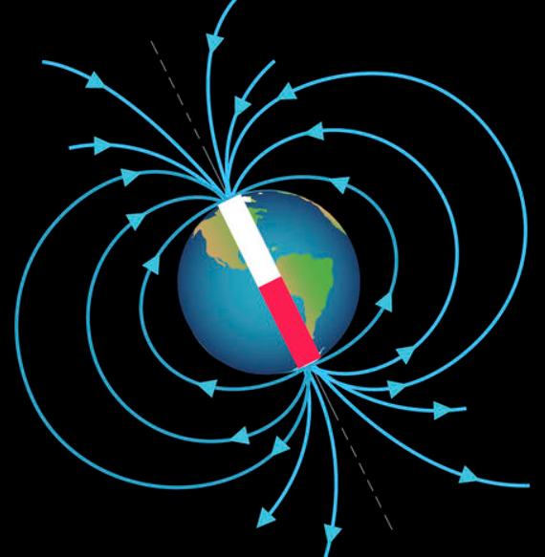
Is Earth’s polarity about to flip? Misconceptions
Wrong Visual Model
The source is not a simple bar magnet
The polarity is not North-type just because compass
needles ‘point North’
The field does not originate near the surface
https://mrlilholt.wordpress.com/5th-grade-text/chapter-7/7-5-earths-magnetic-field/
Heliophysics Education Activation Team

Slide 12
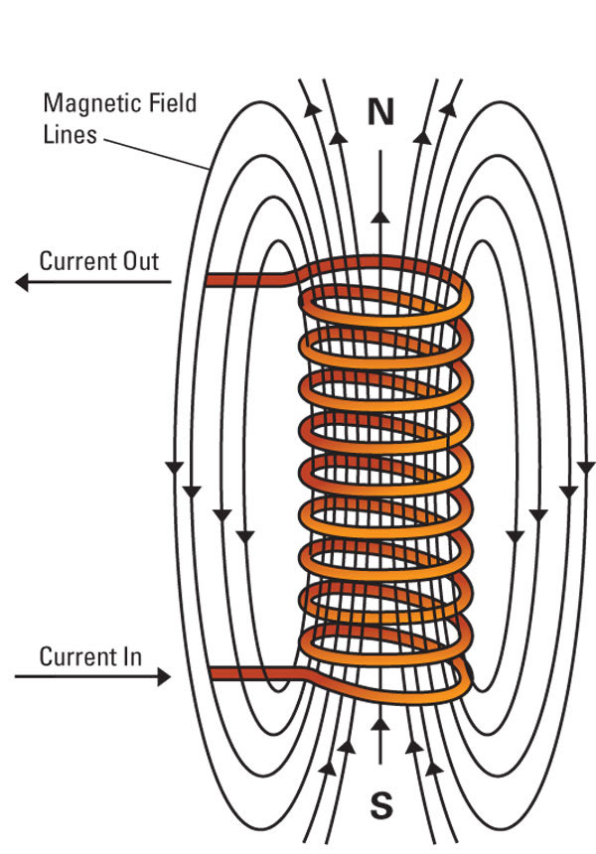
Is Earth’s polarity about to flip? Misconceptions
Wrong Visual Model
The source is not a simple bar magnet
The polarity is not North-type just because compass
needles ‘point North’
The field does not originate near the surface
The field is not a simple electromagnet
Credit: https://www.hvrmagnet.com/blog/solenoid-electromagnet-commonly-asked-questions/
Heliophysics Education Activation Team

Slide 13

Is Earth’s polarity about to flip? Geomagnetism
What are some basic properties of Earth?
?
Mary Hill Museum
Heliophysics Education Activation Team

Slide 14
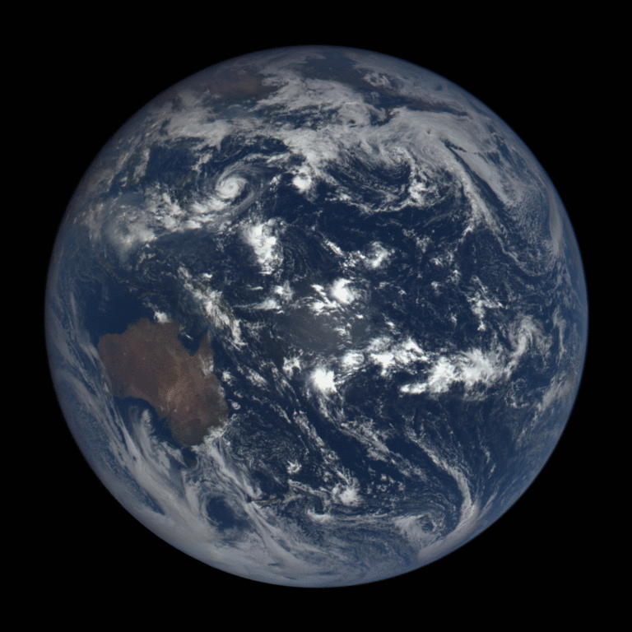
Is Earth’s polarity about to flip? Magnetic Dynamo
Right Visual Model
Earth is a rotating body
Image by Wikipedia: Earth’s rotation; NASA/EPIC
Heliophysics Education Activation Team

Slide 15
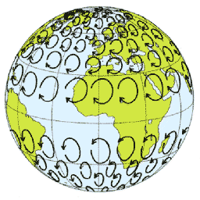
Is Earth’s polarity about to flip? Magnetic Dynamo
Right Visual Model
Earth is a rotating body
Rotation produces Coriolis forces
Image by Wikipedia: Coriolis Effect
Heliophysics Education Activation Team

Slide 16
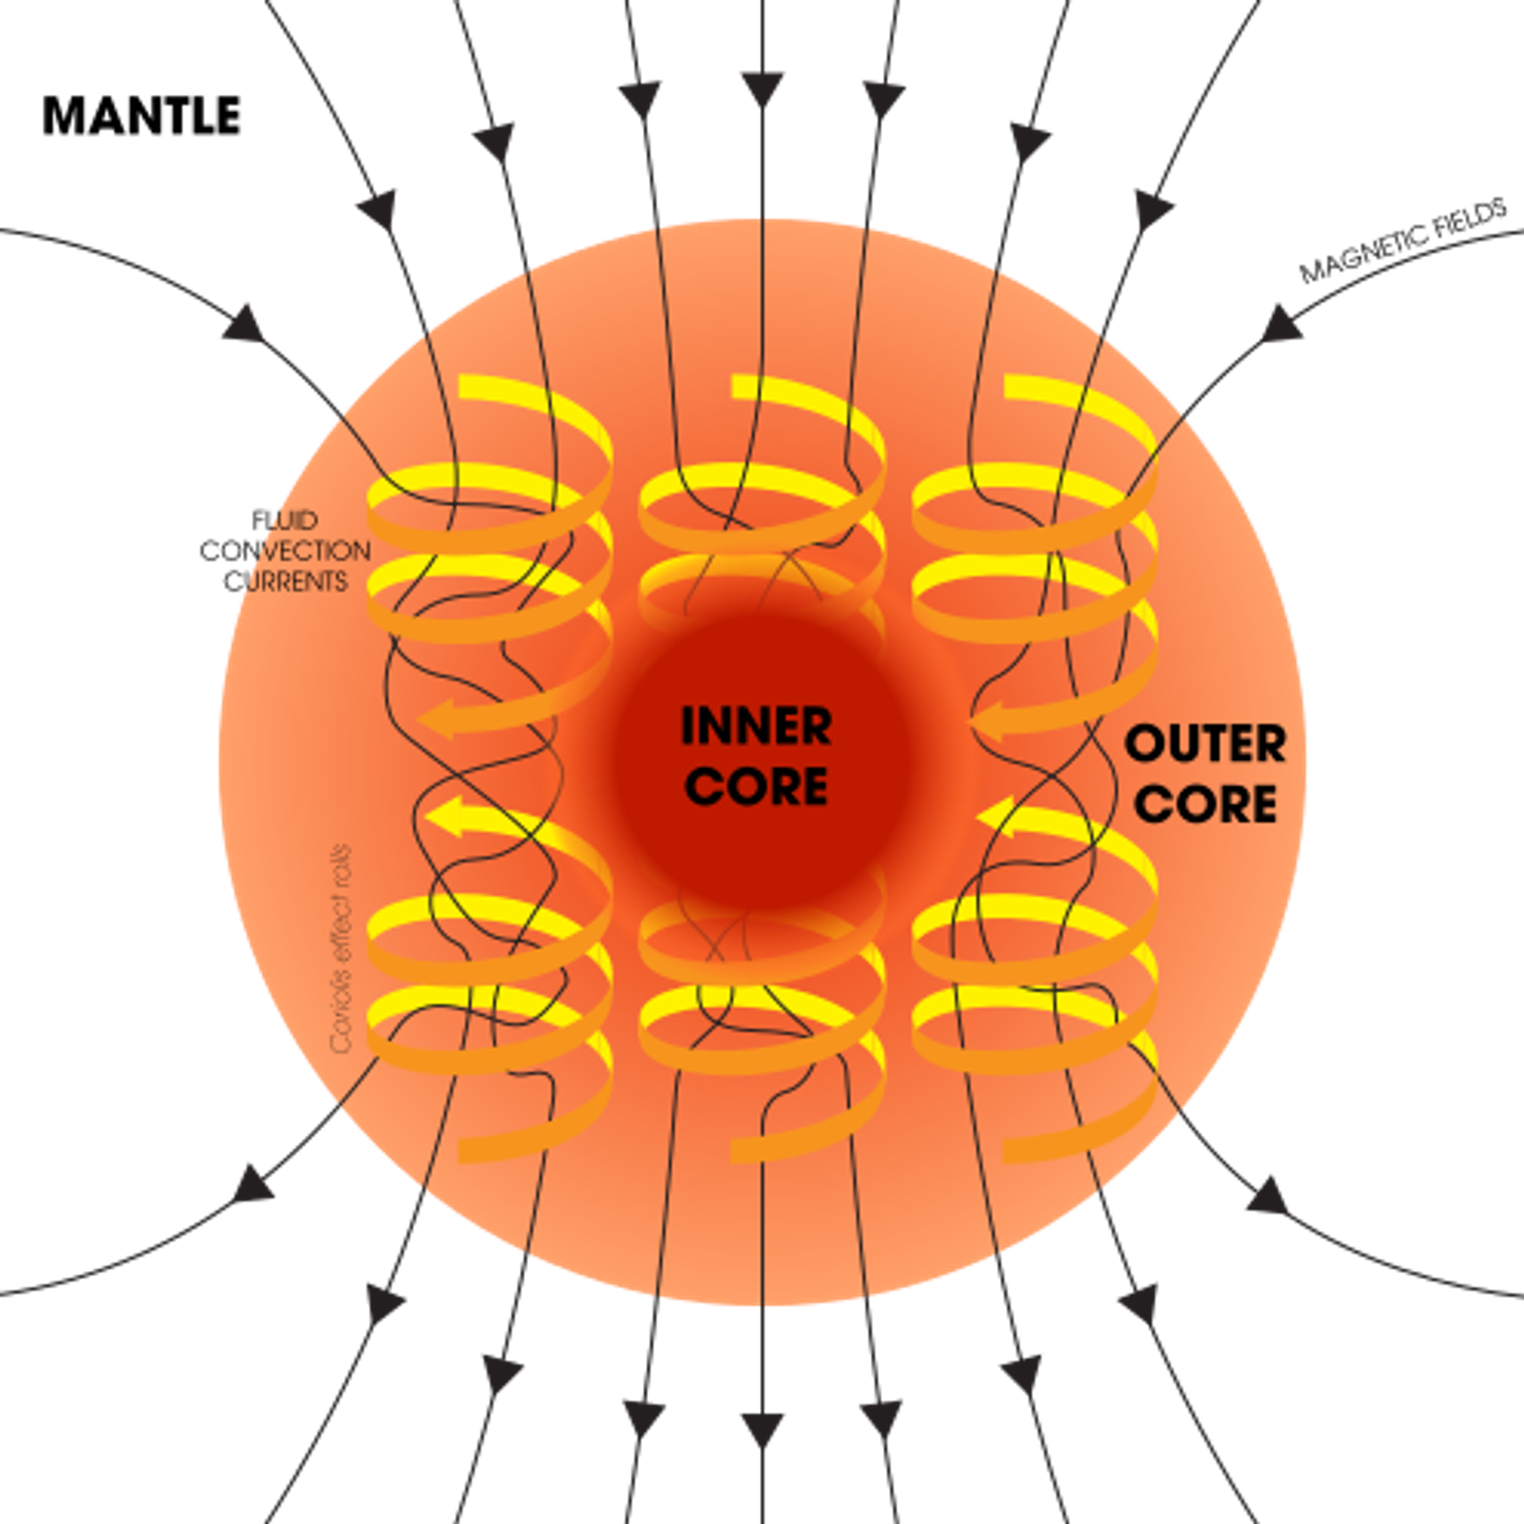
Is Earth’s polarity about to flip? Magnetic Dynamo
Right Visual Model
Earth is a rotating body
Rotation produces Coriolis forces
Coriolis forces produce rotating columns of
currents in Earth’s conducting outer core
Image by Wikipedia: Dynamo Theory; USGS
Heliophysics Education Activation Team

Slide 17
Is Earth’s polarity about to flip? Magnetic Dynamo
Right Visual Model
Earth is a rotating body
Rotation produces Coriolis forces
Coriolis forces produce rotating columns of currents
Each column generates its own ‘bar magnet’ field
https://planet-earth-2017.com/the-true-source-of-earth-magnetic-field/
Image by Wikipedia: Dynamo Theory; USGS
Heliophysics Education Activation Team

Slide 18
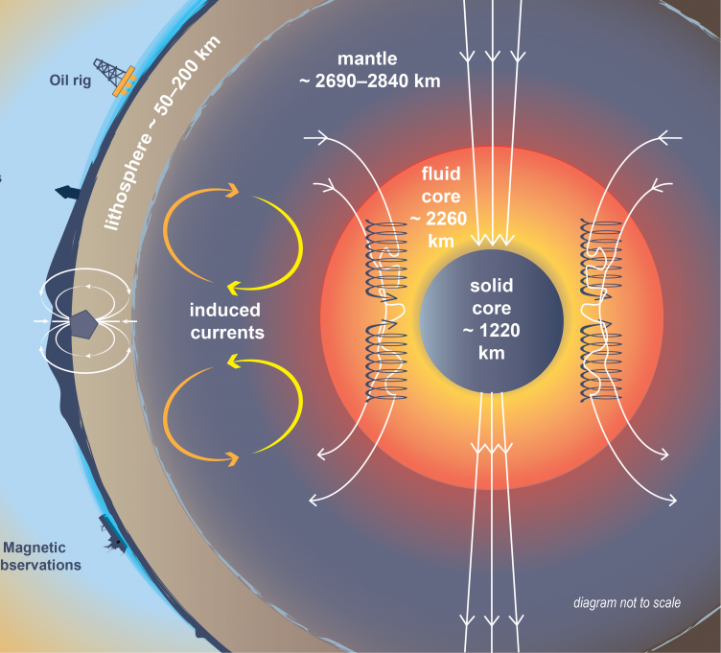
Is Earth’s polarity about to flip? Magnetic Dynamo
Right Visual Model
Earth is a rotating body
Rotation produces Coriolis forces
Coriolis forces produce rotating columns of currents
Each column generates its own ‘bar magnet’ field
These individual fields merge together in the outer mantle
Earth's magnetic structure. Courtesy of NOAA NCEI.
Heliophysics Education Activation Team

Slide 19
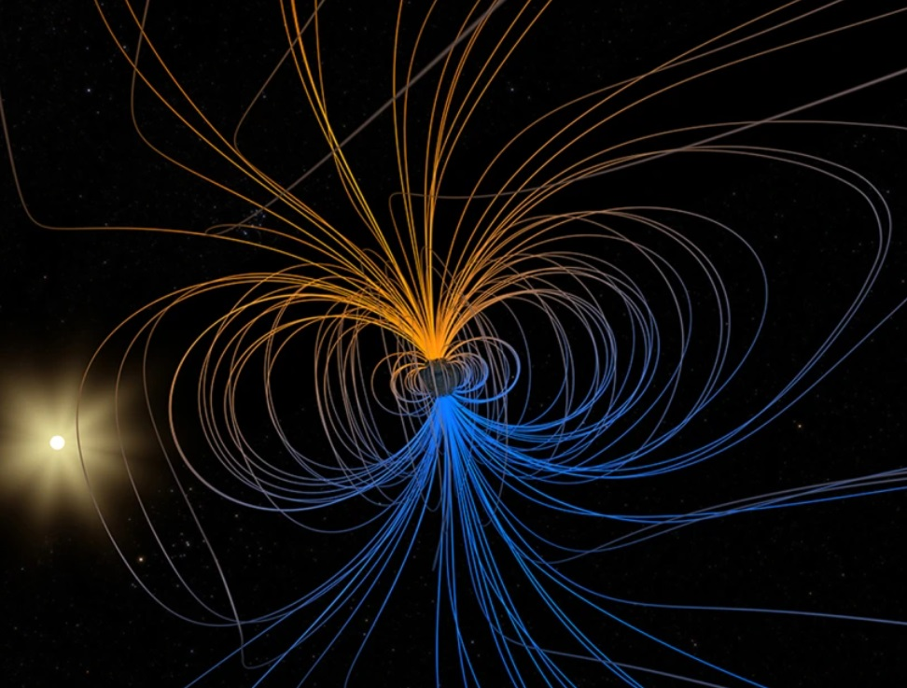
Is Earth’s polarity about to flip? Magnetic Dynamo
Right Visual Model
Earth is a rotating body
Rotation produces Coriolis forces
Coriolis forces produce rotating columns of currents
Each column generates its own ‘bar magnet’ field
These individual fields merge together in the outer mantle
The resulting exterior field looks like a bar magnet!
Image by NASA
Heliophysics Education Activation Team

Slide 20
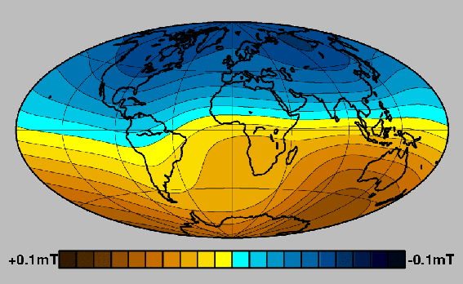
Is Earth’s polarity about to flip? Surface Field
Earth’s field is not uniform
ESA SWARM satellite map of
Earth’s surface field. January-June 2014
Blue = +60,000 nT SOUTH-Type
Gold = -60,000 nT NORTH Type
European Space Agency/Technical University of Denmark (ESA/DTU Space)
Heliophysics Education Activation Team

Slide 21
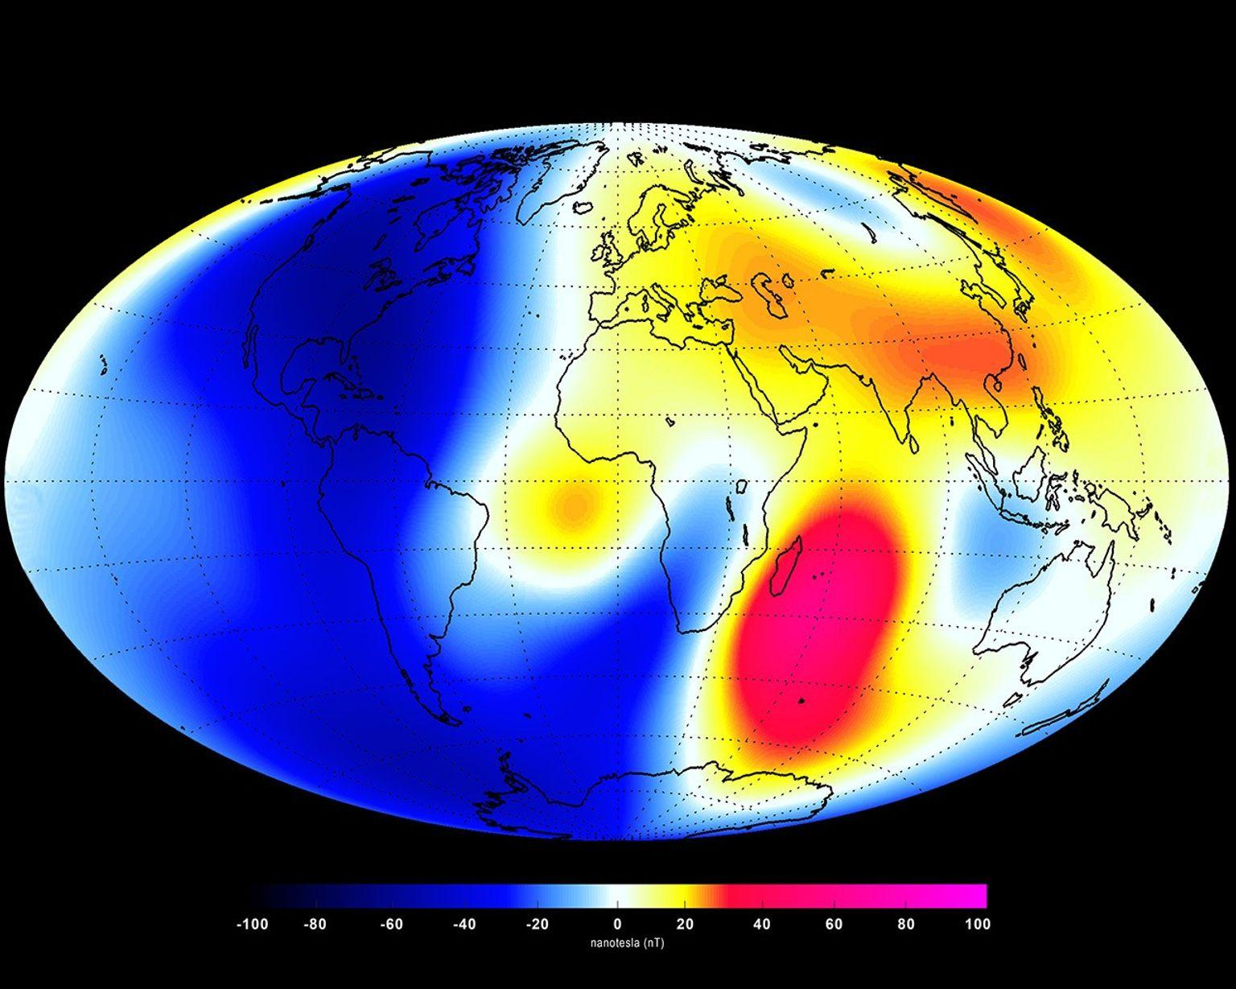
Is Earth’s polarity about to flip? Surface Field
Earth’s ‘difference’ field is not uniform either
ESA SWARM satellite map of
Earth’s surface field. January-June 2014
Red = +40 nT SOUTH-Type
Blue = -40 nT NORTH Type
https://science.nasa.gov/science-research/earth-science/earths-magnetosphere-protecting-our-planet-from-harmful-space-energy/
European Space Agency/Technical University of Denmark (ESA/DTU Space)
Heliophysics Education Activation Team

Slide 22
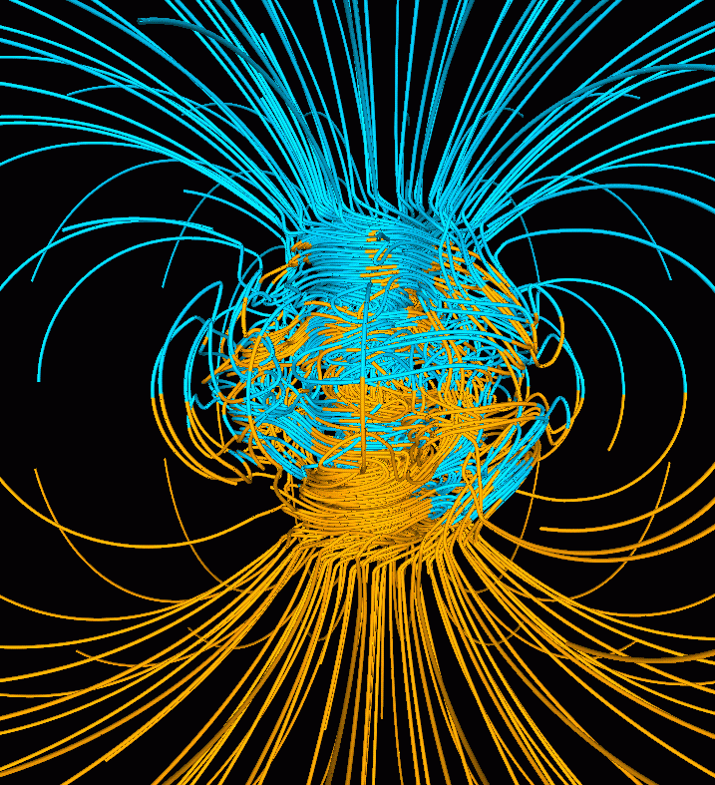
Is Earth’s polarity about to flip? Dynamo Instability
A supercomputer simulation of the Earth's field
in a period of normal polarity.
The lines represent magnetic field lines,
blue (South-type) gold (North-type).
Irregularities at Earth’s surface field are caused by
chaotic changes in interior currents.
Dr. Gary A. Glatzmaier - Los Alamos - U.S. DoE
Heliophysics Education Activation Team

Slide 23
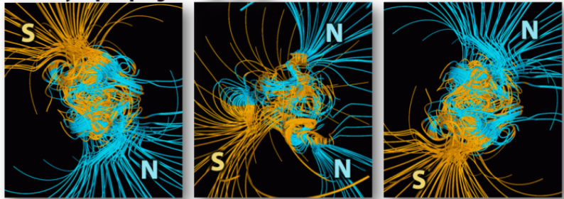
Is Earth’s polarity about to flip? Actual reversal
Supercomputer model of evolution of geomagnetic field dynamo.
Karla Panchuk (2021) CC BY 4.0
Heliophysics Education Activation Team

Slide 24
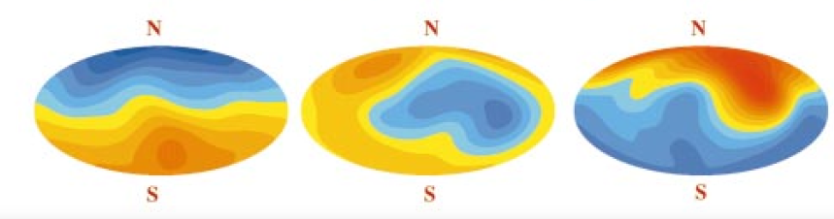
Is Earth’s polarity about to flip? Actual reversal
Credit: Glatzmaier et al., 1999 ;
https://www.semanticscholar.org/paper/Geodynamo-theory-and-simulations-Roberts-Glatzmaier/
5bb472aa711d5b445101862a23f71981f30c57de
Heliophysics Education Activation Team

Slide 25
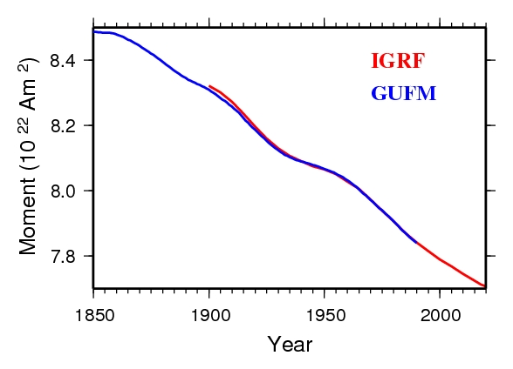
Is Earth’s polarity about to flip? Weakening field
The strength of Earth’s
dipole field is weakening
Heliophysics Education Activation Team

Slide 26
Is Earth’s polarity about to flip? Weakening field
Are we headed for a reversal?
Yes? | No?
Mary Hill Museum and LNG in Northern BC
Heliophysics Education Activation Team

Slide 27
Is Earth’s polarity about to flip? Beginners - trends
The strength of Earth’s dipole field
value = 8.45 x 10²² Am²
2000 value = 7.8x10²² Am²
Linear Equation:
M = (7.8-8.45) / (2000 – 1850)
M = -0.0043
Y = Mx + b
Y = -0.0043 (T-1850) + 8.45
Heliophysics Education Activation Team

Slide 28
Is Earth’s polarity about to flip? Beginners - trends
The strength of Earth’s dipole field
value = 8.45 x 10²² Am²
2000 value = 7.8x10²² Am²
Linear Equation:
M = (7.8-8.45) / (2000 – 1850)
M = -0.0043
Y = Mx + b
Y = -0.0043 (T-1850) + 8.45
Y = 0 in the year T = 3815 CE
Heliophysics Education Activation Team

Slide 29
Is Earth’s polarity about to flip? Beginners - trends
The strength of Earth’s dipole field
value = 8.45 x 10²² Am²
2000 value = 7.8x10²² Am²
Linear Equation:
M = (7.8-8.45) / (2000 – 1850)
M = -0.0043
Y = Mx + b
Y = -0.0043 (T-1850) + 8.45
But wait! It’s not that simple!!!
Y = 0 in the year T = 3815 CE
Heliophysics Education Activation Team

Slide 30
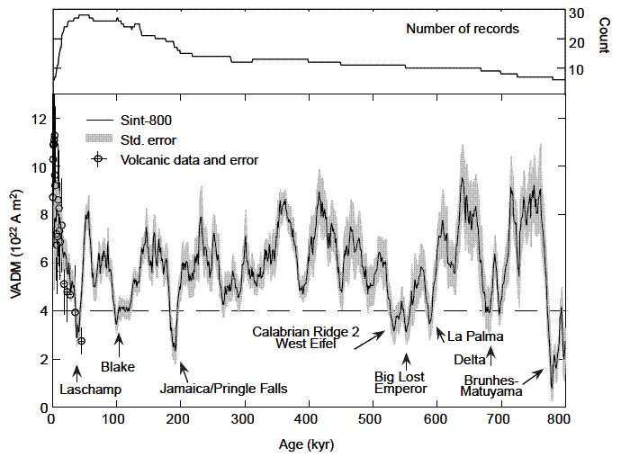
Is Earth’s polarity about to flip? Reversal vs Excursion
All reversals are excursions
but
not all excursions are reversals
2000 CE
Magnetic Excursions
No reversal
Full Reversal of polarity
Bruhes/Matuyama
Heliophysics Education Activation Team

Slide 31
Is Earth’s polarity about to flip? Intermediate - odds
In 800,000 years there has been
1- magnetic reversal
16 –magnetic excursions
Calculating the odds:
Excursion: 16/17 = 16 in 17 odds
Reversal: 1/17 = 1 in 17 odds
Heliophysics Education Activation Team

Slide 32
Is Earth’s polarity about to flip? Intermediate - odds
Earth’s field is declining
But it has a long way to go
before it gets as low as the
most recent Laschamp Excursion.
From the record, it is 16-times
more likely we are headed for
another Laschamp Excursion
than a full reversal.
2000 CE
Laschamp
Excursion
Reversal threshold
Heliophysics Education Activation Team

Slide 33
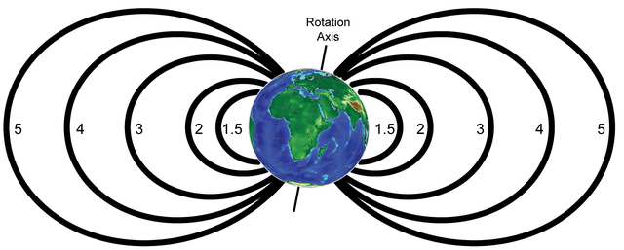
Is Earth’s polarity about to flip? Rotation axis too?
Earth rotation on north-south axis from west to east
Magnetic dipole axis closely aligned with rotation
axis with South-type in Northern Hemisphere and
North-type in Southern Hemisphere
Rotation Axis
Magnetic axis
Image: Wikipedia/Dipole model of Earth’s magnetic field
Heliophysics Education Activation Team

Slide 34
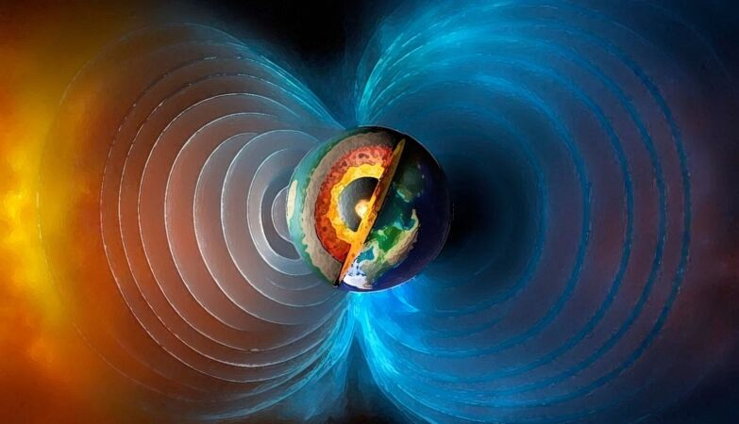
Is Earth’s polarity about to flip?
Will the rotation axis also flip?
Yes? | No?
Mary Hill Museum and LNG in Northern BC
Heliophysics Education Activation Team

Slide 35
Is Earth’s polarity about to flip? Advanced - Energy
Energy stored in Earth’s magnetic field:
Estimate:
B²
E = Volume x ----------
8 π
B = 0.5 gauss
Volume = 4/3 π (6378x10⁵)³
= 1.0 x 10²⁷ cm³
E = 10²⁷ x (0.5)²/25.1
E = 1.0 x 10²⁵ ergs.
E = 1.0 x 10¹⁸ Joules
Energy stored in rotation of Earth:
E = ½ I ω²
I = moment of inertia
ω = angular velocity in steradians/sec
I (Earth) = 9.7 x 10³⁷ kg m²
= 2 π/24hrs = 7.2x10⁻⁵ radians/sec
E = 0.5 x (9.7x10³⁷) x (7.2x10⁻⁵)²
E = 2.5x10²⁹ Joules
Heliophysics Education Activation Team

Slide 36
Is Earth’s polarity about to flip? But NOT rotation
Earth rotation on north-south axis from west to east
Magnetic dipole axis closely aligned with rotation
axis with South-type in Northern Hemisphere and
North-type in Southern Hemisphere
Rotation Axis
If the magnetic polarity during a reversal
changes, that does NOT cause rotational
axis to ‘flip’
Magnetic axis
Image: Wikipedia/Dipole model of Earth’s magnetic field
Heliophysics Education Activation Team

Slide 37
Is Earth’s polarity about to flip? In the Media
Beware of web articles that confuse reversals and excursions.
Plenty of popularizations call Laschamp a reversal event. It was, in fact, a magnetic excursion.
University of Melbourne: ‘When the Earth’s magnetic field flipped’
https://pursuit.unimelb.edu.au/articles/when-the-earth-s-magnetic-field-flipped
New Scientist: ‘Earth’s magnetic field flipping linked to extinctions 42,000 years ago
https://www.newscientist.com/article/2268520-earths-magnetic-field-flipping-linked-to-extinctions-42000-years-ago/
The Conversation: Why Earth’s magnetic poles could be about to swap places and how it would affect us.
https://theconversation.com/why-the-earths-magnetic-poles-could-be-about-to-swap-places-and-how-it-would-affect-us-71910
Newsweek: The Earth’s magnetic field will reverse one day.
https://www.newsweek.com/earth-magnetic-field-reversal-flip-1322291
Heliophysics Education Activation Team

Slide 38
Is Earth’s polarity about to flip?
Hazards to think about during a genuine Reversal
Extinction of some species? - Nope! No fossil evidence.
Power grid problems caused by induced geomagnetic currents? – Probably
Aurora seen in unusual geographic locations? - Very likely
Disoriented animal navigation and migration? – Very likely
Human health risks from UV exposure – Possibly
Health risks during jet flights at high altitude – Very likely
Day to day life impacted? Nope.
Mass hysteria? Nope… ‘Boiling frogs’
Heliophysics Education Activation Team

Slide 39
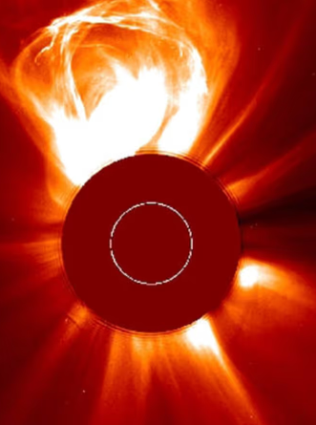
Next time
Is there a solar super-flare in our future?
You betcha!
Heliophysics Education Activation Team

