Slide 1




The Heliophysics Big Year
National Aeronautics and Space Administration
Dr. Sten Odenwald, Astronomer
NASA Heliophysics Education Activation Team

Slide 2


December 2024: What is Heliophysics?
Heliophysics is the discipline in space science that deals with the matter and energy of our Sun and its effects on the solar system.
It also studies how the Sun varies and how those changes pose a hazard to humans on Earth and in space
Heliophysics Education Activation Team

Slide 3



Heliophysics Big Year Timeline
Annular Eclipse
Total Eclipse
Solar Parker
Probe Perihelion
October 14, 2023
April 8, 2024
December 24, 2024
ADD MEDIA HERE
ADD MEDIA HERE
ADD MEDIA HERE
Heliophysics Education Activation Team

Slide 4

Heliophysics Big Year Themes
2023
October- Annular Solar Eclipse
November- Mission Fleet
December- Citizen Science
2024
January- Sun Touches Everything
February- Fashion
March- Experiencing the Sun
April- Total Solar Eclipse
May- Visual Art
June- Performance Art
July- Physical and Mental Health
August- Back to School
September- Environment
October – Solar Cycles
November- Bonus Science
December- Parker’s Perihelion
https://www.nasa.gov/science-research/heliophysics/nasa-announces-monthly-themes-to-celebrate-the-heliophysics-big-year/
Heliophysics Education Activation Team

Slide 5
December 2024 : NASA’s Big Questions
1. What causes the Sun to vary?
2. How do the Earth and the heliosphere respond?
3. What are the impacts on humanity?
These Big Questions form the basis for the
Framework for Heliophysics Education
https://science.nasa.gov/learn/heat/big-ideas/
Heliophysics Education Activation Team

Slide 6
How to Teach Heliophysics
Framework for Heliophysics Education
What causes the Sun to vary?
1.1 The Sun is really big and its gravity influences all objects in the solar system. (PS2, ESS1)
1.2 The Sun is active and can impact technology on Earth via space weather. (PS1,PS2, PS4, ESS2, ESS3)
1.3 The Sun’s energy drives Earth’s climate, but the climate is in a delicate balance and is changing due to human activity. (PS1, PS2, PS3, LS4, ESS2, ESS3)
How do Earth, the solar system, and the heliosphere respond to changes on the Sun?
2.1 Life on Earth has evolved with complex diversity because of our location near the Sun. It is just right! (PS3, PS4, LS1, LS2, ESS2)
2.2 The Sun defines the space around it, which is different from interstellar space. (PS2, ESS1, ESS2)
2.3 The Sun is the primary source of light in the solar system. (PS1, PS2, PS3,PS4, ESS1)
What are the impacts of changes on the Sun on humans?
3.1 The Sun is made of churning plasma, causing the surface to be made of complex, tangled magnetic fields. (PS1, PS2, ESS1, ESS2)
3.2 Energy from the Sun is created in the core and travels outward through the Sun and into the heliosphere. (PS1, PS3, PS4, ESS1, ESS2, ESS3)
3.3 Our Sun, like all stars, has a life cycle. (PS1, LS1, ESS1)
3 Heliophysics Investigatory Questions
3 NGSS-aligned
Big Ideas per Question
3 Guiding Questions per Idea
-1 Question per Level-
Heliophysics
Resource Database
Heliophysics Education Activation Team
Notes:
The Framework for Heliophysics Education provides the background and scaffolding educators need to incorporate heliophysics topics into existing STEM curricula. Using the three main questions that heliophysicists investigate as the foundation, this framework connects heliophysics topics with NGSS Disciplinary Core Ideas, to create NGSS-aligned Heliophysics Big Ideas.
The nine Heliophysics Big Ideas encompass the major heliophysics concepts that can be explored through existing Next Generation Science Standards (NGSS) disciplinary core ideas. Each Heliophysics Big Idea has a guiding question for each level, designed to support inquiry-based learning.
Introductory Learner = A younger learner (K-5), or a learner new to the subject matter.
Intermediate Learner = A middle-aged learner (6-8), or a learner that has some familiarity with the subject matter.
Advanced Learner = An older learner (9-12+), or a learner that has a lot of experience with the subject matter.

Slide 7
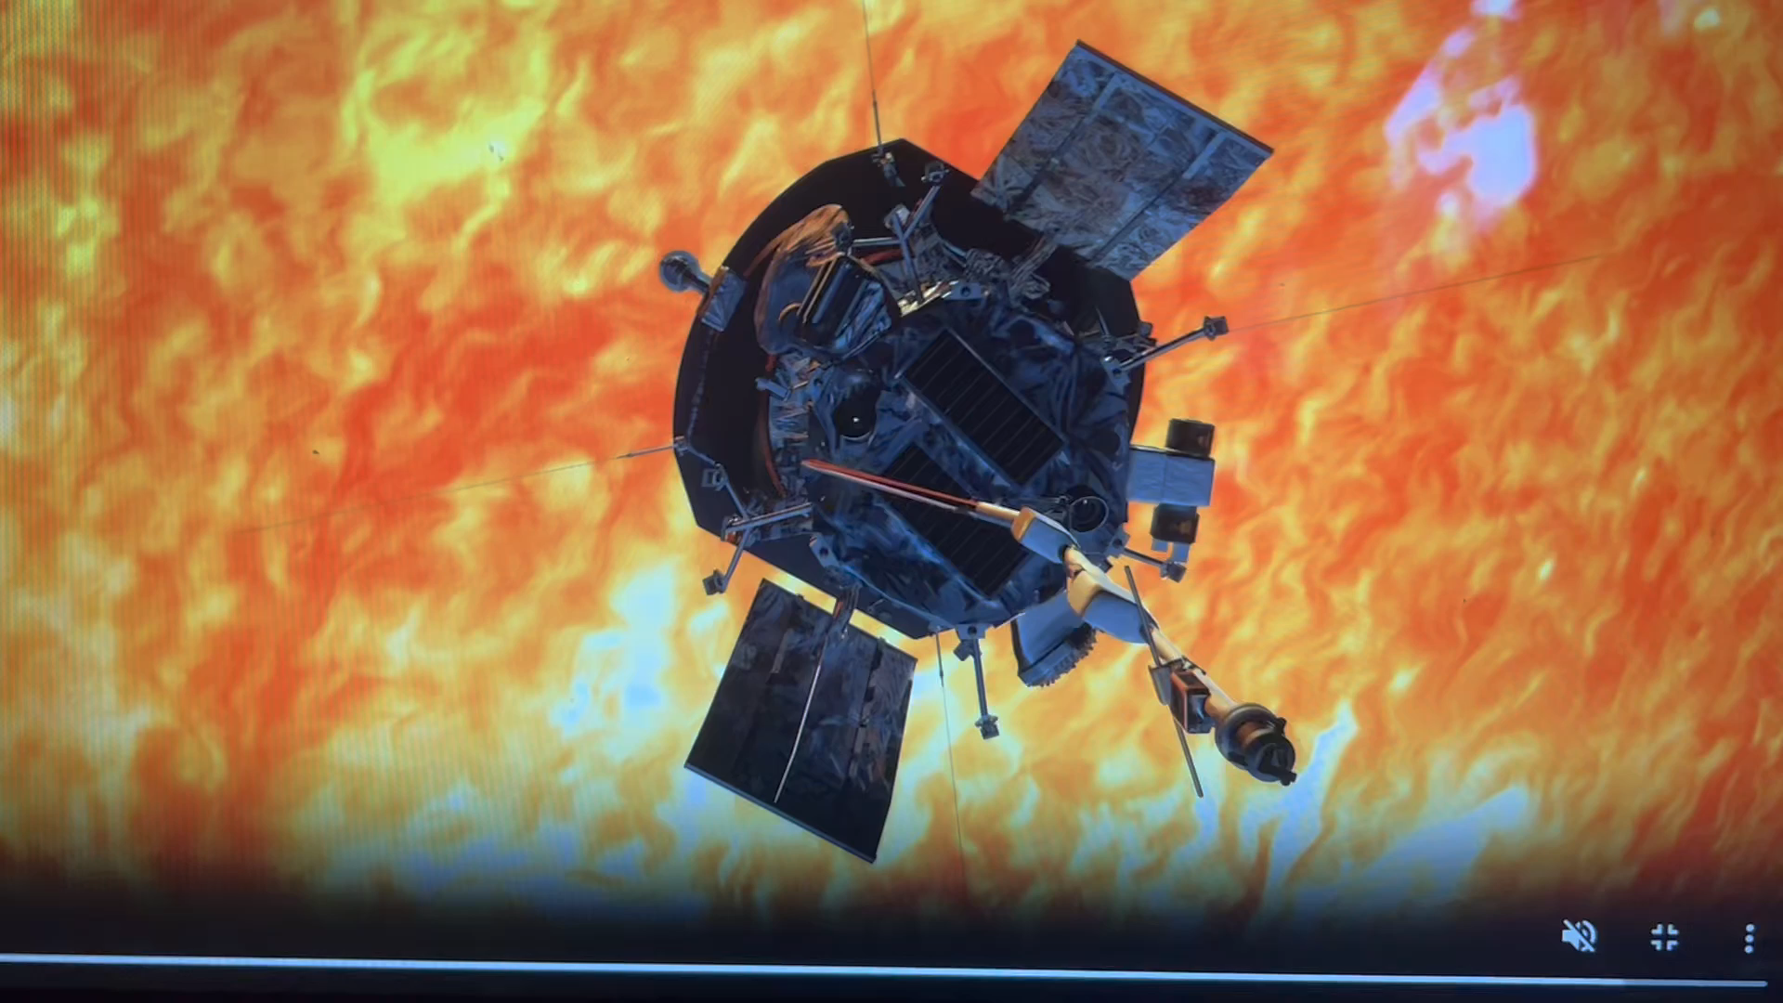
December 2024: The Parker Solar Probe
Launched:
August 12, 2018
Current Orbit:
22
Perihelion:
7.3 million km
Heliophysics Education Activation Team

Slide 8
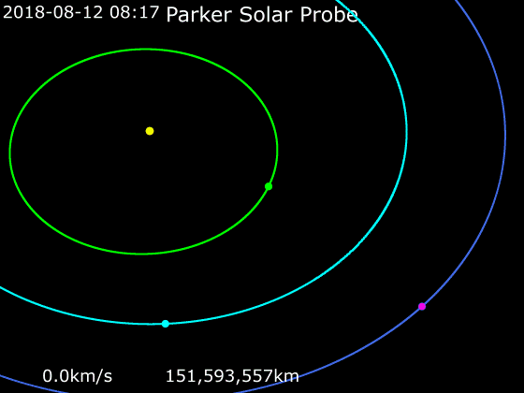
December 2024: Parker Solar Probe
The goal is to study the inner corona and investigate the origin of the solar wind and other phenomena.
Parker orbits: NASA/JPL/Horizons System
Heliophysics Education Activation Team

Slide 9
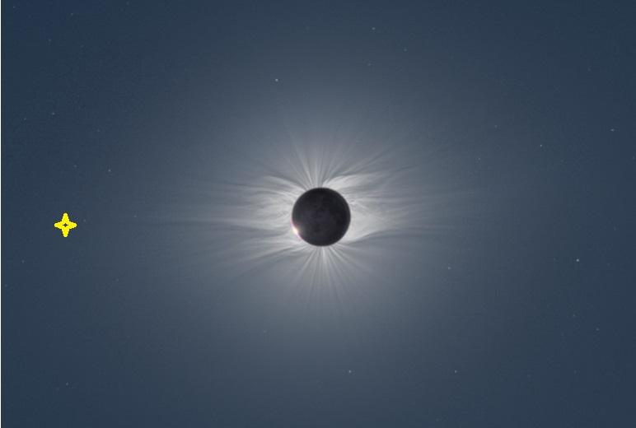
December 2024: Parker Solar Probe
Spacecraft Temp : 2,600 F
Speed: 640,000 km/h
400,000 mph
Closest Approach
2009 Eclipse (Credit: Miloslav Druckmuller)
Heliophysics Education Activation Team

Slide 10
December 2024: Parker Solar Probe
Spacecraft Temp : 2,600 F
Speed: 640,000 km/h
400,000 mph
Travel time to Mars: 88 hours
Closest Approach
2009 Eclipse (Credit: Miloslav Druckmuller)
Heliophysics Education Activation Team

Slide 11
December 2024: Parker Solar Probe
Discoveries so far:
First direct measurements and samples of solar atmosphere
Detection of Alfven Surface where solar wind originates
Detection of coronal streamers from surface that produce the wind
Detection of boundary of the dust-free zone
Discovery of magnetic ‘switchbacks’ of reversed polarity between supergranules
SEPs are very common and not all related to CME shock compression
Heliophysics Education Activation Team

Slide 12
December 2024: Parker Solar Probe- Beginning
Problem: On June 23, 2023
the speed of the solar wind was measured by Parker as 350 km/s
The density was 300 protons/cc
The distance was 21.5 million kilometers.
How much mass was in the shell with a radius of R and a thickness of V x 1 second?
Heliophysics Education Activation Team

Slide 13
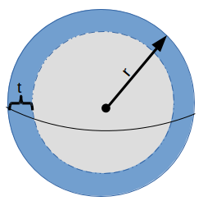
December 2024: Parker Solar Probe- Beginning
Surface area of shell:
A = 4 π (21.5 million x 1000)² = 5.8x10²¹ m²
Thickness: 350 km/s x 1 sec x 1000 m/km
t = 350,000 meters.
Volume = Area x thickness = 2.0x10²⁷ m³
Heliophysics Education Activation Team

Slide 14
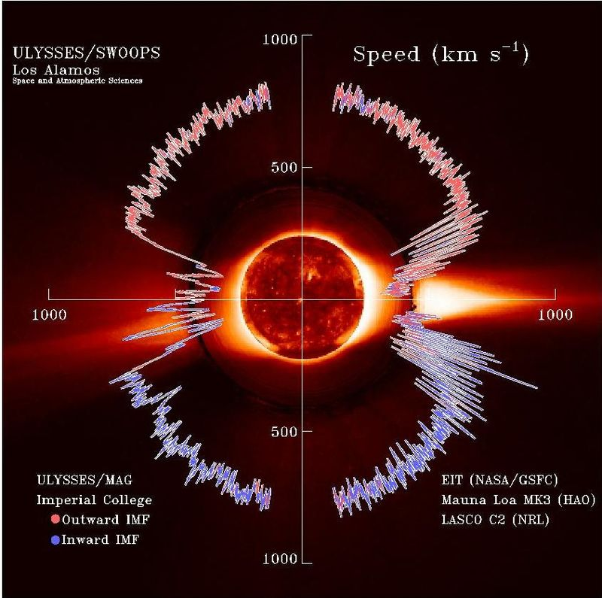
December 2024: Parker Solar Probe- Beginning
Mass of the shell:
M = Volume x density
M = 2x10²⁷ m³ x 300 protons/cm³ x (10⁶ cm³/m³)
M = 6x10³⁵ protons.
1 proton = 1.7x10⁻²⁷ kg.
Mass = 6x10³⁵ x 1.7x10⁻²⁷
Mass = 1 billion kg.
Sun looses 1 billion kg/sec of mass.
Heliophysics Education Activation Team

Slide 15
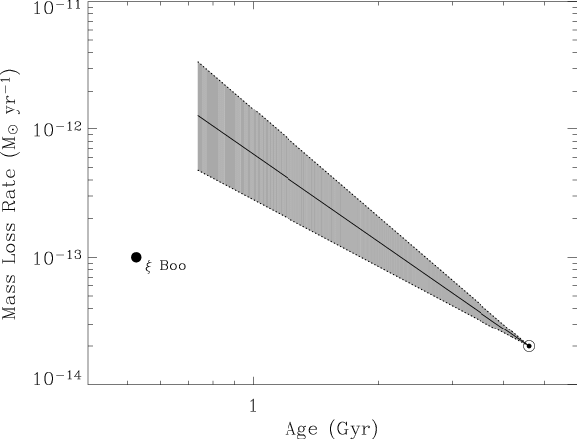
December 2024: Parker Solar Probe- Beginning
At a rate of one billion kg/sec, how much mass has the
sun lost in 4 billion years?
M = 10⁹ kg/s x 4x10⁹ years x 365 days x 86,400 s/day
Mass = 1.3x10²⁶ kg.
Mass of sun = 2x10³⁰ kg
Percent of mass lost =
100% x 1.3x10²⁶/2x10³⁰ = 0.007%
Our estimate from Parker: 1.6x10⁻¹⁴ Msun/year.
Previous values: between 1 and 5 x 10⁻¹⁴ Msun/year.
Historical mass loss rates for the sun.
(Credit: Wood, Redfield, Linsky and Muller)
Heliophysics Education Activation Team

Slide 16
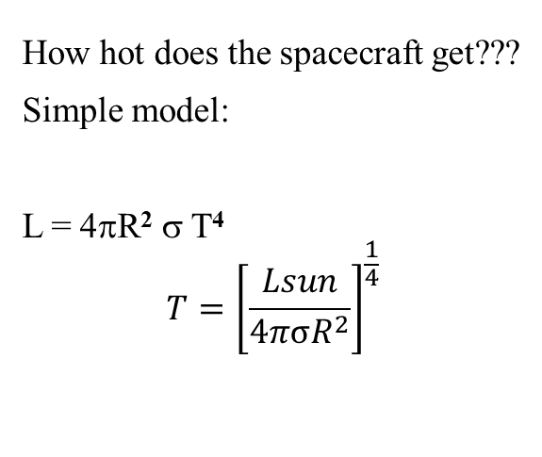
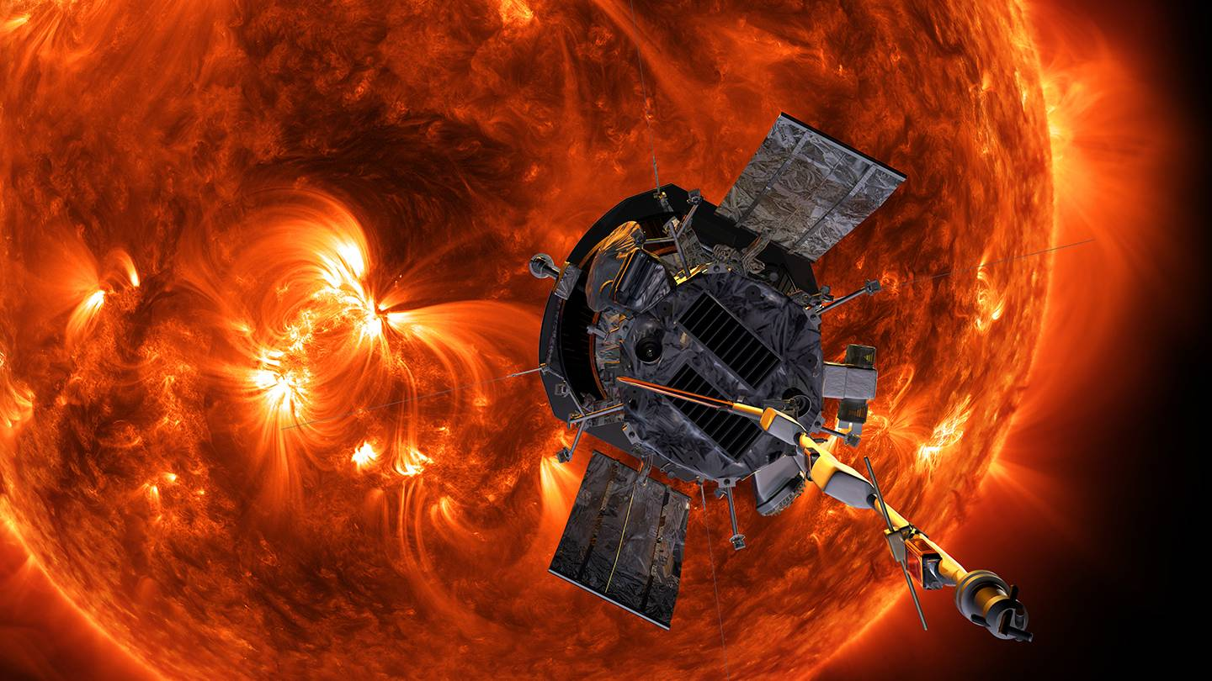
December 2024: Parker Solar Probe- Intermediate
Heliophysics Education Activation Team

Slide 17
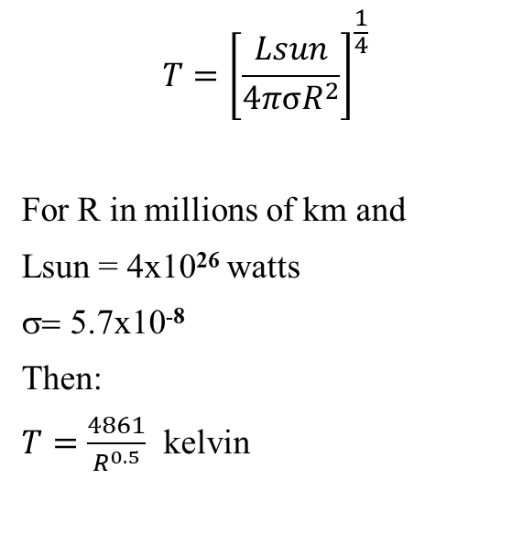
December 2024: Parker Solar Probe- Intermediate
Heliophysics Education Activation Team

Slide 18
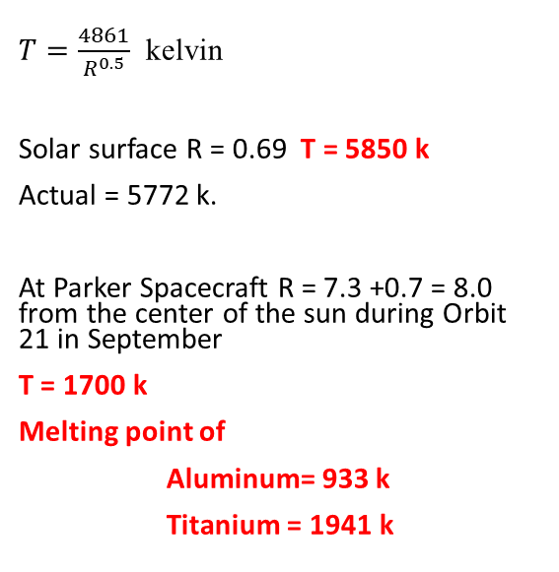
December 2024: Parker Solar Probe- Intermediate
Heliophysics Education Activation Team

Slide 19
December 2024: Parker Solar Probe- Advanced
Problem: What would be the predicted density of the solar corona at the perihelion of 7.3 million km from the solar surface (8.0 from the center) during Orbit 21 in September?
Data from previous perihelia with:
distance in millions of km from center
density in particles/cc
Perihelion # | Distance | Density
11 | 9.3 | 2000
14 | 9.2 | 1500
6 | 14 | 1000
7 | 14 | 800
4 | 19 | 500
1 | 25 | 350
10 | 30.5 | 60
Orbit data : https://psp-gateway.jhuapl.edu/
SWEAP density only available to April 13, 2024.
Distance from surface = Distance – 0.7
Heliophysics Education Activation Team

Slide 20
December 2024: Parker Solar Probe- Advanced
Graph it.
Heliophysics Education Activation Team

Slide 21
December 2024: Parker Solar Probe- Advanced
Model with a power law. D(x) = Ax^{-n}
Trial and error
Model 1 : A=160000 n = 2.0
Model 2: A = 350000 n=2.5
Model 3: A = 2500000 n = 3.0
Heliophysics Education Activation Team

Slide 22
December 2024: Parker Solar Probe- Advanced
Trial 2: Select D(x)=Ax^{-2.5}
Adjust A to get a better match to closed-in points where we will make the prediction
A1= 30000 Best for x > 15
A2= 400000 works best for x<10
A3 = 500000
Heliophysics Education Activation Team

Slide 23
December 2024: Parker Solar Probe- Advanced
On December 24, 2024 Orbit 22, Parker perihelion is at 6.2 million km from surface or 6.9 million km from center.
Predicted density at X = 6.9 million km
D(x) = 400000 (6.9)^{-2.5} our best model
D(x) = 3200 protons/cc
https://psp-gateway.jhuapl.edu/website/Tools/SummaryImagePlotter
Heliophysics Education Activation Team

Slide 24
December 2024: Parker Solar Probe- ChatGPT
Let ChatGPT calculate the models!
ChatGPT Query. Find a power-law of the form Y= Ax^-2.5 that fits the six data points (9.3,2000), (14,900) and (30 ,60), (9.2,1500), (19, 500), (25, 350). Find the best value for A that passes close to the three points. Show your work.
2000 = A(9.3)^{-2.5}
900 = A(14)^{-2.5}
60=A(30)^{-2.5}
1500 =A(9.2)^{-2.5}
500 = A (19)^{-2.5}
350 = A(25)^{-2.5}
Average value for A = 1,527,211
Heliophysics Education Activation Team

Slide 25
December 2024: Parker Solar Probe- ChatGPT
Let ChatGPT calculate the models!
It provides the worst fit of all trials because it does a straight average of all six values for A.
Best = 400000
ChatGPT= 1,527,211
Heliophysics Education Activation Team

Slide 26
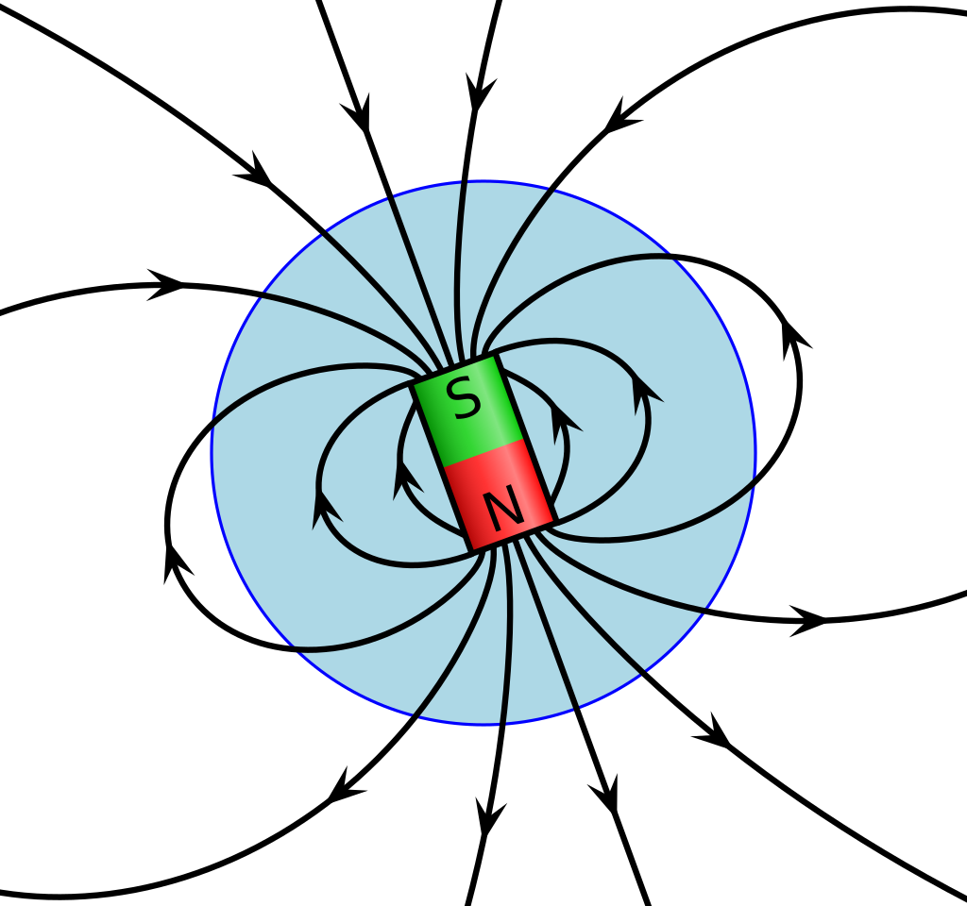
January– New Webinar Series Starts
Is Earth about to reverse its polarity?
Facts and Misconceptions
Wikipedia
Heliophysics Education Activation Team

Slide 27
Slides and Recordings
Slides: https://rb.gy/qsgmbr
Previous webinar recordings https://www.youtube.com/watch?v=lwf8Y_fOOls&list=PL5mpEj48YwXntxhPvZBgJn0ZG5MRm4UlS
Heliophysics Education Activation Team

