Slide 1




The Heliophysics Big Year
National Aeronautics and Space Administration
Dr. Sten Odenwald, Astronomer
NASA Heliophysics Education Activation Team

Slide 2
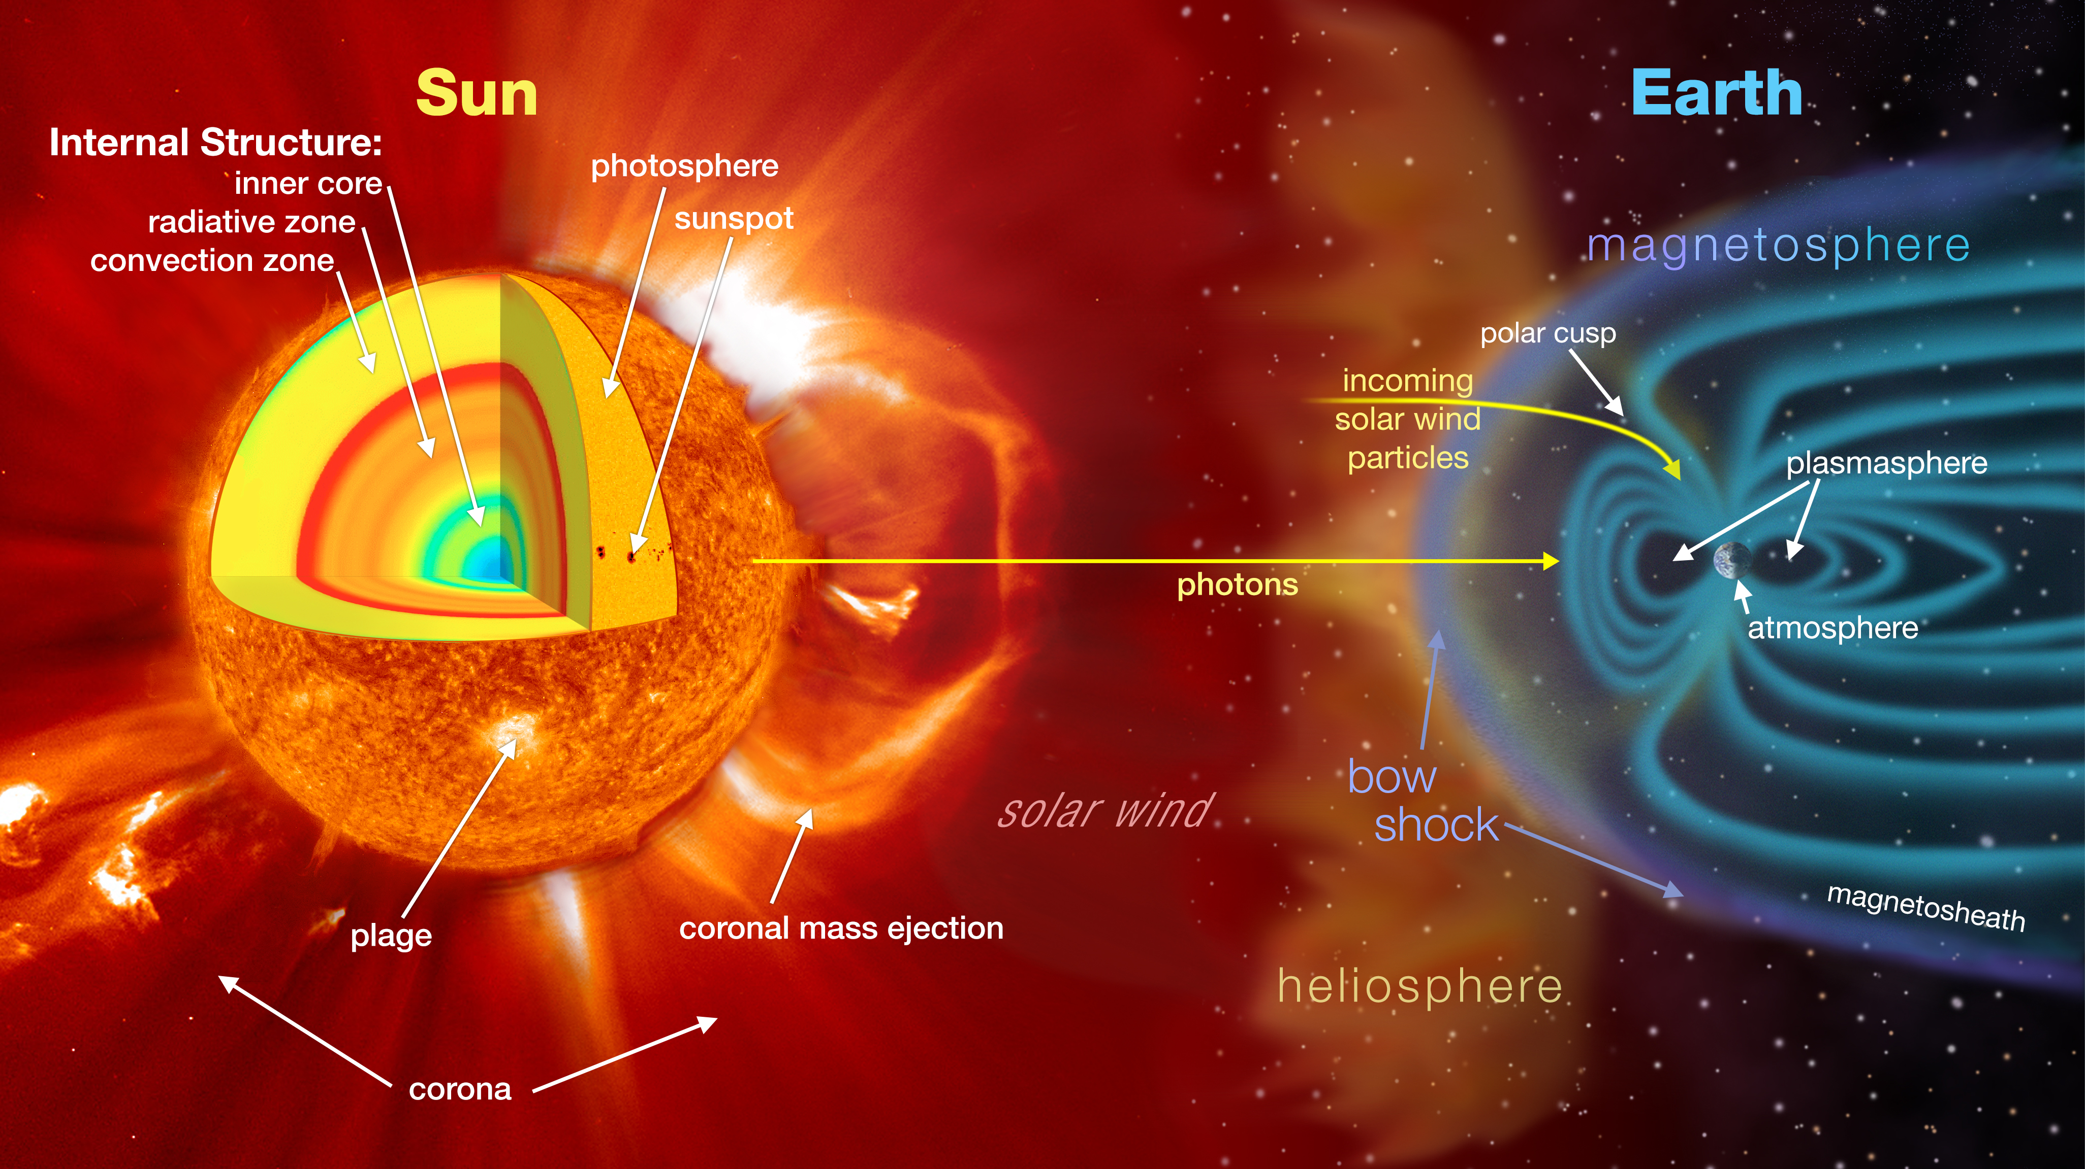

November 2024: What is Heliophysics?
Heliophysics is the discipline in space science that deals with the matter and energy of our Sun and its effects on the solar system.
It also studies how the Sun varies and how those changes pose a hazard to humans on Earth and in space
Heliophysics Education Activation Team

Slide 3
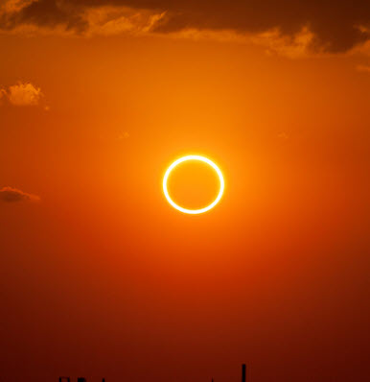
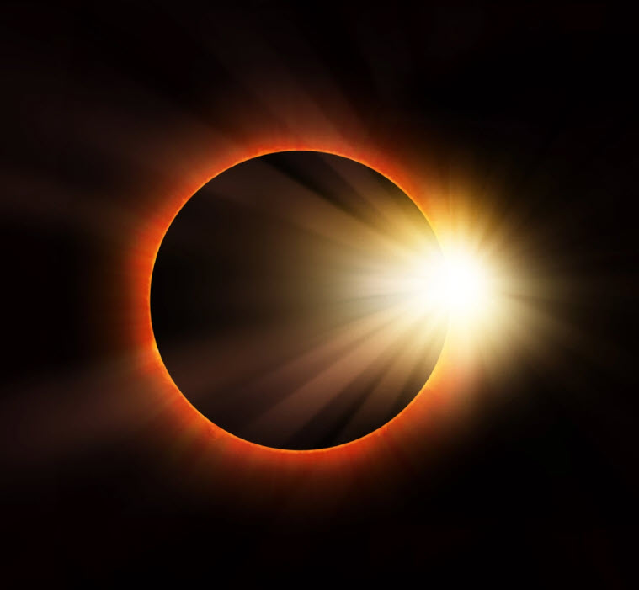
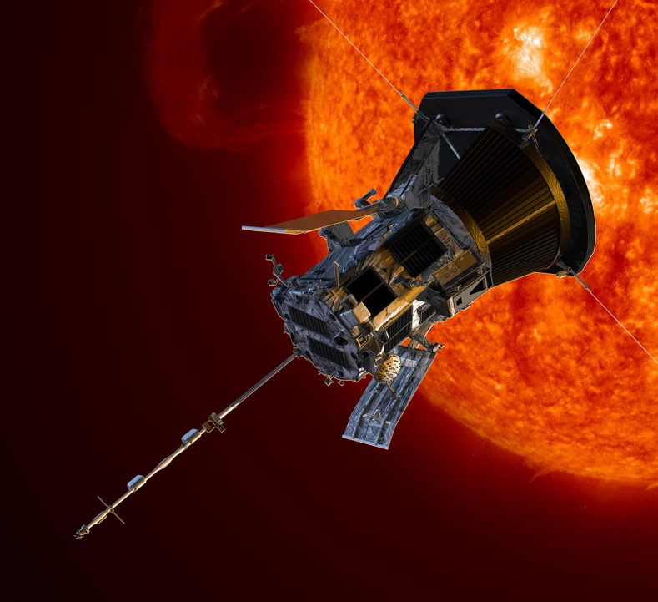
Heliophysics Big Year Timeline
Annular Eclipse
Total Eclipse
Solar Parker
Probe Perihelion
October 14, 2023
April 8, 2024
December 24, 2024
ADD MEDIA HERE
ADD MEDIA HERE
ADD MEDIA HERE
Heliophysics Education Activation Team

Slide 4

Heliophysics Big Year Themes
2023
October- Annular Solar Eclipse
November- Mission Fleet
December- Citizen Science
2024
January- Sun Touches Everything
February- Fashion
March- Experiencing the Sun
April- Total Solar Eclipse
May- Visual Art
June- Performance Art
July- Physical and Mental Health
August- Back to School
September- Environment
October – Solar Cycles
November- Bonus Science
December- Parker’s Perihelion
https://www.nasa.gov/science-research/heliophysics/nasa-announces-monthly-themes-to-celebrate-the-heliophysics-big-year/
Heliophysics Education Activation Team

Slide 5
November 2024 : NASA’s Big Questions
1. What causes the Sun to vary?
2. How do the Earth and the heliosphere respond?
3. What are the impacts on humanity?
These Big Questions form the basis for the
Framework for Heliophysics Education
https://science.nasa.gov/learn/heat/big-ideas/
Heliophysics Education Activation Team

Slide 6
How to Teach Heliophysics
Framework for Heliophysics Education
3 Heliophysics Investigatory Questions
What causes the Sun to vary?
1.1 The Sun is really big and its gravity influences all objects in the solar system. (PS2, ESS1)
1.2 The Sun is active and can impact technology on Earth via space weather. (PS1,PS2, PS4, ESS2, ESS3)
1.3 The Sun’s energy drives Earth’s climate, but the climate is in a delicate balance and is changing due to human activity. (PS1, PS2, PS3, LS4, ESS2, ESS3)
How do Earth, the solar system, and the heliosphere respond to changes on the Sun?
2.1 Life on Earth has evolved with complex diversity because of our location near the Sun. It is just right! (PS3, PS4, LS1, LS2, ESS2)
2.2 The Sun defines the space around it, which is different from interstellar space. (PS2, ESS1, ESS2)
2.3 The Sun is the primary source of light in the solar system. (PS1, PS2, PS3,PS4, ESS1)
What are the impacts of changes on the Sun on humans?
3.1 The Sun is made of churning plasma, causing the surface to be made of complex, tangled magnetic fields. (PS1, PS2, ESS1, ESS2)
3.2 Energy from the Sun is created in the core and travels outward through the Sun and into the heliosphere. (PS1, PS3, PS4, ESS1, ESS2, ESS3)
3.3 Our Sun, like all stars, has a life cycle. (PS1, LS1, ESS1)
3 NGSS-aligned
Big Ideas per Question
3 Guiding Questions per Idea
-1 Question per Level-
Heliophysics
Resource Database
Heliophysics Education Activation Team
Notes:
The Framework for Heliophysics Education provides the background and scaffolding educators need to incorporate heliophysics topics into existing STEM curricula. Using the three main questions that heliophysicists investigate as the foundation, this framework connects heliophysics topics with NGSS Disciplinary Core Ideas, to create NGSS-aligned Heliophysics Big Ideas.
The nine Heliophysics Big Ideas encompass the major heliophysics concepts that can be explored through existing Next Generation Science Standards (NGSS) disciplinary core ideas. Each Heliophysics Big Idea has a guiding question for each level, designed to support inquiry-based learning.
Introductory Learner = A younger learner (K-5), or a learner new to the subject matter.
Intermediate Learner = A middle-aged learner (6-8), or a learner that has some familiarity with the subject matter.
Advanced Learner = An older learner (9-12+), or a learner that has a lot of experience with the subject matter.

Slide 7
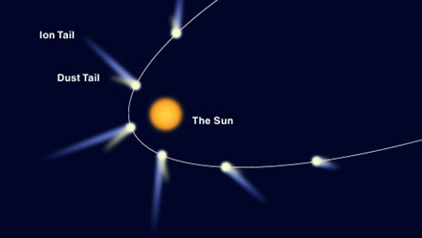
November 2024: The Solar Wind-Origin
We have known about the solar wind since the 1950s.
Comet tails = wind socks
Light pressure too weak
Particle pressure needed
Emitted from sun radially.
Heliophysics Education Activation Team

Slide 8
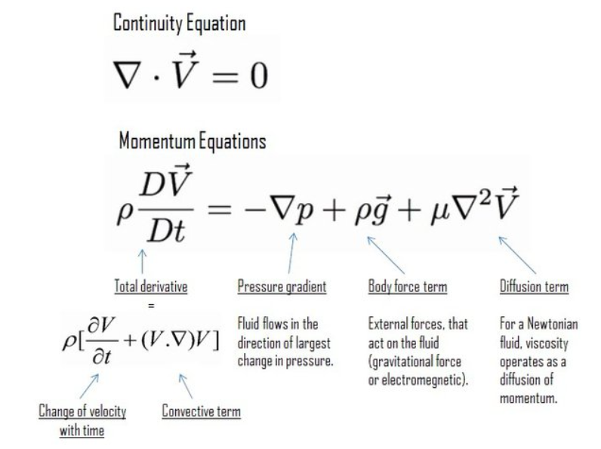
November 2024: The Solar Wind-Origin
Eugene Parker models ca 1957
Gas hydrodynamics described by
Navier-Stokes Equation
Heliophysics Education Activation Team

Slide 9
November 2024: The Solar Wind-Origin
Eugene Parker models ca 1957
Gas hydrodynamics described by
Navier-Stokes Equation: F=ma
Let’s look at simplest one!
Heliophysics Education Activation Team

Slide 10
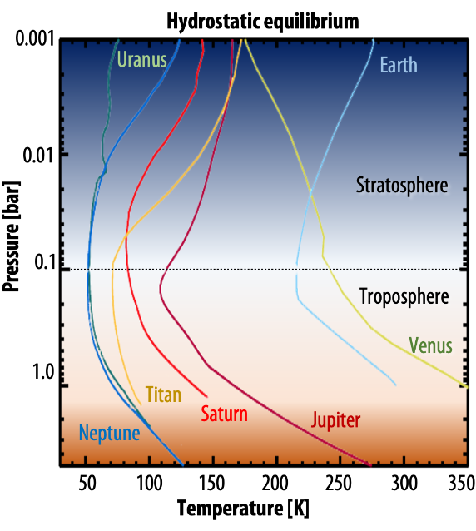
November 2024: The Solar Wind-Origin
Planetary atmosphere solution.
Isothermal
Gravity in one direction
Hydrostatic equilibrium
Credit: NASA https://psg.gsfc.nasa.gov/helpatm.php
Heliophysics Education Activation Team

Slide 11
November 2024: The Solar Wind-Origin
Planetary atmosphere solution.
Isothermal
Gravity in one direction
Hydrostatic equilibrium
Here’s another solution!
Credit: NASA https://psg.gsfc.nasa.gov/helpatm.php
Heliophysics Education Activation Team

Slide 12
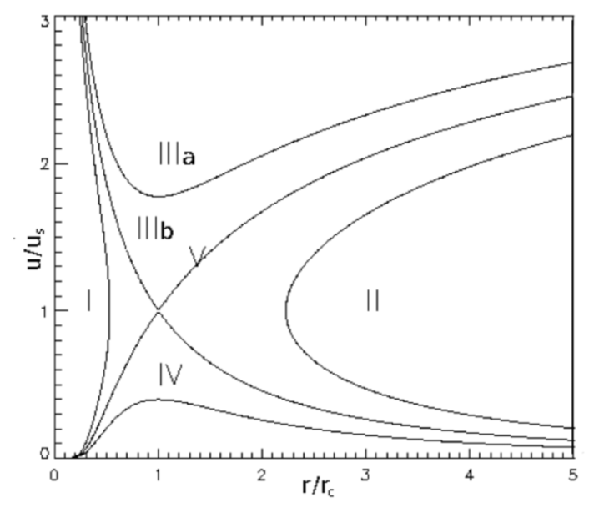
November 2024: The Solar Wind-Origin
Parker solar wind solutions
Heated from base
Mass inflow
Temperature gradient
Five classes of solutions
Solar wind = Solution V
Heliophysics Education Activation Team

Slide 13
November 2024: The Solar Wind-Origin
Parker solar wind solutions
Heated from base
Mass inflow
Temperature gradient
Five classes of solutions
Solar wind = Solution V
300 km/s
Transition to
supersonic outflow
Earth
Distance
Heliophysics Education Activation Team

Slide 14
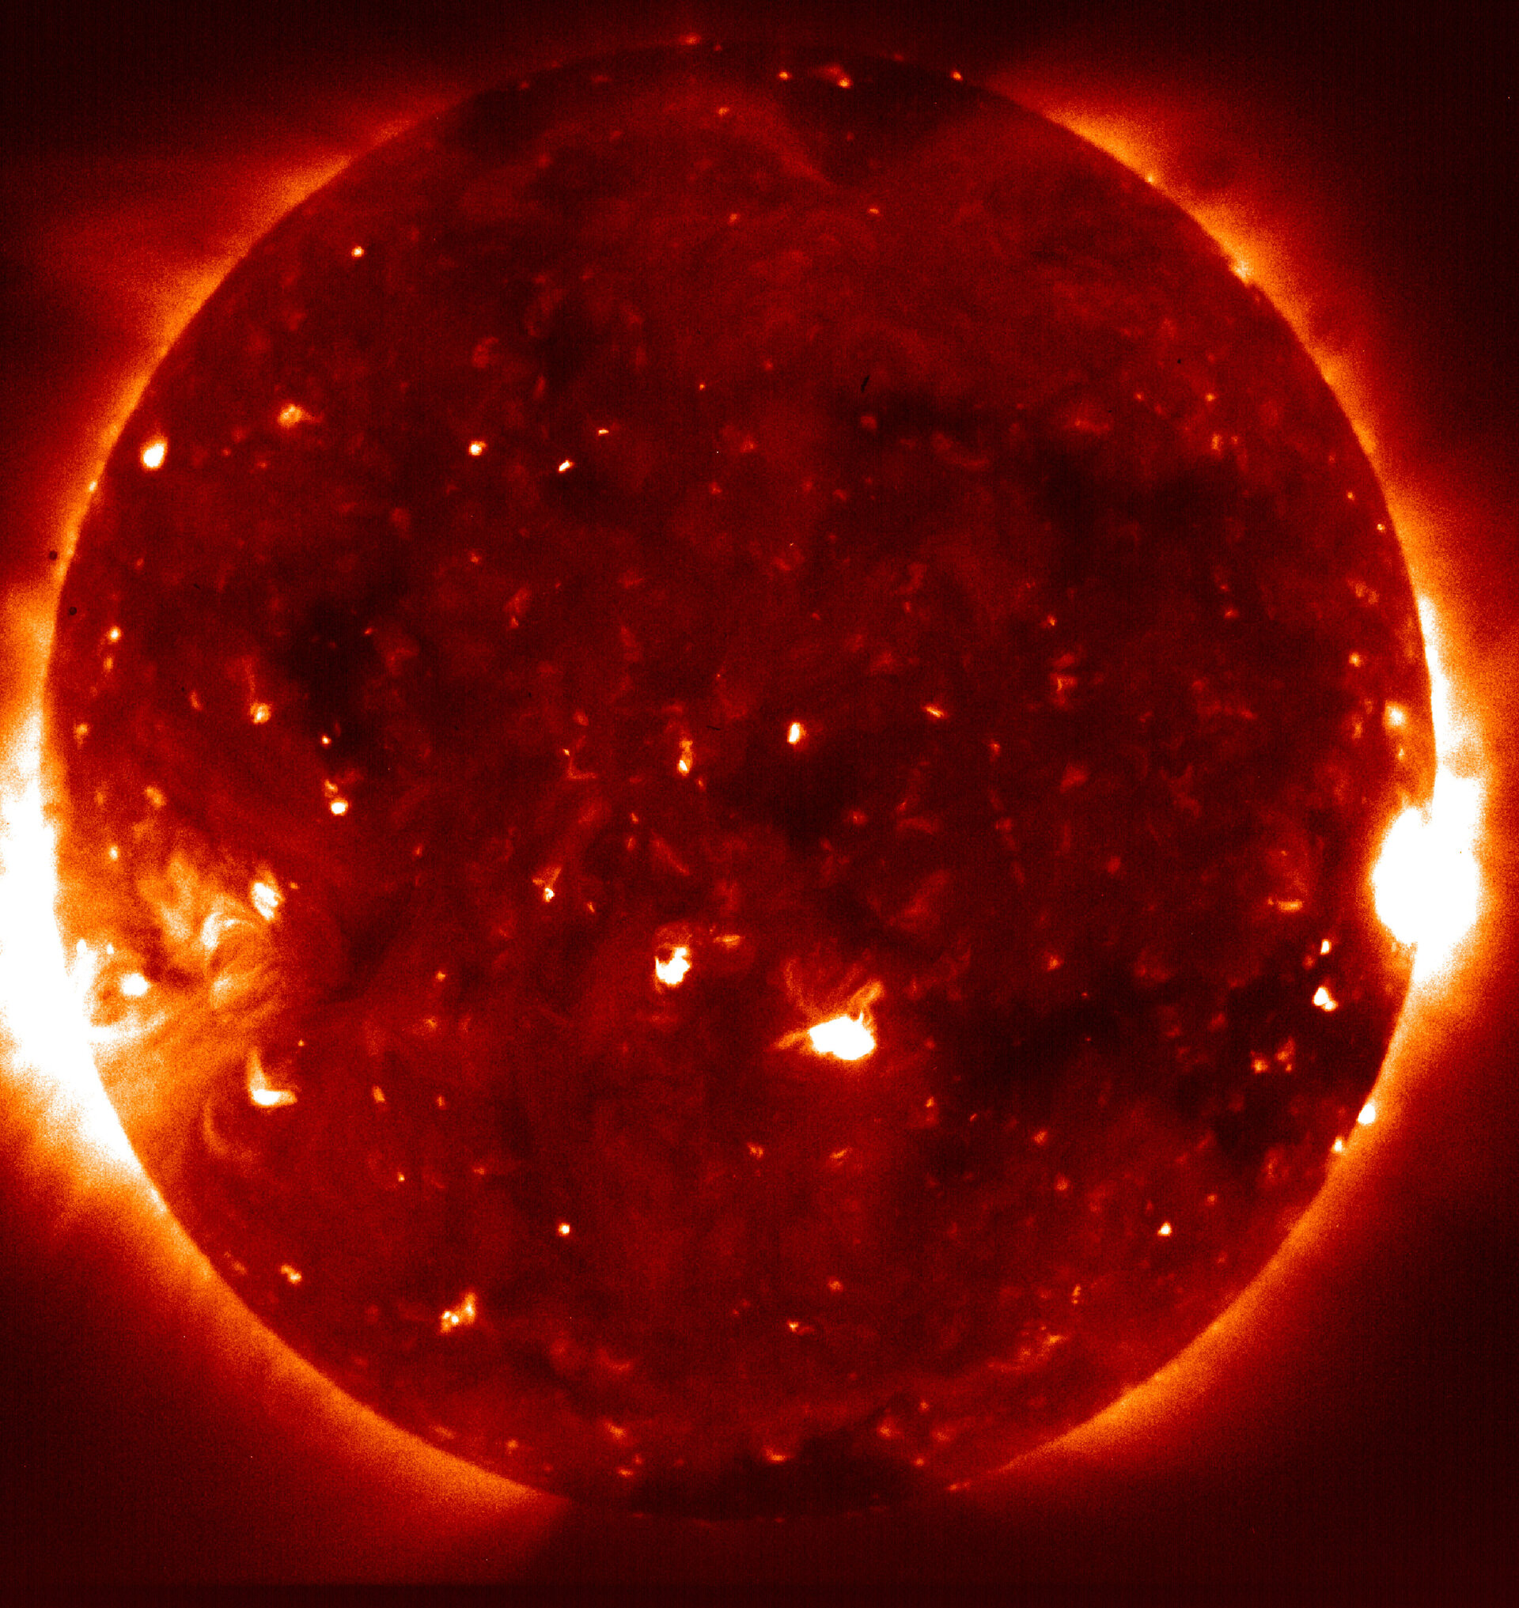
December 2024 – Where does it come from?
Hinode spacecraft 2006
Nanoflares
Heliophysics Education Activation Team

Slide 15
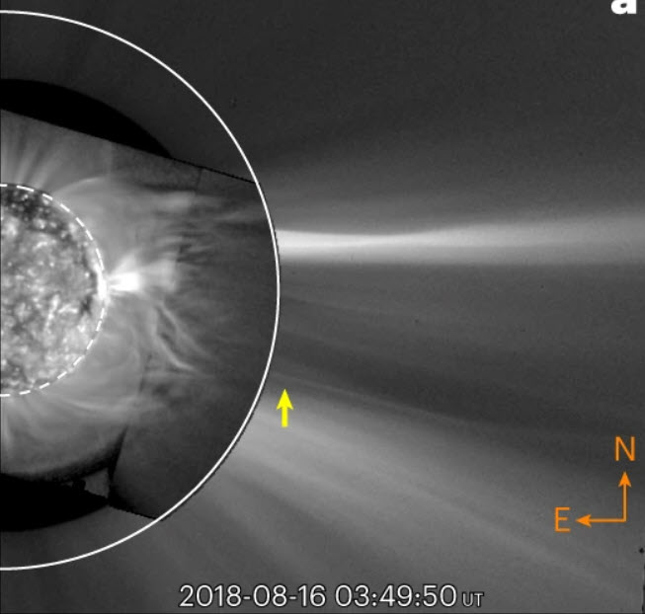
December 2024 – Where does it come from?
Direct observations of a complex coronal web driving highly structured slow solar wind.
GOES plus SOHO/LASCO
Yeimy Rivera et al 2022
https://doi.org/10.1038/s41550-022-01834-5
GOES/EUV
LASCO
Heliophysics Education Activation Team

Slide 16
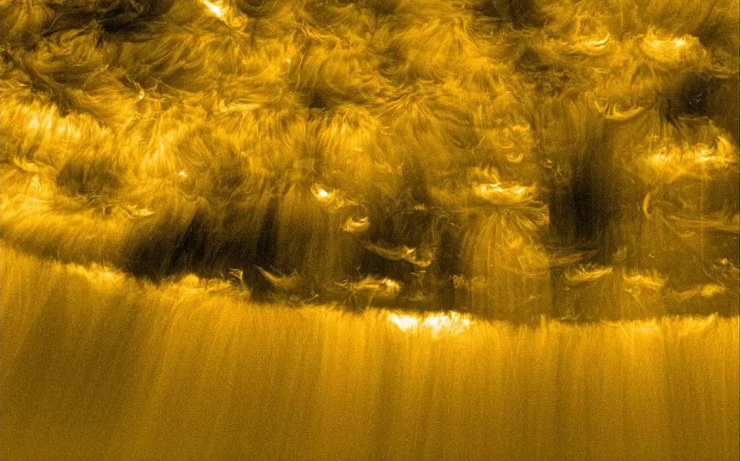
December 2024 – Where does it come from?
Numerous small picojets jets seen by Solar Orbiter spacecraft
Chitta et al. 2023
https://www.science.org/doi/10.1126/science.ade5801
Credit: ESA/https://www.mps.mpg.de/tiny-plasma-jets-power-the-solar-wind
Heliophysics Education Activation Team

Slide 17
December 2024 – Beginners – Picojets
If each picojet is a cylinder 200 km in radius.
How many picojets could cover the entire sun with a radius of 690,000 km?
Solar surface = 4π R²
= 4π (690000)²
= 6x10¹² km²
Jet area = π R²
= π(200)²
= 1.3x10⁵ km²
So N = 6x10¹²/1.3x10⁵
= 48 million
Heliophysics Education Activation Team

Slide 18
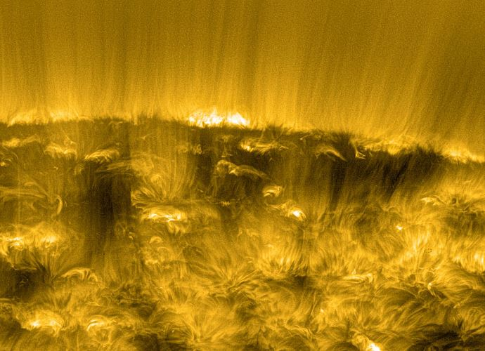
December 2024 – Beginners - Picojets
The solar wind carries off 2 billion kg every second.
How much matter is carried off by a single picojet?
Heliophysics Education Activation Team

Slide 19
December 2024 – Beginners - Picojets
The solar wind carries off 2 billion kg every second.
How much matter is carried off by a single picojet?
From our previous calculation,
there are as many as
48 million picojets
covering the solar surface.
Mass = 2 billion kg / 48 million
= 40 kg
Heliophysics Education Activation Team

Slide 20
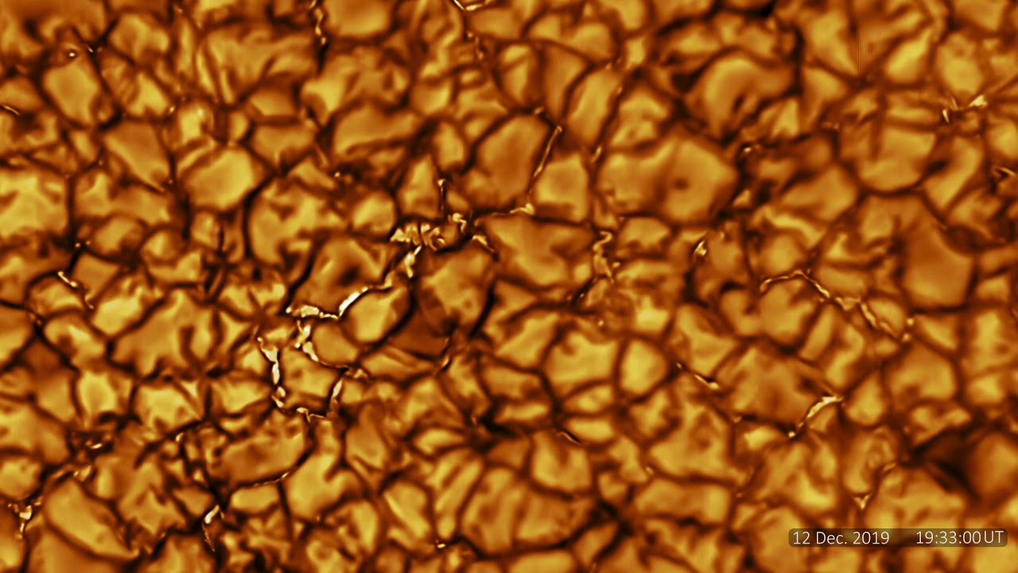
December 2024 – Intermediate - Networks
We know that the full sun is not completely covered by picoflares.
Instead there are networks of active regions matching the solar granulation scale.
Each granule is about 1,500 km across.
Inouye solar telescope: https://www.youtube.com/watch?v=CCzl0quTDHw
Heliophysics Education Activation Team

Slide 21
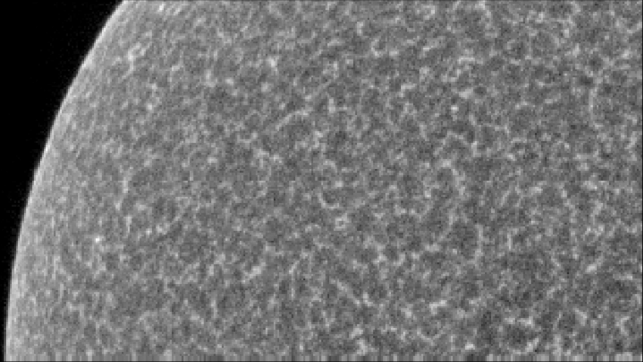
December 2024 – Intermediate - Networks
We know that the full sun is not completely covered by picoflares.
Instead there are networks of active regions matching the solar granulation scale.
Each granule is about 1,500 km across.
This produces the chromospheric network of active regions.
SUMER Data/ D. Hassler
https://www.researchgate.net/figure/An-example-of-the-chromospheric-network-pattern-showing-the-intensity-of-the-Si-I_fig2_226879894
Heliophysics Education Activation Team

Slide 22
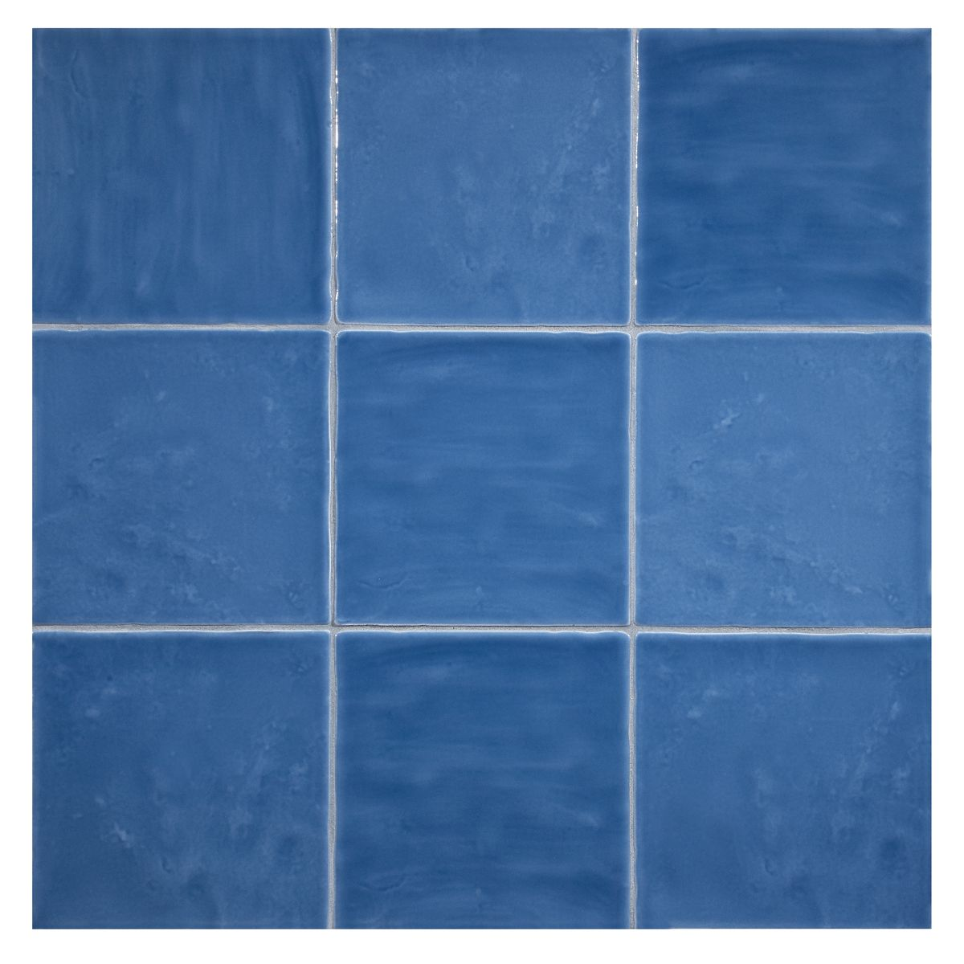
December 2024 – Intermediate - Networks
If the average distance between picojets is 1500 km in the chromospheric network, how many jets are present in the chromosphere?
From properties of a square
D = √Area
D
D
D
Heliophysics Education Activation Team

Slide 23
December 2024 – Intermediate - Networks
If the average distance between picojets is 1500 km in the chromospheric network, how many jets are present in the chromosphere?
From properties of a square
D = √Area
Area of sun = 6 x 10¹² km²
Area of network cell = (1500)²
= 2.2x10⁶ km²
Number of jets = 6x10¹² / 2.2x10⁶
= 2.7 million
Heliophysics Education Activation Team

Slide 24
December 2024 – Intermediate - Networks
If the average distance between picojets is 1500 km in the chromospheric network, how many jets are present in the chromosphere?
From properties of a square
D = √Area
To create a solar wind with 2 billion kg/sec, how much mass has to flow in each jet?
Area of sun = 6 x 10¹² km²
Area of network cell = (1500)²
= 2.2x10⁶ km²
Number of jets = 6x10¹² / 2.2x10⁶
= 2.7 million
2 billion kg/sec / 2.7 million jets
= 740 kg/sec.
Heliophysics Education Activation Team

Slide 25
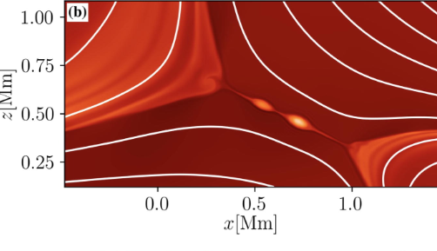
December 2024 – Advanced - Energy
Magnetic reconnection converts stored magnetic energy into kinetic and thermal energy.
Opposite polarity lines come together and re-connect into a simpler shape. Plasma is heated to thousands of degrees in between.
Heated Plasma
Credit: Eric Priest
https://www.sciencedirect.com/science/article/pii/S0273117722002149
Heliophysics Education Activation Team

Slide 26
December 2024 – Advanced - Energy
Available magnetic energy in a volume
De= B²/8π ergs/cm³
Energy = Volume x De
If jets are cylinders 200 km in radius and 10,000 km tall, and the magnetic field has a strength of 100 gauss, what is the total available energy?
Heliophysics Education Activation Team

Slide 27
December 2024 – Advanced - Energy
Available magnetic energy in a volume
De= B²/8π ergs/cm³
Energy = Volume x De
If jets are cylinders R=200 km in radius and H=10,000 km tall, and the magnetic field has a strength of about B= 10 gauss, what is the total available energy in ergs?
Heliophysics Education Activation Team

Slide 28
December 2024 – Advanced - Energy
De= 100²/8π
= 40 ergs/cm³
Volume = π (200)² 10000
= 1.25x10⁹ km³
100,000 cm = 1 km
Volume = 1.25x10²⁴ cm³
E = (40) x (1.25x10²⁴)
= 5x10²⁵ ergs per flare
Heliophysics Education Activation Team

Slide 29
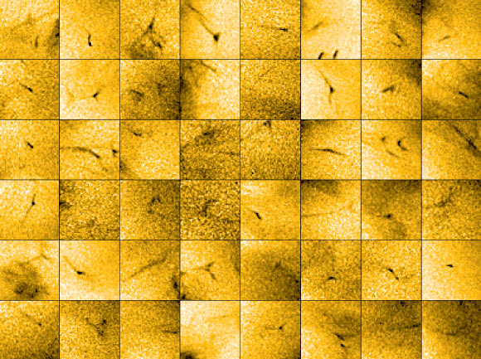
December 2024 – Advanced - Energy
De= 100²/8π
= 40 ergs/cm³
Volume = π (200)² 10000
= 1.25x10⁹ km³
100,000 cm = 1 km
Volume = 1.25x10²⁴ cm³
E = (40) x (1.25x10²⁴)
= 5x10²⁵ ergs per flare
= 1200 megatons TNT each minute
ESA / NASA / Solar Orbiter / EUI Team / Lakshmi Chitta,
Max Planck Institute for Solar System Research / CC BY-SA 3.0 IGO.
Heliophysics Education Activation Team

Slide 30
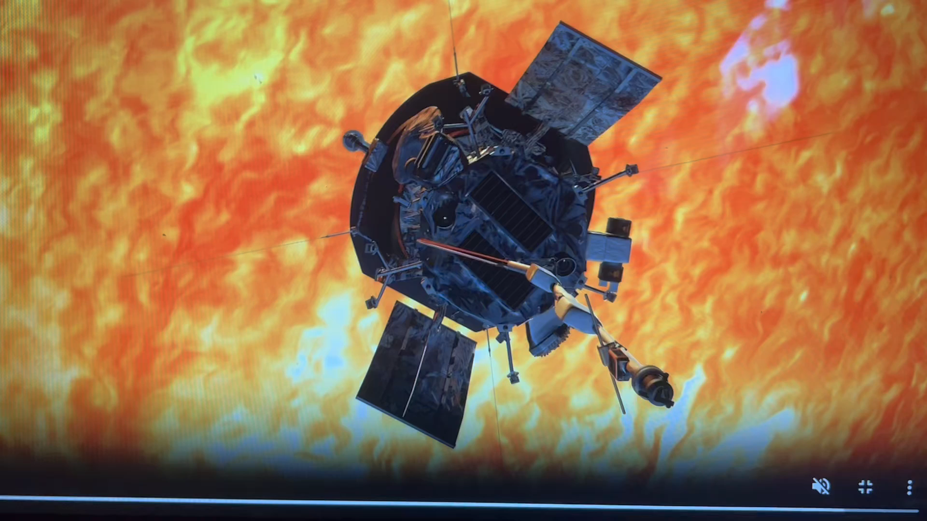
December 2024 – Intermediate
Next Time!
The Parker Solar Probe
Heliophysics Education Activation Team

Slide 31
Slides and Recordings
Slides: https://rb.gy/qsgmbr
Previous webinar recordings https://www.youtube.com/watch?v=lwf8Y_fOOls&list=PL5mpEj48YwXntxhPvZBgJn0ZG5MRm4UlS
Heliophysics Education Activation Team

