Slide 1




The Heliophysics Big Year
National Aeronautics and Space Administration
Dr. Sten Odenwald, Astronomer
NASA Heliophysics Education Activation Team

Slide 2


October 2024: What is Heliophysics?
Heliophysics is the discipline in space science that deals with the matter and energy of our Sun and its effects on the solar system.
It also studies how the Sun varies over time and how those changes can sometimes pose a hazard to humans on Earth and in space.
Heliophysics Education Activation Team

Slide 3



Heliophysics Big Year Timeline
Annular Eclipse
Total Eclipse
Solar Parker
Probe Perihelion
October 14, 2023
April 8, 2024
December 24, 2024
ADD MEDIA HERE
ADD MEDIA HERE
ADD MEDIA HERE
Heliophysics Education Activation Team

Slide 4

Heliophysics Big Year Themes
2023
October- Annular Solar Eclipse
November- Mission Fleet
December- Citizen Science
2024
January- Sun Touches Everything
February- Fashion
March- Experiencing the Sun
April- Total Solar Eclipse
May- Visual Art
June- Performance Art
July- Physical and Mental Health
August- Back to School
September- Environment
October – Solar Cycles
November- Bonus Science
December- Parker’s Perihelion
https://www.nasa.gov/science-research/heliophysics/nasa-announces-monthly-themes-to-celebrate-the-heliophysics-big-year/
Heliophysics Education Activation Team

Slide 5
October 2024 : NASA’s Big Questions
1. What causes the Sun to vary?
2. How do the Earth and the heliosphere respond?
3. What are the impacts on humanity?
These Big Questions form the basis for the
Framework for Heliophysics Education
https://science.nasa.gov/learn/heat/big-ideas/
Heliophysics Education Activation Team

Slide 6
How to Teach Heliophysics
Framework for Heliophysics Education
3 Heliophysics Investigatory Questions
What causes the Sun to vary?
1.1 The Sun is really big and its gravity influences all objects in the solar system. (PS2, ESS1)
1.2 The Sun is active and can impact technology on Earth via space weather. (PS1,PS2, PS4, ESS2, ESS3)
1.3 The Sun’s energy drives Earth’s climate, but the climate is in a delicate balance and is changing due to human activity. (PS1, PS2, PS3, LS4, ESS2, ESS3)
How do Earth, the solar system, and the heliosphere respond to changes on the Sun?
2.1 Life on Earth has evolved with complex diversity because of our location near the Sun. It is just right! (PS3, PS4, LS1, LS2, ESS2)
2.2 The Sun defines the space around it, which is different from interstellar space. (PS2, ESS1, ESS2)
2.3 The Sun is the primary source of light in the solar system. (PS1, PS2, PS3,PS4, ESS1)
What are the impacts of changes on the Sun on humans?
3.1 The Sun is made of churning plasma, causing the surface to be made of complex, tangled magnetic fields. (PS1, PS2, ESS1, ESS2)
3.2 Energy from the Sun is created in the core and travels outward through the Sun and into the heliosphere. (PS1, PS3, PS4, ESS1, ESS2, ESS3)
3.3 Our Sun, like all stars, has a life cycle. (PS1, LS1, ESS1)
3 NGSS-aligned
Big Ideas per Question
3 Guiding Questions per Idea
-1 Question per Level-
Heliophysics
Resource Database
Heliophysics Education Activation Team
Notes:
The Framework for Heliophysics Education provides the background and scaffolding educators need to incorporate heliophysics topics into existing STEM curricula. Using the three main questions that heliophysicists investigate as the foundation, this framework connects heliophysics topics with NGSS Disciplinary Core Ideas, to create NGSS-aligned Heliophysics Big Ideas.
The nine Heliophysics Big Ideas encompass the major heliophysics concepts that can be explored through existing Next Generation Science Standards (NGSS) disciplinary core ideas. Each Heliophysics Big Idea has a guiding question for each level, designed to support inquiry-based learning.
Introductory Learner = A younger learner (K-5), or a learner new to the subject matter.
Intermediate Learner = A middle-aged learner (6-8), or a learner that has some familiarity with the subject matter.
Advanced Learner = An older learner (9-12+), or a learner that has a lot of experience with the subject matter.

Slide 7
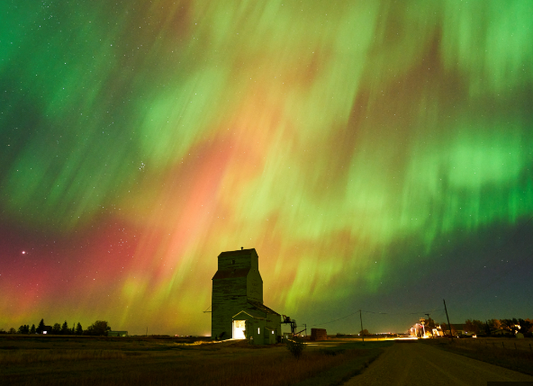
October 2024: Solar Cycles
We are now at ‘sunspot maximum’ when the sun is at its stormiest and aurora borealis light up the skies every few months.
This is not a random process, but follows an 11-year cadence called the sunspot cycle.
October 10-12, 2024 Aurora
Heliophysics Education Activation Team

Slide 8
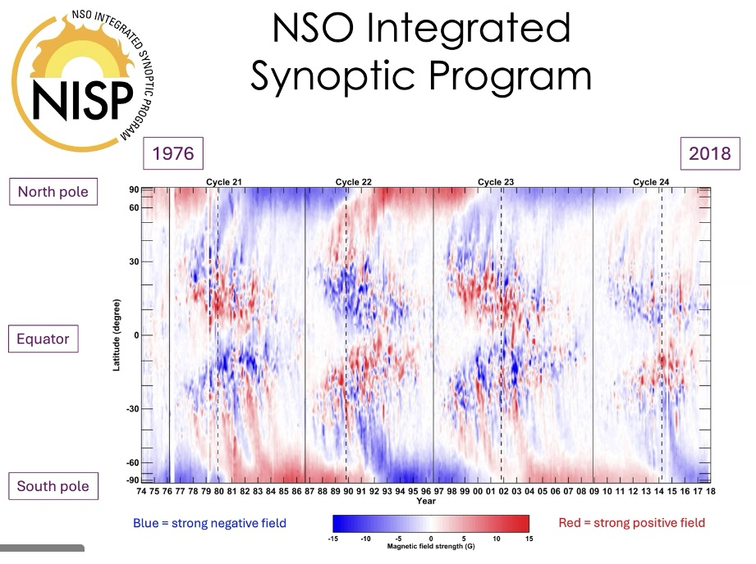
October 2024: Solar Cycles
Sunspots appear in the northernmost latitudes of the sun at the start of each cycle, and form at lower latitudes as the cycle progresses.
The global magnetic field of the sun reverses polarity every cycle, so that after two cycles (22-years) it has returned to its original polarity in each hemisphere. This is called the Hale Magnetic Cycle.
Cycle Start
Cycle End
North
North
October Aurora
22 years
Heliophysics Education Activation Team

Slide 9
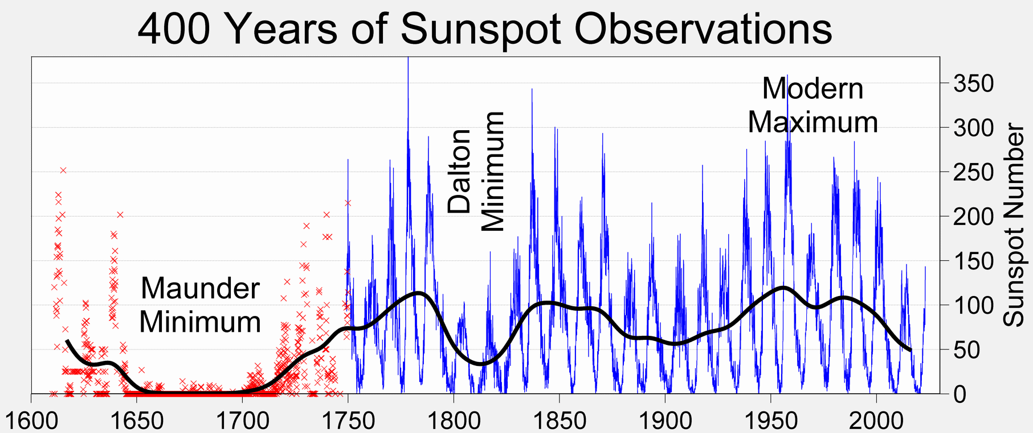
October 2024: Solar Cycles
The most famous solar cycle is due to the rise and fall of the number of sunspots on its surface, first discovered in the early-1800s.
Wikipedia: Robert A. Rohde - the Global Warming Art project.
Heliophysics Education Activation Team

Slide 10
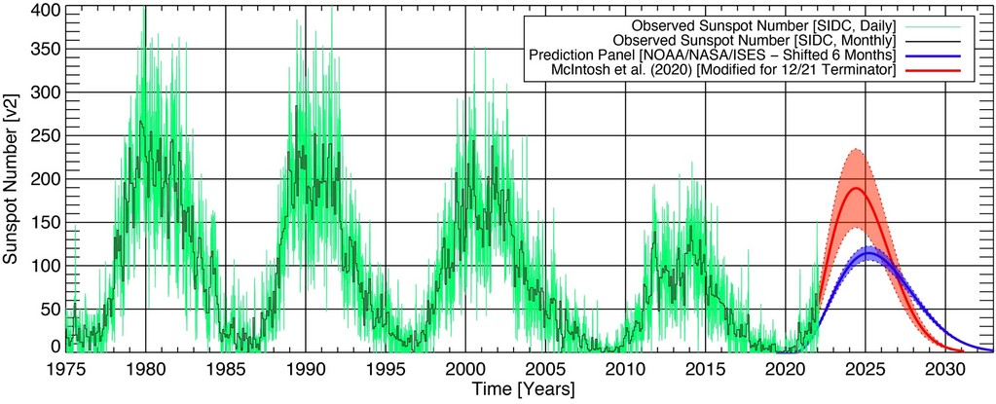
October 2024:
The last few cycles are likely ones that you might have recalled from news reports.
McIntosh, 2020: https://swling.com/blog/tag/solar-cycle-25/
Heliophysics Education Activation Team

Slide 11
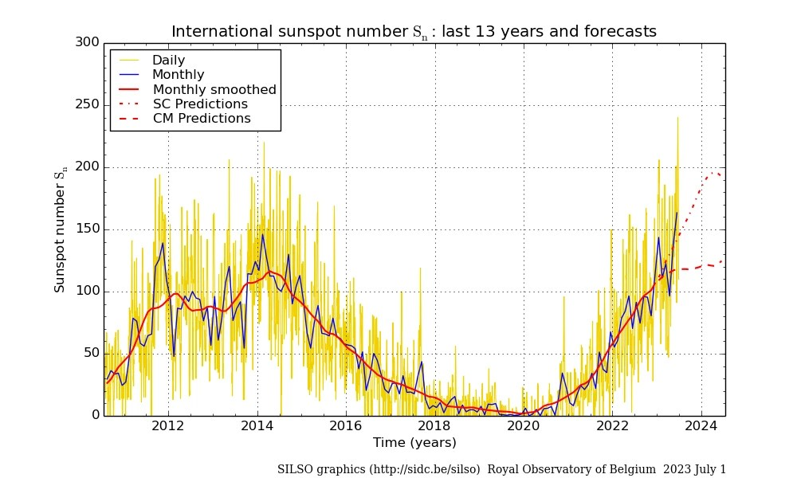
October 2024:
The current NOAA prediction for Cycle 25 looks like this:
Heliophysics Education Activation Team

Slide 12
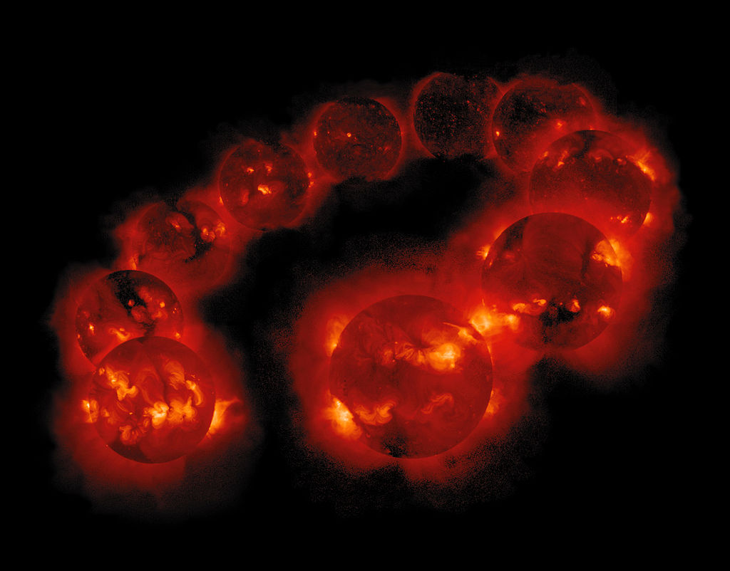
October 2024:
Keeping track of solar storminess protects us from unexpected satellite and power grid damage, along with astronaut health issues.
David Chenette, Yohkoh/Lockheed Martin.
Heliophysics Education Activation Team

Slide 13
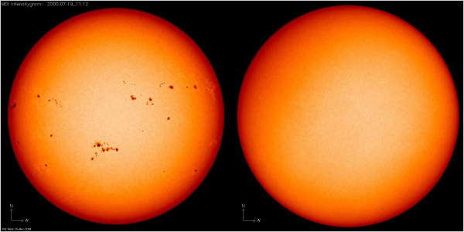
October 2024: Beginning – The next sunspot cycles
Assume the sunspot cycles obey the following rules:
Period = 11 years.
Maximum = July 2024.
Minimum= January 2020.
Height = ??????
When will the next 3 sunspot cycles occur?
Tabulate and plot. Assume all peaks have equal heights to Cycle 25.
Credit: NASA
Heliophysics Education Activation Team

Slide 14
October 2024: Beginning – The next sunspot cycles
Assume the sunspot cycles obey the following rules:
Period = 11 years.
Maximum = July 2024.
Minimum= January 2020.
Height = ?????
When will the next 3 sunspot cycles occur?
Tabulate and plot.
Assume all peaks have equal heights to Cycle 25.
Cycle 25: Maximum: July 2024 = 2024.6
Minimum: January 2020 = 2020.1
Cycle 26: Maximum = 2024.6 + 11 = 2035.6
Minimum = 2020.1 + 11 = 2031.1
Cycle 27: Maximum = 2046.6 Minimum = 2042.1
Cycle 28: Maximum = 2057.6 Minimum = 2053.1
Heliophysics Education Activation Team

Slide 15
October 2024: Beginning – The next sunspot cycles
Assume the sunspot cycles obey the following rules:
Period = 11 years.
Maximum = July 2024.
Minimum= January 2020.
When will the next 3 sunspot cycles occur?
Tabulate and plot.
If you live 80 years, what is the most distant sunspot cycle you will hear about?
25 26 27 28
Heliophysics Education Activation Team

Slide 16
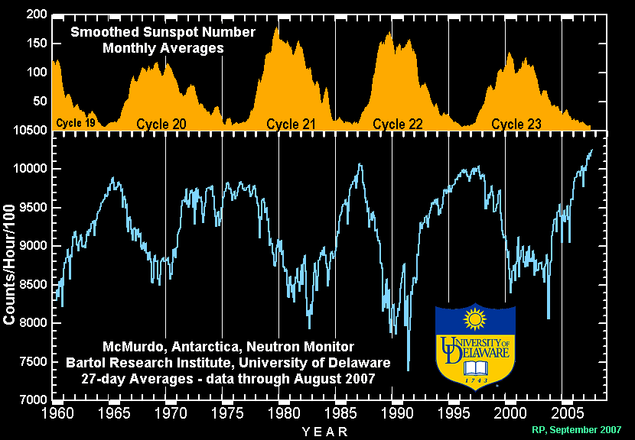
October 2024: Intermediate – The Cosmic Ray Cycle
Cosmic rays are blocked when our sun’s magnetic field is at maximum during sunspot maximum.
They can enter the inner solar system when the sun’s field is more concentrated near the solar surface at sunspot minimum.
Heliophysics Education Activation Team

Slide 17
October 2024: Intermediate – The Cosmic Ray Cycle
Math 2: Draw a second curve on top of the sunspot cycle curve that shows the next three cosmic ray cycles.
Assume
Minimum = July 2024.7
Maximum = June 2020.1
Maximum height = 150 units.
Cycle 25: Minimum: July 2024 = 2024.6
Maximum: January 2020 = 2020.1
Cycle 26: Minimum = 2024.6 + 11 = 2035.6
Maximum = 2020.1 + 11 = 2031.1
Cycle 27: Minimum = 2046.6 Maximum = 2042.1
Cycle 28: Minimum = 2057.6 Maximum = 2053.1
Heliophysics Education Activation Team

Slide 18
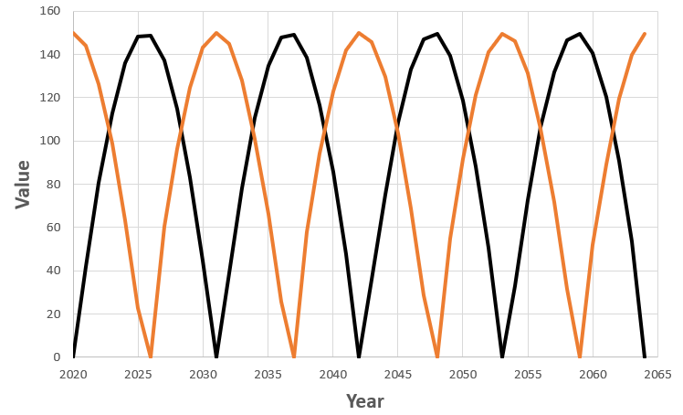
October 2024: Intermediate – The Cosmic Ray Cycle
Draw a second curve on top of the sunspot cycle curve that shows the next three cosmic ray cycles.
Assume
Minimum = July 2024.7
Maximum = June 2020.1
Maximum height = 150 units.
25 26 27 28
Heliophysics Education Activation Team

Slide 19
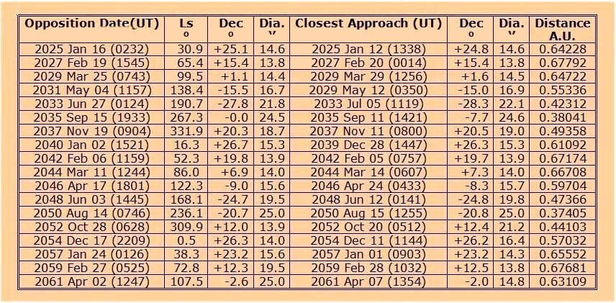
October 2024 – Advanced – The Journey to Mars
When are the best times to go?
Opposition dates come every 770 days (2.1 years)
Next opposition is in January 2025.
Use the table and show these opposition years on the sunspot and cosmic ray cycle plot.
Heliophysics Education Activation Team

Slide 20
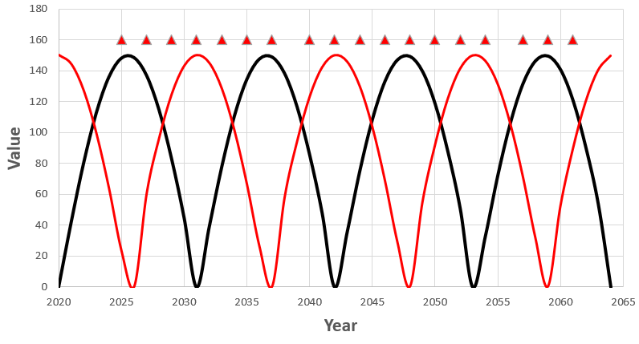
October 2024 –Advanced – The Journey to Mars
When might be the best times to travel?
Heliophysics Education Activation Team

Slide 21
October 2024 –Advanced – The Journey to Mars
When might be the best times to travel?
There might not be any right answer but each opposition has its advantages and disadvantages.
Here’s one set of possibilities. The long arrows are when the opposition distances are at their minimum for the 21st century.
Red = solar flares Black = cosmic rays
Heliophysics Education Activation Team

Slide 22
October 2024 – Ask ChatGPT
Query: Between now and 2065, given the sunspot cycles, the cosmic ray cycles, and mars opposition distances, when would be the best years for astronauts to travel to Mars?
To find optimal years, you need to align these factors:
Mars Oppositions: The best years for missions to Mars
will be when Mars is at opposition. Some upcoming
oppositions are in 2025, 2027, 2033, 2035, 2040,
2042, 2048, 2050, 2056, and 2058.
Sunspot Cycles: To minimize sunspot activity, you would
prefer to launch during or near solar minimum phases.
The next solar minima are expected around the early
2020s, mid-2030s, mid-2040s, early 2050s, and late 2060s.
Based on these factors, 2027, 2033, 2040, 2048, and 2056
would be some of the best years to send missions to Mars.
Each of these years balances proximity to Mars with
minimized exposure to solar and cosmic radiation.
ChatGPT did NOT
factor in cosmic rays
Heliophysics Education Activation Team

Slide 23

November 2024 – Bonus Science!
Next Time!
Unexpected
discoveries!
Cover art for "Alien #1" from Marvel Comics. (Image credit: Marvel Comics)
Heliophysics Education Activation Team

Slide 24
Slides and Recordings
Slides: https://rb.gy/qsgmbr
Previous webinar recordings https://www.youtube.com/watch?v=lwf8Y_fOOls&list=PL5mpEj48YwXntxhPvZBgJn0ZG5MRm4UlS
Heliophysics Education Activation Team

