Slide 1




The Heliophysics Big Year
National Aeronautics and Space Administration
Dr. Sten Odenwald, Astronomer
NASA Heliophysics Education Activation Team

Slide 2


September 2024: What is Heliophysics?
Heliophysics is the discipline in space science that deals with the matter and energy of our Sun and its effects on the solar system.
It also studies how the Sun varies over time and how those changes can sometimes pose a hazard to humans on Earth and in space.
Heliophysics Education Activation Team

Slide 3



Heliophysics Big Year Timeline
Annular Eclipse
Total Eclipse
Solar Parker
Probe Perihelion
October 14, 2023
April 8, 2024
December 24, 2024
ADD MEDIA HERE
ADD MEDIA HERE
ADD MEDIA HERE
Heliophysics Education Activation Team

Slide 4

Heliophysics Big Year Themes
2023
October- Annular Solar Eclipse
November- Mission Fleet
December- Citizen Science
2024
January- The Sun Touches Everything
February- Fashion
March- Experiencing the Sun
April- Total Solar Eclipse
May- Visual Art
June- Performance Art
July- Physical and Mental Health
August- Back to School
September- Environment / Sustainability
November- Bonus Science
December- Parker’s Perihelion
https://www.nasa.gov/science-research/heliophysics/nasa-announces-monthly-themes-to-celebrate-the-heliophysics-big-year/
Heliophysics Education Activation Team

Slide 5
September 2024 : NASA’s Big Questions
1. What causes the Sun to vary?
2. How do the Earth and the heliosphere respond?
3. What are the impacts on humanity?
These Big Questions form the basis for the
Framework for Heliophysics Education
https://science.nasa.gov/learn/heat/big-ideas/
Heliophysics Education Activation Team

Slide 6
How to Teach Heliophysics
Framework for Heliophysics Education
3 Heliophysics Investigatory Questions
What causes the Sun to vary?
1.1 The Sun is really big and its gravity influences all objects in the solar system. (PS2, ESS1)
1.2 The Sun is active and can impact technology on Earth via space weather. (PS1,PS2, PS4, ESS2, ESS3)
1.3 The Sun’s energy drives Earth’s climate, but the climate is in a delicate balance and is changing due to human activity. (PS1, PS2, PS3, LS4, ESS2, ESS3)
How do Earth, the solar system, and the heliosphere respond to changes on the Sun?
2.1 Life on Earth has evolved with complex diversity because of our location near the Sun. It is just right! (PS3, PS4, LS1, LS2, ESS2)
2.2 The Sun defines the space around it, which is different from interstellar space. (PS2, ESS1, ESS2)
2.3 The Sun is the primary source of light in the solar system. (PS1, PS2, PS3,PS4, ESS1)
What are the impacts of changes on the Sun on humans?
3.1 The Sun is made of churning plasma, causing the surface to be made of complex, tangled magnetic fields. (PS1, PS2, ESS1, ESS2)
3.2 Energy from the Sun is created in the core and travels outward through the Sun and into the heliosphere. (PS1, PS3, PS4, ESS1, ESS2, ESS3)
3.3 Our Sun, like all stars, has a life cycle. (PS1, LS1, ESS1)
3 NGSS-aligned
Big Ideas per Question
3 Guiding Questions per Idea
-1 Question per Level-
Heliophysics
Resource Database
Heliophysics Education Activation Team
Notes:
The Framework for Heliophysics Education provides the background and scaffolding educators need to incorporate heliophysics topics into existing STEM curricula. Using the three main questions that heliophysicists investigate as the foundation, this framework connects heliophysics topics with NGSS Disciplinary Core Ideas, to create NGSS-aligned Heliophysics Big Ideas.
The nine Heliophysics Big Ideas encompass the major heliophysics concepts that can be explored through existing Next Generation Science Standards (NGSS) disciplinary core ideas. Each Heliophysics Big Idea has a guiding question for each level, designed to support inquiry-based learning.
Introductory Learner = A younger learner (K-5), or a learner new to the subject matter.
Intermediate Learner = A middle-aged learner (6-8), or a learner that has some familiarity with the subject matter.
Advanced Learner = An older learner (9-12+), or a learner that has a lot of experience with the subject matter.

Slide 7
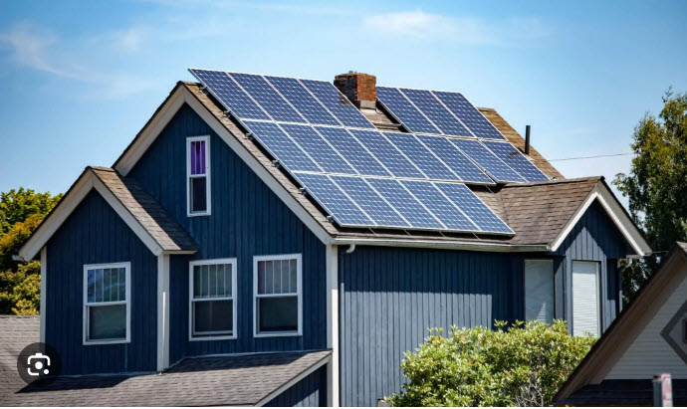
September 2024: Environment / Sustainability
The Sun is a powerful source of energy. In modern times, we rely on the Sun to help produce the electricity we use every day.
To make this work, we use solar panels to convert sunlight into electricity.
https://sciencephotogallery.com/featured/life-cycle-of-the-sun-mark-garlickscience-photo-library.html
Heliophysics Education Activation Team

Slide 8
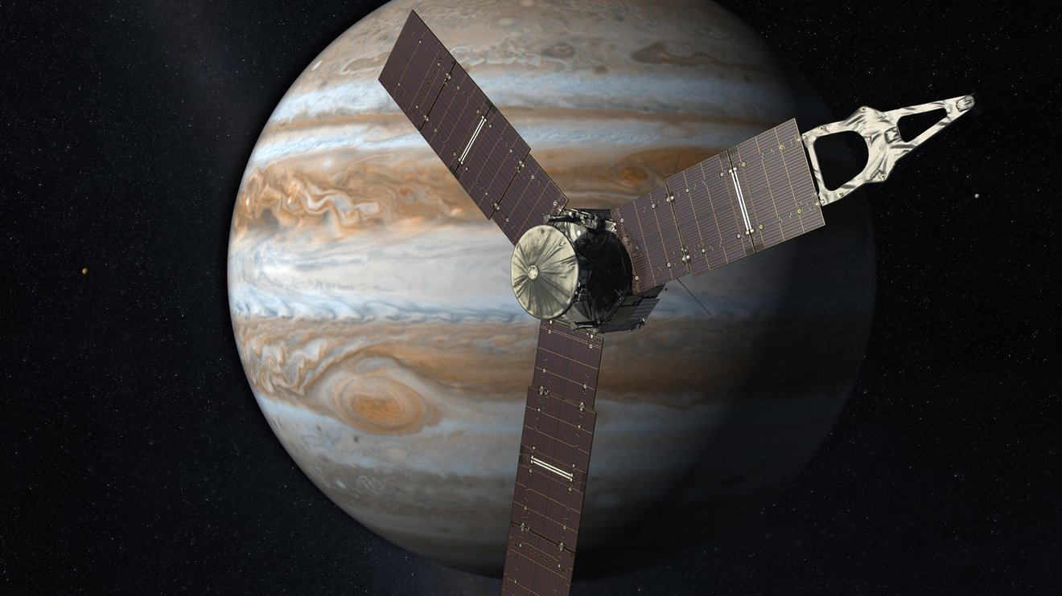
September 2024: Environment / Sustainability
The Sun is a powerful source of energy. In modern times, we now rely on the Sun to produce electricity.
Spacecraft also use solar panels to generate the power they need to operate millions of miles from Earth.
NASA / Juno Spacecraft
Heliophysics Education Activation Team

Slide 9
September 2024 – Beginning – Power Math
A typical home needs about 30,000 watt-hours (30 kWh) or 1,200 watts to operate each day.
The average cost of electricity is $0.16 per kWh.
The average CO2 emission per kWh is about 1 kg/kWh for coal and petroleum.
How much does it cost to run this house for one year and how much CO2 is produced?
Heliophysics Education Activation Team

Slide 10
September 2024 – Beginning – Power Math
A typical home needs about 30,000 watt-hours (30 kWh) or 1,200 watts to operate each day.
The average cost of electricity is $0.16 per kWh.
The average CO2 emission per kWh is about 1kg/kWh for coal and petroleum.
How much does it cost to run this house for one year and how much CO2 is produced?
House = 30 kWh
Cost = $0.16/kWh x 30 kWh
= $4.80/day
= $1,752/year
CO2 = 1kg/kWh x 30 kWh/day
= 30 kg/day
= 12 tons/year.
Heliophysics Education Activation Team

Slide 11
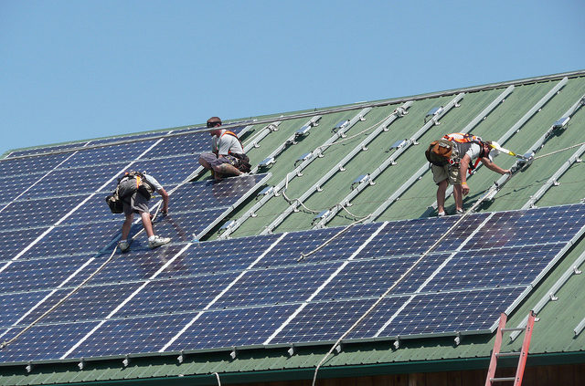
September 2024 – Beginning – Solar Electricity
A typical solar panel for homes generates about 400 watts. But there are only about 5 sunny hours every day to generate electricity.
How many panels do you need to generate the 30 kWh to run your home?
Heliophysics Education Activation Team

Slide 12
September 2024 – Beginning – Solar Electricity
A typical solar panel for homes generates about 400 watts. But there are only 5 sunny hours every day to generate electricity.
How many panels do you need to generate 30 kWh to run your home?
If it costs $9 per watt including installation, how much will your system cost?
400 watts x 5 hours = 2000 Wh or 2 kWh.
But you need 30 kWh to run your home, so
Number = 30 kWh / (2 kWh per panel)
You need 15 panels.
Home = 30,000 Wh/24h = 1200 watts
Cost = $9/ watt x 1200 watts = $10,800.
For more about costs: https://evergreensolar.com/cost-savings/
Heliophysics Education Activation Team

Slide 13

September 2024 – Intermediate – Carbon reduction
If you install solar panels and become 100% ‘green’ you save about 6 tons of CO2 production every year, and over the 30-year life of solar panels that’s about 180 tons.
Coal plant smoke: Getty Images
Stock photo ID:167231386
Heliophysics Education Activation Team

Slide 14
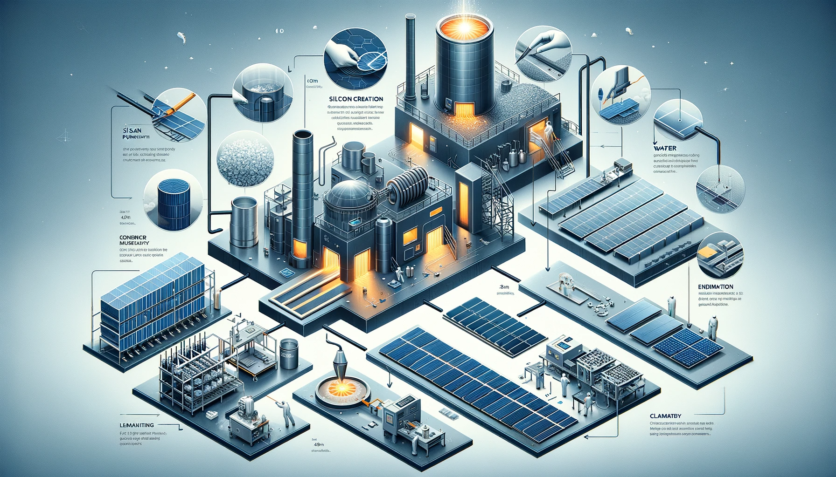
September 2024 – Intermediate – Carbon reduction
Smelting
Solar panels have to be manufactured. This process produces pollution. The mining and melting of silicon releases about 50 grams/kWh.
For your home, this is a one-time cost once you install your panels.
How many kg of CO2 was released in creating a 30 kWh home system?
Heliophysics Education Activation Team

Slide 15
September 2024 – Intermediate – Carbon reduction
Solar panels have to be manufactured. This process produces pollution. The mining and melting of silicon releases about 50 grams/kWh.
For your home, this is a one-time cost once you install your panels.
How many kg of CO2 was released in creating a 30 kWh home system?
How does this compare with a 30-year use of fossil fuels?
CO2 = 0.05 kg/kWh x 30 kWh = 1.5 kg.
We just calculated that our 30 kWh electricity
from fossil fuels produces 180 tons of CO2.
Clearly, solar panels are a green source
of energy even when you include
manufacturing.
180,000 kg saved versus
1.5 kg expended
over 30 years.
Heliophysics Education Activation Team

Slide 16
September 2024 – Advanced- EV and Solar Power
A typical car burns fossil fuels and produces about 44 tons every 10 years. An electric vehicle (EV) runs on battery electricity, and for typical driving, this saves about 44 tons of CO2 every 10 years because gasolene is not burned.
Charging: An electric car uses 20 kWh of energy per 62 miles (100 km) on average.
You'll produce 1.8 lbs of CO2 each 60 miles if you fill it up using solar power and
44 lbs (20 kg) if you use coal-powered electricity. So over the course of 10 years,
Coal-powered charging (12,000 miles/year) = 10x (12000/60) x 44 lbs = 44 tons
Solar-powered charging (12,000 miles/year) = 10x (12000/60) x 1.8 lbs = 1.8 tons.
Your best bet is to convert your house to solar, buy an EV and charge it at home.
Net savings in 10 years = 44 tons – 1.8 tons = 42 tons of CO2
Heliophysics Education Activation Team

Slide 17
September 2024 - Advanced
The annual US CO2 savings in megatons from solar homes can be modeled by
H=0.06x²+1.4x + 23
The annual US CO2 savings from EVs in megatons can be modeled by
EV = 0.3x² +1.4x + 15
where x = current year-2025
For what year will the EV and Home CO2 savings be equal in the US?
Heliophysics Education Activation Team

Slide 18
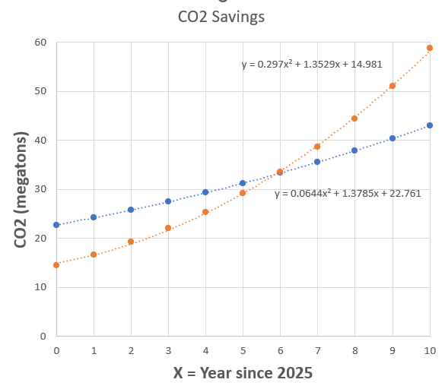
September 2024 – Advanced
H=EV
0.06x²+1.4x + 23 =0.3x² +1.4x + 15
0 = 0.24x² -8
X² = 8/0.24
X = +/- 5.8
So X = +5.8 = current year – 2025
Year = 2031
EV
Homes
Heliophysics Education Activation Team

Slide 19
September 2024 – ChatGPT
ChatGPT query: H=0.06x²+1.4x + 23 and EV = 0.3x² +1.4x + 15. For what value of X will
EV and H intersect? Show your work. Evaluate to one significant figure.
Abbreviated ChatGPT response:
Set H = EV
Simplify to 8 = 0.24x²
Then x² = 8/0.24
Take the square-root x = +/- 10/√3
so x = + 5.77, and to one SF X = +5.8
Heliophysics Education Activation Team

Slide 20
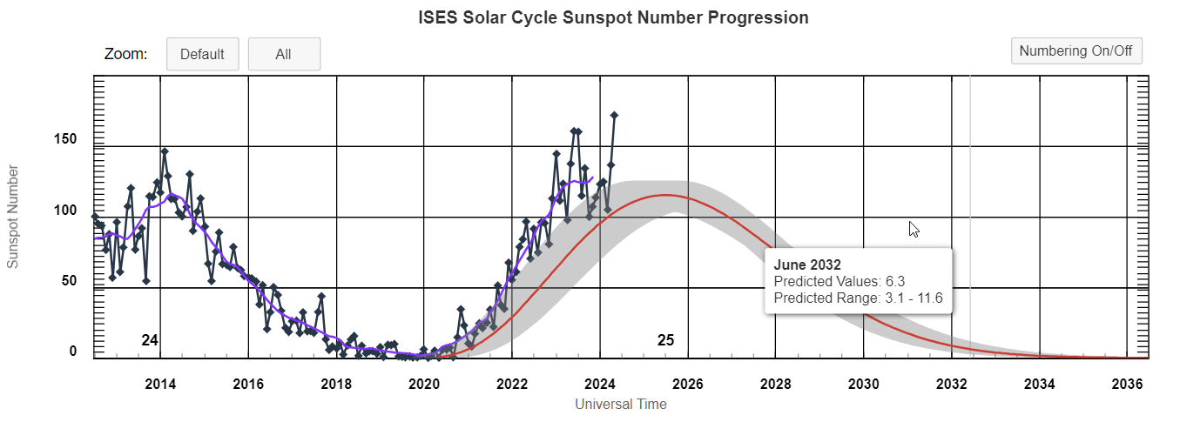
October 2024 – Solar Cycle and Solar Max
Next Time!
The Sun’s 11-year activity cycle will be nearing its maximum point during this month, which will include activities to explore the solar cycle.
Solar flares, cosmic rays and astronaut hazards.
When will the next few sunspot cycles occur and when would be the best times for astronauts to travel to Mars?
From NOAA/SWPC:
https://www.swpc.noaa.gov/products/solar-cycle-progression
Heliophysics Education Activation Team

