Slide 1




The Heliophysics Big Year
National Aeronautics and Space Administration
Dr. Sten Odenwald, Astronomer
NASA Heliophysics Education Activation Team

Slide 2


July 2024: What is Heliophysics?
Heliophysics is the discipline in space science that deals with the matter and energy of our Sun and its effects on the solar system.
It also studies how the Sun varies and how those changes pose a hazard to humans on Earth and in space
Heliophysics Education Activation Team

Slide 3



Heliophysics Big Year Timeline
Annular Eclipse
Total Eclipse
Solar Parker
Probe Perihelion
October 14, 2023
April 8, 2024
December 24, 2024
ADD MEDIA HERE
ADD MEDIA HERE
ADD MEDIA HERE
Heliophysics Education Activation Team

Slide 4

Heliophysics Big Year Themes
2023
October- Annular Solar Eclipse
November- Mission Fleet
December- Citizen Science
2024
January- The Sun Touches Everything
February- Fashion
March- Experiencing the Sun
April- Total Solar Eclipse
May- Visual Art
June- Performance Art
July- Physical and Mental Health
August- Back to School
September- Environment / Sustainability
November- Bonus Science
December- Parker’s Perihelion
https://www.nasa.gov/science-research/heliophysics/nasa-announces-monthly-themes-to-celebrate-the-heliophysics-big-year/
Heliophysics Education Activation Team

Slide 5
August 2024 : NASA’s Big Questions
1. What causes the Sun to vary?
2. How do the Earth and the heliosphere respond?
3. What are the impacts on humanity?
These Big Questions form the basis for the
Framework for Heliophysics Education
https://science.nasa.gov/learn/heat/big-ideas/
Heliophysics Education Activation Team

Slide 6
How to Teach Heliophysics
Framework for Heliophysics Education
3 Heliophysics Investigatory Questions
1. What causes the Sun to vary?
1.1 The Sun is really big and its gravity influences all objects in the solar system. (PS2, ESS1)
1.2 The Sun is active and can impact technology on Earth via space weather. (PS1,PS2, PS4, ESS2, ESS3)
1.3 The Sun’s energy drives Earth’s climate, but the climate is in a delicate balance and is changing due to human activity. (PS1, PS2, PS3, LS4, ESS2, ESS3)
2. How do Earth, the solar system, and the heliosphere respond to changes on the Sun?
2.1 Life on Earth has evolved with complex diversity because of our location near the Sun. It is just right! (PS3, PS4, LS1, LS2, ESS2)
2.2 The Sun defines the space around it, which is different from interstellar space. (PS2, ESS1, ESS2)
2.3 The Sun is the primary source of light in the solar system. (PS1, PS2, PS3,PS4, ESS1)
3. What are the impacts of changes on the Sun on humans?
3.1 The Sun is made of churning plasma, causing the surface to be made of complex, tangled magnetic fields. (PS1, PS2, ESS1, ESS2)
3.2 Energy from the Sun is created in the core and travels outward through the Sun and into the heliosphere. (PS1, PS3, PS4, ESS1, ESS2, ESS3)
3.3 Our Sun, like all stars, has a life cycle. (PS1, LS1, ESS1)
3 NGSS-aligned
Big Ideas per Question
3 Guiding Questions per Idea
-1 Question per Level-
Heliophysics
Resource Database
Heliophysics Education Activation Team
Notes:
The Framework for Heliophysics Education provides the background and scaffolding educators need to incorporate heliophysics topics into existing STEM curricula. Using the three main questions that heliophysicists investigate as the foundation, this framework connects heliophysics topics with NGSS Disciplinary Core Ideas, to create NGSS-aligned Heliophysics Big Ideas.
The nine Heliophysics Big Ideas encompass the major heliophysics concepts that can be explored through existing Next Generation Science Standards (NGSS) disciplinary core ideas. Each Heliophysics Big Idea has a guiding question for each level, designed to support inquiry-based learning.
Introductory Learner = A younger learner (K-5), or a learner new to the subject matter.
Intermediate Learner = A middle-aged learner (6-8), or a learner that has some familiarity with the subject matter.
Advanced Learner = An older learner (9-12+), or a learner that has a lot of experience with the subject matter.

Slide 7
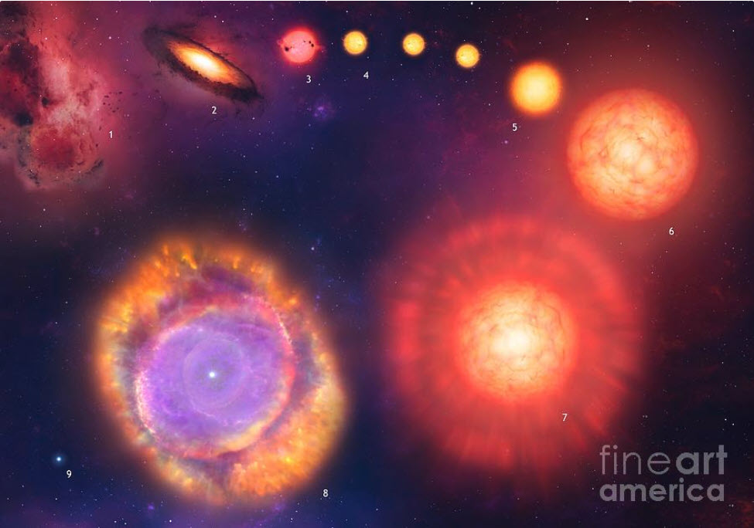
August 2024: Back to School
Many things are controlled by cycles, such as every September we start a new school year.
There is also the ‘Cycle of Life’ that begins at birth and ends at death.
This month we will explore our sun’s life cycle and how Today’s Sun is different from yesterday’s and tomorrow’s.
https://sciencephotogallery.com/featured/life-cycle-of-the-sun-mark-garlickscience-photo-library.html
Heliophysics Education Activation Team

Slide 8
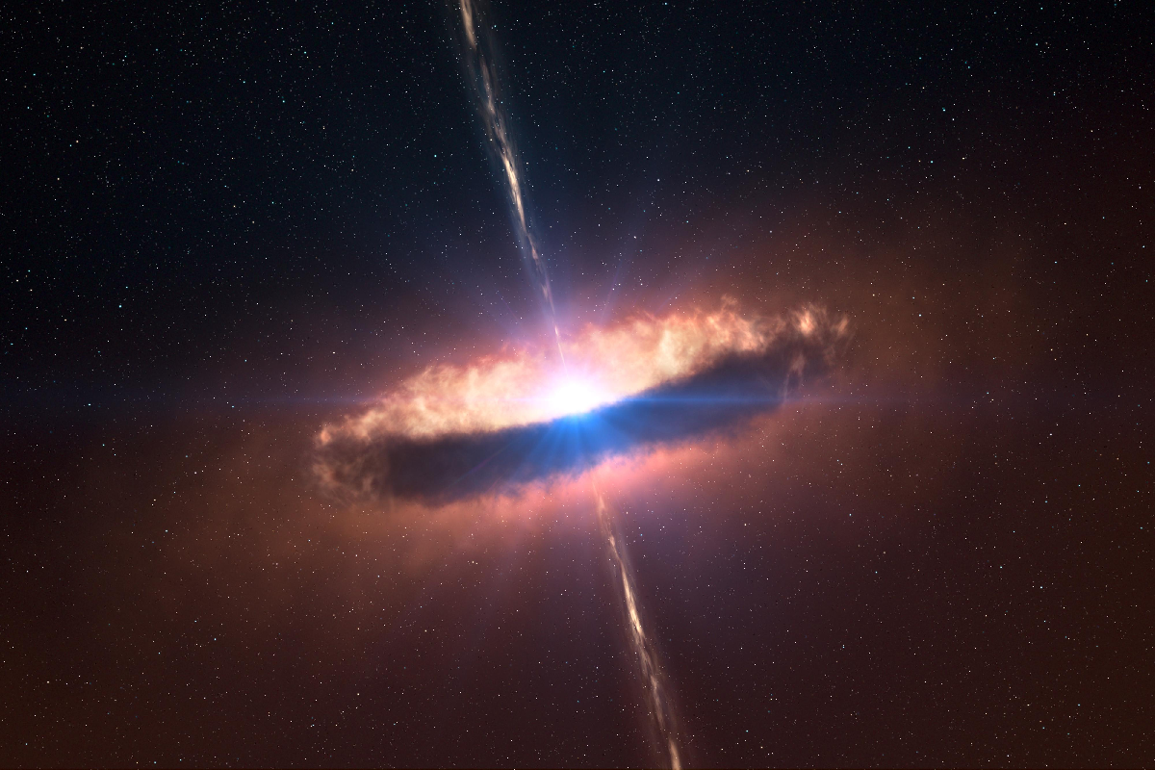
August 2024 – Beginning – Cloud Collapse
A proto-stellar nebula has a radius of 1 light year ( 6 trillion km).
If the infall speed is 0.5 km/sec, about
how long will it take for the star to form?
https://keystagewiki.com/index.php/File:Protostar.png#mw-jump-to-license
Heliophysics Education Activation Team

Slide 9
August 2024 – Beginning – Cloud Collapse
Distance = 1 light year
Speed = 0.5 km/s
Time = Distance/speed
Time = 6x10¹² km/(0.5 km/s)
Time = 1.2x10¹³ seconds
Time = 400,000 years.
https://keystagewiki.com/index.php/File:Protostar.png#mw-jump-to-license
Heliophysics Education Activation Team

Slide 10
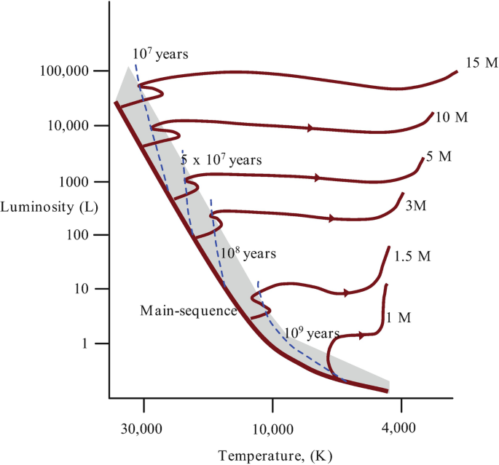
August 2024 – Intermediate – The Main Sequence
The star is now stable and is fusing hydrogen into helium to maintain internal pressure and prevent further collapse. This is the longest phase of a star’s life cycle. The duration of this phase is given by the simple formula
1
T = 10 billion years x -------------
Mass^{2.5}
Heliophysics Education Activation Team

Slide 11
August 2024 – Intermediate – The Main Sequence
Compare the lifetimes of three stars:
Proxima Centauri M = 0.1 msun Red Dwarf
The Sun M = 1.0 msun Main Sequence
Betelgeuse M = 20 msun Red Supergiant
Which star is the most likely to vanish tomorrow?
1
T = 10 billion years x -------------
Mass^{2.5}
Heliophysics Education Activation Team

Slide 12
August 2024 – Intermediate – The Main Sequence
Proxima Centauri M = 0.1 msun
T = 10 billion / (0.1)^{2.5} = 3 trillion years.
The Sun M = 1.0 msun
T = 10billion / (1)^{2.5} = 10 billion years
Betelgeuse M = 20 msun
T = 10billion / (20)^{2.5} = 1.8 billion years.
Which star is the most likely to vanish tomorrow? Probably Betelgeuse.
Heliophysics Education Activation Team

Slide 13
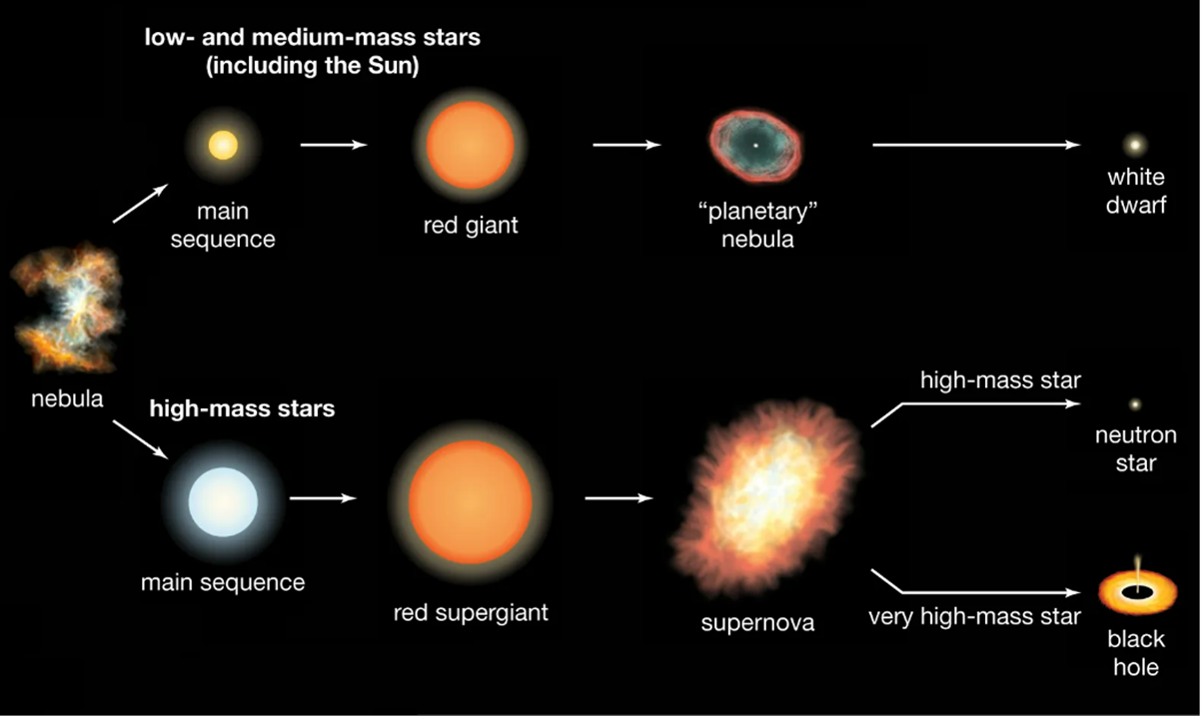
August 2024 – Advanced – Stellar Remnants
What is left behind after a star ‘dies’ depends on its mass.
Stars like our sun:
0.1 to 5 suns = White Dwarfs
Stars with intermediate masses:
6-20 suns = Neutron Stars
Stars with high masses:
> 20 suns = Black Holes.
https://explainingscience.org/2023/05/07/the-end-of-the-universe/
Heliophysics Education Activation Team

Slide 14
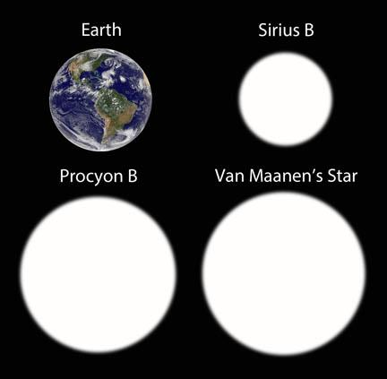
August 2024 – Advanced – Stellar Remnants
A white dwarf has a size comparable to Earth (radius: 6000km) with a mass equal to our sun (2x10³⁰ kg).
What is its density?
How much would a 1cm sugar cube weigh in tons?
Bob King; Earth photo: NASA
Heliophysics Education Activation Team

Slide 15
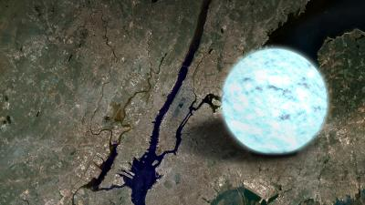
August 2024 – Advanced – Stellar Remnants
A Neutron Star has a radius of 12 km with a mass equal to our sun (2x10³⁰ kg).
What is its density?
How much would a 1cm sugar cube weigh in tons?
Credit: NASA
Heliophysics Education Activation Team

Slide 16
August 2024 – Advanced – Stellar Remnants
A Neutron Star has a size of 12 km with a mass equal to our sun (2x10³⁰ kg).
What is its density?
How much would a 1cm sugar cube weigh in tons?
Density of an atomic nucleus is
2x10¹⁷ kg/m³.
Volume = 4/3π (12000)³ = 7x10¹² m³
Density = Mass/Volume
= 2x10³⁰ kg/ 7x10¹² m³
= 3x10¹⁷ kg/m³
= 300,000 trillion tons/m³
Volume = (1cm/100cm)³ = 10⁻⁶ m³.
Mass = 3x10¹⁷ tons/m³ x 10⁻⁶ m³
= 300 billion tons.
Heliophysics Education Activation Team

Slide 17
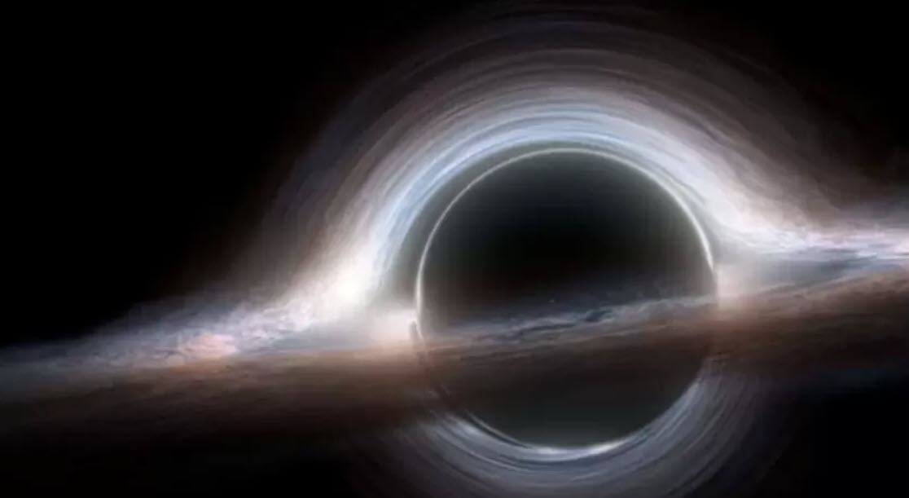
August 2024 – Advanced – Stellar Remnants
A Black Hole has a size that depends on its mass in multiples of the mass of our sun.
This size is defined by its Event Horizon.
Radius (km) = 2.8 x Mass
What is the Event Horizon radius for a 20-solar mass black hole?
Heliophysics Education Activation Team

Slide 18
August 2024 – Advanced – Stellar Remnants
Radius (km) = 2.8 x Mass
What is the Event Horizon radius for a 20-solar mass black hole?
Radius = 2.8 x 20 = 5.6 km
Heliophysics Education Activation Team

Slide 19
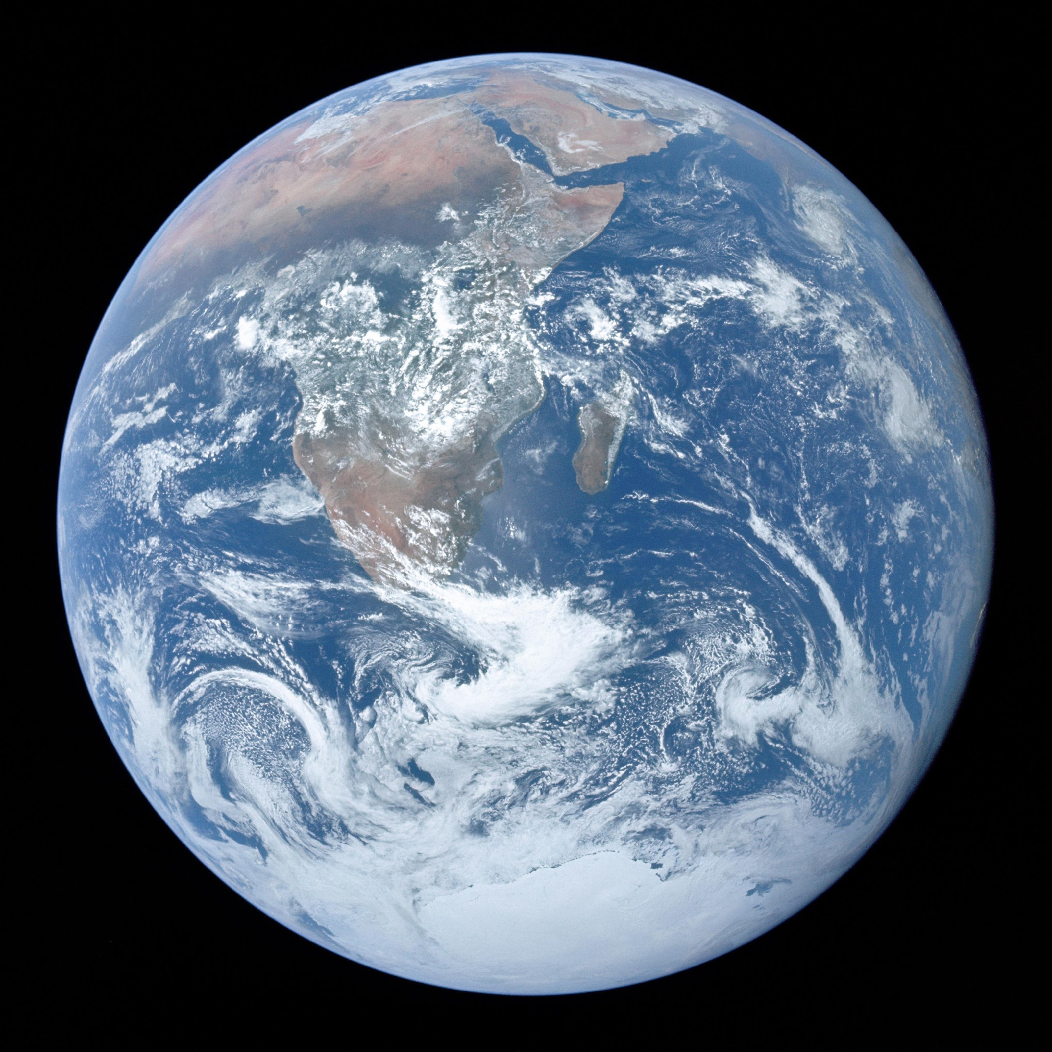
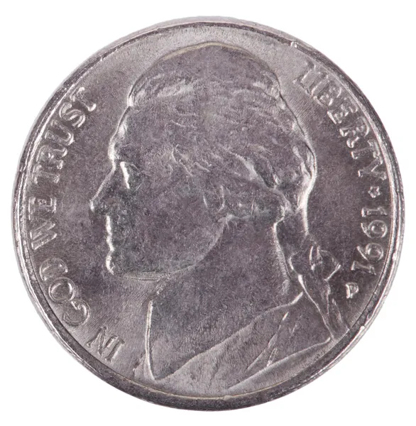
August 2024 – Advanced – Stellar Remnants
If Earth became a black hole, what would be its radius?
M = 3x10⁻⁶ msun
Radius (km) = 2.8 x (3x10⁻⁶)
= 8.4x10⁻⁶ km
= 8.4 millimeters
Heliophysics Education Activation Team

Slide 20
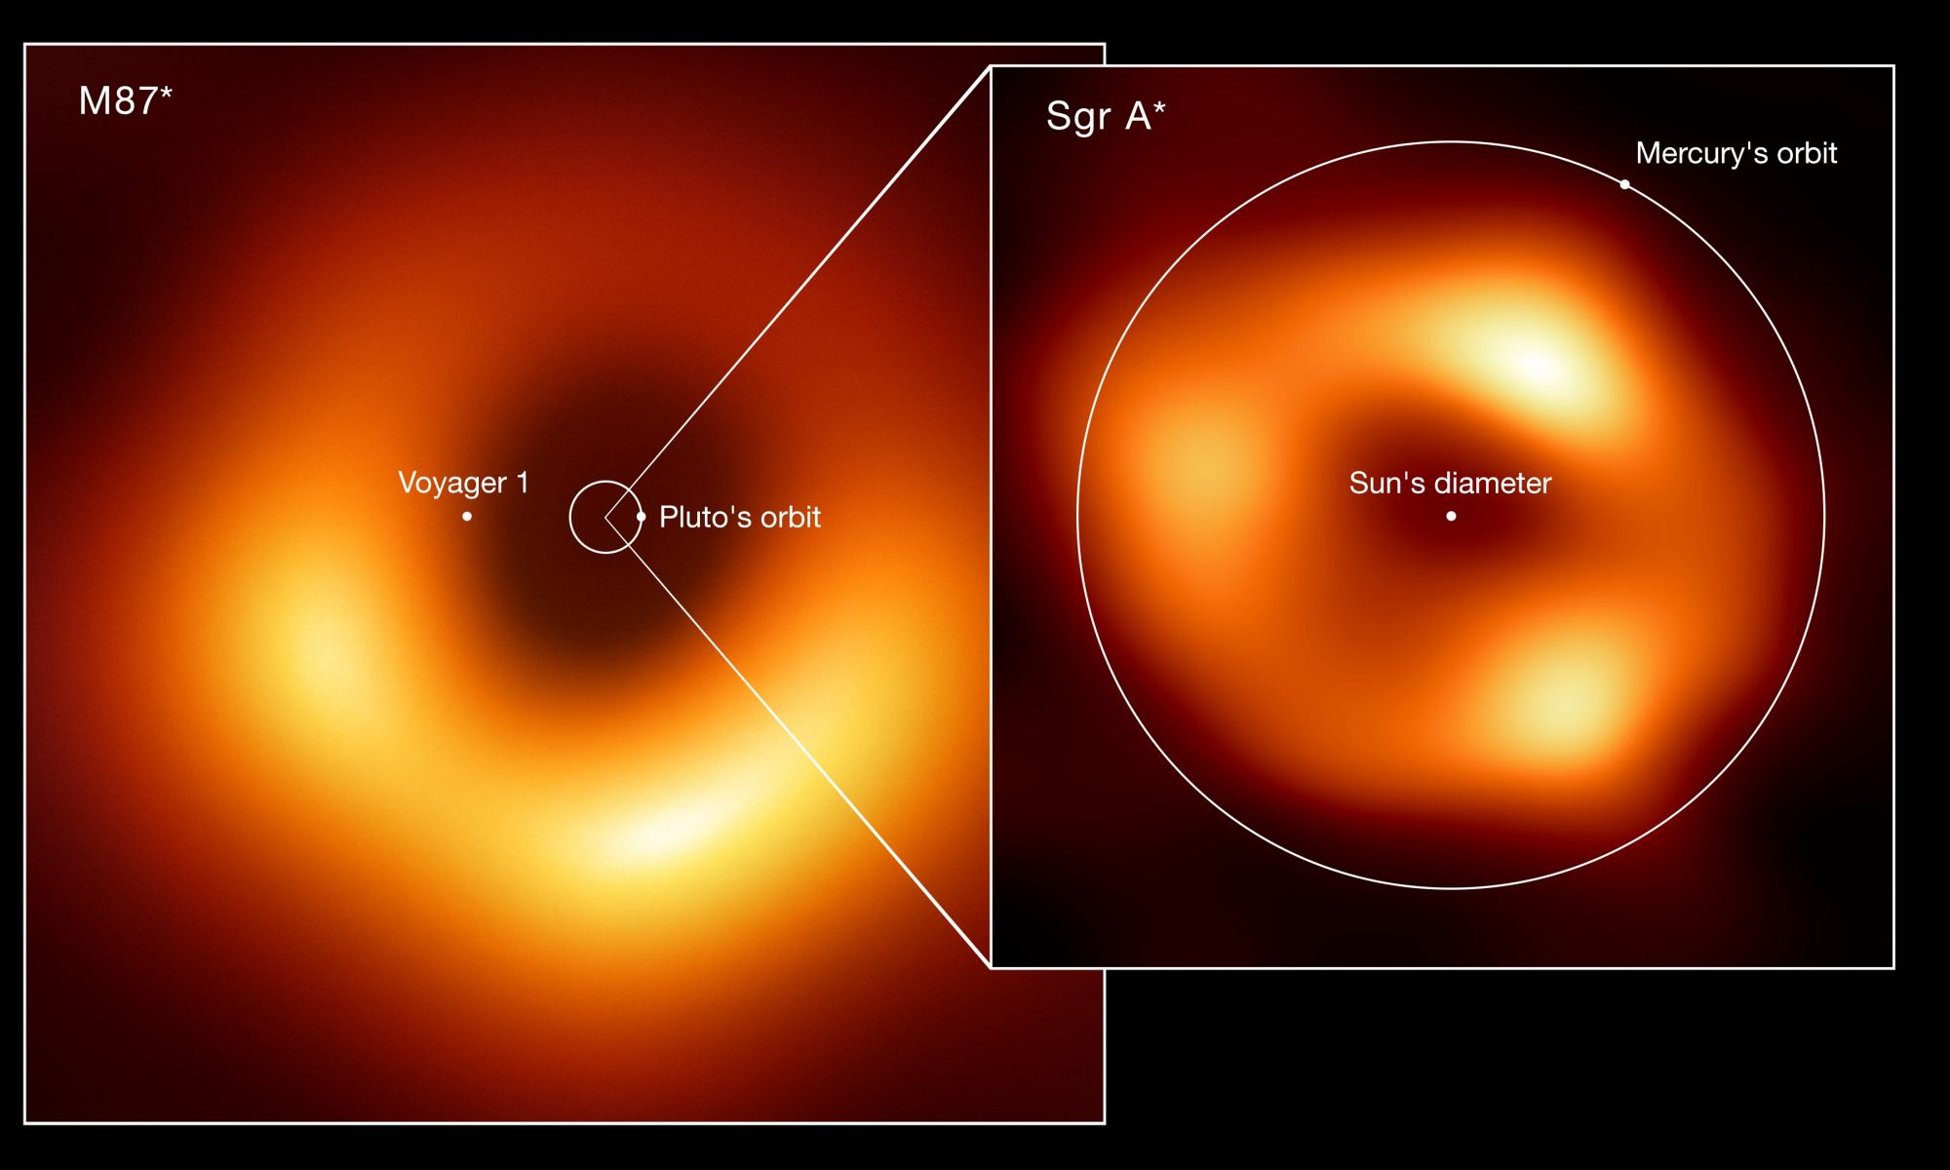
August 2024 – Advanced – Supermassive Remnants
What is the radius of a supermassive black hole with a mass of 10 billion suns, like the one in the core of the galaxy Messier 87?
R = 2.8 x 10 billion = 28 billion km
Orbit of Pluto: 5.2 billion km.
M87 would easily swallow our entire solar system.
Heliophysics Education Activation Team

Slide 21
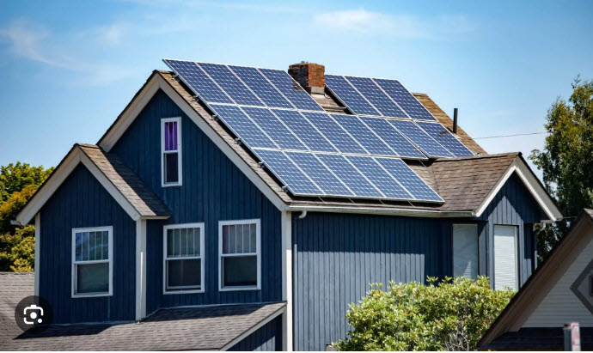
September 2024 – Environment and Sustainability
Next Time!
The Sun is a powerful source of energy. In modern times, we now rely on the Sun to produce electricity.
To make this work, we use solar panels to convert sunlight into electricity.
Heliophysics Education Activation Team

Slide 22
Slides and Recordings
Slides: https://rb.gy/qsgmbr
Previous webinar recordings https://www.youtube.com/watch?v=lwf8Y_fOOls&list=PL5mpEj48YwXntxhPvZBgJn0ZG5MRm4UlS
Heliophysics Education Activation Team

