Slide 1
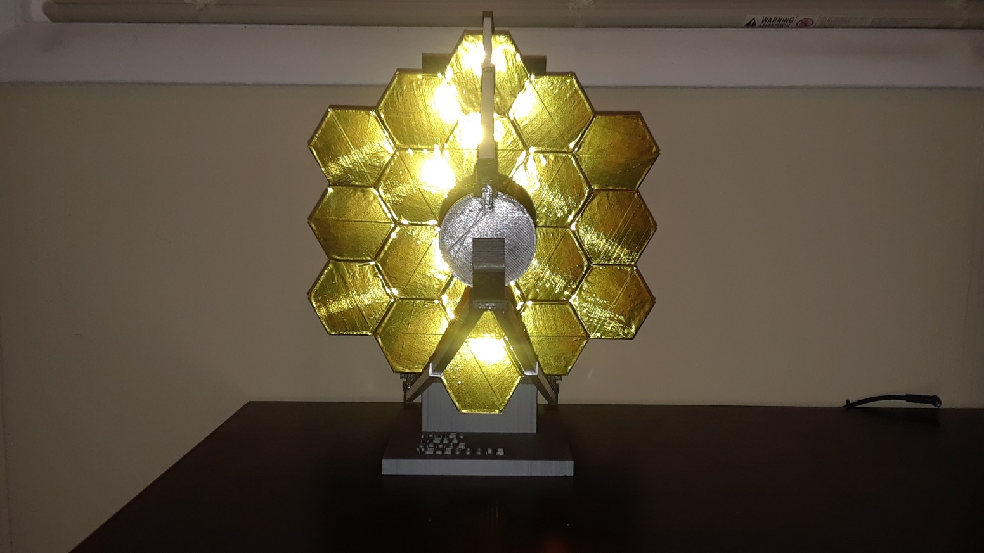
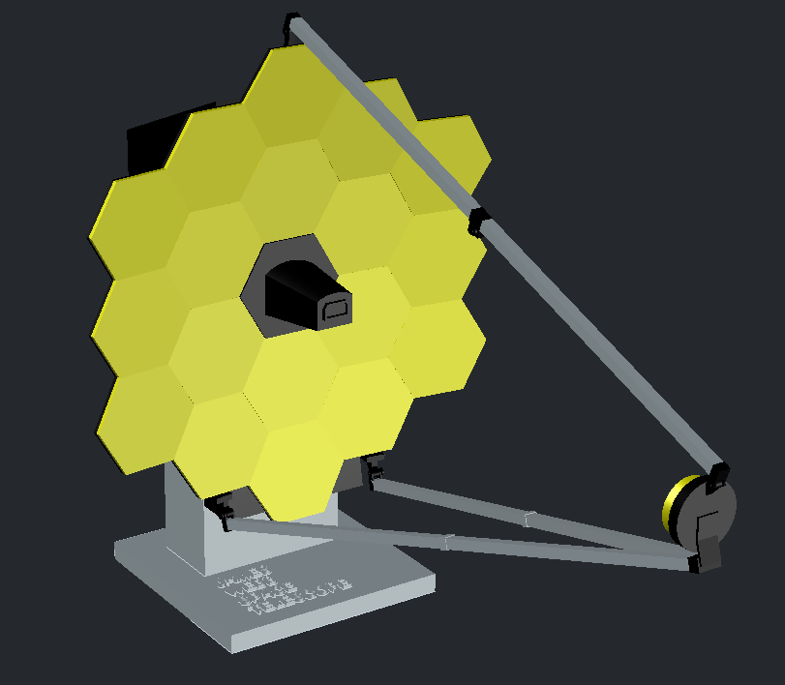

James Webb Space Telescope Mirror Model
Assembly Directions
Finished Model
Raised Lettering on Base
Computer Generated Model

Slide 2
Materials Used:
Prusa i3 MK3S 3D printer
PLA filament (1.75 mm)
Spray paint – black and metallic silver (or those colors in PLA filament)
Gold Mylar tape – or gold spray paint, the Mylar adds a shiny realism
Wooden dowels (2) – 12 in. long, 1/16 in. diameter (for secondary mirror rods to make them sturdy)
Aluminum tubing – 12 in. long, 3/32 in. diameter, cut into two 5 1/8 in. long pieces (for back hinges)
Glue – for assembly, I used Gorilla glue but any brand should suffice
Acetone – to bring back the shine after gluing the pieces with Mylar, the glue vapors show fingerprints (like a CSI scene), only a gentle wipe is needed
Patience and Time!

Slide 3
STL files: Total Needed
Back bottom (1)
Back hinge cap (4)
Back hinge (8)
Back top (1)
Base rod (1)
Base (1)
Detector (1)
Hinge pc 1 (1)
Hinge pc 2 (2)
Hinge rod short (5)
Mirror panel (18)
Mirror support (1-4deg) (2)
Mirror support (2-4deg) (6)
Mirror support (11)
Rod (7.5 with hole) (2)
Rod (8 with hole) (2)
Rod (8) (2)
Rod cap joint (2)
Rod cap (2)
Rod hinge (4)
Sec. mirror (1)
SM base (1)
STL files: Total Needed
SM rod cap piece (1)
SM rod caps (1)
SMR left hinge (1)
SMR right hinge (1)
SMR top hinge (1)
Total files = 27 STL files
Total pieces printed = 83 pieces
Printing scale = 2540% scale
Model dimensions once completed = 20 in. deep
11 in. wide
14.75 in. tall
22.5 in. tall (when folded)

Slide 4
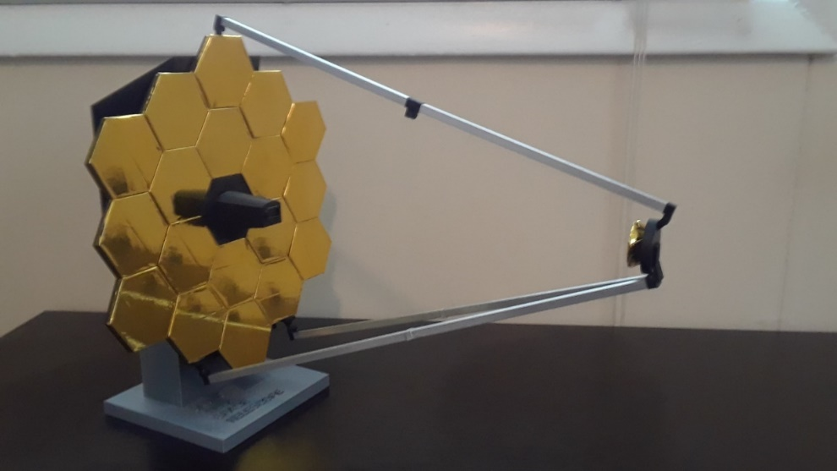
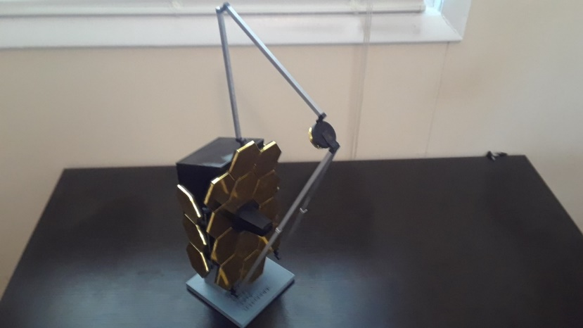
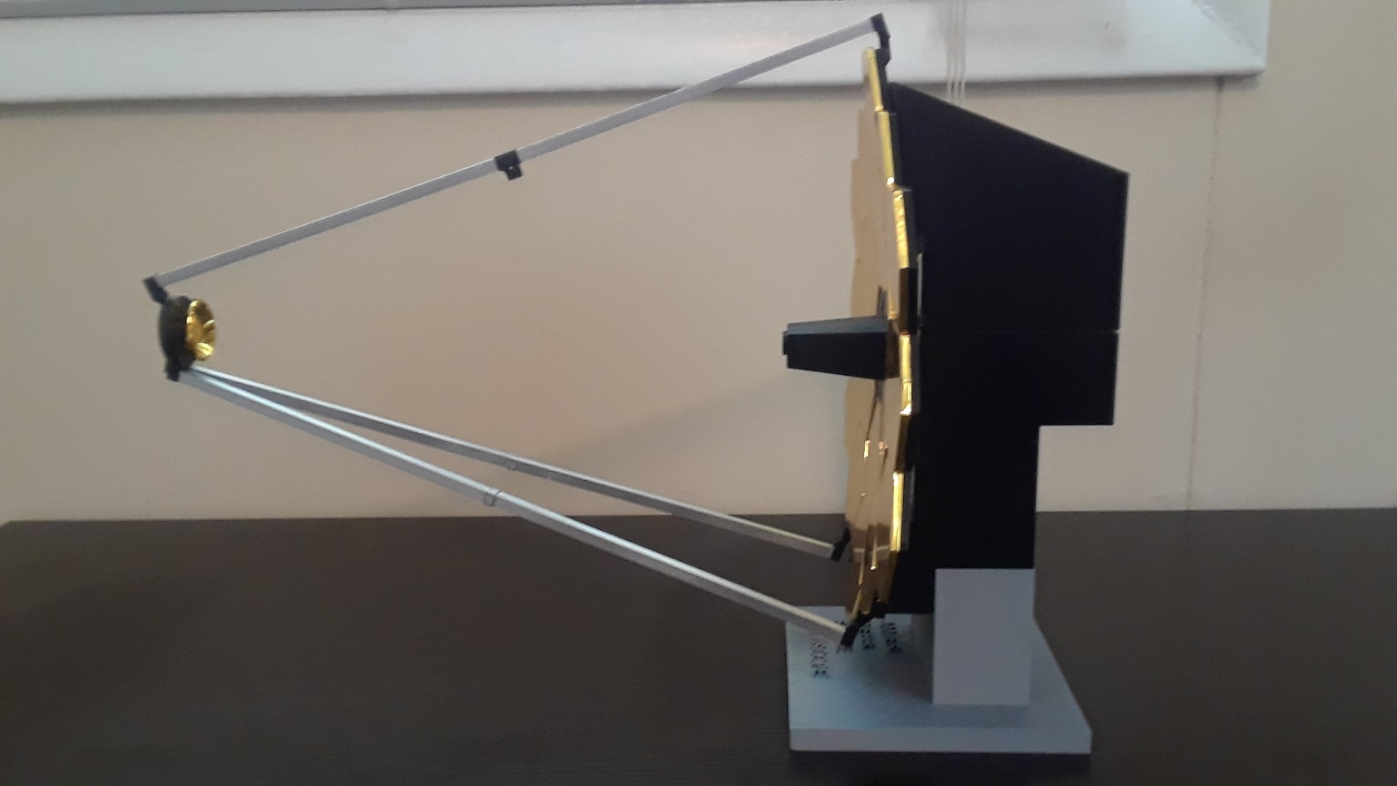
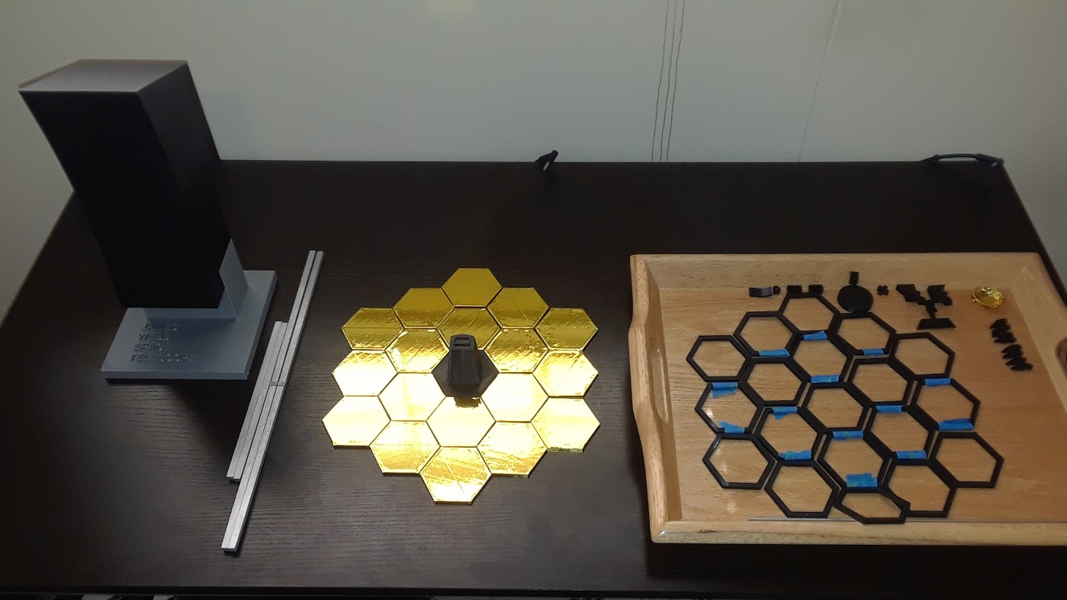
Sides folded back,
rods folded up
All the pieces made before final assembly

Slide 5
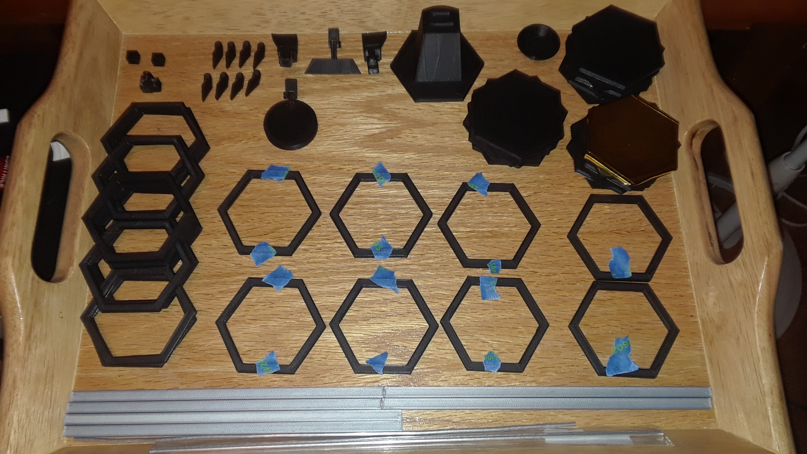
Note: The mirror support (1-4deg) and mirror support (2-4deg) have 4 degree slants designed to maintain
curvature, mark the pieces so you don’t forget which is which. When you bring up the STL file, they are on
the front and back, respectively
(2-4deg) slant on front and back of pieces
(1-4deg) slant on front of piece

Slide 6

The yellow support panels are only to
show where the mirror support
(1-4deg) pieces are placed during
assembly
The red support panels are only to
show where the mirror support
(2-4deg) pieces are placed during
assembly
This design allows for a natural
curvature of the mirror, all pieces
have a 4 degree slant in this
configuration which goes up 4
additional degrees as each piece is
added

Slide 7
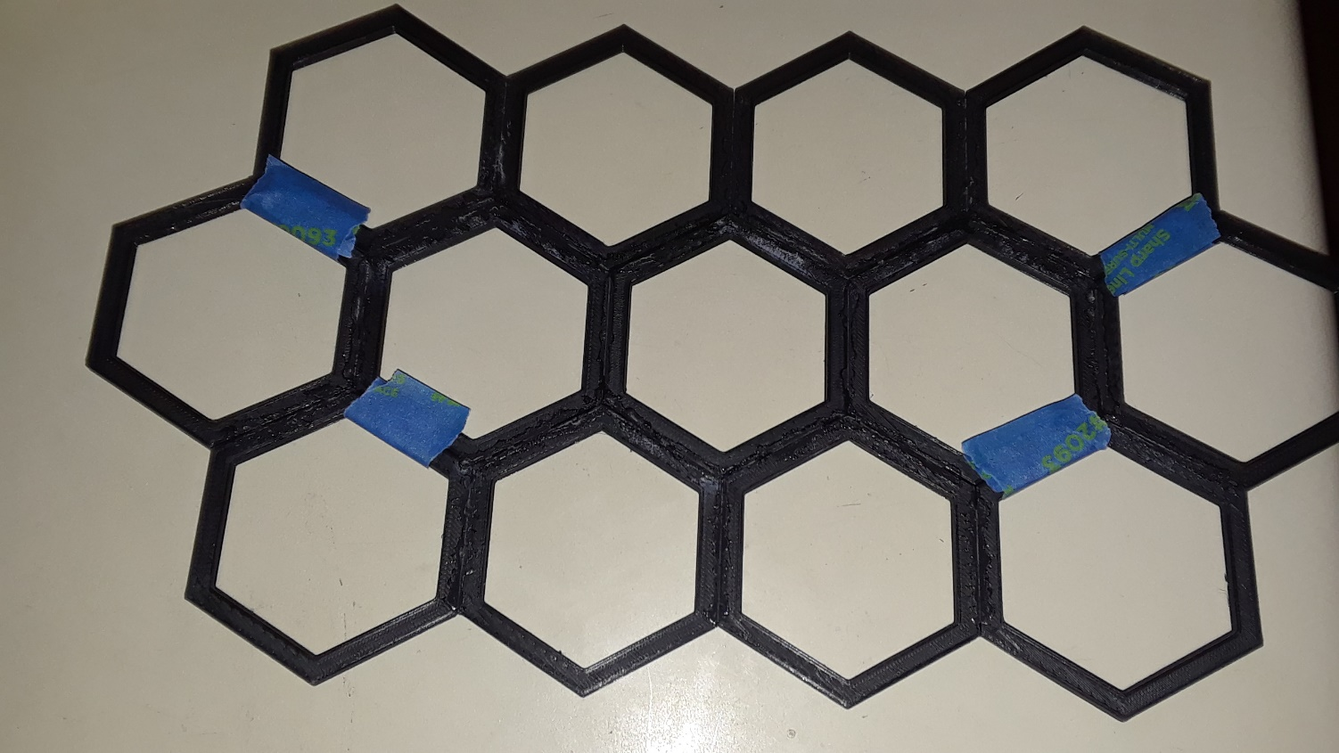
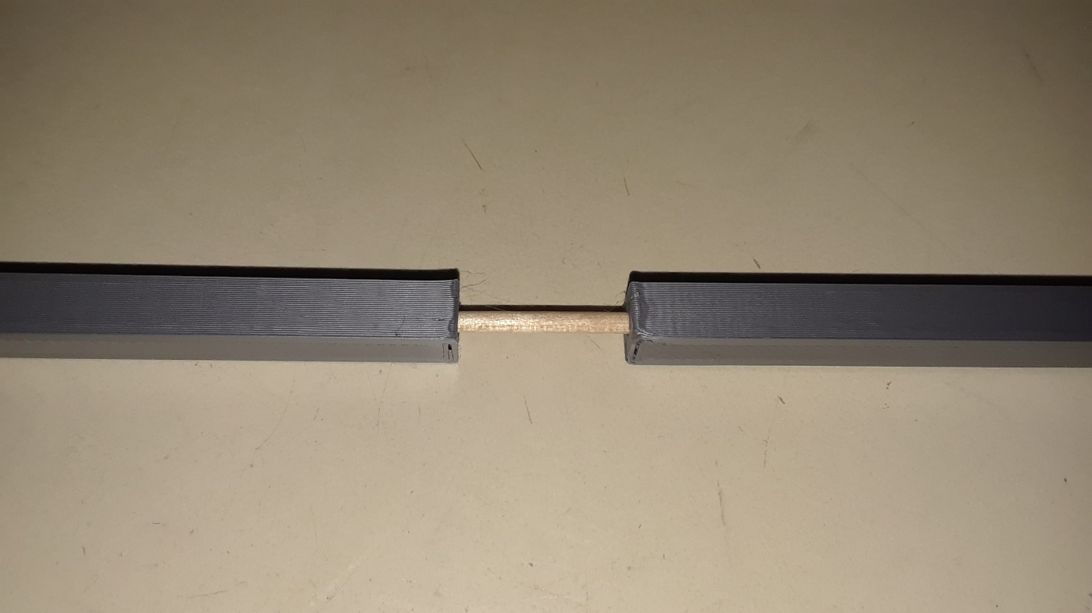
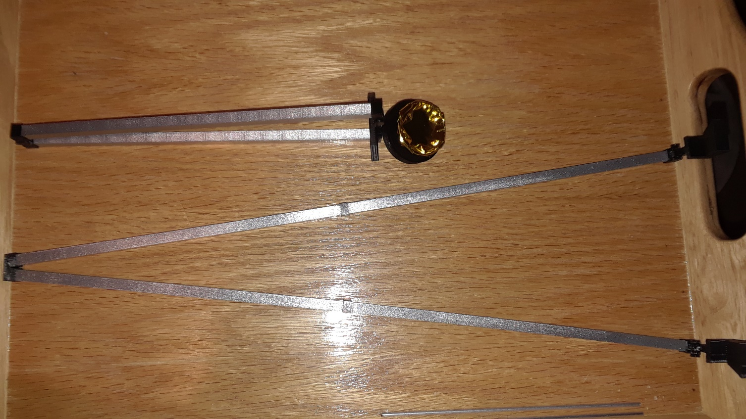
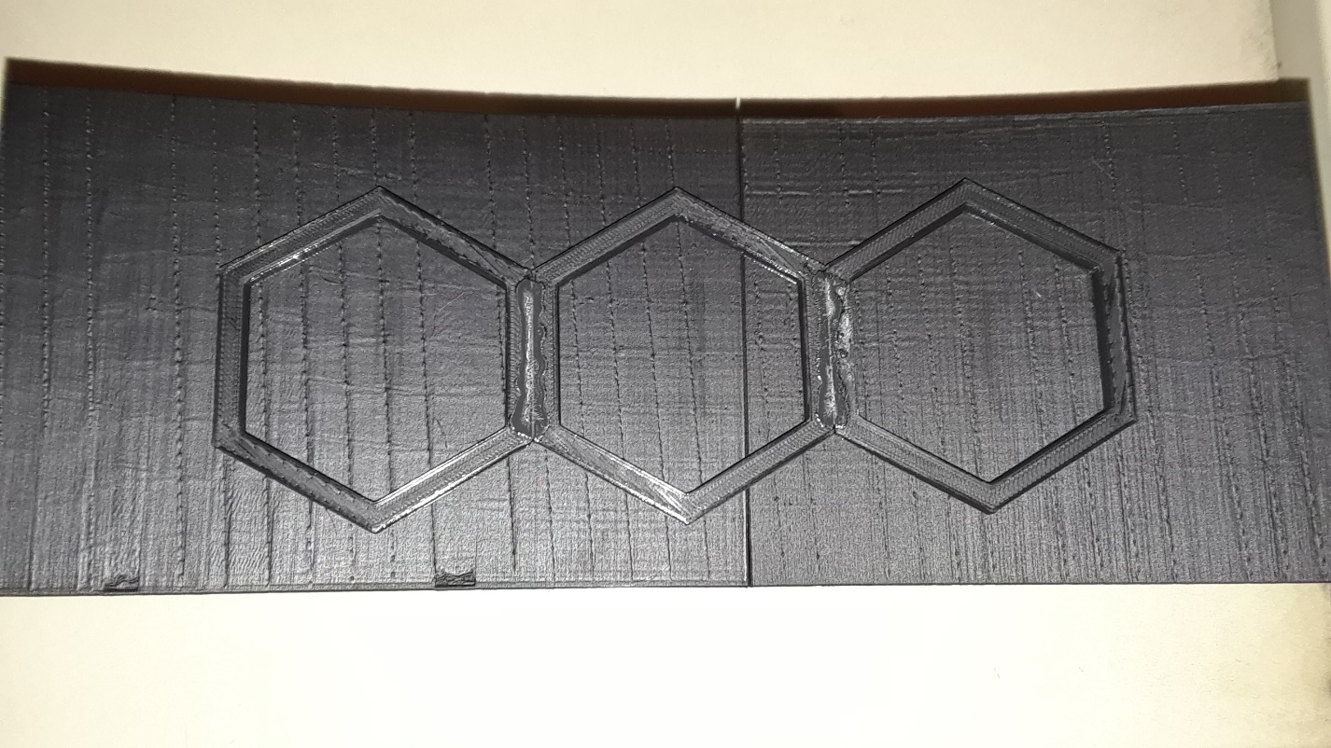
Glue the rows of support panels individually, then tape the middle
three rows to make gluing them easier: DO NOT GLUE THE OUTER
PANELS TO THE MIDDLE THREE, they will swing back with hinges
Insert wooden dowel between the 7.5 and 8 in rods,
then slide the rod cap joint over the seem, gluing the
pieces together
Remove tape once glue has dried, then glue where tape was,
smooth out glue to not lump up
Assembled rods with secondary mirror and hinges
Use the curved back surface to glue the support panels
together, this will help maintain the mirror curvature

Slide 8
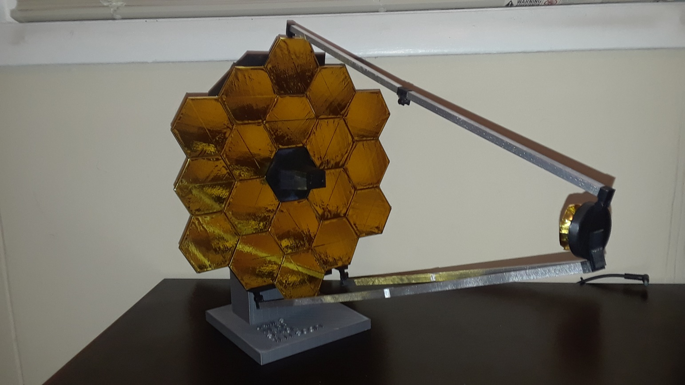
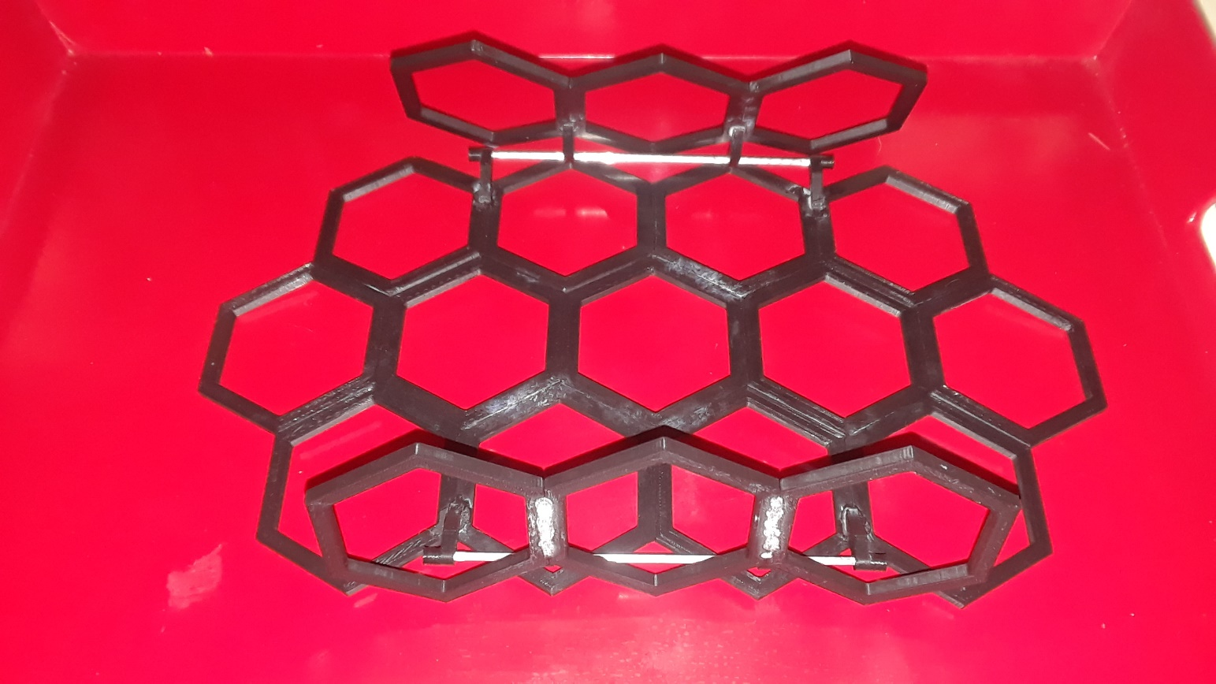
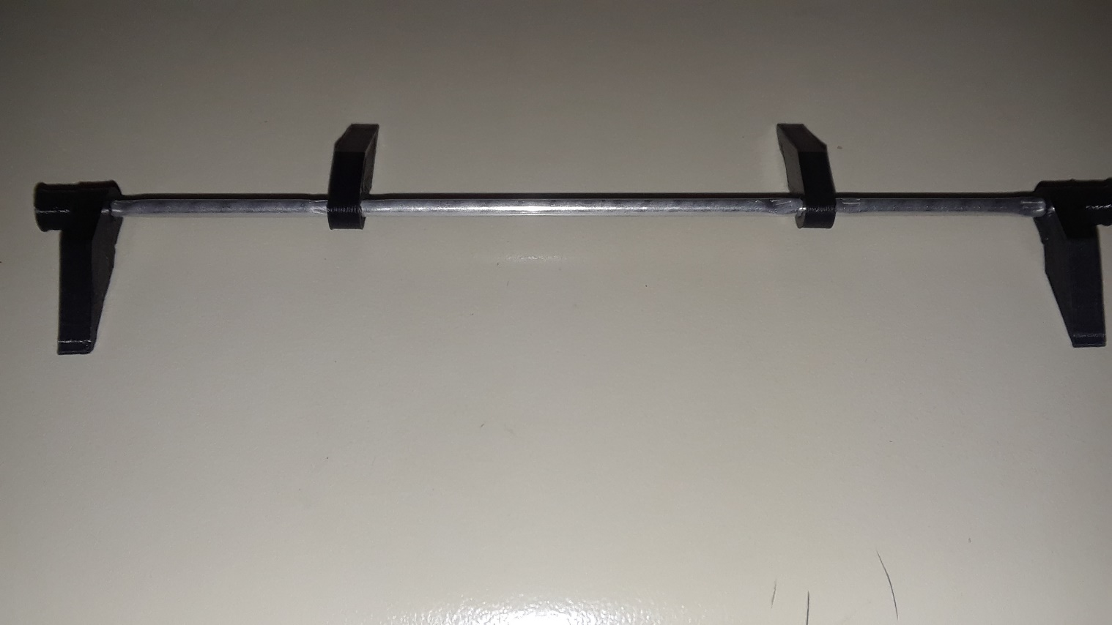
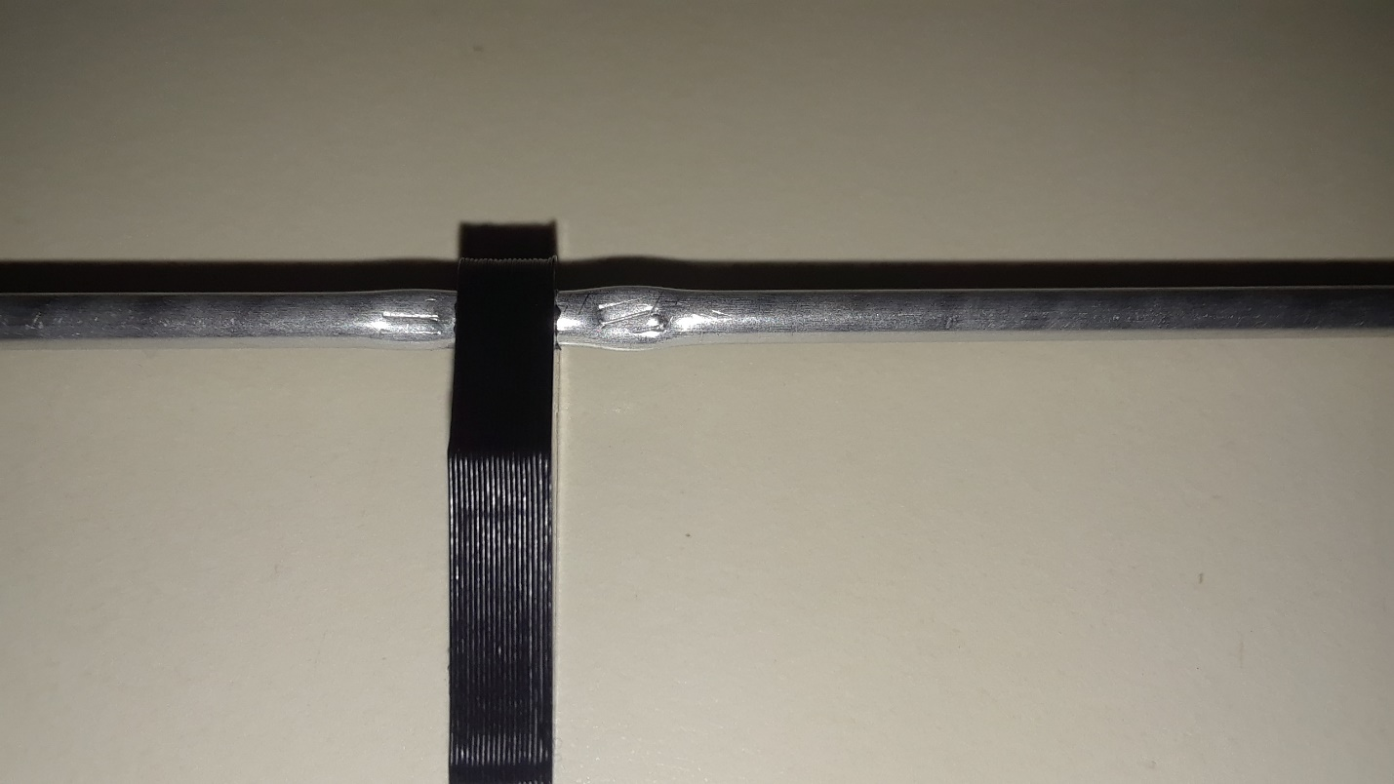
Glue assembled back hinges once support panels are
glued together, use tape to hold sides in place until hinges dry
1 inch
1 inch
Back hinges
2 ¼ inch
Crimp the rod with pliers around
the hinges to help prevent slippage
5 1/8 inch Cut Rod
+ 4 back hinges + 2 back hinge caps

Slide 9
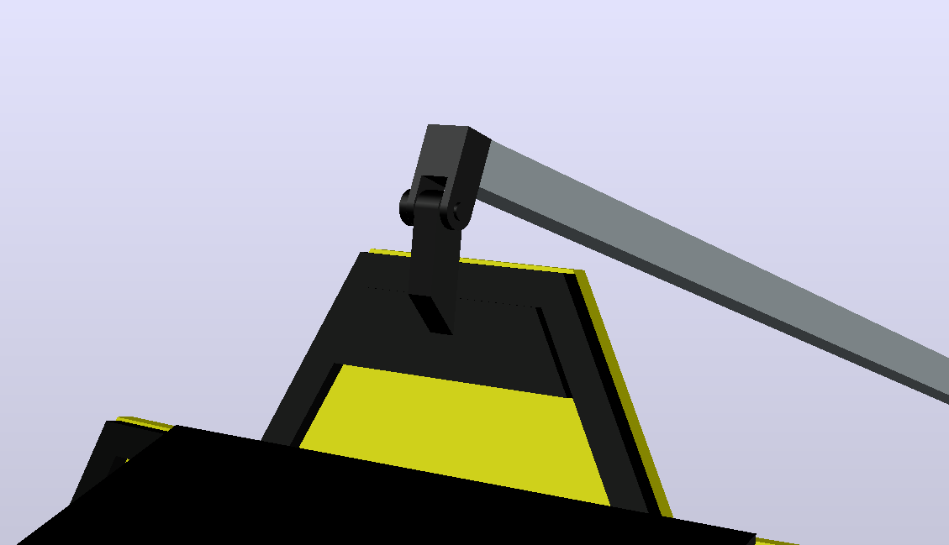
Rod hinge and hinge rod
SMR Top Hinge
Glue the SMR top hinge to support panel

Slide 10
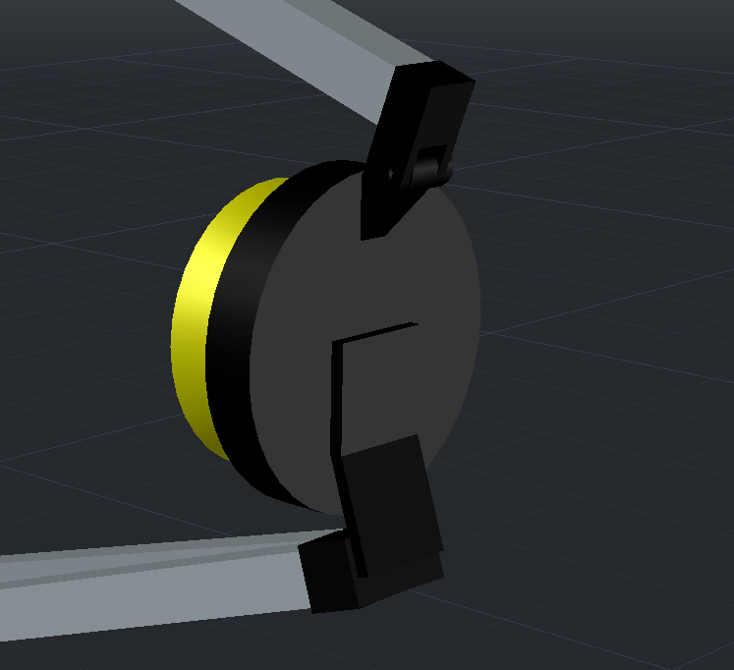
Rod hinge and hinge rod
Sec. mirror (attach Mylar or paint gold, then glue to base)
SM base
SM rod cap piece (glue to base)
SM rod caps (glue to rod cap piece)

Slide 11
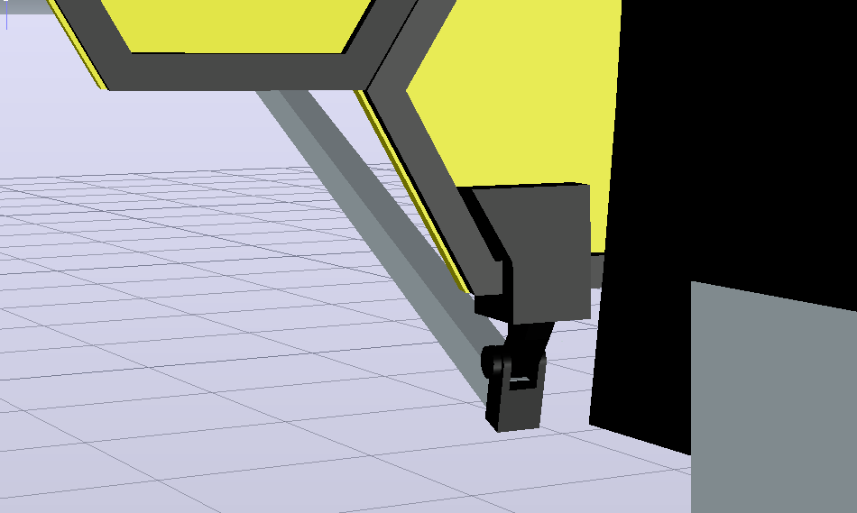
The SMR left and right hinges
will fit over the support panels
SMR Right
Hinge
Rod hinge and hinge rod

Slide 12
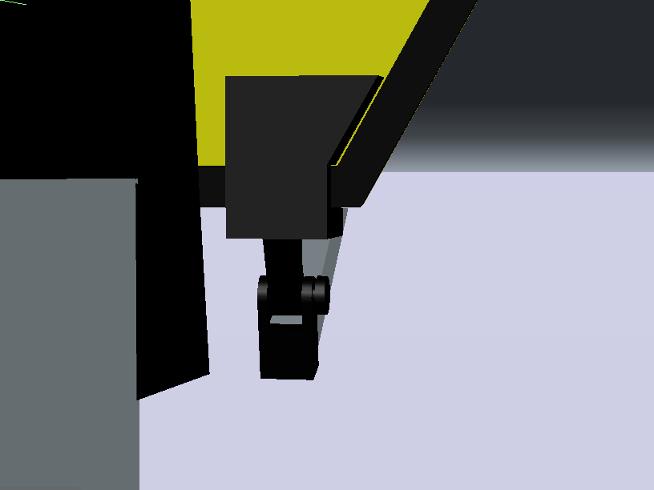
The SMR left and right hinges
will fit over the support panels
SMR Left Hinge
Rod hinge and hinge rod

Slide 13
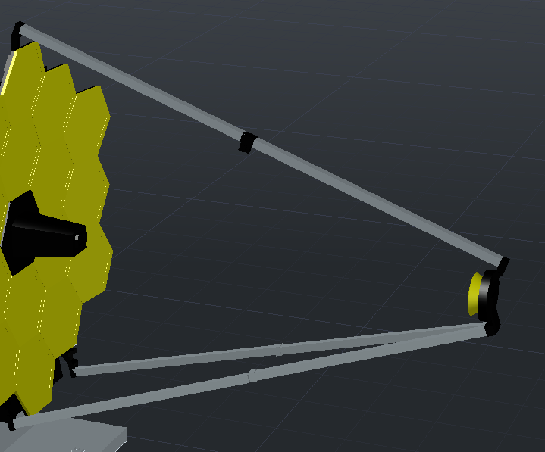
Rod (8) x2
Rod (8 with hole) x2
Rod (7.5 with hole) x2
Rod cap joint x2

Slide 14
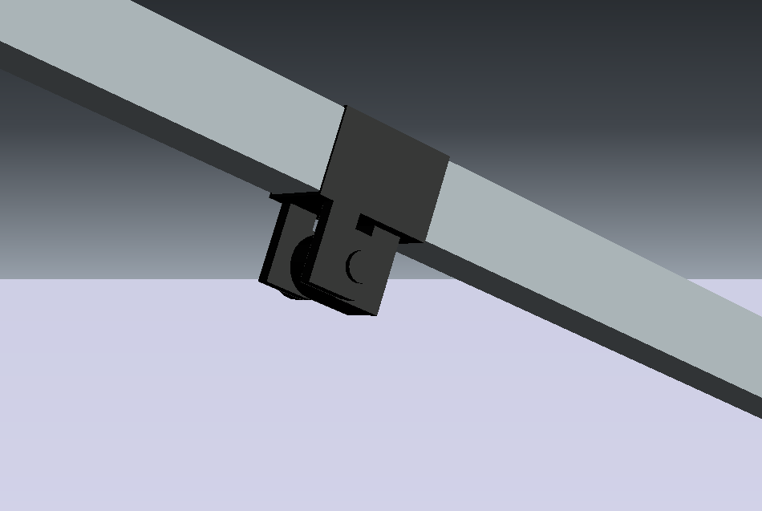
Rod cap x2
Hinge pc 2 x2
Hinge pc 1 + Hinge rod
Insert the rod into the hinge pieces
Before you glue to the rod caps, this
will make this step easier

Slide 15
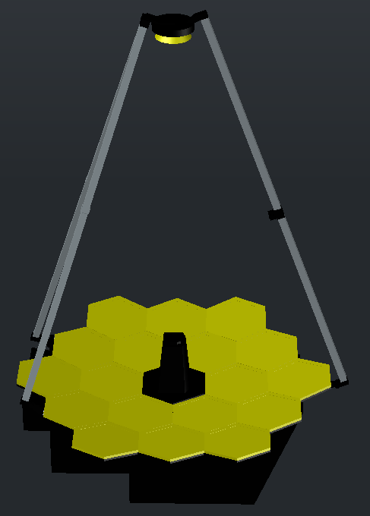
Glue the assembled support panel structure, with rod
assembly, centered onto the back pieces before gluing
the detector and mirror panels, (attach gold mylar or
paint gold BEFORE attaching mirror panels)

Slide 16
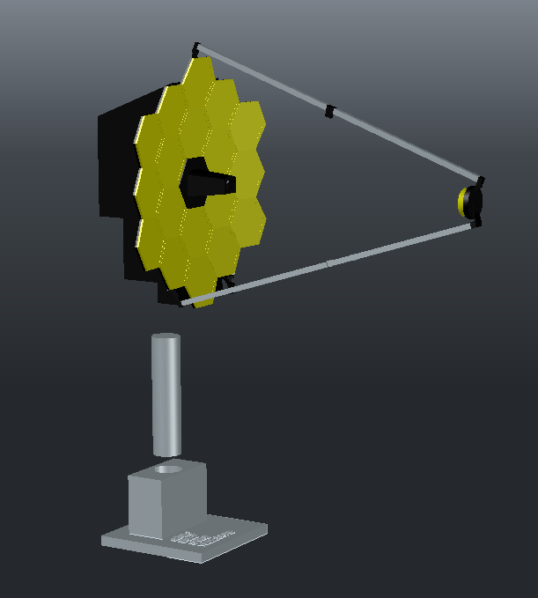
Insert the base rod into the base, then
lower the mirror assembly onto them both
and glue them all together

Slide 17
The finished model should like this, the sides should fold
back and secondary mirror should fold up to mimic the
configuration during storage for flight
Appreciate your hard work at this point and enjoy your new
model!

