Slide 1
Technology Gap Prioritization Process
Brendan Crill, ExEP Deputy Program Chief Technologist
Jason Derleth, PhysCOS/COR Chief Technologist
Opher Ganel, PhysCOS/COR Technologist
Rachel Rivera, PhysCOS/COR Technology Development Manager
Nick Siegler, ExEP Program Chief Technologist
May 14, 2024

Slide 2
What We’ll Cover Today
Overview of NASA Astrophysics Division (APD) strategic technology development
Why we prioritize technology gaps
Our gap prioritization process
Our starting point for 2024

Slide 3
APD Funds All Levels of Technology Maturity to Enable Future Missions
The Astrophysics Research and Analysis (APRA) program:
  Solicits basic research proposals relevant to NASA’s astronomy and astrophysics programs, from basic principles through flight missions (Technology Readiness Level, TRL, 1 through 9); includes suborbital investigations (balloons, sounding rockets); award duration up to five years.
The Strategic Astrophysics Technology (SAT) program:
  Matures key technologies that address the needs of future strategic missions, taking them from proof of concept through validation in relevant environment (TRL 3 to 6); award duration up to three years.
The Internal Scientist Funding Model (ISFM) program:
  Similar to SAT or APRA awards. Awarded to NASA scientists.
Flight projects:
  Address final maturation (TRL 6 through 9) proving technology flight-worthiness for mission-specific applications.
The strategic technology gap prioritization informs the SAT program

Slide 4
Strategic Technology Development Sequence
The Decadal Survey Prioritizes the science
APD Develops an implementation plan
The astrophysics community Identifies strategic technology gaps
Tech Management Board (TMB) Prioritizes technology gaps
APD Solicits and makes investments
The astrophysics community Develops and matures technologies
The Program Offices Monitors, tracks, and advocates for technology developments

Slide 5
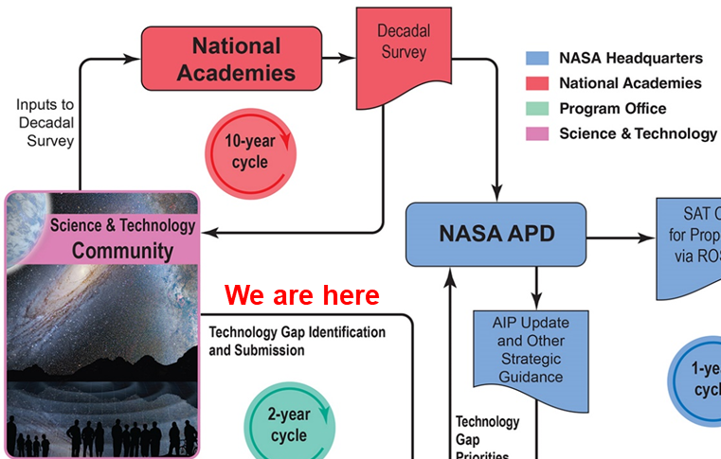
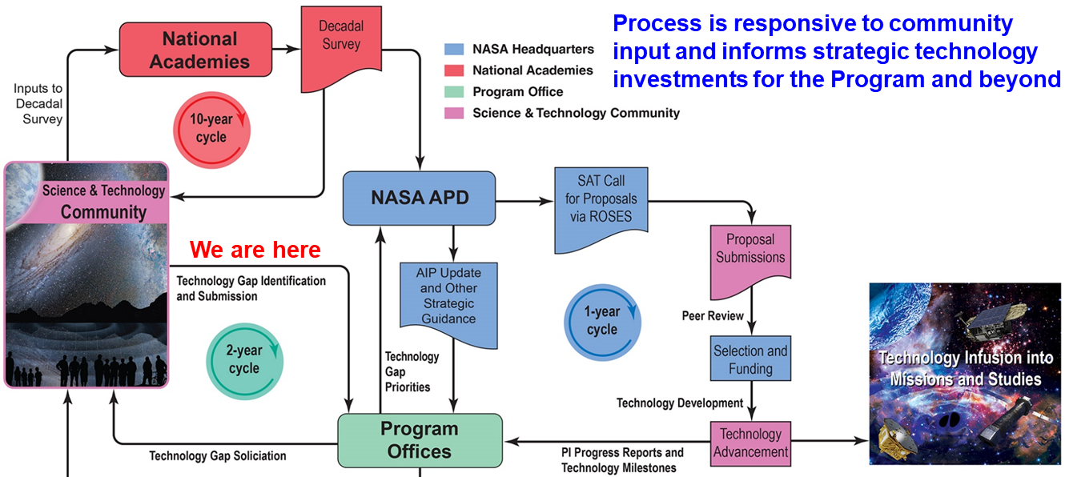
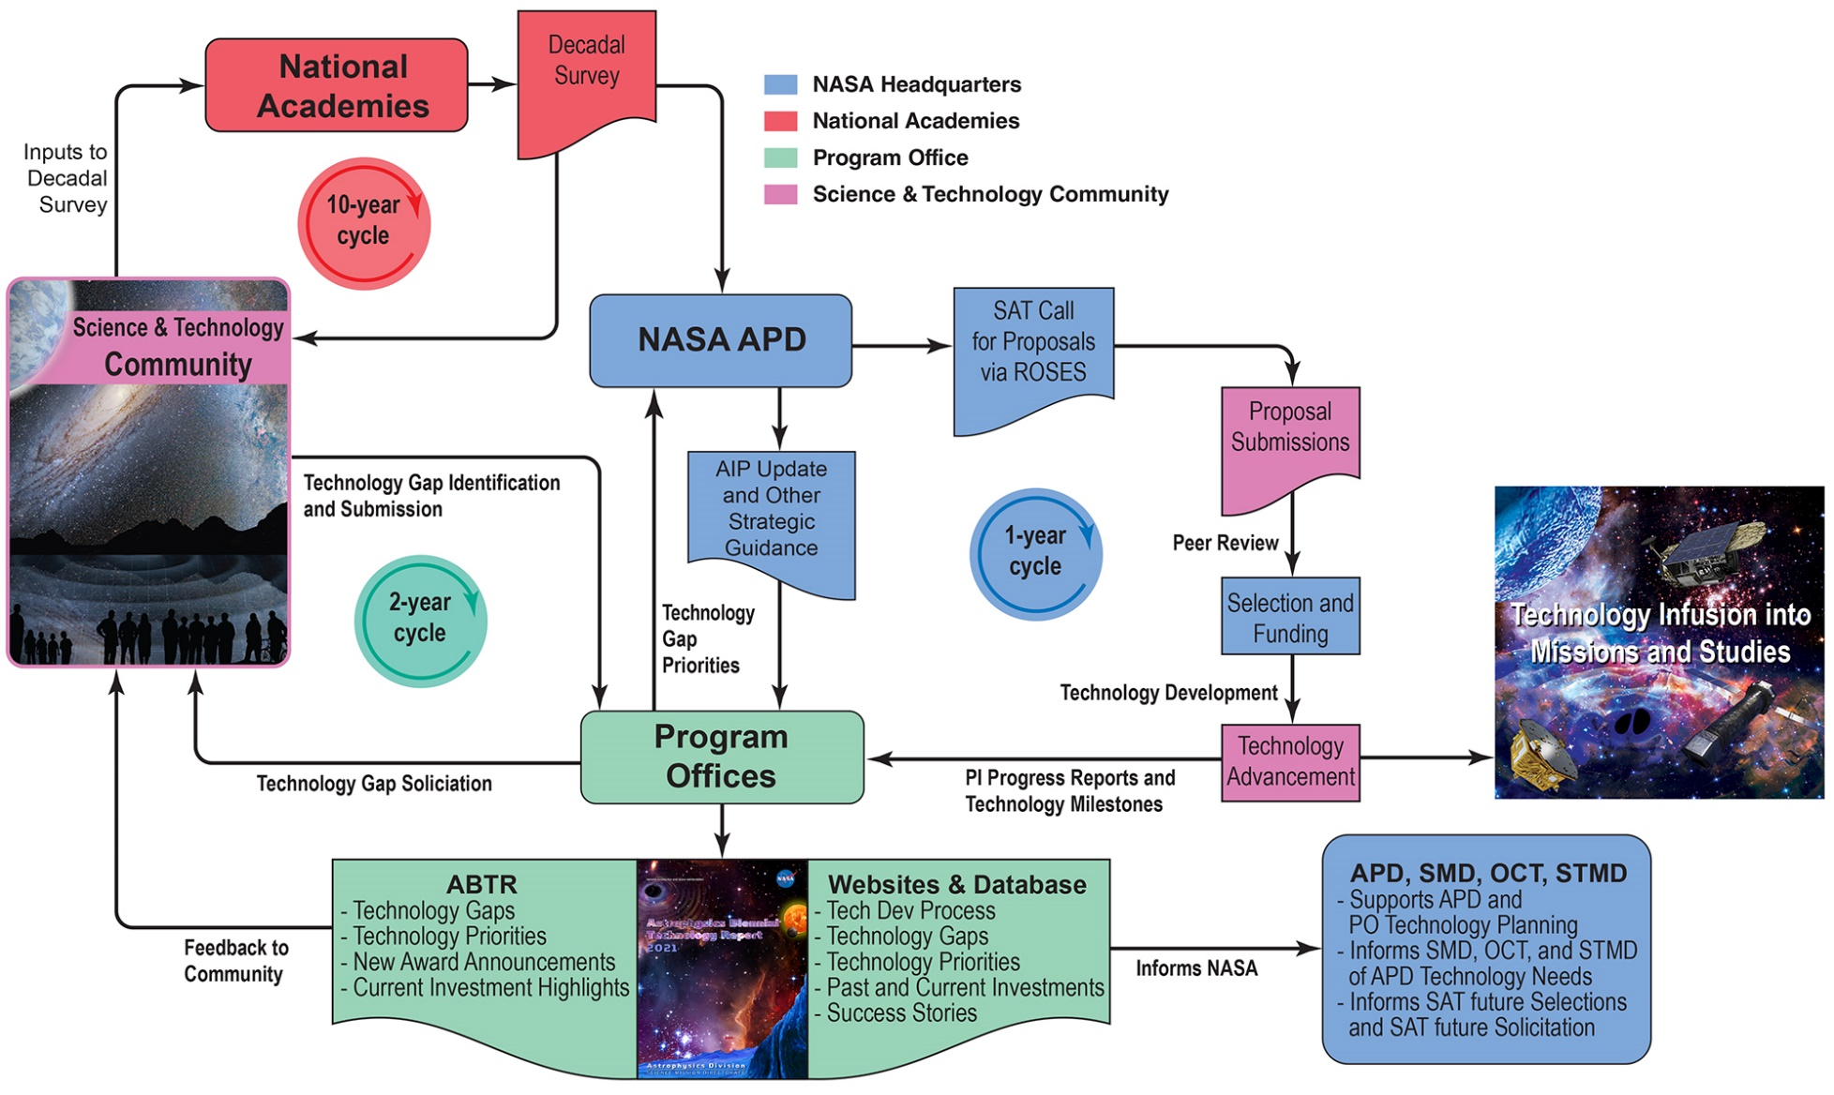
Strategic Technology Development Process
Process is responsive to community input and informs strategic technology investments for the Program and beyond
Process is responsive to community input and informs strategic technology investments for the Program and beyond
We are here
We are here
We are here
ATU
Technology Highlights
New Award Announcements
Infusion and TRL Updates
ATUs to be published between ABTR publication years

Slide 6
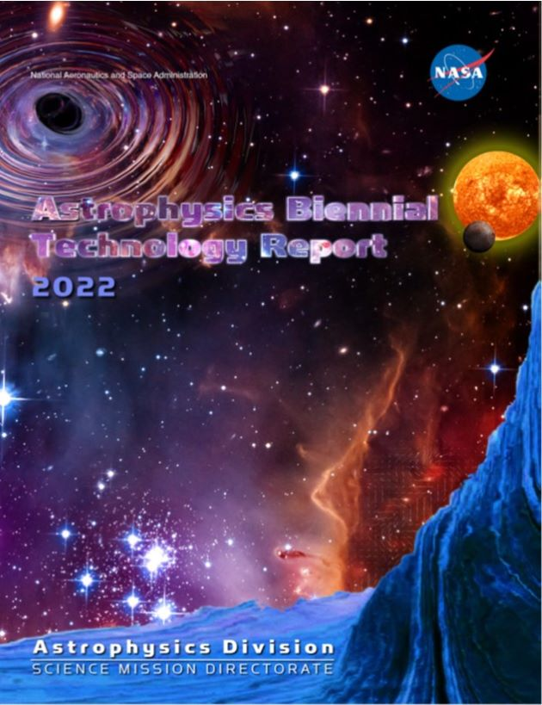
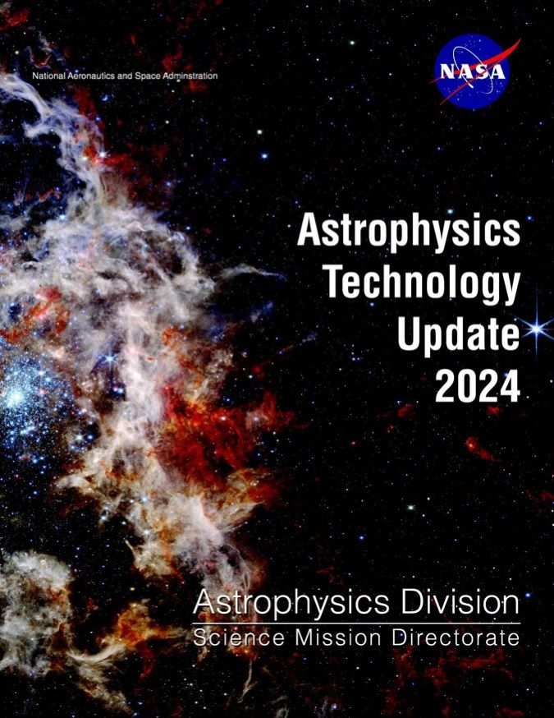
What Are the ABTR and ATU?
The Astrophysics Biennial Technology Report (ABTR) is published every other year, summarizing APD technology development activities over the prior two years
Provides an overview of APD technology development activities and processes (“big-picture” investment summary and metrics).
Lists current technology development portfolios, highlights significant progress, identifies technology infusions, and announces new SAT award selections, if any.
Provides a prioritized list of technology capability gaps to inform SAT proposal calls and selection decisions for the coming two years, as well as future technology development planning.
The Astrophysics Technology Update (ATU) is published every other year (between ABTRs) summarizing APD technology highlights over the prior two years.
Provides an overview of APD technology development activities and processes (“big-picture” investment summary and metrics).
Highlights significant progress, identifies technology infusions, and announces new SAT award selections, if any.
In 2024, the first ATU was published in the same year as the upcoming ABTR, to highlight recent Astrophysics technology development news at the SPIE meeting in Yokohama. This ATU includes only highlights.

Slide 7
Why Prioritize Gaps?
Objectives
  Identify technology gaps applicable and relevant to Astrophysics strategic objectives as described in the Decadal Survey, AIP, and any other strategic guidance from APD
  Rank these technology gaps with respect to strategic alignment, benefits and impacts, urgency, and cross-cutting capabilities to inform APD strategic technology development solicitation, planning, and investments
Purposes
  Inform the SAT solicitation and other NASA technology development programs (APRA, SBIR, and other OCT and STMD activities)
  Inform technology developers of APD technology gaps to help focus efforts
  Inform selection of awards to align with APD goals and science objectives
  Improve transparency and relevance of APD technology investments
  Inform and engage the community in our technology development process
  Leverage technology investments of external organizations by defining our strategic technology gaps and identifying NASA as a potential customer

Slide 8
Technology Gap Prioritization Process
  Technology gaps are solicited from the community (current cycle due date is Jun 3rd, 2024)
  Program technologists from the three POs review the gap inputs and assign each to the Program that would be most impacted by closing it (Gap Distribution)
  Each PO consolidates its assigned inputs
  The integrated gap lists are sent to the COPAG Executive Committee (EC) or PhysPAG EC as appropriate for review before prioritization of PhysCOS/COR gaps
  The TMB/ExoTAC review and prioritize technology gaps in Jul/Aug
  TMB membership is diverse and includes senior members of APD and POs, STMD, and subject matter experts
  The ExoTAC is a standing independent expert panel advising ExEP
  Prioritization is based on a published set of criteria addressing strategic alignment, benefits and impacts, urgency, and scope of applicability (see next slide)
After APD approval, the prioritized list is used to inform the SAT solicitation amendment in Sep, posted on PO websites, and published in the ABTR
Notes:
Comprehensive:
Identification of gaps
Maturation
Insertion
Our technology program is science driven
Community involvement is key – solicit community input throughout the process
Inform our stakeholders to get our message across
Strategic and transparent in what we do. Transparency and openness are critical. Making the process as open and visible to all interested members of the community as possible
Ensure relevance in our technology development – must benefit program science
Leverage resources whenever we can

Slide 9
Prioritization Criteria Address…
Strategic Alignment: How well does the technology align with astrophysics science and/or programmatic priorities set out in the Astro2020 Decadal Survey?
Benefits and Impacts: How much impact does the technology have on applicable missions? To what degree does it enable and/or enhance achievable science objectives, reduce cost, and/or reduce mission risks?
Urgency: Given the anticipated difficulty of maturing from the current TRL to TRL 6, assessed against the time available until anticipated launch and/or other schedule drivers, how urgently does the gap need to be addressed?
Scope of Applicability: How crosscutting is the technology? How many Astrophysics programs and/or mission concepts (strategic or other) would benefit by closing the gap?

Slide 10

Technology Gap Submission Form
Technology gap submission form can be downloaded here:
https://apd440.gsfc.nasa.gov/tech/Tech_gap_form_2023-12-11.docx
Name of technology capability gap
Strategic Missions enabled or enhanced
Description of technology capability needed
Description of quantitative/ measurable performance goals and objectives to fill this capability gap
Assessment of current state-of-the-art TRL
References for TRL justification
Scientific, engineering, and/or programmatic benefits of achieving this capability (filling the “gap”)
Potential applications and relevant mission(s) (not limited to strategic Astrophysics missions)
Urgency, estimated launch date or other schedule driver, complexity, and difficulty

Slide 11
Technology Capability Gaps Guidance
Focus on technology gaps associated with missions prioritized in Astro2020 and relevant programmatic directives
Submit technology gaps directly applicable to Program objectives. Don’t submit gaps beyond our charter (e.g., ones associated with launch vehicle, rover, avionics, spacecraft systems, etc.)
Don’t include gaps that don’t require technology development, are not well defined, and/or are redundant (duplicate, similar, or subsets of other needs)
Submit inputs as technology capability gaps between the current state-of-the-art and what is needed to achieve the science objective targeted, not specific implementations
Don’t endorse or advertise any organization, mission, or person
Don’t include proprietary or ITAR/EAR-sensitive information

Slide 12
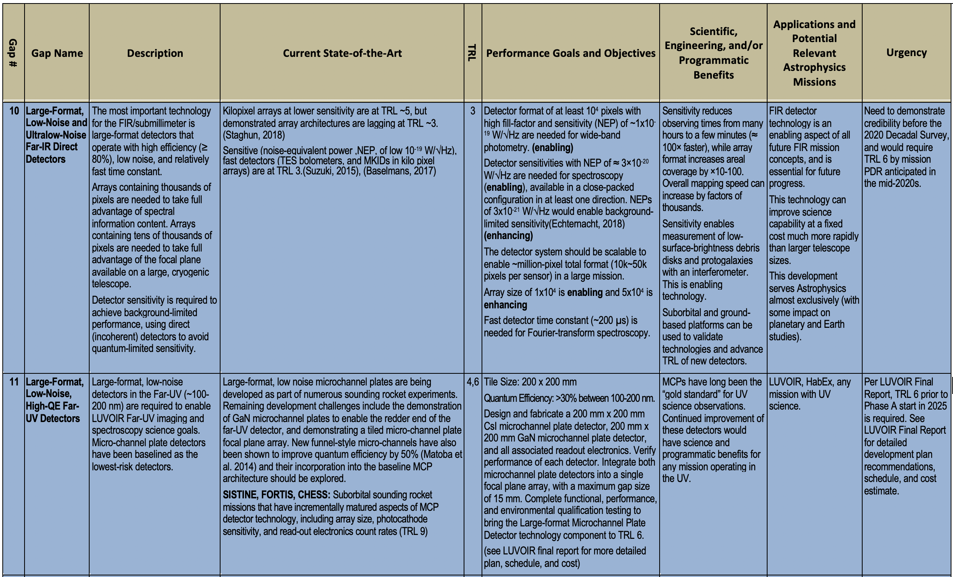
Sample Excerpt of 2022 Tech Gap Details

Slide 13
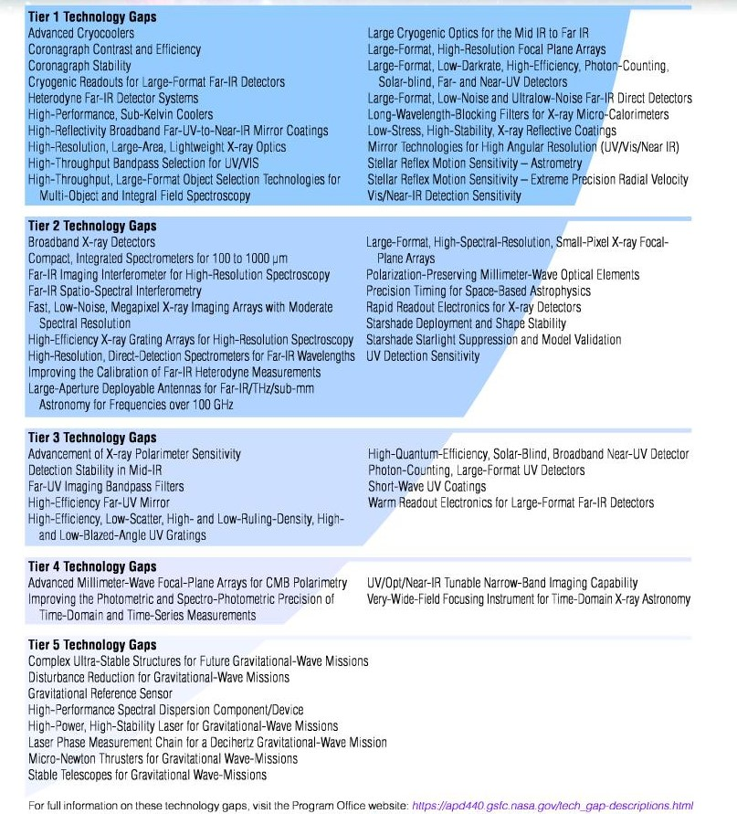

Full 2022 Technology Gap Priorities List
Tiers are in descending priority order.
Gaps within any given tier are considered equally prioritized which is why they are arranged alphabetically within each tier.
Gaps in Tiers 1-4 are automatically included in the following prioritization cycle so there is no need to resubmit them unless you want to propose edits
Gaps in Tier 5 are not strategic and are thus excluded from the following prioritization cycle.
This 2022 Prioritized Gaps List can be downloaded here: https://apd440.gsfc.nasa.gov/images/tech/2022tiers.pdf

Slide 14
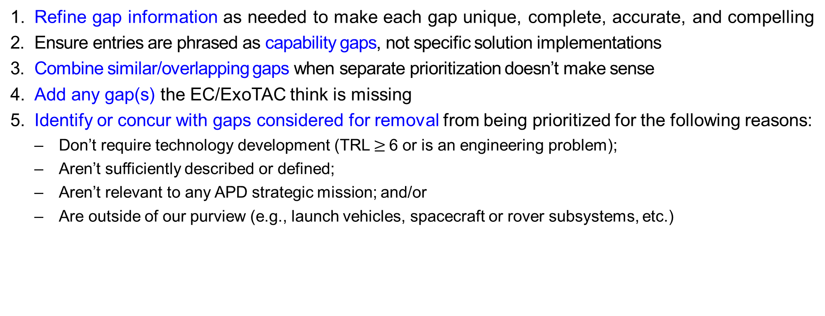
How the PhysPAG and COPAG ECs Help
  Refine gap information as needed to make each gap unique, complete, accurate, and compelling
  Ensure entries are phrased as capability gaps, not specific solution implementations
  Combine similar/overlapping gaps when separate prioritization doesn’t make sense
  Add any gap(s) the EC/ExoTAC think is missing
  Identify or concur with gaps considered for removal from being prioritized for the following reasons:
    Don’t require technology development (TRL $≥$6 or is an engineering problem);
    Aren’t sufficiently described or defined;
    Aren’t relevant to any APD strategic mission; and/or
    Are outside of our purview (e.g., launch vehicles, spacecraft or rover subsystems, etc.)

Slide 15
What Missions Are Considered “Strategic”?
Strategic Astrophysics missions are ones APD is developing, participating in, or interested in, to respond to high-priority science questions or mandate. These are missions identified as priorities by the current Decadal Survey and/or identified for execution by APD.
Strategic missions are usually large and multi-purpose and are generally assigned to a NASA Center to implement, with science instruments and platform components selected in open competitions.
Strategic missions relevant for technology gap submission during the 2024 prioritization cycle are shown below in blue:
  Decadal Survey flagship missions: HWO, far-IR flagship, X-ray flagship
  Decadal Survey Probes: Far-IR Probe, X-ray Probe, CMB Probe
  Strategic non-mission activities:
    Decadal Survey high-priority activities: Time-Domain/Multi-Messenger (TDAMM)
    Other fields mentioned in Astro2020 (e.g., gamma ray, cosmic rays, etc.)

Slide 16
Starting Point for 2024 Gap Prioritization
All Tier 1-4 gaps from 2022 are automatically included (no need to resubmit unless proposing edits).
All Tier 5 gaps from 2022 are automatically excluded, as they are not strategic.
All gaps submitted by the community by June 3rd will be considered.
The leadership of the HWO Science, Technology, and Architecture Review Team (START) and HWO Technical Assessment Group (TAG) plans to submit authoritative HWO technology gaps (per Matt Bolcar).

Slide 17
Summary
The POs are prioritizing technology gaps for APD this summer.
The due date for entries is June 3rd. Gaps submitted later will be considered in 2026.
The HWO START/TAG leadership plans to submit a set of authoritative HWO gaps.
Unless you want to propose an edit, there’s no need to resubmit 2022 gaps
  Gaps in Tiers 1-4 are automatically included
  Tier 5 gaps are automatically excluded.
The 2024 prioritized Astrophysics Technology Gaps list will be published by Sep 30th.
Technology gaps that do not enable or enhance strategic Astrophysics missions can be, and often are funded through other programs (e.g., APRA, RTF, ISFM, etc.)
APD invests in facilities to close capability gaps, but this is in parallel to the technology gaps process.

