Slide 1
Specular Black Coating For Starshade Razor Edges
September 18th, 2019
David A. Sheikh
ZeCoat Corporation
Torrance, California

Slide 2
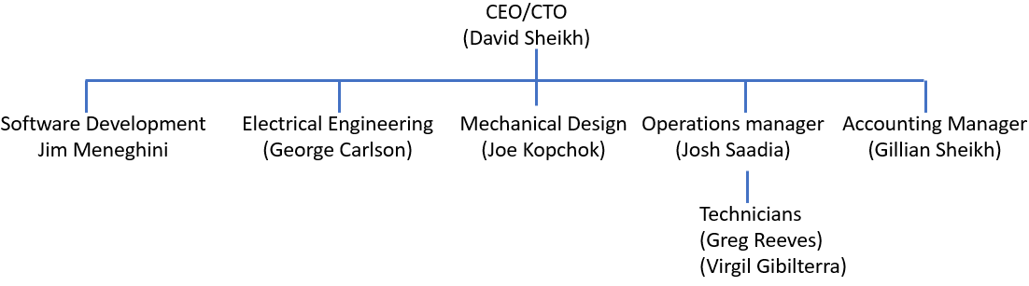
ZeCoat Corporation
Organizational Structure

Slide 3
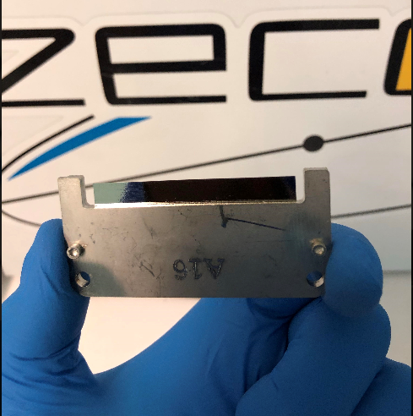
Starshade blade

Slide 4
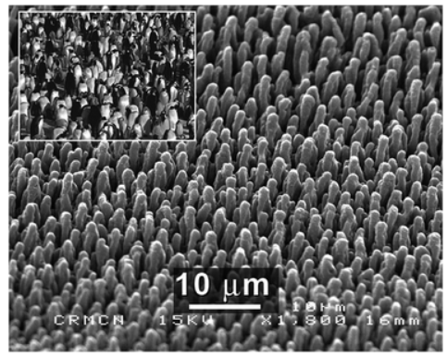
What is a specular black coating and why might we need them for starshade edges?
Answer: Most black coatings (photo right) are textured
and use the shape of the surface to trap the light.
However, this type of black coating is typically several
microns thick, and this thickness covers up the 250-nm
edge of the blade, dulling it.
ZeCoat’s black coating is smooth and works by interference, and is only about 300-nm thick.
Addition of a thin black coating to the edge of the blade may help reduce glint bouncing
back into the telescope, without increasing the radius of the edge too much.

Slide 5
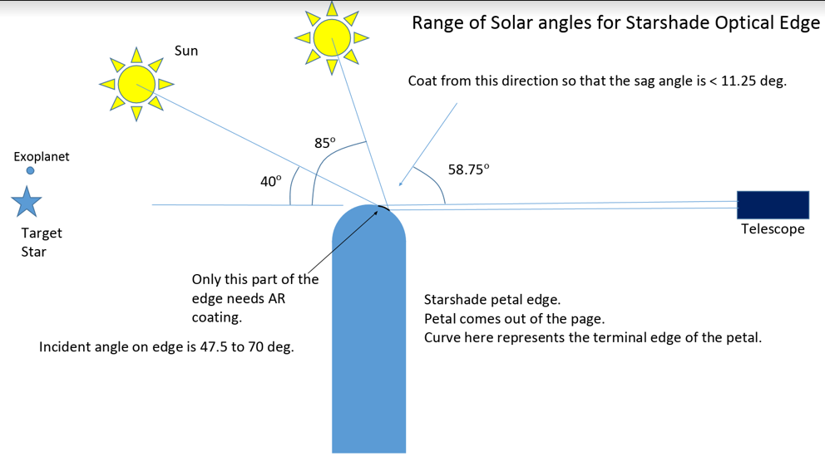

Slide 6
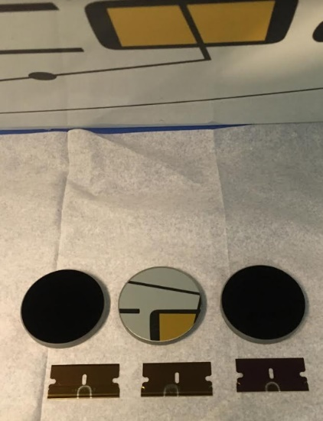
Applications for smooth black coatings include;
(1) Low α/ε coatings for solar power generation
in space.
(2) Low moonlight reflection and high IR reflection for
Ground-based IR telescopes like the ELT.
(3) Black edges for starshades
Figure 1 - Black mirror sample coating to bring technology to TRL 2

Slide 7
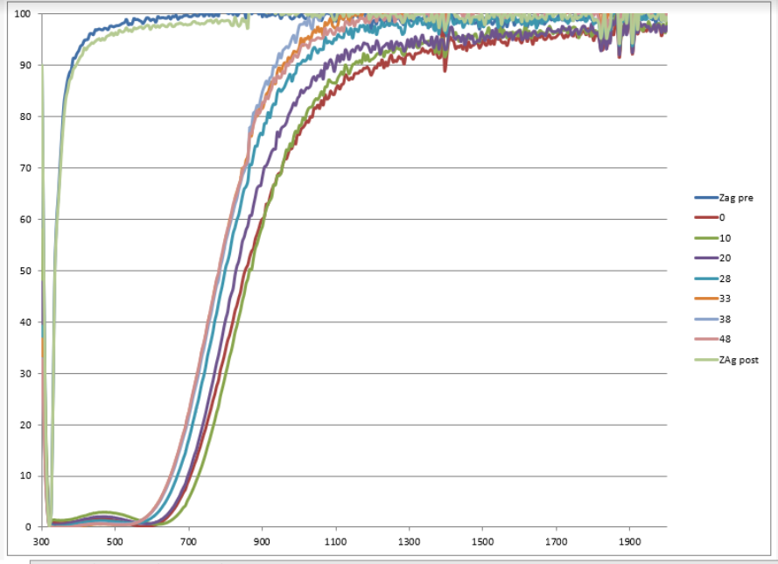
Example: Specular High α/ε coating
Reflectance vs. Wavelength (nm)

Slide 8
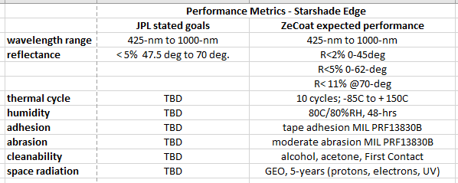

Slide 9
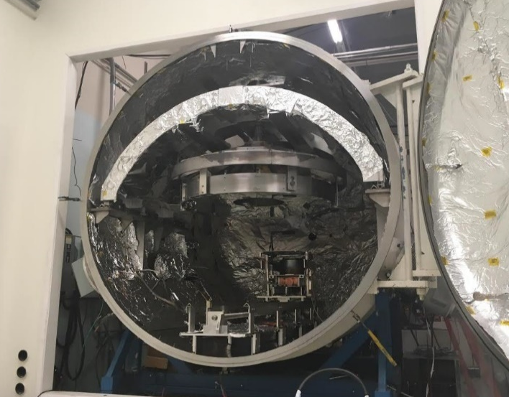
ZeCoat’s 2.4-meter coating chamber with integrated
motion-controlled evaporation system

Slide 10
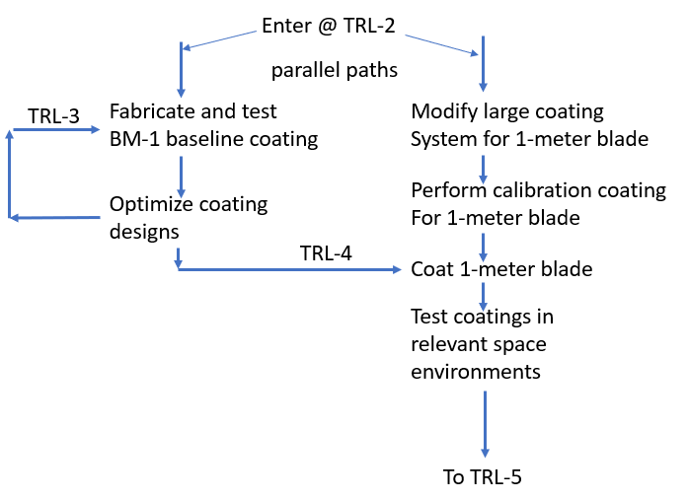

Slide 11
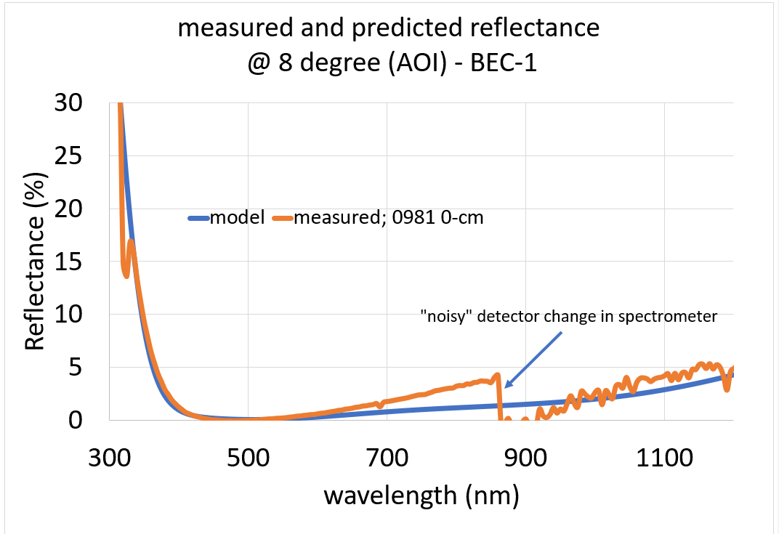

Slide 12
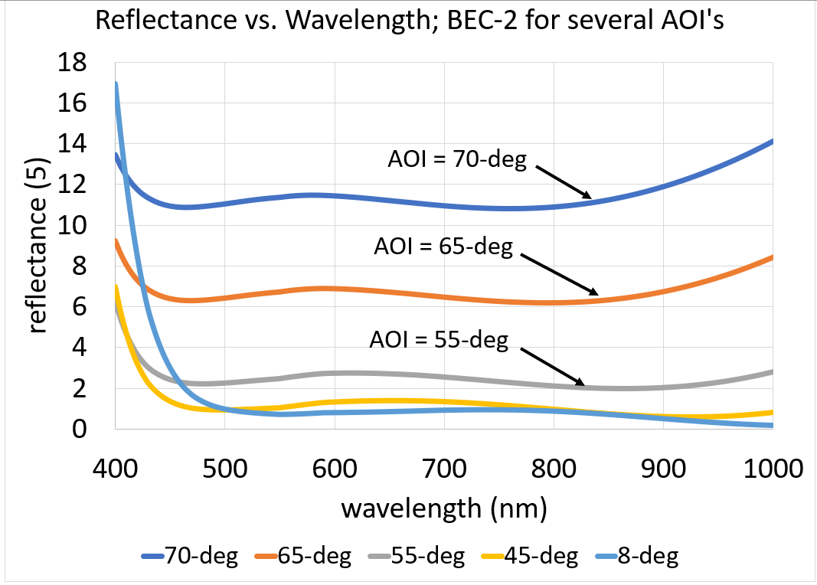

Slide 13
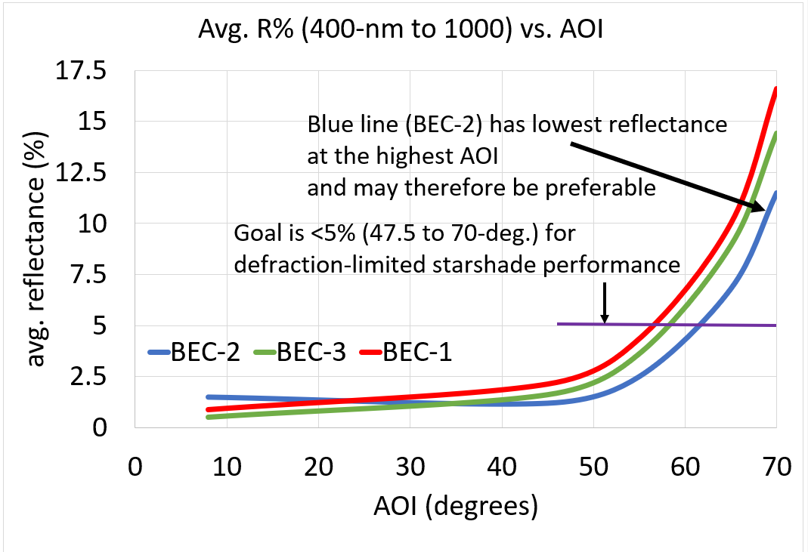

Slide 14
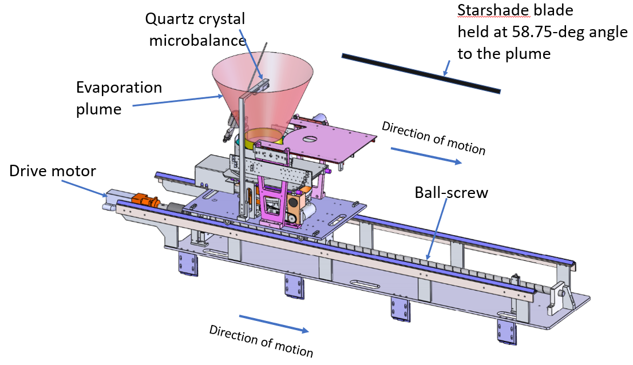

Slide 15
TASKS
1. Apply BEC-1 and BEC-2 coatings to customer-supplied amorphous sample blades and measure scatter and collect micrographs at JPL
2. Determine optical constants n,k for the amorphous metal substrate and for select coating materials, and optimize black interference coating designs for high AOI
3. Scale coating process with linear motion to coat 1-meter piece and perform calibration single-layer coating runs with linear motion system.
4. Make and test optimized designs on small amorphous blade sample.
5. Cost 1-meter full-size starshade blade
6. Environmental testing

Slide 16
QUESTIONS?

