Slide 1
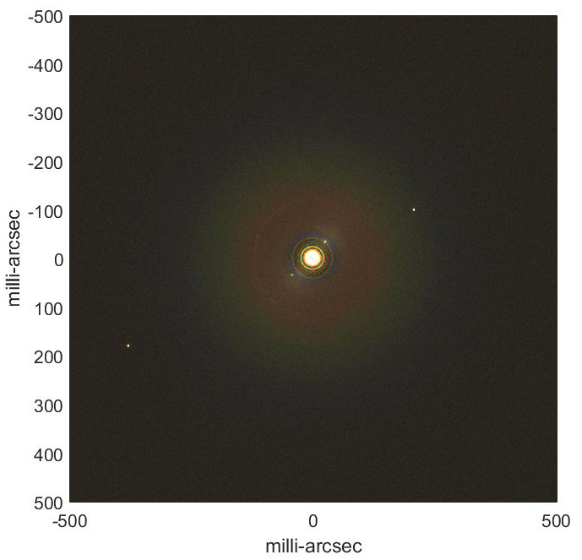
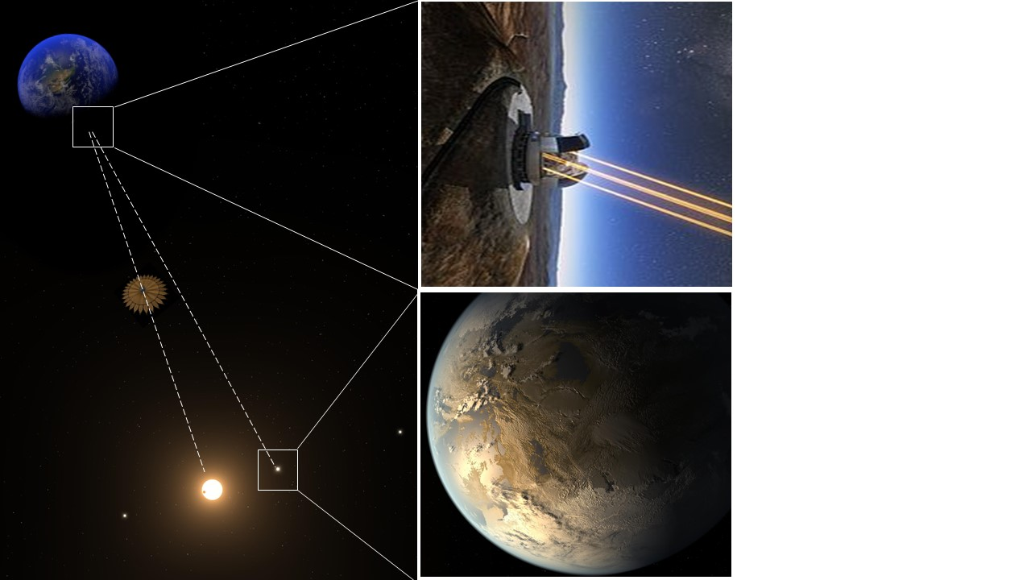
Remote Occulter
An orbiting starshade working with Extremely large telescopes on the ground to study exoplanets and planetary systems.
Eliad Peretz, John Mather.
Goddard Space Flight Center
Sept. 19, 2019

Slide 2
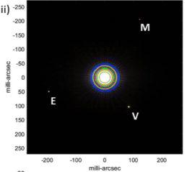
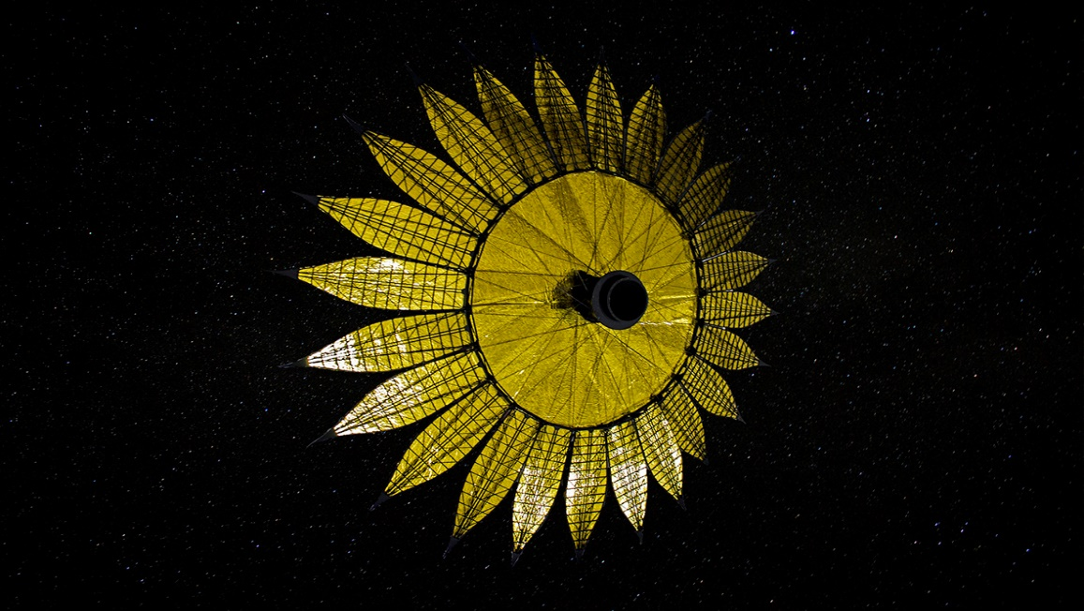
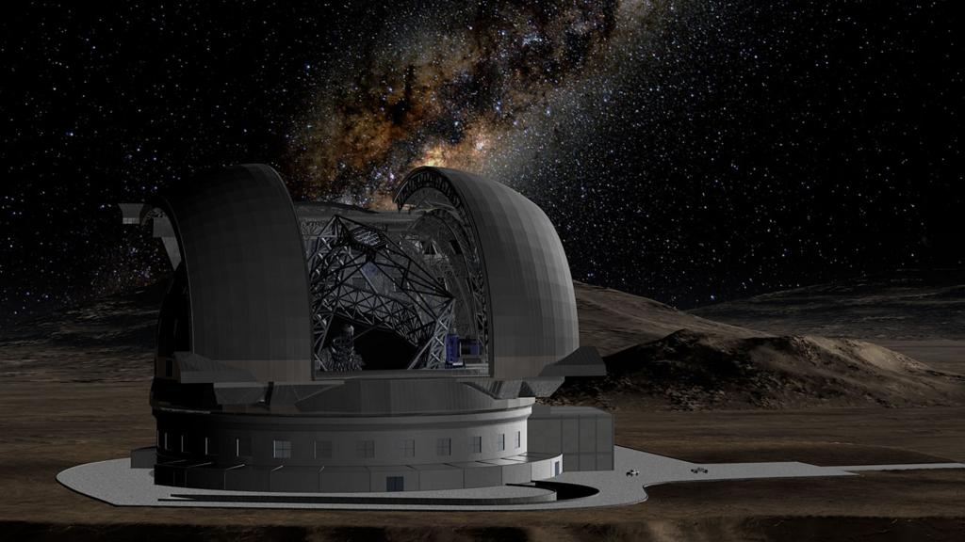
98 Meter class Starshade
200,000 km altitude, 4-day orbit matches observatory v ~ 400 m/sec
Accelerate during observation
Laser beacon ensures AO performance
SISTER (JPL) - 2018

Slide 3

Why work on the orbiting starshade?
Reflected light spectroscopy of Exo-Earths is top recommendation of the Exoplanet Science Strategy report
Only alternative to space telescopes, with/without starshades
Opportunity for ELTs and ground-based community to contribute
Possibility that orbiting starshade could fly sooner than HabEx/LUVOIR
Possibility that HabEx/LUVOIR might not meet stability or contrast requirements
$${(10}^{−7} Maybe,{10}^{−8} optimistic)$$

Slide 4
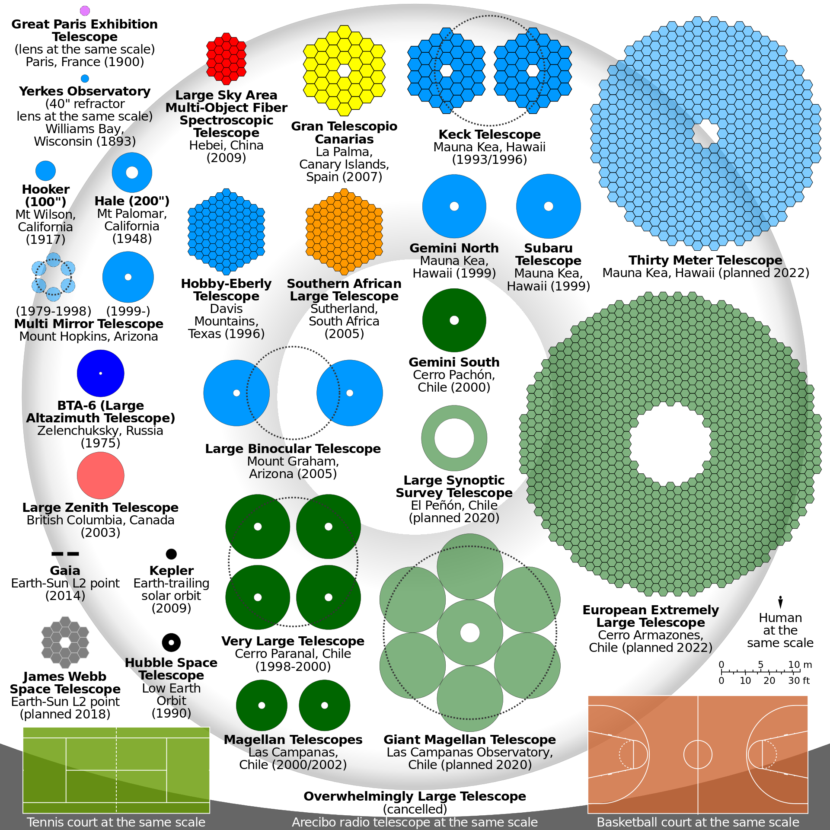
Ideal Angular resolution @550 nm:
EELT - ~3.5 mas
TMT - ~4.5 mas
GMT – ~5.6 mas
AO Performances:
MagAO-X: project status and first laboratory results
Proceedings Volume 10703, Adaptive Optics Systems VI; 70309
80% @ 656 nm
90% @ 900 nm
0
EELT – (PCS):
V-band [0.55um] = 40% R-band [0.64um] = 65% I-band [0.79um] = 80% J-band [1.25um] = 90% H-band [1.6um] = 90% K-band [2.2um] = 90%)
Key Science Programs NOAO
https://www.noao.edu/us-elt-program/astro2020swp.php
The real challenge However for ground based telescopes is light suppression.

Slide 5
MagAO-X, Males et al., Proc SPIE 2018

Slide 6
Orbiting Starshade Teams
Study Team Leads:
John Mather(GSFC)
Eliad Peretz(GSFC)
Richard Slonaker (HQ)
Phil Willems (ExEP)
Keith Warfield (ExEP)
Science and Ground Based Telescope team:
Sara Seager (MIT)
Christopher Stark (STScI)
Ignas Snellen (Leiden)
Michele Cirasuolo (EELT)
Stefan Kimeswenger (Innsbruck)
Norbert Przybilla (Innsbruck)
Wolfgang Kausch (Innsbruck)
Stefan Noll (DLR)
Casey Lisse (APL)
Randy Campbell (Keck)
John O’Meara (Keck)
Starshade Technology Development:
Jon Arenberg (NG)
Stuart Shaklan (JPL)
Sergi Hildebrandt (JPL)
Anthony Harness (Princeton)
Mark Lake (Roccor)
Dana Turse (Roccor)
Orbital Mechanics:
Simone D’Amico (Stanford)
Adam Koenig (Stanford)
David Folta (GSFC)
Tiffany Hoerbelt (GSFC)
Robert Pritchett (GSFC)
Cassandra Webster (GSFC)
Donald Dichmann (GSFC)
Daniel Solomon (GSFC)
Sun-Hur Diaz (GSFC)
Rizwan Qureshi (GSFC)

Slide 7
Activities:
Begun - Feb 2018
IRAD Study -2018 (GSFC)
Team A Study – Aug 2018 (JPL)
IRAD Study -2019 (GSFC)
APD Mission Study -2019 (HQ/ExEP)
Science Workshop – May 2019 (GSFC)
Team-X Study – June 2019 (JPL)
Engineering Workshop - July 2019 (GSFC)
Astro 2020 – Remote Occulter APC white Paper
Astro 2020 – ORCAS APC white Paper
SPIE San Diego 2019 – paper on observable sky
IRAD Study -2018 (GSFC), Team A Study (JPL) : [study initiation]
What can be seen through the atmosphere?
How much of the sky can be seen?
What is the required size and shape?
Sky coverage and estimates on fuel budget?
IRAD Study -2019 (GSFC), APD Mission Study -2019 (HQ/ExEP), Science Workshop 2019 (GSFC)
1. Establishing Architecture A science goals
2. Deriving initial engineering requirements
Team-X Study – June 2019 (JPL)
Establishing a single closed design point of reference
First cost and yield estimates
Engineering Workshop - July 2019 (GSFC)
Starshade mechanical structure
Mission Operation Concept
Current work: High Fidelity imaging and spectra simulations, Starshade Architecture trade, Detailed Mission Operation Concept. Value of split system – separating propulsion module from starshade during observations.

Slide 8
Key differences from other starshades
ELT resolves starshade image (radius 50 mas, resolution 3 mas), AND is out of focus (40 mas diameter blur)
Telescope provides much of contrast
Greatly relaxed requirements for sun glints, holes, shape tolerances, stability
Extreme angular resolution separates planets, increases contrast
Resolves exo-zodi dust
Resolves background galaxies
More edge-on (within 1°) to Sun, to observe at meridian (not hard requirement)
Up to 20° tilted from line of sight
Too big to spin
Fuel limited yield (shared with other starshades)
Need super-ultralight design, might be very different from WFIRST concept
Split starshade from propulsion during observation
Need refueling
Propulsion during observation
Pulsed, due to plume brightness
Excitation of mechanical modes
Earthshine important – black surface, not dusty
Super-black carbon nanotubes
Specular black coating

Slide 9
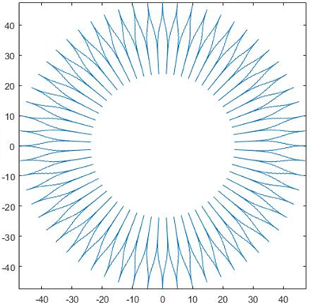
Starshade Tolerances – Moving from 1.5 to 20 $\left[\frac{λ}{D}\right]$ angular size – Resolved Observation
UH 47 Design
It is not going the be built the same way..
Need to better understand the mass drivers for existing designs

Slide 10
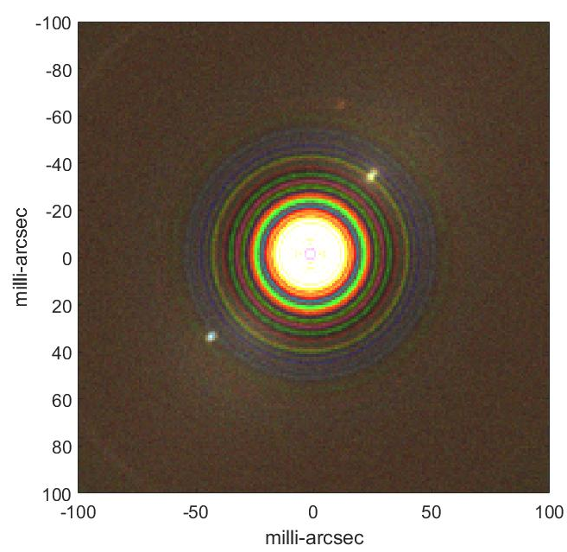
We can see molecules through the atmosphere
SISTER (JPL) – 2019, Including atmosphere
Ground team– 2019, Including atmosphere
Mars
Jupiter
Venus
Saturn
Earth
Figure 2. Left: Solar System with V=6 star at 17 pc, 20 min exposure, 400-700 nm, exozodi=5x solar system value, system inclined 60°, with Earthshine from starshade. Mars is at 1:00, Venus at 2:00, Earth at 7:30. Right: same with different angular scale. Jupiter and Saturn are at 2:00 and 8:00. Assumed Strehl 0.7, δθ= 3 milliarcsec, seeing disk 0.5”. Venus is at IWA.
Figure 3. Simulated spectra for planets at 5 pc with Strehl = 0.5. Top panel R = λ/δλ = 2500, bottom R=150. 1 pixel = λ₀/2R = 0.14 nm for R = 2000 and 2.34 nm for R = 150 at λ₀ = 700 nm. Red curves are sky brightness at the ELT in Chile. Widths of curves are ± 1σ. Water and oxygen are seen on exo-Earth and not on exo-Venus, and methane registers on a 2 AU Jupiter.

Slide 11
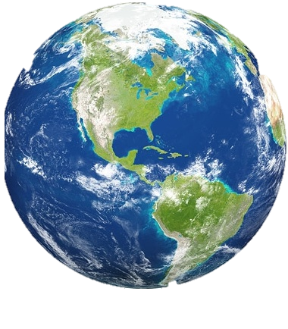
Observational requirements
Requirement driver | Observational requirement | Logic
1. Ground based Telescope | The pointing vector to the sun shall be at least 18 degrees below the horizon as seen by the telescope | Make sure the sky is dark enough
2. Ground Based Telescope | The telescope shall be pointed within 60 deg of its local zenith direction. | Work within ground instruments air-mass constraints
1.
2.
Local
zenith
Compliant telescope locations during observations
(7:15PM-4:45AM local solar time)
Compliant telescope pointing directions during observations

Slide 12
Observational requirements
Requirement driver | Observational requirement | Logic
3. Starshade Optical Performance | The normal vector to the starshade plane shall be within 20 deg of parallel to the line of sight from the telescope to the target star. | Shadow cast on the ground telescope is deep enough; cosine loss of projected starshade size
4. Starshade Optical requirement | The target-facing normal vector to the starshade plane shall be within 89 deg of the pointing vector to the sun. | Starshade telescope facing side is not illuminated by the sun during an observation.
3.
4.
Telescope
Compliant starshade plane orientations w.r.t. target star
Compliant sun locations w.r.t starshade

Slide 13
Orbital requirements
Requirement driver | Observational requirement | Logic
5. Starshade Optical performance | The center of the starshade shall remain within ±1m of the line of sight from the telescope to the target star. | Shadow cast on the ground telescope is deep enough
6. Starshade Safety | The orbit perigee shall have an altitude of at least 1000 km. | Safety Consideration
7. Operational consideration | The starshade orbit shall be commensurable to the sidereal day. (?) | Ensures recurring observations at the right time.
5.
6,7.
±1m
Telescope
±200Mm
Starshade
Compliant relative position envelope during observations
Compliant orbit geometries

Slide 14
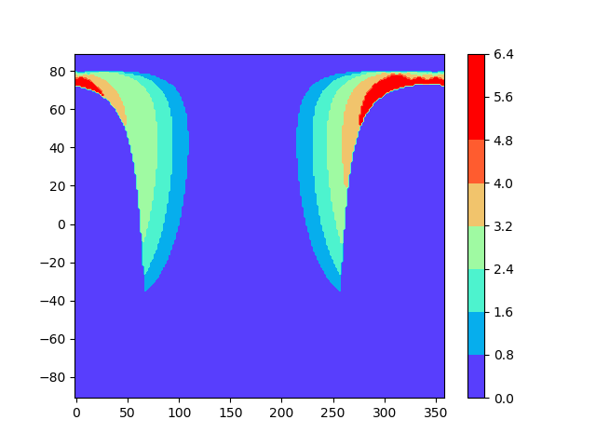
Observable Sky, Dec 3rd, 2031, Mauna Kea
DEC [Degrees]
RA [Degrees]
Observation
Time
[Hours]
Evolving Field: 1 (Deg/Day) + Geometrical constraints.

Slide 15
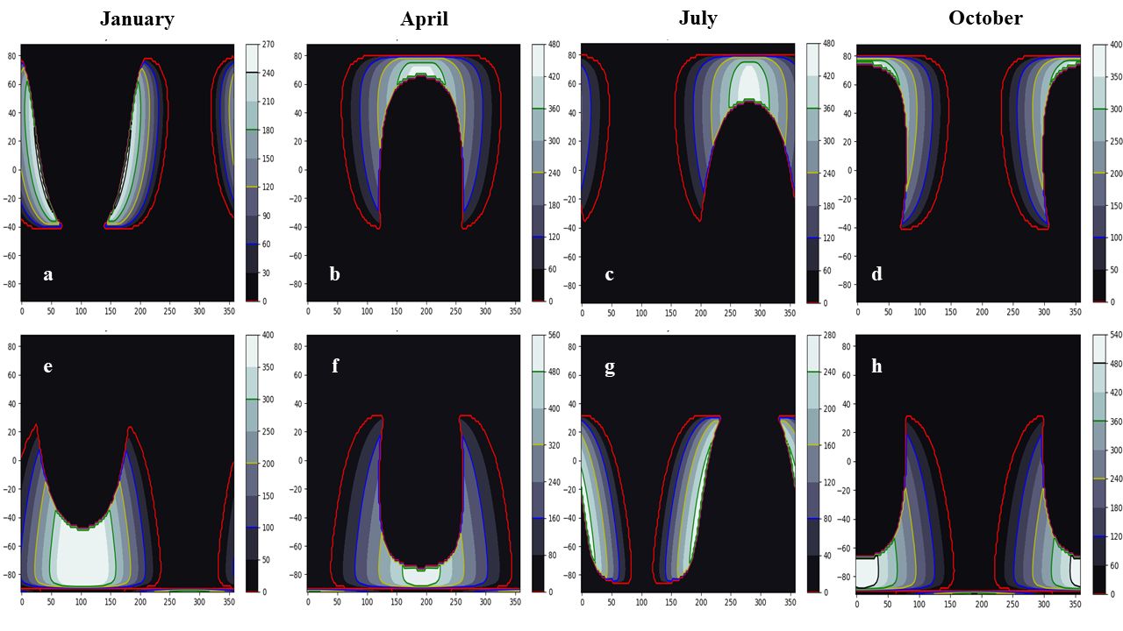
Figure 6. Observable night sky, showing minutes available for observation each night as indicated by the color bar. Range of each image is 0-360° right ascension and -90° to +90° for declination. Upper set is for Mauna Kea, lower set for Las Campanas. Dates are the first of each month, 2035.

Slide 16
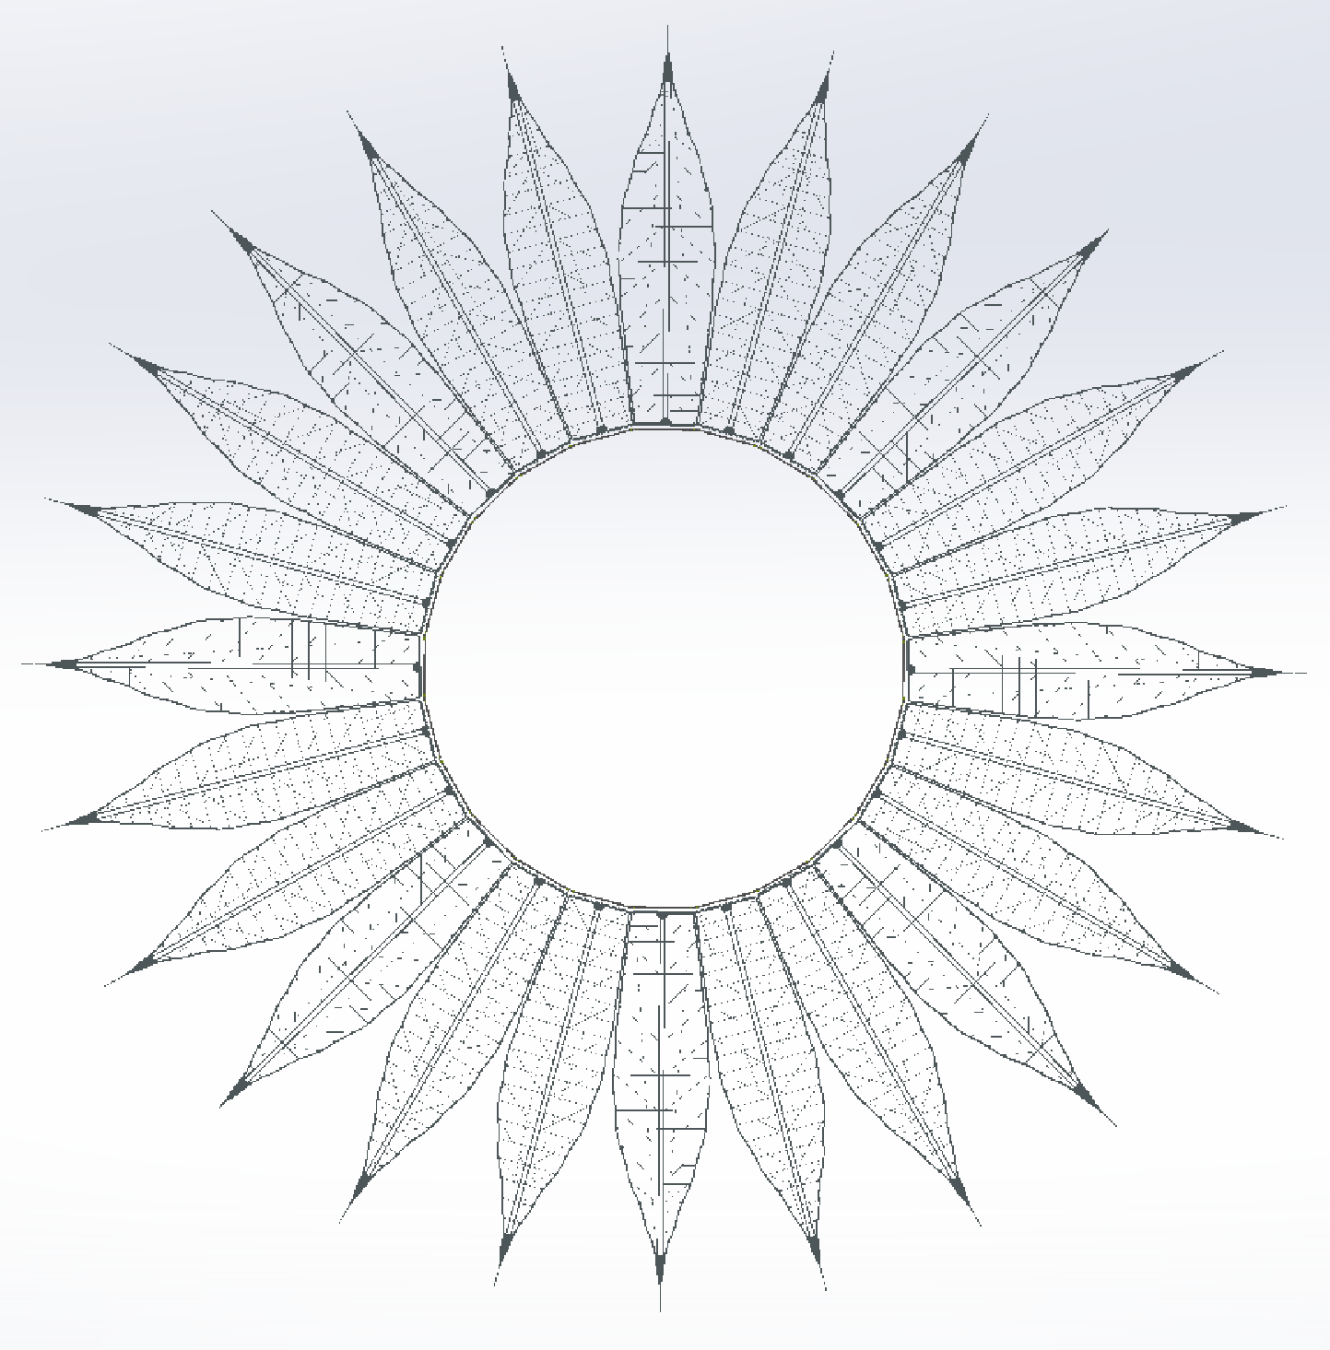
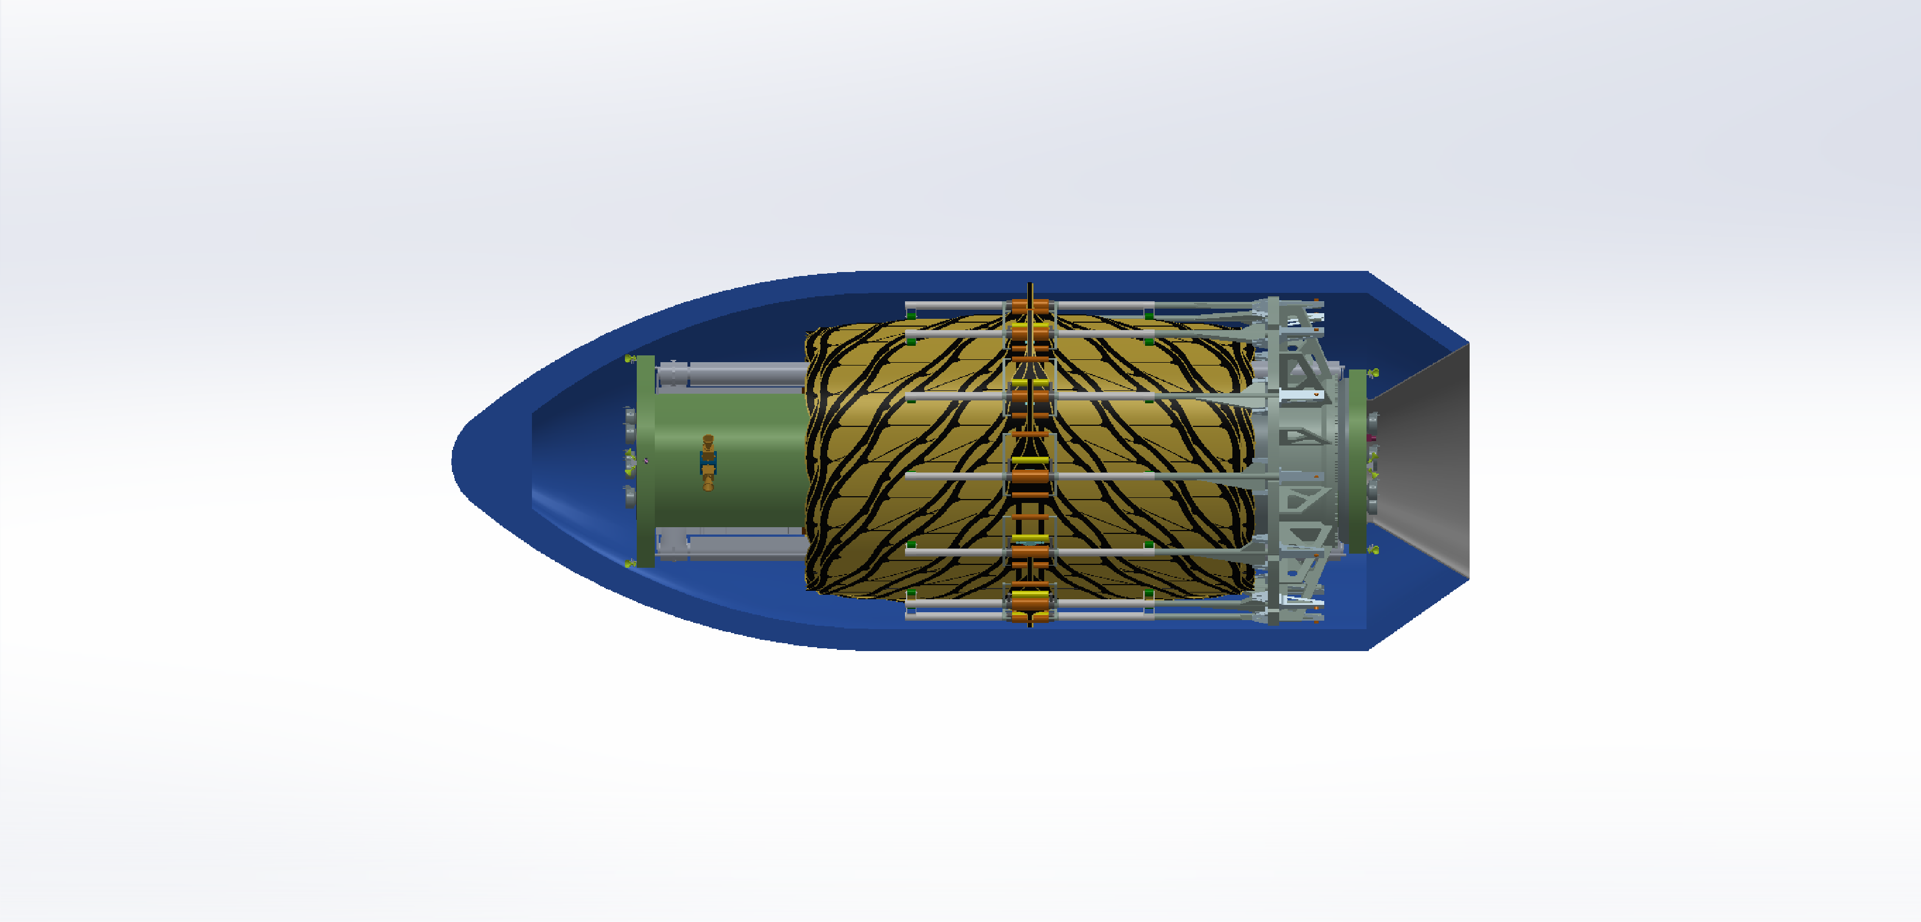
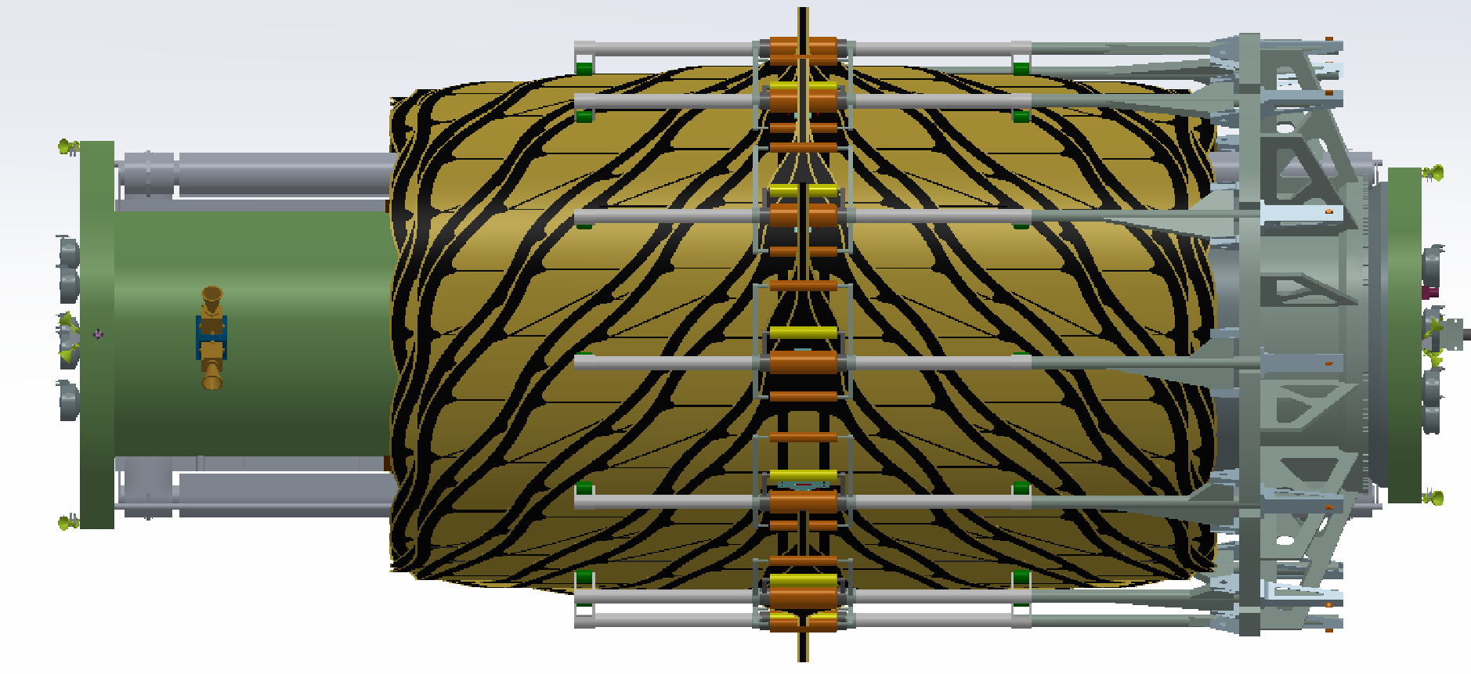
Team X Concept.
This potentially could be achieved in reality.
Need to reduce mass, enable refueling; fuel limited.

Slide 17
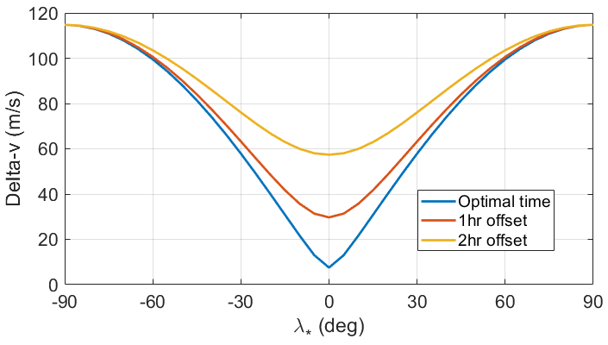
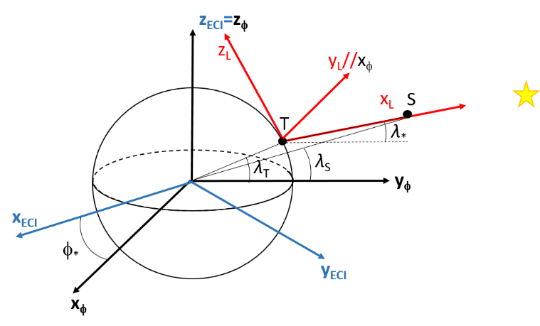
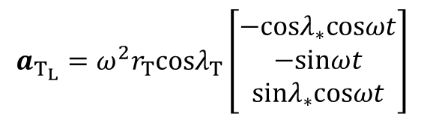
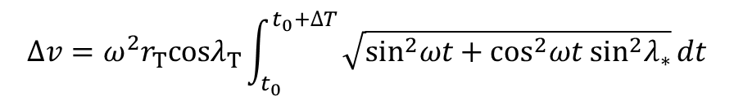

Observation Delta - V
$$a_{S}=−µ\frac{r_{S}}{r_{S}^{3}}$$
$$a_{T_{L}}=ω^{2}r_{T}cosλ_{T}\left[\begin{matrix}−cosλ_{∗}cosωt \\ −sinωt \\ sinλ_{∗}cosωt\end{matrix}\right]$$
$$∆v=ω^{2}r_{T}cosλ_{T}\int_{t_{0}}^{t_{0}+∆T}{\sqrt{\sin^{2}ωt+\cos^{2}ωt\sin^{2}λ_{∗}}}dt$$

Slide 18
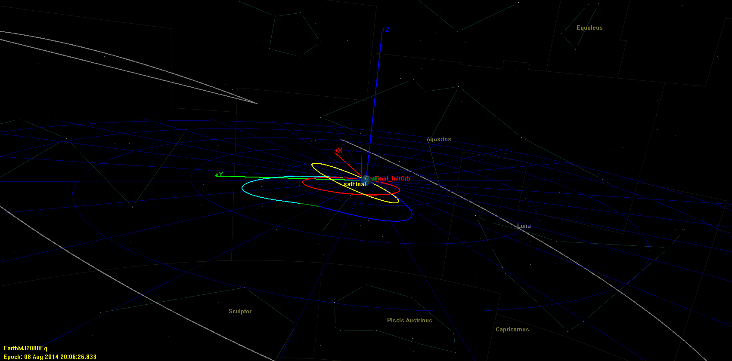
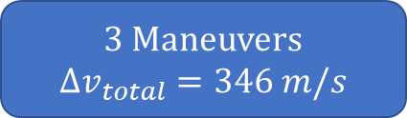
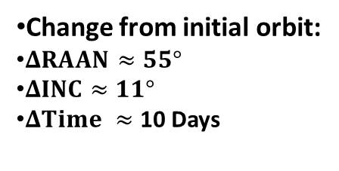
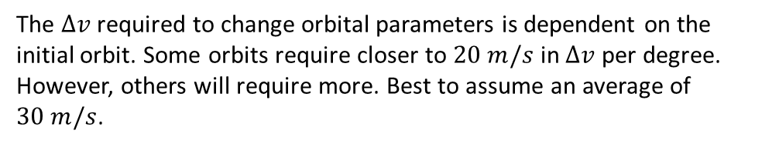
Large maneuvers – SEP
Small maneuvers – SEP (<12 degrees)
1. TESS, Moon Flyby.
Test # | Delta [Deg] | Total Coast Time [Days] | Total Burn Time [Days] | Total time of Orbit Transfer | Total DV [m/s]
1 | 1 | 1.99 | 1.00 | 2.99 | 29.21
1(b) | 1 | 4.84 | 1.14 | 5.98 | 28.03
2 | 1.5 | 4.67 | 1.32 | 5.98 | 42.49
3 | 2.5 | 3.72 | 2.26 | 5.98 | 73.14
4 | 3 | 3.28 | 2.70 | 5.98 | 90.23
5 | 4 | 5.45 | 3.52 | 8.98 | 119.06
6 | 5 | 4.42 | 4.55 | 8.98 | 154.03
Initial Target Orbit
Lunar Flyby
Midcourse Correction
Transfer to Final
Final Target Orbit
Change from initial orbit:
$ΔRAAN≈55°$
$ΔINC≈11°$
$ΔTime ≈$ 10 Days
The $Δv$ required to change orbital parameters is dependent on the initial orbit. Some orbits require closer to $20 m/s$ in $Δv$ per degree. However, others will require more. Best to assume an average of $30 m/s$.
3 Maneuvers
$$Δv_{total}=346 m/s$$
2. Deep Space Maneuvers

Slide 19
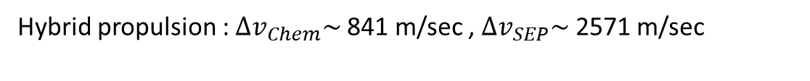
7 (metric) Ton SS -> 4.5 Ton SS
5.8 ton Chem
1.7 ton SEP
7.5 Ton Spacecraft
22 total wet
Operation Concepts:
Chemical propulsion Only: $∆v\sim$ 1241 m/sec
Hybrid propulsion : ${∆v}_{Chem}\sim$ 841 m/sec , ${∆v}_{SEP}\sim$ 2571 m/sec
Hybrid propulsion, Separated : ${∆v}_{Chem}\sim$ 2127 m/sec , ${∆v}_{SEP} \sim$ 3000 m/sec, ${∆v}_{Chem}\sim$ 3183 m/sec
Observation (1,2,3)
Retargeting (Small SEP)
Observation (5,6,7)
Retargeting (Large SEP)
16 days
8 days
16 days
15 days
Chemical | SEP | Chemical | SEP
~390 m/sec | ~300 m/sec | ~390 m/sec | ~400 m/sec
~5 targets (15 observations every) ~150 days, ~8 targets (40 observations every) ~220 days
Refueling will be required
This is still work in progress

Slide 20
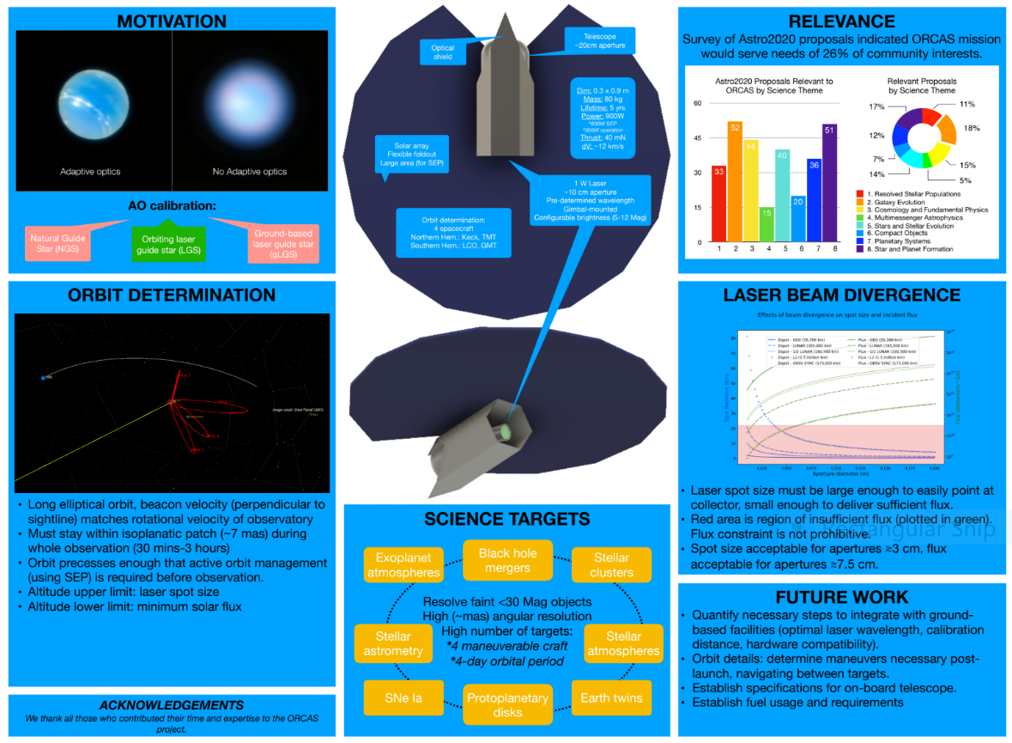
ORCAS: Orbiting Configurable Artificial Star
Orbiting Configurable Artificial Star (ORCAS) for Visible Adaptive Optics from the Ground: Astro2020 white paper
http://surveygizmoresponseuploads.s3.amazonaws.com/fileuploads/623127/5043187/66-c09d3c8e99db32fab95d6d3139c2540c_ORCAS_EP_07102019.pdf

Slide 21
Next Steps
NIAC proposal for orbiting guide star, today
Report to HQ, October
Servicing architecture study for starshades in general – initiated conversations
Yield calculation with refueling – improved orbit calculations including Simone
Mechanical concept for lower mass, loose tolerances
Memo update to Decadal Survey
SmallSat proposal for orbiting guide star, Dec. 20
Review error budget spreadsheet and document from WFIRST, HabEx, and make equivalent for Orbiting Starshade
Speak to Decadal Survey

Slide 22
A remote Occulter could work with ground based telescopes to measure the reflected light spectra of temperate planets around sun like stars.
Much work is needed to better understand how many targets can be seen.

