Slide 1
Starshade Science and Industry Partnership
Forum #1 Introduction
Gary Blackwood
NASA Exoplanet Exploration Program
September 18, 2019
Jet Propulsion Laboratory, Pasadena CA
© 2019 All rights reserved
CL # 19-1960

Slide 2
Motivation for Starshade Science and Industry Partnership
The purpose of the Starshade SIP
is to maximize the
technology readiness level of starshades to enable potential future exoplanet science missions.
Notes:
Acknowledge current partners

Slide 3
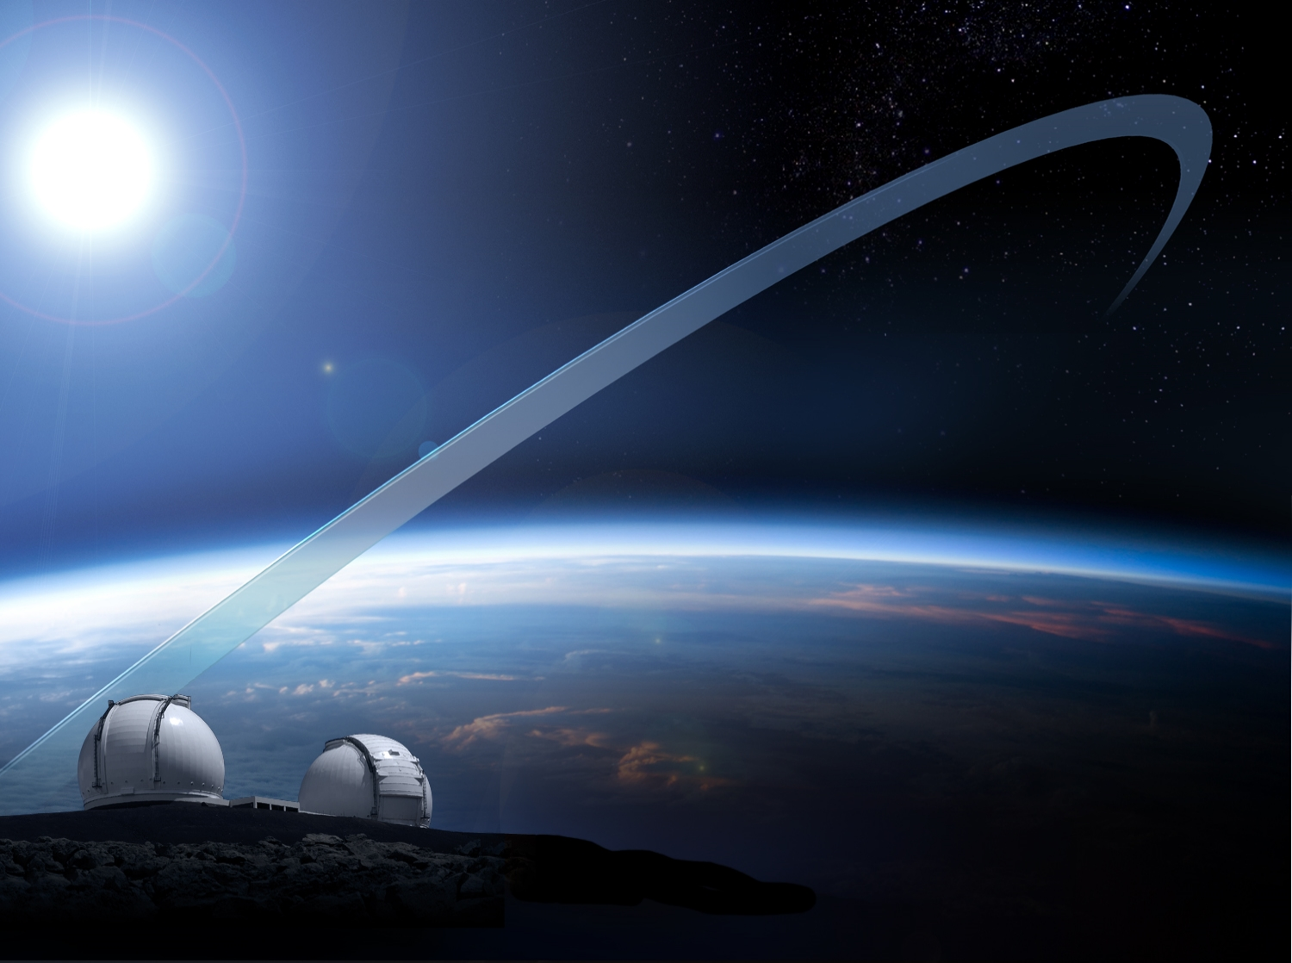
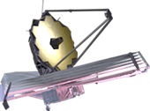
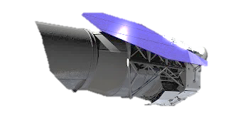

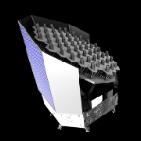
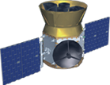
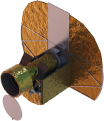
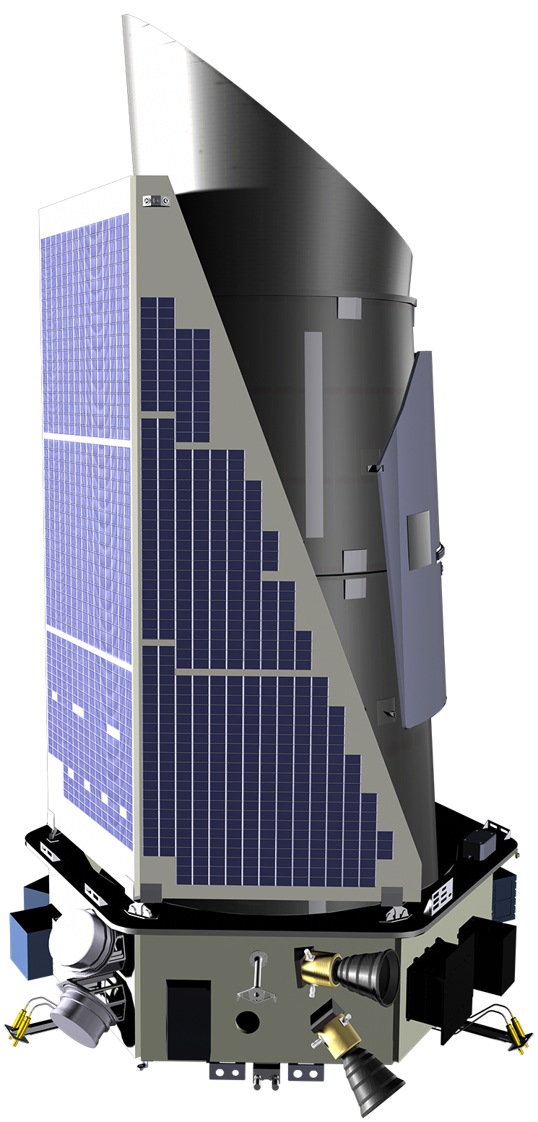
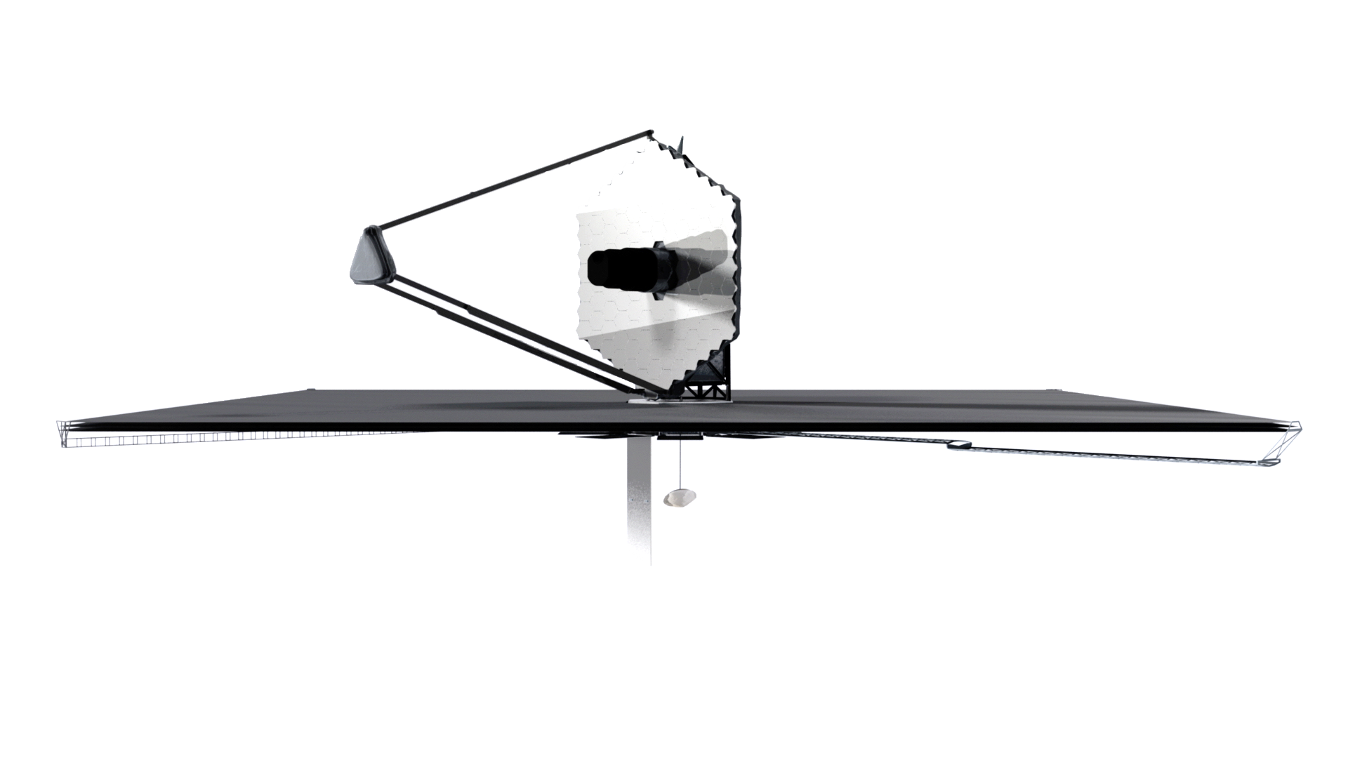
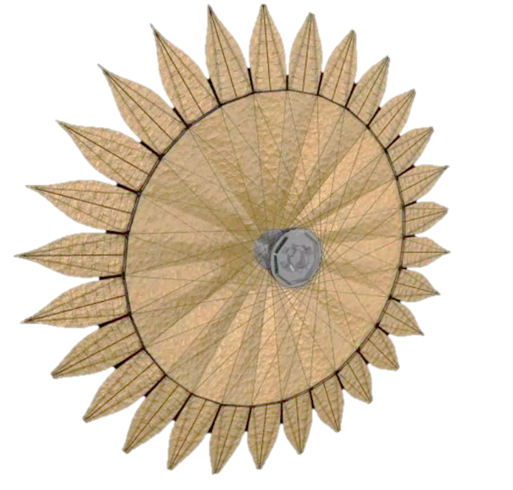
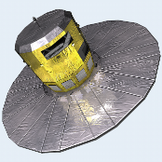
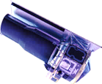
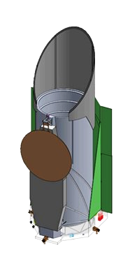
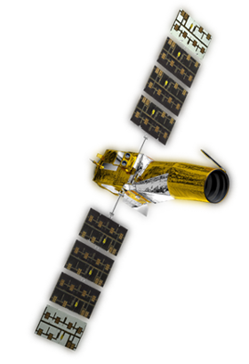
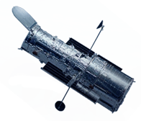
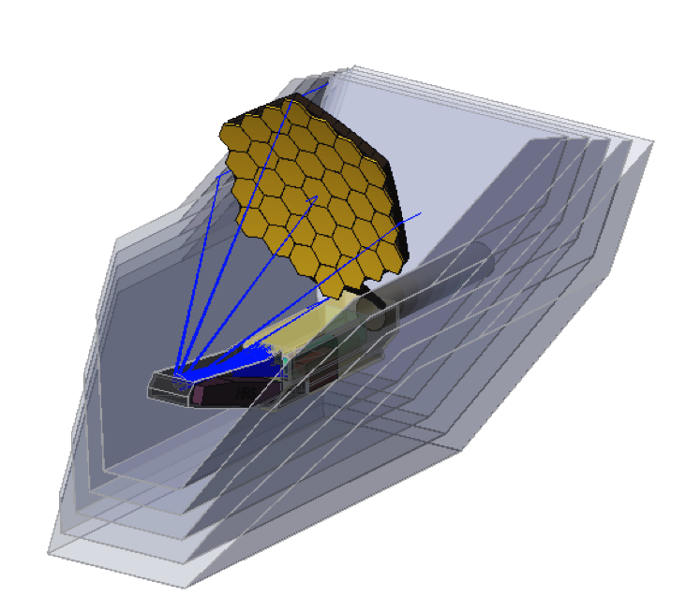
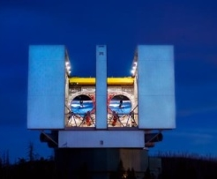
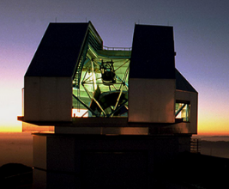
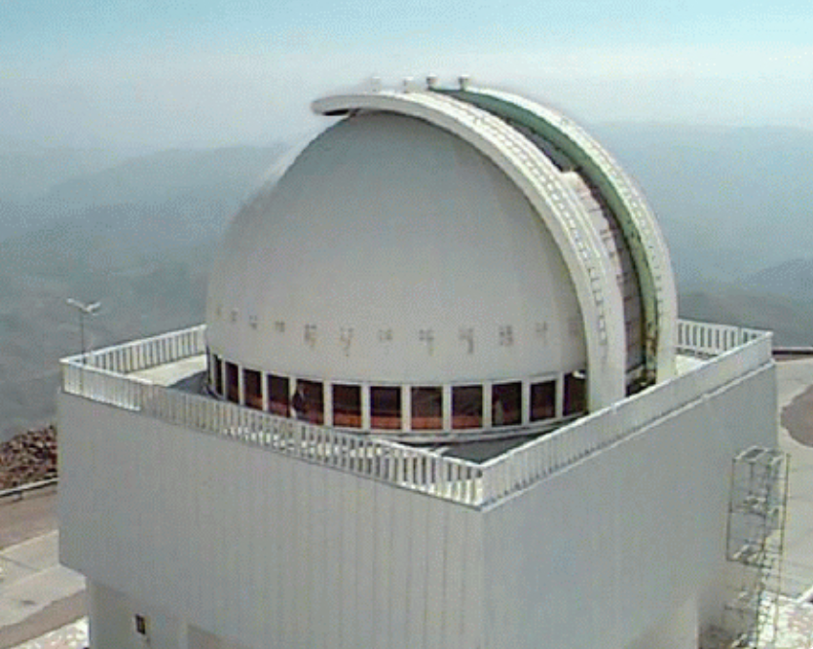
WFIRST
JWST²
PLATO
Missions
TESS
Kepler
LUVOIR⁵
CHEOPS ⁴
Spitzer
Gaia
Hubble¹
Starshade
Rendezvous⁵
HabEx⁵
CoRoT³
Non-NASA
Missions
OST⁵
NASA
Missions
W. M. Keck Observatory
Large Binocular
Telescope
¹ NASA/ESA Partnership
² NASA/ESA/CSA Partnership
³ CNES/ESA
⁴ ESA/Swiss Space Office
WIYN ⁶
SMARTS 1.5m ⁶
Ground Telescopes with NASA participation
⁵ 2020 Decadal Survey Studies
⁶ NSF Partnership (NN-EXPLORE)
Notes:
Credit: NASA / JPL

Slide 4
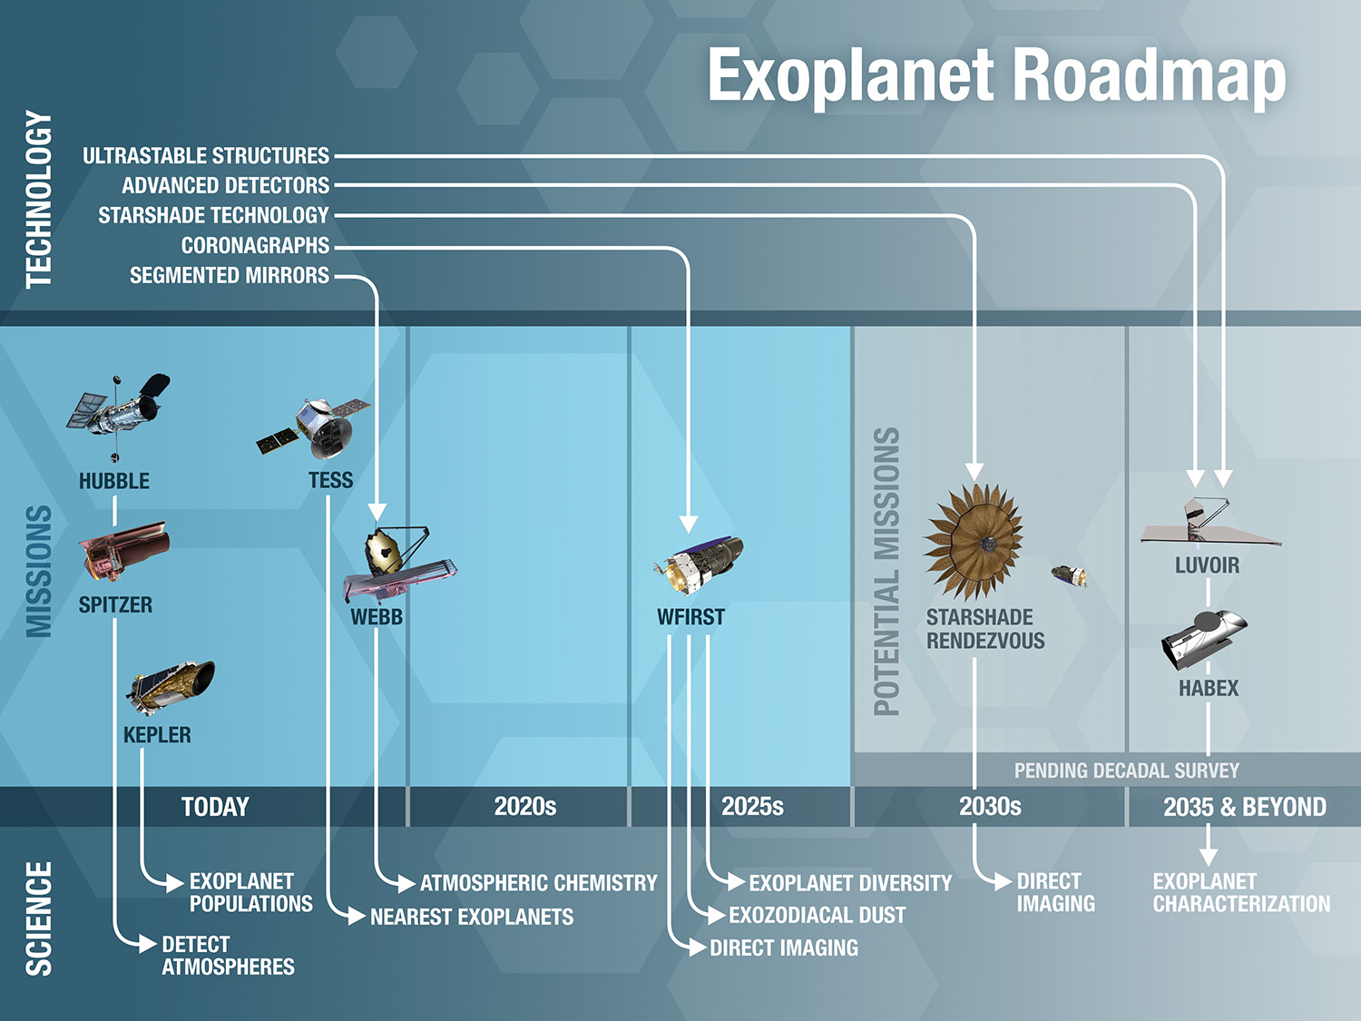
Notes:
Credit: NASA / JPL

Slide 5
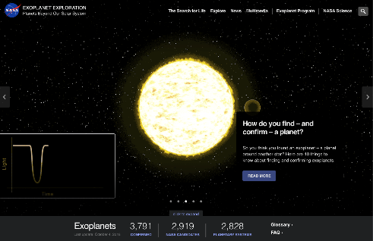

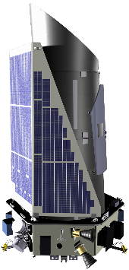
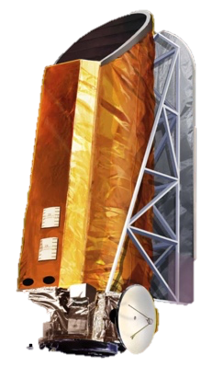
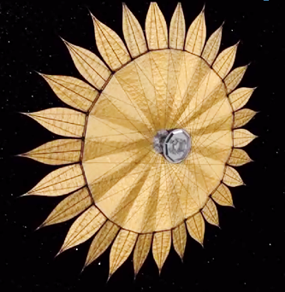
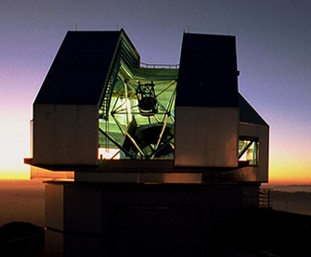
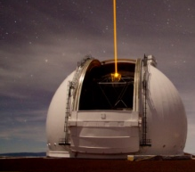

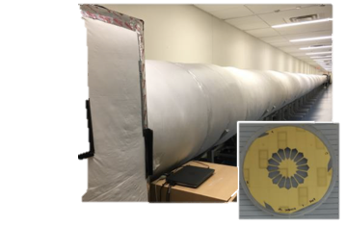
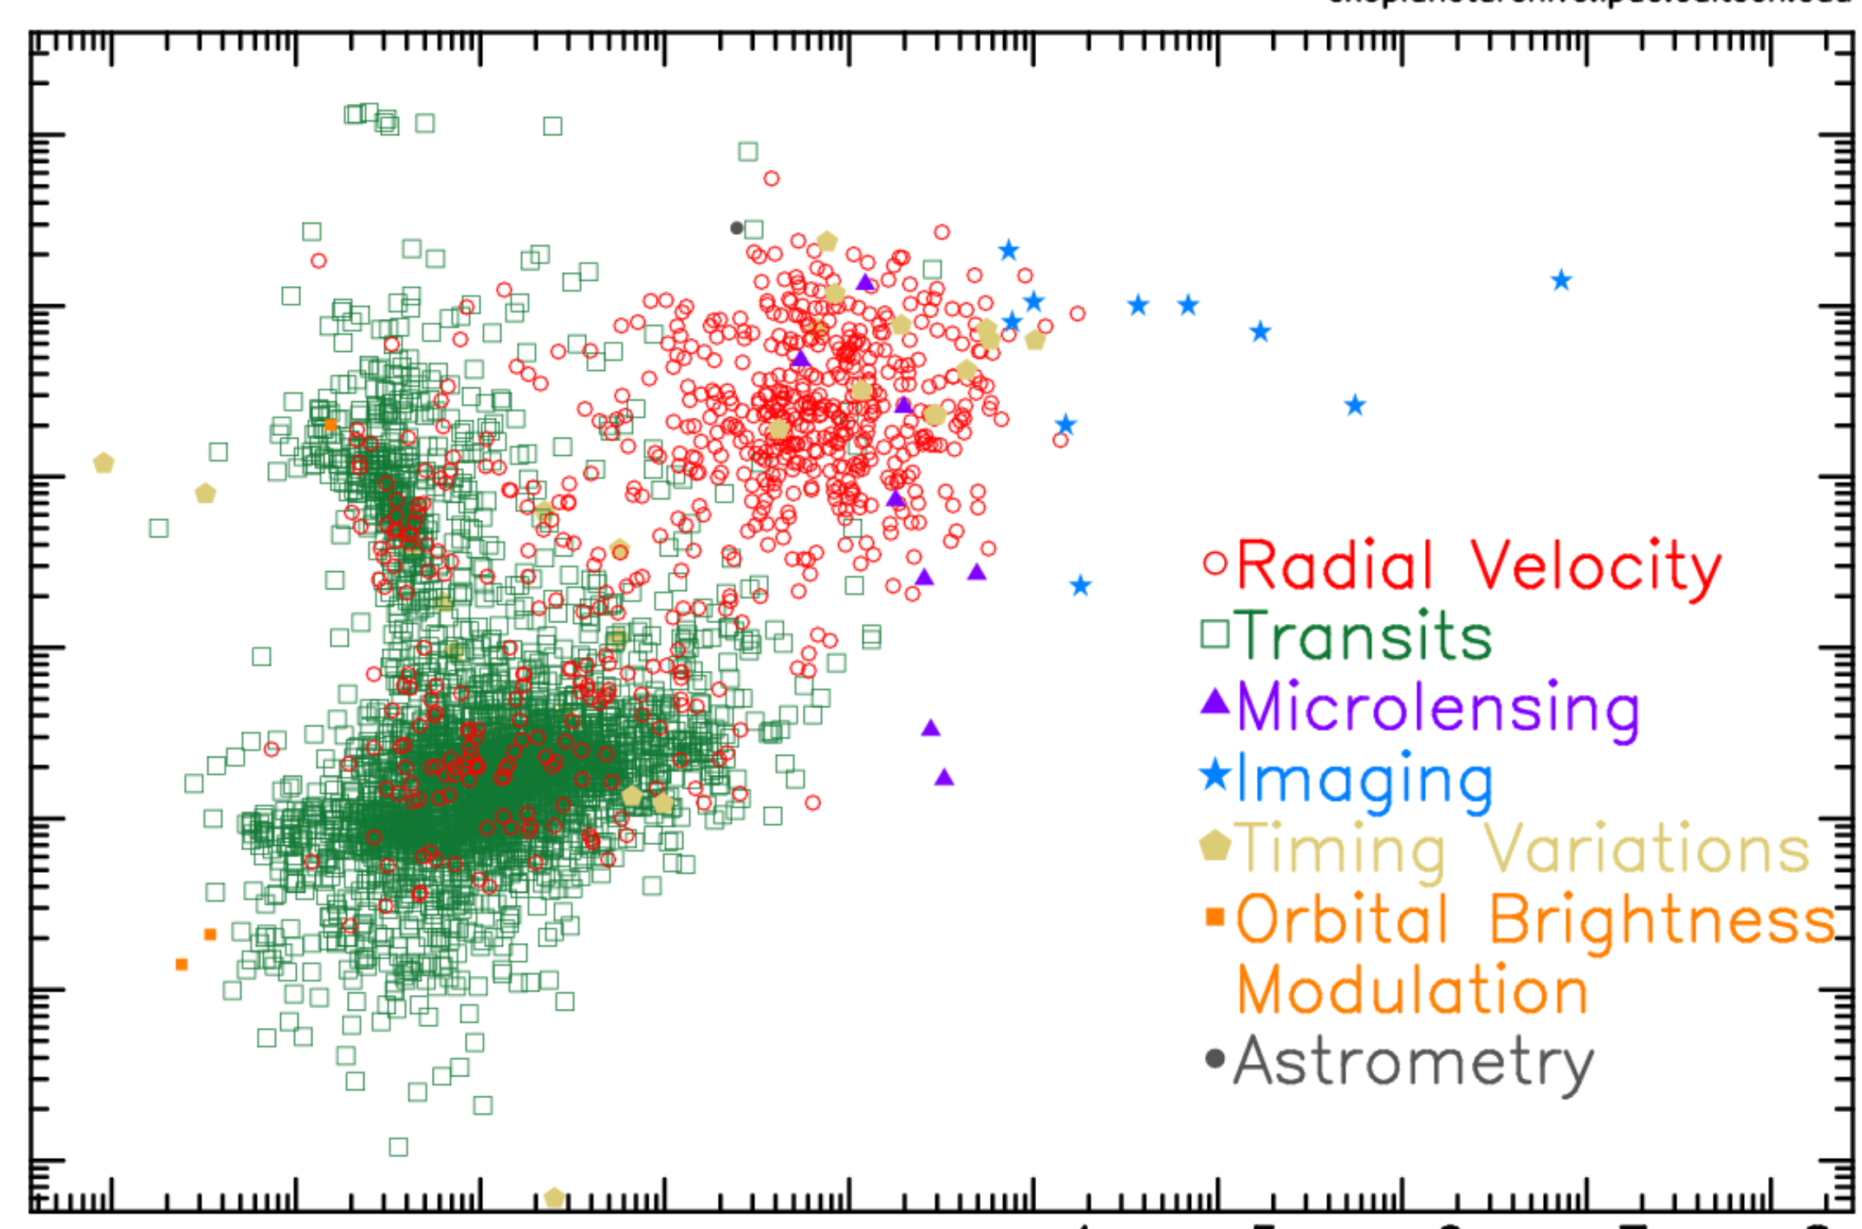

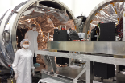
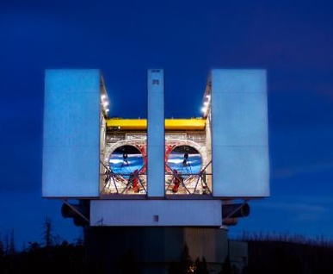
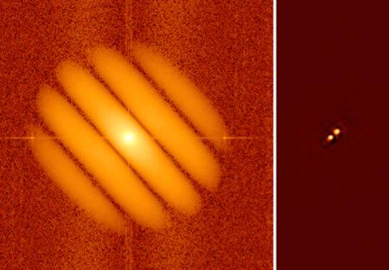

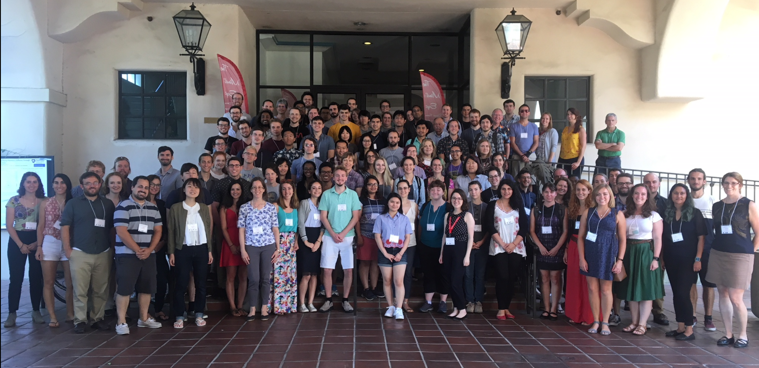
NASA Exoplanet Exploration Program
Space Missions and Concept Studies
Exoplanet Communications
Large- and Probe-Scale Mission Concepts
Kepler K2
Starshade
Coronagraph
Supporting Research & Technology
Key Sustaining Research
NASA Exoplanet
Science Institute (NExScI)
Technology Development
NN-EXPLORE
Keck Observatory
Large Binocular
Telescope
Interferometer
High Resolution
Imaging
Coronagraph
Technology
Development
Starshade
Technology Development (S5)
Archives, Tools, Sagan Program, Professional Engagement

Slide 6
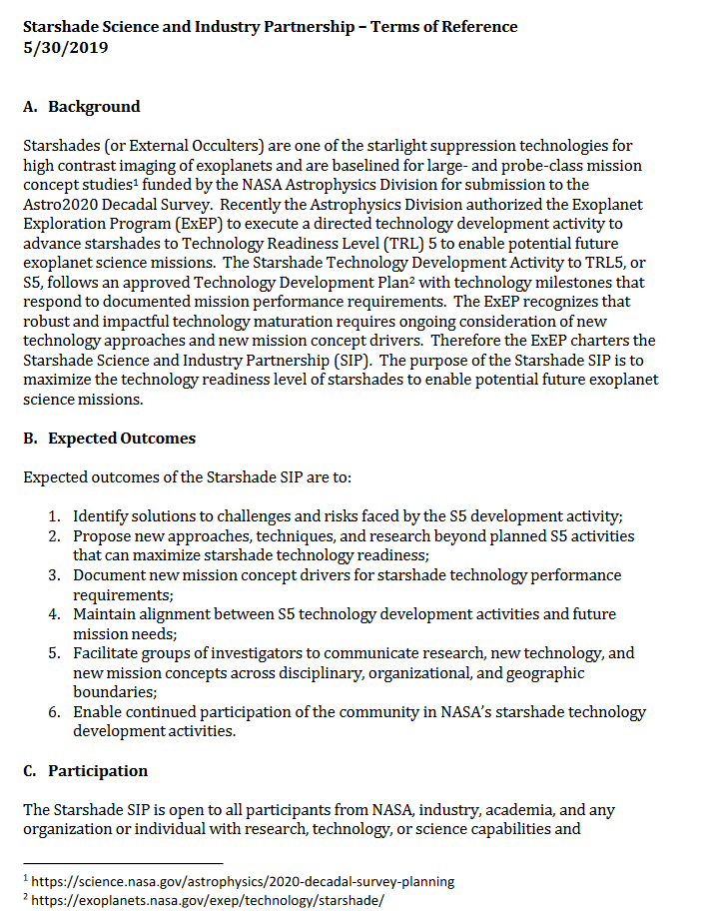
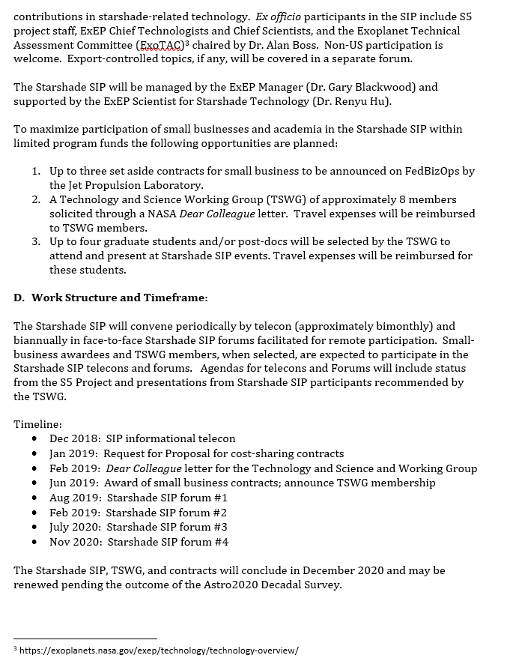
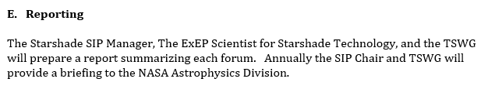
Starshade SIP – Terms of Reference
https://exoplanets.nasa.gov/exep/technology/starshade/

Slide 7
Starshade Science and Industry Partnership
SIP
Technology and Science Working Group (TSWG)
Starshade Technology Development Activity (S5)
SIP Industry Subcontracts

Slide 8
Expected Outcomes of the Starshade SIP
Identify solutions to challenges faced by the S5 development activity;
Propose new approaches, techniques, and research beyond planned S5 activities that can maximize starshade technology readiness;
Document new mission concept drivers for starshade technology performance requirements;
Maintain alignment between S5 technology development activities and future mission needs;
Facilitate groups of investigators to communicate research, new technology, and new mission concepts across disciplinary, organizational, and geographic boundaries;
Enable continued participation of the community in NASA’s starshade technology development activities.

Slide 9
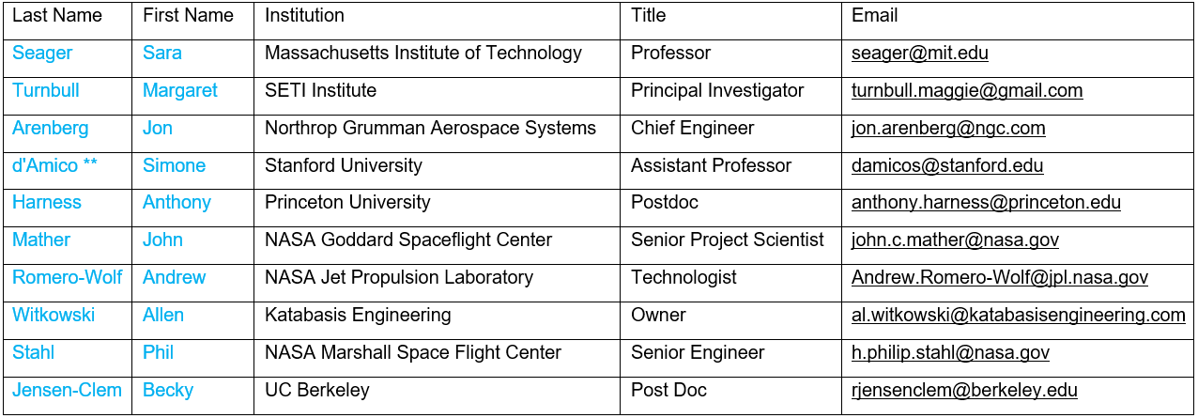
Technology and Science Working Group
Congratulations and Welcome!
** Chair

Slide 10
Technology and Science Working Group
Context:
TSWG is a steering group for the SIP
The SIP will help S5 achieve its milestones, and, help NASA understand if S5 has the right milestones
TSWG members will:
Identify solutions to challenges faced by the S5 development activity
Propose new approaches, techniques, and research beyond planned S5 activities that can maximize starshade technology readiness
Document new mission concept drivers for starshade technology performance requirements
Maintain alignment between S5 technology development activities and future mission needs
Document findings in annual Starshade SIP reports to NASA APD
The TSWG will select up to four graduate students and postdocs to attend and present at each SIP forum (travel expenses reimbursed), starting with forum #2

Slide 11
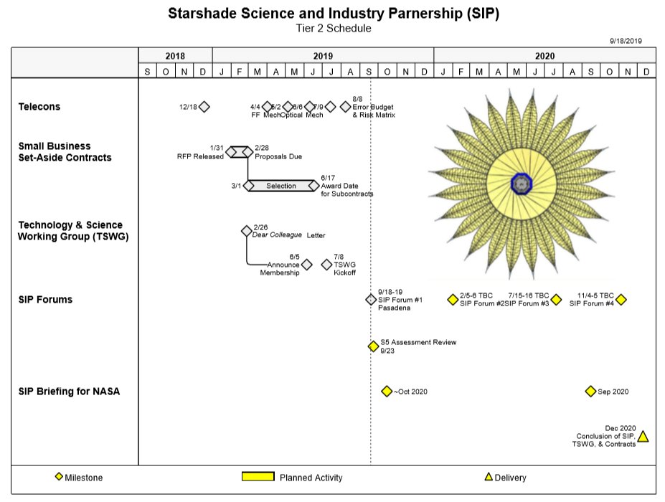
8

Slide 12
Industry Subcontracts
Zecoat Corporation, Torrance CA. Zecoat will evaluate, optimize, and test performance of a specular black coating on the starshade edges to minimize solar glint.
Opterus Research and Development Inc., Fort Collins CO. Opterus will evaluate creep behavior of composite material resins through test and analysis.
Tendeg, LLC, Louisville CO. Tendeg will perform analysis and test of petal and PLUS deployments and petal deformations under stowage loads.
ATA Engineering, Inc., San Diego CA. ATA will evaluate multiple structural analysis methodologies and software and assess the benefits of the approaches using petal deployment and position error as case studies.

Slide 13
Other Meeting Logistics
Rebecca Gonzales – Meeting Recorder
Will be posting slides to website when released
Important Logistics:
Refreshments
Restrooms
Starshade Lab Tour / Walk or Bus
Lunch / Escort
Patio, Quiet Space
Optional Group Dinner tonight
Earthquake Procedure
Meeting protocol: Export, Media

Slide 14
Copyright 2019 California Institute of Technology. Government sponsorship acknowledged.

Slide 15
Acknowledgements
This work was carried out at the Jet Propulsion Laboratory, California Institute of Technology under contract with the National Aeronautics and Space Administration. © 2019 All rights reserved.

Slide 16
Program Office – Key Participants
NASA Exoplanet Exploration Program (ExEP)
Science and Industry Partnership
Gary Blackwood, NASA ExEP Manager, Starshade SIP Chair
Yuriy Tsurkan, Subcontract Manager
Renyu Hu, ExEP Scientist for Starshade Technology
Starshade Technology Development Activity (S5)
Kendra Short, NASA ExEP Deputy Manager,
Phil Willems, Manager of S5, LBTI Project Manager

Slide 17
Contact Information
Starshade Science and Industry Partnership
Gary Blackwood, NASA ExEP Manager, Starshade SIP Chair
Gary.blackwood@jpl.nasa.gov
W: 818 354 6263
M: 818 458 0507
Yuriy Tsurkan, Subcontract Manager
Yuriy.Tsurkan@jpl.nasa.gov
W: 818 393-8052
M: 747 261-8928
Renyu Hu, ExEP Starshade Scientist
Renyu.Hu@jpl.nasa.gov
W: 818 354 6090
M: 818 281-9459
Kendra Short, S5 acting Manager, NASA ExEP Deputy Manager
Kendra.Short@jpl.nasa.gov
W: 818 354 9286
M: 818 634 3918

Slide 18
NASA Headquarters Leadership
Astrophysics Division
Shahid Habib, Program Executive for ExEP
Douglas Hudgins, Program Scientist for ExEP
Martin Still, Deputy Program Scientist for ExEP
Nasser Barghouty, Division Technology Lead
Jeff Volosin, Deputy Division Director
Paul Hertz, Division Director

