Slide 1
SAG19: Signal Detection Theory and Rigorous Performance Metrics for Exoplanet Imaging
Chairs: Dimitri Mawet (Caltech) and
Rebecca Jensen-Clem (UC Berkeley)
Team members: Olivier Absil (ULg), Ruslan Belikov (NASA AMES), Steve Bryson (NASA AMES), Faustine Cantalloube (MPIA), Elodie Choquet (JPL), Brendan Crill (JPL), Thayne Currie (Subaru), Tiffany Glassman (Northrop), Carlos Gomez (ULg), M. Kenworthy (Leiden), John Krist (JPL), Christian Marois (NRC), Johan Mazoyer (STScI), Tiffany Meshkat (JPL), T.J. Rodigas (Carnegie DTM), Garreth Ruane (Caltech), Jean-Baptiste Ruffio (Stanford), Angelle Tanner (MSU), John Trauger (JPL), Maggie Turnbull (SETI), Marie Ygouf (IPAC)

Slide 2
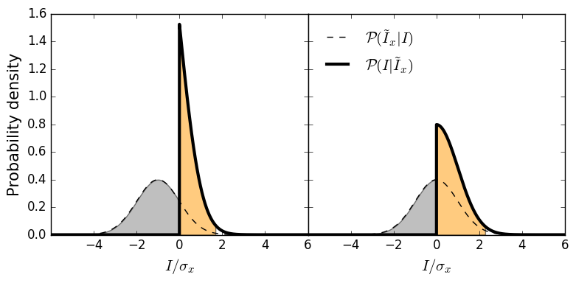
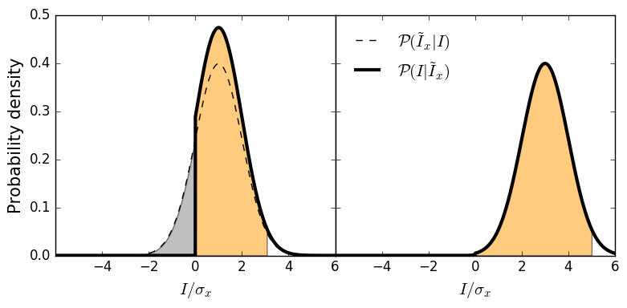
Bayesian upper limits for direct imaging
Problem: In the case of a non-detection, how do we place rigorous upper limits?
An upper limit is defined from the brightness posterior of a planet given the observation, not from the contrast curve
Likelihood
Posterior
Applications:
Mass upper limit from non-detection.
Constraining models of disk gap formation.
Combining RV detection and direct imaging upper-limits.
98%
Fig.: Brightness posterior of a planet at a known location and 98% upper-limit as a function measured brightness (-1𝝈,0,1𝝈,3𝝈).
Credit: Ruffio et al., in prep.
Notes:
Directly imaging a planet is hard and often ends up with a non detection, which is why rigorously defining upper-limits is important.
It is common practice to define an upper-limit from the contrast curve (5 sigma planet-to-star flux ratio), which is a detection threshold, not an upper limit.
Upper limits are rigorously defined from the brightness posterior of a planet given an observation.
The figure on the right shows the simulated posteriors of a planet at a known location as a function of the measured signal there. The orange area shows the 98% confidence interval. A 3sig and a -1sig measurement should obviously result in different upper-limits, which is not the case when using a contrast curve. A Bayesian upper limit fully exploit the information contained in the data.
Upper limits are scientifically very important, they are used to:
Constrain the planet color when the planet is known but undetected in some spectral band.
Define mass upper limits of hypothetical planet in a gap and constrain gap formation/planet accretion models.
Combine RV detections (and mass lower limit) with direct imaging data (mass upper limit) to more derive planet mass and orbital parameters.

Slide 3
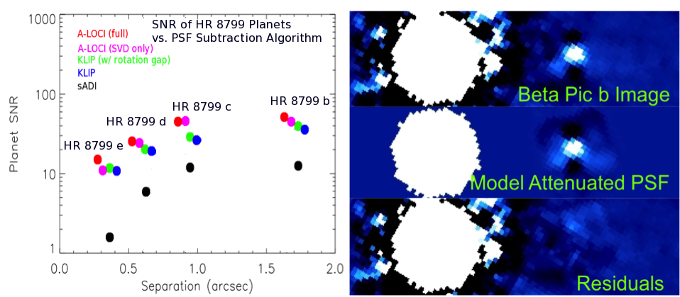
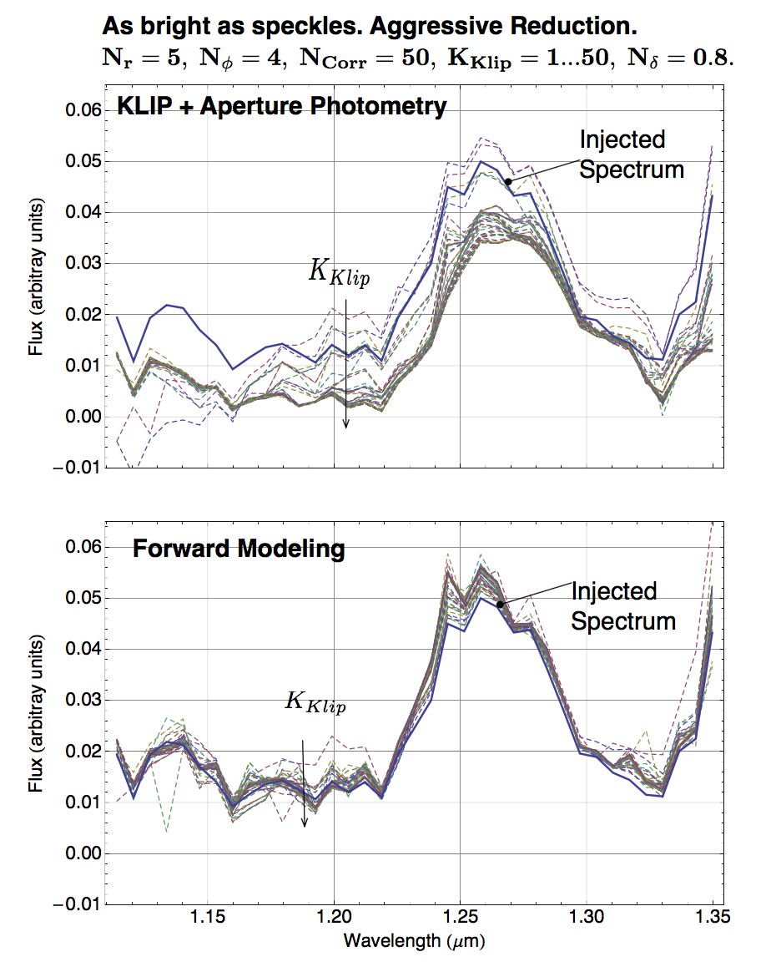
Deriving Realistic Uncertainties, Assessing Limits on Exoplanet Properties from Spectral Extraction
Spectral Retrieval with KLIP-FM (Pueyo 2016)
Forward-Modeling of beta Pic b GPI detection with A-LOCI (reduction by T. Currie)
Task: Need a comprehensive assessment of the precision limits from spectral extraction through forward-modeling that also considers:
Small sample statistics & uncertain noise distribution at small angles key for exo-Earth detection (Mawet et al. 2014; Jensen-Clem et al. 2018), spectral covariance (Greco & Brandt 2016)
How does this affect science goals (e.g. atmosphere retrieval, biosignature detection)
PSF Subtraction methods corrupt astrophysical signal (planet, disk)
Significant mitigation advances in in IFS data through forward-modeling: Marois+10,14; Currie+15; Pueyo+16, Ruffio+17
Slide Credit: T. Currie

Slide 4
The high contrast imaging data challenge
Three stages
Focused kick-off meeting(s) by telecon
Open participation period
One-day workshop to present results at the Grenoble Aples Data Institute
Key points to be defined by consensus:
Standardized, open source datasets and metrics
Sub-tasks and scenarios, e.g. observing strategy
Detection vs characterization (param est, error bars)
From lessons learned, open to data science/ML communities
C. A. Gomez Gonzalez @
Notes:
Kick-off meetings brainstorm and reach a concensus:
- telecons since the participants are geographically distributed
- only a few key researchers to discuss the idea of this HCI data challenge
- duration of the challenge, time for submissions (couple of months probably)
- website with the defined scope, rules, datasets, and leaderboard
Post-processing algorithms don’t need to be open-source. But datasets and metrics must be!
1-day workshop to be funded by the Grenoble Alpes Data Institute. In principle to be hosted in France/Europe.
The data challenge could lead to a review-type paper on post-processing algorithms for HCI presenting the results of our community challenge
From the lessons learned with this domain data challenge we will prepare a more focused Kaggle-style competition open to any data scientist or machine learning researcher

Slide 5
Summary
Several papers published / submitted / in prep:
R. Jensen-Clem, D. Mawet, et al. “A New Standard for Assessing the Performance of High Contrast Imaging Systems,” 2018, AJ, 155 19
D. Mawet et al. “Deep dive on ε Eridani with Keck MS-band Vortex Coronagraphy and Radial Velocities,” submitted to AJ
Ruffio et al. in prep on Bayesian upper limits
Close-out after data challenge by the end of the year

