Slide 1
Exoplanet Exploration Program Technology Update
Jet Propulsion Laboratory
California Institute of Technology
Brendan Crill
Deputy Program Chief Technologist
Exoplanet Exploration Program
Jet Propulsion Laboratory / California Institute of Technology
ExoPAG EC Telecon
7 January 2018
Cleared for public release
Copyright 2017 California Institute of Technology. U.S. Government sponsorship acknowledged.

Slide 2
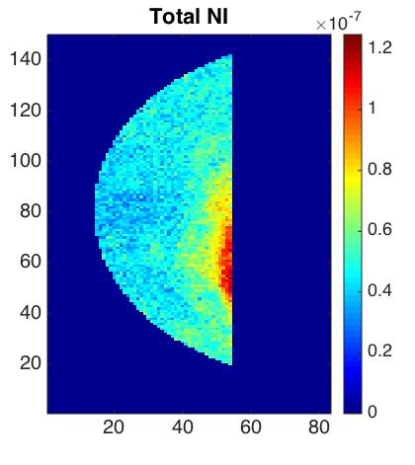
Program Technology Updates since Last ExoPAG
Active TDEM news https://exoplanets.nasa.gov/exep/technology/TDEM-awards/
  TDEM-13 PI Eduardo Bendek completed:
  Demonstrated microarcsecond
  astrometry with a diffractive pupil
  and demonstrated an in-air PIAA
  coronagraph with same pupil
  Final report reviewed and approved
  by ExoTAC
  TDEM-14 PI Gene Serabyn first light in HCIT:
  first round of testing a charge-4 vortex
  coronagraph achieved 5.1×10⁻⁸ contrast
  at 2% band around
  550 nm, centered at 550 nm
  spanning 3-9 λ/D; incoherent light leak
  identified, aiming for 10⁻⁹ contrast in
  next run

Slide 3
Program Technology Updates since Last ExoPAG
Active TDEM news (cont’d)
  TDEM-15 Jim Breckinridge providing input to WFIRST-CGI, HabEx, and LUVOIR regarding effects of polarization aberration on coronagraph performance.
New TDEM awards
  TDEM-16 PI John Trauger: Super Lyot Coronagraph
  TDEM-16 PI Rus Belikov: PIAACMC
  TDEM-16 PI Rus Belikov: Multi-star wavefront control
    Belikov Milestone Whitepapers currently under review by ExoTAC

Slide 4
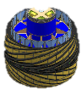
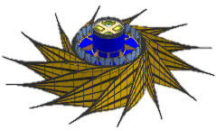
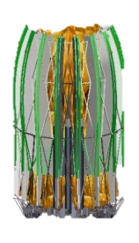
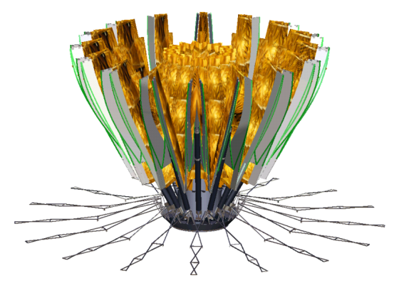
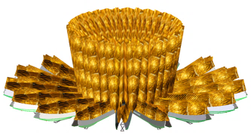
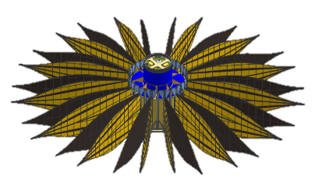
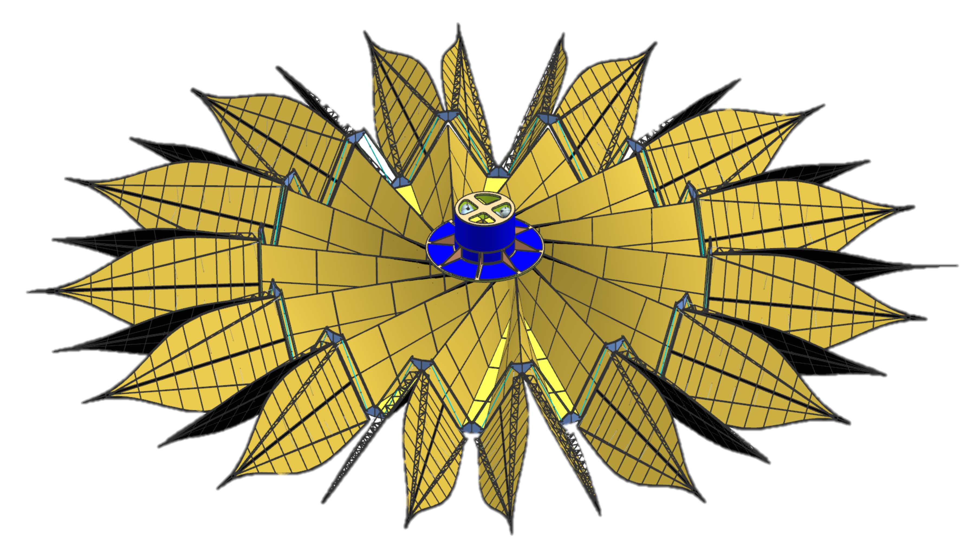
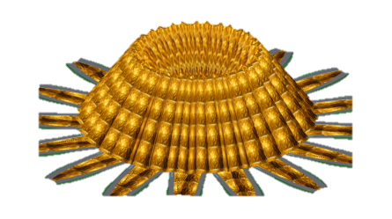
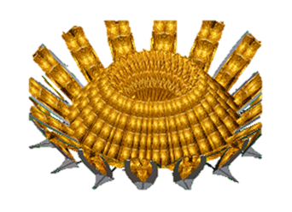

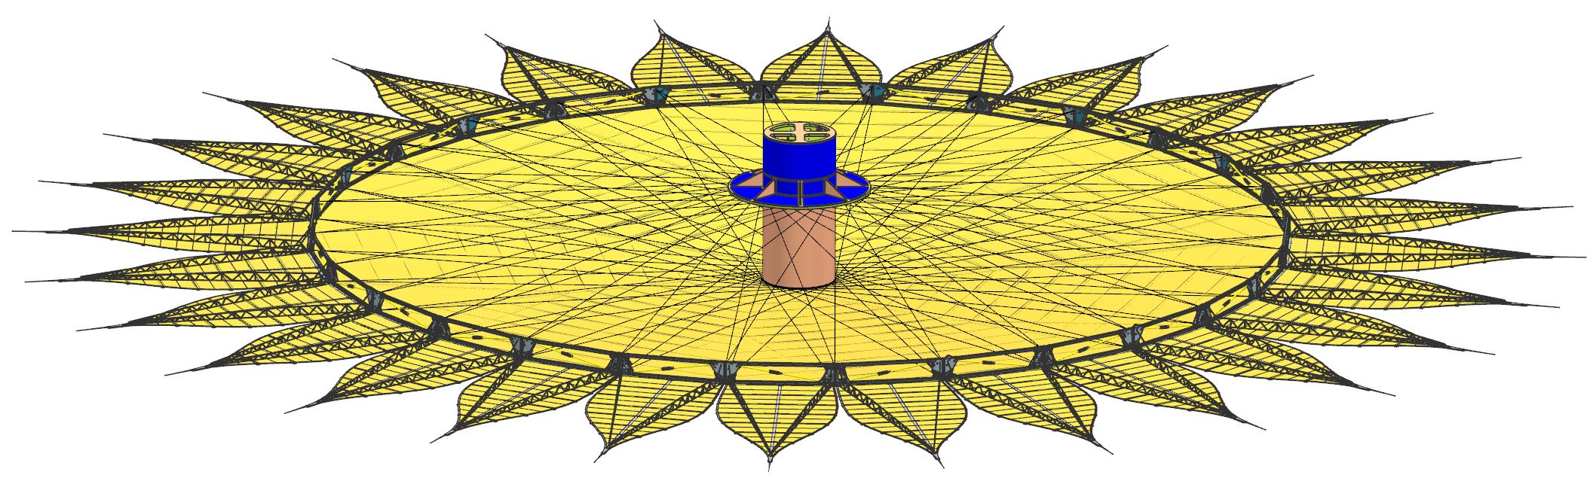
Program Technology Updates since Last ExoPAG
Starshade technology activity
  Plan for TRL 5 expected April 2018
  Deployment trade study kicked off
Wrapped petals
Folded petals
Notes:
Independent Trade Evaluation Team (TET) will establish the trade criteria and evaluate trade options
Kendra Short (ExEP), Nick Siegler (ExEP), Joe Pitman (ExEP TAC), Keith Belvin (STMD), Sergio Pellegrino (Caltech), Keats Wilkie (LaRC), Kim Aaron (JPL), Dale Hoffman (retired NGAS)

Slide 5
Program Technology Updates since Last ExoPAG
in-Space Service and Assembly
Technical Interchange Meeting held at Goddard Nov 1-3 brought together 70+ representatives of gov’t, industrtry, and academia to discuss potential iSSA for future large space observatories

Slide 6
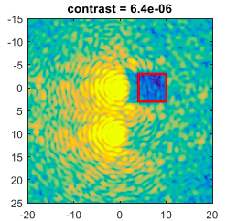
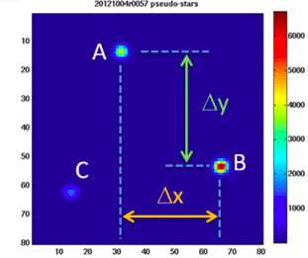
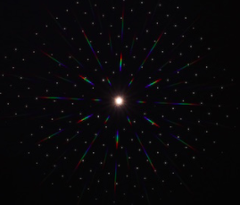
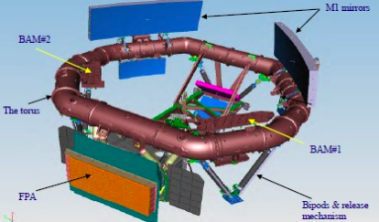
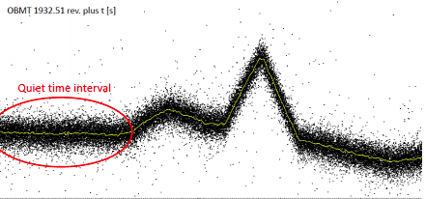
Program Technology Updates since Last ExoPAG
ExEP Technology Colloquium Series continues
https://exoplanets.nasa.gov/exep/technology/tech_colloquium/
  Astrometry, GAIA design and on-orbit lessons learned, Multi-star wavefront control
Technology Selection and Prioritization Process concluded
  2018 Technology List is online
  https://exoplanets.nasa.gov/exep/technology/gap-lists/
E.Bendek (NASA/ARC)
R. Belikov (NASA/ARC)
M. Shao(JPL)
A. Atzei (ESA/ESTEC)
D. Milligan (ESA/ESOC)

Slide 7
2018 Technology Selection and Prioritization Process Results
In the 2017 Technology Plan Appendix, we had 18 items on the prioritized Technology List and 4 on the Watch List
This summer, we received 37 technology inputs from the community
  14 from LUVOIR STDT
  15 from HabEx STDT
  4 from OST STDT
  2 from community at large
  2 redirected from COR
Results:
  None were rejected
  32 were consolidated into existing technologies already on the List
  5 new additions to the Technology List
  2 from Watch List upgraded to the Technology List
  0 additions to the Watch List
  1 listed technology was broken down into 3 finer component/subsystem technologies
There are now 24 technologies on the 2018 prioritized list and 2 on the Watch List https://exoplanets.nasa.gov/exep/technology/gap-lists/

Slide 8
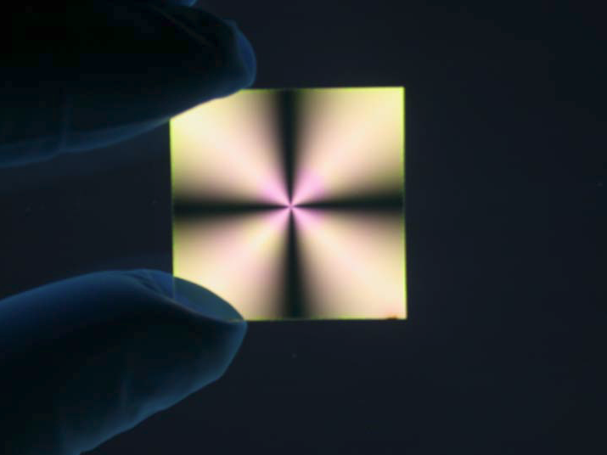
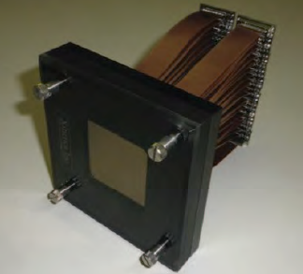
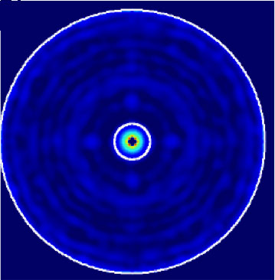
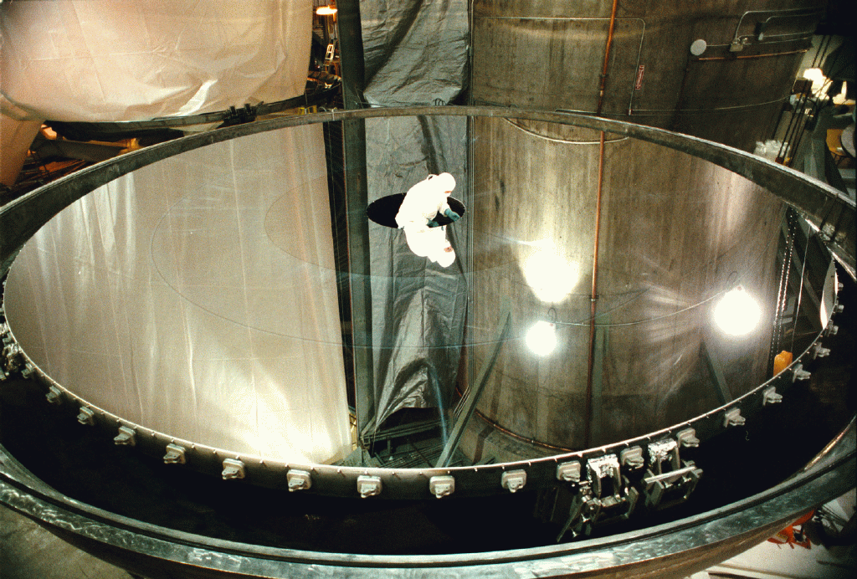
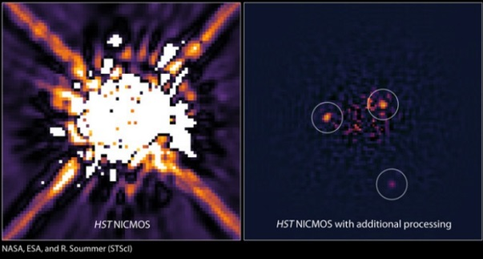
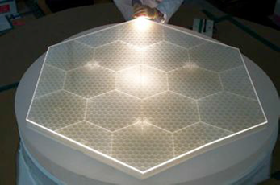
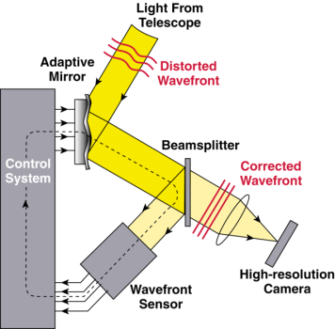
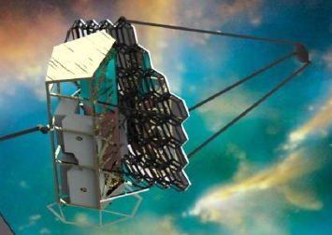
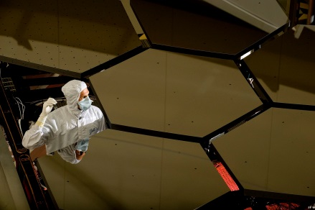
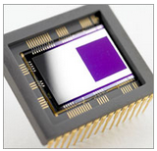
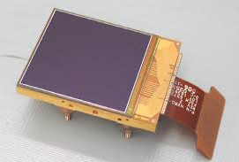
V-NIR Coronagraph/Telescope Technology Gaps
Contrast
Angular Resolution
CG-2: Coronagraph
Demonstrations
and Modeling
CG-3: Deformable
mirrors
CG-1: Large monolith
mirrors
CG-4: Data
post-processing
CG-1: Segmented
mirrors
Contrast Stability
Detection Sensitivity
CG-5: Wavefront
sensing and control
CG-7: Telescope vibration
sensing and control or reduction
Ultra-low noise visible (CG-8)
and infrared (CG-9) detectors
CG-6: Segment phasing and rigid body
sensing and control

Slide 9
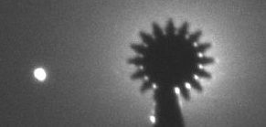
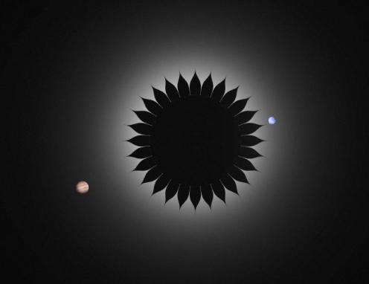
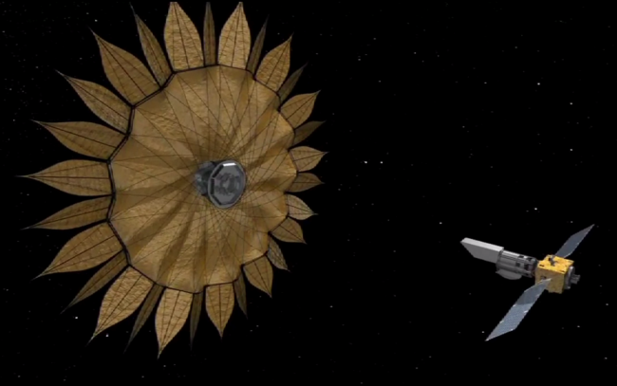
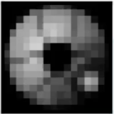
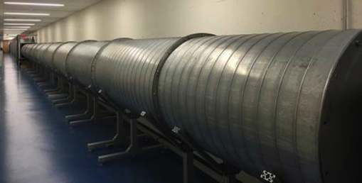
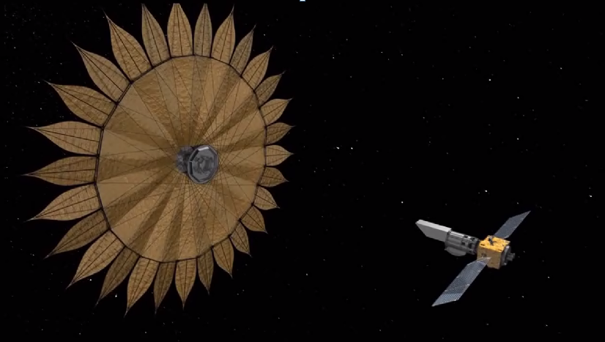
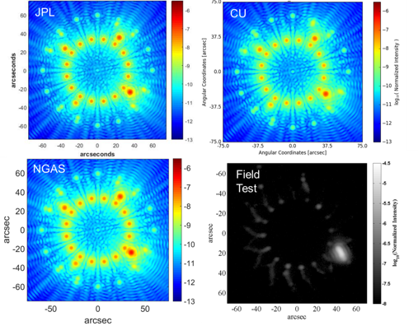
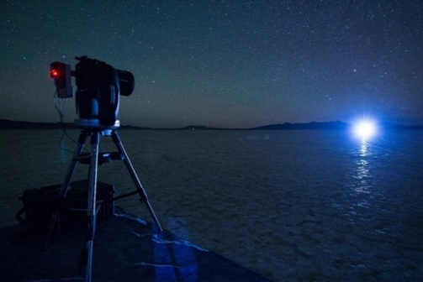
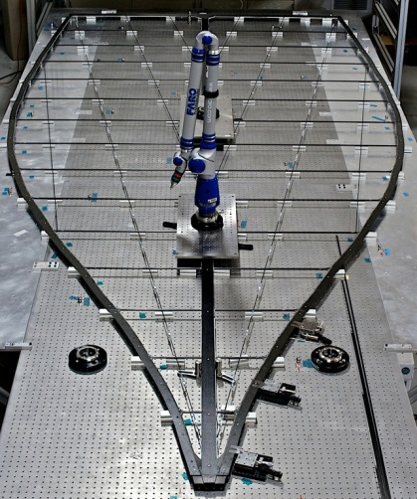
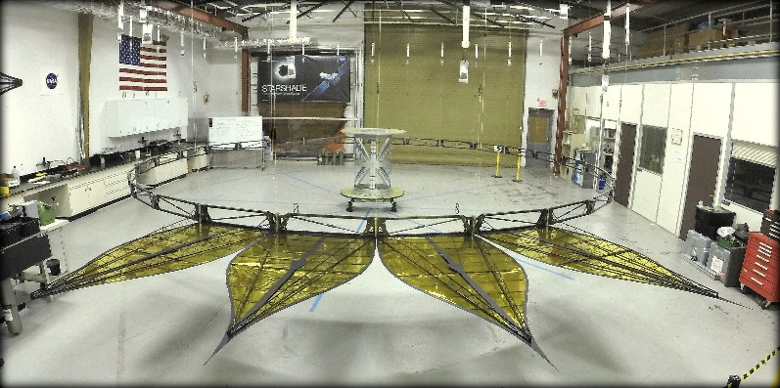
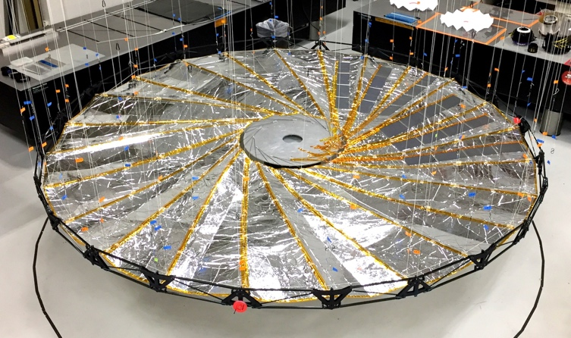
Starshade Technology Gaps
Contrast (Starlight Suppression)
Contrast Stability (Formation Sensing)
S-1: Controlling Scattered Sunlight
S-3: Lateral Formation
Sensing
Deployment Accuracy and Shape Stability
S-2: Starlight Suppression and Model Validation
S-4: Petal Shape
And Stability
S-5: Petal Positioning Accuracy and Opaque Structure
9

Slide 10
Mid-IR Coronagraph/Telescope Technology Gaps
Contrast
Angular Resolution
CG-15: Mid Infrared
Coronagraph Optics and Architecture
CG-14: Mid-IR Large
Aperture Telescopes
CG-16: Cryogenic
Deformable Mirror
Detection Sensitivity
CG-13: Low noise Mid-IR detectors
M-4: Ultra-stable Mid-IR detectors for transit spectroscopy

Slide 11
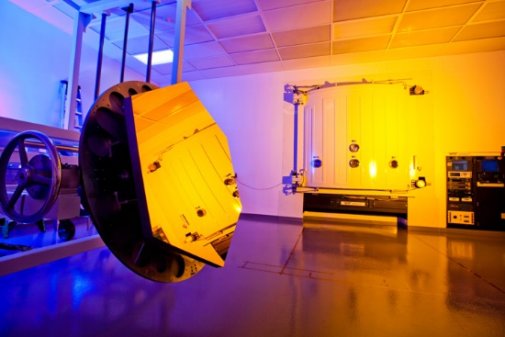
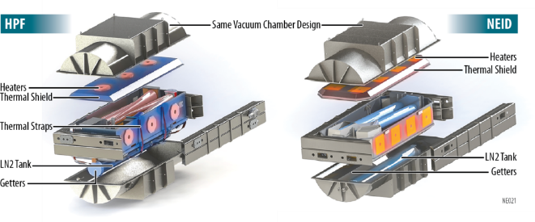
Other Technology Gaps
Tangential Stellar
Motion Sensitivity
UV Contrast
CG-10 UV/V/NIR
mirror coatings
M-3: Astrometry
Radial Stellar
Motion Sensitivity
UV Detection Sensitivity
M-1: Ground-based Ultra-high precision Radial Velociity
M-2: Laser Frequency Combs
for Space-based EPRV
CG-12: Ultra-low noise UV detectors

Slide 12



Investments in ExEP Technologies
Tech. ID | Technology Title
CG-2 | Coronagraph Architecture
S-2 | Starlight Suppression and Model Validation
S-1 | Controlling Scattered Sunlight
S-3 | Lateral Formation Sensing
S-5 | Petal Positioning Accuracy and Opaque Structure
S-4 | Petal Shape and Stability
CG-3 | Deformable Mirrors
CG-1 | Large Aperture Primary Mirrors
CG-6 | Mirror Segment Phasing
CG-7 | Telescope Vibration Sense/Control or Reduction
CG-9 | Ultra-Low Noise Near-Infrared Detectors
CG-5 | Wavefront Sensing and Control
CG-8 | Ultra-Low Noise Visible Detectors
M-4 | Ultra-Stable Mid-IR detector
M-3 | Astrometry
CG-4 | Data Post-Processing Algorithms and Techniques
CG-10 | Mirror Coatings for UV/NIR/Vis
M-2 | Space-based Laser Frequency Combs
CG-13 | Ultra Low-noise Mid-IR detectors
M-1 | Extreme Precision Ground-based Radial Velocity
CG-14 | Mid-IR Large Aperture Telescopes
CG-15 | Mid-IR Coronagraph Optics and Architecture
CG-16 | Cryogenic Deformable mirror
CG-12 | Ultra-Low Noise UV Detectors
SAT / APRA
directed
mission or mission concept
funded to TRL 5 *
funded to TRL 5 *
for some mission
architectures
Carried over from 2017
New to list in 2018
* for an exo-Earth imaging mission
12

Slide 13
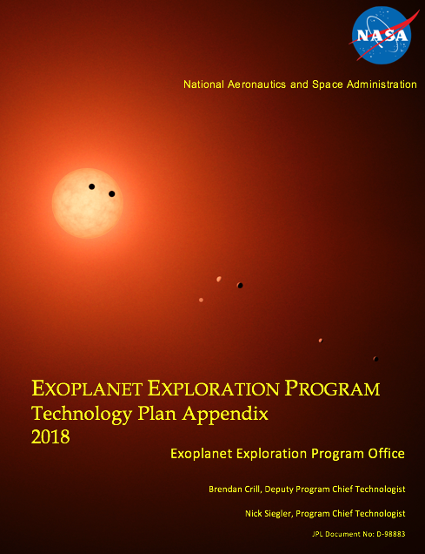
Reminders
2018 Technology List published on ExEP website
https://exoplanets.nasa.gov/exep/technology/gap-lists/
SAT Amendment was released on NSPIRES on Nov. 19
Please note that there is a Mandatory NOI for SAT proposals
due January 25, 2018
Draft 2018 update to ExEP Technology Plan Appendix coming

Slide 14
Additional slides

Slide 15
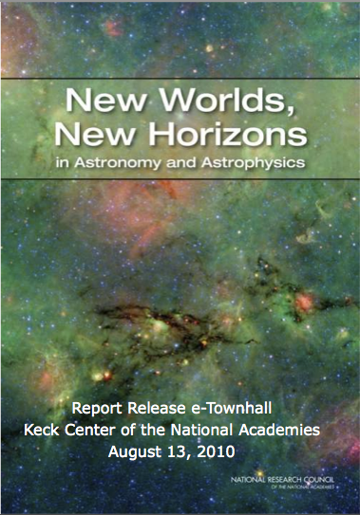
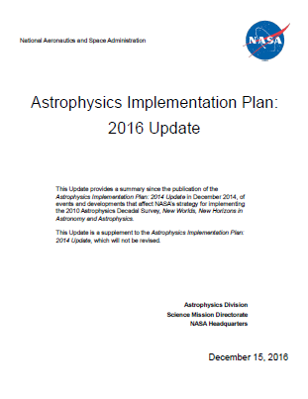
ExEP’s Technology Focus
The driving ExEP science goals are to:
  Discover planets around other stars
  Characterize their properties
  Identify candidates that could harbor life
As recommended in the 2010 Astrophysics Decadal Survey and planned in NASA’s Astrophysics Implementation Plan, the ExEP develops technologies that will enable the direct imaging and characterization of exoplanets in the habitable zone of Sun-like stars.

Slide 16
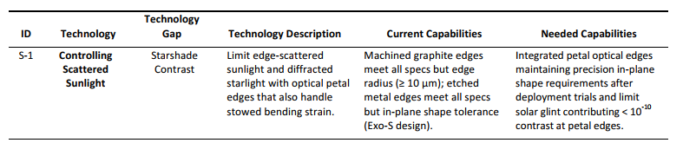
ExEP Technology List
24 technologies currently tracked
Technology List posted here:
https://exoplanets.nasa.gov/exep/technology/gap-lists/
More detail coming soon in the Technology Plan Appendix

Slide 17
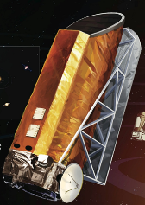
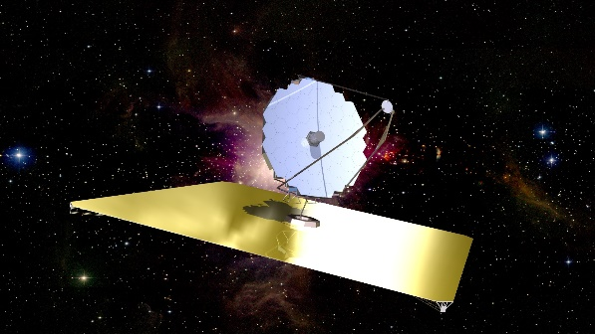

ExEP Technology Selection and Prioritization Process
New technology recommendations from exoplanet community
Technologies carried over from previous year
Selection Criteria: Enables or enhances direct detection and/or characterization of exoplanets?
No
Not accepted
No, but could still benefit
exoplanet science
Reviewed by (1) APD Program Offices and (2) Exo-TAC
Yes
Watch List
Accepted and Prioritized:
(Impact, Urgency, and Trend)
Reviewed by Exo-TAC
Tech Plan Appendix
Informs SAT/TDEM Call
ExEP Technology List
17

Slide 18
2018 ExEP Prioritized Technology List
Tech. ID | Technology Title | Impact | Urgency | Trend | 2018 Score | 2017 Score
 | weight: | 10 | 10 | 5
CG-2 | Coronagraph Architecture | 4 | 4 | 2 | 90 | 85
S-2 | Starlight Suppression and Model Validation | 4 | 4 | 2 | 90 | 90
S-1 | Controlling Scattered Sunlight | 4 | 4 | 2 | 90 | 90
S-3 | Lateral Formation Sensing | 4 | 4 | 2 | 90 | 90
S-5 | Petal Positioning Accuracy and Opaque Structure | 4 | 4 | 2 | 90 | 90
S-4 | Petal Shape and Stability | 4 | 4 | 2 | 90 | 90
CG-3 | Deformable Mirrors | 4 | 4 | 2 | 90 | 80
CG-1 | Large Aperture Primary Mirrors | 4 | 3 | 3 | 85 | 85
CG-6 | Mirror Segment Phasing | 4 | 3 | 3 | 85 | 85
CG-7 | Telescope Vibration Sense/Control or Reduction | 4 | 3 | 3 | 85 | 85
CG-9 | Ultra-Low Noise Near-Infrared Detectors | 4 | 3 | 3 | 85 | 85
CG-5 | Wavefront Sensing and Control | 4 | 3 | 2 | 80 | 80
CG-8 | Ultra-Low Noise Visible Detectors | 4 | 3 | 2 | 80 | 80
M-4 | Ultra-Stable Mid-IR detector | 3 | 3 | 4 | 80
M-3 | Astrometry | 3 | 3 | 3 | 75
CG-4 | Data Post-Processing Algorithms and Techniques | 4 | 2 | 2 | 70 | 70
CG-10 | Mirror Coatings for UV/NIR/Vis | 3 | 3 | 2 | 70 | 70
M-2 | Space-based Laser Frequency Combs | 3 | 3 | 2 | 70
CG-13 | Ultra Low-noise Mid-IR detectors | 2 | 3 | 4 | 70
M-1 | Extreme Precision Ground-based Radial Velocity | 2 | 3 | 3 | 65 | 75
CG-14 | Mid-IR Large Aperture Telescopes | 2 | 3 | 3 | 65
CG-15 | Mid-IR Coronagraph Optics and Architecture | 2 | 3 | 3 | 65
CG-16 | Cryogenic Deformable mirror | 2 | 3 | 3 | 65
CG-12 | Ultra-Low Noise UV Detectors | 2 | 3 | 2 | 60 | 60
Carried over from 2017
New to list in 2018

Slide 19
Impact, Urgency, Trend Prioritization Scoring

Slide 20
Technology Selection and Prioritization Process for 2018
ID | Activity
1 | Technology needs input window opens | 06/18/17
 | email ExoPAG announce: Technology Gap Lists, input forms, process explanation | 06/09/17
 | presentation at June ExoPAG | 06/18/17
2 | Technology window closes | 08/28/17
3 | Technology Selection and Prioritization Criteria Review by APD Program Offices | 08/25/17
4 | Selection and Prioritization Criteria Review by ExoTAC | 09/15/17
5 | Technology List Assessment Review by APD Program Offices | 09/25/17
6 | Technology List Assessment Review by ExoTAC | 10/16/17
7 | Technology Lists inform TDEM Amendment | Early Nov
8 | Technology Amendment released through NSPIRES | 11/16/18
9 | ExEP Technology Plan Appendix updated and released | 01/06/18
 | Presentation at January ExoPAG | 01/06/18
10 | TDEM Proposal Deadline | 03/15/18
11 | TDEM Awards Selected | Aug 2018
✓
✓
✓
✓
✓
✓
✓
✓

