Slide 1
NASA Headquarters Updates
ExoPAG #17
Gaylord National Resort & Convention Center, Maryland
January 7, 2018
Martin Still
ExoPAG Executive Secretary
Astrophysics Division
Science Mission Directorate
Martin.Still@nasa.gov

Slide 2
The ExEP and the ExoPAG: Defintions https://exoplanets.nasa.gov/system/internal_resources/details/original/553_ExoPAG-TOR_2017.pdf
The Exoplanet Exploration Program (ExEP) Office is chartered by the Astrophysics Division (APD) of NASA’s Science Mission Directorate (SMD) to carry out science, research, and technology tasks that advance NASA’s science goal to “Discover and study planets around other stars, and explore whether they could harbor life.”
ExEP serves NASA and the community by acting as a focal point for exoplanet science and technology, managing research and technology initiatives, facilitating access to scientific data, and integrating the results of previous and current missions into a cohesive strategy to enable future discoveries.
ExEP is a program within APD. The ExEP Office is based at the Jet Propulsion Laboratory (JPL) and manages ExEP for APD. The ExEP Office is responsible for executing science and technology functions assigned to the program by APD.
The Exoplanet Exploration Program Analysis Group (ExoPAG) serves as a community-based, interdisciplinary forum for soliciting and coordinating community analysis and input in support of Exoplanet Exploration objectives and of their implications for architecture planning and activity prioritization and for future exploration.
The ExoPAG reports findings of analyses to the NASA Astrophysics Division Director.

Slide 3


Exoplanet Exploration Program

Slide 4
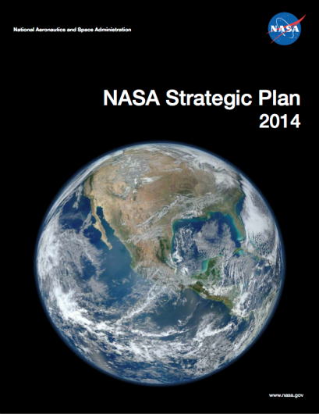
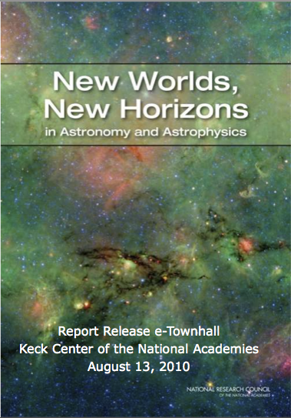

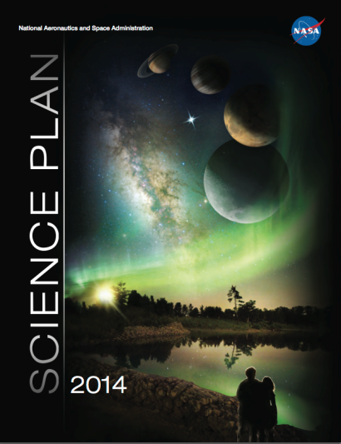
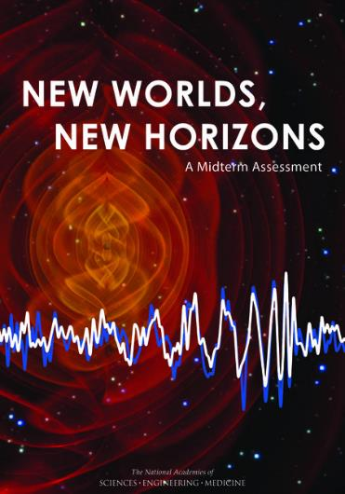
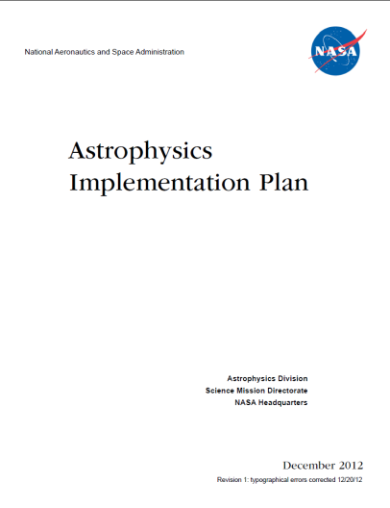
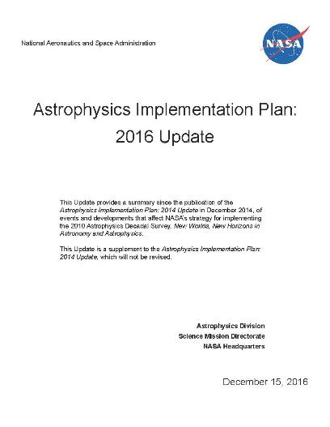
Astrophysics Strategic Planning
2016 update includes:
Response to Midterm Assessment
Planning for 2020 Decadal Survey
To be updated in 2018 (per GPRAMA)
https://science.nasa.gov/astrophysics/documents
Notes:
Government Performance and Results Act, Modernization Act. GPRAMA.

Slide 5
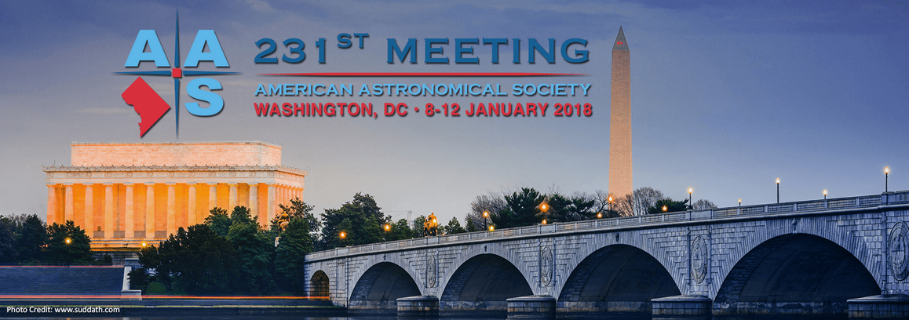
We are executing a balanced strategic program for Astrophysics
Operating missions, large and small, continue to deliver paradigm changing science
See the many science results reported at this AAS meeting
JWST Proposal Planning - Sun @ 8:30 am
Using Python to Search NASA's Archives - Sun, Mon
ExoPAG - Sun, Mon
NASA COPAG Far-IR SIG - Mon @ 8:30 am
NASA Gravitational Wave SIG - Mon @ 8:30 am
NASA PhysPAG Cosmic-Ray SIG - Mon @ 8:30 am
NASA COPAG COR Technology Interest Group - Mon @ 9:00 am
NASA COPAG UV-VIS SIG - Mon @ 9:00 am
NASA COPAG Cosmic Dawn SIG - Mon @ 10:30 am
NASA PhysPAG GAMMA-Ray SIG - Mon @ 10:30 am
NASA PhysPAG x-Ray SIG - Mon @10:30 am
NASA Joint PAG Meeting - Mon 1:30 pm
NASA COPAG and NASA PhysPAG - Mon 3:00 pm
NASA COPAG Far-SIG Meeting - Tues @ 9:30 am
NICER Mission Overview, Status and GO opportunities - Tues @10:00 am
NASA Decadal Preparations I: Large-scale Studies - Tues @ 10:00 am
Astrophysics Enabled by HST's UV Initiative - Tues @10 am
Big Bang to BioSignatures: The Science of the LUVOIR Mission Concept - Tues @ 2 pm
Learning with NASA Astrophysics: How to Get Connected - Tues @ 2 pm
NASA Decadal Preparations II: Probes Mission Concept Studies - Tues @ 2:00 pm
The Habitable ExoPlanet Imaging Missions (HABEX) - Tues @ 6:30 pm
NASA's K2 and TESS Missions and Opportunities - Tues @ 7:30 pm
Exoplanet Science with WFIRST - Wed, Jan 10 @ 10 am
NASA Town Hall - Wed @ 12:45 pm in Potomac Ballroom C
Origins Space Telescope (OST) STDT Face-to-Face Meeting - Wed @ 1:30 pm in Chesapeake H
What Can I do with LUVOIR - Wed @ 2 pm in Chesapeake 7-8
NAS Town Hall, Astro2020: The Next Decadal Survey of Astronomy and Astrophysics - Wed @ 6:30 pm in Potomac Ballroom C
NASA ExoPlanet Exploration Program Update - Thur @ 10 am in Chesapeake I
NASA Scientific Ballooning Roadmap - Thur @ 12:45 pm in Potomac Ballroom D
Ground Based Support for NASA Exoplanet Missions - Thur @ 2:00 pm in National Harbor 7
NASA Postdoctoral Program (NPP) Meet and Greet - Thur @ 7:30 pm in National Harbor 14
SOFIA Town Hall: New Opportunities - Thurs @ 7:30 pm in Potomac Ballroom D
The exoplanet population revealed by K2 - Fri @ 2:00 pm in Maryland Ballroom D
The Transiting Exoplanet Community Early Release Science for JWST - Fri @ 2:30 National Harbor 11

Slide 6
Content
ExoPAG Status
Budget Status (tomorrow at the joint-PAG meeting)
Current Missions Status
Future Missions Status
Mission AO Status
Decadal Studies Status

Slide 7
ExoPAG Status

Slide 8
Exoplanet Program Analysis Group
The ExoPAG enables direct regular communication between NASA and the community, and within the community, through public meetings that give the community opportunities to provide its scientific and programmatic input
Structurally, the ExoPAG Chair and the ExoPAG Executive Committee (EC) are appointed members whose responsibilities include organizing meetings and collecting and summarizing community input
The full ExoPAG consists of all members of the community who participate in these open meetings
The ExoPAG may be tasked to carry out the following:
Articulate and prioritize the key scientific drivers for Exoplanet Exploration research;
Evaluate the expected capabilities of potential ExEP missions for achieving the science goal of the program
Evaluate ExEP goals, objectives, investigations and required measurements on the basis of the widest possible community outreach;
Articulate and prioritize focus areas for needed mission technologies; and
Provide findings on related activities such as ground-based observing, theory and modeling programs, laboratory astrophysics, suborbital investigations, data archiving and community engagement.

Slide 9
The ExoPAG Executive Committee (EC)
The ExoPAG Chair is a member of the NASA Astrophysics Advisory Committee
The EC helps the ExoPAG Chair:
capture and organize community input
keep the community informed of ongoing activities and opportunities within the exoplanet program
oversee ExoPAG analyses
prepare ExoPAG findings and inputs to the Astrophysics Subcommittee
EC members are selected to reflect the broad range of scientific disciplines and interests represented in exoplanet exploration
New EC members will be selected by the Astrophysics Division Director in the new year

Slide 10
ExoPAG Executive Committee
Name | Home | Year
Alan Boss (chair) | Carnegie Institution | 3/3
Daniel Apai | Arizona | 3/3
David Ciardi | NExScI | 3/3
Shawn Domagal-Goldman | NASA GSFC | 3/3
Tiffany Glassman | Northrop Grumman | 2/3
Dimitri Mawet | Caltech/JPL | 2/3
Tyler Robinson | UC Santa Cruz | 2/3
Eliza Kempton | Grinnell College | 1/3
Michael Meyer | Michigan | 1/3
Chris Stark | STScI | 1/3
Johanna Teske | Carnegie Institution | 1/3
After year 3, EC members Daniel Apai, David Ciardi, and Shawn Domegal-Goldman will roll off the EC
New member Call for Nominations: https://exoplanets.nasa.gov/exep/exopag
Deadline: Jan 2018

Slide 11
ExoPAG Chair Handover
Alan Boss will relinquish the chair to Vikki Meadows (U. Washington) at the end of this ExoPAG meeting.

Slide 12
Science Analysis Group Status https://exoplanets.nasa.gov/exep/exopag/sag
Delivered | SAG | Title | Lead
2015 | 8 | Requirements and Limits of Future Precision Radial Velocity Measurements | Latham, Plavchan
2015 | 9 | Exoplanet Probe to Medium Scale Direct-Imaging Mission Requirements and Characteristics | Soummer
2015 | 10 | Characterizing the Atmospheres of Transiting Planets with JWST and Beyond | Cowan
2014 | 11 | Preparing for the WFIRST Microlensing Survey | Yee
2017 | 12 | Scientific potential and feasibility of high-precision astrometry for exoplanet detection and characterization | Bendek
2017 | 13 | Exoplanet Occurrence Rates and Distributions | Belikov
-- | 14 | Characterization of Stars Targeted for NASA Exoplanet Missions | Stassun
2017 | 15 | Exploring Other Worlds: Observational Constraints and Science Questions for Direct Imaging Exoplanet Missions | Apai
-- | 16 | Exoplanet biosignatures | Domagal-Goldman
-- | 17 | Community Resources Needed for K2 and TESS Planetary Candidate Confirmation | Ciardi
-- | 18 | Metrics for Direct-Imaging with Starshades | Glassman, Turnbull
-- | 19 | Exoplanet Imaging Signal Detection Theory and Rigorous Contrast Metrics | Mawet, Jensen-Clem

Slide 13
Current Missions Status

Slide 14
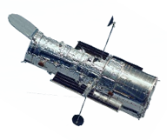
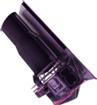
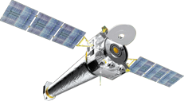

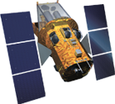
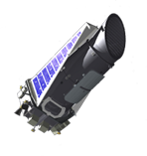
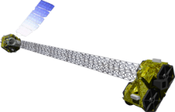

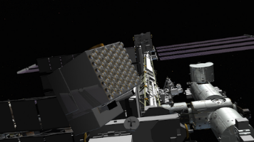
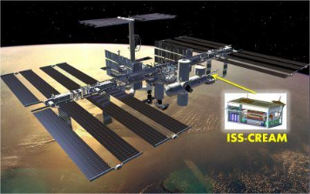

Astrophysics Missions in Operation
Hubble
4/1990
Chandra
7/1999
XMM-Newton
12/1999
Spitzer
8/2003
NASA Strategic Mission
NASA Strategic Mission
ESA-led Mission
NASA Strategic Mission
Hubble Space Telescope
Chandra X-ray Observatory
X-ray Multi Mirror - Newton
Spitzer Space Telescope
Swift
11/2004
Fermi
6/2008
Kepler
NuSTAR
6/2012
Webb
3/2009
NASA MIDEX Mission
NASA Strategic Mission
NASA Discovery Mission
NASA SMEX Mission
Swift Gamma-ray Burst Explorer
Fermi Gamma-ray
Space Telescope
Kepler Space Telescope
Nuclear Spectroscopic
Telescope Array
SOFIA
5/2014
ISS-NICER
6/2017
ISS-CREAM
8/2017
NASA Strategic Mission
NASA Explorers Mission of Opportunity
NASA Research Mission
Stratospheric Observatory
for Infrared Astronomy
Neutron Star Interior
Composition Explorer
Cosmic Ray Energetics
And Mass

Slide 15
Future Missions Status

Slide 16
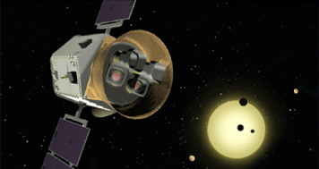
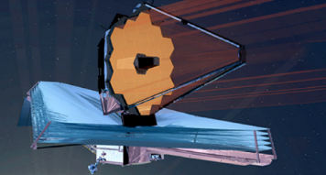
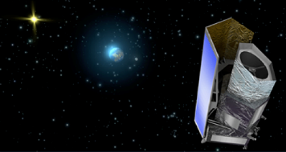
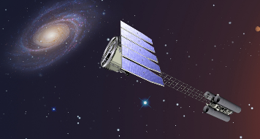
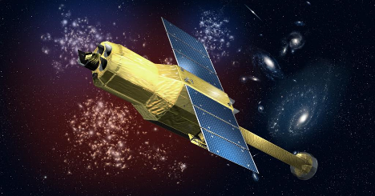
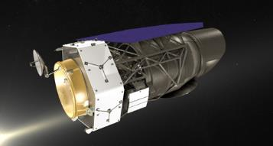
Astrophysics Missions in Development
TESS
3/2018
Webb
2019
Euclid
2020
IXPE
2021
Webb
NASA Mission
NASA Mission
ESA-led Mission
NASA Mission
Transiting Exoplanet
Survey Satellite
James Webb
Space Telescope
NASA is supplying the NISP
Sensor Chip System (SCS)
Imaging X-ray Polarimetry Explorer
GUSTO
2021
XARM
2021
WFIRST
Mid 2020s
NASA Mission
JAXA-led Mission
NASA Mission
Galactic/ Extragalactic ULDB
Spectroscopic Terahertz Observatory
NASA is supplying the SXS
Detectors, ADRs, and SXTs
Wide-Field Infrared
Survey Telescope

Slide 17
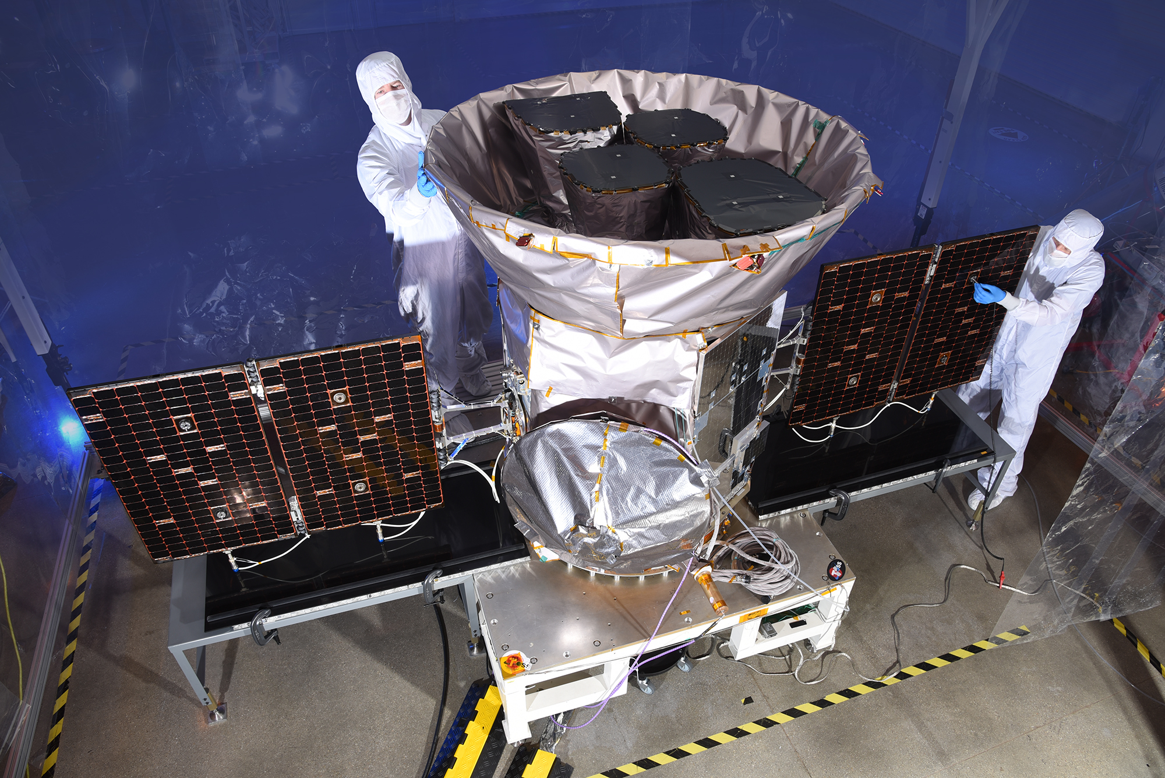
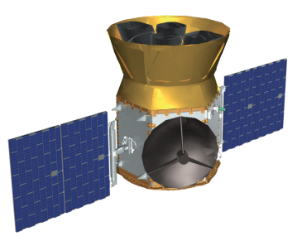
TESS Transiting Exoplanet Survey Satellite
CURRENT STATUS:
Both instrument and spacecraft bus completed and integrated.
Observatory environmental testing completed.
Spare camera long-duration testing has shown no unexpected focus drift anomalies to date.
Cycle 1 Guest Investigator proposals received October 6, 2017
SCHEDULE:
July 2017 – SIR
August 2017 – KDP-D
Sept 2017 – PER
October – Vibration testing
November – TVAC testing
Late Jan 2018 – Observatory I&T complete
Early Feb 2018 – Delivery to KSC payload processing facility
February 2018 – Selection of Cycle 1 GOs
March 2018 – Launch readiness date from Cape Canaveral FL
Medium Explorer (MIDEX) Mission
PI: G. Ricker (MIT)
Mission: All-Sky photometric exoplanet mapping mission.
Science goal: Search for transiting exoplanets around the nearby, bright stars.
Instruments: Four wide field of view (24x24 degrees) CCD cameras with overlapping field of view, operating in the Visible-IR spectrum (0.6-1 micron).
Operations: NLT June 2018 launch with a 3-year prime mission including 2 years of spacecraft operations and an additional 1 year ground-based observations and analysis. High-Earth elliptical orbit (17 x 58.7 Earth radii).
https://tess.gsfc.nasa.gov/
https://tess.mit.edu/

Slide 18
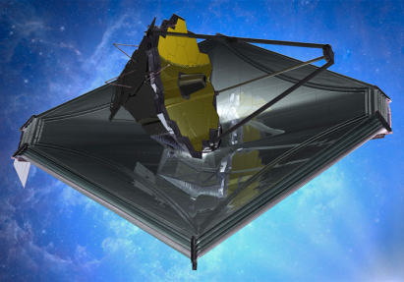
Webb James Webb Space Telescope
2017 Accomplishments
Completed Science Payload vibration, and acoustics testing
Solicited and selected Early Release Science proposals
Received All Sunshield membranes
Completed cryovacuum testing of the science payload
Integrated the sunshield and spacecraft forming the Spacecraft Element (SCE)
Completed first flight hardware sunshield deployment test
2018 Plans
Complete Spacecraft Element testing
Receive and Review Cycle 1 GO proposals
Integrate the Science Payload to the SCE, forming the Observatory
Begin testing the Observatory
Webb Town Hall: Tue @ 6:30 pm
Large Infrared Space Observatory
Top priority of 2000 Decadal Survey
Science themes: First Light; Assembly of Galaxies; Birth of Stars and Planetary Systems; Planetary Systems and the Origins of Life
Mission: 6.5m deployable, segmented telescope at L2, passively cooled to <50K behind a large, deployable sunshield
Instruments: Near IR Camera, Near IR Spectrograph, Mid IR Instrument, Near IR Imager and Slitless Spectrograph
Operations: 2019 launch for a 5-year prime mission
Partners: ESA, CSA
Webb remains within its
replan budget guidelines
Notes:
Updated December 2017

Slide 19
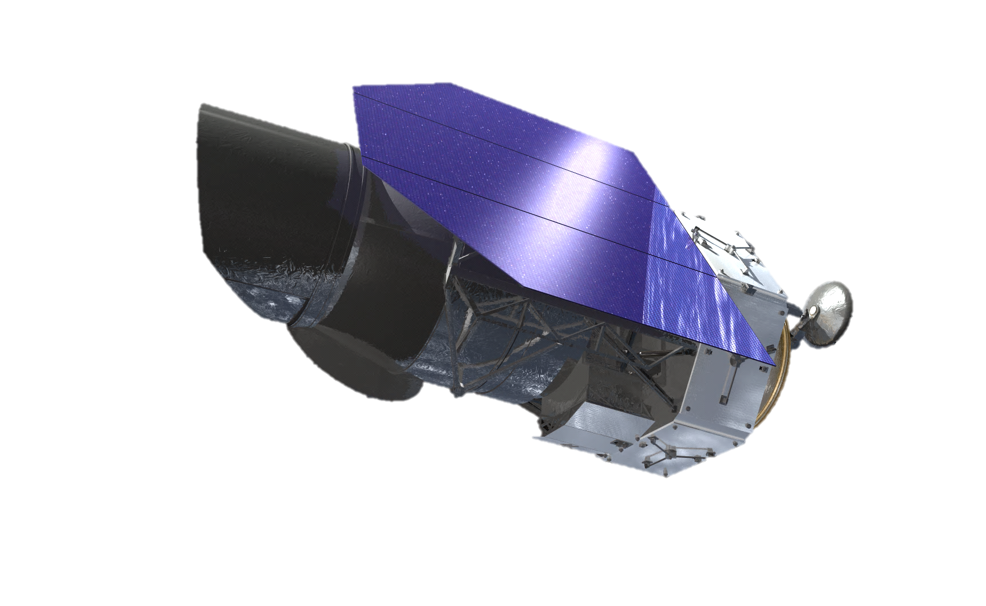
WFIRST Wide-Field Infrared Survey Telescope
CURRENT STATUS:
Completed three-year technology development activities on WFIRST’s two critical mission technologies (near infrared detectors and coronagraph technologies)
WFIRST Formulation Science Working Group and Science Investigation Teams selected
Conducted WFIRST Independent External Technical/Cost/Management Review (WIETR) in response to findings and recommendations in National Academies’ Midterm Assessment
WFIRST directed by SMD AA to modify the current WFIRST design in order to reduce cost and complexity sufficient to have a cost estimate consistent with the $3.2B cost target set at the beginning of Phase A.
Coronagraph is technology demonstration instrument
An independent cost assessment will be conducted to validate the estimated cost as being consistent with the $3.2B cost target.
SRR/MDR planned for February 2018.
KDP-B planned for March/April 2018.
Jeff Kruk is Project Scientist following loss of Neil Gehrels
Wide-Field Infrared Survey Telescope
Top priority of 2010 Decadal Survey
Science themes: Dark Energy, Exoplanets, Large Area Near Infrared Surveys
Mission: 2.4m widefield telescope at L2; using existing hardware, images 0.28deg² at 0.8-2µm
Instruments (design reference mission): Wide Field Instrument (camera plus IFU), Coronagraph Instrument (imaging/IFS)
Phase: Currently in Formulation (Phase A)
>50 WFIRST Posters @ AAS Meeting
WFIRST & Exoplanets, Wed @ 10:00 am
WFIRST & Public Policy, Fri @ 10:00 am
https://wfirst.gsfc.nasa.gov/
Notes:
Updated December 2017

Slide 20
WFIRST: Response to the WEITR Report
Project estimate of cost to Science Mission Directorate has been reduced from ~$3.6B to ~$3.2B.
Changes include the following (some up, most down):
Contribution to coronagraph technology demonstration instrument by NASA Space Technology Mission Directorate
Coronagraph Instrument treated as technology demonstration instrument
Fewer operation modes while retaining essential technology elements
Fewer science functions and no science pipeline
Shared risk Participating Scientist Program replaces GO Program
Reduced some Wide Field Instrument capabilities
Fewer operation and pipeline modes
Integral Field Channel contributed by international partners (NASA increase due to cost of accommodation)
Grism data pipeline contributed by international partner
Relaxed detector requirements increases yield during manufacture
Improved budget profile and accelerated schedule
Pulls in launch date 6 months
Project Management has been transferred to NASA HQ
Additional mission risk reduction (sparing, testing, parts, etc.)
WFIRST will continue to be formulated “starshade-ready”

Slide 21
Mission AO Status

Slide 22
Current and Future Explorer AOs
NASA is maintaining a cadence of 4 Astrophysics Explorers AOs per decade, as recommended by Decadal Survey and validated by Midterm Assessment.
Midterm Assessment Recommendation 4-3: “NASA’s Astrophysics Division should execute its current plan, as presented to the committee, of at least four Explorer Announcements of Opportunity during the 2012-2021 decade, each with a Mission of Opportunity call, and each followed by mission selection.”
Most recent Astrophysics Explorers Program AO, released in September 2016, was for a MIDEX and Mission of Opportunity (MO).
Three MIDEX mission proposals and three Mission of Opportunity proposals selected in August 2017 for 9-month competitive Phase A studies
Down-selection: Early 2019 (target)
MIDEX launch readiness date no later than December 2023
MO launch readiness date no later than December 2022, except for Partner MOs whose launch date is set by the host mission.
Next Astrophysics Explorers Program AO will be for a SMEX and MO and is targeted for release in 2019.
Subsequent Astrophysics Explorers Program AO is for a MIDEX and MO and is targeted for release in late 2021.

Slide 23



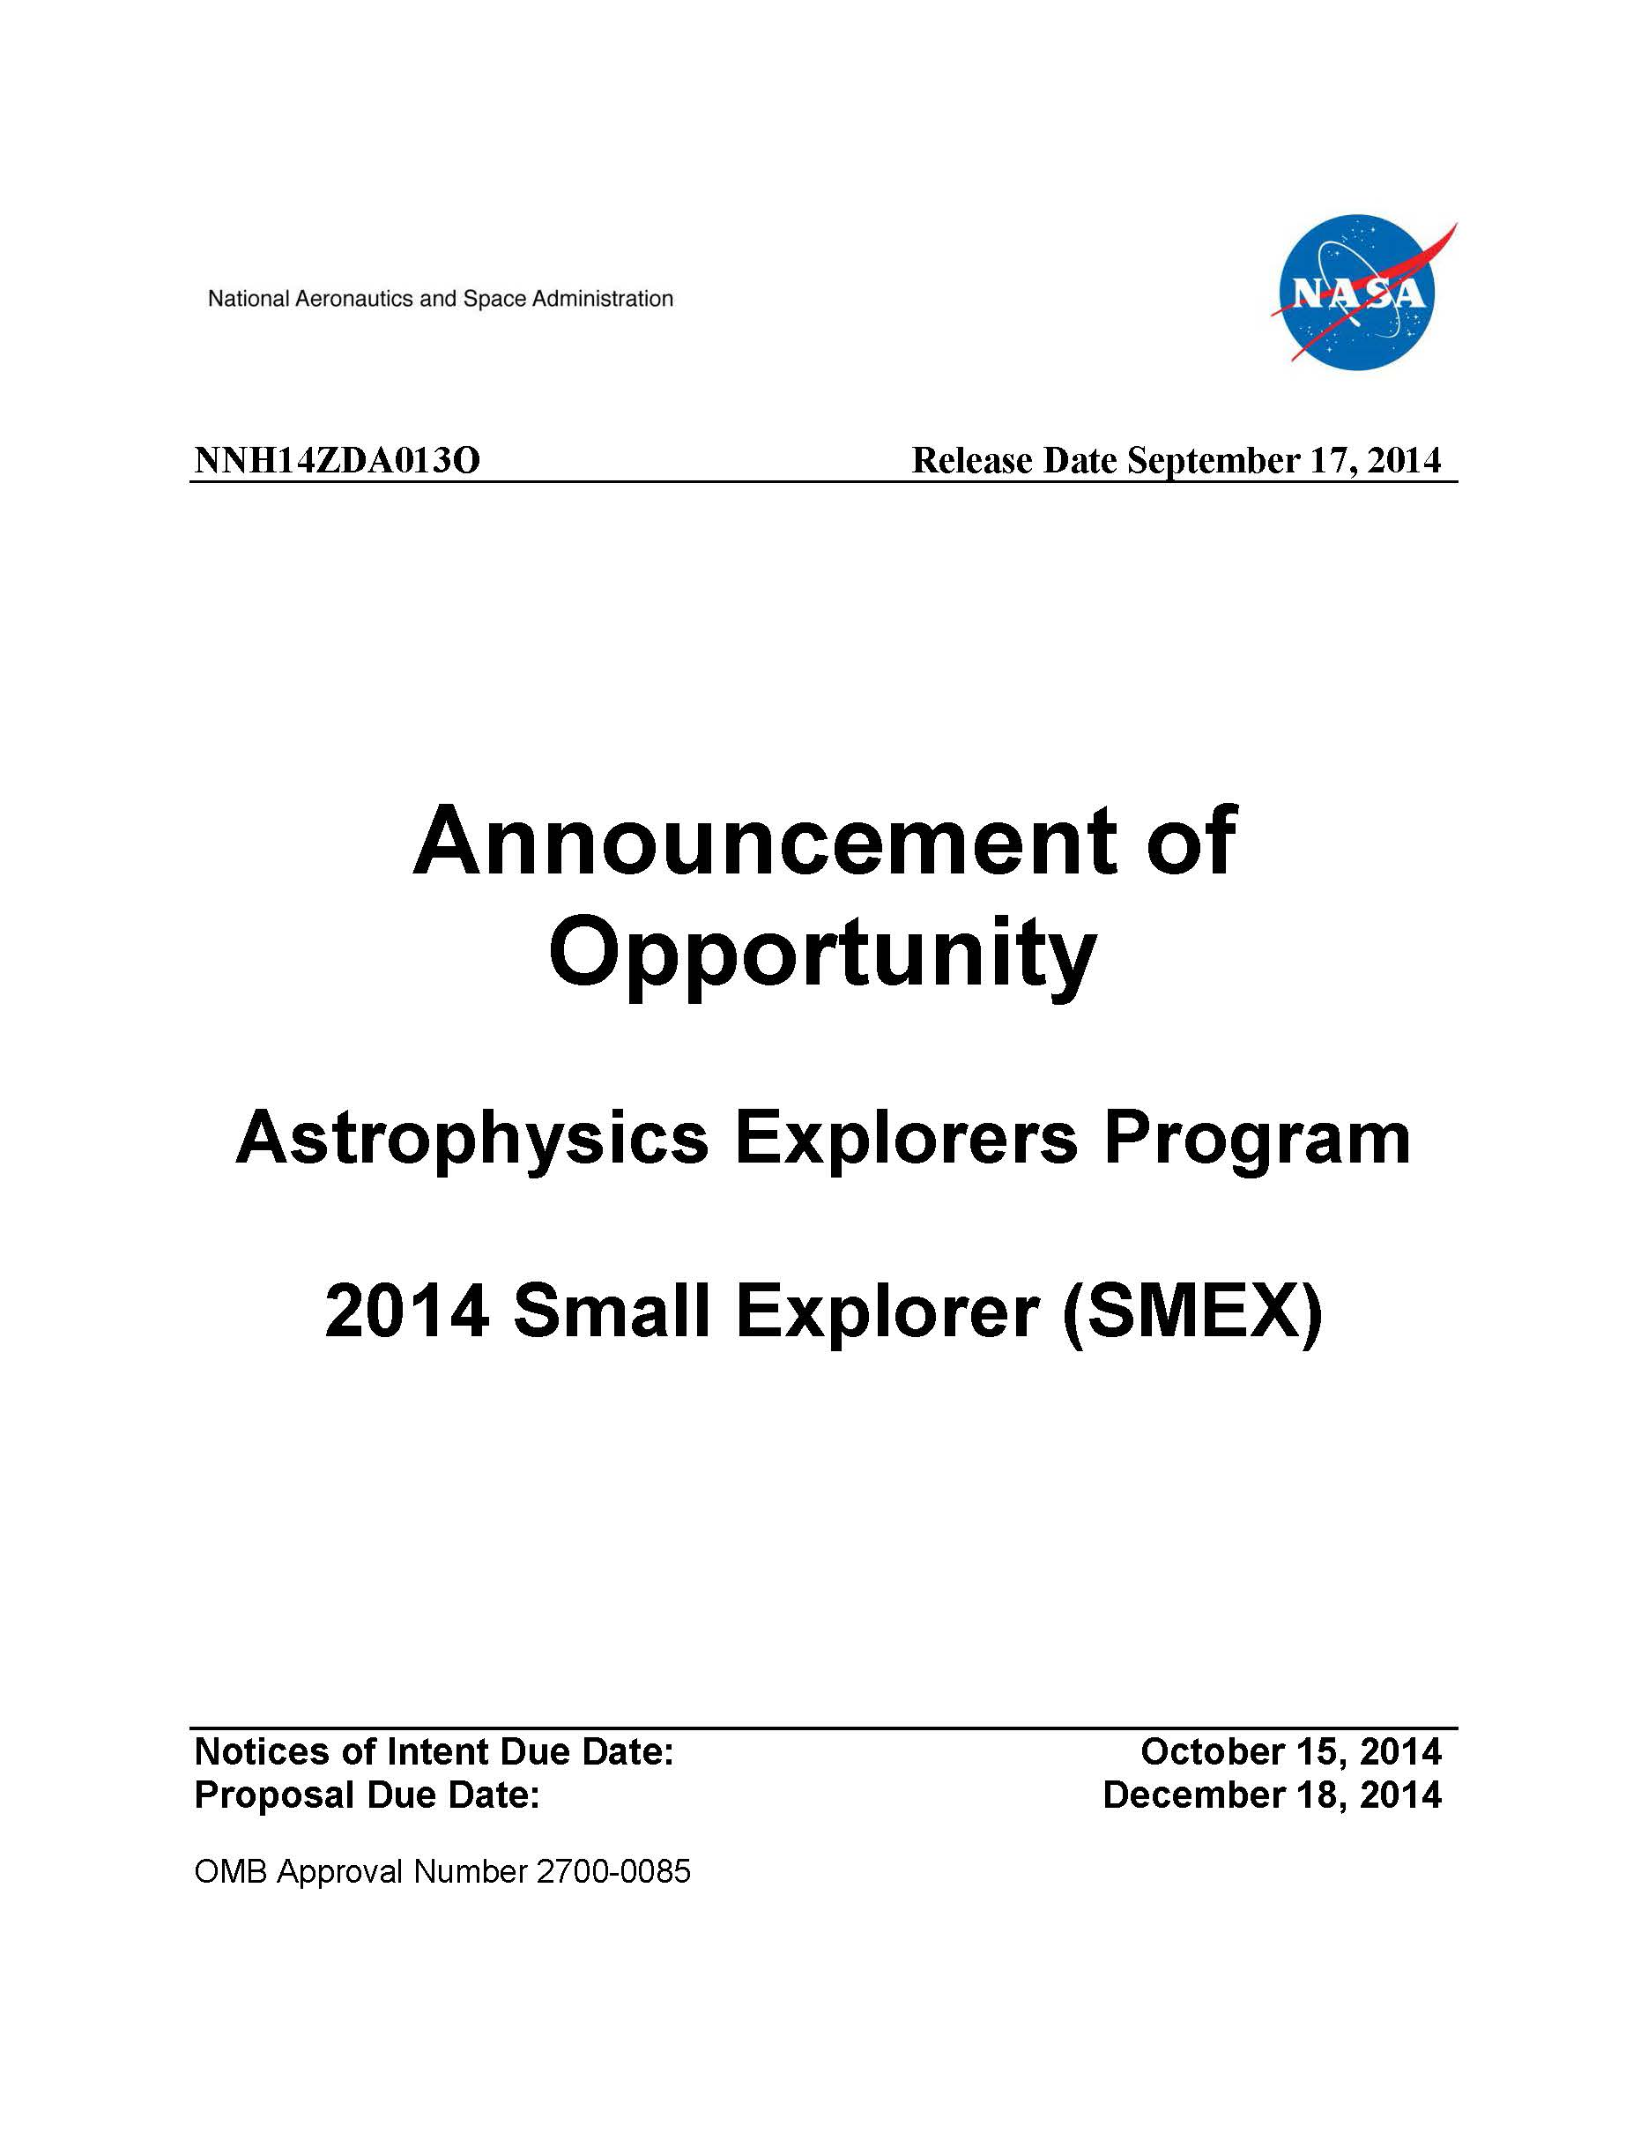
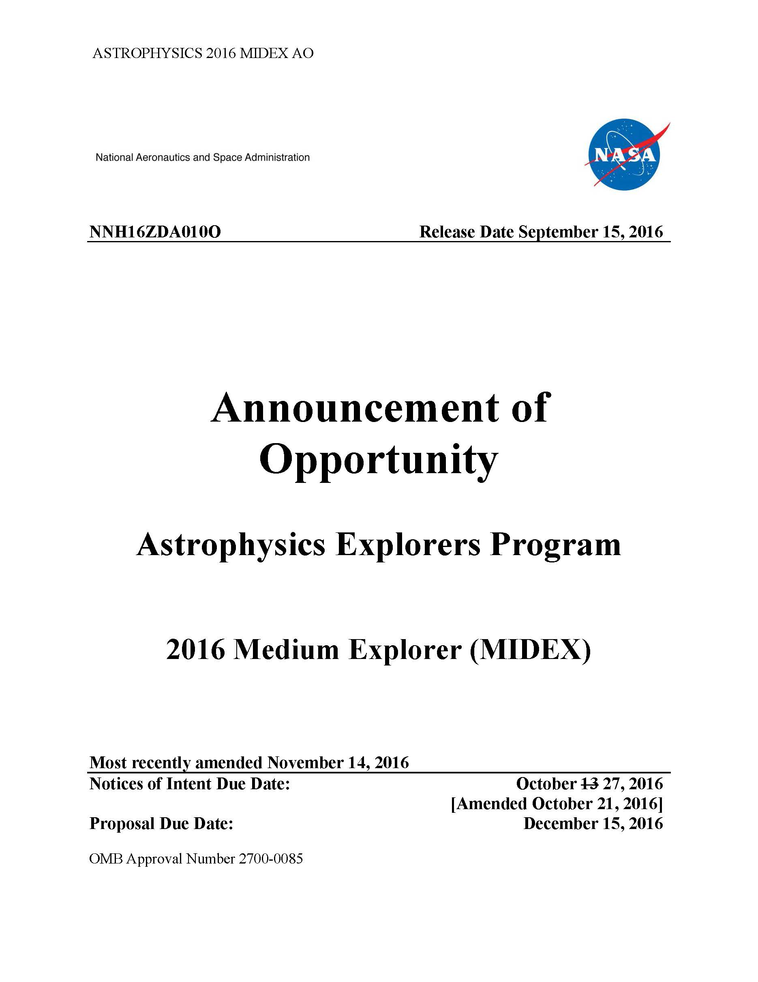
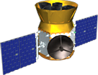
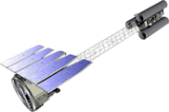
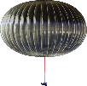
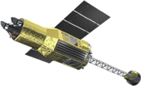
Astrophysics Explorers Program
Swift
NuSTAR
NICER
2019
MIDEX
2011
SMEX
2014
MIDEX
2016
SMEX
2019
(planned)
Small and
Mid-Size
Missions
Arcus
FINESSE
SPHEREx
CASE
COSI-X
ISS-TAO
TESS
IXPE
Missions of
Opportunity
NICER
GUSTO
XARM

Slide 24
Decadal Studies Status

Slide 25
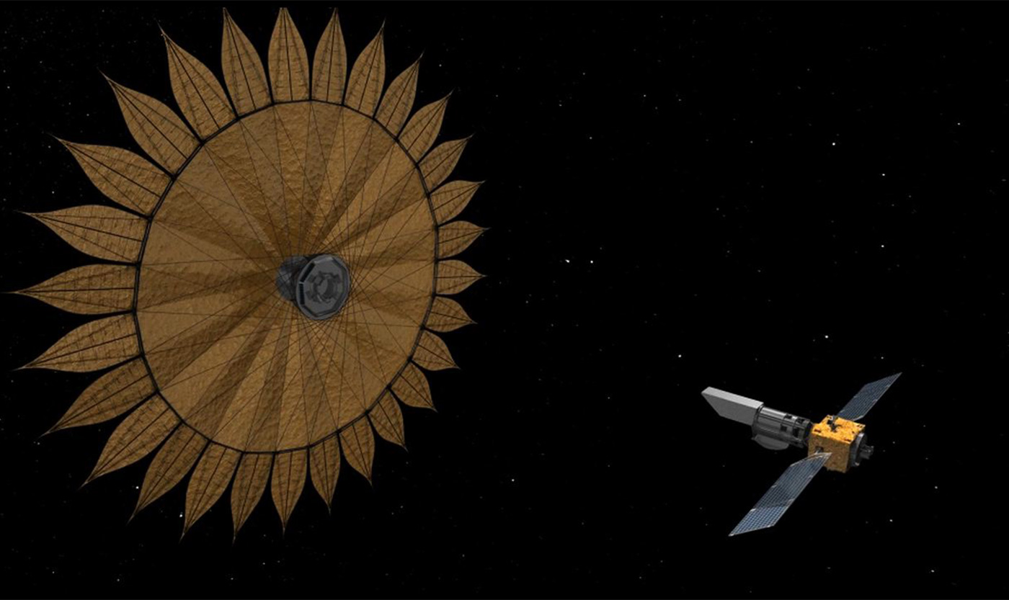
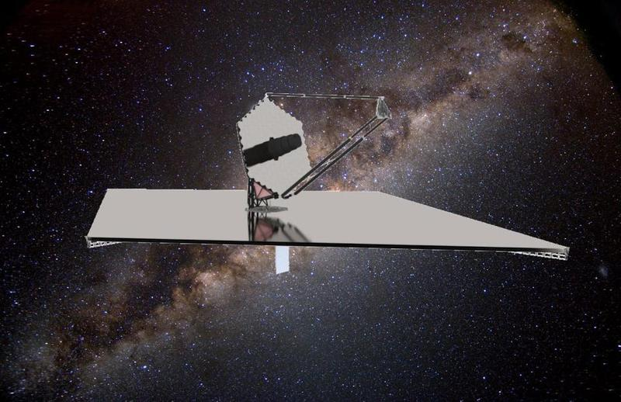
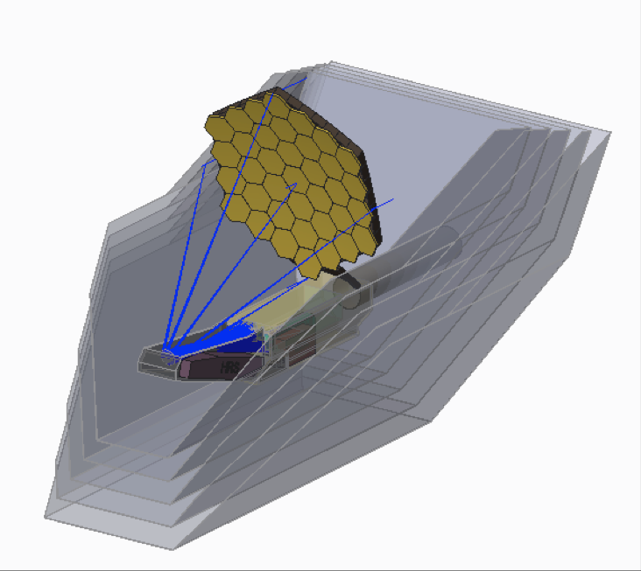
Preparing for the 2020 Decadal Survey
Large Mission Concept Studies
Medium (Probe) Concept Studies
Cosmic Dawn Intensity Mapper (A. Cooray)
Cosmic Evolution through UV Spectroscopy Probe (W. Danchi)
Galaxy Evolution Probe (J. Glenn)
High Spatial Resolution X-ray Probe (R. Mushotzky)
Inflation Probe (S. Hanany)
Multi-Messenger Astrophysics Probe (A. Olinto)
Precise Radial Velocity Observatory (P. Plavchan)
Starshade Rendezvous Mission (S. Seager)
Transient Astrophysics Probe (J. Camp)
X-ray Timing and Spectroscopy Probe (P. Ray)
HabEx
LUVOIR
Lynx
OST
https://science.nasa.gov/astrophysics/2020-decadal-survey-planning

Slide 26
Preparing for the 2020 Decadal Survey Large Mission Concepts Interim study reports are due Mar 2018 Pause & Learn planned for May 2018
 | Community STDT Chairs | AAS Sessions
Habitable Exoplanet Imaging Mission www.jpl.nasa.gov/habex | Scott Gaudi Sara Seager | Tue @ 6:30 pm in Maryland 1-2
Large UV/Optical/IR Surveyor asd.gsfc.nasa.gov/luvoir | Debra Fischer Bradley Peterson | Tue @ 2:00 pm in Chesapeake I Wed @ 2:00 pm in Chesapeake 7-8
Lynx X-ray Surveyor wwwastro.msfc.nasa.gov/lynx | Feryal Ozel Alexey Vikhlinin
Origins Space Telescope asd.gsfc.nasa.gov/firs | Asantha Cooray Margaret Meixner | Wed @ 1:30 pm in Chesapeake H
Special Session on NASA Mission Concept Studies:
Large Scale Studies, Tue @ 10:00 am
Probes mission concept studies, Tue @ 2:00 pm
http://science.nasa.gov/astrophysics/2020-decadal-survey-planning/

Slide 27
Preparing for the 2020 Decadal Survey Technology Development
HabEx
12 of 12 gaps being addressed
mirror coatings, starshade starlight suppression, starshade controlling scattered sunlight, starshade lateral formation sensing, starshade petal position accuracy, starshade petal shape and stability, telescope vibration control, deformable mirrors, visible detectors, large aperture primary mirror, wavefront sensing and control, coronagraph optics and architecture
LUVOIR
7 of 9 gaps being addressed
closed-loop segment phasing, vibration isolation, wavefront sensing and control, mirror segments, high-contrast segmented-aperture coronagraphy, deformable mirrors, near infrared detectors, visible detectors, mirror coatings
Lynx X-ray Surveyor
4 of 5 gaps being addressed
high-resolution lightweight X-ray optics, non-deforming X-ray reflecting coatings, megapixel X-ray imaging detectors, large-format, high resolution ion X-ray detectors, X-ray grating arrays
Origins Space Telescope
2 of 5 gaps being addressed
far-infrared (FIR) detectors, cryogenic readouts for large-format FIR detectors, warm readout electronics for large-format FIR detectors, sub-Kelvin Coolers, cryogenic FIR mirror segments
Red: technologies being advanced through SAT or directed development,
Bold: technologies being advanced by WFIRST or ATHENA
Italics: technologies being worked on through the STDT’s design studies
Additional gaps being addressed through APRA but not tallied here

Slide 28
Segmented Mirror Telescope Technology
NASA is committed to advance and mature key mirror technologies for future large telescopes that could be recommended in the upcoming decade.
Genesis: RFI issued on February 6, 2017 (NNG17FB01RFI), multiple responses received; informed planning.
Phase 1: ROSES NRA (D.15) issued on December 1, 2017; $2.5M available in FY18 to fund one or more 1-year system-level segmented telescope design studies; proposals due February 1, 2018.
NASA is soliciting industry proposals to carry out system-level engineering design and modeling studies of large segmented-aperture telescopes, with integrated coronagraphs, that will lead to the identification of priority technology investments.
For astronomy at ultraviolet, visible, and near-infrared wavelengths a key technology priority sub-nanometer wavefront stability.
For astronomy at mid- and far-infrared wavelengths, a key technology priority is to dramatically reduce mirror manufacturing and verification costs.
Phase 2: RFP for 2-years soliciting testbed and laboratory demonstrations of key technologies; $10M for FY19 and FY20 (planned).
Phase 3: Post-Decadal, RFP for 3-years soliciting maturing key technologies; $15M for FY21-23 (tentative, depends on Decadal Survey priorities).

Slide 29
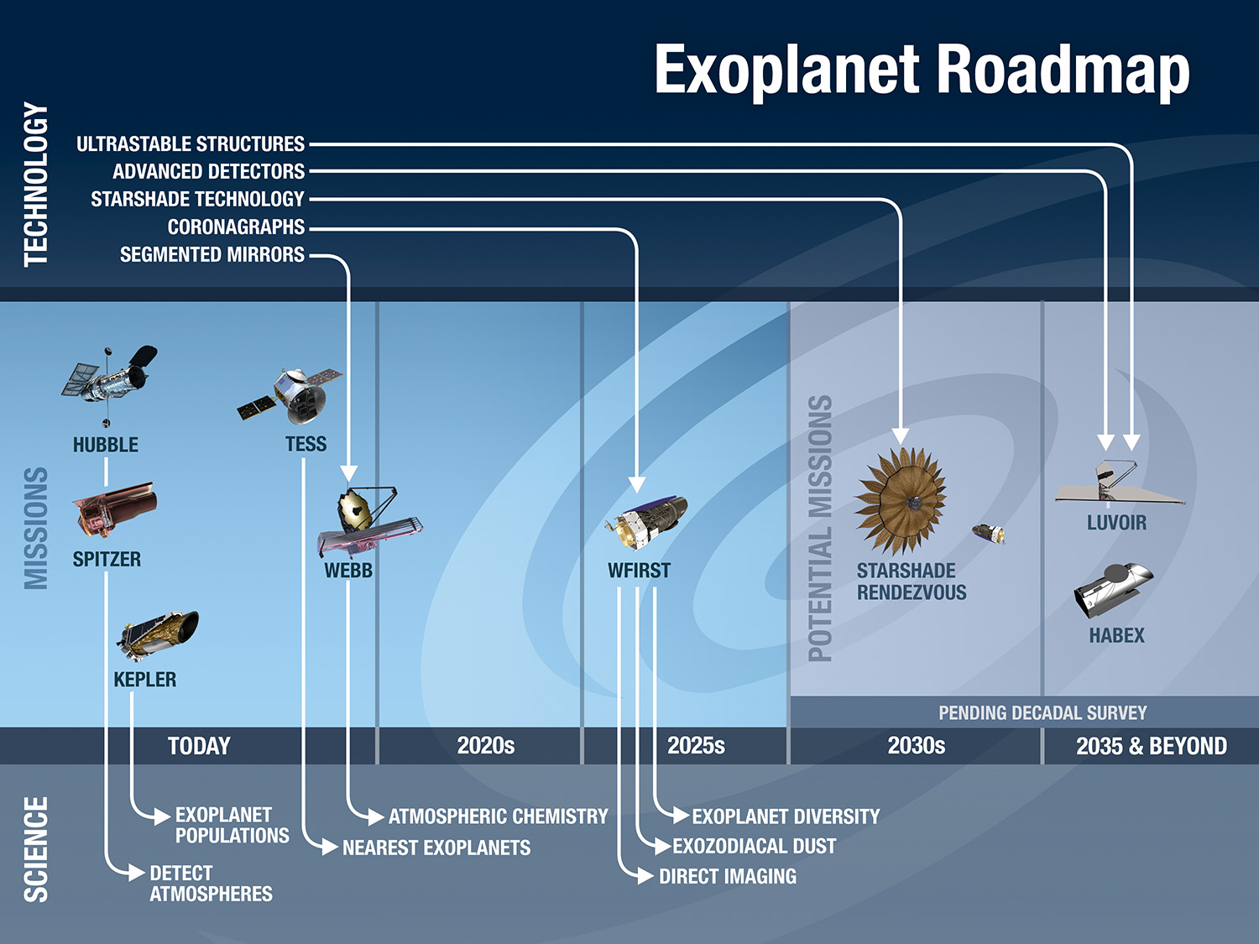

Slide 30
Backup Slides

Slide 31
Charter for the Large Mission Concept Studies Report Team
One of the milestones of the four studies is the delivery of an Interim Report (deliverable M4) by March 2018. The Management Plan lists the Interim Report Deliverable scope as
Provide science case and mission concept, using Concept Maturity Level 3 as a guide
Deliver initial technology roadmaps; estimate technology development cost/schedule
Provide the tailored approach to Concept Maturity Level 4 that will be the basis of the final report.
The Interim Reports will be reviewed by the Large-Studies Report Team (LRT). This Charter addresses the tasks of the LRT.
A. Completeness with respect to M4 Deliverable Scope per the Management Plan for Large Mission Concept Studies – (https://science.nasa.gov/astrophysics/2020-decadal-survey- planning)
B. Whether the STDTs are on the right track for delivering the final report. In particular:
Are the science requirements described in the Interim Reports flowing effectively and efficiently into mission requirements?
Are the mission requirements clearly stated?
(If submitted) Is the plan for the technology maturation (to TRL 6) sufficiently articulated? Are the presented schedules and milestones realistic?
(If submitted) Are the cost and risk adequately addressed? Are they realistic?
The LRT shall NOT provide an assessment of the science goals and their merit. This is the job of the Decadal Survey Committee.
The LRT shall
Participate in a kickoff meeting in February 2018
Deliver independent written reports for each of the four studies, addressing the above questions, and any other comments and concerns, to HQ. The report shall be delivered by May 21, 2018. The report is a document no longer than 15 pages
Deliver a telecon outbrief to each large mission STDT
Participate a two-day Pause and Learn discussion with the Decadal Studies Management Team and the leadership from each large mission STDT.
The LRT will be disbanded after the delivery of the written reports or as needed by NASA.

Slide 32
National Academies of Sciences, Engineering and Medicine - Space Studies Board
Astrobiology Science Strategy for the Search for Life in the Universe (http://sites.nationalacademies.org/SSB/CurrentProjects/SSB_180812)
Next meeting: January 16-18, 2018 Irvine, CA
In preparation for and as an input to the upcoming decadal surveys in astronomy and astrophysics and planetary science, the National Academies of Sciences, Engineering, and Medicine will appoint an ad hoc committee to carry out a study of the state of the science of astrobiology as it relates to the search for life in the solar system and extrasolar planetary systems.
Science Strategy for the Exploration of Extrasolar Planets
Next meeting: ?
Sec. 508 of the NASA Transition Authorization Act (2017) requires NASA to contract with the National Academies to develop a science strategy for the study and exploration of extrasolar planets; this strategy is due 18 months after enactment (~September 2018)
Best Practices for a Future Open Code Policy for NASA Space Science
(http://sites.nationalacademies.org/SSB/CurrentProjects/SSB_178892)
Next meeting: January 17-19, 2018 Washington, DC
The National Academies of Sciences, Engineering, and Medicine will establish an ad hoc committee to investigate and recommend best practices for NASA as it considers whether to establish an open code and open models policy, complementary to its current open data policy.
Notes:
NASA Transition Authorization Act (2017)

Slide 33

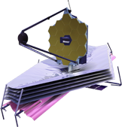
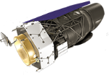


Spitzer
8/25/2003
Kepler
3/7/2009
Formulation
+ MIDEX/MO (2023), SMEX/MO (2025), etc.
Implementation
Primary Ops
Extended Ops
Webb
2019
WFIRST
Mid 2020s
Euclid (ESA)
2020
XMM-Newton (ESA)
12/10/1999
TESS
2018
Chandra
7/23/1999
NuSTAR
6/13/2012
Fermi
6/11/2008
IXPE
2021
Swift
11/20/2004
Hubble
4/24/1990
XARM (JAXA)
2021
ISS-NICER
6/3/2017
ISS-CREAM
8/14/2017
GUSTO
2021
SOFIA
Full Ops 5/2014
+ Athena (late 2020s), LISA (mid 2030s)
Revised
December 1, 2017
Notes:
2017-09-25 - Added XARM
2017-08-16 - Updated ISS-CREAM color and launch date.

