Slide 1
Interactive PowerPoint Slides to be Used in Public Engagement
National Aeronautics and Space Administration
A set of slides designed to help teachers and Subject Matter Experts explain complex topics in a fun way.

Slide 2
Author:
Yasuhiro Hasegawa, Jet Propulsion Laboratory, California Institute of Technology
Acknowledgement:
This work was carried out at the Jet Propulsion Laboratory, California Institute of Technology, under a contract with the National Aeronautics and Space Administration,
through funding from the NASA Exoplanet Exploration Program
All artwork made at JPL-Caltech.

Slide 3
INSTRUCTIONS:
These files have built-in interactive elements. To view them, PowerPoint must be in "Slide Show" mode; you can then move to the next slide or interactive event either by clicking your mouse, the spacebar, or the arrow keys.
These slides will not work in "regular viewing mode.”

Slide 4
List of slides
Comparison of Exoplanets’ Locations
Comparison of Exoplanets’ Locations (Kelvin)
Comparison of Host Stars
Comparison of Host Stars (Kelvin)
Comparison of Metal Phases on Exoplanets – Quiz
Comparison of Planet Sizes – Exoplanets
Comparison of Planet Sizes - Solar Systems
Comparison of Space Telescopes
Comparison of TRAPPIST-1 – with Inner Solar System
Habitable Zones Compared to the Size of the Hosting Star - with different types of stars
Habitable Zones Compared to the Size of the Hosting Star
Planet Formation
Planets vs Stars - Brightness, Size, and Weight (Mass)
Spectroscopy - Detection of Bio Signatures
Speed Comparison – Jet Airliner vs. Small Astronomical Bodies

Slide 5
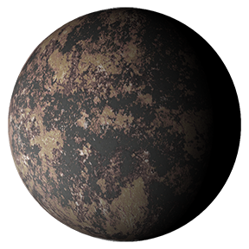
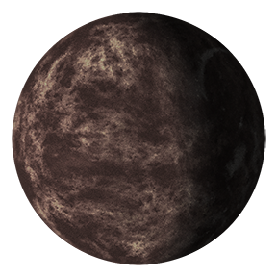
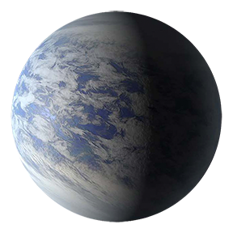
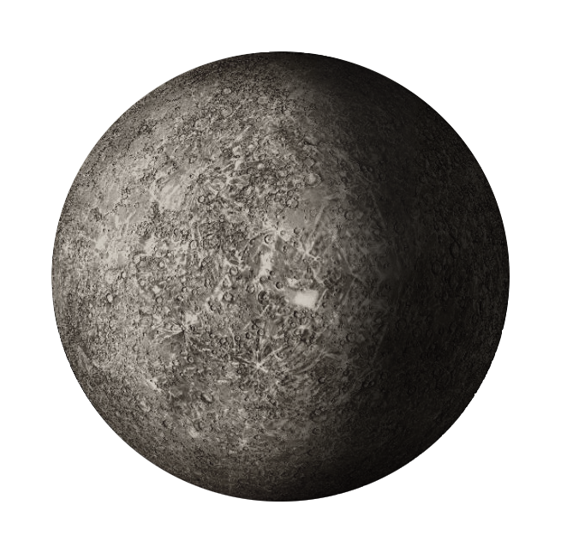
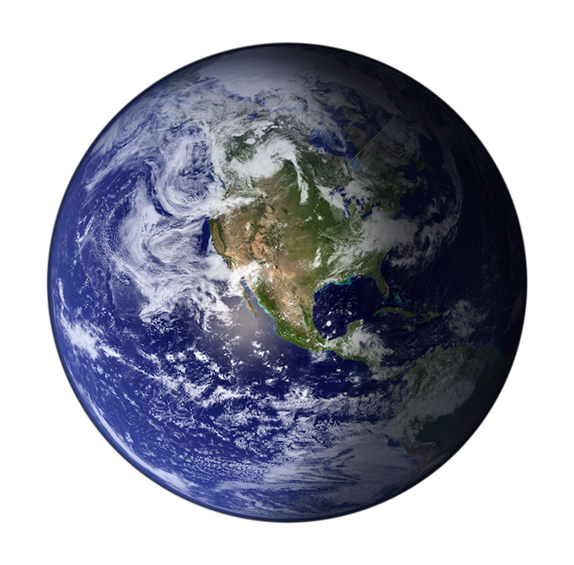
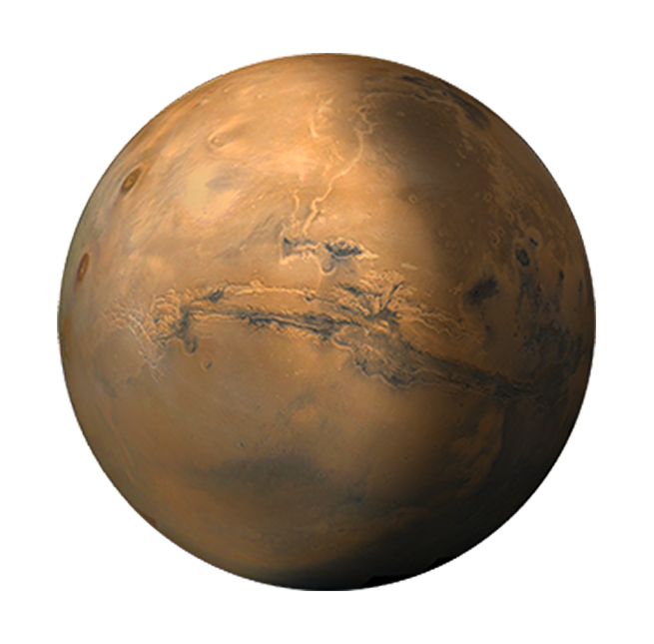
Comparison of Exoplanets’ Locations – with Solar System Planets
Exoplanet Communications
Temperature Exo System
Distance (from star)
2240° F
(1227° C)
980° F
(527° C)
80° F
(27° C)
0.1
0.2
0.3
0.4
0.5
0.6
0.7
0.8
0.9
1
1.1
1.2
1.3
1.4
1.5
1.6
Astronomical Units
Temperature Solar System
Distance (from Sun)
800°/-290° F
(427°/-180° C)
62° F
(17° C)
-82° F
(-63° C)
0.1
0.2
0.3
0.4
0.5
0.6
0.7
0.8
0.9
1
1.1
1.2
1.3
1.4
1.5
1.6
Astronomical Units
Notes:
This slide shows how far the planets are from their respective stars and how that influences how hot they are. The first view shows the temperatures of planets in the solar system compared to those in an exo system; the second view puts the planets in the proper distance from the star, illustrating why some are much hotter than others.
NOTE: This PowerPoint file has built-in interactive elements. To view them, you must be in "Slide Show" mode; you can then move to the next view either by clicking your mouse, the spacebar, or the arrow keys. This slide will not work in "regular viewing mode."
Credit
NASA/JPL-Caltech
The additional info:
Top: exoplanetary systems around the Sun
the temperature of the inner one is >1500K (0.04 au),
the middle one is 800K (0.13 au)
the outer one is 300K (1 au)
bottom: solar system
Mercury: 340K
Earth: 290K
Jupiter: 170K

Slide 6
Comparison of Exoplanets’ Locations – with Solar System Planets
Exoplanet Communications
Temperature (Degrees Kelvin)
Distance (from star)
|
1500° K
|
800° K
|
300° K
0.1
0.2
0.3
0.4
0.5
0.6
0.7
0.8
0.9
1
1.1
1.2
1.3
1.4
1.5
1.6
Astronomical Units
Temperature (Degrees Kelvin)
Distance (from Sun)
|
340° K
|
290° K
|
210° K
0.1
0.2
0.3
0.4
0.5
0.6
0.7
0.8
0.9
1
1.1
1.2
1.3
1.4
1.5
1.6
Astronomical Units
Notes:
Audience: 5th grade and older (introduces Kelvin)
This slide shows the difference in temperature between planets orbiting an M Dwarf star and our Sun. The second view shows their relative distance from their star.
Key point: Exoplanets orbit in the vicinity of the host star, so they are generally much hotter than planets in the solar system.
NOTE: This PowerPoint file has built-in interactive elements. To view them, you must be in "Slide Show" mode; you can then move to the next view either by clicking your mouse, the spacebar, or the arrow keys. This slide will not work in "regular viewing mode."
Credit
NASA/JPL-Caltech
The additional info:
Top: exoplanetary systems around the Sun
the temperature of the inner one is >1500K (0.04 au),
the middle one is 800K (0.13 au)
the outer one is 300K (1 au)
bottom: solar system
Mercury: 340K
Earth: 290K
Jupiter: 170K

Slide 7
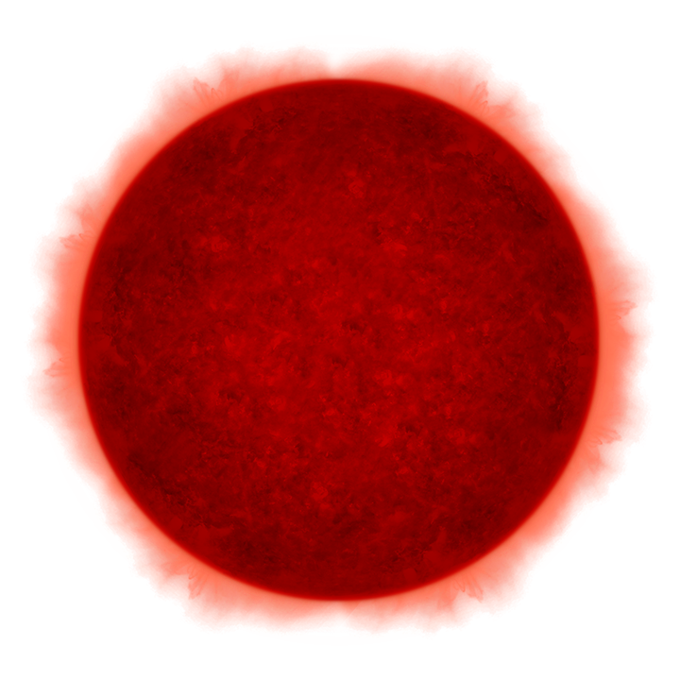
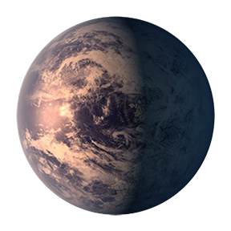
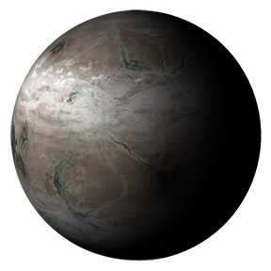
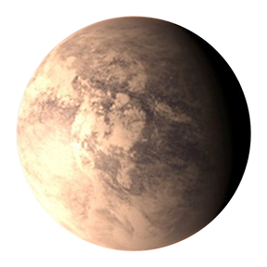
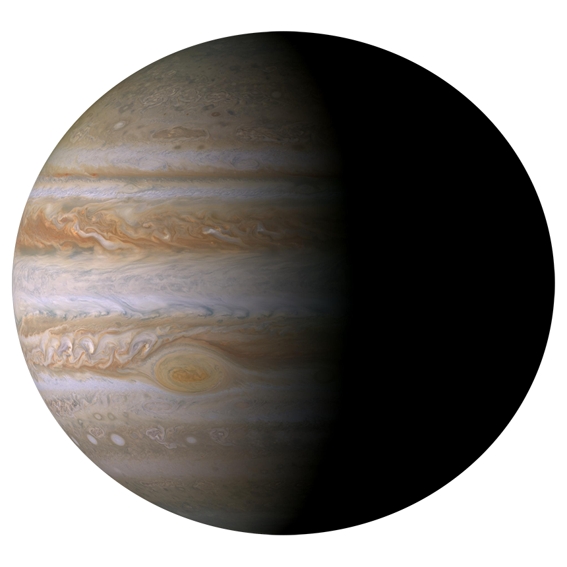
Comparison of Host stars – with Solar System Planets
Exoplanet Communications
Distance (from star)
Temperature Around M Dwarf
800°/-290° F
(427°/-180° C)
62° F
(17° C)
-82° F
(-63° C)
-154° F
(-103° C)
0.1
0.2
0.3
0.4
0.5
0.6
0.7
0.8
0.9
1
1.1
1.2
1.3
1.4
1.5
1.6
Astronomical Units
Distance (from Sun)
Temperature Around Sun
800°/-290° F
(427°/-180° C)
62° F
(17° C)
-82° F
(-63° C)
-154° F
(-103° C)
0.1
0.2
0.3
0.4
0.5
0.6
0.7
0.8
0.9
1
1.1
1.2
1.3
1.4
1.5
1.6
Astronomical Units
Jupiter
Notes:
Audience: 3rd grade and older
This slide shows the difference in temperature between planets orbiting an M Dwarf star and our Sun. The second view shows their relative distance from their star.
Key point: Exoplanets orbit in the vicinity of the host star, so they are generally much hotter than planets in the solar system.
NOTE: This PowerPoint file has built-in interactive elements. To view them, you must be in "Slide Show" mode; you can then move to the next view either by clicking your mouse, the spacebar, or the arrow keys. This slide will not work in "regular viewing mode."
Credit
NASA/JPL-Caltech
The additional info:
Top: exoplanets around M dwarfs
exoplanetary systems
the temperature of 340K is 0.05 au,
the temperature of 290K is 0.07 au
the temperature of 210K is 0.13 au
the temperature of 170K is 0.2 au
Bottom: solar system
Mercury: 340K (0.39 au)
Earth: 290K (1 au)
Mars: 210 K (1.5 au)
Jupiter: 170K (5 au)

Slide 8
Comparison of Exoplanets’ Locations – with Solar System Planets
Exoplanet Communications
Temperature (Degrees Kelvin)
Distance (from star)
|
1500° K
|
800° K
|
300° K
0.1
0.2
0.3
0.4
0.5
0.6
0.7
0.8
0.9
1
1.1
1.2
1.3
1.4
1.5
1.6
Astronomical Units
Temperature (Degrees Kelvin)
Distance (from Sun)
|
340° K
|
290° K
|
210° K
0.1
0.2
0.3
0.4
0.5
0.6
0.7
0.8
0.9
1
1.1
1.2
1.3
1.4
1.5
1.6
Astronomical Units
Notes:
Audience: 5th grade and older (introduces Kelvin)
This slide shows the difference in temperature between planets orbiting an M Dwarf star and our Sun. The second view shows their relative distance from their star.
Key point: Exoplanets orbit in the vicinity of the host star, so they are generally much hotter than planets in the solar system.
NOTE: This PowerPoint file has built-in interactive elements. To view them, you must be in "Slide Show" mode; you can then move to the next view either by clicking your mouse, the spacebar, or the arrow keys. This slide will not work in "regular viewing mode."
Credit
NASA/JPL-Caltech
The additional info:
Top: exoplanets around M dwarfs
exoplanetary systems
the temperature of 340K is 0.05 au,
the temperature of 290K is 0.07 au
the temperature of 210K is 0.13 au
the temperature of 170K is 0.2 au
Bottom: solar system
Mercury: 340K (0.39 au)
Earth: 290K (1 au)
Mars: 210 K (1.5 au)
Jupiter: 170K (5 au)

Slide 9
Comparison of Metal Phases on Exoplanets – Quiz
Exoplanet Communications
Temperature
2240° F
(1227° C)
980° F
(527° C)
80° F
(27° C)
Titanium
Gold
Lead
Mercury
Notes:
Audience: 5th grade and older
This slide is designed to interact with the audience: three planets are shown with their average temperatures (in F and C); the second view shows which metal would melt at those temperatures. Key message: Observed exoplanets are very hot, so much so that many common metals would melt.
NOTE: This PowerPoint file has built-in interactive elements. To view them, you must be in "Slide Show" mode; you can then move to the next view either by clicking your mouse, the spacebar, or the arrow keys. This slide will not work in "regular viewing mode.”
Credit
NASA/JPL-Caltech
The additional info:
Top: exoplanetary systems
the temperature of the inner one is >1500K,
Titanium, Tungsten are solid
gold, copper, and silver melt
the middle one is 800K
Aluminum is solid
Lead and Zinc melt
the outer one is 300K
mercury melts

Slide 10
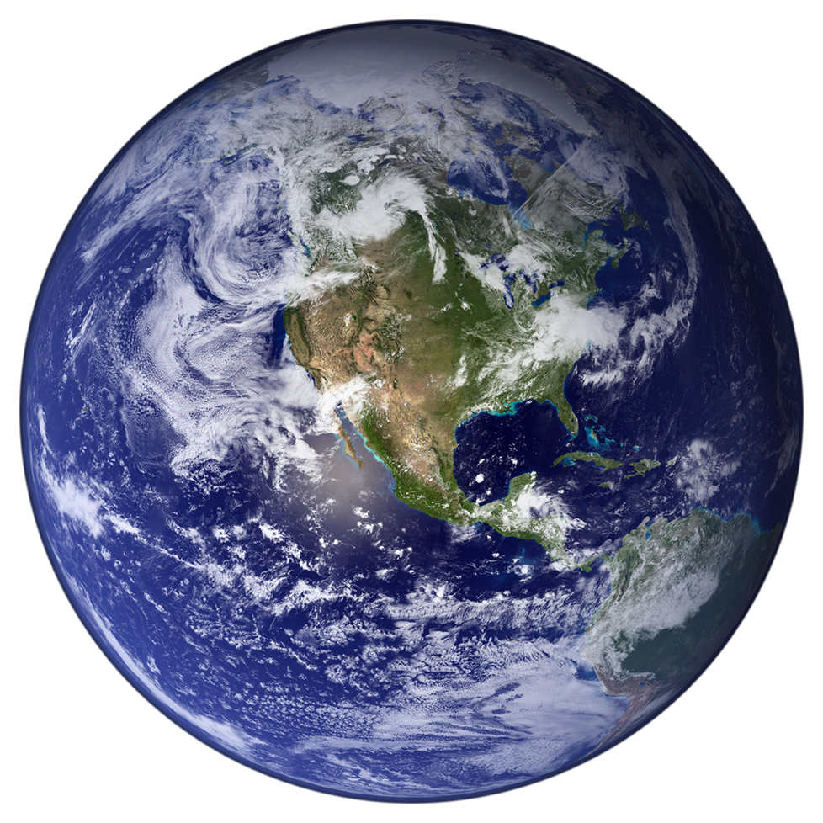
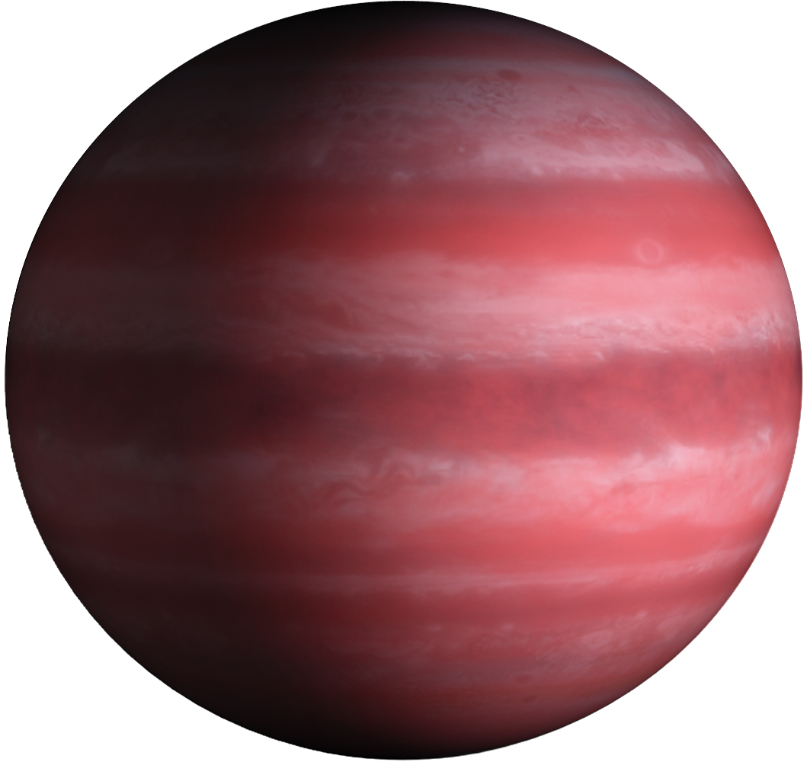
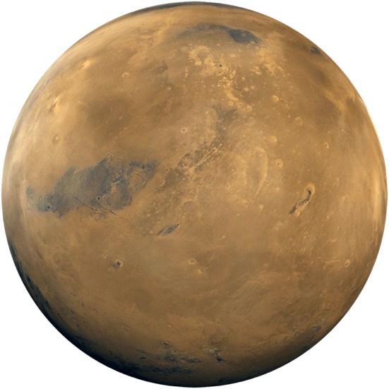
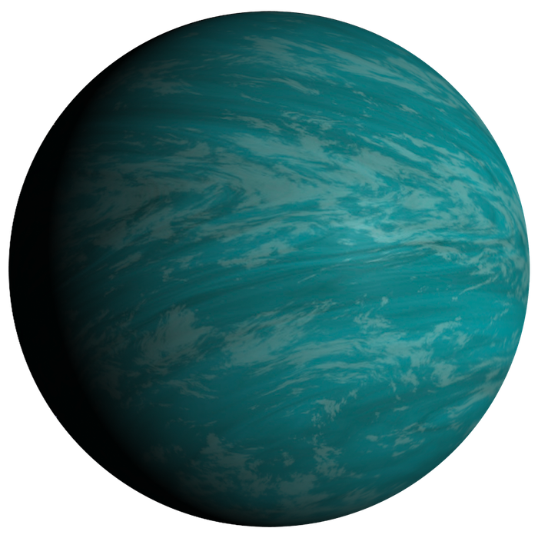
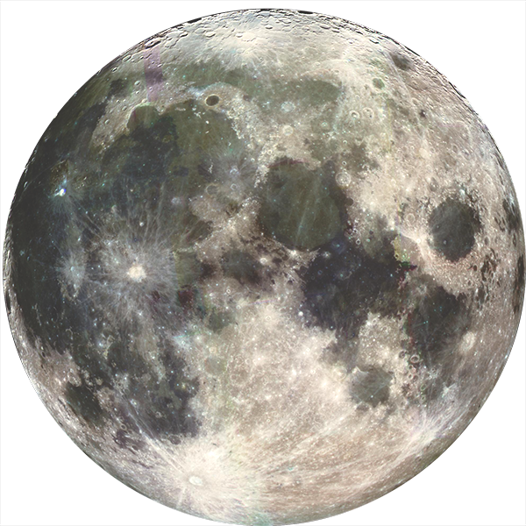
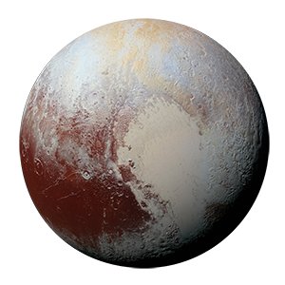
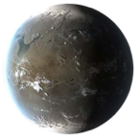
Comparison of Planet Sizes – Exoplanets
Exoplanet Communications
Earth
Mars
Moon
Pluto
Ceres
Earth
Mars
Moon
Pluto
Ceres
Gas Giant
Neptunian
Super-Earth
exoplanets.nasa.gov
Notes:
Audience: 3rd grade and older
This slide compares the difference in size between planets in our solar system and with three kinds of exoplanets: Super Earth, Neptunian and Gas Giants.
A "Super Earth" is a type of planet observed in exo systems that is intriguing scientists because there is nothing similar to it in our solar system.
NOTE: This PowerPoint file has built-in interactive elements. To view them, you must be in "Slide Show" mode; you can then move to the next view either by clicking your mouse, the spacebar, or the arrow keys. This slide will not work in "regular viewing mode."
Credit
NASA/JPL-Caltech
The additional info:
Ceres (as a large planetesimal): R=470 km, density= 2 g/cm^3
Pluto (as a protoplanet):R=1.2 mega m, density = 1.9 g/cm^3
Mars (as a protoplanet):R=3.4 mega m, density = 3.9 g/cm^3 Earth (as a planet):R=6.4 mega m, density = 5.5 g/cm^3
SuperEarth (use image for size): R ~ 10 mega m
Neptune (possibly a superEarth?): R=25 mega m, density = 1.6 g/cm^3
Jupiter: R=70 mega m, density = 1.3 g/cm^3
https://exoplanets.nasa.gov/what-is-an-exoplanet/planet-types/super-earth/

Slide 11
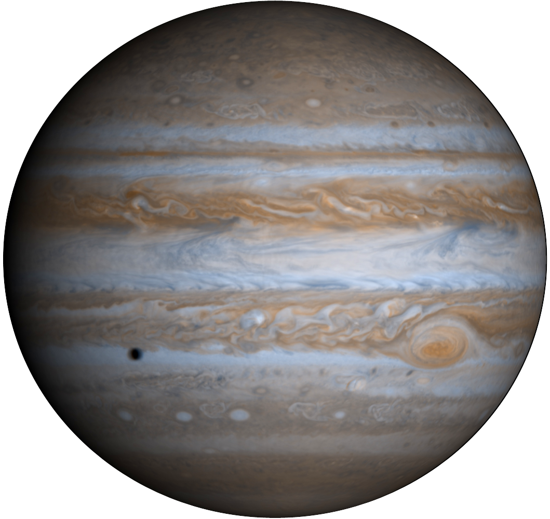
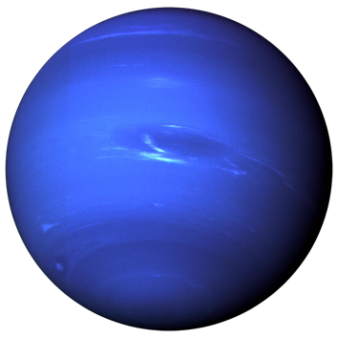
Comparison of Planet Sizes – Solar System
Exoplanet Communications
Earth
Mars
Moon
Pluto
Ceres
Earth
Mars
Moon
Pluto
Ceres
Jupiter
Neptune
Super-Earth
exoplanets.nasa.gov
Notes:
Audience: 3rd grade and older
This slide shows how dramatically different the planets in our solar system are in size. Some of the smallest bodies in our solar system are shown in the first view, from Ceres to Earth; in the second view, Earth is next to Jupiter and other larger planets.
Also shown is the size of a "super-Earth" - a type of planet observed in exoplanetary systems that is intriguing scientists because there is no such thing in our solar system.
NOTE: This PowerPoint file has built-in interactive elements. To view them, you must be in "Slide Show" mode; you can then move to the next view either by clicking your mouse, the spacebar, or the arrow keys. This slide will not work in "regular viewing mode."
Credit
NASA/JPL-Caltech
The additional info:
Ceres (as a large planetesimal): R=470 km, density= 2 g/cm^3
Pluto (as a protoplanet):R=1.2 mega m, density = 1.9 g/cm^3
Mars (as a protoplanet):R=3.4 mega m, density = 3.9 g/cm^3 Earth (as a planet):R=6.4 mega m, density = 5.5 g/cm^3
SuperEarth (use image for size): R ~ 10 mega m
Neptune (possibly a superEarth?): R=25 mega m, density = 1.6 g/cm^3
Jupiter: R=70 mega m, density = 1.3 g/cm^3
https://exoplanets.nasa.gov/what-is-an-exoplanet/planet-types/super-earth/

Slide 12
Comparison of Space Telescopes
Exoplanet Communications
Hubble Space Telescope
Operation Period: 1990-now
Mirror Size: 2.4m
Weight: 12,200 kg
Kepler/K2
Operation Period: 2009-2018
Mirror Size: 1.4m
Weight: 1052.4 kg
James Webb Space Telescope
Operation Period: 2021 (planned)
Mirror Size: 6.5m
Weight: 6500 kg
TESS
Operation Period: 2018-now
Mirror Size: 10.5 cm
Weight: 362 kg
jpl.nasa.gov
Notes:
Audience: 3rd grade and older
This slide introduces four major space telescopes that are contributing to our study of exoplanets: Hubble, Kepler/K2, Tess, and James Webb.
NOTE: This PowerPoint file has built-in interactive elements. To view them, you must be in "Slide Show" mode; you can then move to the next view either by clicking your mouse, the spacebar, or the arrow keys. This slide will not work in "regular viewing mode."
Credit
NASA/JPL-Caltech

Slide 13
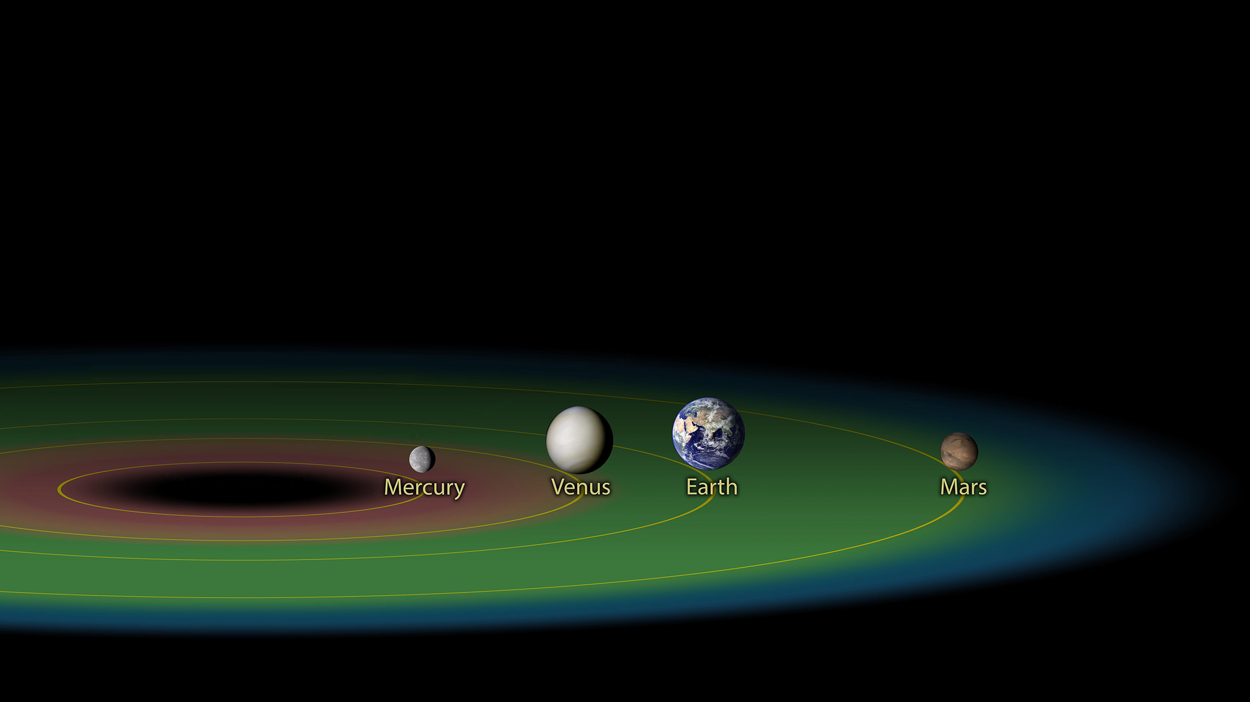
Comparison of TRAPPIST-1 – with Inner Solar System
Exoplanet Communications
TRAPPIST-1 System
Inner Solar System
Notes:
Audience: 3rd grade and older
The first view shows the TRAPPIST-1 system and the Solar System; in the second view, the size of the two systems is compared, revealing that the TRAPPIST-1 system is much more compact.
Key message: "Some exoplanets are in the so-called habitable zone."
NOTE: This PowerPoint file has built-in interactive elements. To view them, you must be in "Slide Show" mode; you can then move to the next view either by clicking your mouse, the spacebar, or the arrow keys. This slide will not work in "regular viewing mode."
Credit
NASA/JPL-Caltech
The additional info:
Adapted from existing image.
– Cutout TRAPPIST-1 section and created left hand section of orbits (not in original image).

Slide 14
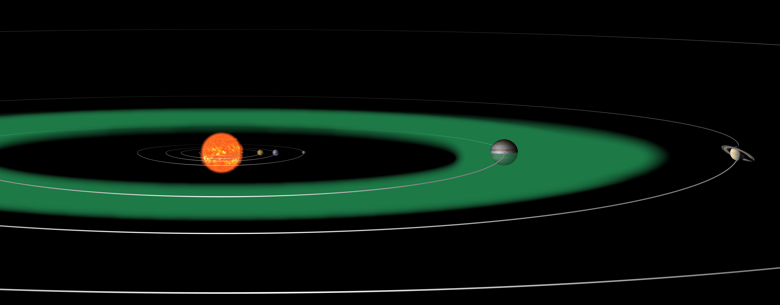
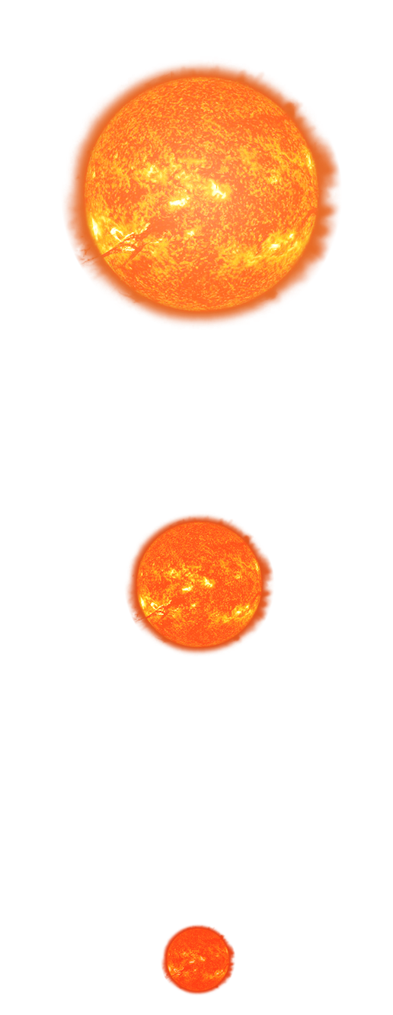
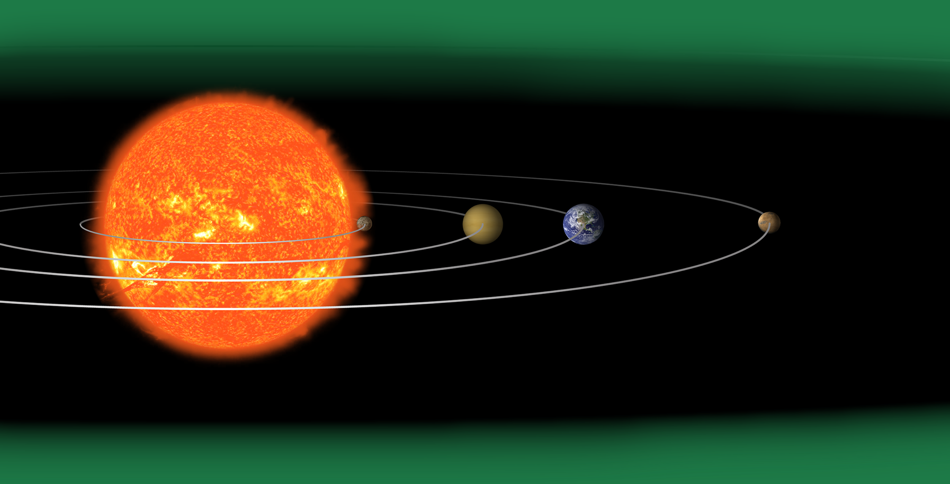
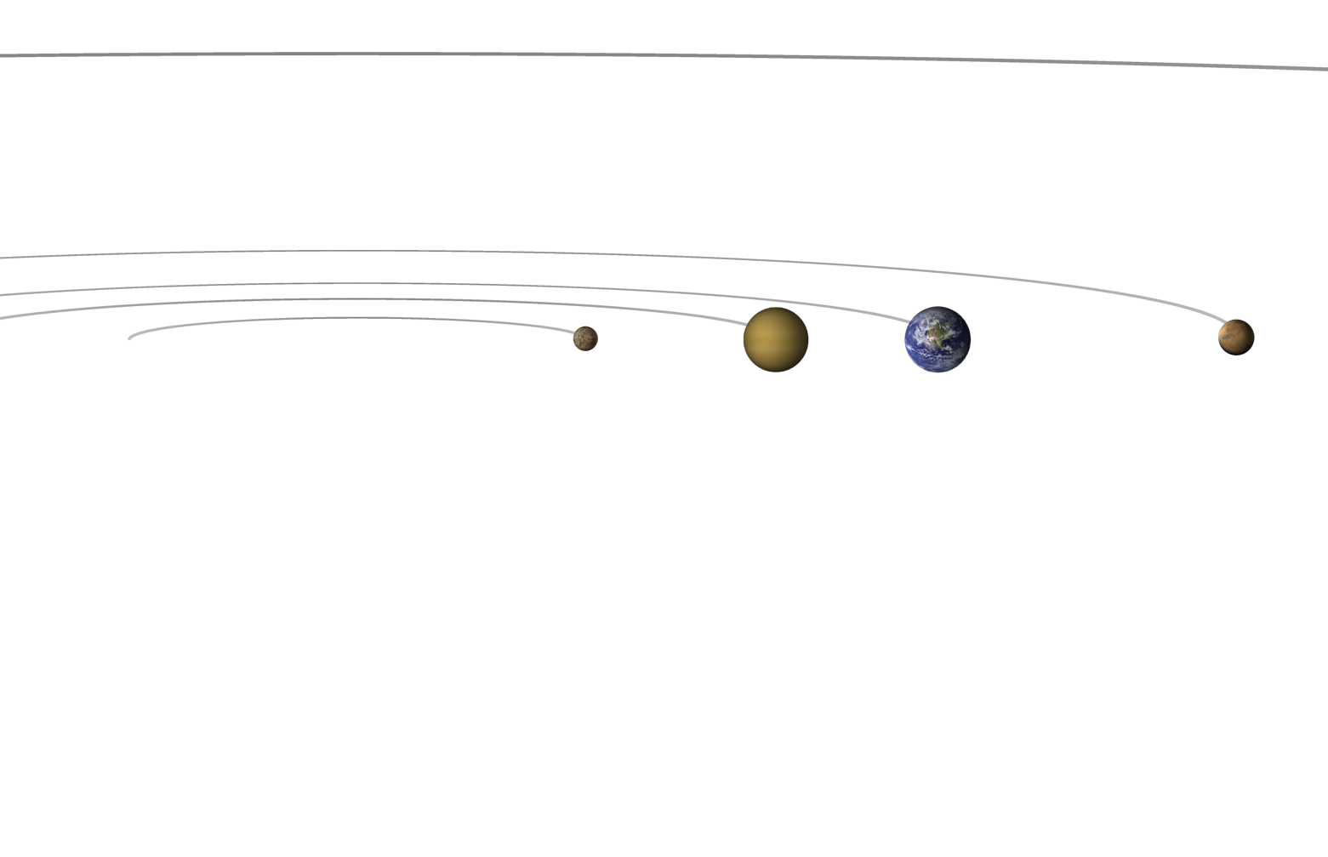
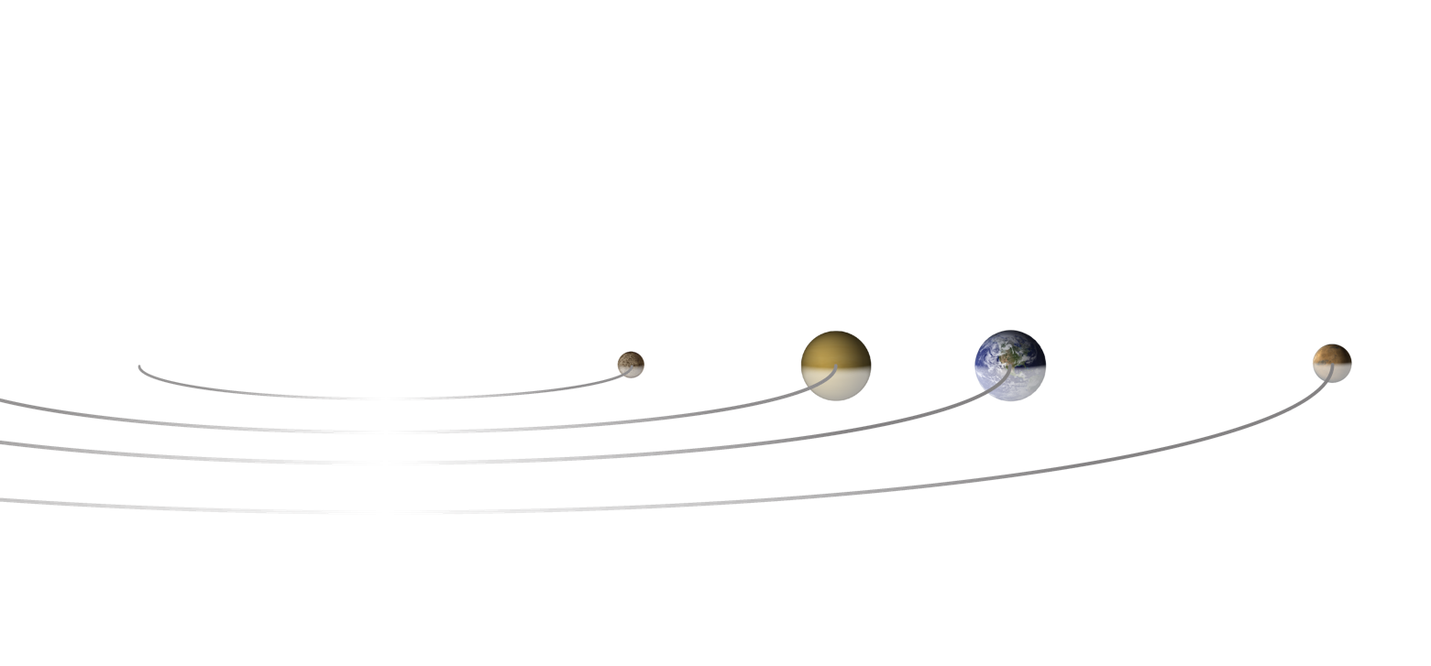
Comparison of Habitable Zones – With Different Types of Stars
Balance for zoom out
Exoplanet Communications
Twice the size of our Sun
Our Sun
Half the size of our Sun
Scale of Sun and planets are greatly exaggerated
Notes:
Habitable Zones Compared to the Size of the Hosting Star -- Audience: 4th Grade and older.
This slide explains and illustrates what the "habitable zone" is, and how it would change if the size of the hosting star is dramatically different.
User's note: Scale of Sun and planets are greatly exaggerated. Depending on its size, a star can be "whiter" or "redder" - as it was approximately reflected in this slide. However, the exact color of each of the three sizes of star in these slides is not accurate; the focus of these slides is to teach about the "Habitable Zone" as the size of the hosting star changes.
Click 1: The Sun moves out and is replaced by a star half the size of the Sun; habitable zone scales accordingly
Click 2: The small star moves out and is replaced by a star twice the size of the Sun; habitable zone scales accordingly

Slide 15
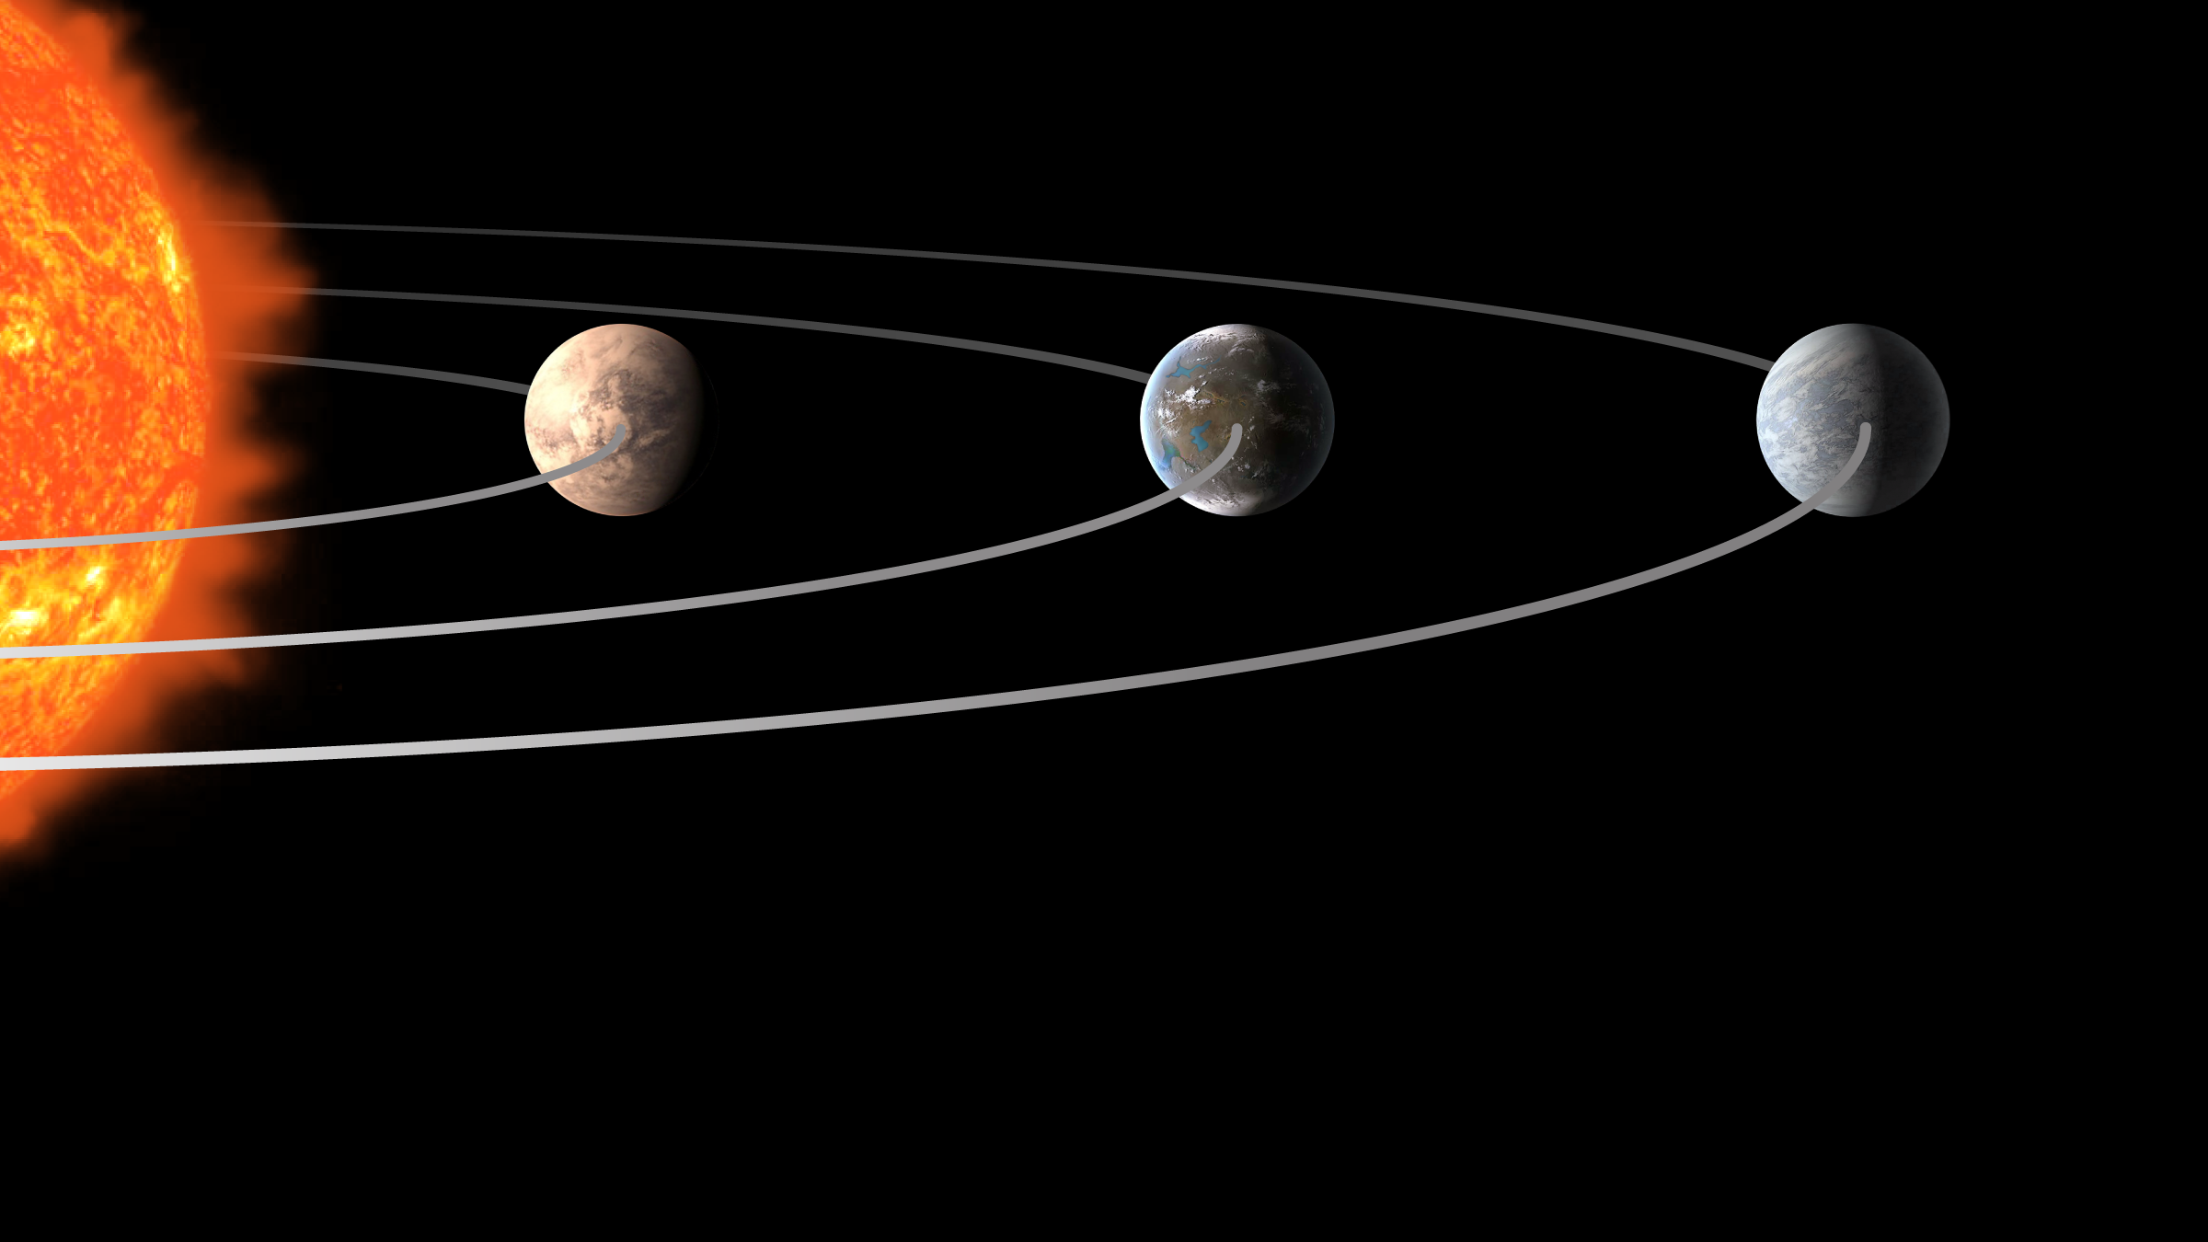
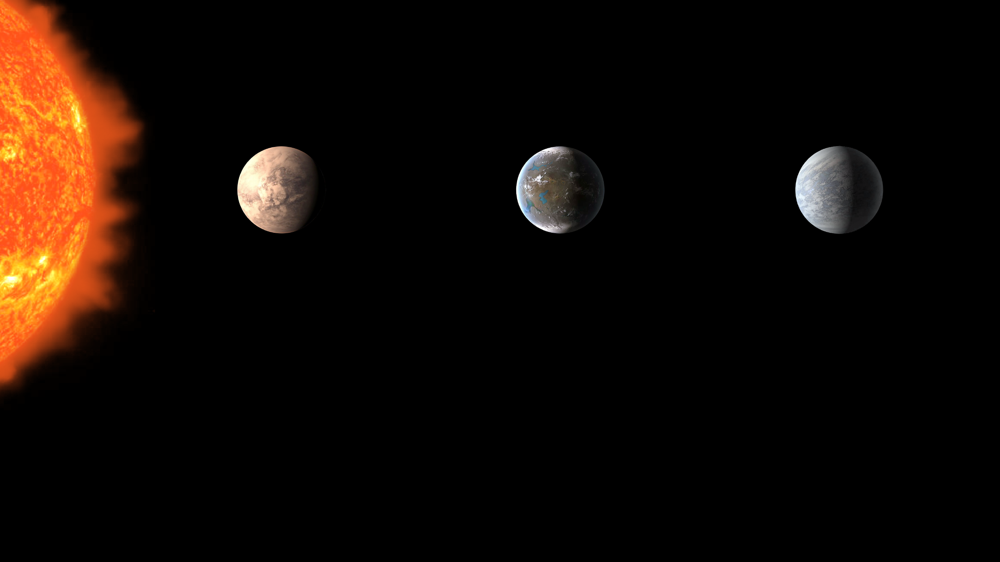
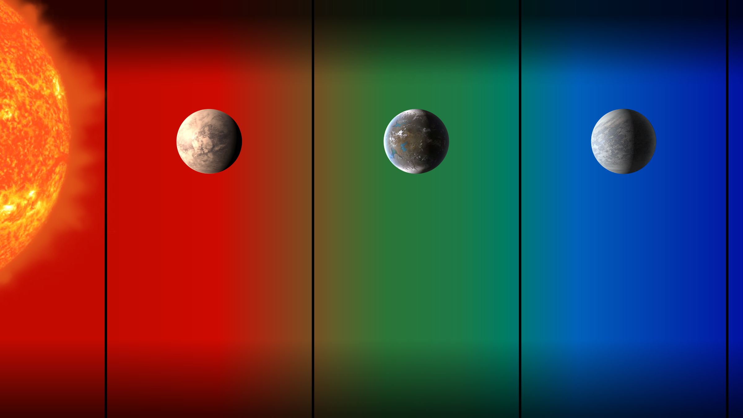
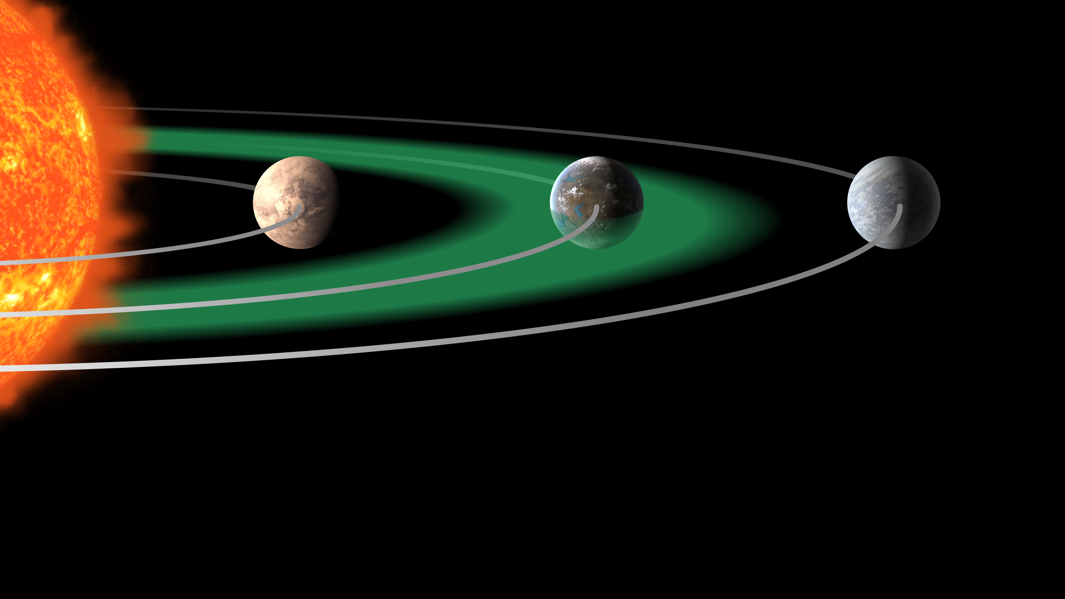
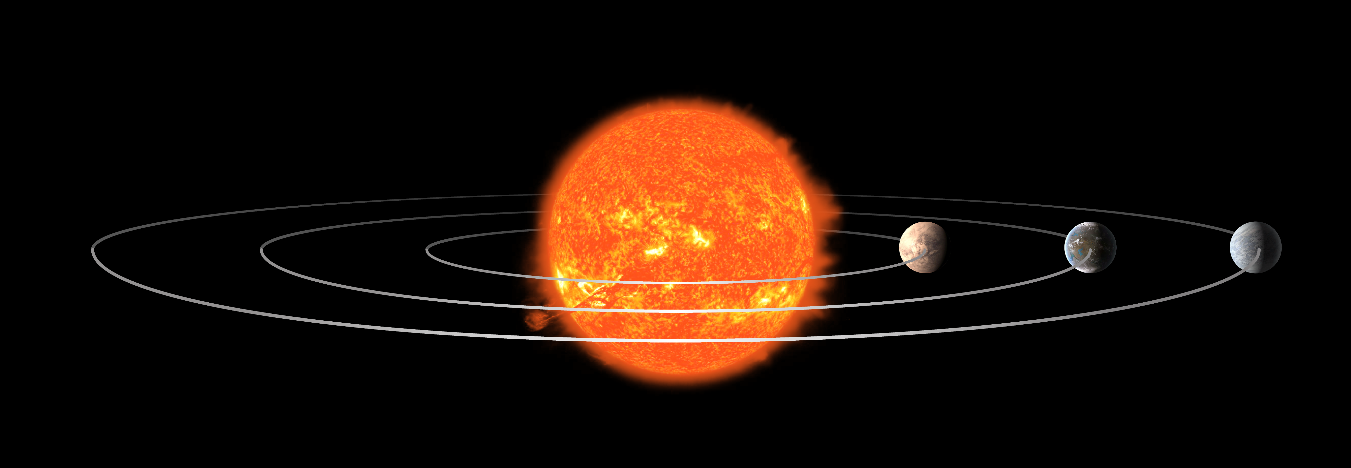
The Habitable Zone
Exoplanet Communications
too hot
just right
too cold
exoplanets.nasa.gov
Notes:
Habitable Zones Compared to the Size of the Hosting Star -- Audience: 4th Grade and older.
Description:
This slide explains and illustrates what a "habitable zone" is, and how it would change based on the size of the host star.
User's notes: The represented Scale of Sun and planets are greatly exaggerated. Depending on its size, a star can be "whiter" or "redder" - as it was approximately reflected in this slide. However, the exact color of each of the three sizes of star in these slides is not accurate; the focus of these slides is to explain the "Habitable Zone" and how it changes based on the size of the hosting star.
NOTE: This PowerPoint file has built-in interactive elements. To view them, you must be in "Slide Show" mode; you can then move to the next view either by clicking your mouse, the spacebar, or the arrow keys. This slide will not work in "regular viewing mode."
Animation in presentation mode:
1st click: zoom in on 3 planets
2nd click: 3 colored zones appear
3rd click: thermometers appear showing ”too hot”, ”too cold” and “just right”
4th click: container appears with liquid water
5th click: a second container appears with water vapor
6th click: a third container appears with frozen water
7th click: graphics change to show habitable zone represented as a green disk

Slide 16
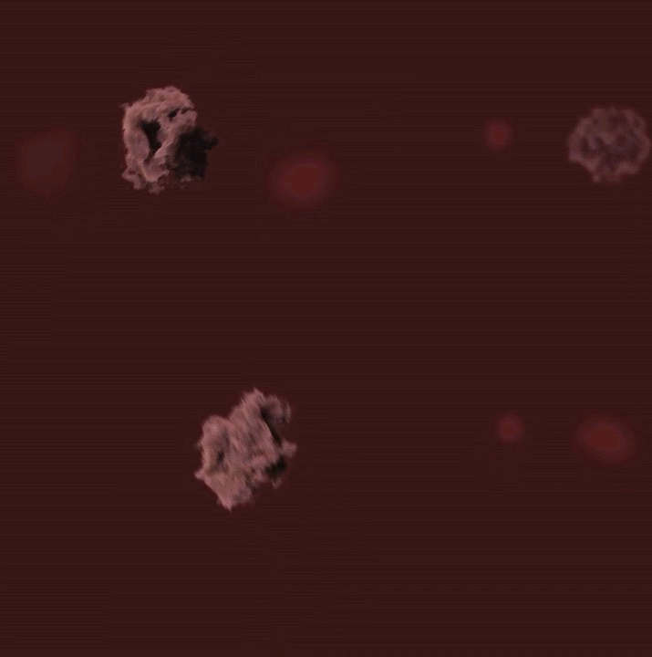
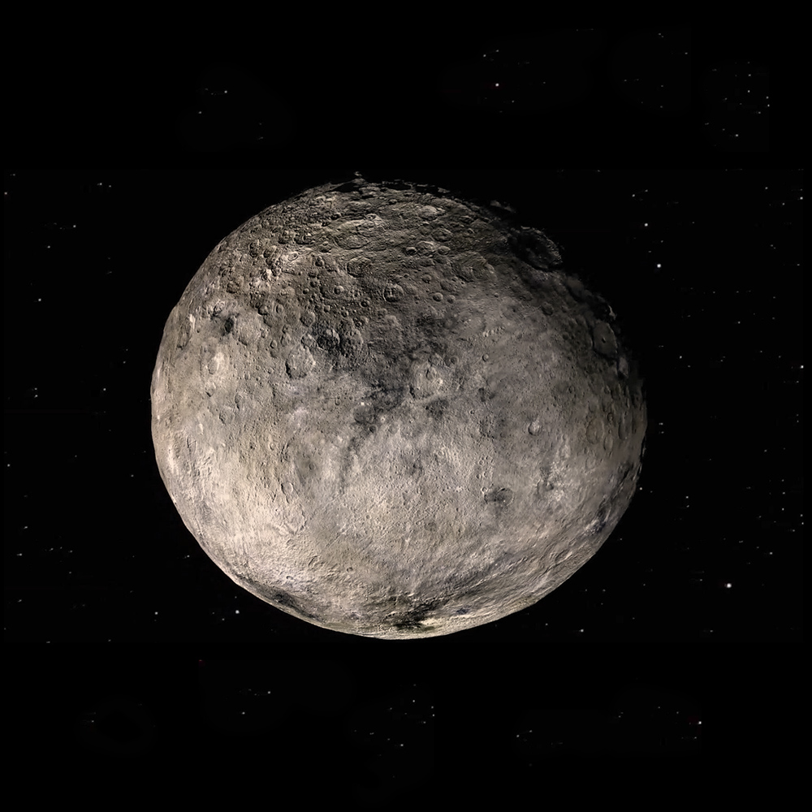
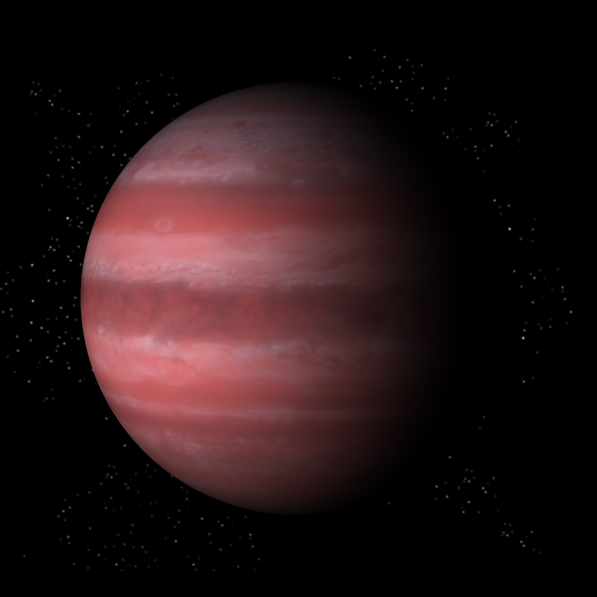
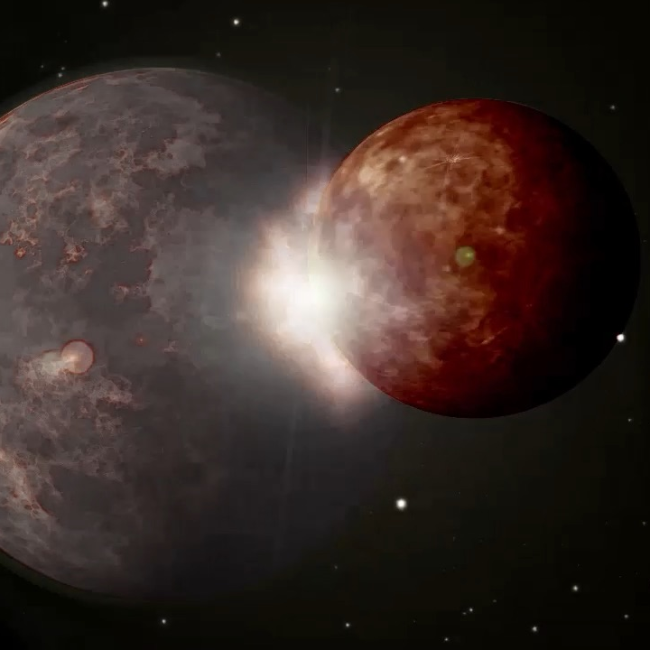
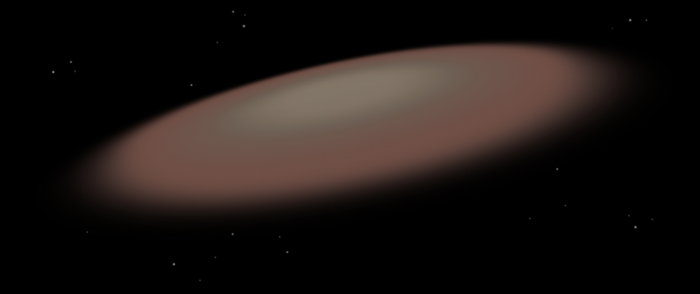
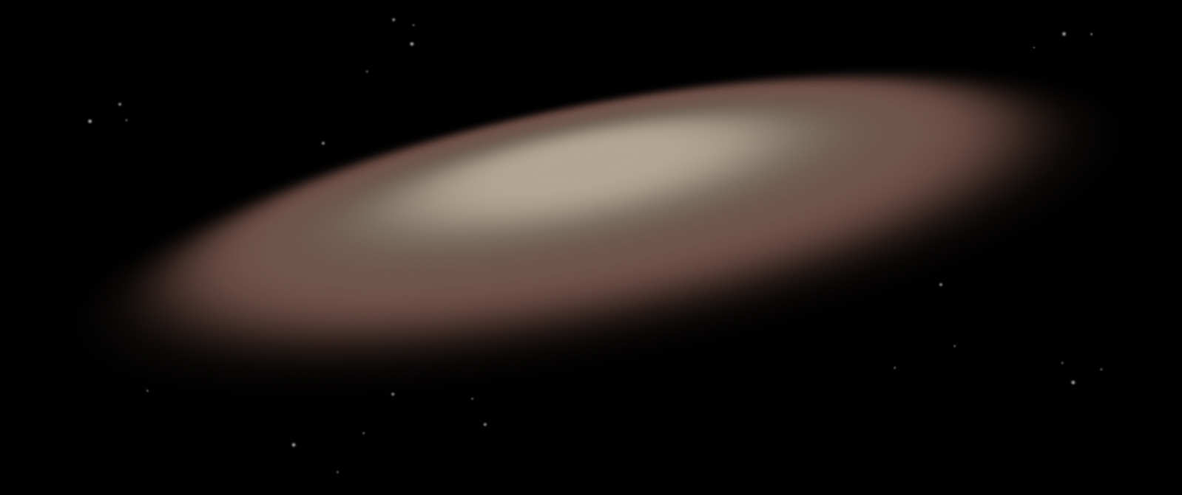
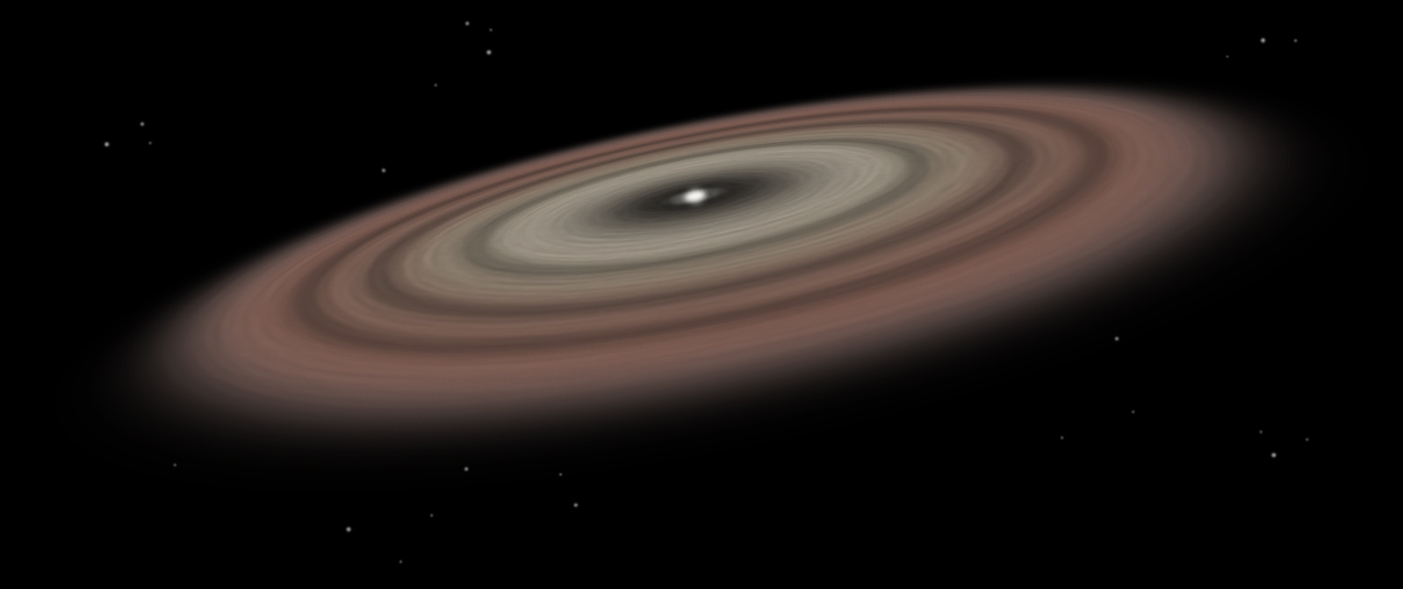
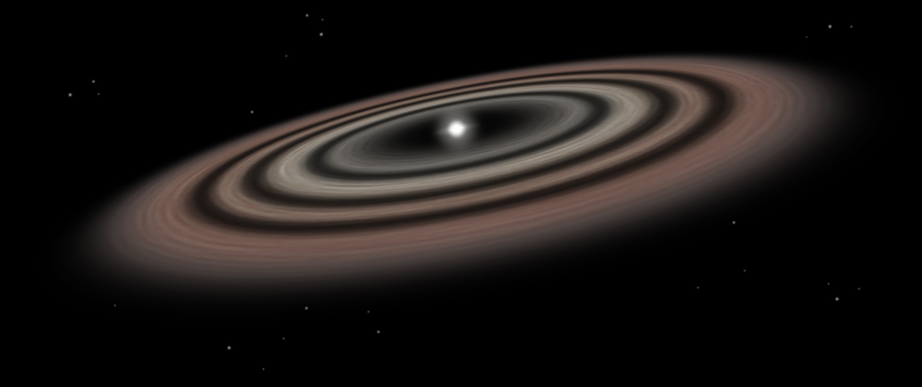
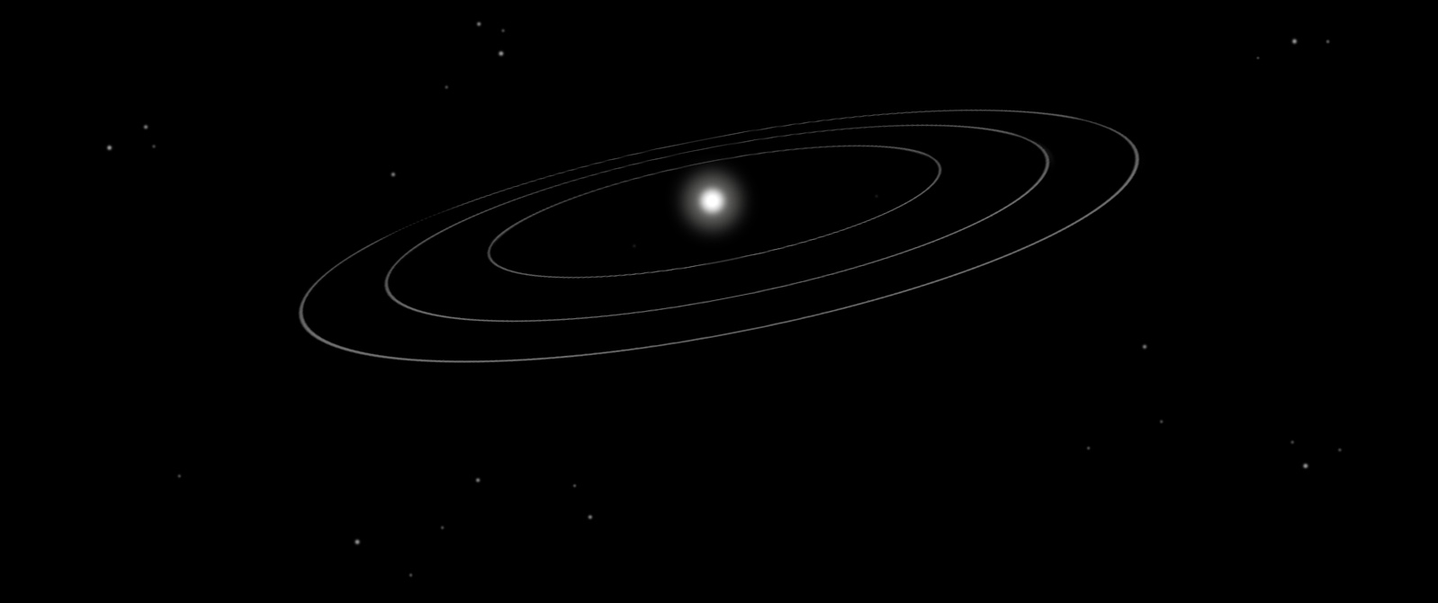
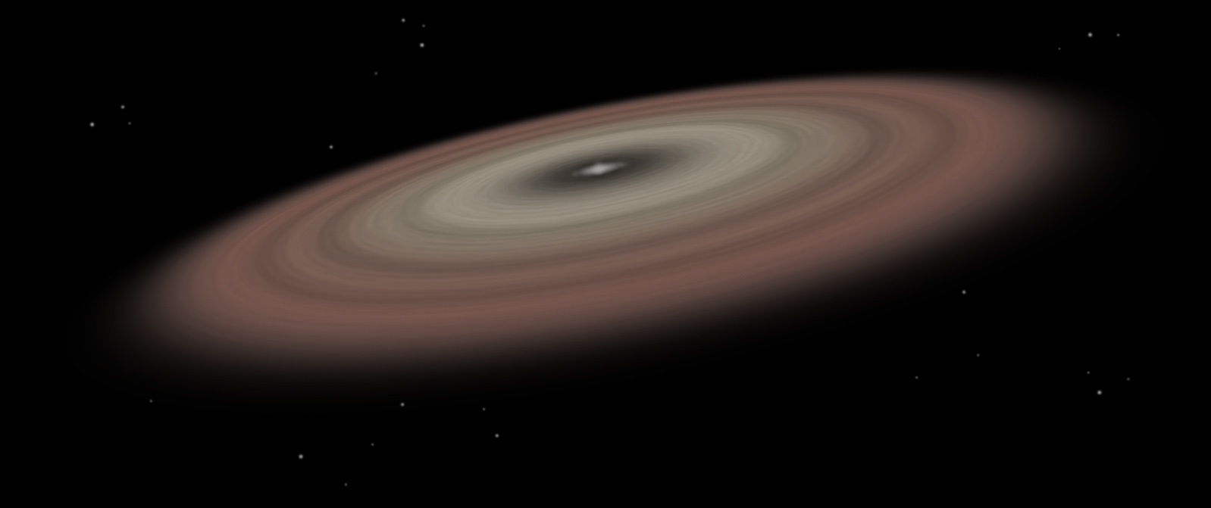
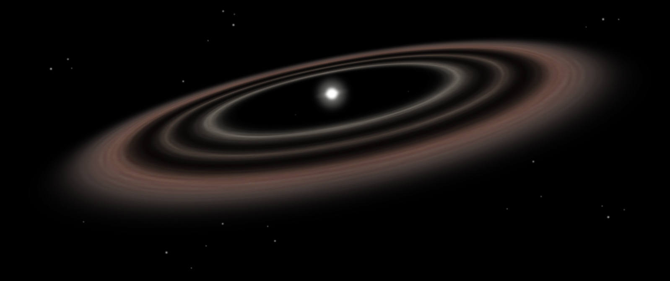
Planet Formation – from Dust to Planets
Exoplanet Communications
00
0
2
7
4
Giant planets
Formation timescale: 1-10 million years
Planet formation is complete
Timescale: ~ a few 100 million years
Protoplanets: embryos of planets
Size: ~ 1000 km or larger
Planetesimals: Building blocks of planets
Size: ~ a few km to a few 100 km
Astronomical dust
Size: ~ 0.1 micron to ~ a few mm
Protoplanetary disks: Birthplace of planets
Lifetime: 1-10 million years
Rocky, terrestrial planets
Formation timescale: 10-100 million years
6
8
exoplanets.nasa.gov
Notes:
Planet Formation Audience: 9th Grade and older.
Description:
This slide illustrates how planets form from dust in a few hundred million years. Steps illustrated include planetesimal, protoplanets, giant and rocky planets.
Click #1: Astronomical dust
Click #2: Planetesimals
Click #3: Protoplanets
Click #4: Giant planets
Click #5: Rocky, terrestrial planets
Click #6: Planet formation is complete

Slide 17
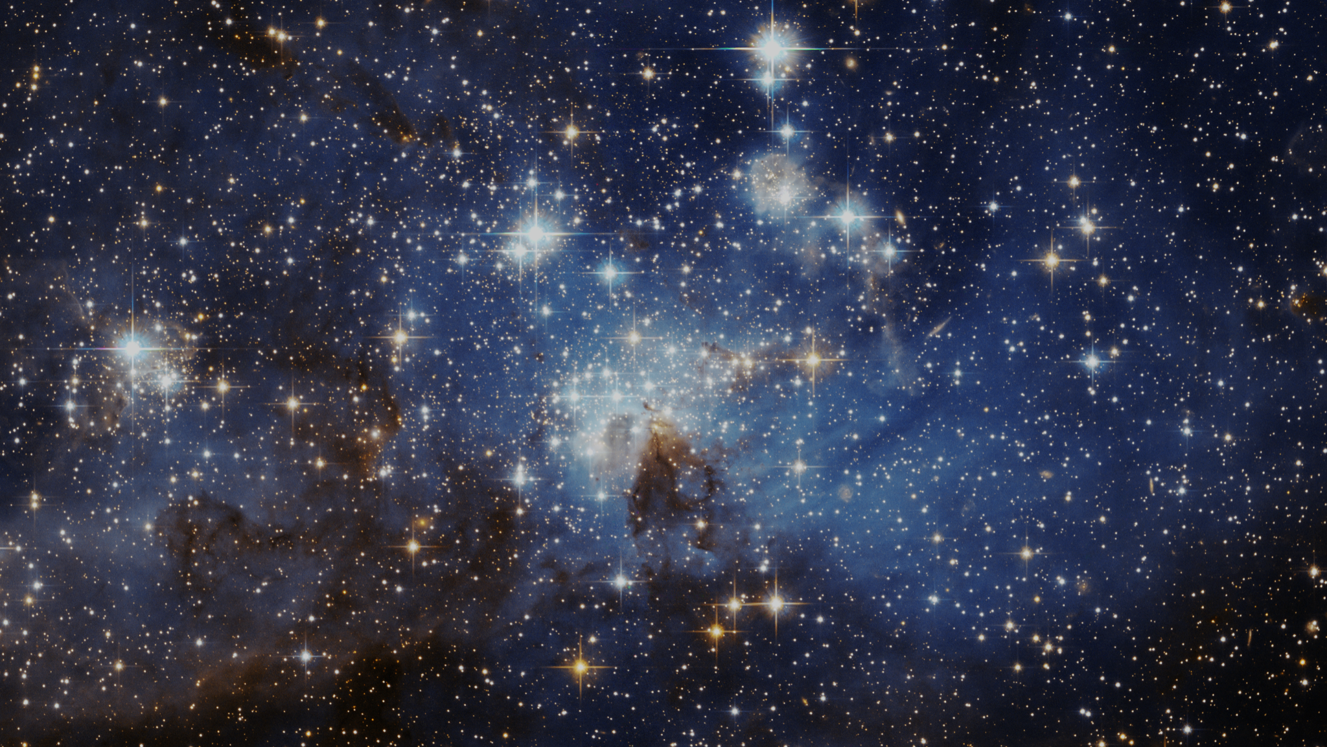
Stars vs. Planets –
Exoplanet Communications
There are many reasons why we can easily see stars in the night sky, but not their planets…
17
exoplanets.nasa.gov
Notes:
Planets vs Stars: Brightness, Size, and Weight ('Mass’) -- Audience: 4th Grade and older.
This slide illustrates why we can easily see stars in the night sky but not their planets. The slide incorporates a graphic comparison of Brightness, Size, and Weight.
User's notes: This slide is geared toward students in 4th grade; so it uses a concrete term ("weight") rather than an abstract one ("mass") since most young students are not yet familiar with physics concepts. Weight makes sense to all kids, it's something practical, something they can converse about it; the concept of "mass" only makes sense to kids familiar with physics concepts.
NOTE: This PowerPoint file has built-in interactive elements. To view them, you must be in "Slide Show" mode; you can then move to the next view either by clicking your mouse, the spacebar, or the arrow keys. This slide will not work in "regular viewing mode."
Animation:
Click 1: Transitions to next slide

Slide 18
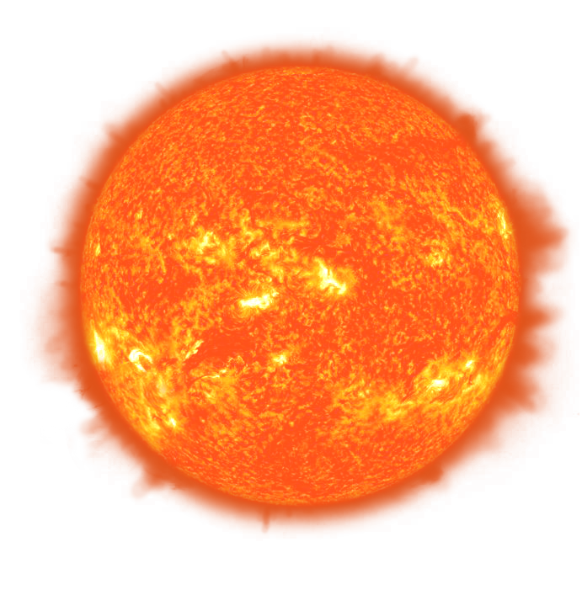
Stars vs. Planets – Brightness
Exoplanet Communications
Brightness:
The light reflected by a planet is extremely dim compared to the intense light from a star.
So, how many times brighter is the light emitted by the Sun…
…compared to the light reflected by Earth?
About 3,400,000,000 times brighter
(3.4 billion times brighter)
18
exoplanets.nasa.gov
Notes:
Animation: auto play of brightness statement
Click 1: question is displayed “how many times brighter?”
Click 2: answer is displayed “3.4 billion”
Click 3: transitions to next slide showing comparison (candle and lighthouses)

Slide 19
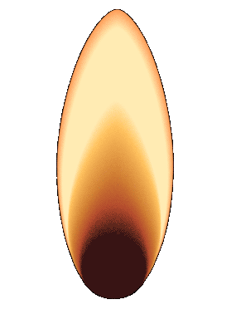
Stars vs. Planets – Brightness
Exoplanet Communications
It’s almost like comparing the tiny light from a candle…
…not with one single lighthouse…
But with the light from about
2,000 lighthouses!
19
exoplanets.nasa.gov
Notes:
Animation: auto play of candle comparison to 2000 lighthouses
Click 1: transitions to next slide

Slide 20
Stars vs. Planets – Size
Exoplanet Communications
?
Size:
110
Stars like the Sun are massive objects, far wider than planets such as Earth.
So, how many Earths would it take to equal the width of the Sun?
The Sun is 110 times wider than Earth.
20
exoplanets.nasa.gov
Notes:
Animation: auto play of size statement
Click 1: Sun scales down; question is posed, “how many Earth’s”?
Click 2: animation plays showing many tiny Earths extending across the Sun; answer is displayed (110 Earths)
Click 3: transitions to next slide where comparison animation plays (popcorn)

Slide 21
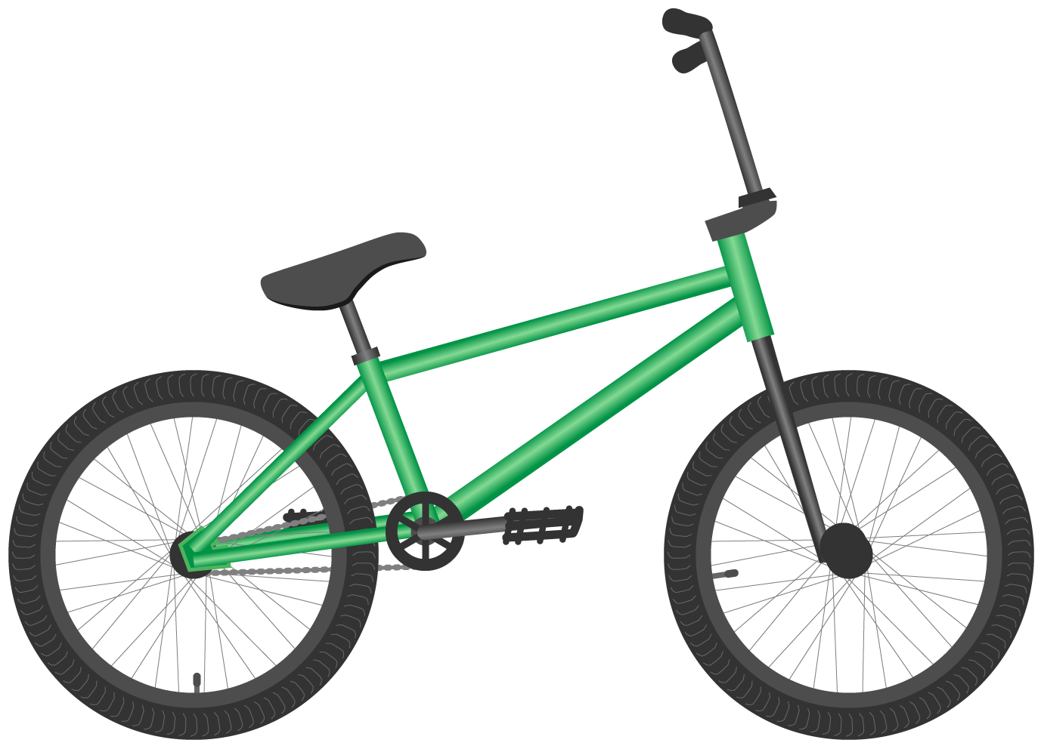
Stars vs. Planets – Size
Exoplanet Communications
It’s almost like comparing a piece of popcorn…
to a bicycle.
21
exoplanets.nasa.gov
Notes:
Animation: auto play of popcorn comparison to bicycle
Click 1: transitions to next slide

Slide 22
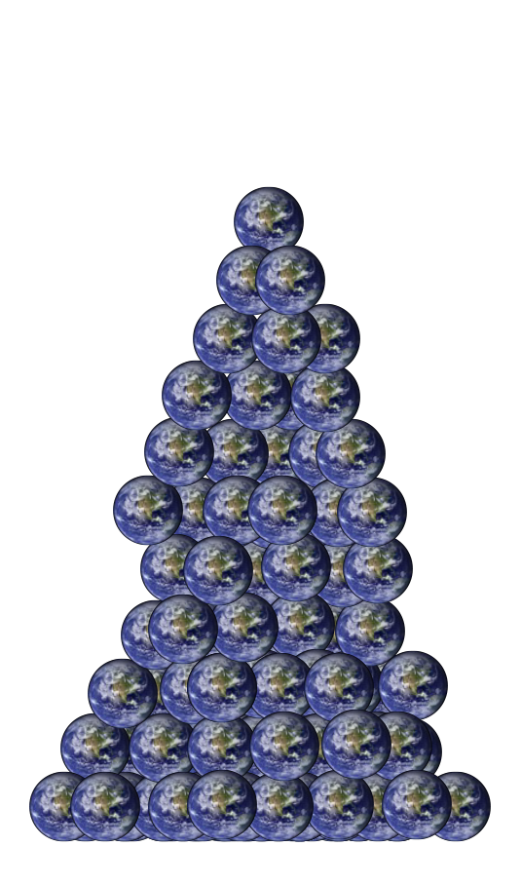
Stars vs. Planets – Weight (Mass)
Exoplanet Communications
So, how many Earths would it take to equal the weight of the Sun?
Weight:
Planets are much lighter than stars, which tend to be massive…
(Way too many to show here)
22
exoplanets.nasa.gov
Notes:
Animation: auto play of weight statement
Click 1: scale appears; questions is posed: “how many Earths would it take to equal the weight of the Sun?”
Click 2: animation plays showing many Earths stacking up on the balance scale
Click 3: transitions to next slide where answer to question appears “(333,000 Earths)”

Slide 23
Stars vs. Planets – Weight (Mass)
Exoplanet Communications
About
333,000 Earths
It’s almost like comparing a paperclip…
equal the weight of the Sun.
to a sumo wrestler.
23
exoplanets.nasa.gov
Notes:
Planets vs Stars: Brightness, Size, and Weight (Mass) Audience: 4th Grade and older.
This slide illustrates why we can easily see stars in the night sky but not their planets. The slide incorporates a graphic discussion of Brightness, Size, and Weight.
User’s note: This slide uses a concrete term ("weight") rather than an abstract one ("mass") because in 4th grade students are not yet familiar with physics concepts. Weight makes sense to all kids, it's something practical, something they can converse about it; "mass" only makes sense to kids familiar with physics concepts.
Animation: auto play of answer (about 333,000 Earths)
Click 1: comparison animation plays (paperclip, etc.)
Click 2: transitions to next slide

Slide 24
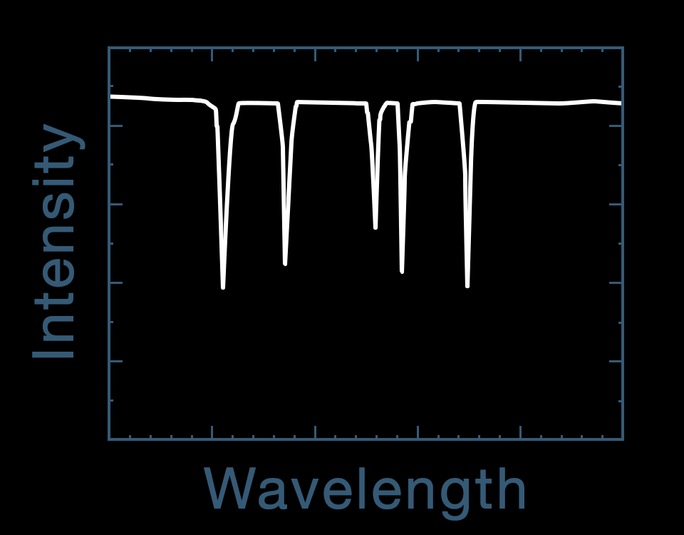
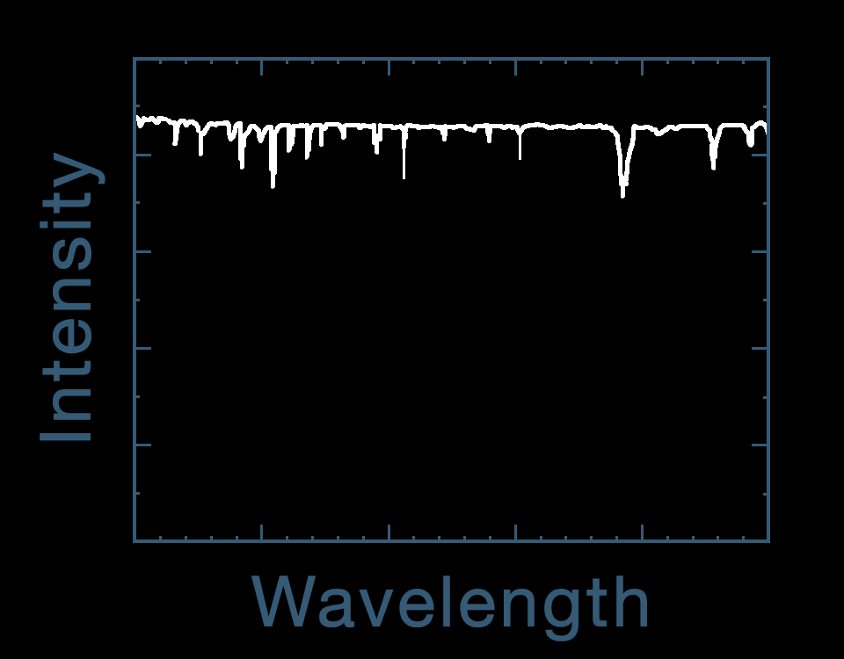
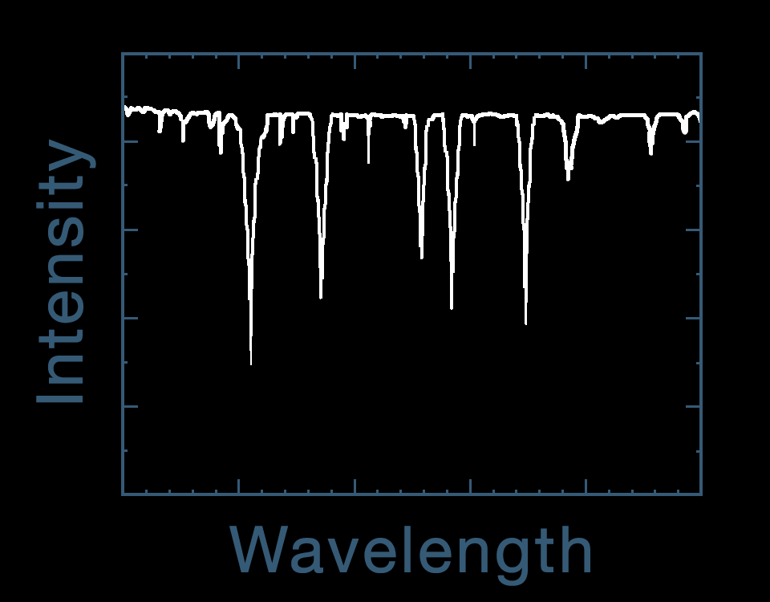
Spectroscopy – Detection of Biosignatures
Exoplanet Communications
Light from star
minus
−
equals
=
Star
Instrument
Light from
star & planet
Light from
star only
Light from
planet only
Light from star passes through planet’s atmosphere
Notes:
Spectroscopy - Detection of Bio Signatures Audience: 9th Grade and older.
Description:
This slide illustrates how scientists use Spectroscopy to determine what substances are present in the atmosphere of a celestial body.
User's notes: In these charts, the dips are extremely exaggerated, especially for “the light from planet only.” In reality, such dips are very shallow, and that’s why astronomers require such big telescopes. One dip in “Light from planet only” does not correspond to either water or methane. This indicates that another atom/molecule is present in the planet's atmosphere.
NOTE: This PowerPoint file has built-in interactive elements. To view them, you must be in "Slide Show" mode; you can then move to the next view either by clicking your mouse, the spacebar, or the arrow keys. This slide will not work in "regular viewing mode."
Click 1: light from star passes through prism
Click 2: light from star passes through planet’s atmosphere before passing through prism
Click 3: star, prism and gradients disappear, then absorption lines reposition, then labels appear
Click 4: slide change

Slide 25
Spectroscopy – Detection of Biosignatures
Exoplanet Communications
Water (H₂0)
Light from planet only
Methane (CH₄)
Light from
planet only
Notes:
Absorption feature relocates automatically after slide change
Click 1: blue line traces over absorption feature, then repositions to show evidence of water
Click 2: red line traces over absorption feature, then repositions to show evidence of methane
Click 3: slide change

Slide 26
Speed Comparison – Jet Airliner vs. Small Astronomical Bodies
Exoplanet Communications
jpl.nasa.gov
Notes:
Audience: 3rd grade and older
In the first view, this slide illustrates the difference in speed between a car and an airplane. In the second view, the speed of an airplane is compared to that of two interstellar objects, Oumuamua and Bennu. A third view shows the size difference between these two bodies and an average airplane.
Key messages: Asteroids move much faster than airplanes; and are also much bigger.
NOTE: This PowerPoint file has built-in interactive elements. To view them, you must be in "Slide Show" mode; you can then move to the next view either by clicking your mouse, the spacebar, or the arrow keys. This slide will not work in "regular viewing mode."
Credit
NASA/JPL-Caltech

Slide 27
Speed Comparison – Jet Airliner vs. Small Astronomical Bodies
Exoplanet Communications
Asteroid Bennu
100x faster
Size Comparison?
Interstellar Object Oumuamua
100x faster
jpl.nasa.gov
Notes:
Bennu → indicate speed (100 times faster than plane); about 500 meters long
Oumuamua → indicate speed (100 times faster); 100-1000 meters long (probably 400 m)
Airplane - about 1,000 Km/h; 70 meters long; 38.5 m long (may be more common)

