Slide 1
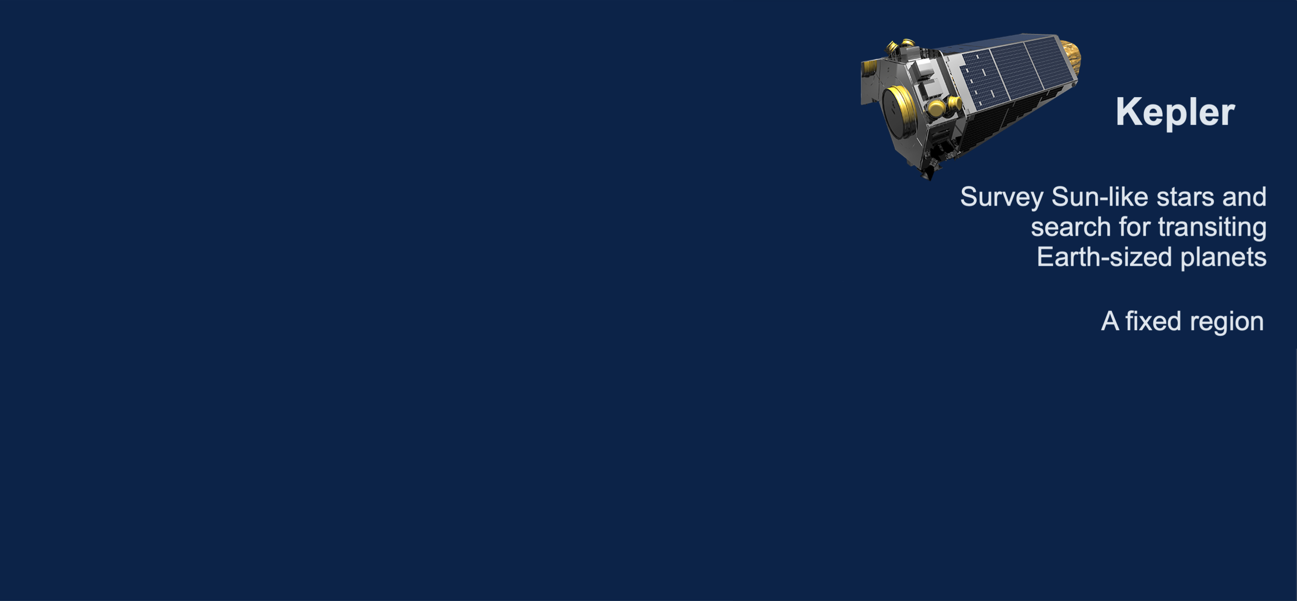
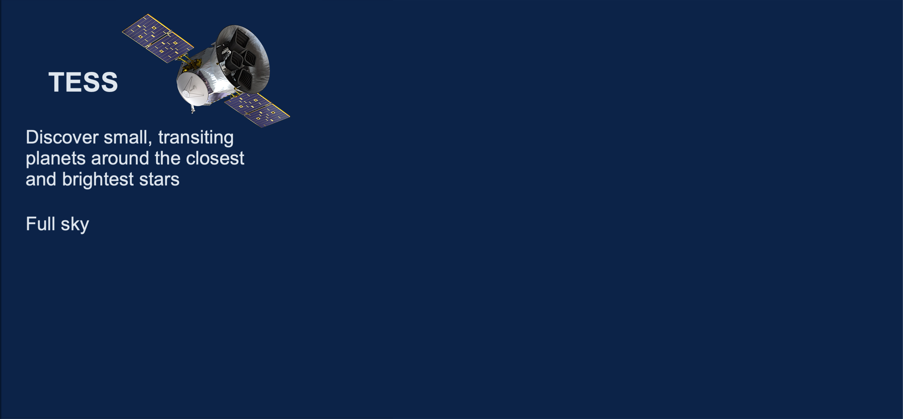
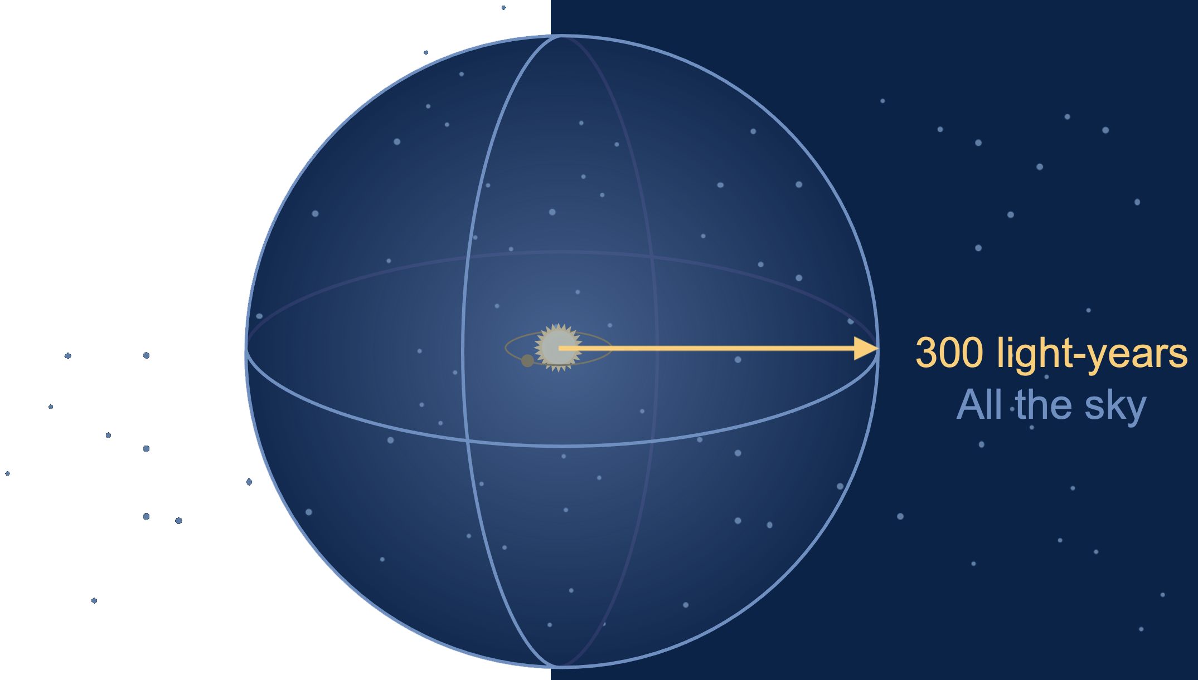

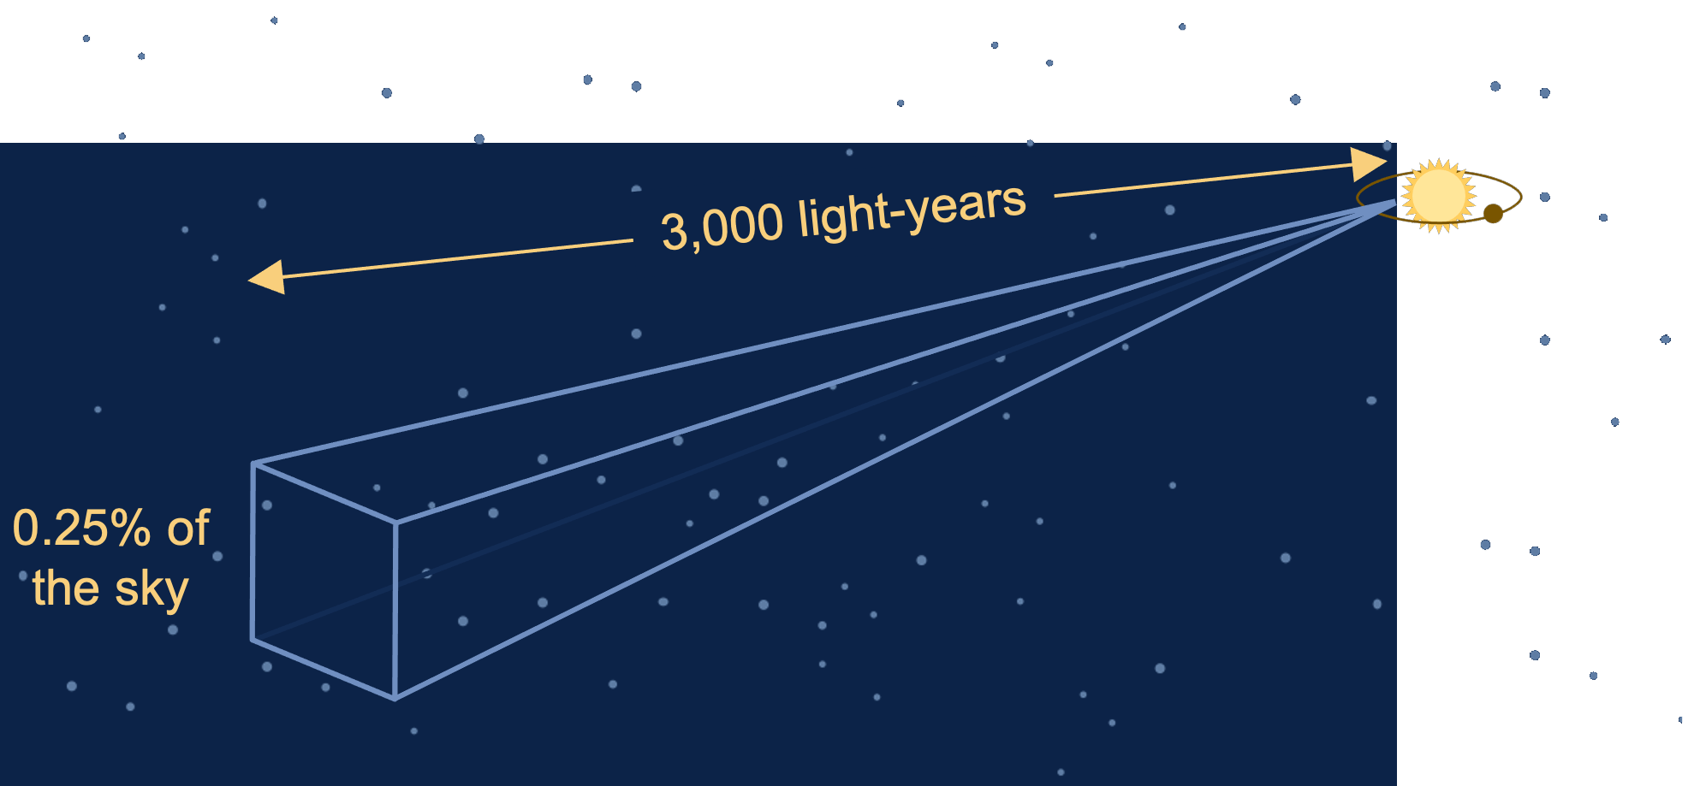

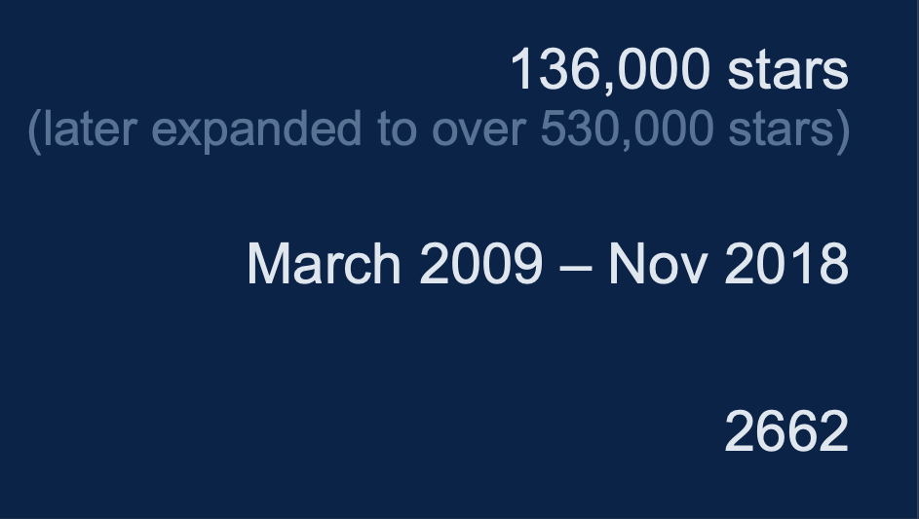
Kepler vs TESS – Comparison of Telescopes
Exoplanet Communications
3,000 light-years
⧫ | Goal | ◆
⧫ | Sky Coverage | ◆
300 light-years
All the sky
⧫ | Target Stars | ◆
200,000 stars
0.25% of
the sky
⧫ | Mission Periods | ◆
April 2018 – the present
(the original plan was 2-years)
2709
(as of May, 2022)
⧫ | Confirmed Planets | ◆
204
(as of May, 2022)
exoplanets.nasa.gov
Notes:
This slide requires 11 clicks:
First click – reveals goals for both Kepler and TESS
Second click – reveals sky coverage for both Kepler and TESS
Third click – hides TESS panel, preps for Kepler coverage animation
Forth click – plays animation describing Kepler sky coverage
Fifth click – returns TESS panel
Sixth click – hides Kepler panel, preps for TESS coverage animation
Seventh click – plays animation describing TESS sky coverage
Eighth click – returns Kepler panel
Ninth click – reveals "target stars" for both Kepler and TESS
Tenth click – reveals "mission periods" for both Kepler and TESS
Eleventh click – reveals "confirmed planets" for both Kepler and TESS
Twelfth click – transitions to next slide
Audience:
4th Grade and older.
Description:
This slide explains and illustrates how different Kepler and TESS telescopes are.
User's notes:
The additional information can be available at e.g., https://exoplanets.nasa.gov/what-is-an-exoplanet/in-depth/
NOTE:
This PowerPoint file has built-in interactive elements.
To view them, you must be in "Slide Show" mode; you can then move to the next view either by clicking your mouse, the spacebar, or the arrow keys.
This slide will not work in "regular viewing mode."
Credit:
NASA/JPL-Caltech

