Slide 1
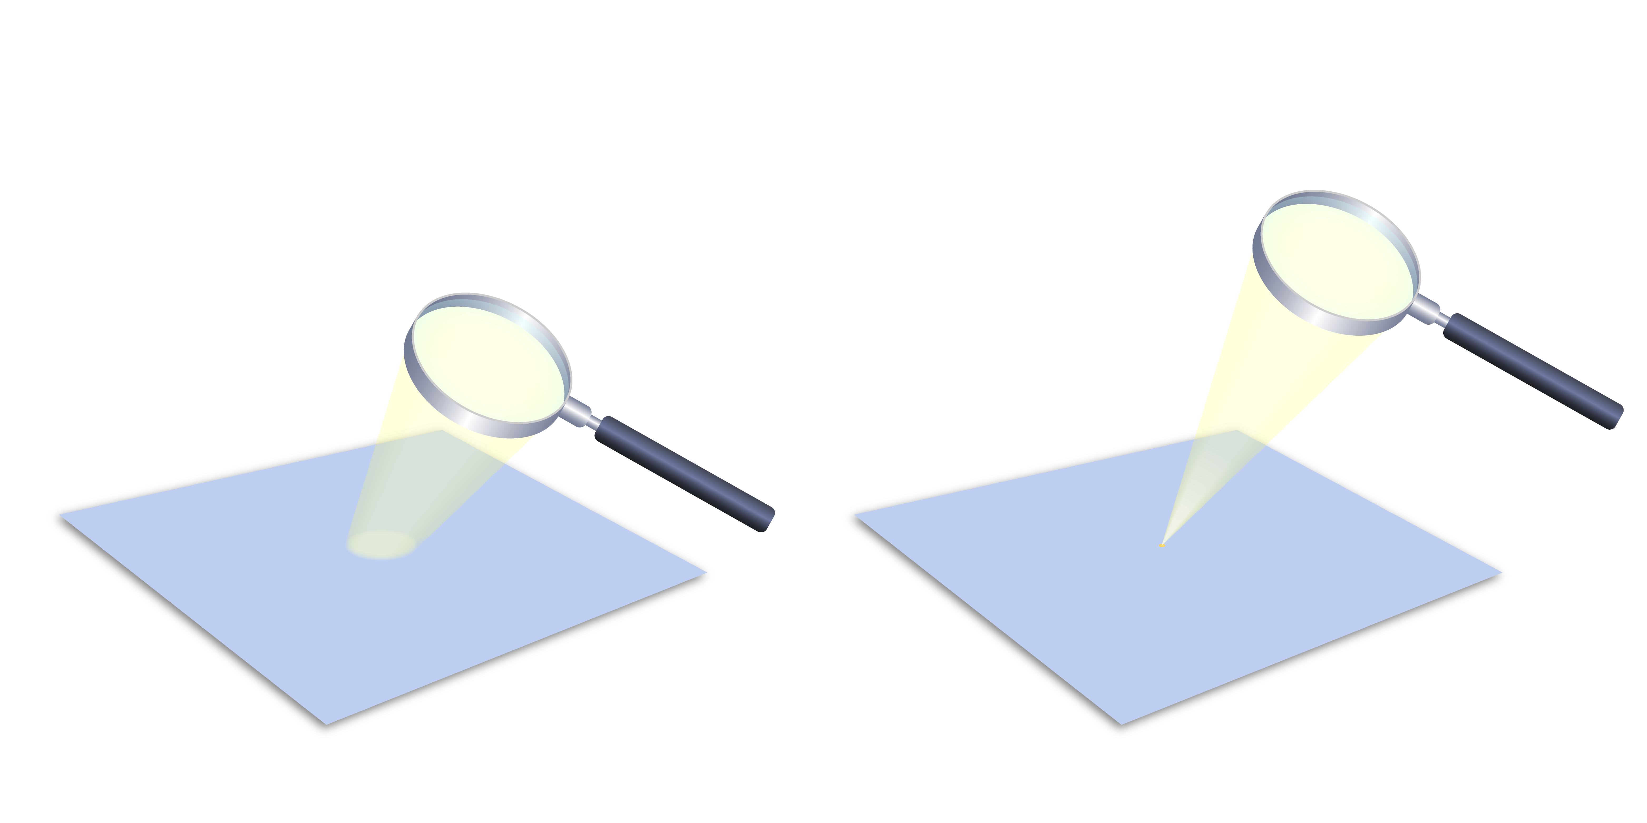
Exoplanet Detection – Microlensing Method
Exoplanet Communications
We know that a lens will focus light.
Notes:
This slide starts automatically, then requires 0 clicks:
The first click transitions to next slide
Audience:
9th Grade and older.
Description:
This slide explains and illustrates how a phenomenon called gravitational microlensing is used to detect exoplanets.
This is a commonplace analogy of gravitational microlensing.
User's notes:
The first cold (i.e., far from the host star) superEarth was discovered by this method (https://www.nature.com/articles/nature04441).
Roman space telescope will use this method to discover exoplanets.
The additional information can be available at e.g., https://exoplanets.nasa.gov/what-is-an-exoplanet/in-depth/
NOTE:
This PowerPoint file has built-in interactive elements.
To view them, you must be in "Slide Show" mode; you can then move to the next view either by clicking your mouse, the spacebar, or the arrow keys.
This slide will not work in "regular viewing mode."
Credit:
NASA/JPL-Caltech

Slide 2
Exoplanet Detection – Microlensing Method
Exoplanet Communications
Astronomers know that
massive objects such as stars and planets can also focus light!
Notes:
This slide starts automatically, then requires 0 clicks:
The first click transitions to next slide

Slide 3

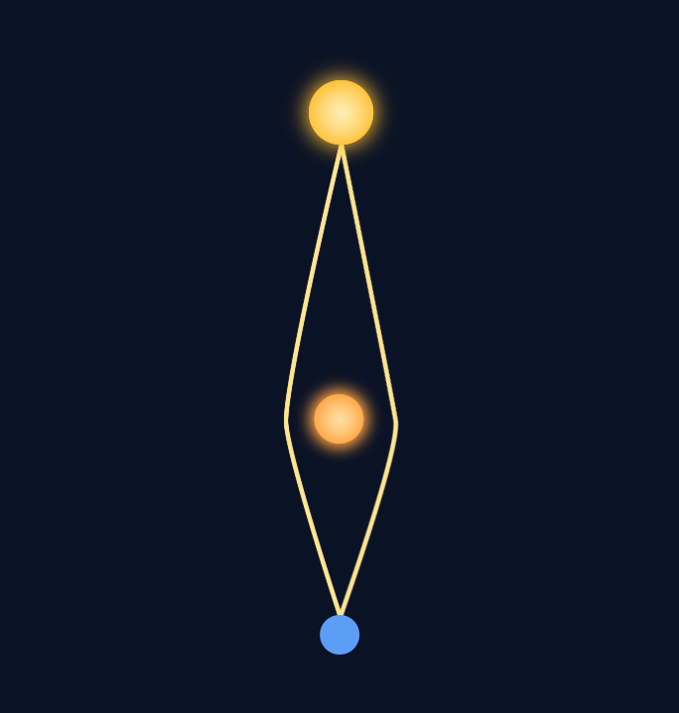
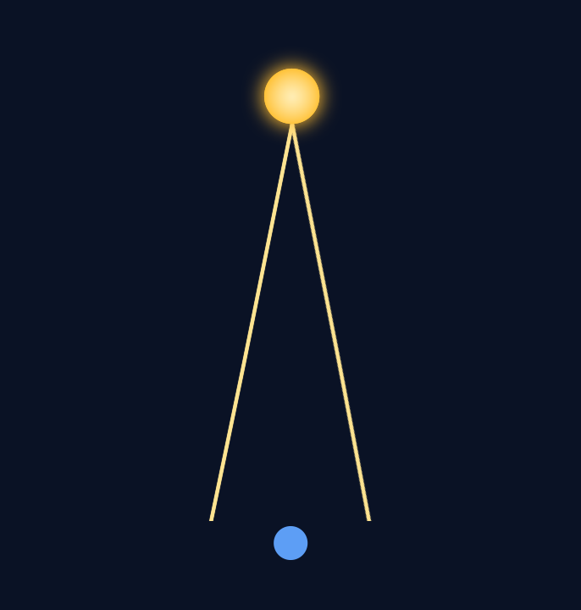
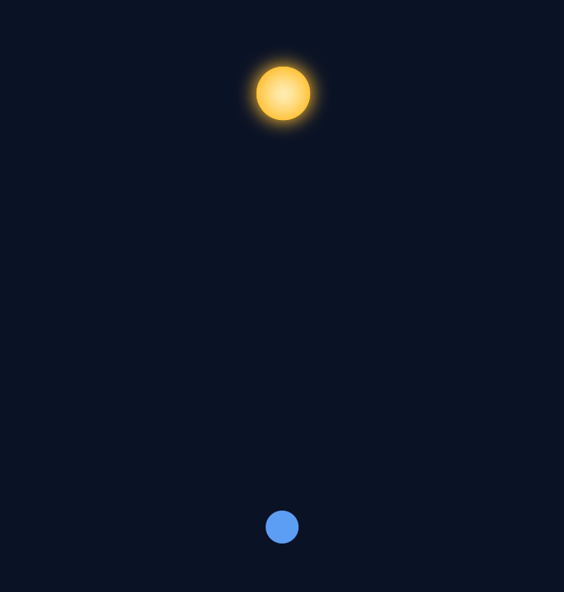
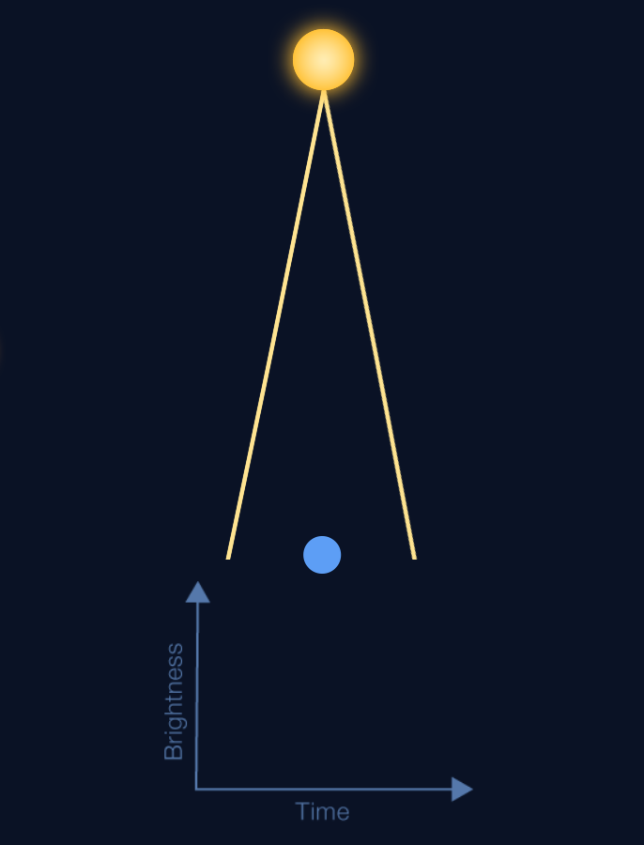

Exoplanet Detection – Microlensing Method
Exoplanet Communications
Background star
Image at 32%
When it reaches the midpoint, the power of its gravity bends the light rays of the background star,
causing it to act like a “lens”.
Light from background star
Here is a star about to pass between Earth and the background star.
Earth (telescope location)
Notes:
This slide starts automatically, then requires 1 click:
First click – sends the star to a point between the background star and Earth
Second click – transitions to next slide
Description:
This slide explains and illustrates the situation where gravitational microlensing occurs.
User's notes:
As an example, two rays are only shown here;
Astronomers compute how the brightness curve will change with time, by tracing all the rays.

Slide 4

Exoplanet Detection – Microlensing Method
Exoplanet Communications
Image at 32%
Data from the observation is recorded in a “brightness curve.”
Notes:
This slide starts automatically and introduces the brightness curve
First click – transitions to next slide (which plays animation showing moving star and bending of light rays)
User's notes:
As an example, two rays are only shown here;
Astronomers compute how the brightness curve will change with time, by tracing all the rays.

Slide 5
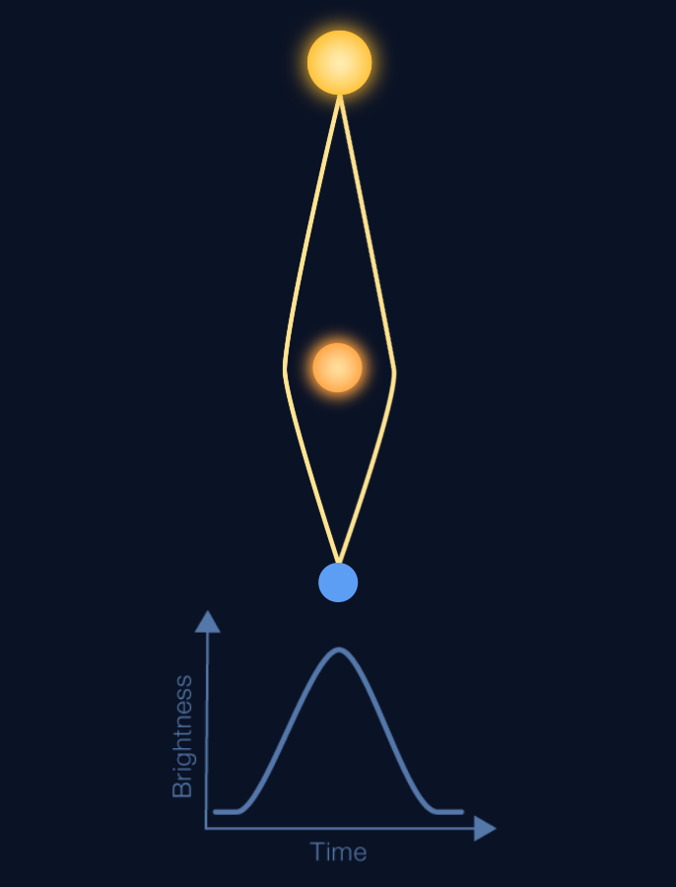

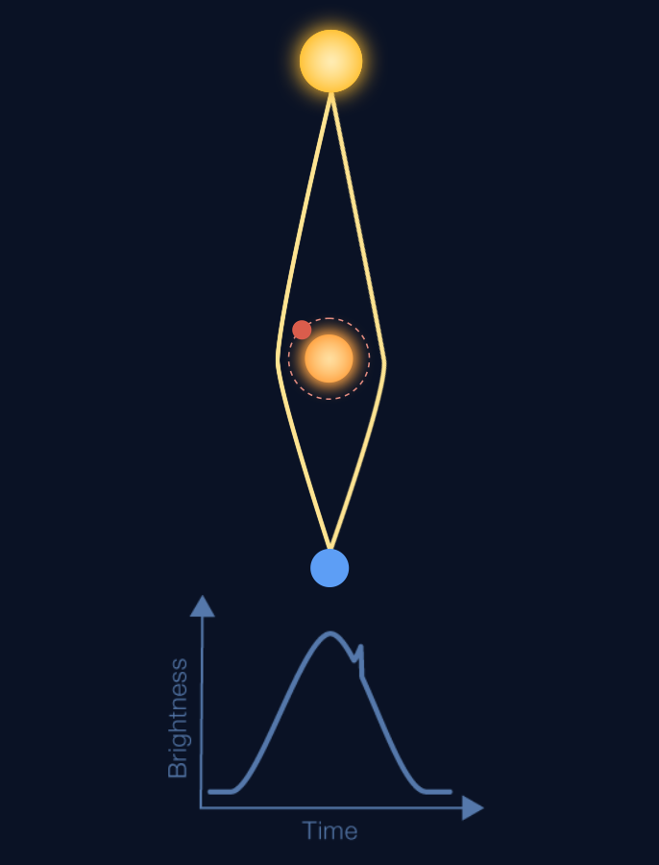
Exoplanet Detection – Microlensing Method
Exoplanet Communications
And if the “lens” star has a planet,
the brightness curve will have two peaks!
If the “lens” star is moving, the brightness curve will show a peak.
Notes:
This slide starts automatically (plays animation showing bending of light rays, along with recording of brightness curve), then requires 1 click:
The first click brings up details about a lens star with an orbiting planet
Second click transitions to next slide
Description:
This slide explains and illustrates how astronomers use microlensing to discover exoplanets,
that is, how brightness curve changes with time due to the microlensing effect.
User's notes:
As an example, two rays are only shown here;
Astronomers compute how the brightness curve will change with time, by tracing all the rays.

