Slide 1
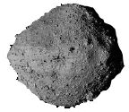
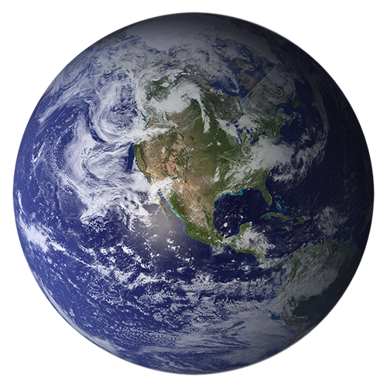
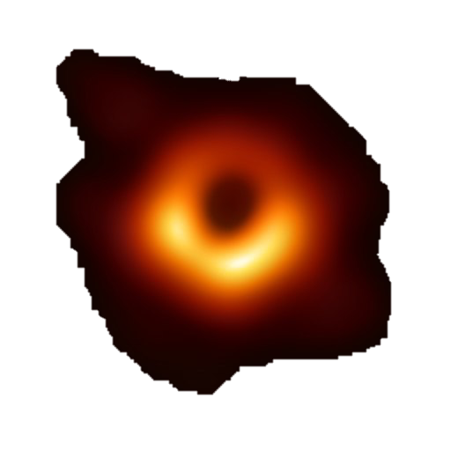
Black Holes – Black Holes vs. Planets
Exoplanet Communications
Planets
Asteroids
Black Holes
exoplanets.nasa.gov
Notes:
This slide is set to auto play
Click to advance to part two of Black Holes vs. Planets
Audience:
4th Grade and older.
Description:
This slide explains and illustrates how the gravity of astronomical objects changes the trajectory of asteroids.
User's notes:
The trajectory of asteroids is approximate;
Depending on the impact parameter (i.e., the nearest distance between the Earth and asteroids), the Earth can bend the trajectory of asteroids.
The additional information can be available at e.g., https://www.nasa.gov/audience/forstudents/k-4/stories/nasa-knows/what-is-a-black-hole-k4.html,
https://eventhorizontelescope.org/press-release-april-10-2019-astronomers-capture-first-image-black-hole,
https://www.ligo.caltech.edu/page/gw-sources.
NOTE:
This PowerPoint file has built-in interactive elements.
To view them, you must be in "Slide Show" mode; you can then move to the next view either by clicking your mouse, the spacebar, or the arrow keys.
This slide will not work in "regular viewing mode."
Credit:
NASA/JPL-Caltech

Slide 2
Black Holes – Black Holes vs. Planets
Exoplanet Communications
Planets
Starlight
Even light cannot escape a black hole
Black Holes
exoplanets.nasa.gov
Notes:
This slide is set to auto play
Click to advance to part three of Black Holes vs. Planets
Description:
This slide explains and illustrates how the gravity of astronomical objects changes the trajectory of light.
User's notes:
The trajectory of stellar light is approximate;
Depending on the impact parameter (i.e., the nearest distance between the Earth and light), the Earth can bend the trajectory of stellar light,
which is used to discover exoplanets, known as microlensing.

Slide 3
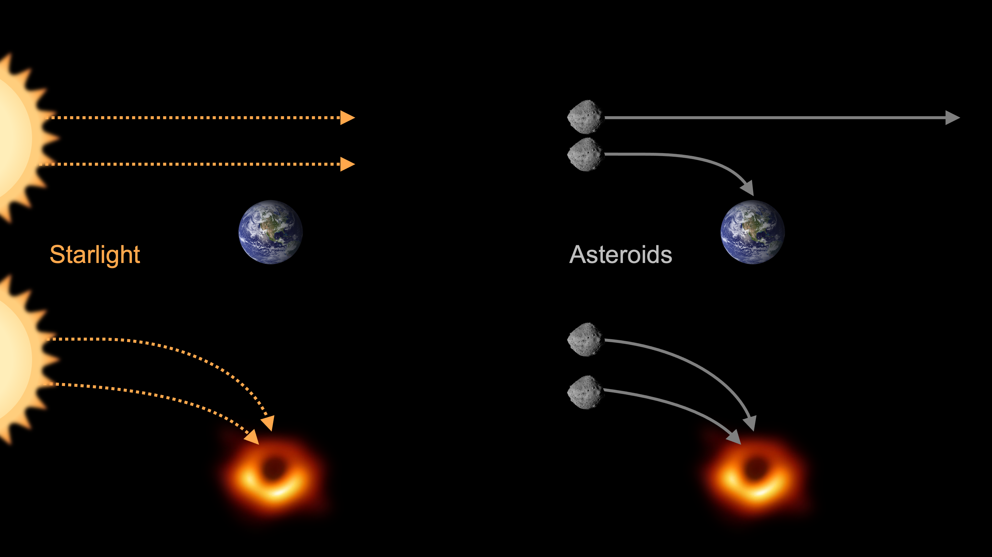
Black Holes – Black Holes vs. Planets
Exoplanet Communications
exoplanets.nasa.gov
Notes:
This slide does not contain any animated elements
Description:
This is the summary slide.

