Slide 1
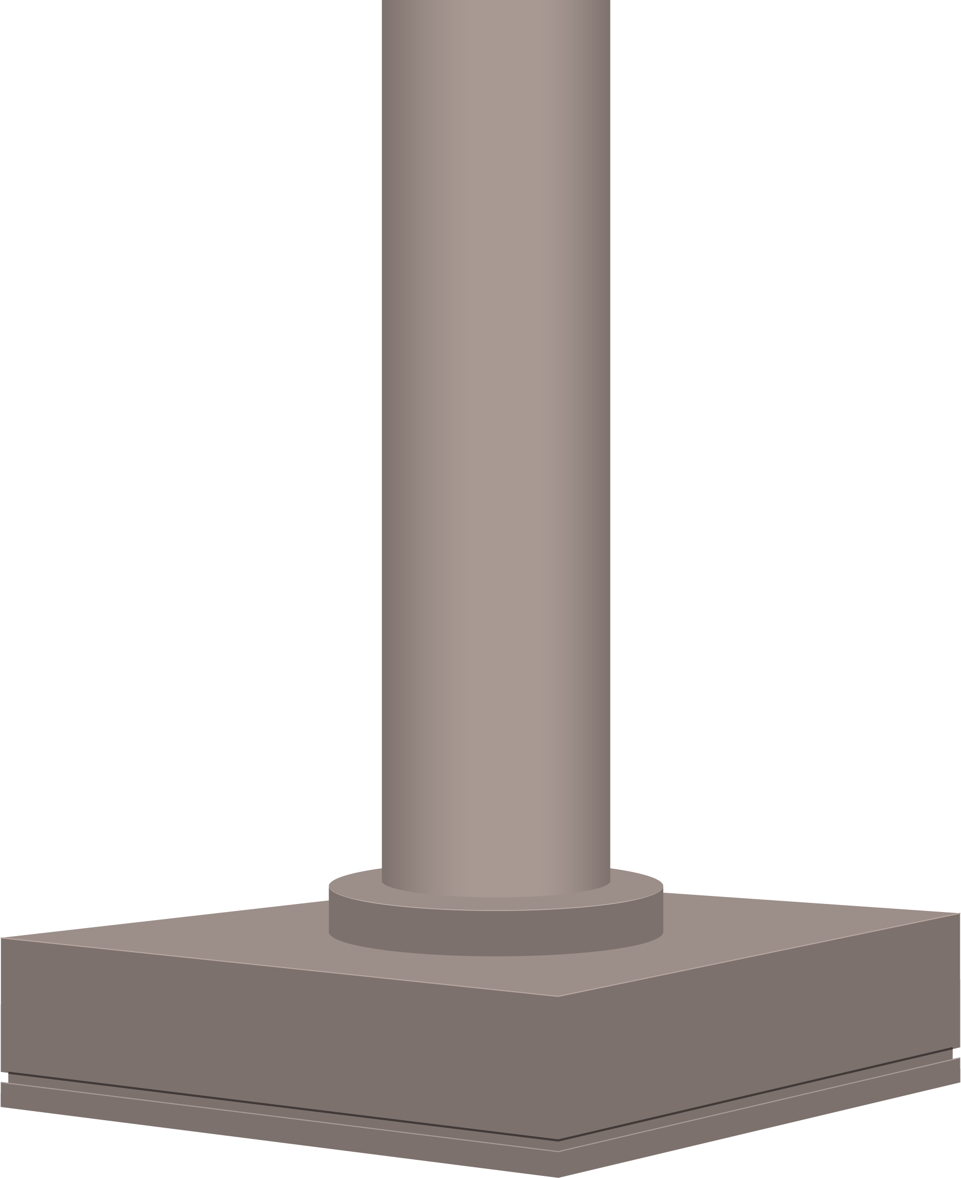
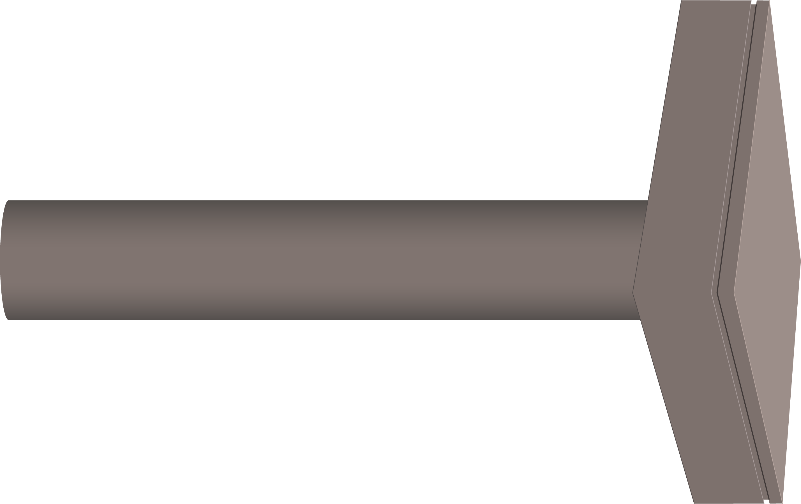
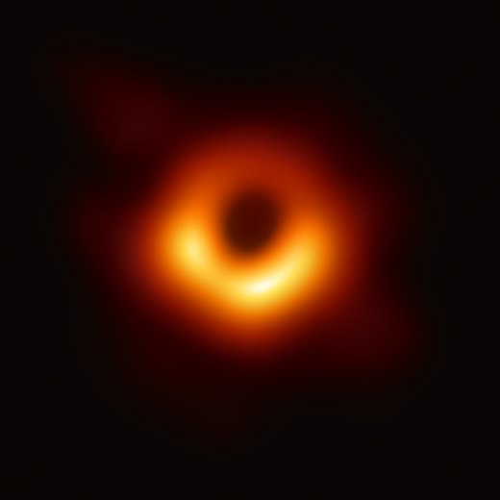

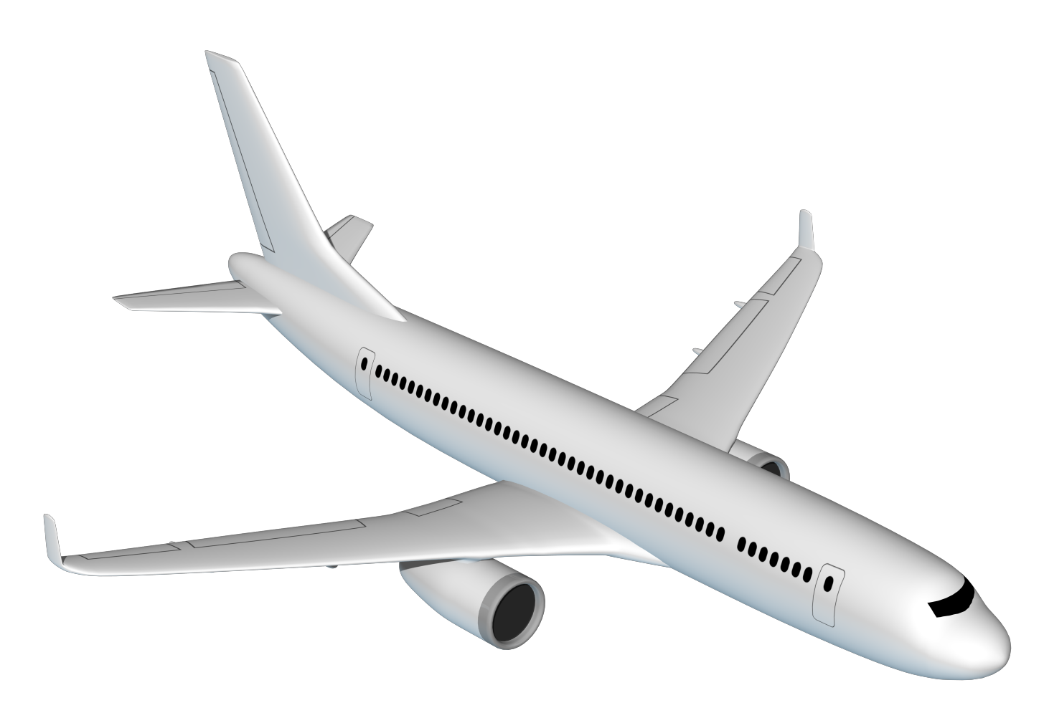
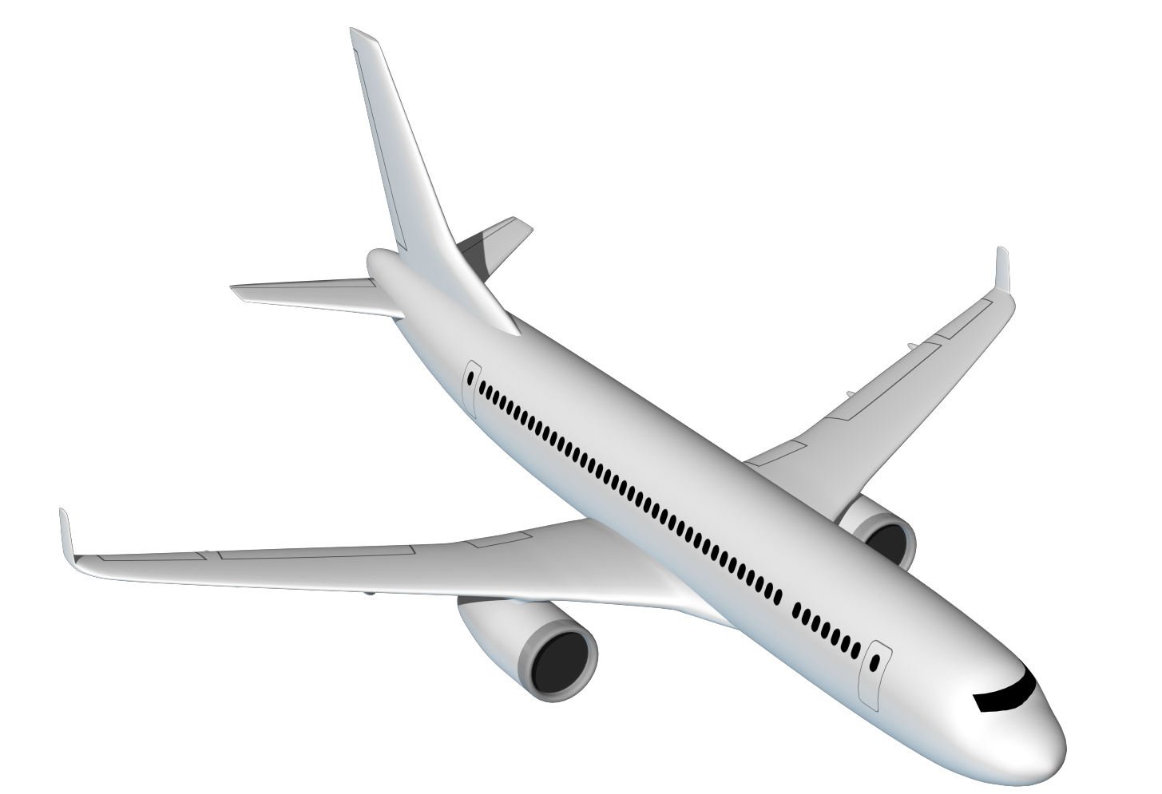
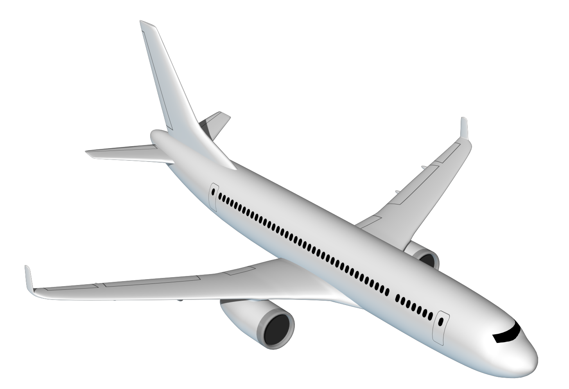
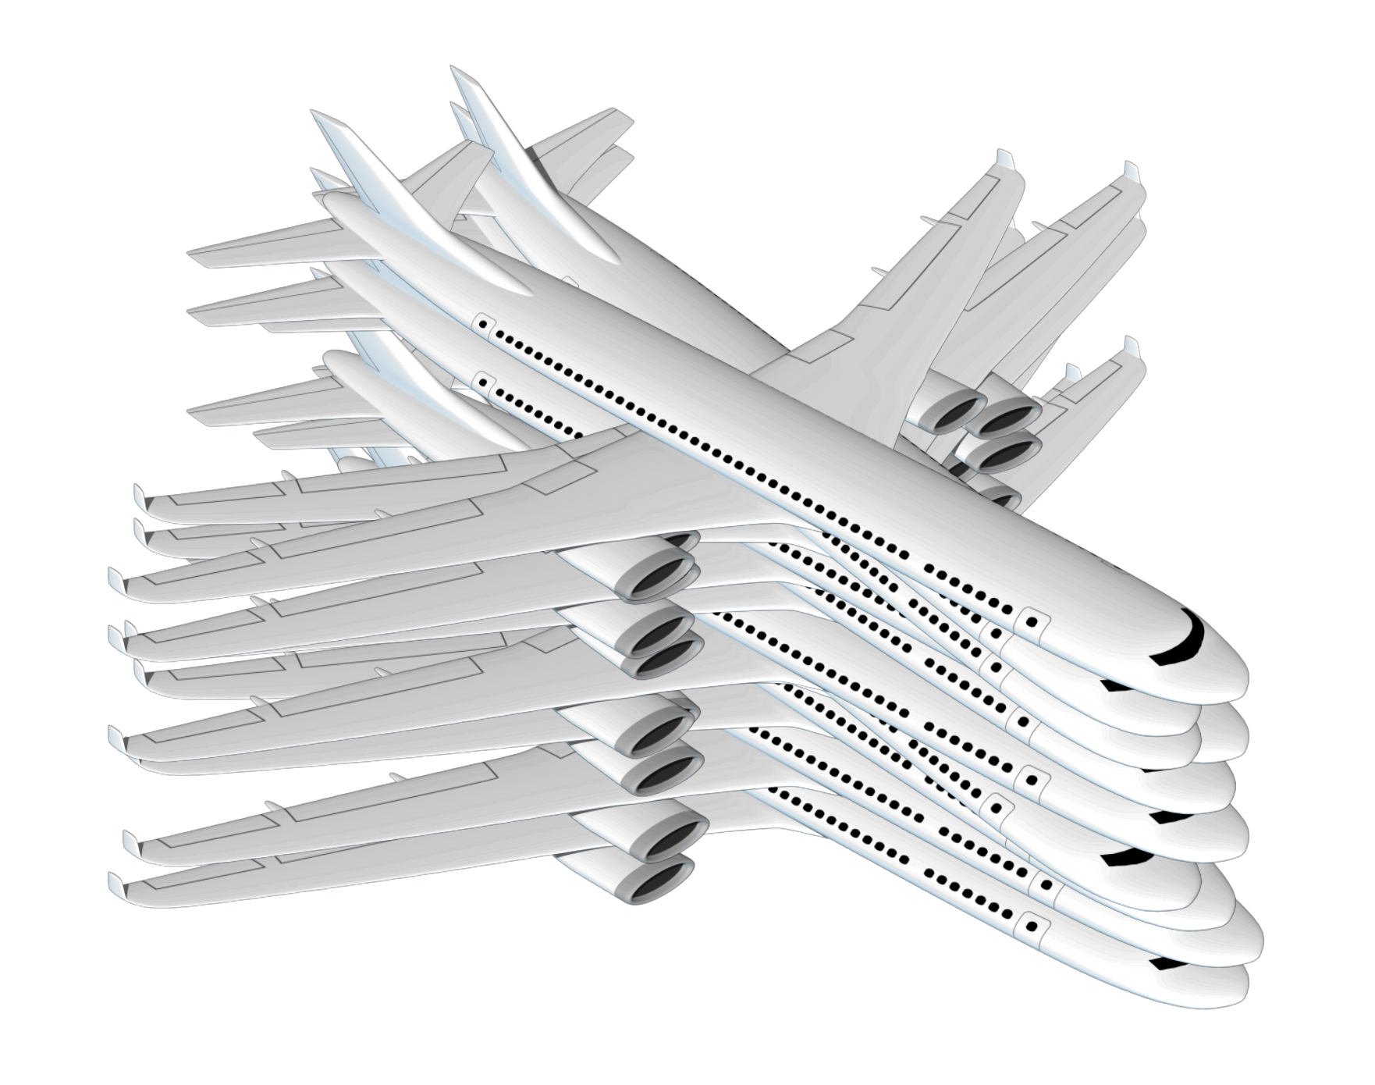

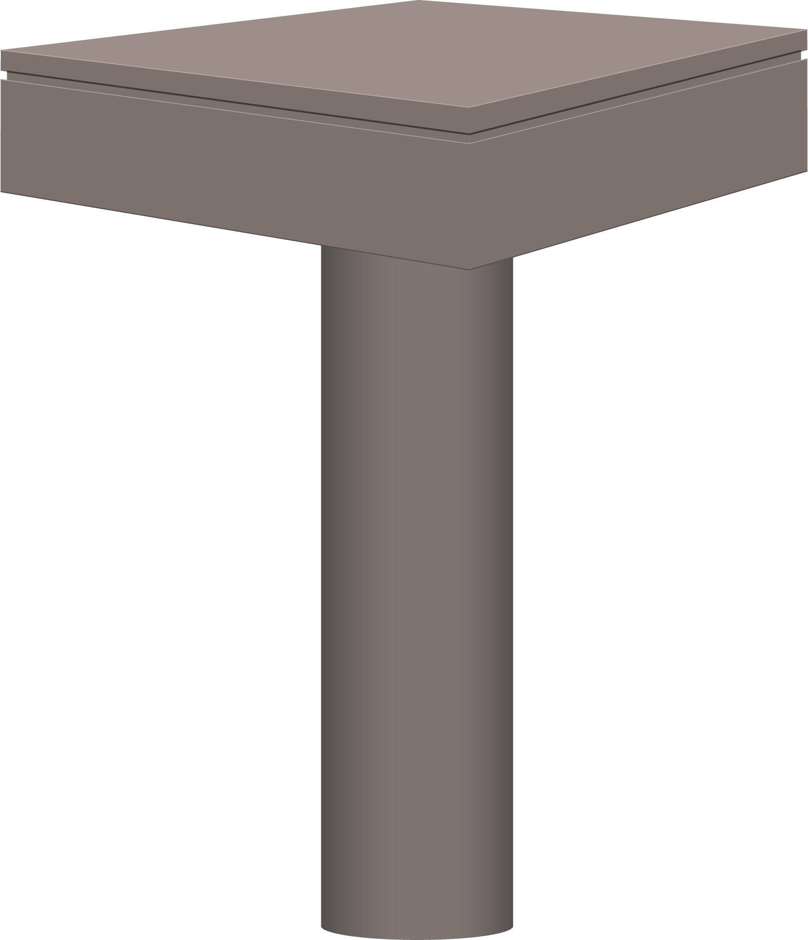
Black Holes – What are Black Holes?
Exoplanet Communications
It’s as if…
One description…
An astronomical object that is very, very massive, and yet whose mass is contained in a very, very small volume.
You had one commercial airliner,
then stacked nine
more on top.
Until you were left with something the size of…
Compressed
them down…
a tiny single die.
Numbers…
Black holes are 1,000 times more massive than that of the Sun,
yet with about the size of Earth.
(Applies to intermediate-mass black holes)
exoplanets.nasa.gov
Notes:
This sequence requires 3 clicks:
First click brings up a description of a black hole
Second click brings up numerical data
3) Third click initiates animation sequence (airliners, compression, magnifying glass)
Audience:
4th Grade and older.
Description:
This slide explains and illustrates how dense black holes are, using the animated example.
User's notes:
The additional information can be available at e.g., https://www.nasa.gov/audience/forstudents/k-4/stories/nasa-knows/what-is-a-black-hole-k4.html,
https://eventhorizontelescope.org/press-release-april-10-2019-astronomers-capture-first-image-black-hole,
https://www.ligo.caltech.edu/page/gw-sources.
NOTE:
This PowerPoint file has built-in interactive elements.
To view them, you must be in "Slide Show" mode; you can then move to the next view either by clicking your mouse, the spacebar, or the arrow keys.
This slide will not work in "regular viewing mode."
Credit:
NASA/JPL-Caltech

