Slide 1
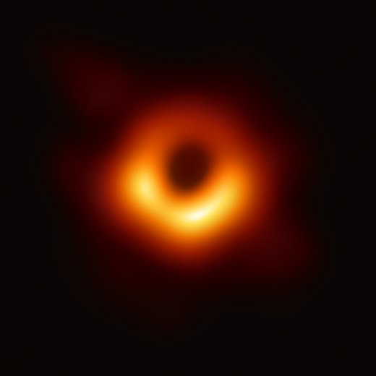
Black Holes – Three Kinds
Exoplanet Communications
Mass: ~ 10 times the Sun
Size: ~ 30 km
Origins:
Form after the death of massive stars (supernovae)
Mass: ~ 1,000 times the Sun
Size: ~ 1000 km
Origins:
Still unknown...
May be the accumulation of surrounding materials and merging of stellar black holes and/or dark matter
Mass: between ~ 100,000 and 10 billion times the Sun
Size: ~ 100,000 km
(~ Jupiter’s diameter)
to ~3 billion km
(~ Uranus’ orbit)
Origins:
Still unknown...
May be the accumulation of surrounding materials and merging of stellar black holes and/or dark matter
Stellar
black holes
Intermediate-mass black holes
Supermassive black holes
exoplanets.nasa.gov
Notes:
This slide requires 3 clicks:
Highlights topic #1 (stellar black holes)
Dims topic #1 and highlights topic #2 (intermediate-mass black holes)
Dims topic #2 and highlights topic #3 (supermassive black holes)
Audience:
9th Grade and older.
Description:
This slide addresses the common questions about black holes raised by the audience.
User's notes:
The additional information can be available at e.g., https://www.nasa.gov/audience/forstudents/k-4/stories/nasa-knows/what-is-a-black-hole-k4.html,
https://eventhorizontelescope.org/press-release-april-10-2019-astronomers-capture-first-image-black-hole,
https://www.ligo.caltech.edu/page/gw-sources.
NOTE:
This PowerPoint file has built-in interactive elements.
To view them, you must be in "Slide Show" mode; you can then move to the next view either by clicking your mouse, the spacebar, or the arrow keys.
This slide will not work in "regular viewing mode."
Credit:
NASA/JPL-Caltech

