Slide 1
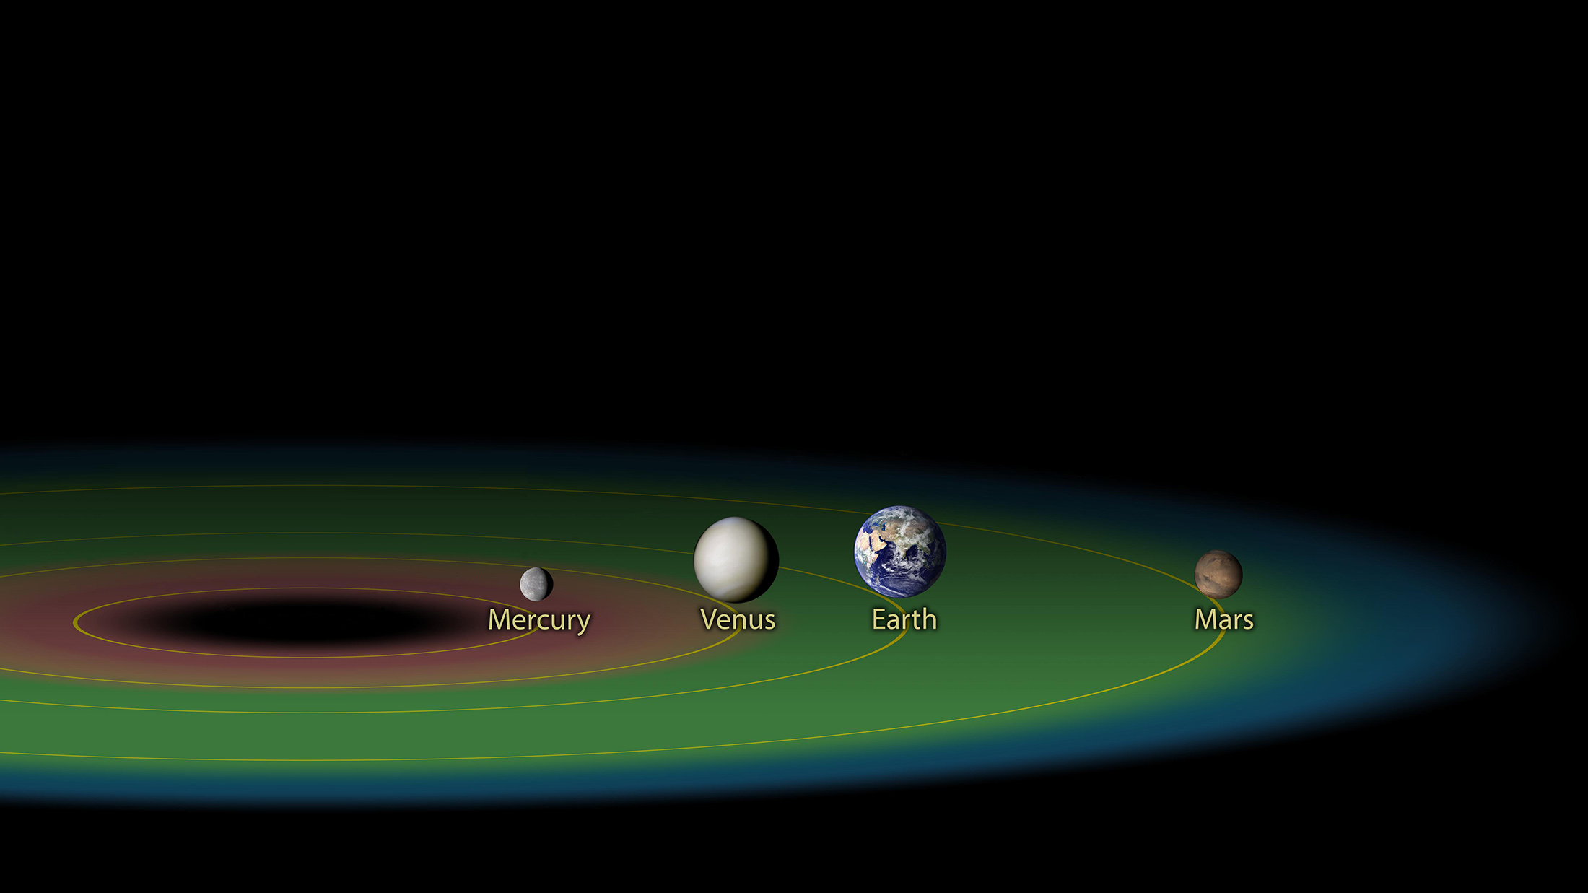


Comparison of TRAPPIST-1 – with Inner Solar System
Exoplanet Communications
TRAPPIST-1 System
Inner Solar System
Notes:
Adapted from existing image.
– Cutout TRAPPIST-1 section and created left hand section of orbits (not in original image).

