Slide 1
Speed Comparison – Jet Airliner vs. Small Astronomical Bodies
Exoplanet Communications
jpl.nasa.gov

Slide 2
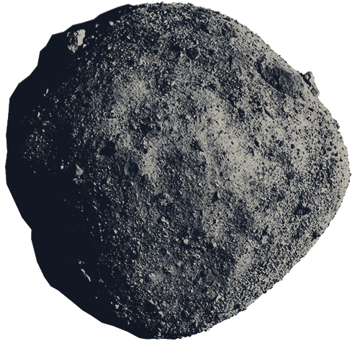
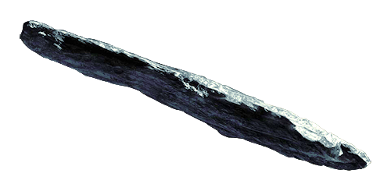
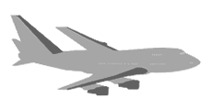
Speed Comparison – Jet Airliner vs. Small Astronomical Bodies
Exoplanet Communications
Asteroid Bennu
100x faster
Size Comparison?
Interstellar Object Oumuamua
100x faster
jpl.nasa.gov
Notes:
Bennu → indicate speed (100 times faster than plane); about 500 meters long
Oumuamua → indicate speed (100 times faster); 100-1000 meters long (probably 400 m)
Airplane - about 1,000 Km/h; 70 meters long; 38.5 m long (may be more common)

