Slide 1


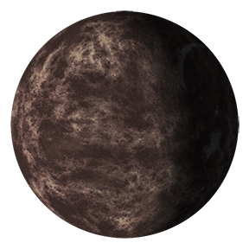
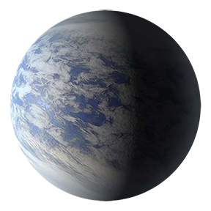


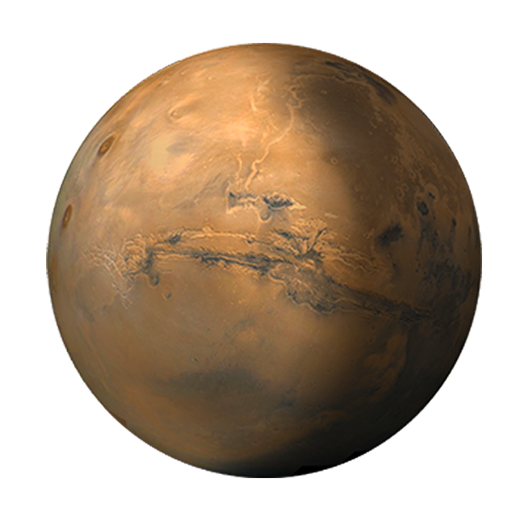
Comparison of Exoplanets’ Locations – with Solar System Planets
Exoplanet Communications
Temperature
(Degrees Kelvin)
Distance
(from star)
|
1500° K
|
800° K
|
300° K
0.1
0.2
0.3
0.4
0.5
0.6
0.7
0.8
0.9
1
1.1
1.2
1.3
1.4
1.5
1.6
Astronomical Units
Temperature
(Degrees Kelvin)
Distance
(from Sun)
|
340° K
|
290° K
|
210° K
0.1
0.2
0.3
0.4
0.5
0.6
0.7
0.8
0.9
1
1.1
1.2
1.3
1.4
1.5
1.6
Astronomical Units
Notes:
Top: exoplanetary systems around the Sun
the temperature of the inner one is >1500K (0.04 au),
the middle one is 800K (0.13 au)
the outer one is 300K (1 au)
bottom: solar system
Mercury: 340K
Earth: 290K
Jupiter: 170K

