Slide 1
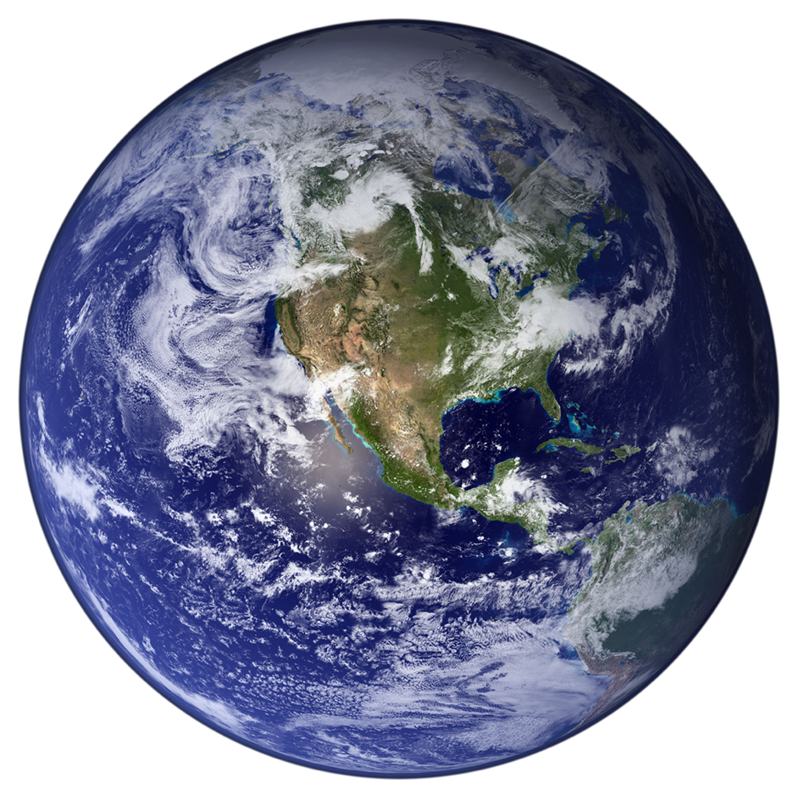
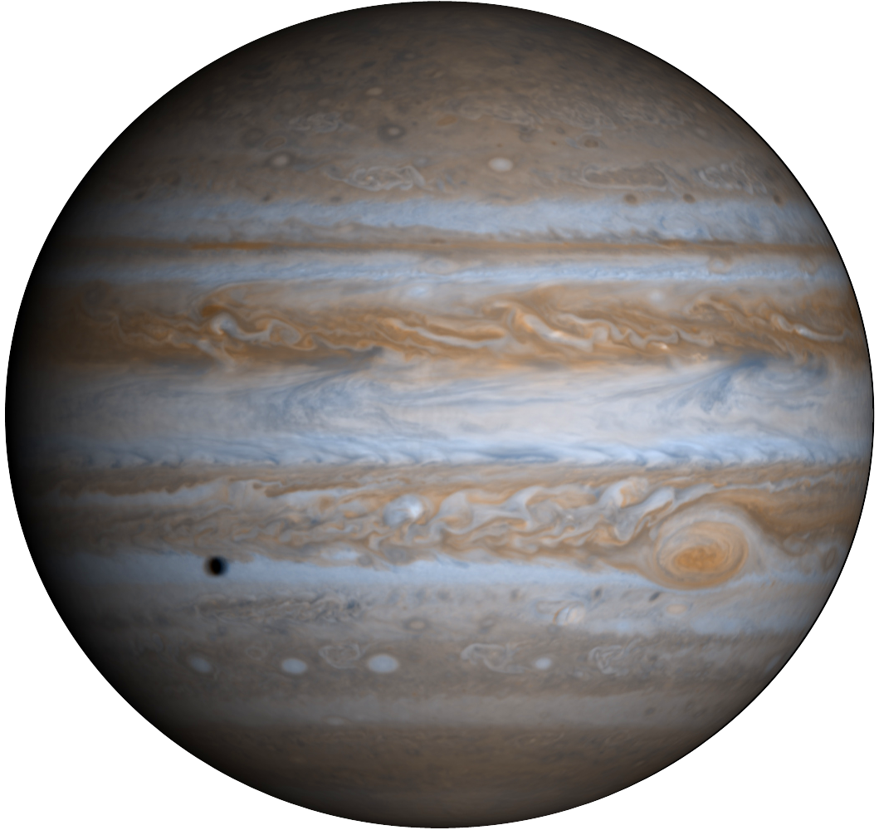
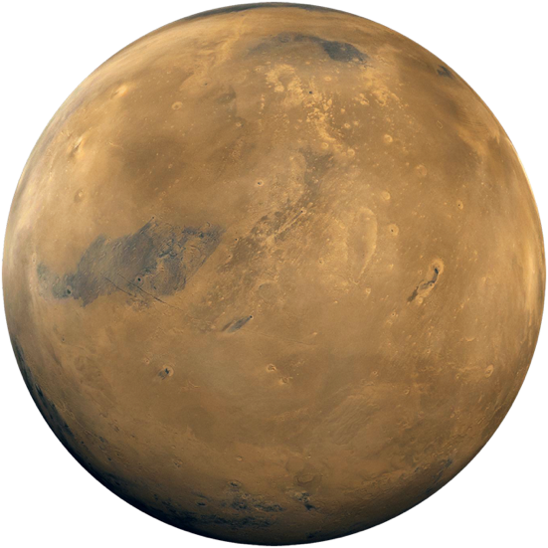
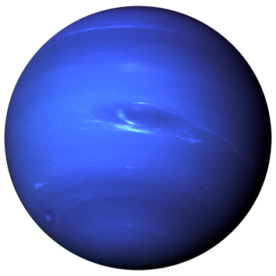
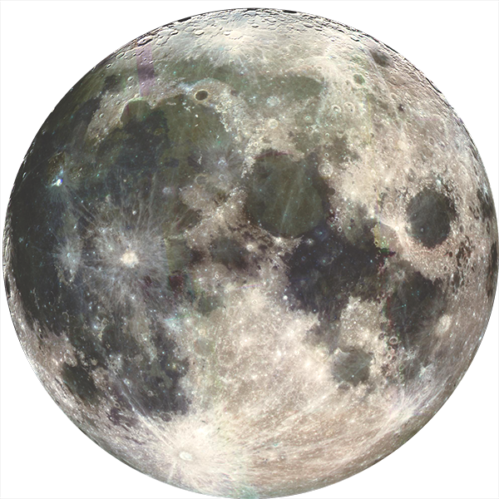
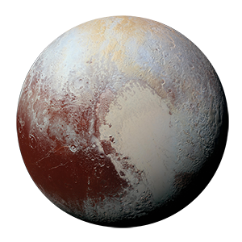
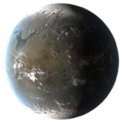

Comparison of Planet Sizes – Solar System
Exoplanet Communications
Earth
Mars
Moon
Pluto
Ceres
Earth
Mars
Moon
Pluto
Ceres
Jupiter
Neptune
Super-Earth
exoplanets.nasa.gov
Notes:
Ceres (as a large planetesimal): R=470 km, density= 2 g/cm^3
Pluto (as a protoplanet):R=1.2 mega m, density = 1.9 g/cm^3
Mars (as a protoplanet):R=3.4 mega m, density = 3.9 g/cm^3
Earth (as a planet):R=6.4 mega m, density = 5.5 g/cm^3
SuperEarth (use image for size): R ~ 10 mega m
Neptune (possibly a superEarth?): R=25 mega m, density = 1.6 g/cm^3
Jupiter: R=70 mega m, density = 1.3 g/cm^3
The additional info can be found at https://exoplanets.nasa.gov/what-is-an-exoplanet/planet-types/super-earth/

