Slide 1
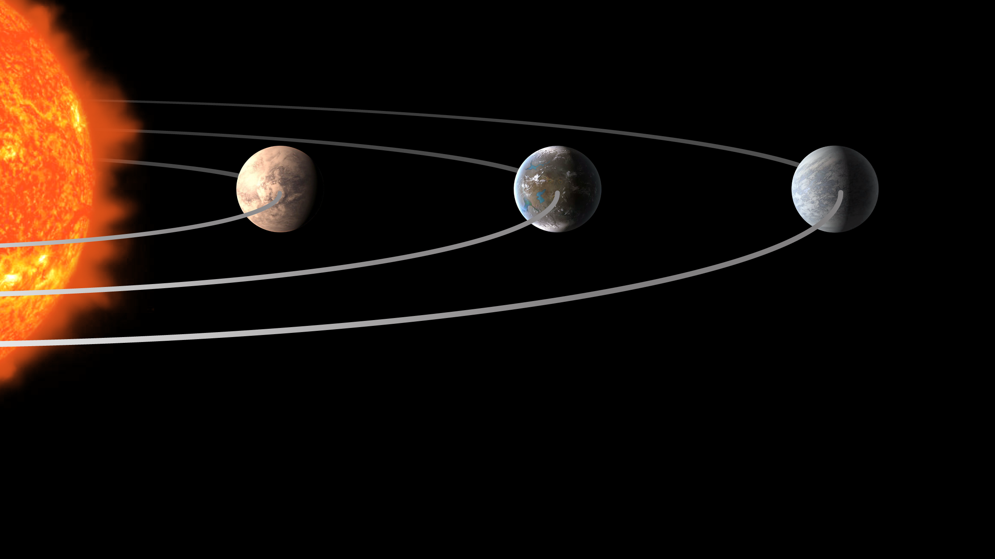
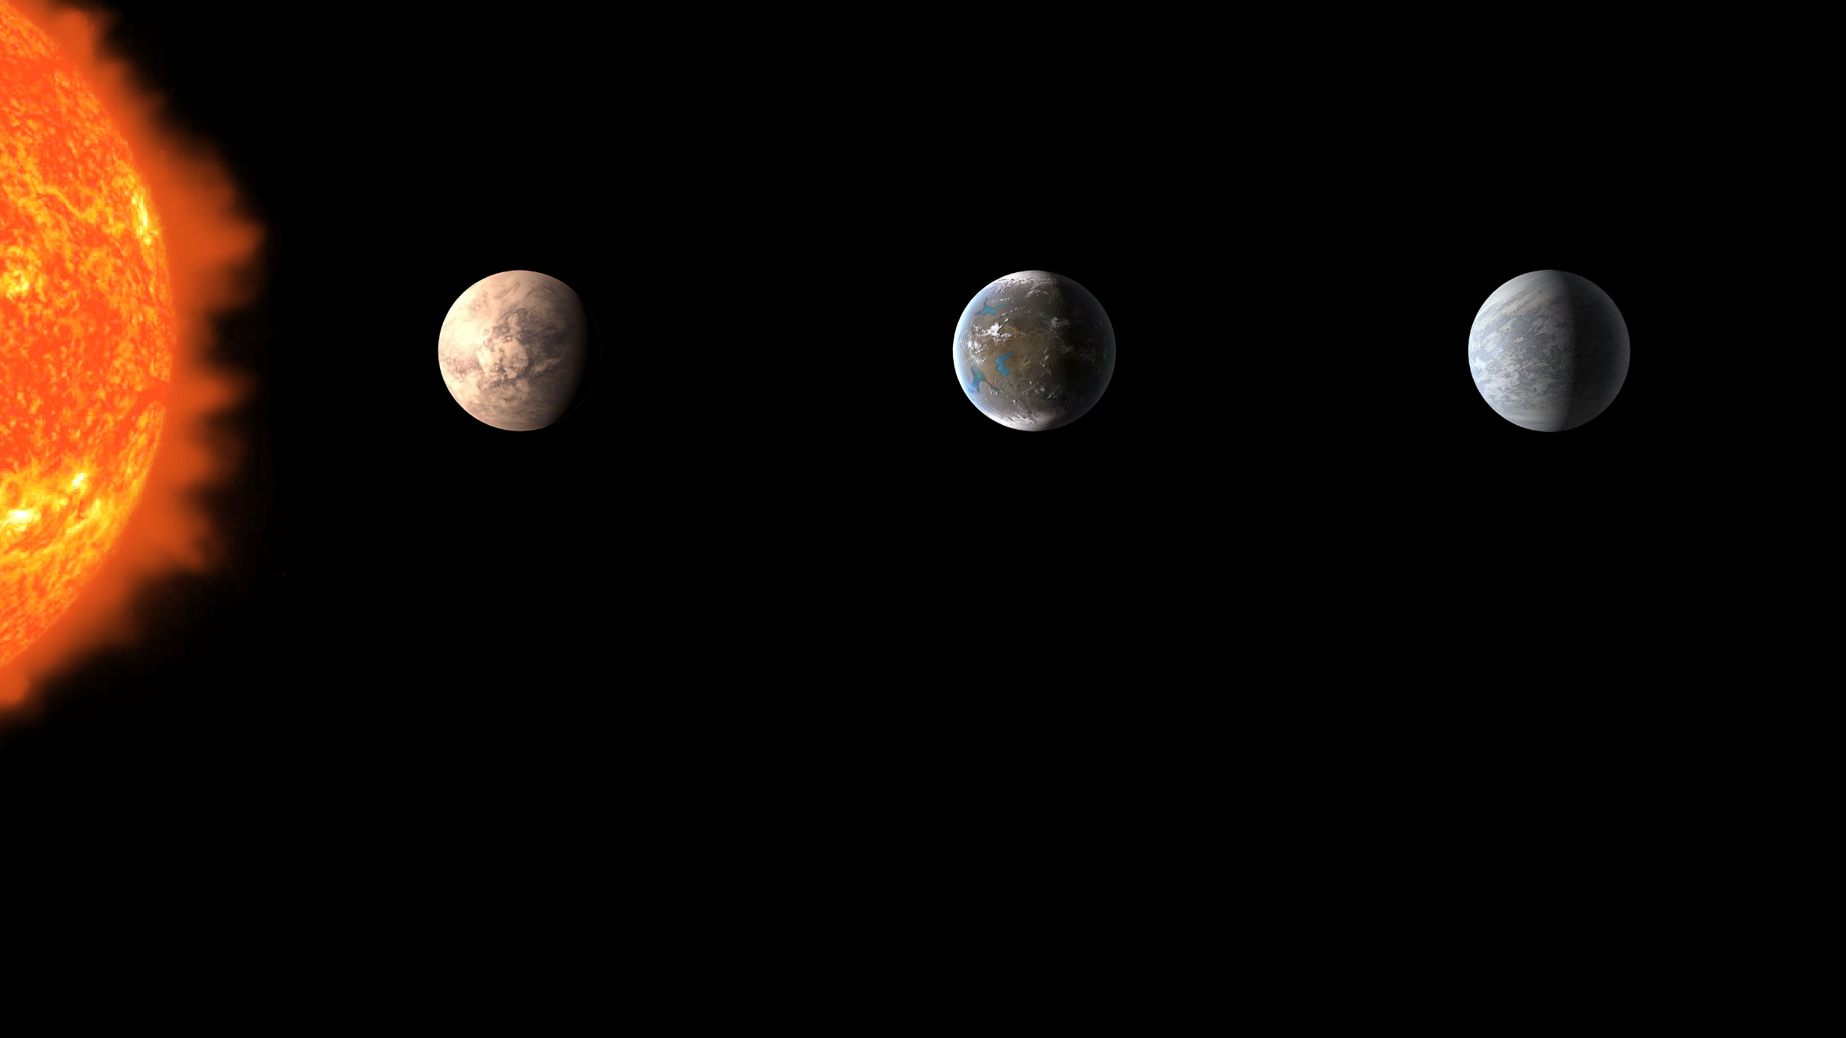
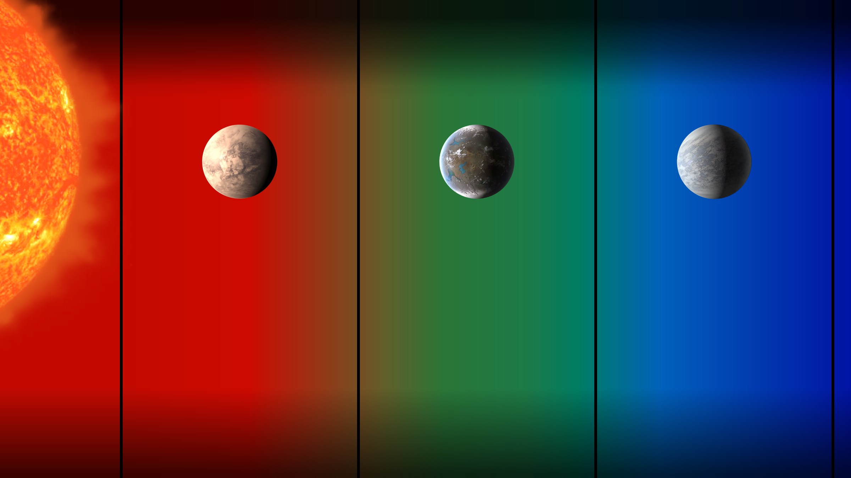
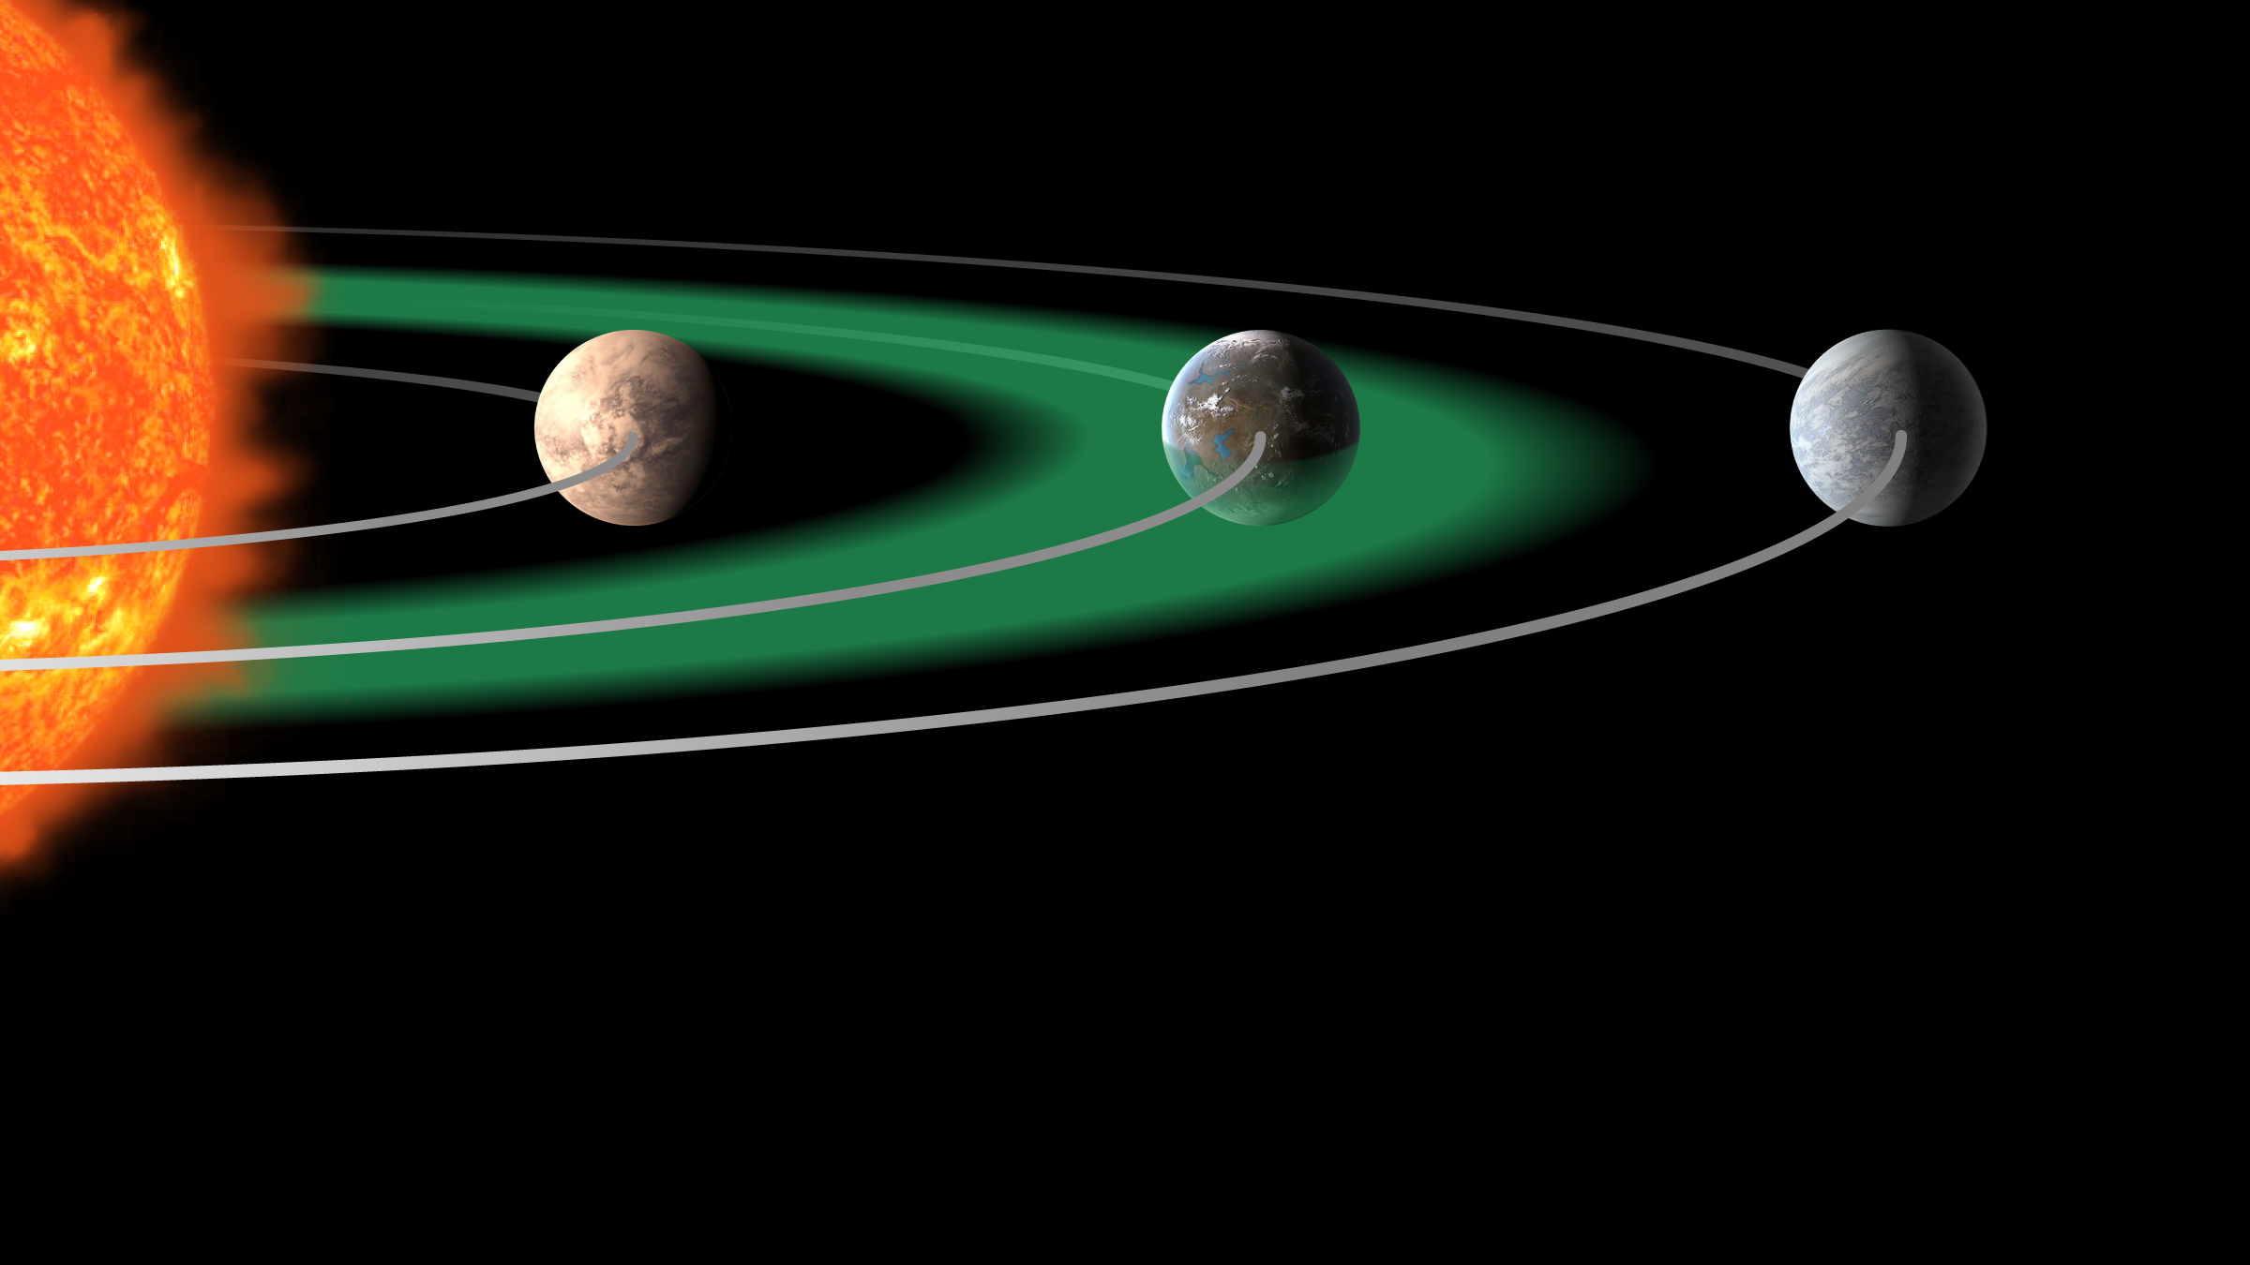
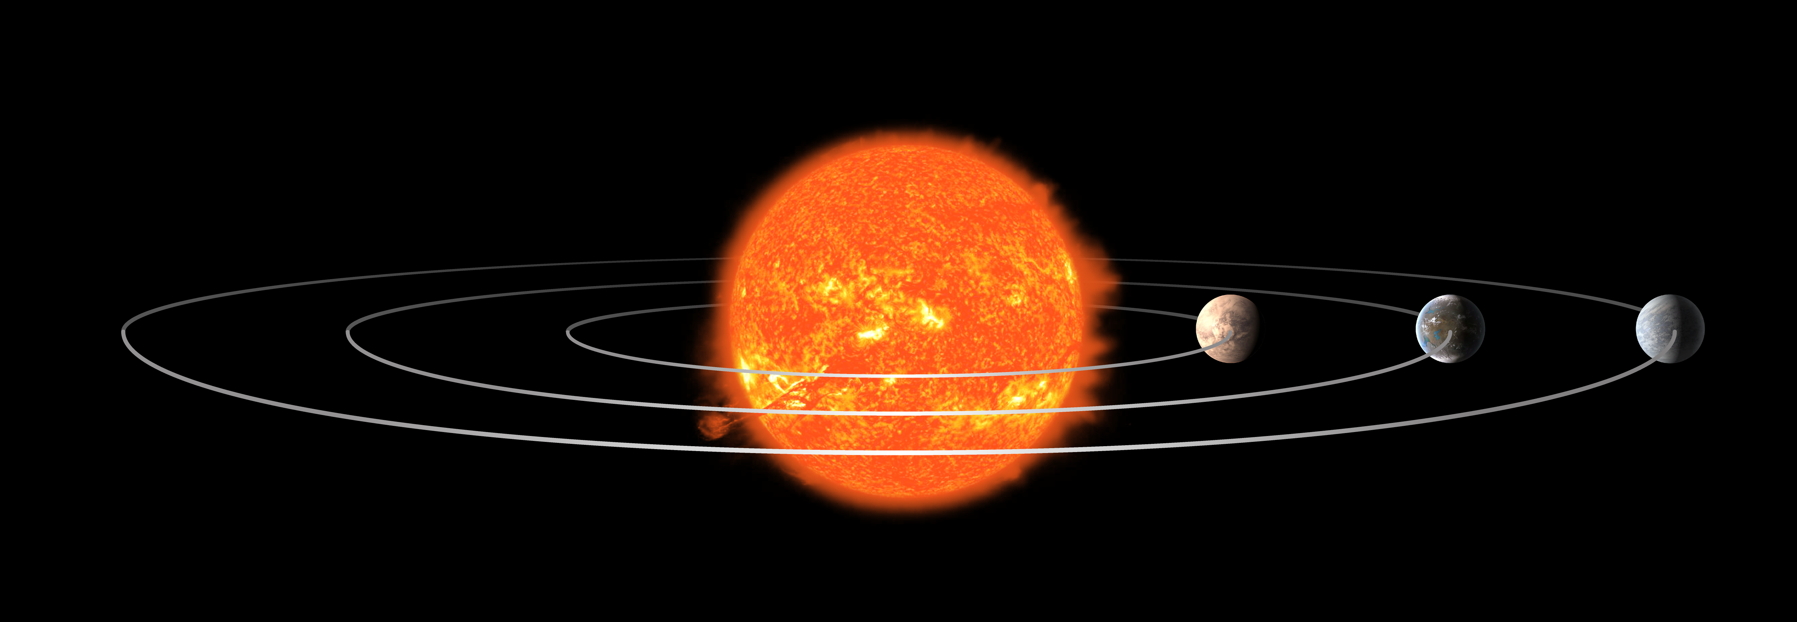





The Habitable Zone
Exoplanet Communications
too hot
just right
too cold
exoplanets.nasa.gov
Notes:
Habitable Zones Compared to the Size of the Hosting Star -- Audience: 4th Grade and older.
Description:
This slide explains and illustrates what a "habitable zone" is, and how it would change based on the size of the host star.
User's notes: The represented Scale of Sun and planets are greatly exaggerated. Depending on its size, a star can be "whiter" or "redder" - as it was approximately reflected in this slide. However, the exact color of each of the three sizes of star in these slides is not accurate; the focus of these slides is to explain the "Habitable Zone" and how it changes based on the size of the hosting star.
NOTE: This PowerPoint file has built-in interactive elements. To view them, you must be in "Slide Show" mode; you can then move to the next view either by clicking your mouse, the spacebar, or the arrow keys. This slide will not work in "regular viewing mode."
Animation in presentation mode:
1st click: zoom in on 3 planets
2nd click: 3 colored zones appear
3rd click: thermometers appear showing ”too hot”, ”too cold” and “just right”
4th click: container appears with liquid water
5th click: a second container appears with water vapor
6th click: a third container appears with frozen water
7th click: graphics change to show habitable zone represented as a green disk

Slide 2
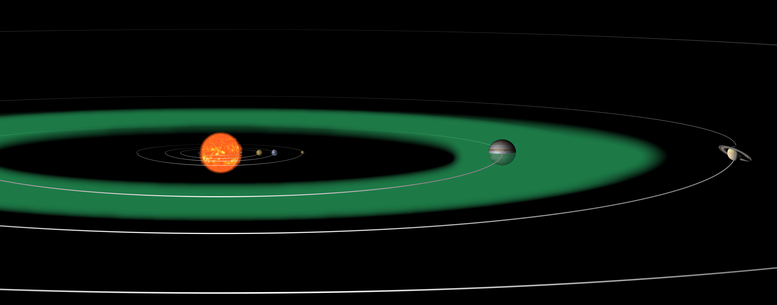


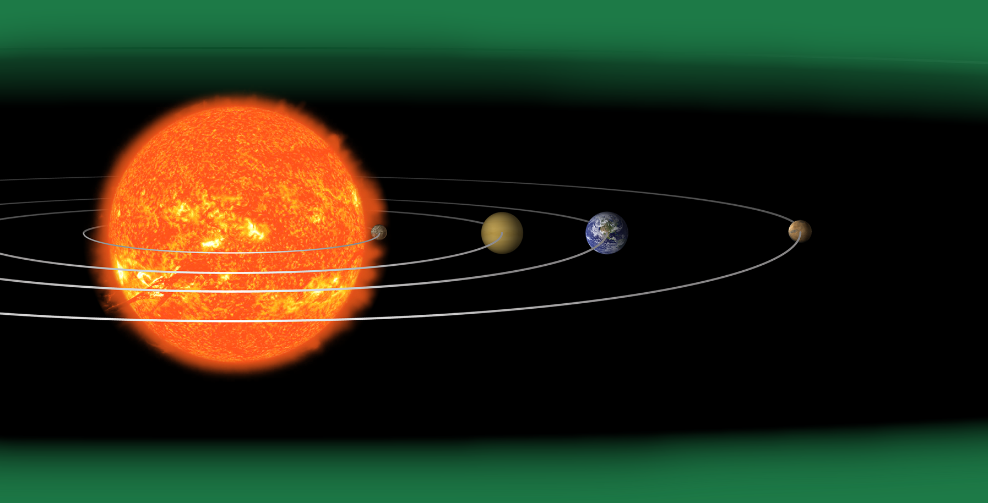
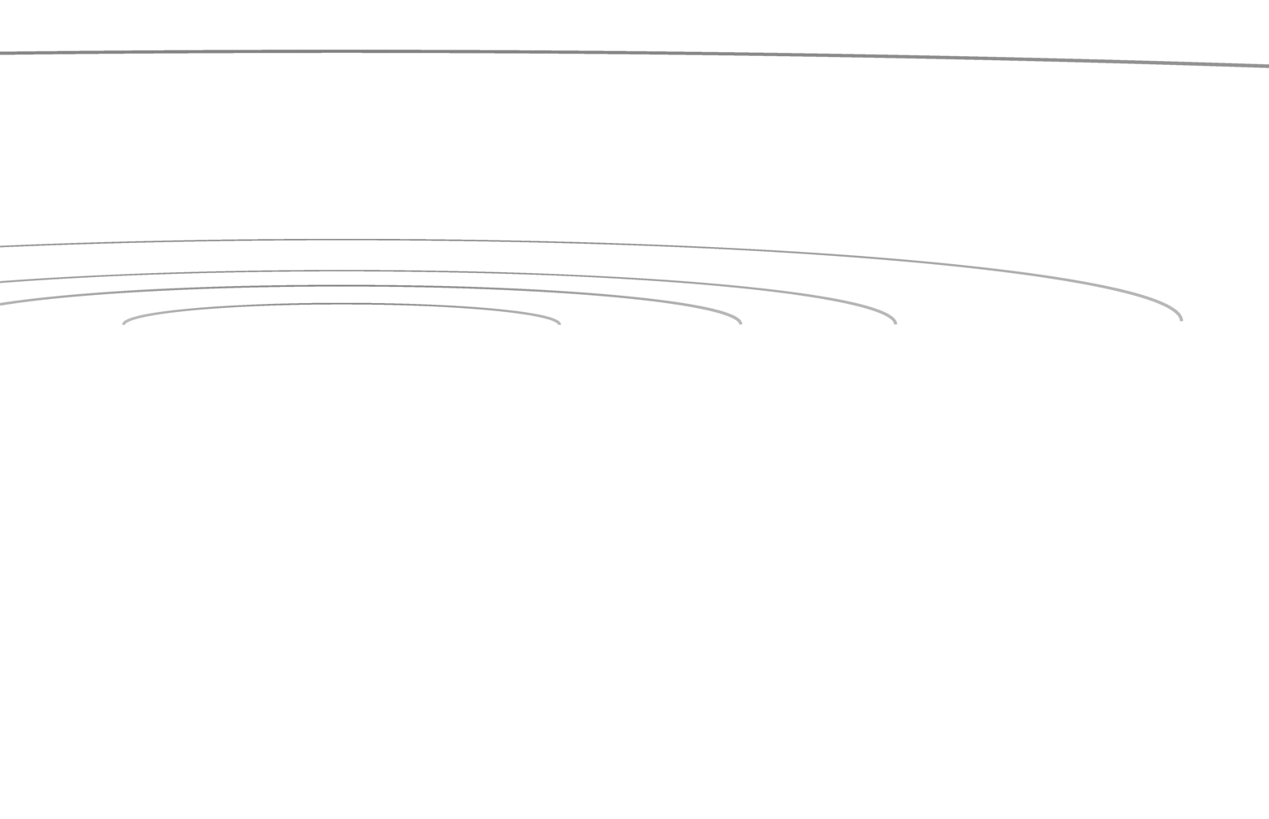
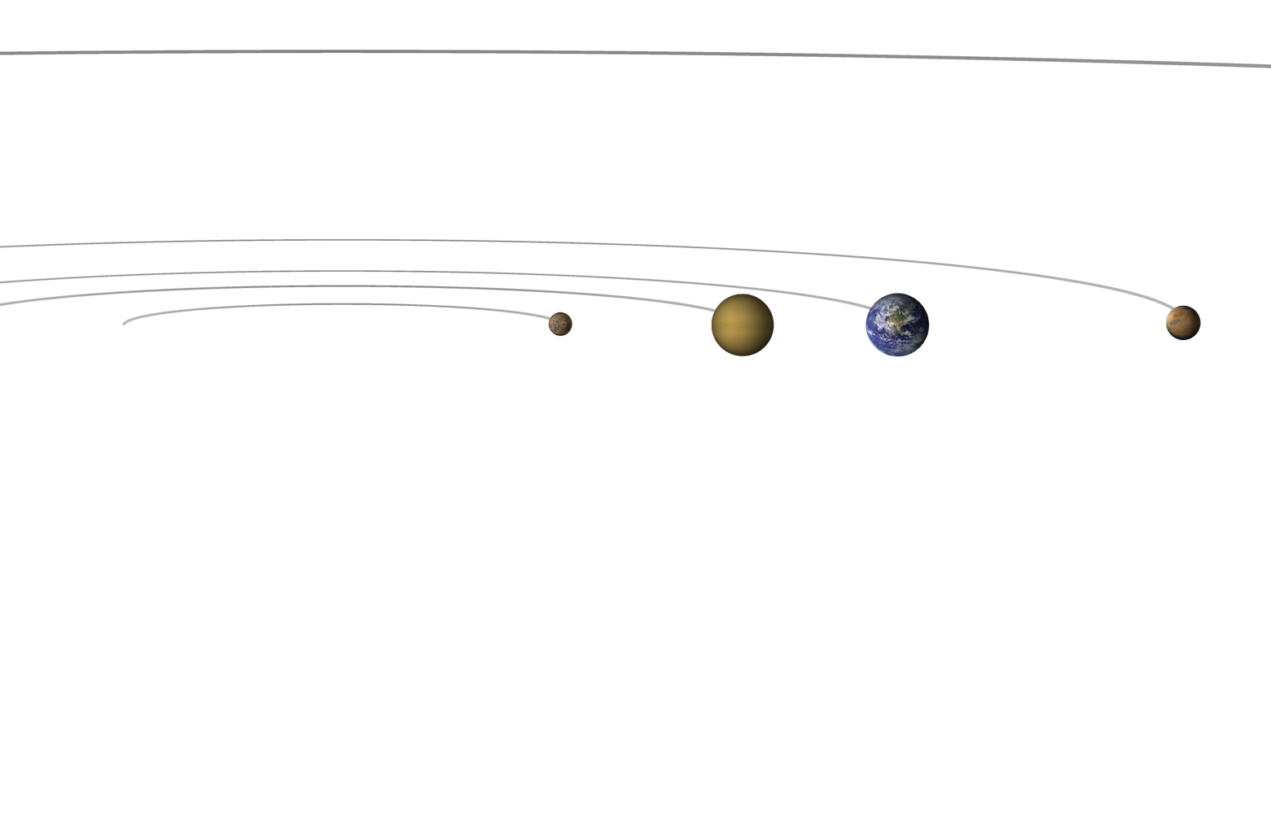
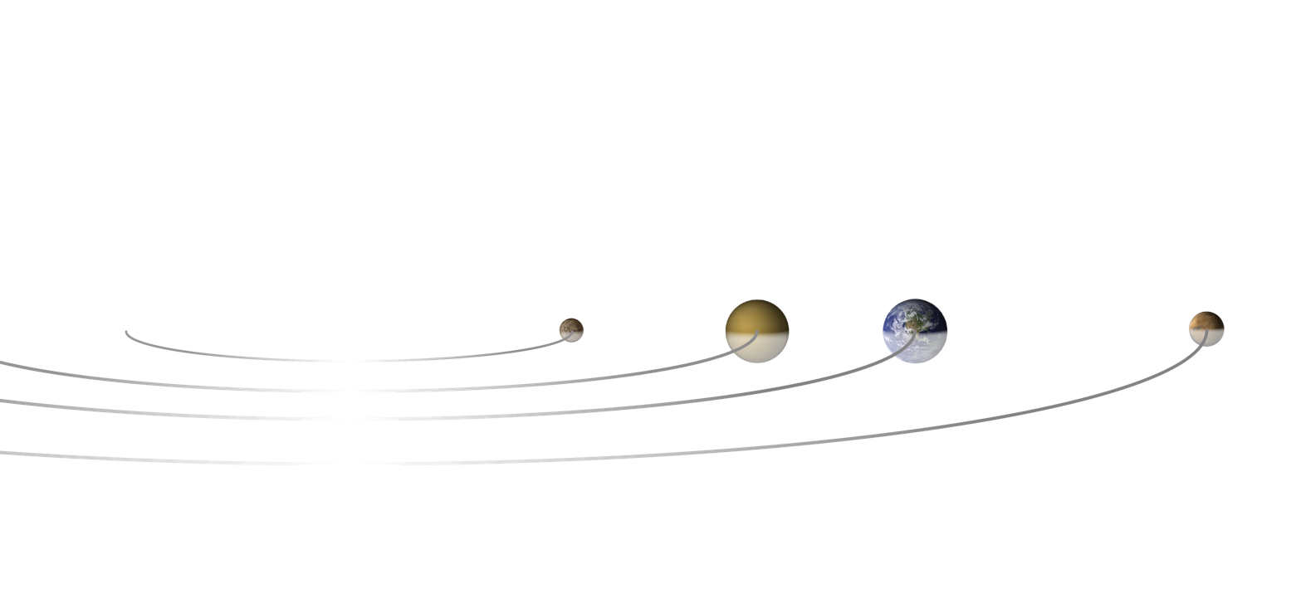


Comparison of Habitable Zones – With Different Types of Stars
Balance for zoom out
Exoplanet Communications
Twice the size of our Sun
Our Sun
Half the size of our Sun
Scale of Sun and planets are greatly exaggerated
Notes:
Habitable Zones Compared to the Size of the Hosting Star -- Audience: 4th Grade and older.
This slide explains and illustrates what the "habitable zone" is, and how it would change if the size of the hosting star is dramatically different.
User's note: Scale of Sun and planets are greatly exaggerated. Depending on its size, a star can be "whiter" or "redder" - as it was approximately reflected in this slide. However, the exact color of each of the three sizes of star in these slides is not accurate; the focus of these slides is to teach about the "Habitable Zone" as the size of the hosting star changes.
Click 1: The Sun moves out and is replaced by a star half the size of the Sun; habitable zone scales accordingly
Click 2: The small star moves out and is replaced by a star twice the size of the Sun; habitable zone scales accordingly

