Slide 1
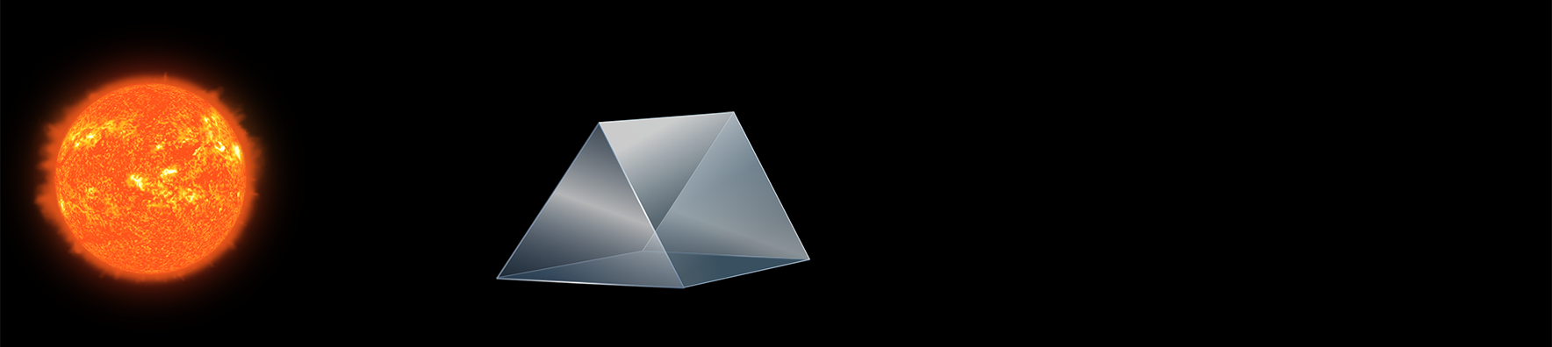
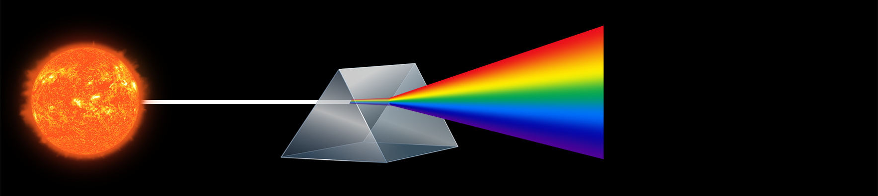

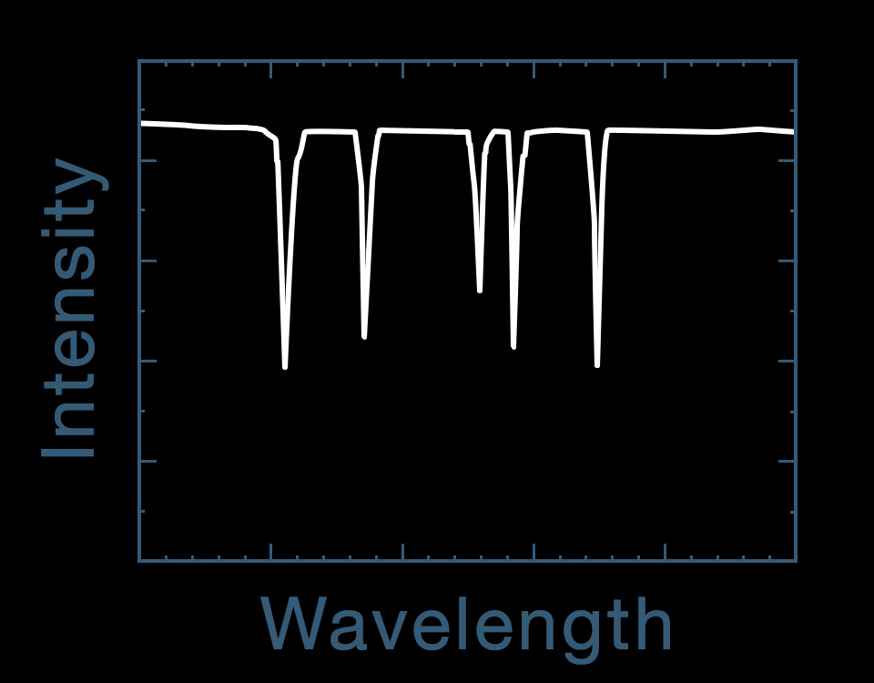
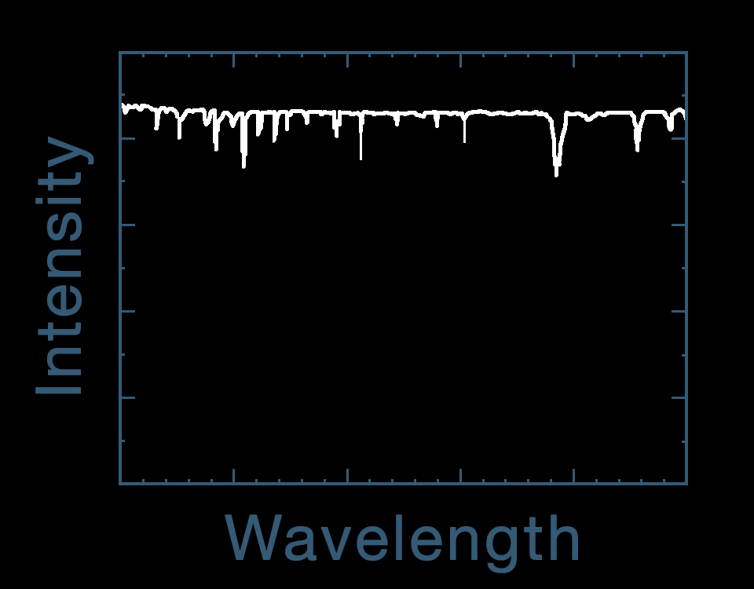
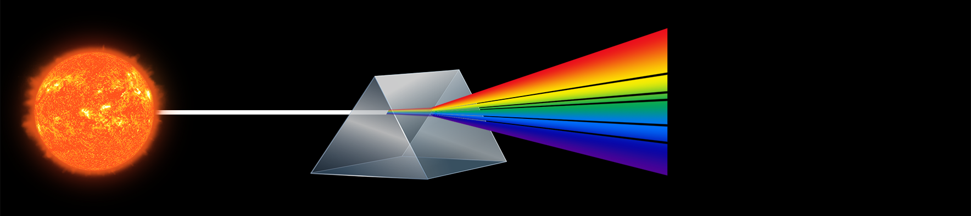

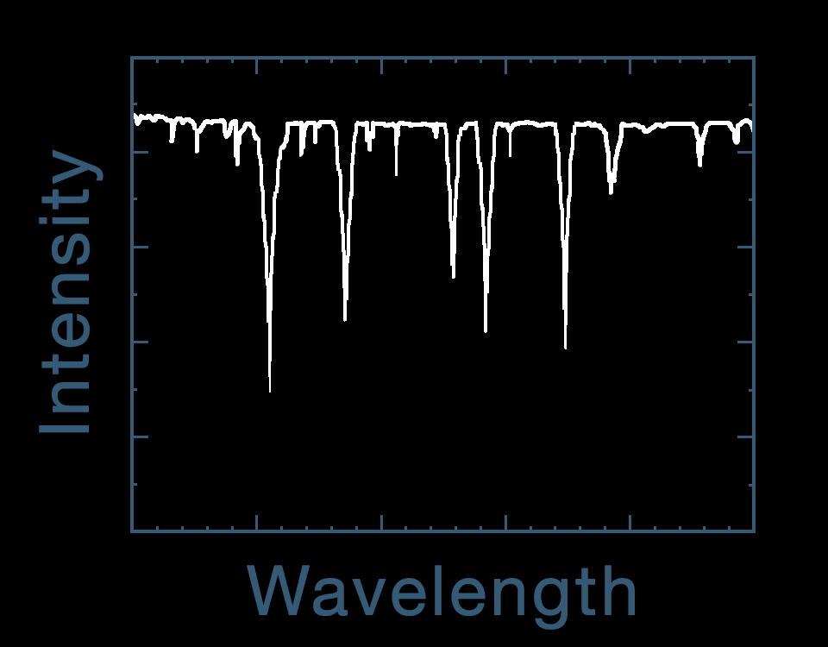
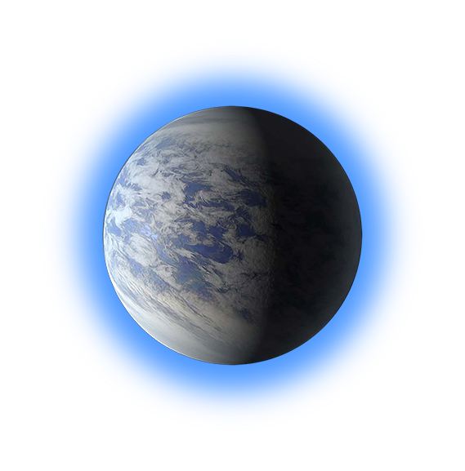
Spectroscopy – Detection of Biosignatures
Exoplanet Communications
Light from star
minus
−
equals
=
Star
Instrument
Light from
star & planet
Light from
star only
Light from
planet only
Light from star
passes through planet’s atmosphere
Notes:
Spectroscopy - Detection of Bio Signatures Audience: 9th Grade and older.
Description:
This slide illustrates how scientists use Spectroscopy to determine what substances are present in the atmosphere of a celestial body.
User's notes: In these charts, the dips are extremely exaggerated, especially for “the light from planet only.” In reality, such dips are very shallow, and that’s why astronomers require such big telescopes. One dip in “Light from planet only” does not correspond to either water or methane. This indicates that another atom/molecule is present in the planet's atmosphere.
NOTE: This PowerPoint file has built-in interactive elements. To view them, you must be in "Slide Show" mode; you can then move to the next view either by clicking your mouse, the spacebar, or the arrow keys. This slide will not work in "regular viewing mode."
Click 1: light from star passes through prism
Click 2: light from star passes through planet’s atmosphere before passing through prism
Click 3: star, prism and gradients disappear, then absorption lines reposition, then labels appear
Click 4: slide change

Slide 2
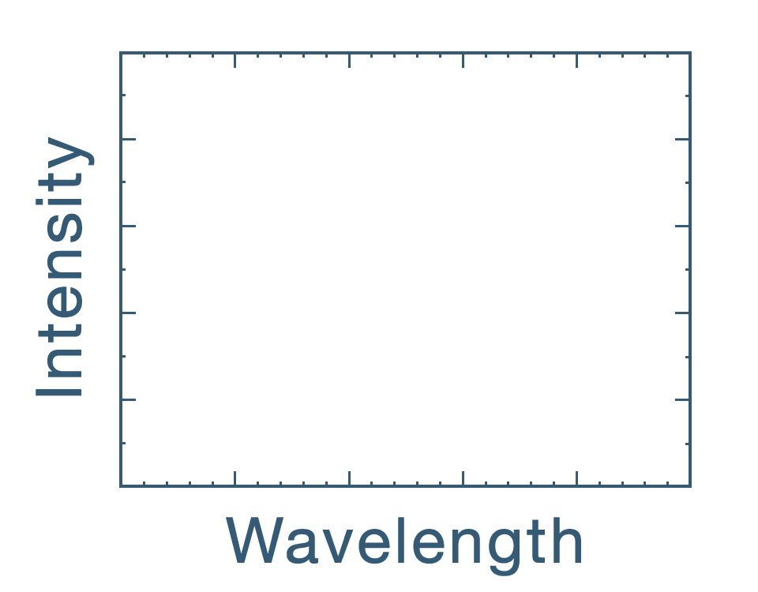
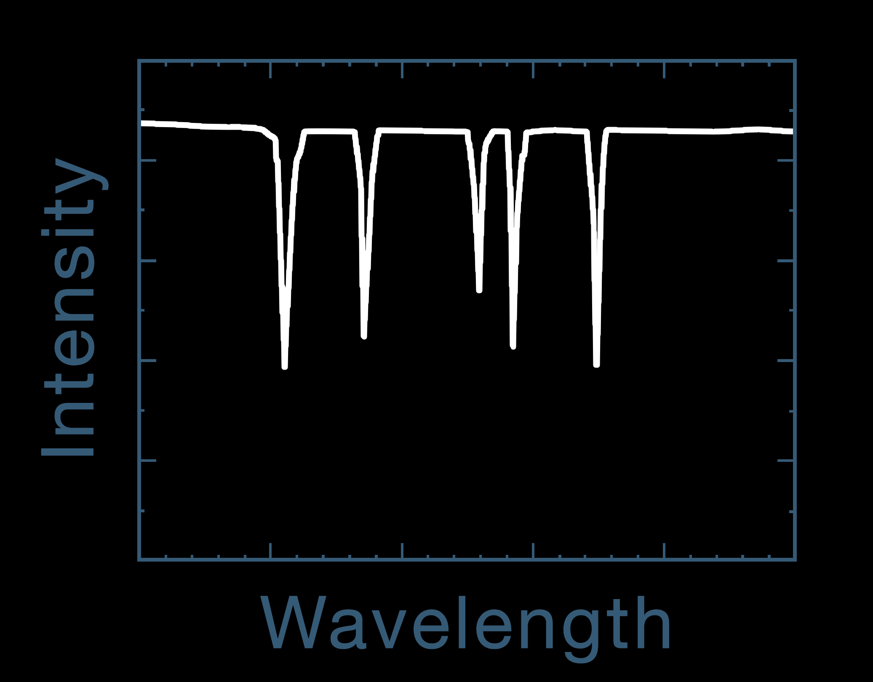
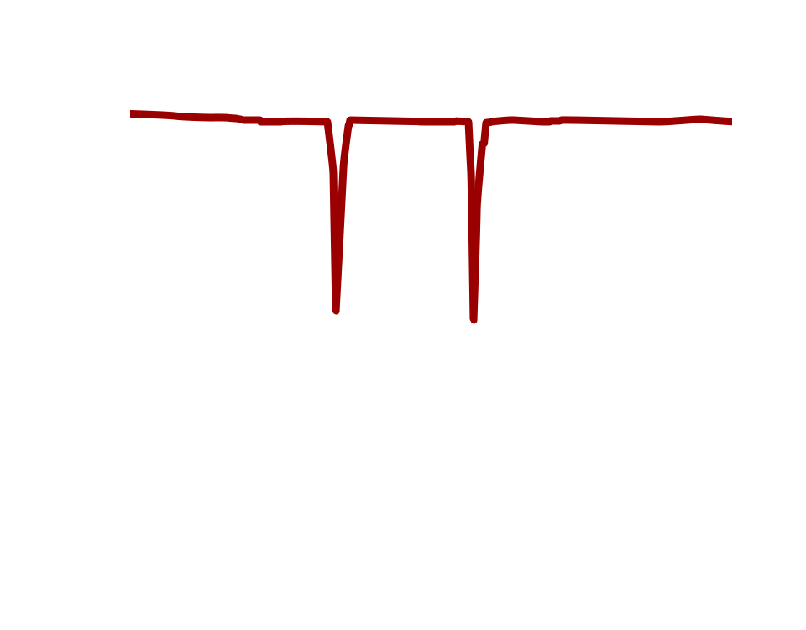
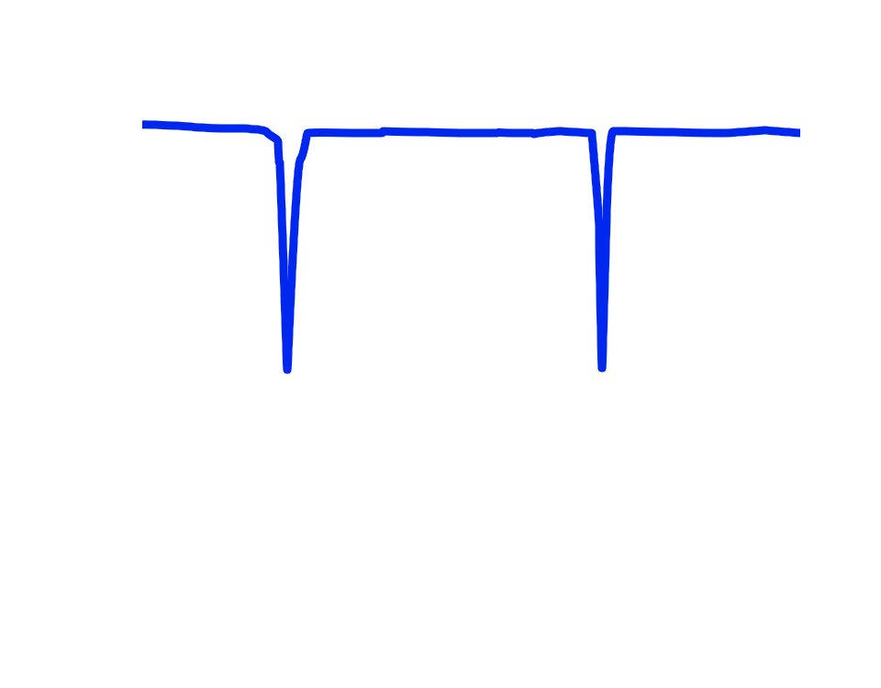
Spectroscopy – Detection of Biosignatures
Exoplanet Communications
Water (H₂0)
Light from planet only
Methane (CH₄)
Light from
planet only
Notes:
Absorption feature relocates automatically after slide change
Click 1: blue line traces over absorption feature, then repositions to show evidence of water
Click 2: red line traces over absorption feature, then repositions to show evidence of methane
Click 3: slide change

